Slide 1
EAMxx infrastructure
Designing a next generation global atmosphere model
Aaron S. Donahue
E3SM All-Hands, April 11, 2024
This work was performed under the auspices of the U.S. Department of Energy by Lawrence Livermore National Laboratory under Contract DE-AC52-07NA27344 IM Release Number
LLNL-PRES-862664
Notes:
Hello everyone, I appreciate this opportunity to discuss with you some of the infrastructure design of the new EAMxx model.

Slide 2
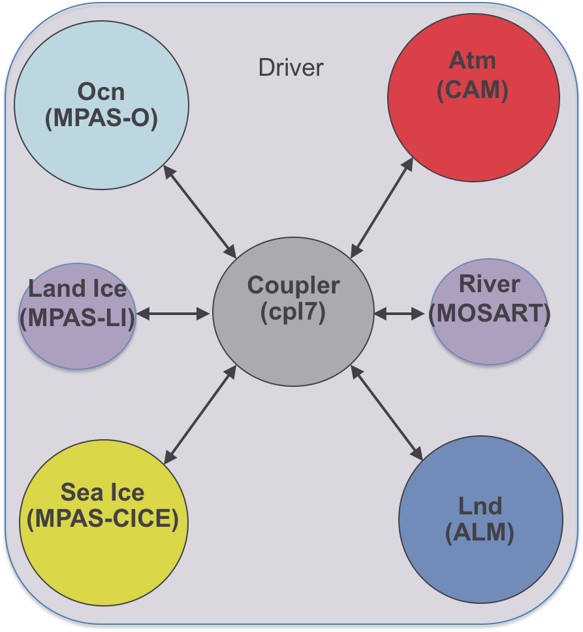
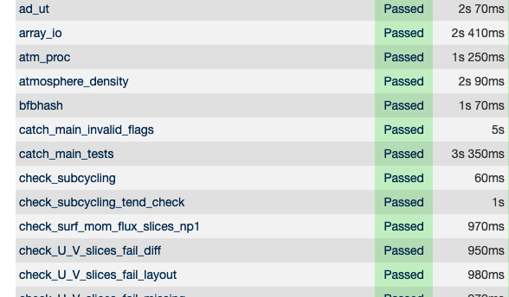
EAMxx Atmosphere Driver
Testing
Physical
Processes
Input/Output
Runtime Options
Notes:
This talk will focus on the development and functionality of the EAMxx Atmosphere Driver. When I say atmosphere driver, I am referring to the brains of the global atmosphere model. As depicted in this cartoon, the Atmosphere Driver manages nearly every aspect of the atmosphere component. It is responsible for communicating with the rest of the Earth System via the component coupler. Coordinates all of the physical processes that make of the atmosphere system. Interfacing with the user by parsing runtime options and distributing them to the respective processes. Working with the IO libraries to read input and write output and finally plays a critical role in facilitating verification and validation of the model. This talk will discuss how each of these aspects are handled in the new EAMxx driver.

Slide 3
Current EAM paradigm
X(t=t_n)
stepon_run1
phys_state
phys_run1
Opaque
phys_tend
phys_state1
cam_out
dyn_state
phys_tend1
CPL
Hardcoded process order,
Hardcoded time-splitting,
Difficult to add new processes,
Difficult to audit
Individual pieces are dependent on the rest of the model.
cam_in
stepon_run2
pbuf
phys_run2
Output
stepon_run3
X(t=t_n+1)

Slide 4
EAMxx Atmosphere Driver
Testing
Physical
Processes
Input/Output
Runtime Options

Slide 5
The new EAMxx paradigm
phys_state
phys_tend
dyn_state
PBUF
cam_in/out
Field Manager Class and Field Objects
All persistent variables are instances of a field object
All fields managed by a single Field Manager
Simplifies operations on fields, e.g.
Remapping to different grids
Adding new fields
Storing field metadata
cam_init
phys_init
dyn/stepon_init
cam_run,1,2,3,4
phys_run1,2
stepon_run1,2,3

Slide 6
What is a Field?
Stores everything the atmosphere model needs to know about a global variable.
As an object allows SCREAM to define universal operations for all fields,
E.g. remapping, arithmetic operations, cloning, property checking, timestep management …
> Name: T_mid
> Units: K
> Layout: (columns, levels)
> Grid: Physics PG2
> Datatype: Real
> Timestamp: TS{2024,11,4,8,30,0}
> Data Pointer: 6efgkh38sahdlgis0372
> Providers: HOMME, SHOC, P3, RRTMGP, Surface-Coupling
> Customers: HOMME, SHOC, P3, RRTMGP, Surface-Coupling
> Extra Metadata: [Mask, Foo, Bar, …]
* Artist depiction

Slide 7
The new EAMxx paradigm
phys_state
phys_tend
dyn_state
PBUF
cam_in/out
Field Manager Class and Field Objects
All persistent variables are instances of a field object
All fields managed by a single Field Manager
Simplifies operations on fields, e.g.
Remapping to different grids
Adding new fields
Storing field metadata
cam_init
phys_init
dyn/stepon_init
cam_run,1,2,3,4
phys_run1,2
stepon_run1,2,3
Atmosphere Driver Class and Atmosphere Process Objects
Every process (physics and dynamics) is an instance of an AP object.
Atmosphere Driver manages all AP’s, including call sequence order, subcycling, grids, IO
Able to handle many runtime configurations.

Slide 8
What is an Atmosphere Process?
An interface to the dynamics or an atmosphere parameterization.
EAMxx supports universal operations on atmosphere processes:
Unit testing, subcycling, backing out tendencies, log msgs, performance timing, …
Has a defined initialization, run and finalization.
> Name: SHOC
> Type: Physics
> Grid: Physics PG2
> Timestamp: TS{2024,11,4,8,30,0}
> Inputs: omega, surf_sens_flux, surf_mom_flux, …, T_mid, qv
> Outputs: surf_evap, T_mid, qv, … , tke, pbl_height
> init_impl: Do ‘xyz’ to initialize SHOC
> run_impl: Do ‘ijk,’ then call shoc_main, do ‘qrs’
> finalize_impl: Nothing to do
* Artist depiction

Slide 9
The new EAMxx paradigm
add_field<X>(…)
X:
Required (IN)
Computed (OUT)
Updated (IN/OUT)
Field Manager Class and Field Objects
All persistent variables are instances of a field object
All fields managed by a single Field Manager
Simplifies operations on fields, e.g.
Remapping to different grids
Adding new fields
Storing field metadata
ad.initialize(comm,params,t0)
ad.run(dt)
ad.finalize() ap.initialize(t0,type)
ap.run(dt)
ap.finalize()
Atmosphere Driver Class and Atmosphere Process Objects
Every process (physics and dynamics) is an instance of an AP object.
Atmosphere Driver manages all AP’s, including call sequence order, subcycling, grids, IO
Able to handle many runtime configurations.

Slide 10
Current EAM paradigm
X(t=t_n)
stepon_run1
phys_state
phys_run1
phys_tend
phys_state1
cam_out
dyn_state
phys_tend1
CPL
cam_in
stepon_run2
pbuf
phys_run2
Output
stepon_run3
X(t=t_n+1)

Slide 11
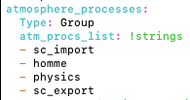
The EAMxx paradigm
X(t=t_n)
Field Manager
Memory Buffer
Simpler
Increased runtime options, and process ordering set at runtime.
Interoperability for atmosphere processes.
Independence for individual processes.
Atmosphere Driver
init
run
output
finalize
CPL
X(t=t_n+1)

Slide 12
Directed Acyclic Graph (DAG)
X(t=t_n)
Reference for how state variables are used.
Quickly audit all global variables in the simulation.
Incredibly useful for debugging.
X(t=t_n+1)

Slide 13
EAMxx Atmosphere Driver
Testing
Physical
Processes
Input/Output
Runtime Options

Slide 14
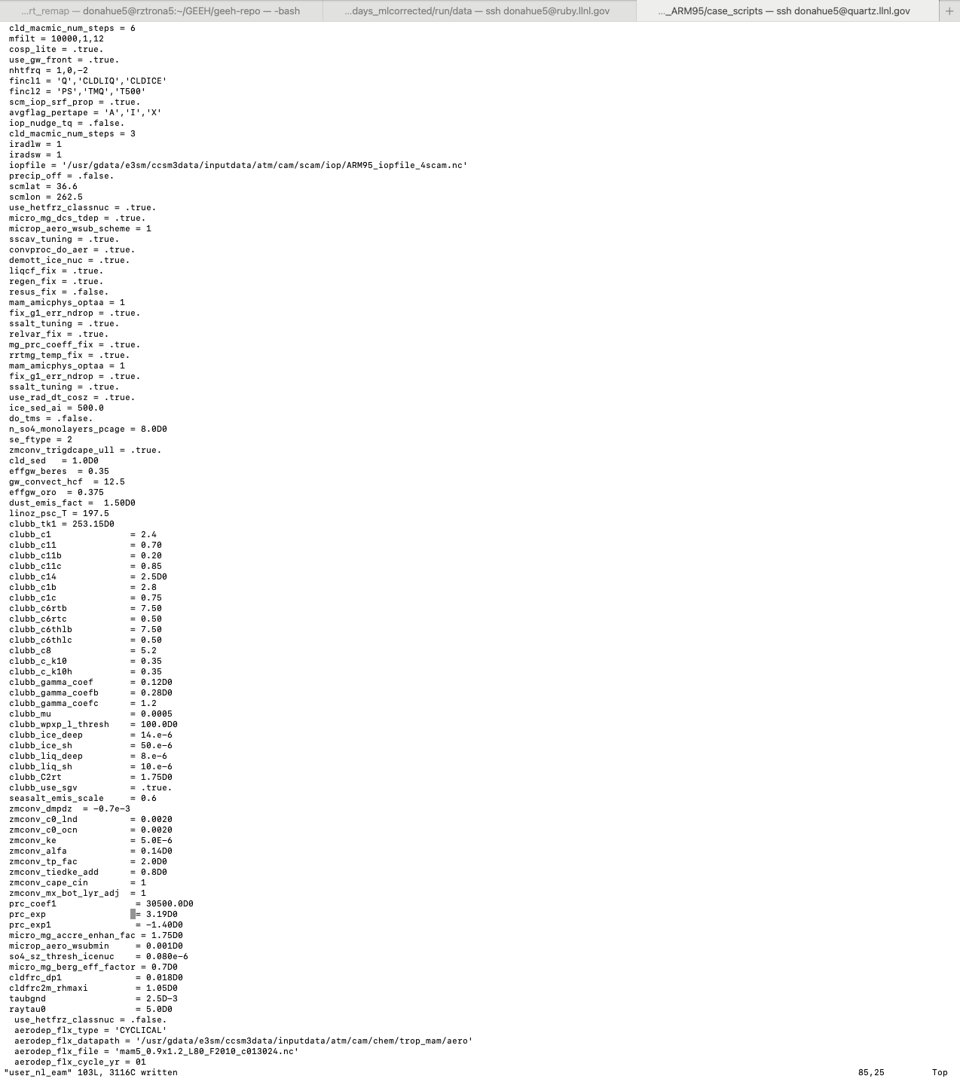
Runtime Options: namelist
Difficult to read/parse
Not organized
Cumbersome to add new options
Difficult to audit, vulnerable to user error
Conflicts only detected if developer adds their own checks.
Multiple entries can lead to unexpected behavior.

Slide 15
Runtime Options: YAML
EAMxx use YAML to handle all runtime options.
Human readable – options organized into relevant sections.
Strict enforcement of each entry.
Support for “info” metadata for user support.
Setting and adding new options is simple. Each process has their own parameter list.
Has similar support to CIME XML functions
./atmchange
./atmquery

Slide 16
EAMxx Atmosphere Driver
Testing
Physical
Processes
Input/Output
Runtime Options

Slide 17
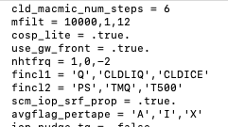
Output Control: user_nl_eam

Slide 18
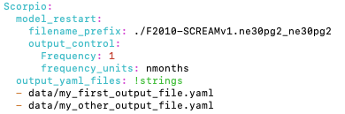
Output Control: YAML

Slide 19
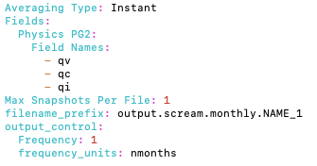
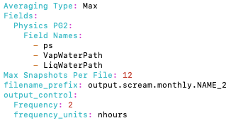
Output Control: YAML

Slide 20
EAMxx Atmosphere Driver
Testing
Physical
Processes
Input/Output
Runtime Options

Slide 21
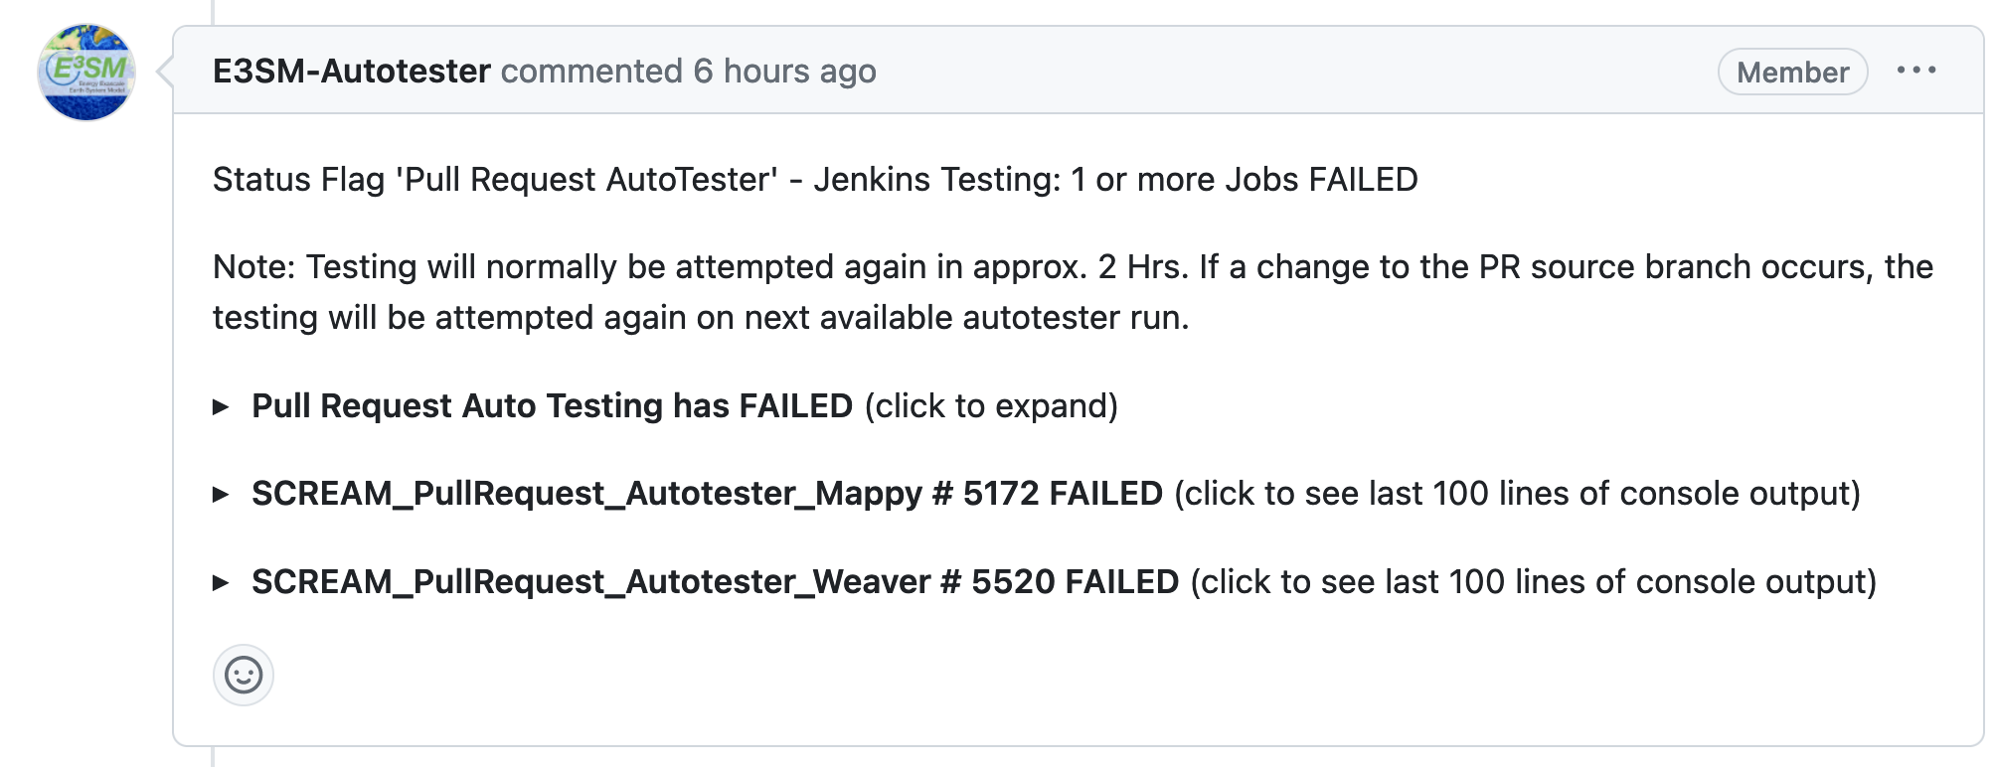
Testing:
EAMxx inherits all the standard E3SM testing coverage, + robust unit tests
This is possible because,
Model elements are independent.
Take advantage of arbitrary class structure in C++.
Incredibly useful for debugging and verification
SCREAM git-repo CI integrates unit testing through the Autotester.

Slide 22
Conclusions:
EAMxx is a complete rewrite of the E3SM global atmosphere model infrastructure in C++/Kokkos
EAMxx incorporates modern software best practices
The adoption of YAML makes runtime options:
More protected against user error,
Human readable,
More organized
The benefits of YAML runtime options is extended to output control.
EAMxx infrastructure was designed with testing in mind. Unit testing:
Makes debugging substantially easier,
Gives more confidence that new features won’t impact or break existing features.

Slide 25
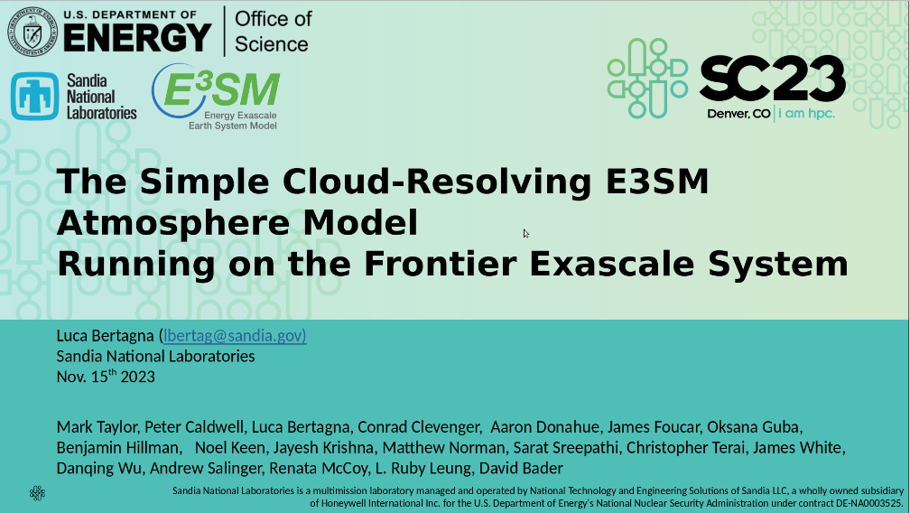
Performance Portability (C++/Kokkos)
https://acme-climate.atlassian.net/wiki/spaces/ECM/pages/4129325057/2024-02-15+All-Hands+Presentation+Meeting+Notes

Slide 26
Performance Portability (C++/Kokkos)
Packs
Vector Unit
NaN
NaN
Vector Unit
https://acme-climate.atlassian.net/wiki/spaces/ECM/pages/4129325057/2024-02-15+All-Hands+Presentation+Meeting+Notes

Slide 27
Performance Portability
(C++/Kokkos)
EAMxx Atmosphere Driver
Transparent
(DAG, YAML)
Adaptable
(Physics Interoperability)
Flexible
(Runtime Control)
Robust
(Unit Testing)

Slide 28
The new EAMxx paradigm
phys_state
phys_tend
dyn_state
PBUF
cam_in/out
Field Manager Class and Field Objects
All persistent variables are instances of a field object
All fields managed by a single Field Manager
Simplifies operations on fields, e.g.
Remapping to different grids
Adding new fields
Storing field metadata
cam_init
phys_init
dyn/stepon_init
cam_run,1,2,3,4
phys_run1,2
stepon_run1,2,3
Atmosphere Driver Class and Atmosphere Process Objects
Every process (physics and dynamics) is an instance of an AP object.
Atmosphere Driver manages all AP’s, including call sequence order, subcycling, grids, IO
Able to handle many runtime configurations.

Slide 29
The EAM paradigm
X(t=t_n)
stepon_run1
phys_state
phys_run1
Opaque
phys_tend
phys_state1
cam_out
dyn_state
phys_tend1
CPL
Hardcoded process order,
Hardcoded time-splitting,
Difficult to add new processes,
Difficult to audit
Individual pieces are dependent on the rest of the model.
cam_in
stepon_run2
pbuf
phys_run2
Output
stepon_run3
X(t=t_n+1)

