Slide 1
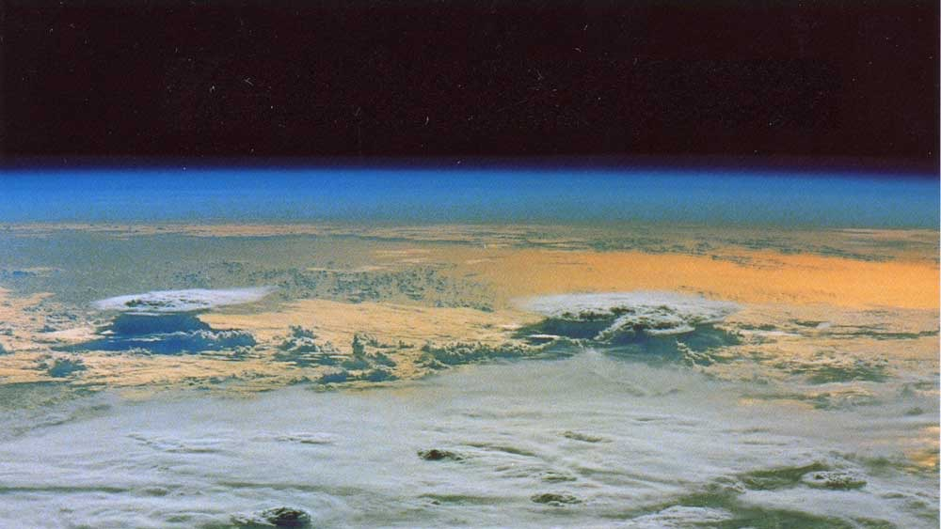
Perturbed Parameter Ensembles (PPE)
Forcing, Feedback and Parameter Uncertainty
Andrew Gettelman, PNNL
Margaret Duffy, Trude Eidhammer, Kate Thayer-Calder, NCAR
Greg Elsaesser, Marcus van Lier-Walqui, NASA-GISS
Duncan Watson-Parris, UC San Diego
PNNL is operated by Battelle for the U.S. Department of Energy

Slide 2
Are (Aerosol) forcing & (Cloud) Feedback related?
Introduction: Clouds and Climate
Cloud feedbacks and climate sensitivity
Aerosol forcing
Methodology: Perturbed Parameter Ensemble (PPE)
Results: PPE
General: Emulators
Aerosol Forcing
Cloud Feedback
Results: Interactions (Preliminary)
Conclusions, Next Steps

Slide 3
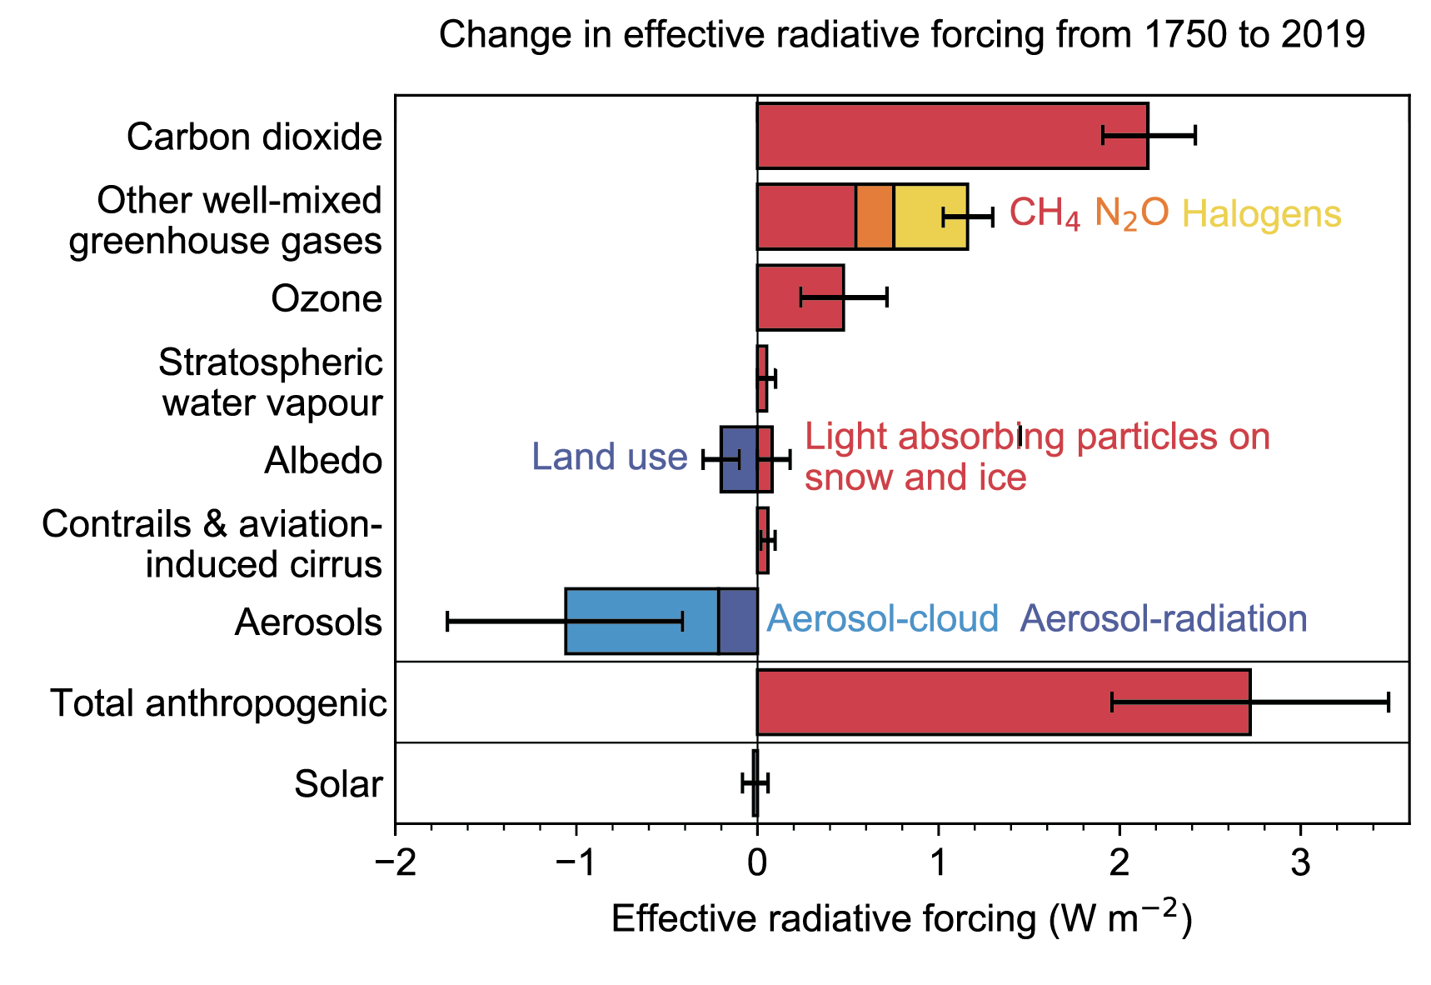
Climate Forcing
3.8 Wm⁻²
(2.3→4.5)
-1.1 Wm⁻²
(-1.9→-0.2)
IPCC, 2021, Fig 7.6
Notes:
Estimated global effects
Largest uncertainty in the forcing is Aerosol Forcing

Slide 4
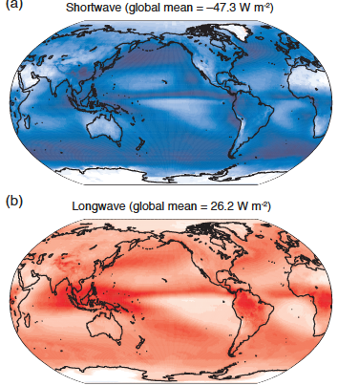
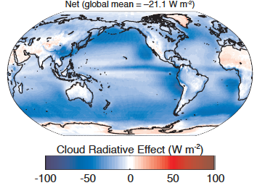
Climate: Cloud Radiative Effects are Large
R_{cloudy} - R_{clear}
IPCC 2013 (Boucher et al 2013) Fig 7.7

Slide 5
Climate Feedbacks: Clouds respond to climate change
Climate Sensitivity Uncertainty: It’s all about cloud feedback
(σT⁴)
Lapse
Rate
RH
Change
Zelinka et al 2020, GRL

Slide 6
CAM6 Perturbed Parameter Ensemble
cldfrc_dp1
cldfrc_dp2
clubb_C2rt
clubb_C6rt
clubb_C6rtb
clubb_C6thl
clubb_C6thlb
clubb_C8
clubb_beta
clubb_c1
clubb_c11
clubb_c14
clubb_c_K10
clubb_gamma_coef
clubb_wpxp_L_thresh
micro_mg_autocon_nd_exp
micro_mg_accre_enhan_fact
micro_mg_autocon_fact
micro_mg_autocon_lwp_exp
micro_mg_berg_eff_factor
micro_mg_dcs
micro_mg_effi_factor
micro_mg_homog_size
micro_mg_iaccr_factor
micro_mg_max_nicons
micro_mg_vtrmi_factor
microp_aero_npccn_scale
microp_aero_wsub_min
microp_aero_wsub_scale
microp_aero_wsubi_min
microp_aero_wsubi_scale
seasalt_emis_scale
dust_emis_fact
sol_factb_interstitial
sol_factic_interstitial
zmconv_c0_lnd
zmconv_c0_ocn
zmconv_capelmt
zmconv_dmpdz
zmconv_ke
zmconv_ke_lnd
zmconv_momcd
zmconv_momcu
zmconv_num_cin
zmconv_tiedke_add
CAM6.3 (~ E3SMv1 physical parameterizations)
43 Parameters
11 Turbulence (CLUBB)
11 Microphysics (MG3/PUMAS )
12 Deep Convection (ZM)
9 Aerosol/Activation
All parameters made namelist parameters
263 parameter sets for simulations, selected using Latin Hypercube Sampling

Slide 7
How to build a PPE (Works for E3SM too)
Off-line notebook for latin-hypercube sampling of parameters
Parameters, ranges, number of ensembles
Generate a file of ensembles (names, parameter sets)
Python script to run the ensemble
Single script, all CIME commands
Clone a ‘control’ case for each parameter set
Using file of parameter sets/ensemble names, update each namelist
Run each parameter set simulation
Typically: run 50 at once….done in a day (mileage may vary)
This is simple, extensible (we added 12 parameter sets to correct an error)

Slide 8
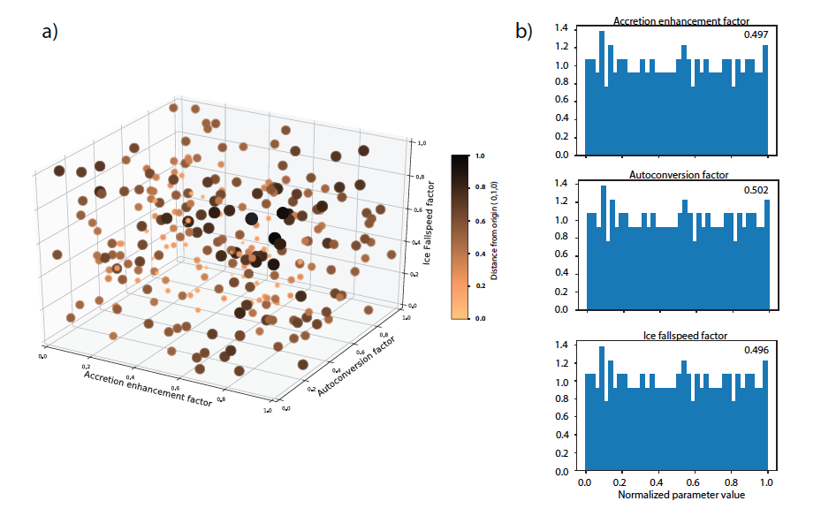
Latin Hypecube Sampling
Frequency

Slide 9
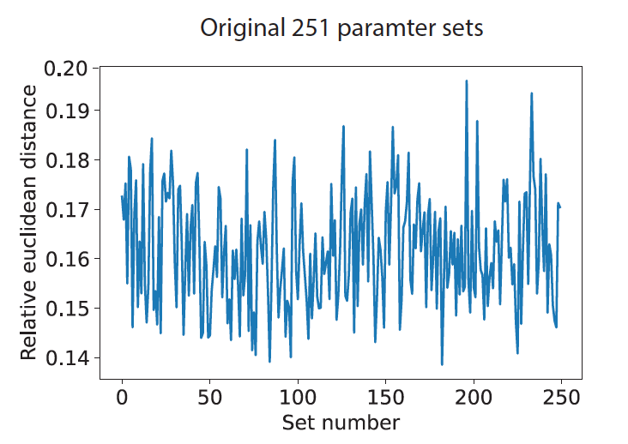
Extending the PPE
Can run any configuration with CESM
E.g.: McCoy (U. Wy) has run same 263 parameter sets for nudged field exp cases
SCAM PPE exists (being analyzed by van Lier-Walqui)
Extensible: added to parameter space
Started with 250 + 1 default cases
Extend range for one parameter
Find average ‘relative Euclidean distance’ between parameters
Run another 7500 parameter sets
Pick 12 with
param in new range
Euclidean distance > average
=263 parameter sets

Slide 10
Explore Forcing and Cloud Feedback: CAM6 Perturbed Parameter Ensemble
Three types of simulations (3 years): all fixed SST (‘Climatological AMIP’)
PD: Present Day forcing, SSTs
PI: Pre-Industrial (1850) Aerosol Emissions
SST4K: Present day with SST + 4K (Cess et al 1989)
Data available (https://doi.org/10.26024/bzne-yf09)
PPE Spread
CCN
TOA
Residual

Slide 11
Large Spread Across the PPE
IWP
Column
SO₄
LWP
N_{c}

Slide 12
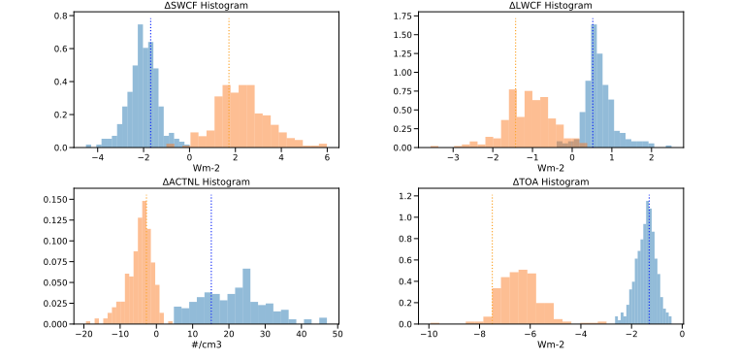
PPE Forcing and Feedback
Shortwave cloud radiative forcing
Longwave cloud radiative forcing
Average cloud top liquid number
Net solar flux at top of model
Forcing: Present day (PD) - Pre-industrial (PI) aerosol
Feedback: 4K SST - Present day (PD)

Slide 13
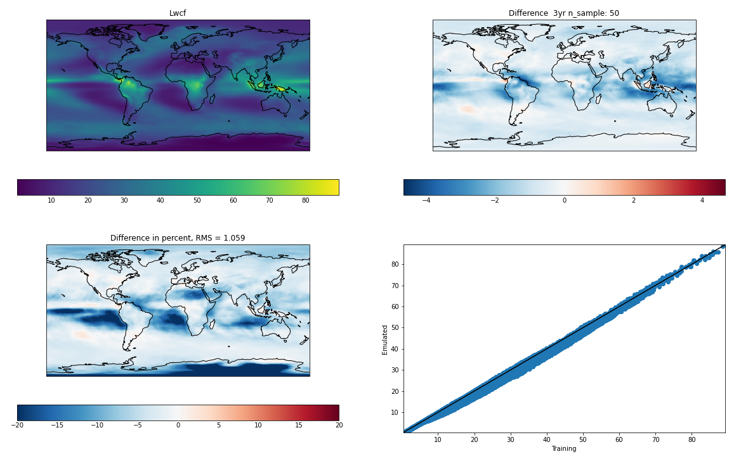
Emulating Longwave Cloud Radiative Forcing
Gaussian Process Emulator (University of Oxford)
W/m²
W/m²
Emulated (W/m²)
Eidhammer, in Prep
Training (W/m²)

Slide 14
Emulator Parameter Sweep
LWP exponent in Autoconversion
Ice & Snow fall speed scaling

Slide 15
Normalized Slopes Output field (horiz axis) v. Parameter (vertical Axis)
LWP exp→
Ice Fall speed →
Buoyancy T’ →

Slide 16
Forcing and Feedback Interaction
Question:
Are (aerosol) forcing and (cloud) feedback related?
If so, what are the key interactions and processes?
Start with some earlier work (Gettelman et al 2016)
Then explore these questions using PPE with parameter uncertainty

Slide 17
Aerosol Mediated Cloud Feedback
3 Sets of Coupled Runs
Constant 21st Century Aerosol, High warming
Decreasing Aerosol, High Warming
Decreasing Aerosol, Moderate warming
Total cloud feedbacks
Includes differences in Aerosol
Now Apply ‘Aerosol Kernel’ to remove changes in clouds due to aerosol (dR/dAOD)
Gettelman et al 2016, J. Climate

Slide 18
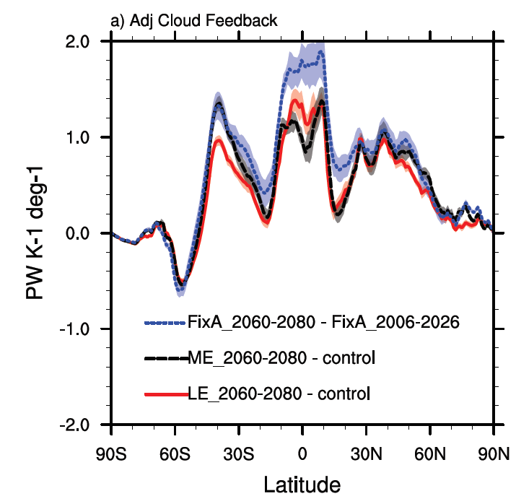
Aerosol Mediated Cloud Feedback
Adjust Feedbacks for Aerosol
Aerosol cooling misdiagnosed as cloud feedback (Feedbacks get more positive)
NH Mid-lat feedback differences smaller
Total difference between Decreasing and Fixed Aerosol cloud feedbacks is 50%
S. Ocean: same aerosol emissions
∆U → ∆AOD(sea salt) → ∆CCN → ∆SWCF
= ‘Aerosol Mediated cloud feedback’
the change in clouds is through aerosols (not temperature)
Gettelman et al 2016, J. Climate

Slide 19
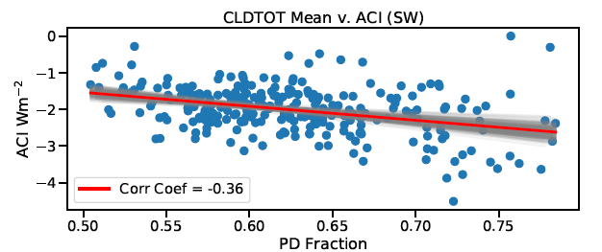
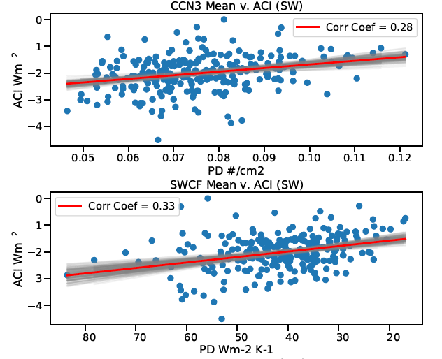
Preliminary Results: ACI Depends on Mean State
Cloud Fraction
ACI
Why is ACI spread limited (-2.5 → 0 Wm⁻²)?
ACI (∆SWCRE, y-axis) depends on mean state
Stronger Negative ACI with:
Larger cloud fraction
Lower CCN (and lower present day SO₄)
Larger negative shortwave cloud effect
Mean state is limiting (‘susceptibility’)
Marginal clouds are more susceptible?
CCN
ACI
ACI
SWCRE

Slide 20
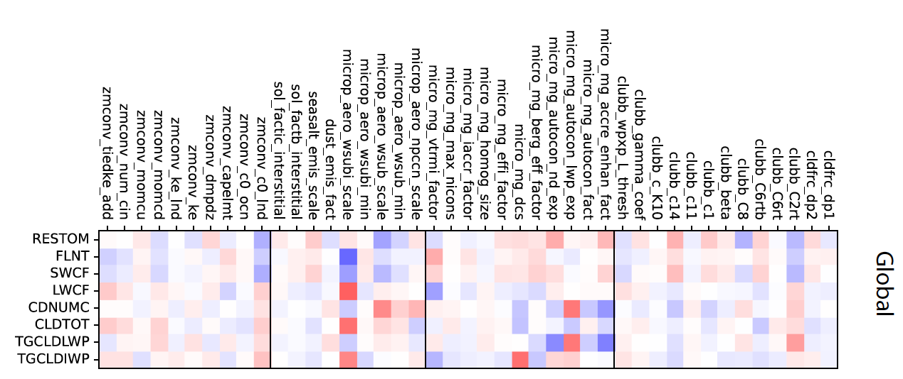
ACI (Forcing) Relationships to Parameters
These processes/parameters increase –∆SWCRE:
Precipitation: Autoconversion & Accretion
Stratiform Ice & Liquid activation: Sub-grid vertical velocity & ice fall speed
Turbulence: Horizontal variance, vertical vel skewness, LWP variance
Ice: LW & Cloud Fraction
Liq: SW, LWP & Nc
Turbulence: Nc & LWP
All ∆

Slide 21
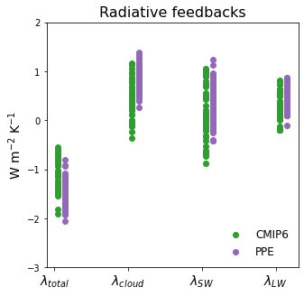
Spread in radiative feedbacks across PPE is comparable to spread across CMIP6 models
Cloud Feedback
M. Duffy
Notes:
From Margaret:
Each green dot is the radiative feedback from a CMIP6 4xCO2 simulation (data from Zelinka’s github page)
Each purple dot is the radiative feedback from a PPE simulation. PPE data have been cleaned to include only the 177 most realistic simulations using TOA radiative imbalance
*SW and LW indicate SW and LW cloud feedbacks

Slide 22
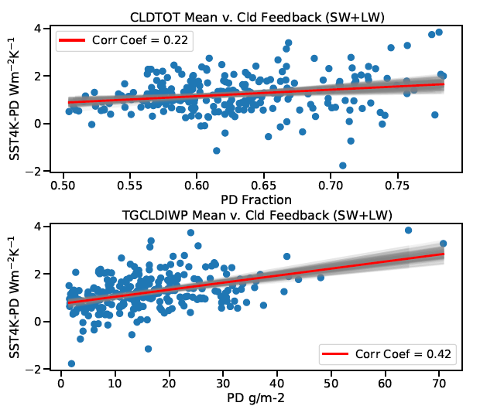
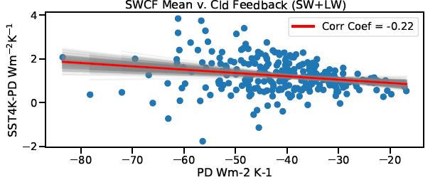
Cloud Feedback Depends on Mean State
Cloud Fraction
Cloud Feedback (y-axis, ΔSWCF+ΔLWCF) also depends on mean state properties.
Stronger Positive Feedback with:
Larger cloud fraction (more cloud to lose)
Larger negative shortwave cloud effect
Higher Ice Water Path
IWP
SWCRE

Slide 23
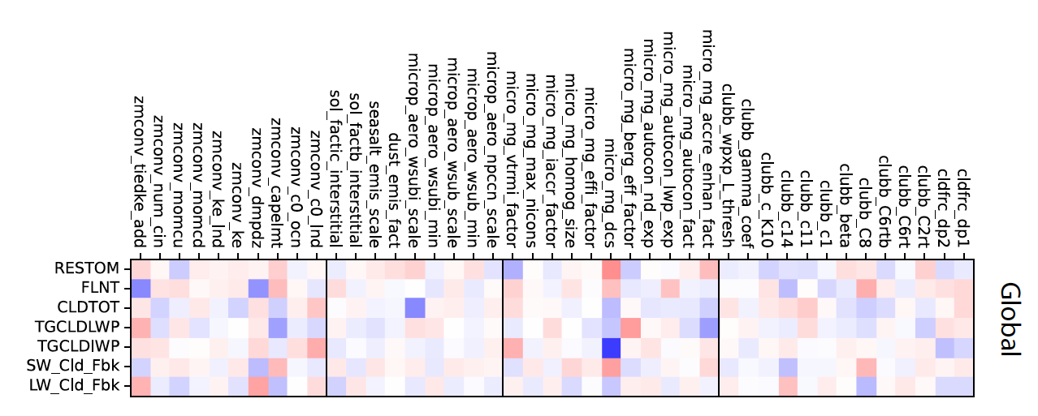
Feedback Relationships to Parameters
Deep Convection: Increasing ice increases LW feedback
Microphysics: Ice: fall speed, autoconversion change ice mass & LW
W_{sub} for ice nucleation changes total cloudiness, not much feedback effect
Turbulence: Damping horiz vel variance and vertical velocity skewness
∆

Slide 24
Correlation Between Forcing and Feedback
Generally negative correlation between ACI (SW mostly) strength and Feedback Strength
Where aerosol forcing is significant (NH), relatively uniform correlations.

Slide 25
Preliminary Conclusions/Next Steps Comments/Suggestions welcome…
Aerosol mediated cloud feedbacks exist in complex GCMs, need to be analyzed.
Causes spread across models due to aerosol diversity
ACI (forcing) seems ‘limited’: stronger with thicker (+Nc, +LWP) base state clouds
Matches parameters that control: LWP, Nc processes (CCN, SO₄, Auto/Accre)
Cloud Feedbacks larger with thicker clouds (more ice, higher cloud fraction)
Ice processes, accretion critical
Microphysics important for cloud feedbacks:
Nc and Precipitation formation processes key: not just mean radiative effect
Significant correlations between aerosol ACI and cloud feedbacks
Larger (negative) ACI is associated with stronger (positive) cloud feedbacks
Stronger cloud forcing, higher PD drop number results in stronger ACI & Cloud Feedback
Lower drop numbers/sulfate burdens are more ‘sensitive’

