Slide 1
Autotuning E3SM using a surrogate model for climatological spatial fields
Drew Yarger, Benjamin Wagman, Lyndsay Shand, Andy Salinger
Sandia National Labs
Acknowledgments: Kenny Chowdhary, NVIDIA; Peter Caldwell, LLNL
E3SM All-hands seminar
March 2, 2023

Slide 2
Goal: Use machine learning to expedite and formalize E3SM tuning
Generate E3SM perturbed parameter ensemble
Build surrogate from parameters to model output
Calibrate and optimize parameters using surrogate and climate observations
Validate parameters in E3SM

Slide 3
E3SM PPE creation using Dakota^{[1]}
Generate E3SM perturbed parameter ensemble
Build surrogate from parameters to model output
Calibrate and optimize parameters using surrogate and climate observations
Validate parameters in E3SM
Workflow
Dakota
  Reads user-defined config_ensemble.yaml
  Does Latin hypercube sampling (LHS)
  Calls cime/scripts/create_clone
  Propagates LHS parameters to each clone's user_nl_eam
Additional python scripts
  Submit simulations in bundles
  Post-process target fields using zppy
Code
https://github.com/E3SM-Project/Autotuning-NGD.git
[1] Adams et al., 2021
Notes:
Dakota: Sandia-developed UQ tool for computer simulations

Slide 4
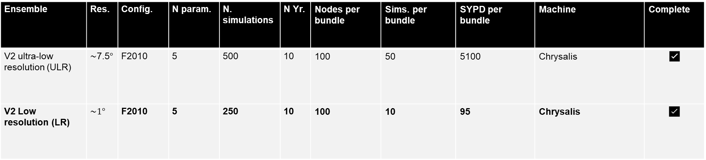
E3SM PPE’s
Ensemble | Res. | Config. | N param. | N. simulations | N Yr. | Nodes per bundle | Sims. per bundle | SYPD per bundle | Machine | Complete
V2 ultra-low resolution (ULR) | $\sim$7.5$°$ | F2010 | 5 | 500 | 10 | 100 | 50 | 5100 | Chrysalis | ✅
V2 Low resolution (LR) | $$\sim 1°$$ | F2010 | 5 | 250 | 10 | 100 | 10 | 95 | Chrysalis | ✅
Autotuning PPE’s (E3SM confluence)

Slide 5
E3SMv2 sampled parameters
E3SMv2 target seasonal climatologies
Parameter | Description | Low__Default__High [1]
clubb_c1 | Constant for dissipation of variance of mean(w’²) | 1.0__2.4__5.0
clubb_gamma_coef | Constant of the width of PDF in w coordinate | 0.1__0.12__0.5
zmconv_tau | Time scale for consumption rate deep CAPE | 1800__3600__14400
zmconv_dmpdz | Parcel fractional mass entrainment rate | -2.0e-3__-0.7e-3__-0.1e-3
micro_mg_ai | Fall speed parameter for cloud ice | 350__500__1400
Field | Coordinates | Spatial resolution | Product
TREFHT | lat x lon | 24x48, 180x360 | ERAI
PRECT | lat x lon | 24x48, 180x360 | GPCP1DD
SWCF | lat x lon | 24x48, 180x360 | ceres_ebaf_toa
LWCF | lat x lon | 24x48, 180x360 | ceres_ebaf_toa
PSL | lat x lon | 24x48, 180x360 | ERAI
FLNT | lat x lon | 24x48, 180x360 | N/A
FSNT | lat x lon | 24x48, 180x360 | N/A
Z500 | lat x lon | 24x48, 180x360 | ERAI
U200 | lat x lon | 24x48, 180x360 | ERAI
U850 | lat x lon | 24x48, 180x360 | ERAI
RELHUM | lat x lev | 24x37, 180x37 | ERAI
T | lat x lev | 24x37, 180x37 | ERAI
U | lat x lev | 24x37, 180x37 | ERAI
[1] Ranges from Qian et al., 2018

Slide 6
Generate E3SM perturbed parameter ensemble
Build surrogate from parameters to model output
Calibrate and optimize parameters using surrogate and climate observations
Validate parameters in E3SM

Slide 7
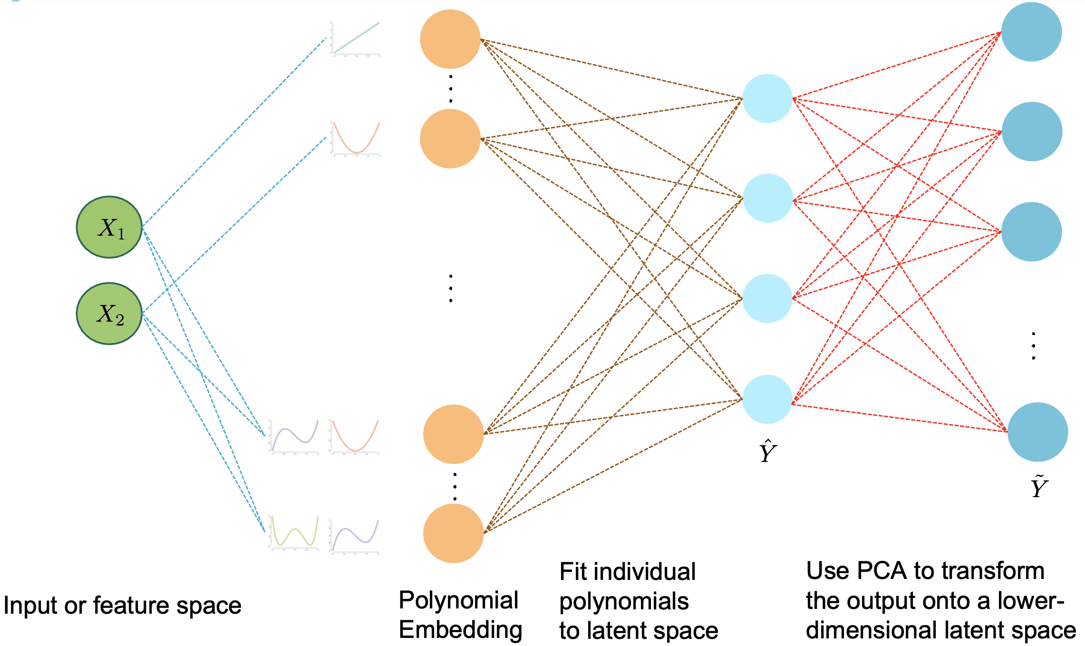
Surrogate function choice: polynomial chaos expansion
Uses Python’s scikit-learn framework and is based off Kenny Chowdhary’s Autotuning 2020-2022 work at Sandia.
  Python package tesuract: https://github.com/kennychowdhary/tesuract
PCA and polynomial chaos expansion: similar or better prediction errors compared to
  neural network,
  random forest,
  support vector machines,
  Gaussian processes.
Hyperparameters of polynomial chaos expansion chosen automatically by cross-validation.

Slide 8
Generate E3SM perturbed parameter ensemble
Build surrogate from parameters to model output
Calibrate and optimize parameters using surrogate and climate observations
Validate parameters in E3SM

Slide 9
Optimization strategy
We minimize the root-mean-squared-error (RMSE) between
  the surrogate predicted fields,
  the observational data.
Regularization terms that normalize the errors from different output fields
  Any one output field does not dominate the optimization.
  Allows Bayesian formulation of the normalization.
Use L-BFGS-B^{[1]} optimization algorithm on the minimization problem.
  Can also use Markov Chain Monte Carlo (MCMC) sampling to visualize uncertainty in optimized parameters.
[1] Byrd, R. H., Lu, P., Nocedal, J. and Zhu, C. (1995). A limited memory algorithm for bound constrained optimization.
SIAM Journal on Scientific Computing, 16, 1190–1208. doi:10.1137/0916069.

Slide 10





Current Workflow
INPUT:
E3SM Parameters
Input X
(m scalar values)
Optimized Parameters $X^{∗}$
Generate E3SM perturbed parameter ensemble
Build surrogate from parameters to model output
Calibrate and optimize parameters using surrogate and climate observations
Validate parameters in E3SM
$$Z=f(X)$$
$$X^{∗}=argmin_{X}g(X)$$
Dimension Reduction
$$Φ$$
Projecting back to original space
$$Φ^{−1}$$
High-Dimensional Output Y
(N spatial fields)
Reduced Output Z
(K<N)
Fitted Values Ẑ
Fitted Output Ŷ
Output for Optimized Parameters
OUTPUT: E3SM time-averaged spatial fields

Slide 11
Generate E3SM perturbed parameter ensemble
Build surrogate from parameters to model output
Calibrate and optimize parameters using surrogate and climate observations
Validate parameters in E3SM

Slide 12
Autotuned E3SMv2 vs. v2 control: % Change in RMSE
 | DJF | MAM | JJA | SON | Average
LWCF | 4.5 | -2.4 | -1.9 | 2.9 | 0.8
PRECT | 1.8 | -2.8 | -4.5 | 3.9 | -0.4
PSL | -9.1 | -7.1 | -1.3 | -8.5 | -6.5
RELHUM | -0.0 | -0.3 | 1.4 | -0.5 | 0.1
SWCF | 2.7 | 0.1 | -3.5 | -1.3 | -0.5
T | -1.6 | -2.8 | 2.4 | -5.4 | -1.9
TREFHT | -8.1 | -13.8 | -4.4 | -6.0 | -8.1
U | -7.9 | -6.2 | -0.4 | -1.1 | -3.9
U200 | 4.6 | -10.7 | -17.6 | -4.0 | -6.9
U850 | 1.2 | -12.6 | -14.8 | -3.7 | -7.5
Z500 | -0.9 | -15.1 | -8.9 | -6.8 | -7.9
Average | -1.2 | -6.7 | -4.9 | -2.8 | -3.9
Area-weighted root-mean-squared-error (RMSE) evaluation on
  180x360 (lat x lon) grid
  180x37 (lat x pressure) grid
Average of 3.9% decrease in RMSE across variables and seasons

Slide 13
Autotuned Control
PRECT
Autotuned improvements are evident in E3SM-diags.
  IICE: Autotuned vs. Control.
Improvements are generally not product dependent.
  E.g. autotuning to RH from ERAI improves the simulation even when evaluated against MERRA2.
Biases have the same spatial pattern in autotuned and control simulations.
  Some biases are structural;
  Other biases are sensitive to parameters that were not sampled.
U850
Rel. humidity
*MERRA2
Annual means
Notes:
Benj

Slide 14
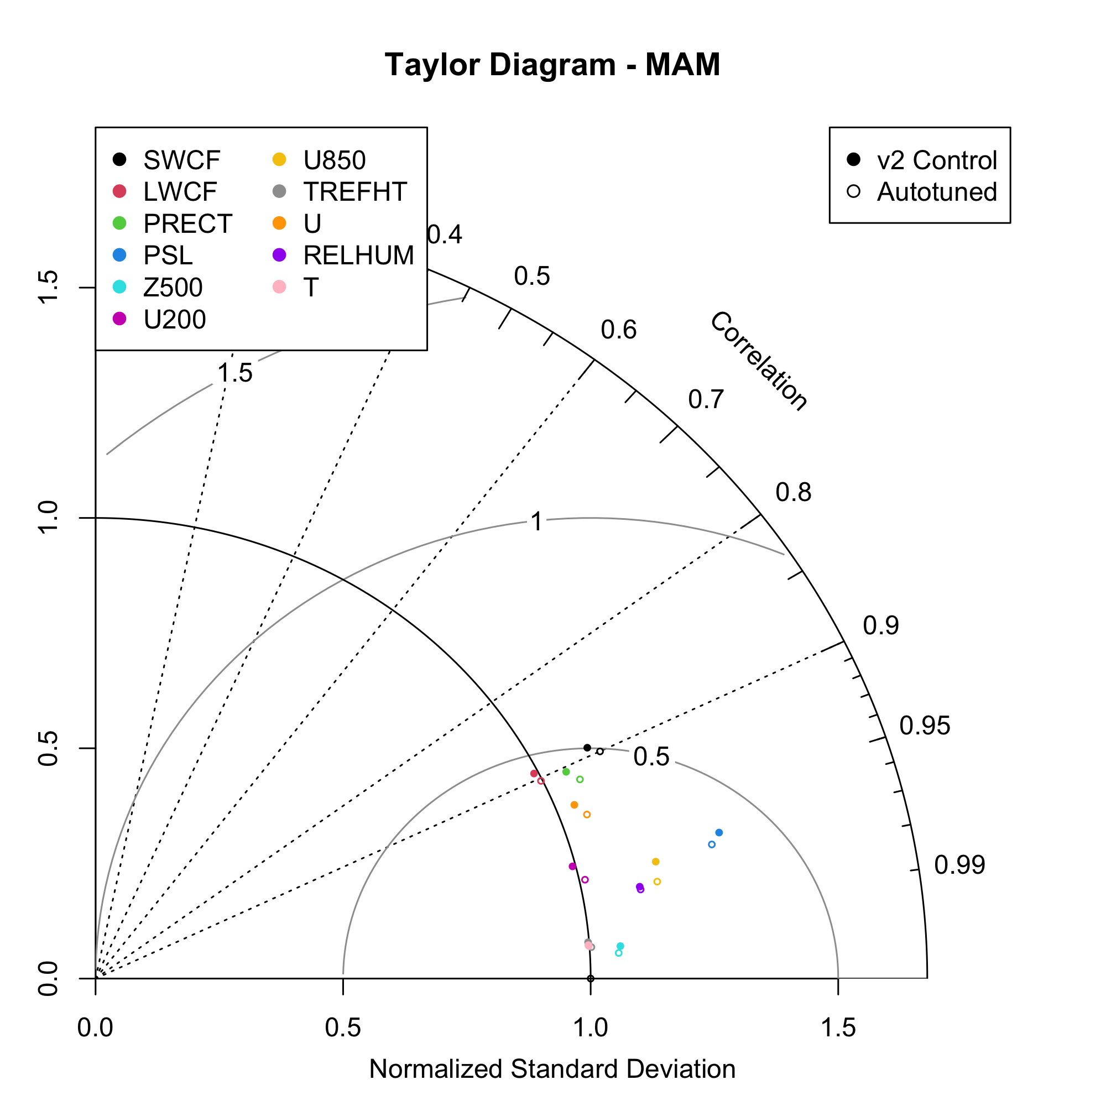
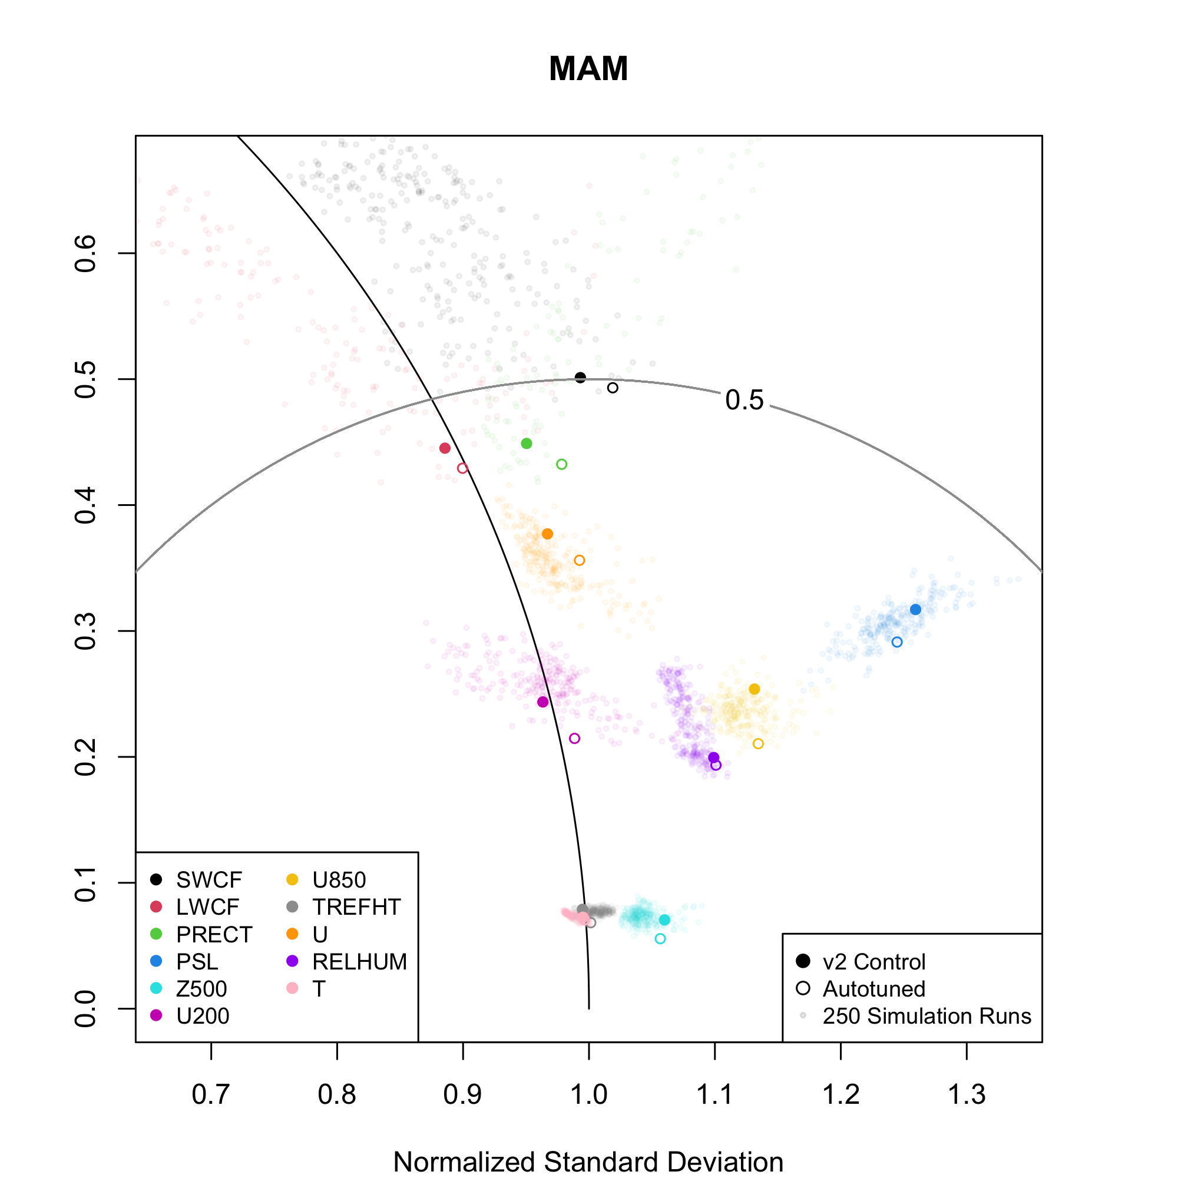
Taylor diagram

Slide 15
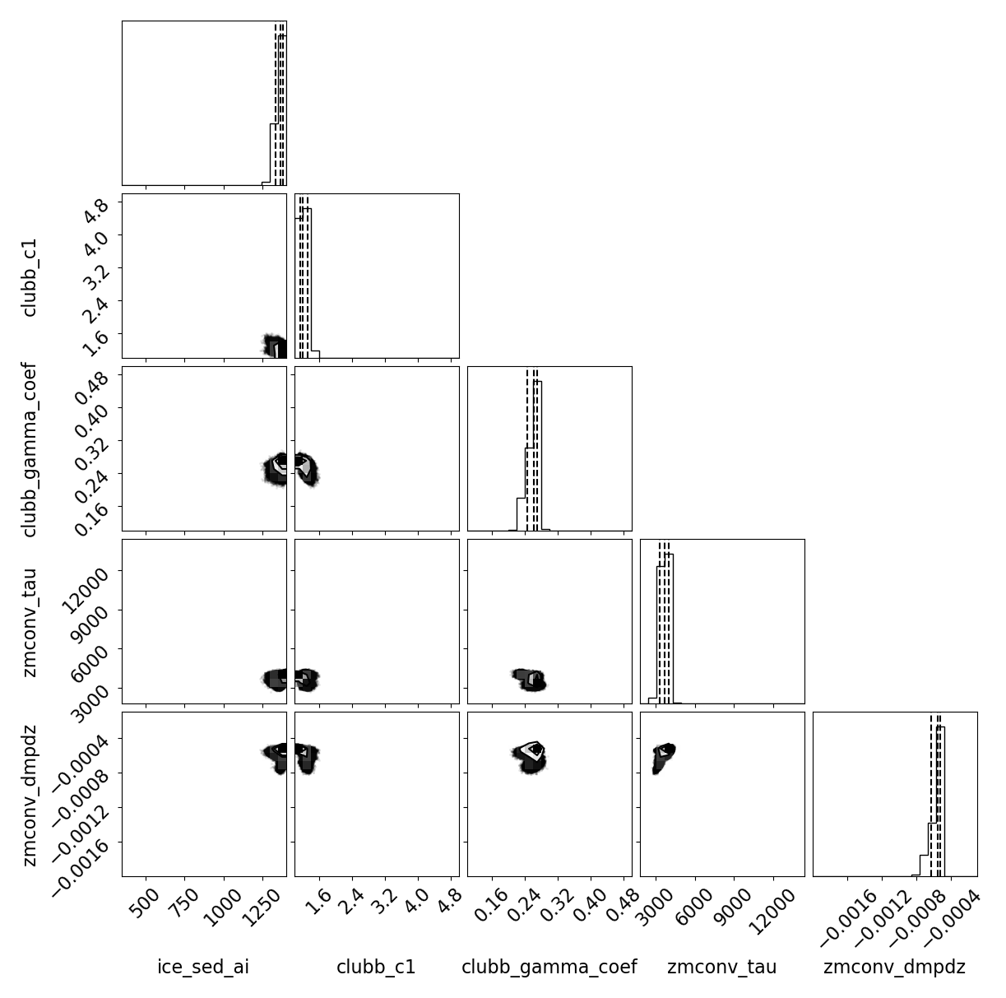
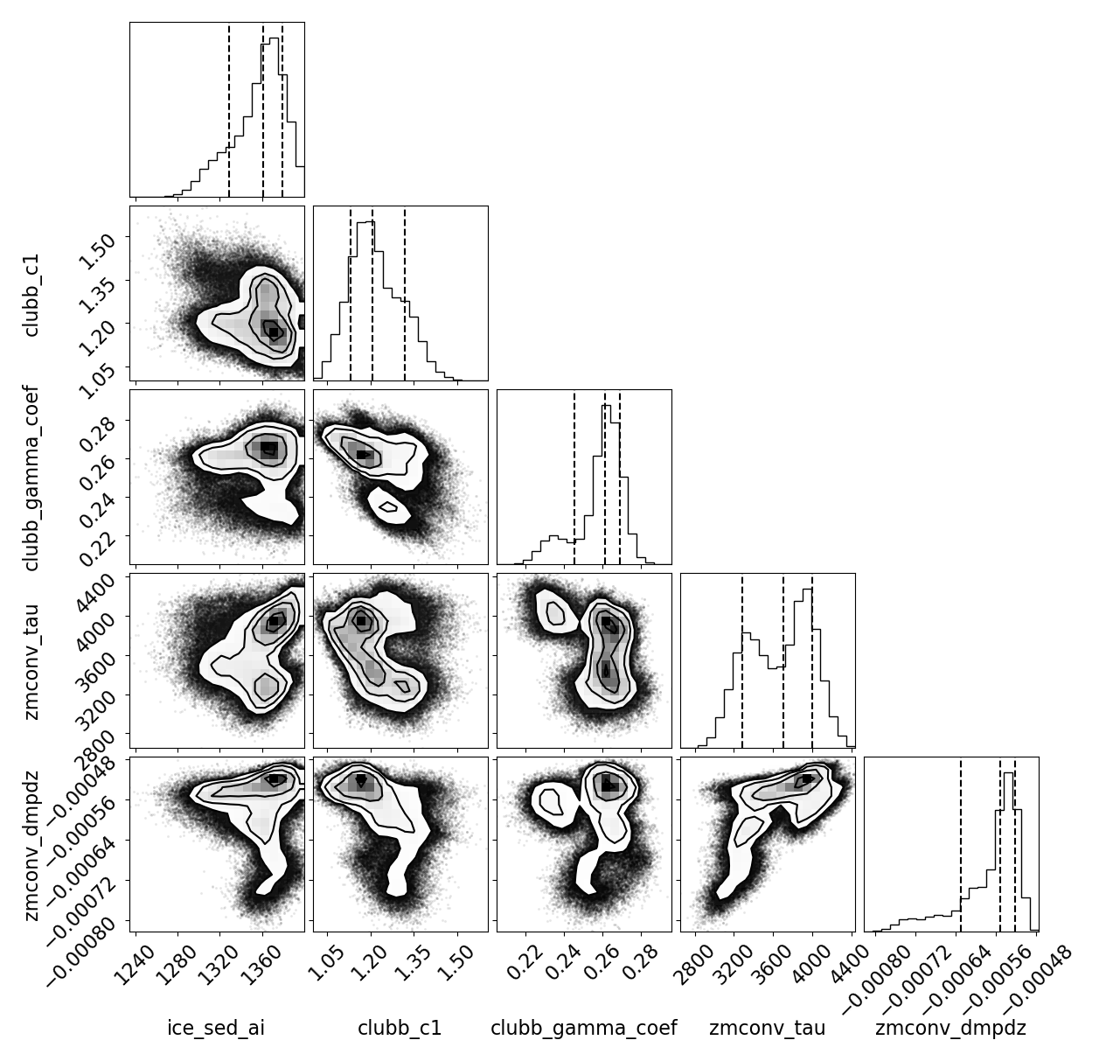
Calibration: Results
Preliminary MCMC results:
Posterior distribution currently much smaller than searched parameter bounds
Potential to choose multiple parameter solutions
(Left) Searched parameter bounds (Right) Zoomed in
Notes:
Each panel is a joint distribution for two parameters

Slide 16
Summary
Created a flexible workflow for automated tuning and demonstrated on the E3SMv2 atmosphere model
  Leverages a surrogate model that predicts high dimensional E3SM climatological spatial fields
  Surrogate is independent of choice of loss function
Autotuned "optimized" E3SMv2 reduces RMSE for 11 spatial fields and 4 seasons by an average of 3.9%.
A Bayesian implementation provides a distribution of optimized tuning parameters.
Notes:
Drew

Slide 17
Next: Auto-tuning E3SMv3
E3SMv3 PPE (March-April 2023)
8 tuning parameters
~200-300 10-yr F2010 simulations and 1-yr SST+4K simulations
Machine: Chrysalis or Compy
Surrogate and optimization
Loss function: user can override automatic field weighting with pre-specified weights
Deliverables
Optimal set of tuning parameters for F2010 to assist E3SMv3 expert tuning
Distribution of tuning parameters from MCMC sampling
Alternative optimized parameters using different field weightings
Alternative tunings with a range of climate sensitivities
Potentially: adapt tools to tune other E3SMv3 configurations
Notes:
Benj

Slide 18
Our PPE’s
Confluence: Autotuning PPE's
Our software
E3SM Autotuning github: E3SM-Project/Autotuning-NGD
Tesuract (surrogate construction): https://github.com/kennychowdhary/tesuract
Other software
    Adams, B.M., Bohnhoff, W.J., Dalbey, K.R., Ebeida, M.S., Eddy, J.P., Eldred, M.S., Hooper, R.W., Hough, P.D., Hu, K.T., Jakeman, J.D., Khalil, M., Maupin, K.A., Monschke, J.A., Ridgway, E.M., Rushdi, A.A., Seidl, D.T., Stephens, J.A., Swiler, L.P., and Winokur, J.G., "Dakota, A Multilevel Parallel Object-Oriented Framework for Design Optimization, Parameter Estimation, Uncertainty Quantification, and Sensitivity Analysis: Version 6.15 User’s Manual," Sandia Technical Report SAND2020-12495, November 2021.

Slide 19
Additional slides

Slide 20
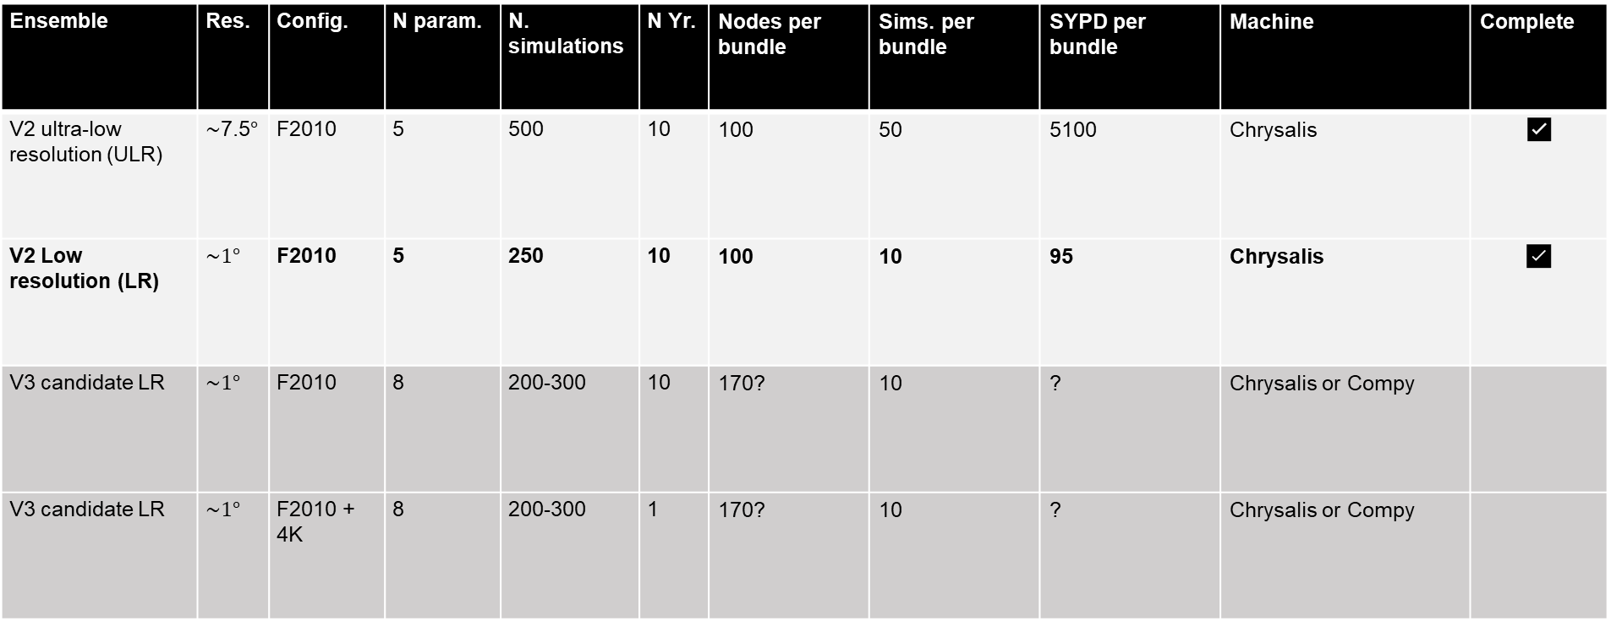
E3SM PPE’s
Ensemble | Res. | Config. | N param. | N. simulations | N Yr. | Nodes per bundle | Sims. per bundle | SYPD per bundle | Machine | Complete
V2 ultra-low resolution (ULR) | $\sim$7.5$°$ | F2010 | 5 | 500 | 10 | 100 | 50 | 5100 | Chrysalis | ✅
V2 Low resolution (LR) | $$\sim 1°$$ | F2010 | 5 | 250 | 10 | 100 | 10 | 95 | Chrysalis | ✅
V3 candidate LR | $$\sim 1°$$ | F2010 | 8 | 200-300 | 10 | 170? | 10 | ? | Chrysalis or Compy
V3 candidate LR | $$\sim 1°$$ | F2010 + 4K | 8 | 200-300 | 1 | 170? | 10 | ? | Chrysalis or Compy
Autotuning PPE’s (E3SM confluence)

Slide 21
Input parameters for E3SMv3 PPE
Scheme | Parameter | Description | Low-Def-High
Clubb | clubb_c1 | Constant for dissipation of variance of mean(w’²) | 1.0__1.335__5.0
Clubb | clubb_gamma_coef | Constant of the width of PDF in w coordinate | 0.1__0.32__0.5
ZM conv. | zmconv_tau | Time scale for consumption rate deep CAPE | 1800__3600__14400
ZM conv. | zmconv_dmpdz | Parcel fractional mass entrainment rate | -2.0e-3__-0.7e-3__-0.1e-3
ZM micro | zmconv_micro_dcs | Autoconversion size threshold for cloud ice (to snow) | 100.e-6__150.e-6__400e.-6
P3 Micro | nucleate_ice_subgrid | Subgrid parameter for ice nucleation | 1.0__1.35__1.4 (Range from original developers) -consider 1.2__1.35__1.4 based on Wuyin’s experience.
P3 Micro | p3_embryonic_rain_size | p3_embryonic_rain_size (micrometers) | 15e-6__25e-6__40e-6
P3 Micro | p3_qc_accret_expon | Accretion qc/qr exponent. Accretion: growth of a precipitation particle by the collision of a frozen particle with a supercooled liquid water droplet which freezes upon impact. | 1.0__1.15__2.0

Slide 22
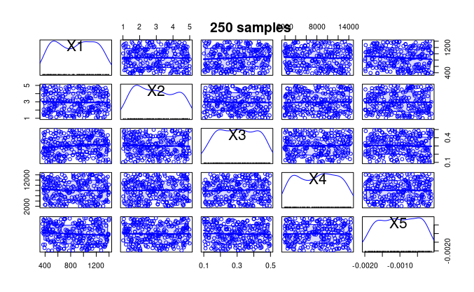
Optimization: Results
Parameter | Description | Low-Default-High (autotuned)
clubb_c1 | Constant for dissipation of variance of mean(w’²) | 1.0__1.335__5.0 (1.13)
clubb_gamma_coef | Constant of the width of PDF in w coordinate | 0.1__0.32__0.5 (0.265)
zmconv_tau | Time scale for consumption rate deep CAPE | 1800__3600__14400 (4049.74)
zmconv_dmpdz | Parcel fractional mass entrainment rate | -2.0e-3__-0.7e-3__-0.1e-3 (-0.49e-3)
micro_mg_ai | Fall speed parameter for cloud ice | 350__500__1400 (360.25)
V2 Control parameters are likely influenced by output fields we have not considered here (climate sensitivity, El Niño, AMOC, coupling).

Slide 23
Calibration strategy (SWAP in from pdf or eliminate)
Bayesian formulation for how different output fields are weighted in the optimization problem.
Markov Chain Monte Carlo (MCMC) sampling

Slide 24
How many simulations do we need?
Randomly sample k = 50, 75, 100, …, 225 of the 250 perturbed parameter ensemble runs.
Perform surrogate construction and optimization using only the sampled runs.
Repeat with 20 different random samples for each k.
Evaluate:
  5 year and 10 year time-averaged fields
  24x48 and 180x360 latitude/longitude resolution
Gives very rough idea of sensitivity to the number of simulations used and the replicability of autotuned parameter sets.

Slide 25
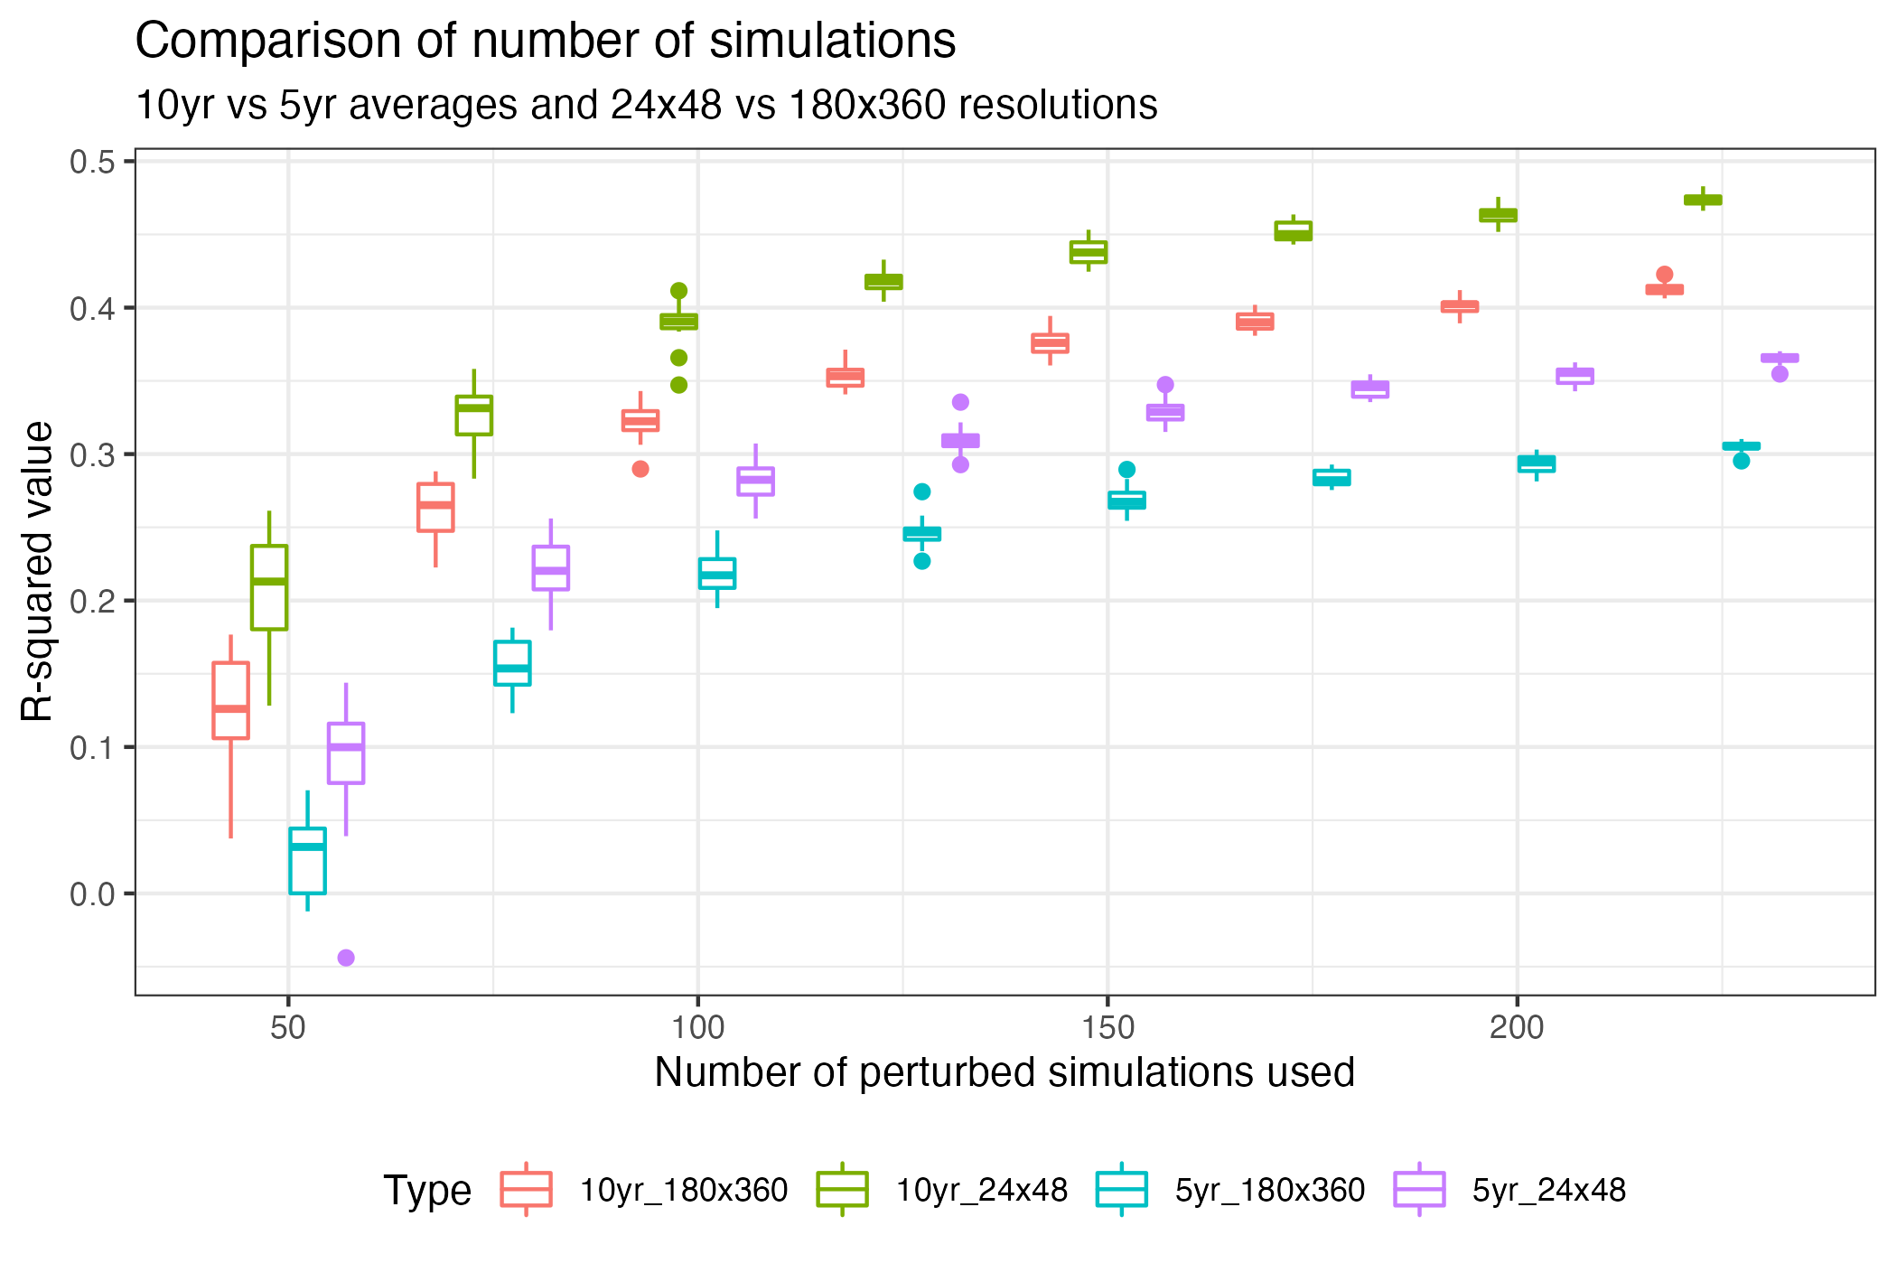
How many simulations? Surrogate fit in terms of R²
Based on this, we use 10 yrs, 24x48

Slide 26
Abstract
Tuning an Earth system model is a time-consuming effort traditionally led by subject matter experts. We are developing an automated tuning method that uses a perturbed parameter ensemble (PPE) and machine learning (ML)/uncertainty quantification (UQ)/optimization tools to select parameter values. We present the workflow and the results of our optimization for E3SMv2. The automated tuning method reduces the RMSE relative to the E3SMv2 release by 3.9% on average for a set of eleven spatial targets over four seasons. We also study the effects of PPE sample size, PPE climatology length (number of simulated years), and surrogate spatial resolution, to determine the most efficient methods for our next effort, the automated tuning of E3SMv3.

Slide 27
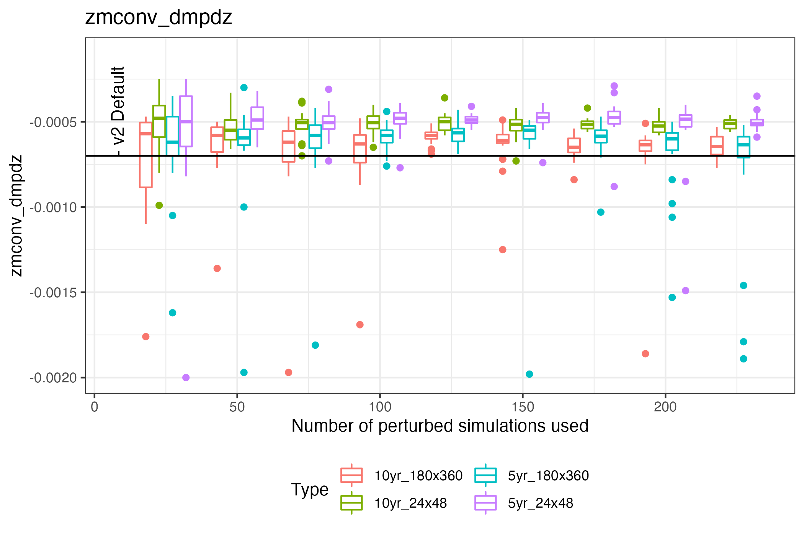
What resolution/sim length should we use for the surrogate?
Based on this, we use 10 yrs, 24x48 to reliably beat the default

Slide 28
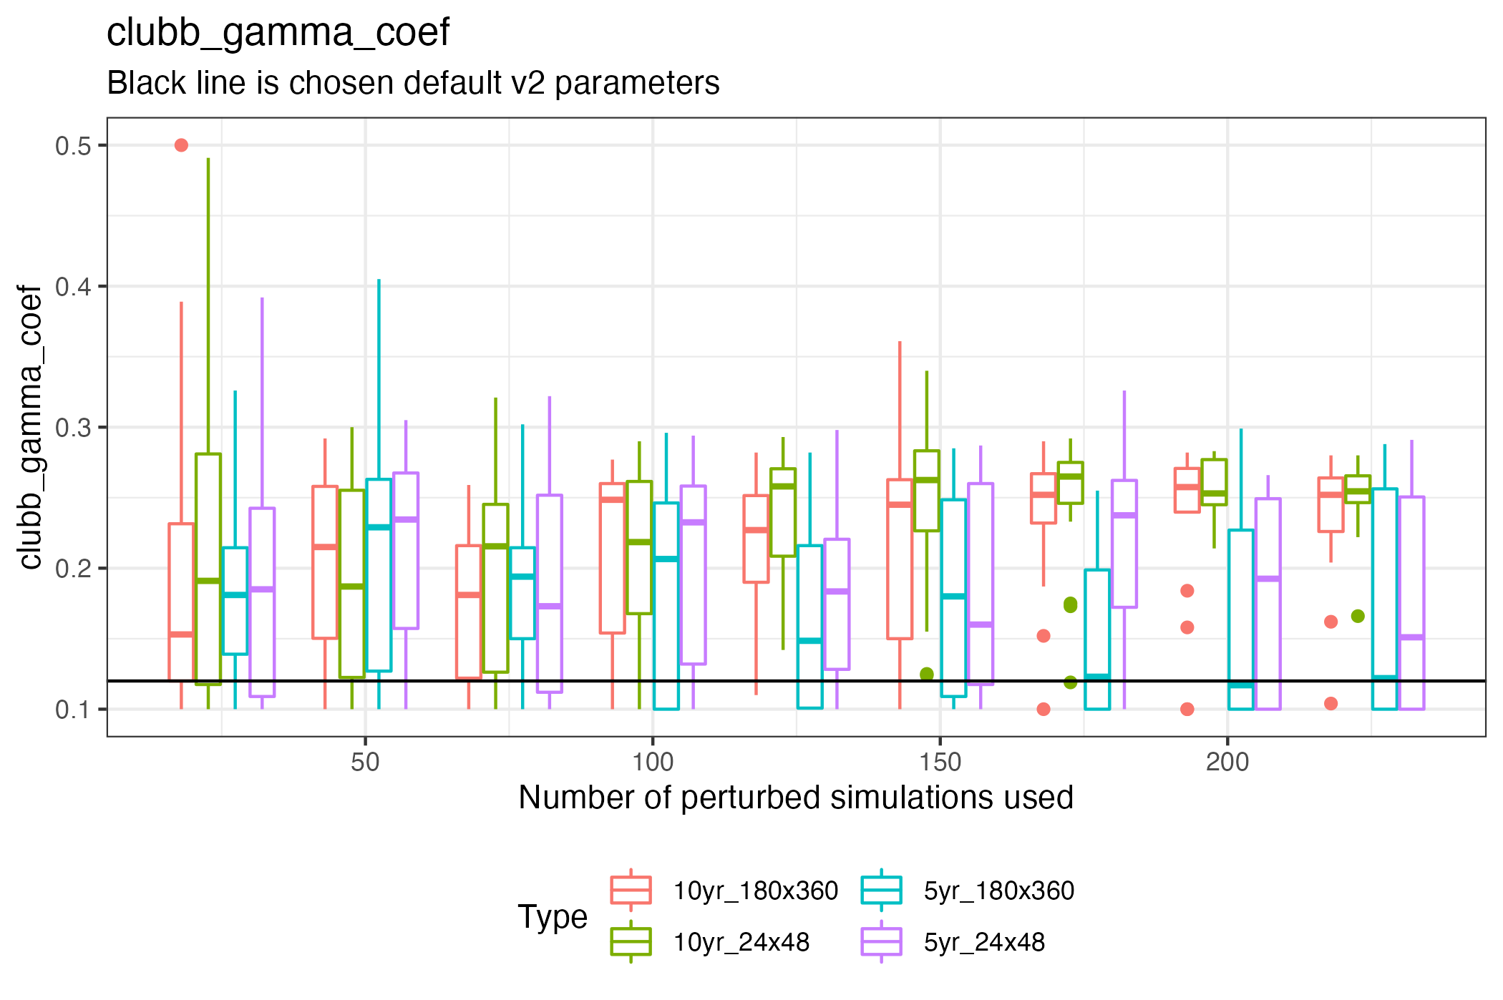
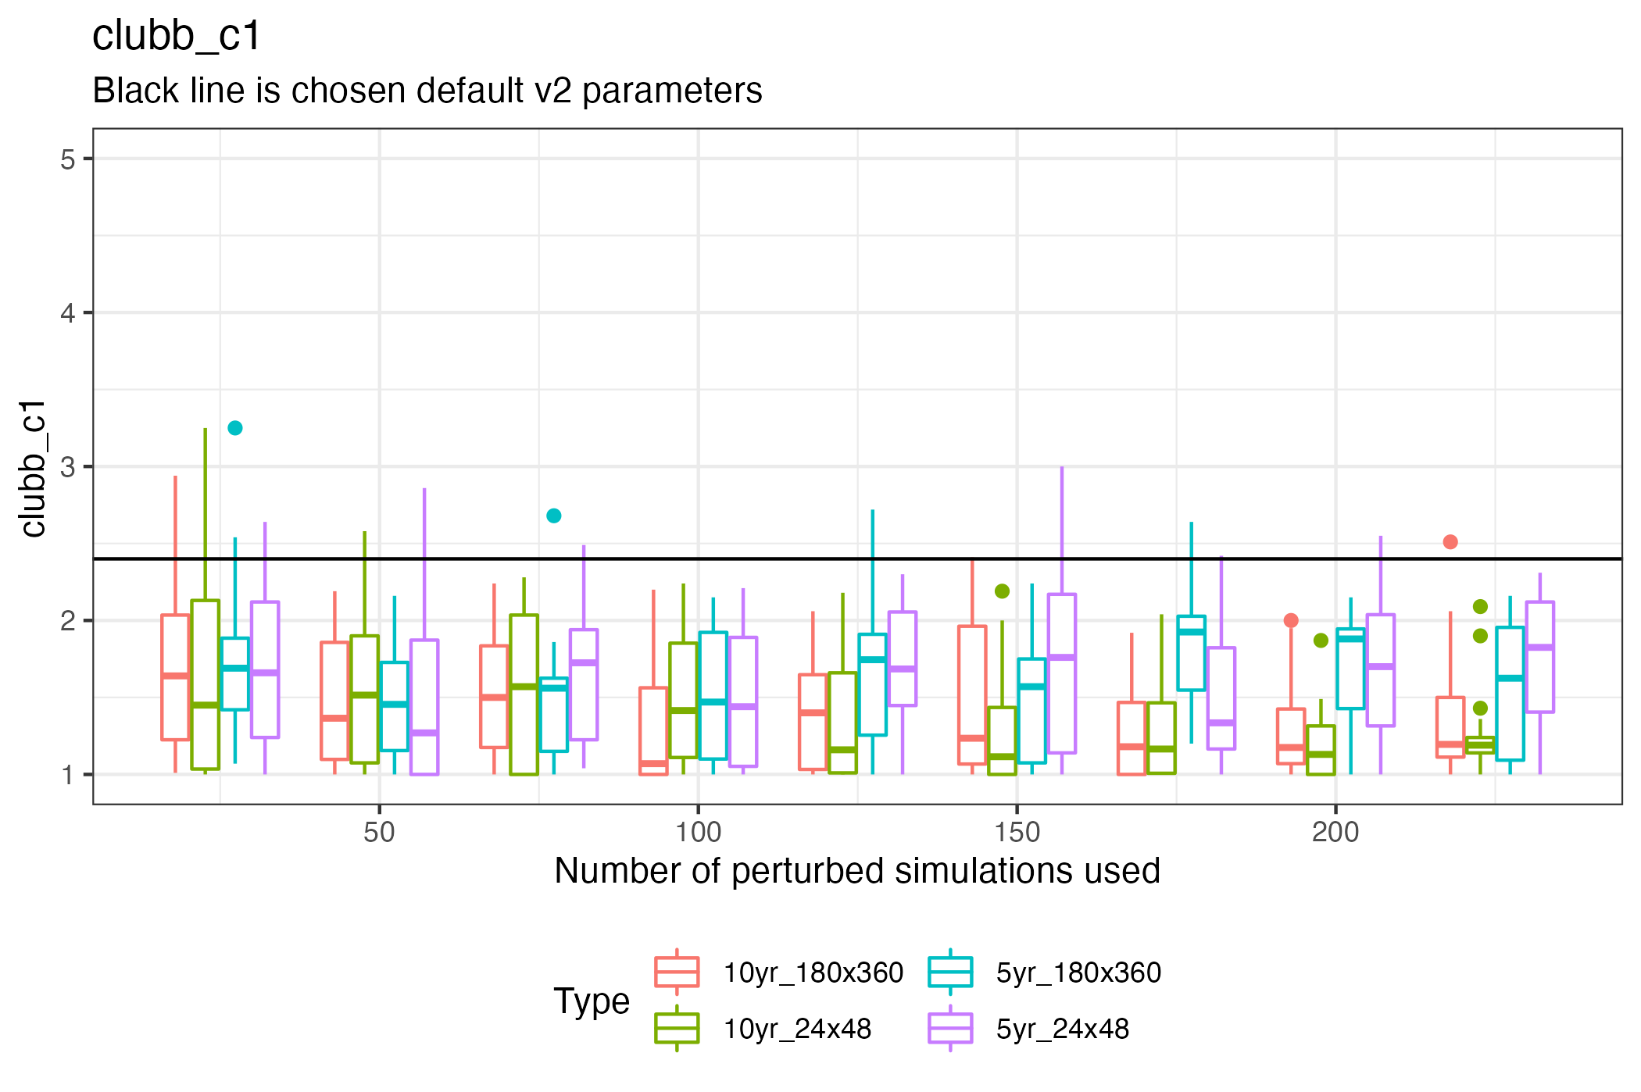
How many simulations? Optimized parameters

Slide 29
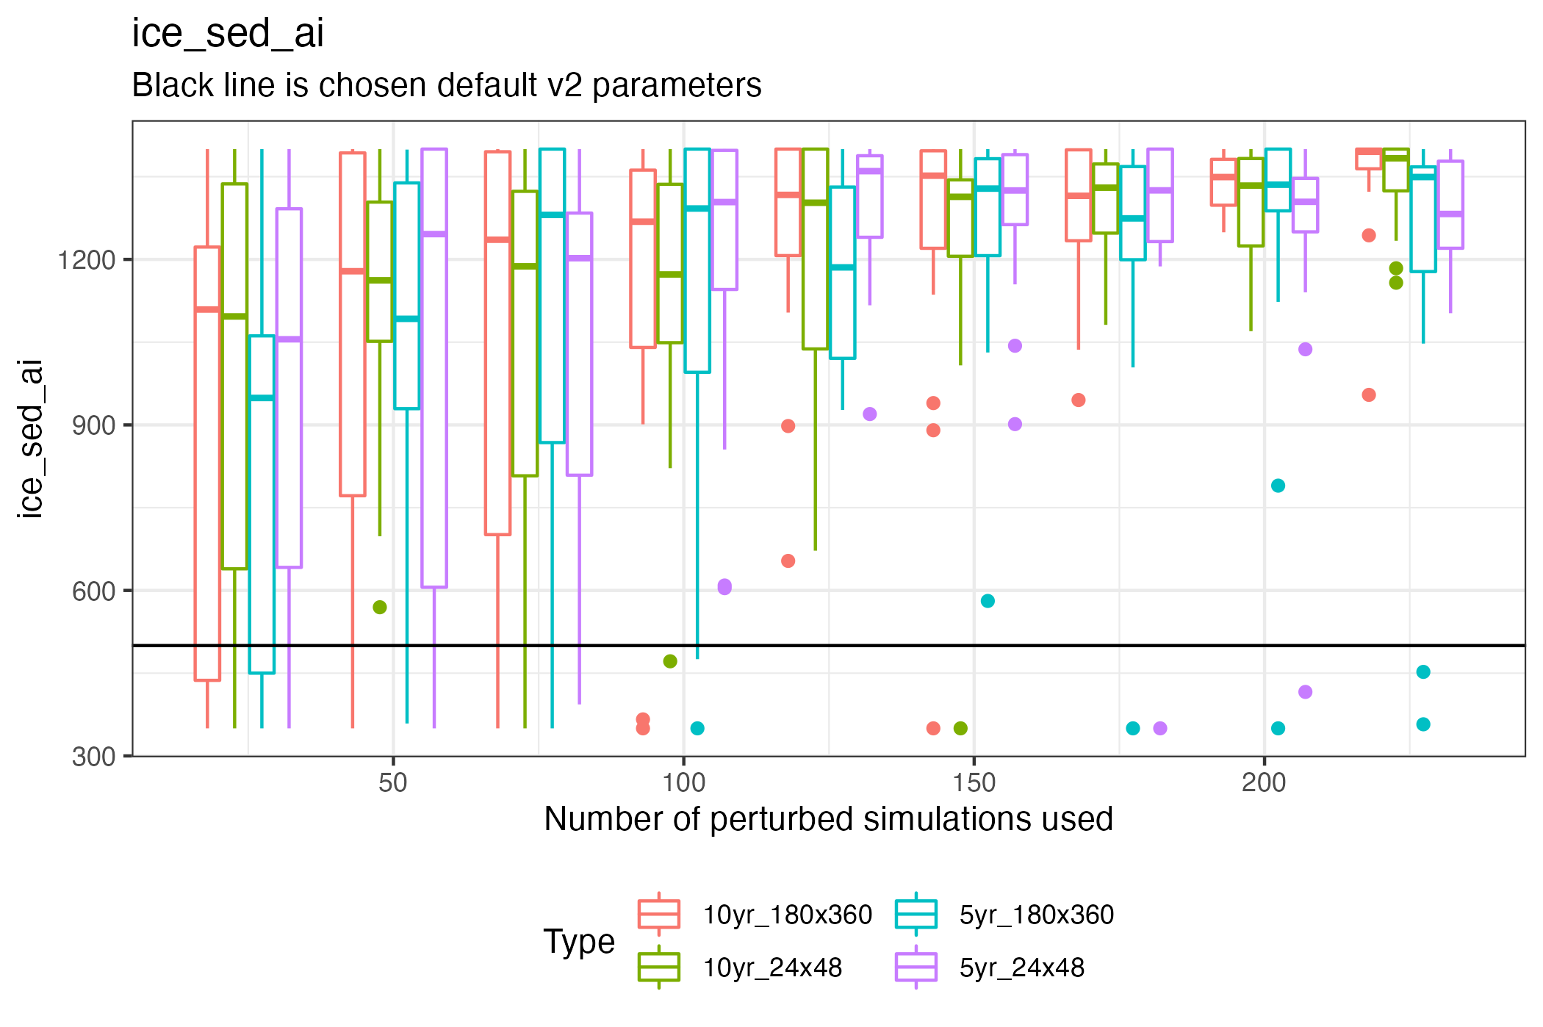
How many simulations? Optimized parameters

Slide 30
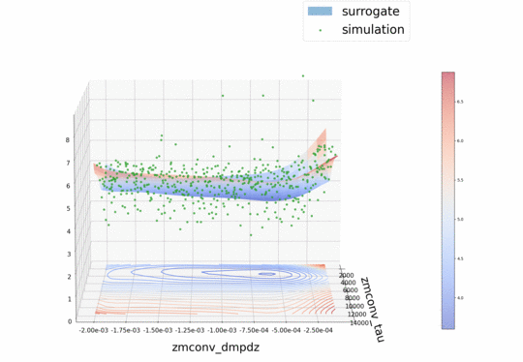

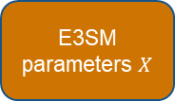



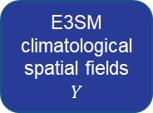
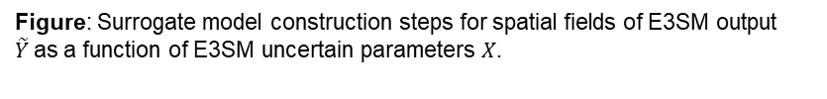
1. Generate Ensemble
2. Build Surrogate Model
SWCF RMSE
E3SM climatological spatial fields
$$Y$$
(1) PCA Dimension Reduction
$$Φ$$
$$\hat{Y}$$
E3SM parameters $X$
$$Φ^{−1}$$
$$\tilde{Y}$$
(2) Build surrogate for latent space
(3) Inverse transform latent space
Figure: SWCF RMSE [Wm⁻²] for autotuning ensemble (green dots) as a function of two deep convection parameters. Error computed with respect to default model tuning.
Figure: Surrogate model construction steps for spatial fields of E3SM output $\tilde{Y}$as a function of E3SM uncertain parameters $X$.
Notes:
1). Sample parameters that represent sub-gridscale processes and are common targets for “hand tuning”
Explain bundle 10 simulations in 100-node jobs. ”Save people time”
2). ML Methods that we tried: multivariate polynomials, random forests, support vector machines, k-nearest neighbors, kernel ridge regression, Gaussian processes, and neural networks. For each method, Kenny performed cross validation and hyperparameter tuning. The winner was multivariate polynomials (polynomial chaos).
Go back and point to surface.

Slide 31
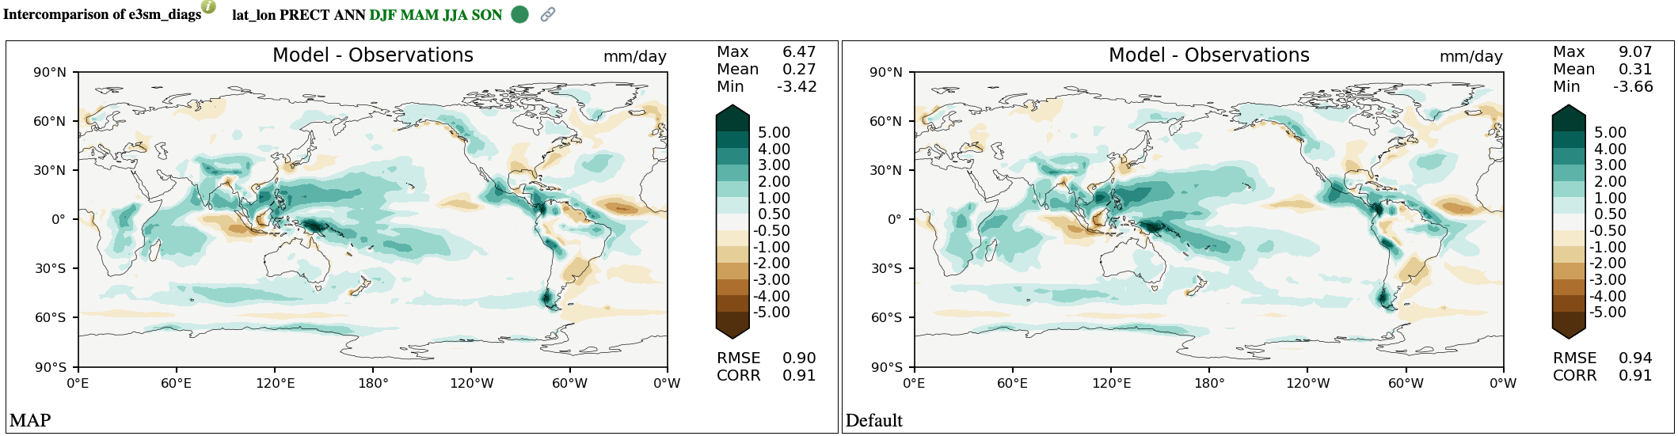
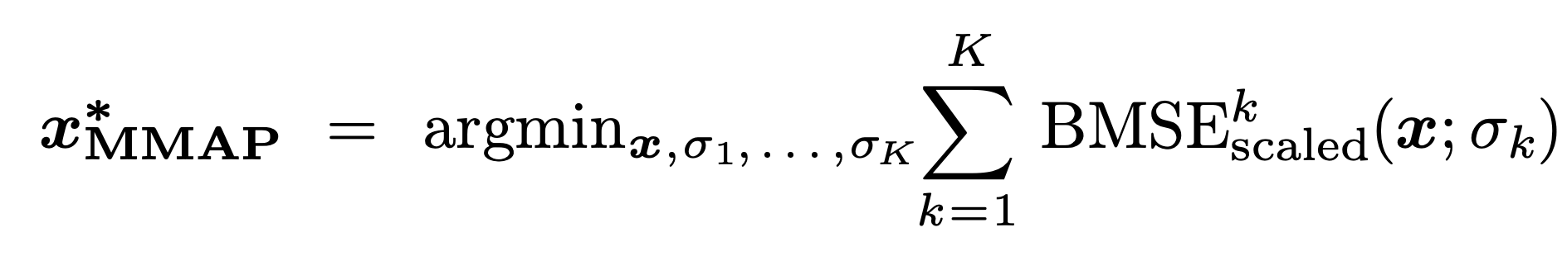
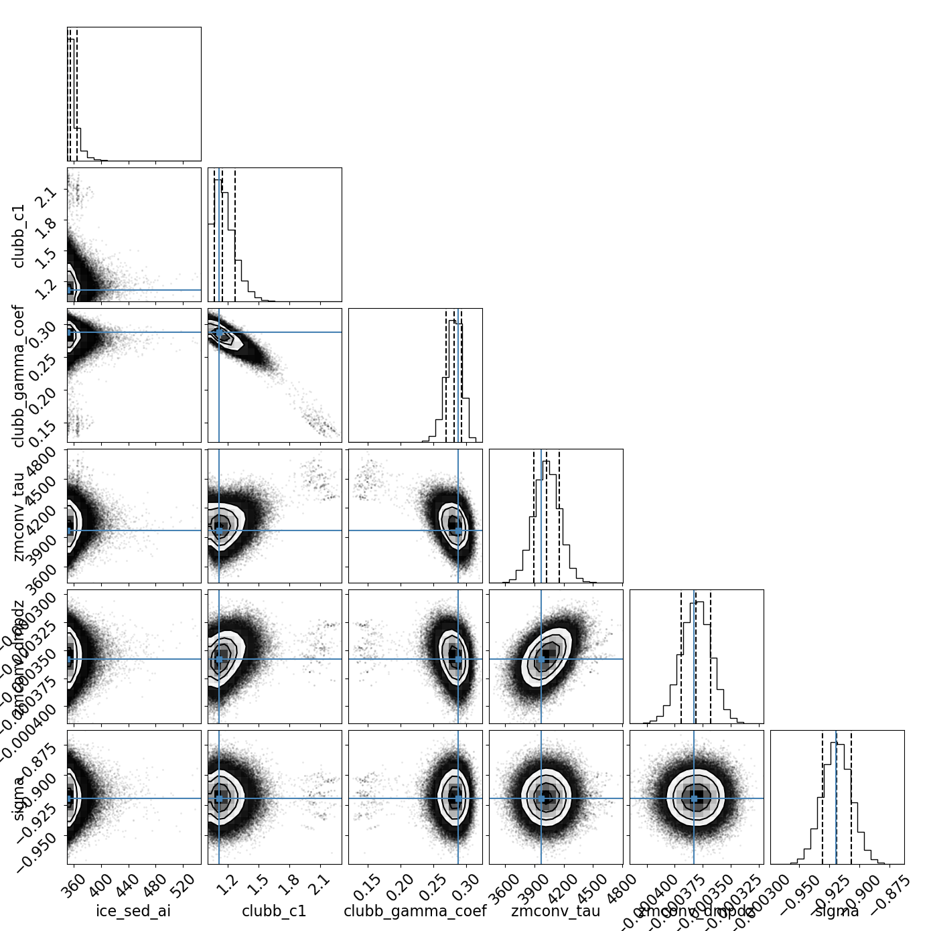
3. Optimize and calibrate surrogate
4. Validate in E3SM
Autotuned
ice_sed_ai
clubb_c1
clubb_gamma_coef
zmconv_tau
Default
zmconv_dmpdz
sigma
ice_sed_ai
clubb_c1
zmconv_tau
sigma
clubb_gamma_coef
zmconv_dmpdz
Figure: Intercomparison of E3SM diagnostics of precipitation climatology vs. observations for autotuned E3SMv2 (top) and default E3SMv2 (bottom). Intercomparison of e3sm diags
Season: DJF-only
Fields: PRECT, SWCF, LWCF
: MAP
Sampling: MCMC
Chains: 200
Figure: Corner plot of E3SMv2 ne30 parameter calibration for SWCF, LWCF, and PRECT against observations. More details on E3SM confluence.
Notes:
3. Optimize: Now that we have the surrogate, we can sample it cheaply and easily, for example, using MCMC sampling. We can do this by
1) MLE by minimize using a using a (quasi) Newton method (LBFGS) at multiple random starting points in parallel to avoid getting stuck at local minimums.
2) MAP which essentially does the calibration (complete with penalty term) and then maximizes the posterior distribution.
Calibrate: we interpret the BMSE as proportional to the negative log probability and we use sampling techniques, e.g., MCMC, to obtain the best set of calibration.
4. Explain that this is

Slide 32
E3SM PPE creation using Dakota^{[1]}
Generate E3SM perturbed parameter ensemble
Build surrogate from parameters to model output
Calibrate and optimize parameters using surrogate and climate observations
Validate parameters in E3SM
Screen recording example
[1] Adams et al., 2021

Slide 33
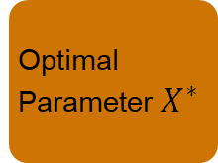
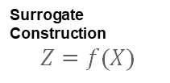

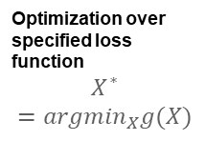
Current Workflow
INPUT:
E3SM Parameters
High-Dimensional Input X
(m scalar values)
Optimal Parameter $X^{∗}$
Perturbed Parameter
Ensemble Generation
Optimization over specified loss function
$$X^{∗}=argmin_{X}g(X)$$
Surrogate Construction
$$Z=f(X)$$
Figure: SWCF RMSE [Wm⁻²] for autotuning ensemble (green dots) as a function of two deep convection parameters. Error computed with respect to default model tuning.
OUTPUT
Dimension Reduction
$$Φ$$
Projecting back to original space
$$Φ^{−1}$$
High-Dimensional Output Y
(N spatial fields)
Reduced Output Z
(K<N)
Fitted Values Ẑ
Fitted Output Ŷ

