Slide 10
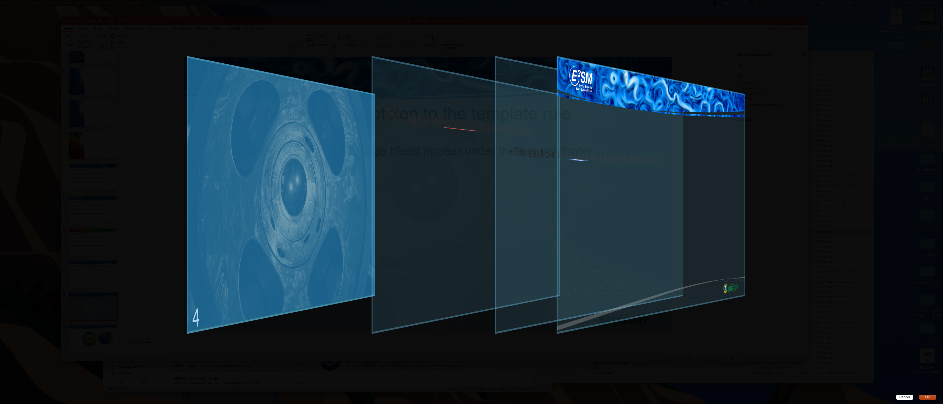
This page is the exception to the template rule
This is built to allow a full page bleed appear under the header/footer

