Slide 1
Impact of the P3 Cloud Microphysics on Simulation of Mesoscale Convective Systems in E3SM Regionally Refined Model (RRM)
J. Wang¹, J. Fan^{1,*}, Z. Feng¹, K. Zhang¹,
E. Roesler², B. Hillman², J. Shpund¹,
W. Lin³, and S. Xie⁴
¹ PNNL, ² SNL, ³ BNL, ⁴ LLNL
* jiwen.fan@pnnl.gov
Acknowledgement:
DOE CMDV and E3SM Programs
Notes:
Stock Image: Abstract Data Visualization Grid

Slide 2
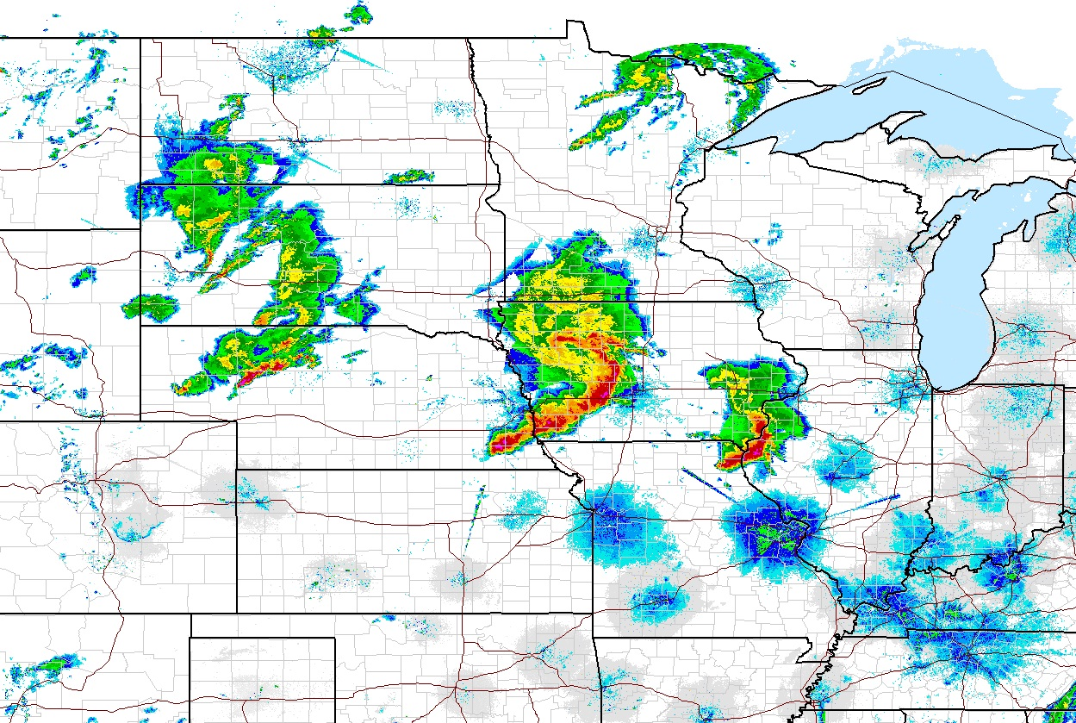
Motivation
Mesoscale Convective Systems (MCSs)
Mesoscale Convective Systems (MCSs) play important roles in global hydrological cycle, radiative budget, and circulation. It is difficult to simulate in GCMs because of coarse resolutions. The regionally refined model (RRM) at 1/4º makes the simulation of MCSs possible.
Cloud microphysics is one of the most poorly represented physics in GCMs. Microphysics parameterization in the released E3SM follows MG2 (Gettelman & Morrison, 2015). Limitations:
The artificial conversion from ice to snow
Neglects the rimed particles that are important hydrometeors in convective systems.
MG2
qi, ni
qs, ns

Slide 3
Small and dense ice
The Predicted Particle Properties (P3) scheme (Morrison & Milbrandt, 2015) addresses both limitations
Ice particles are predicted and evolved locally, removing the artificial conversion (also means less predefined parameter and thresholds).
Rimed particles are considered by predicting rimed mass and volume
8 prognostic variables (Qc, Nc, Qr, Nr, Qi, Ni, Qrim, Bvrim) same as MG2 (Qc, Nc, Qr, Nr, Qi, Ni, Qs, Ns)
partially rimed ice
Graupel/hail
P3
qi, ni, qrim, bvrim

Slide 4
P3 in E3SM
Implementation of P3 into E3SM: (a) subgrid variability in microphysical process rates, (b) cloud fraction, and (c) scaling some tendency terms.
The initial implementation of P3 into E3SM was under CMDV-MCS project (done by K. Zhang).
Later, SCREAM team refactored P3 and implemented into E3SM.
Under NGD project, we merged with the refactored P3 to have a single P3 code base, then debugged and evaluated it (by K. Shpund). The code is being used for the convective assessment task and being evaluated for v3 release.
This study still used the version developed under CMDV-MCS project. A couple of bugs found from the NGD project were applicable to this version and were fixed.
Some features about the E3SM-P3 we used in this study
Heterogenous ice nucleation still follows original P3 – Bigg 1953 for immersion freezing and Cooper (1986) for deposition nucleation, different from CNT used in our P3 under NGD project.
Homogenous aerosol freezing for cirrus clouds (Liu and Penner (2005)
Corrected the aqueous chemistry bug: total condensate mass was changed to liquid water content, leading to smaller aerosol loading

Slide 5
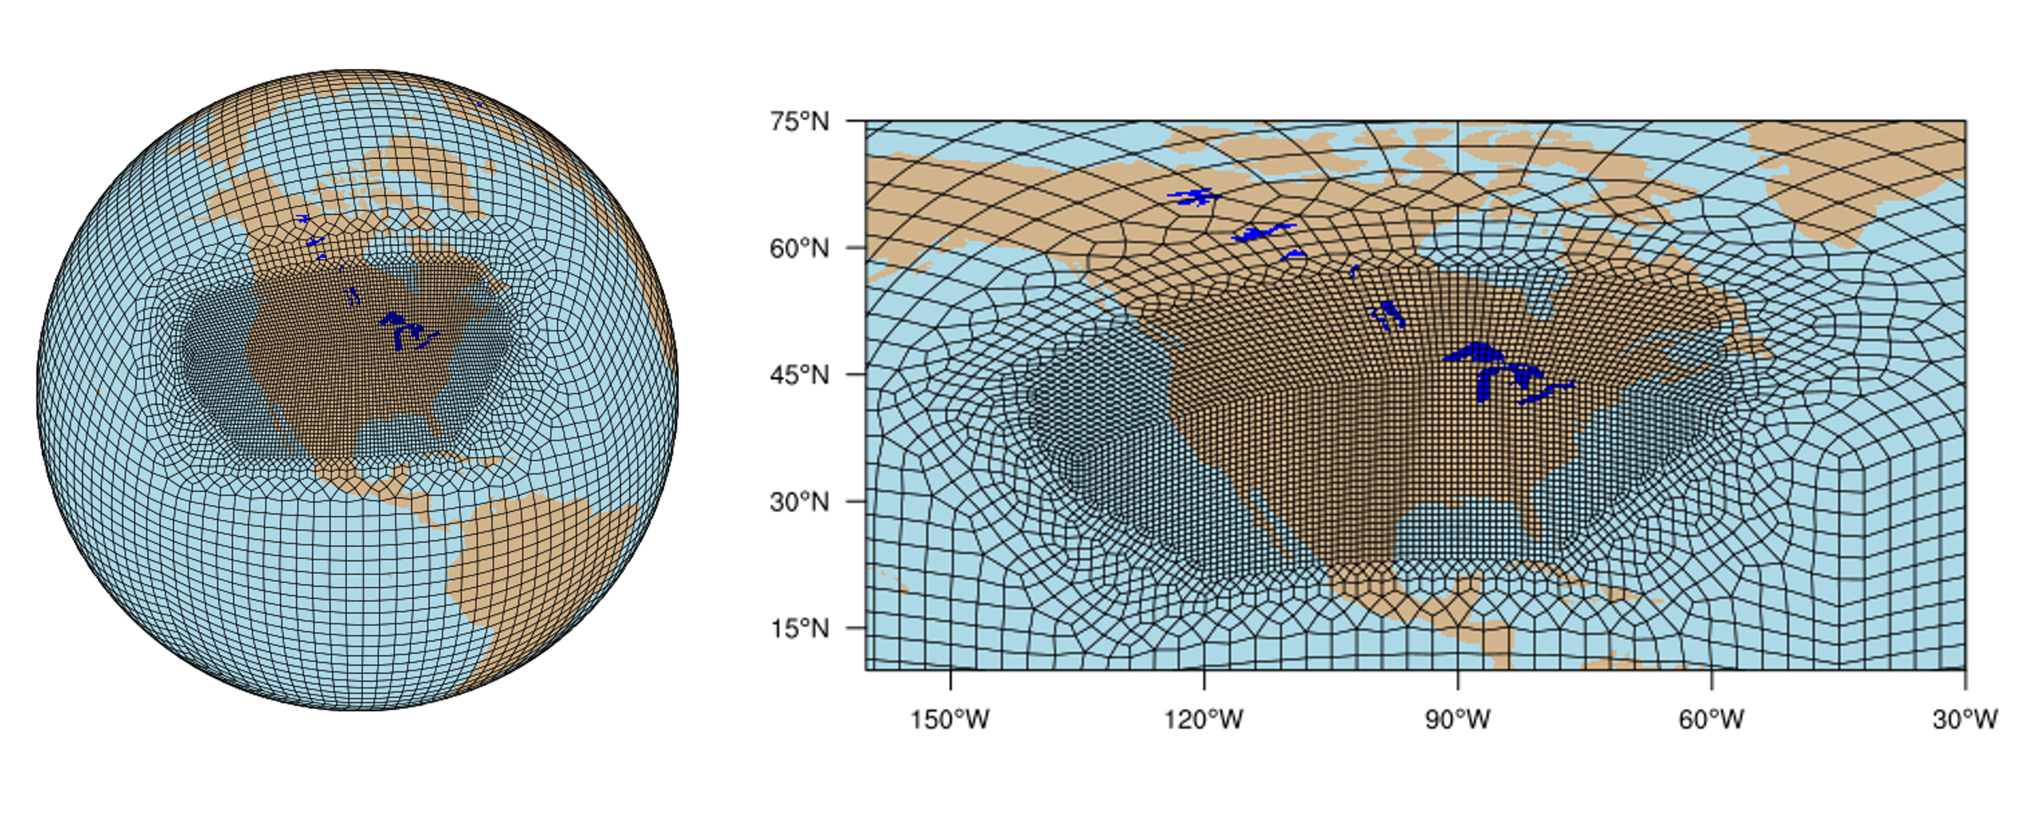
Simulations and Analysis Methods
CONUS RRM ¼ deg
E3SM v1 with some updates of v2; Nudged simulations with linear nudging of winds from ERA-Interim
Ran from Jan. 01 to Sep. 30, 2011
Analysis Methods
Focused on spring 2011 over Central US.
Observation data: Stage IV precipitation and satellite cloud brightness temperature, both are regridded to 1/4º resolution.
MCS tracking at ¼ deg (FLEXTRKR, Feng et al. 2020) applied to both observation and model simulations
Cold cloud shield exceeds 6 × 10⁴ km²
Area, rain rate, and duration of precipitation features exceed certain thresholds
Notes:
Cold cloud shield exceeds 6 × 104 km² and last 6 hours
Precipitation features (> 0.5 mm/hr): area and rain rate exceed certain thresholds.

Slide 6
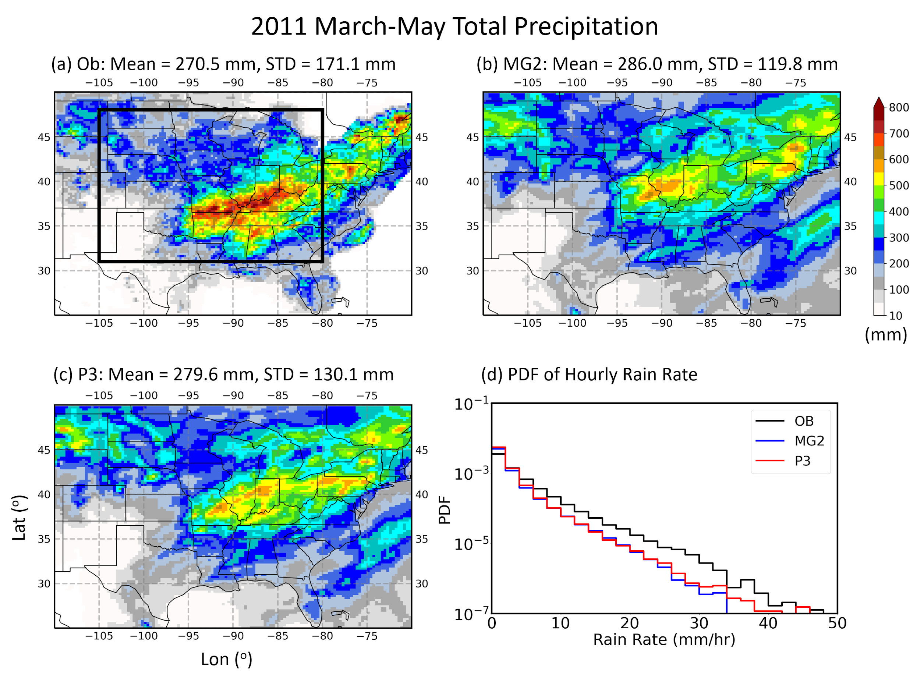
P3 improves precipitation and PDF of rain rate
Central US (Mar-May, 2011)
OBS
MG2
Both P3 and MG2 overestimate the mean precipitation but P3 has lower biases
P3 improves PDF of rain rate significantly by predicting higher frequencies of large rain rates (> 30 mm/h). Capture rain rates larger than 45 mm/h
P3

Slide 7
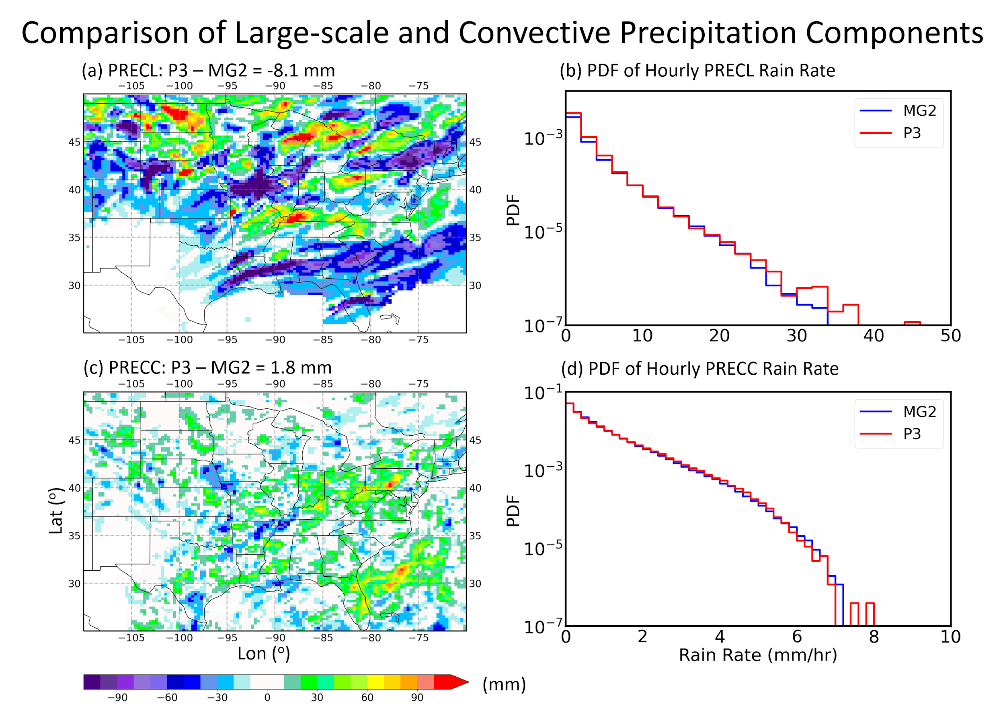
The improvement mainly comes from the large-scale precipitation
Large-scale Precipitation
Convective Precipitation

Slide 8
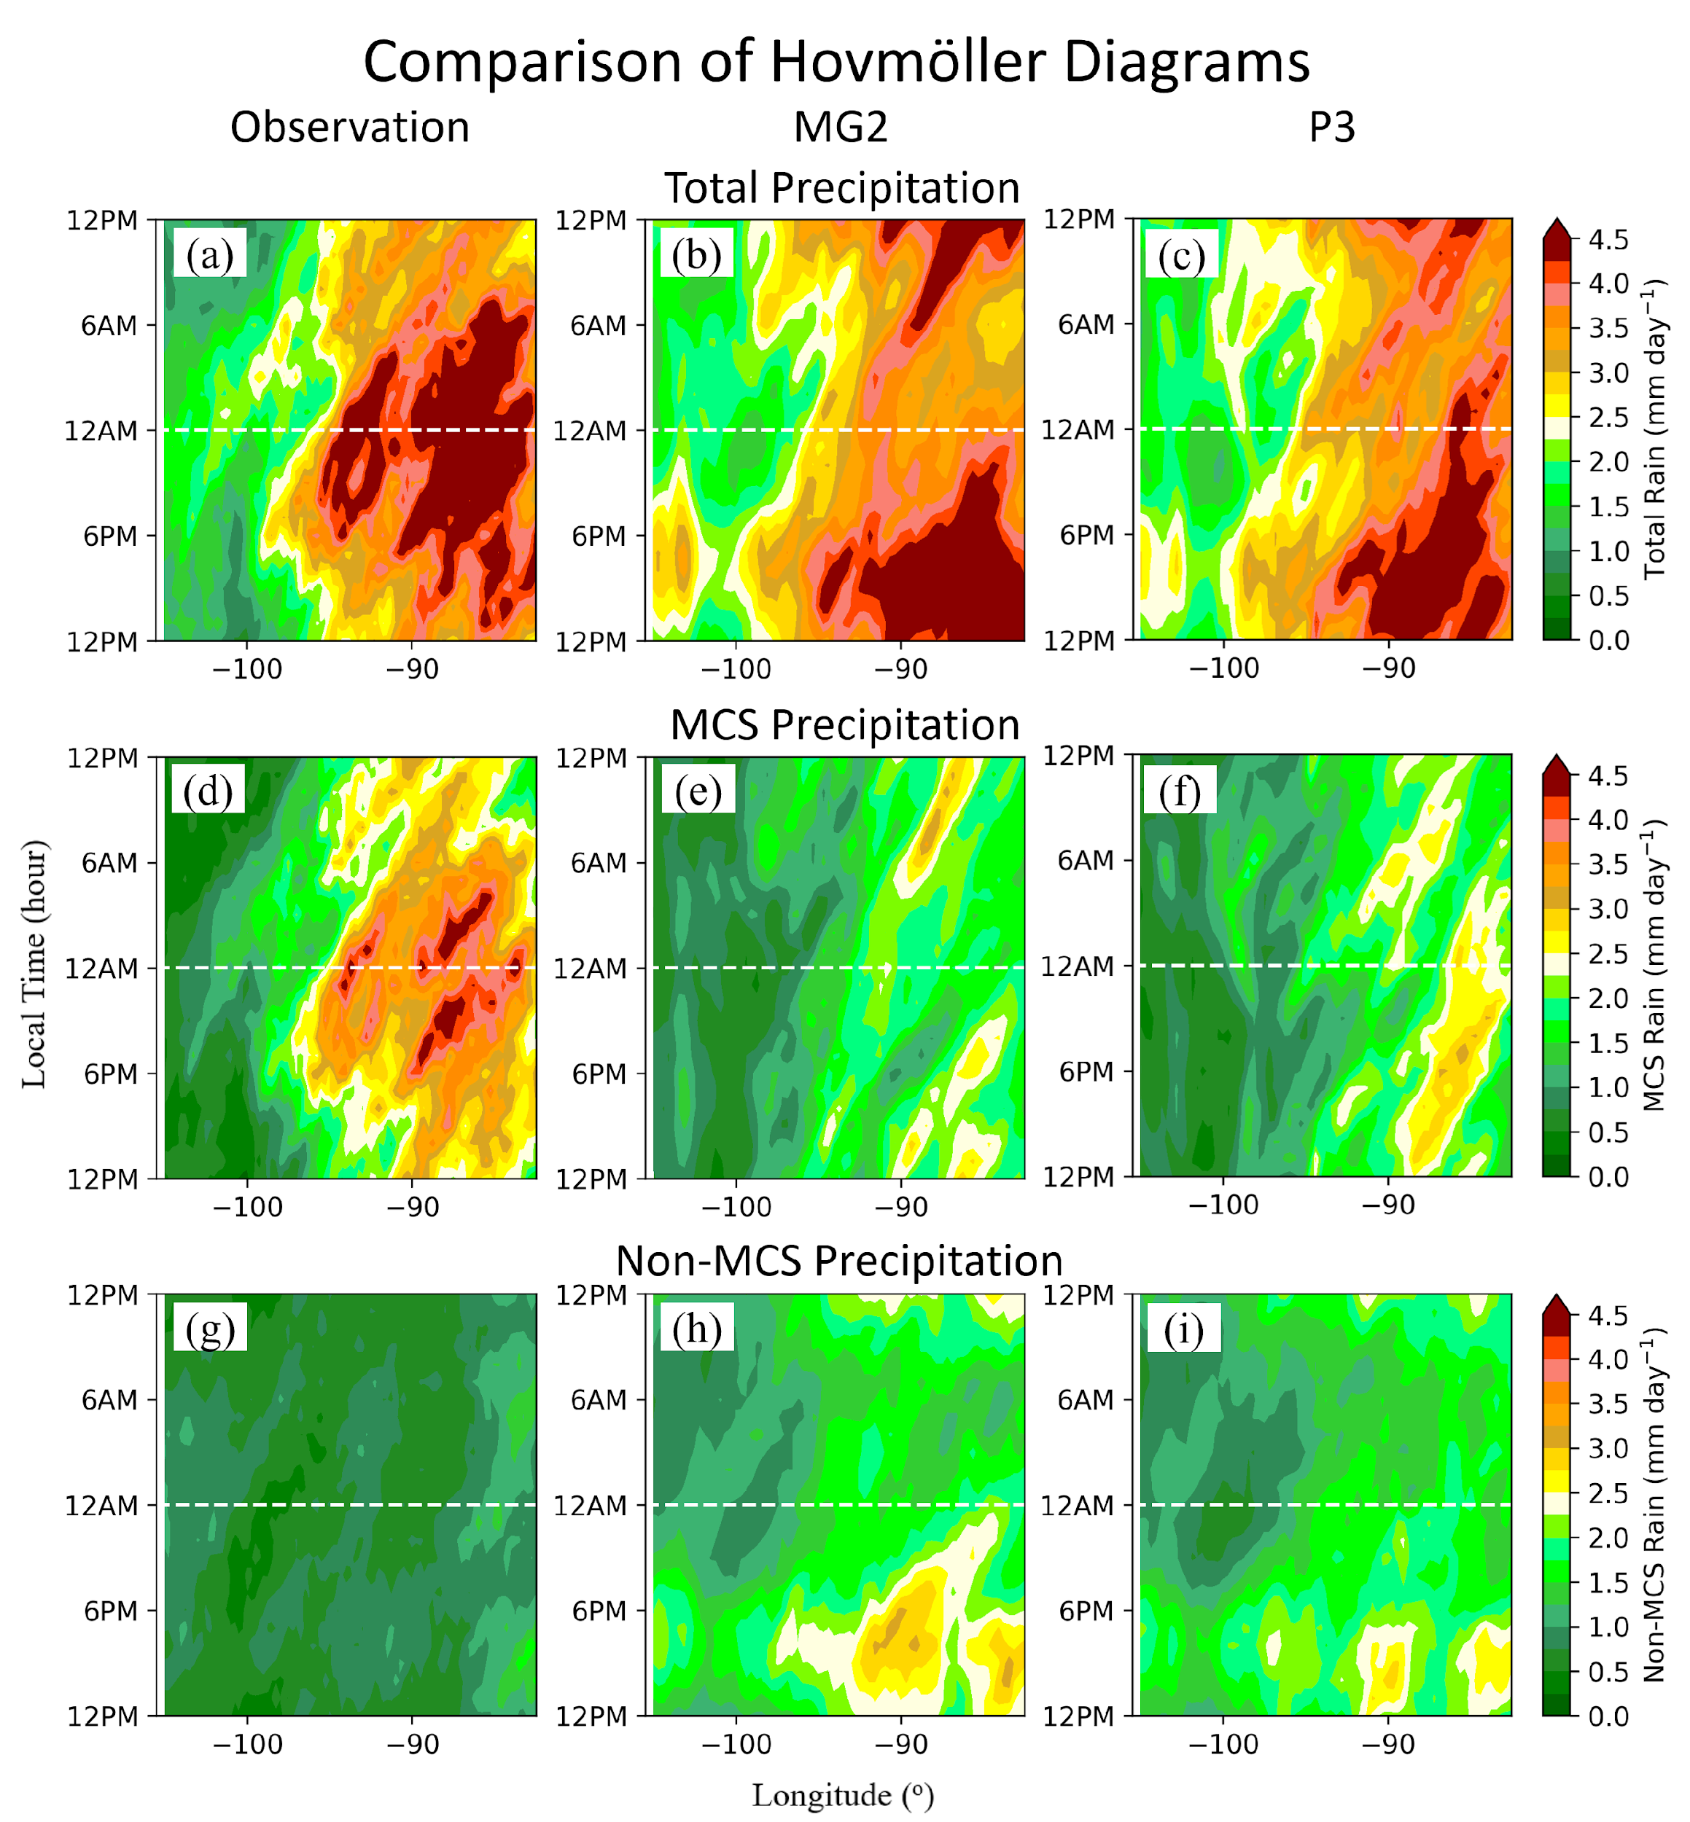
P3 improves MCS precipitation but does not improve the diurnal cycle
OBS
MG2
P3
Total
P3 predicts less morning and afternoon precipitation but more nighttime precipitation, closer to obs.
P3 simulates more MCS precipitation (over 20% in some locations) and less non-MCS precipitation; improves both.
The changes are encouraging but not large enough to shift the phase of diurnal cycle.
MCS
Non-MCS

Slide 9
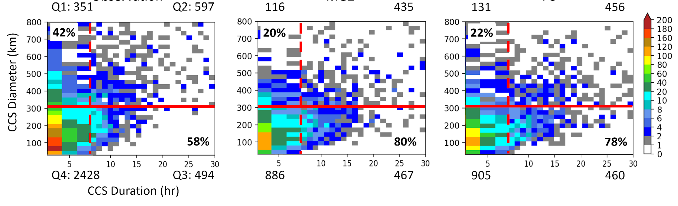
P3 improves MCS number but still has a large low bias
 | Obs. | MG2 | P3
Number of MCS | 122 | 56 | 67
Duration (hr) | 28.6 | 44.6 | 39.1
MCS Diameter (km) | 625.1 | 597.2 | 577.2
The model (either MG2 or P3) underestimates MCS number drastically, mainly because simulated systems are too small in size
P3 predicts 11 more MCSs than MG2 due to higher rain rate. This is significant for one spring season.
Obs
MG2
P3
MCSs
MCSs
MCSs

Slide 10
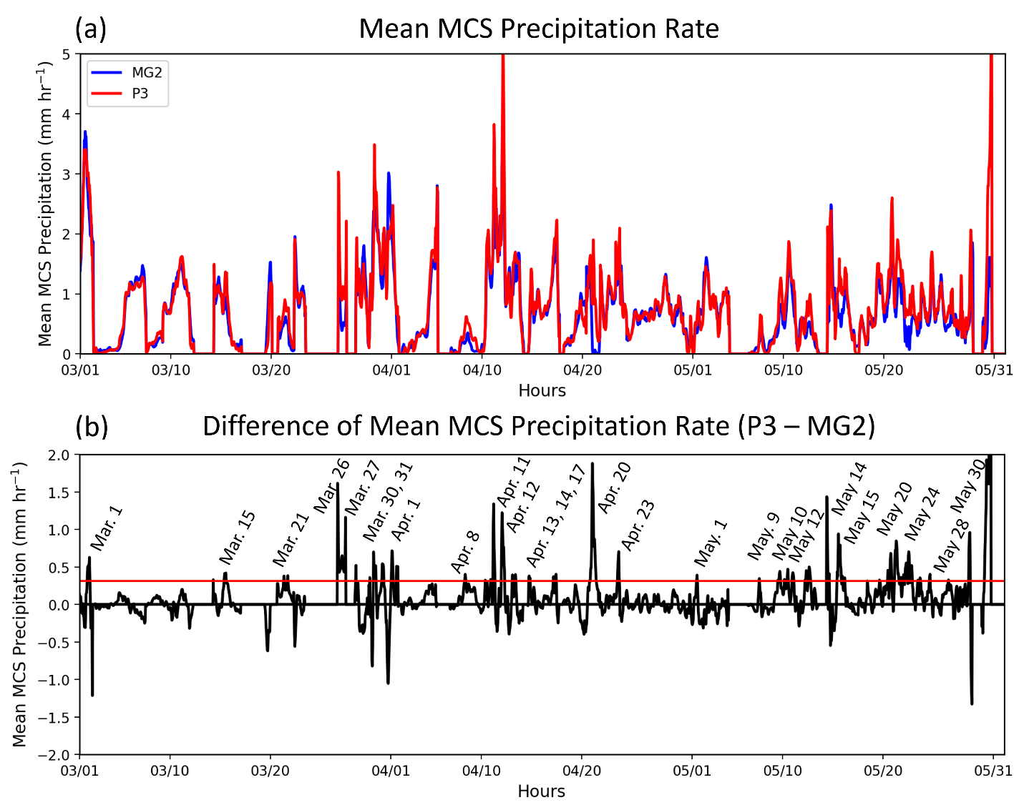
P3 simulates higher precipitation rates thereby more MCSs
Obs
dBZ
qv
MG2
P3

Slide 11
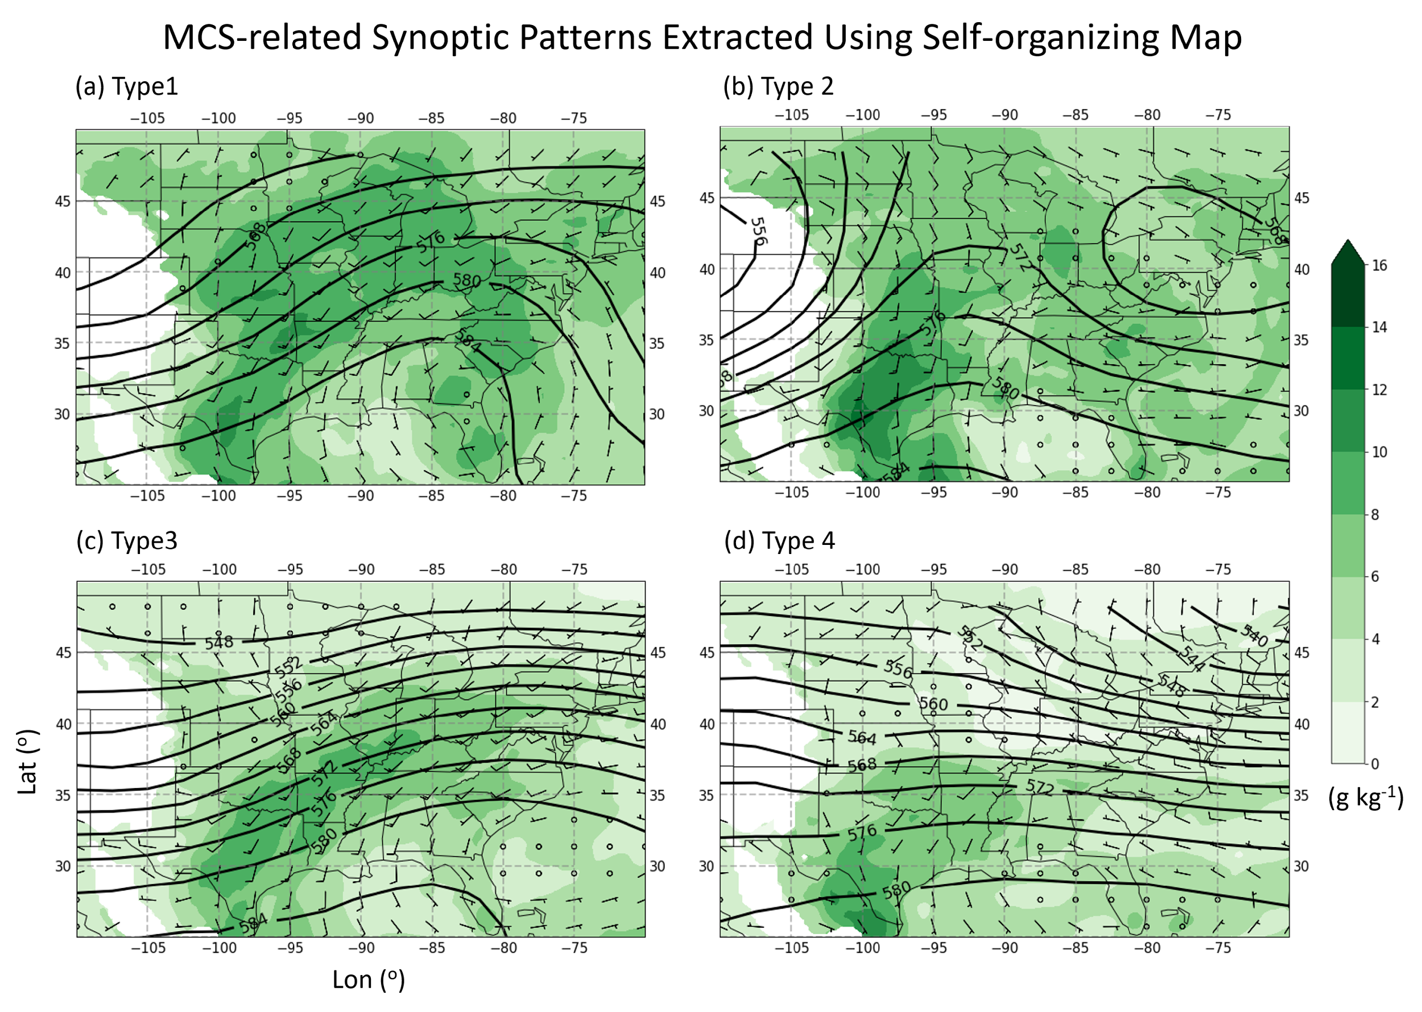
Missed MCSs by MG2 are mainly from large frontal systems with broad stratiform precipitation area
There are 26 time periods when MG2 has drastic lower MCS precipitation.
From the long-term (2004-2016) self-organizing maps (SOMs, Song et al., 2019) analysis, four major types of synoptic patterns of MCS initiation are identified.
The majority of the MG2-missed events occur under Type 1 and Type 3, which are associated with large frontal systems featuring broad stratiform precipitation.
Strong frontal system
GPLLJ
6
1
Weaker frontal system than Type 1
Weaker LLJ
15
4

Slide 12
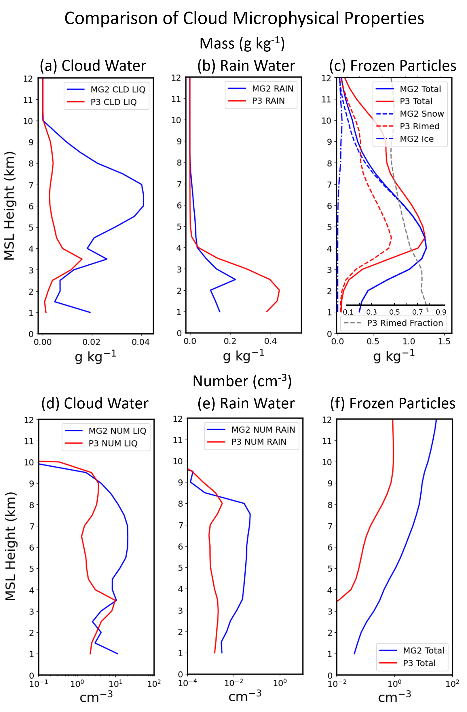
Reasons for larger precipitation rates by P3
Cloud water
Rain water
Ice Particles
Autoconversion
Mass for rain rate >10 mm/hr
P3 simulates much larger rain mass and lower raindrop number, explaining larger precipitation rates.
This is because of much larger ice particle mass content (40%) with decreased ice particle number, since warm rain formation rates are much smaller in P3.
Rimed ice mass contributes to ~50-60% of the total ice mass, indicating deposition growth contributes to increased non-rimed ice mass.
Number (cm⁻³)

Slide 13
Stronger feedback of microphysics to dynamics
Deposition
Condensation+evaporation
Subsidence
Specific humidity
The deposition rates are several times larger in P3, mainly because the deposition in P3 is treated for total ice whereas is only treated for cloud ice not snow in MG2
Added riming and enhanced deposition release more latent heat and feedback to circulation, enhancing large-scale convergence, further enhancing condensation and deposition.

Slide 14
Summary
The new microphysics P3 employed in E3SM improves the simulation of precipitation particularly PDF of precipitation rates
P3 improves the simulation of MCS number and precipitation by predicting higher frequencies of large rain rates, which mainly comes from increased ice mass due to added riming and enhanced deposition
Notable microphysics-dynamics feedback is shown: the latent heat from added riming and enhanced deposition induces strong convergence.
The missed MCSs by MG2 but captured by P3 are mainly associated with large frontal systems with broad stratiform precipitation area.
Under NGD, we are evaluating aerosol forcing particularly aerosol-cloud interaction forcing for the latest E3SM with P3 (E3SM v2 + P3 + aqueous chemistry bug fix + ZM_micro)
Current work

