Slide 1
The Doubly Periodic SCREAM Configuration
Peter Bogenschutz¹, Chris Eldred², and Peter Caldwell¹
¹Lawrence Livermore National Laboratory, Livermore, CA
²Sandia National Laboratory, Albuquerque, NM
* Special thanks to: Noel Keen, Chris Terai, and Hassan Beydoun
E3SM All Hands, February 3rd, 2022
This work was performed under the auspices of the U.S. Department of Energy by LLNL under contract DE-AC52-07NA27344. LLNL IM release: LLNL-PRES-831276-DRAFT

Slide 2
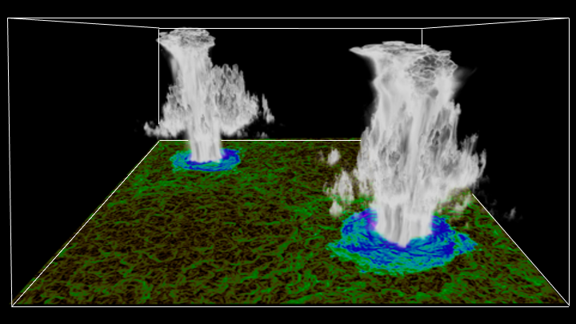
Outline
Introduction to Doubly-Periodic SCREAM (DP-SCREAM)
Motivation
Summary of development
DP-SCREAM case library
Availability and how to use
An example of a scientific application of DP-SCREAM
Assessment of the horizontal resolution sensitivity of SCREAM
Figure courtesy Jungmin Lee

Slide 3
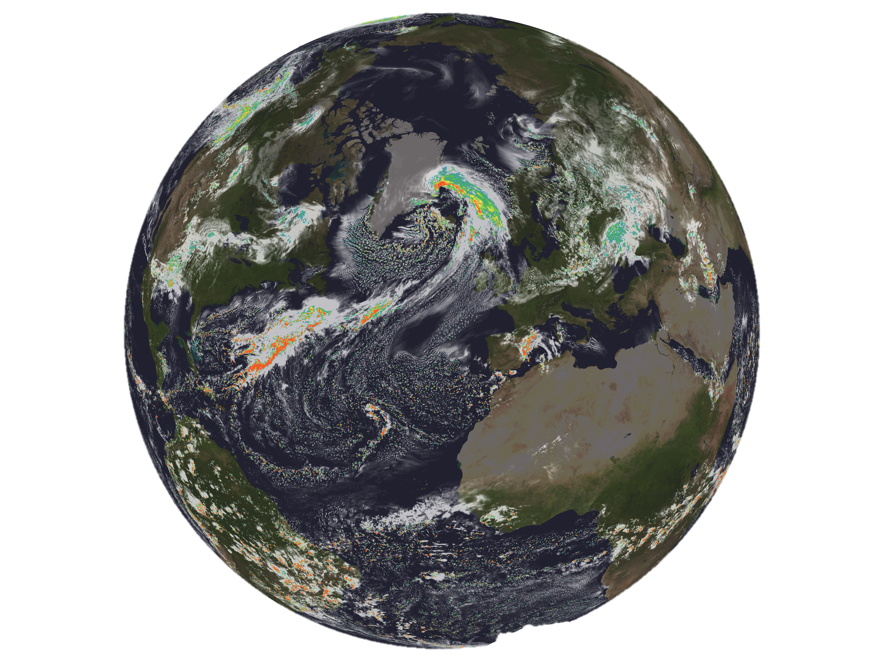
SCREAM
SCREAM = Simple Cloud-Resolving E3SM Atmosphere Model (Caldwell et al. 2021)
Target dx = 3 km globally, 128 vertical layers with a top at 40 km
Contributed to DYAMOND2
Moving to high resolution solves many long-standing problems with E3SM…
Figure courtesy Chris Terai. SCREAM DYAMOND2. White: liq+ice cloud water path. Colors: precip rate.

Slide 4
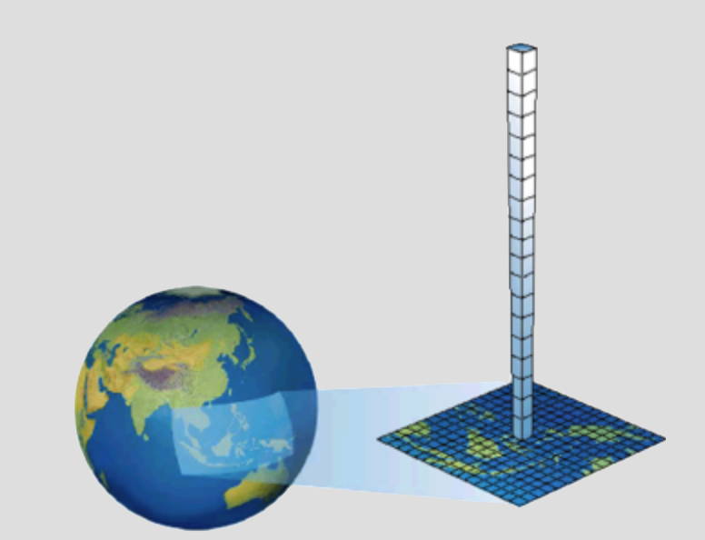
“Efficient Configurations” in GCMs
Global cloud resolving models (GCRMs) (i.e. SCREAM) are far more computationally expensive than “conventional” ~100 km GCMs (i.e. E3SM).
Even these relatively cheap conventional GCMs usually have a “single column model” (SCM) functionality.
Isolates a single column on the globe (driven by “Intensive Observation Period” forcing).
Energy Exascale Earth System Model (E3SM) SCM (Bogenschutz et al. 2020)
Depiction of traditional SCM from a conventional GCM

Slide 5
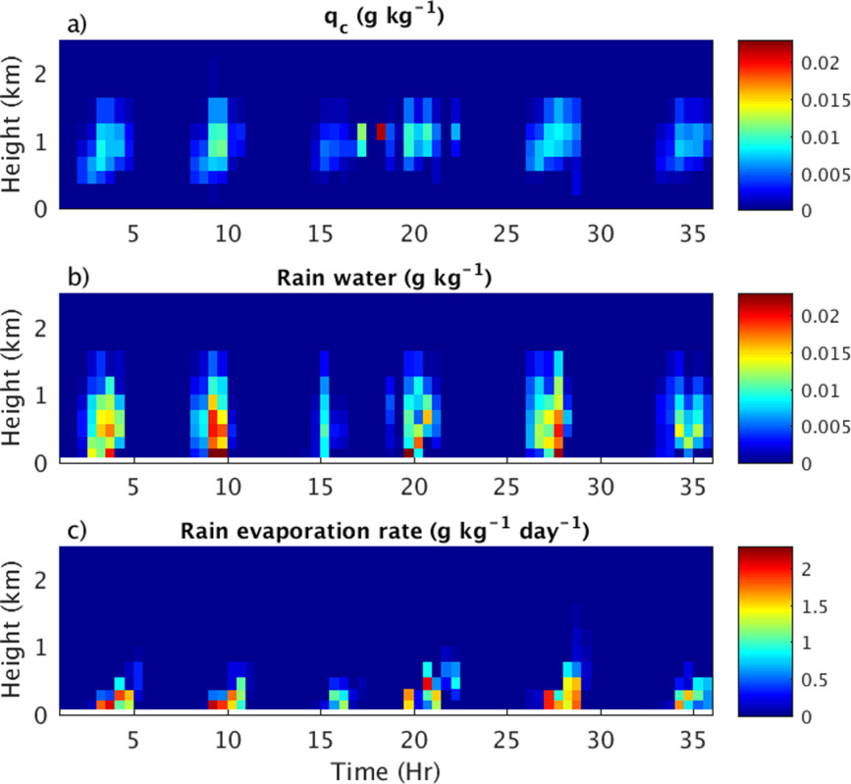
Single Column Models in GCMs
Runs in a matter of minutes on a single node to enable fast feedback of GCM physics.
SCMs insanely useful for:
Efficiently debugging the model.
Parameterization implementation/development (Bogenschutz et al. 2012; Park et al. 2014).
Elucidating parameterization biases/deficiencies (Zheng et al. 2017).
Performing perturbed parameter /ML applications.

Slide 6
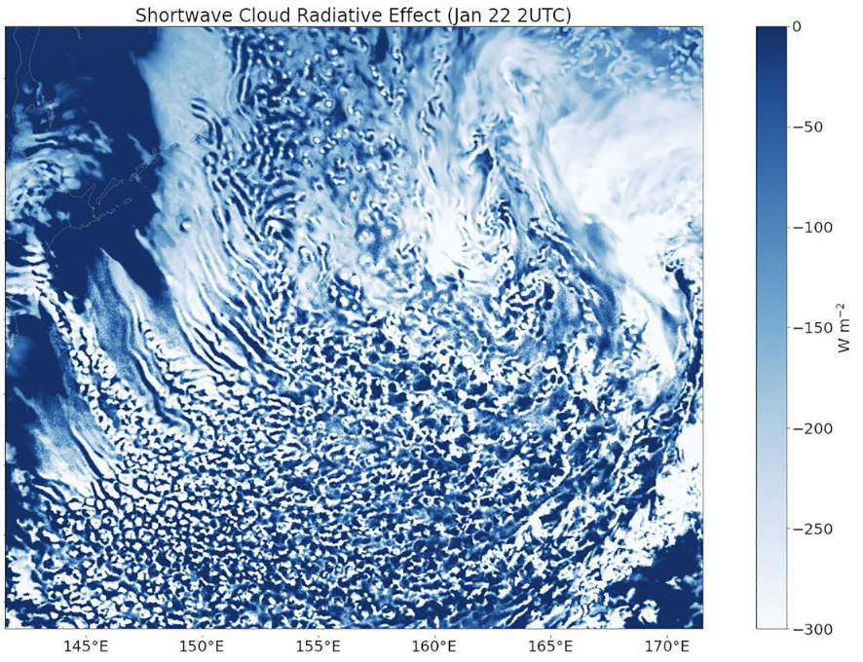
Global Cloud Resolving Models
SCREAM is “convection permitting”, meaning that clouds/convection are resolved over several columns.
Thus, a SCM is not valid for GCRMs.
However, SCREAM is a wildly expensive model so an “efficient” configuration to obtain fast feedback is necessary…
Figure from Caldwell et al. (2021)

Slide 7
Doubly-Periodic SCREAM (DP-SCREAM)
E3SM SCM view
DP-SCREAM represents a “single-point” three-dimensional cloud resolving model.
Size of domain and resolution determined by user.
Location and surface (i.e. land/ocean; radiation) determined from lat/lon of IOP case being used and ne30 grid.
Initialized as a collection of identical columns on a planar grid.
Random temperature perturbations applied to initial condition.
Boundary conditions are periodic in x & y.
DP-SCREAM is NOT a true “limited area” model.
Unlike SCM, DP-SCREAM “exercises” the entire model (i.e. physics AND dynamics).
DP-SCREAM view
Notes:
test

Slide 8
DP-SCREAM Development
A two-step parallel effort:
Infrastructure (Bogenschutz):
Modifications to the SCM infrastructure to enable its use across multiple columns.
Use the lat/lon of the desired case for the entire domain.
Planar HOMME (Eldred):
Ability to run standalone HOMME dynamical core on doubly-periodic planar grids.
Uses shallow water (sweqx) and hydrostatic/non-hydrostatic primitive equations (preqx and theta-l) models.
Final step of stitching these two aspects together and providing resources to make DP-SCREAM accessible to use.

Slide 9
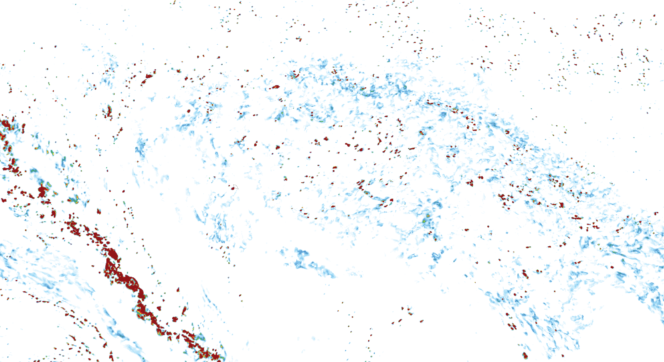
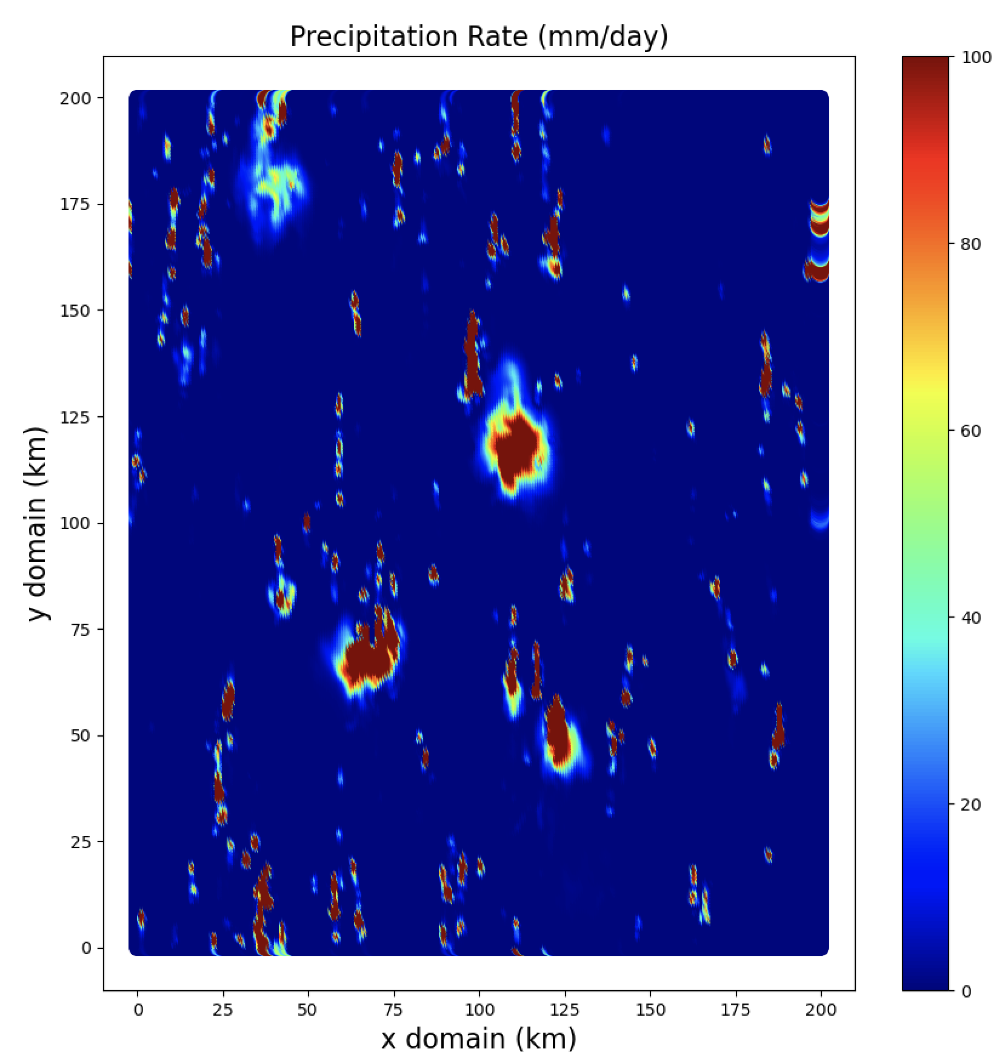
DP-SCREAM Status
Top figure courtesy Chris Terai
DP-SCREAM development is complete and has been in “beta” testing mode for several months.
DP-SCREAM currently only available in SCREAM F90
C++ conversion will take place in 2022
Official F90 “release” will occur in spring 2022.
SCREAM evaluation team uses DP-SCREAM to efficiently replicate biases we see in the global model (i.e. “popcorn convection”).
SCREAMv0.1 precipitation
DP-SCREAM

Slide 10
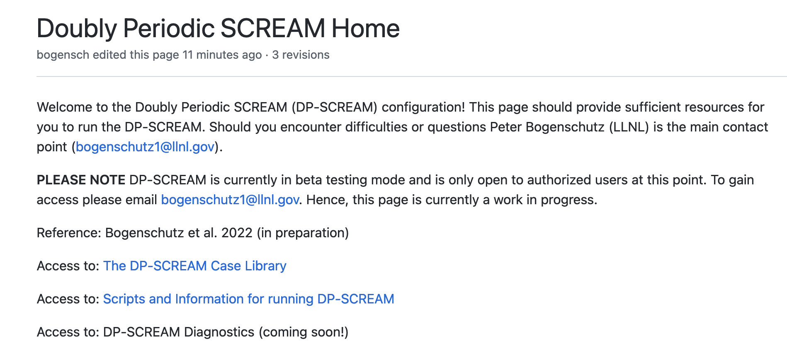
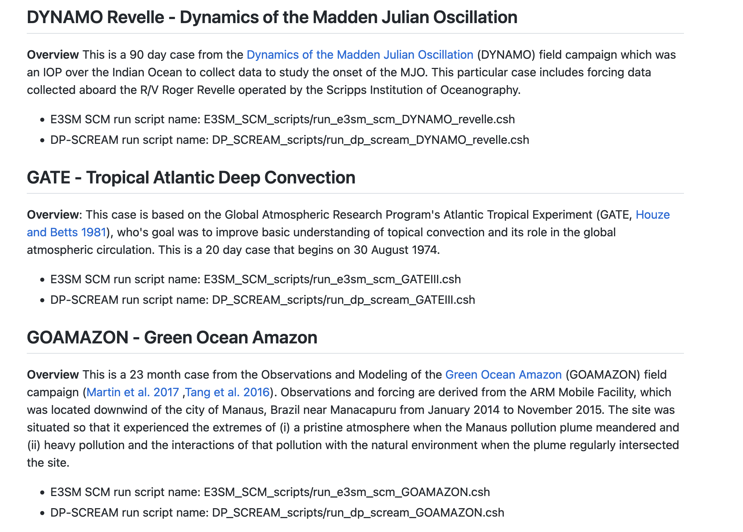
Running DP-SCREAM
To get started go to:
https://github.com/E3SM-Project/scmlib/wiki/
E3SM SCM wiki on Github (publicly viewable) is now supporting both E3SM SCM and DP-SCREAM.
Includes instructions on how to run DP-SCREAM and documents the case library.
Currently we provide support for 27+ cases that will run out of the box with E3SM SCM and DP-SCREAM.
Each case has short description and run script (checked out from repo).
Screenshots from DP-SCREAM wiki and E3SM IOP case library

Slide 11
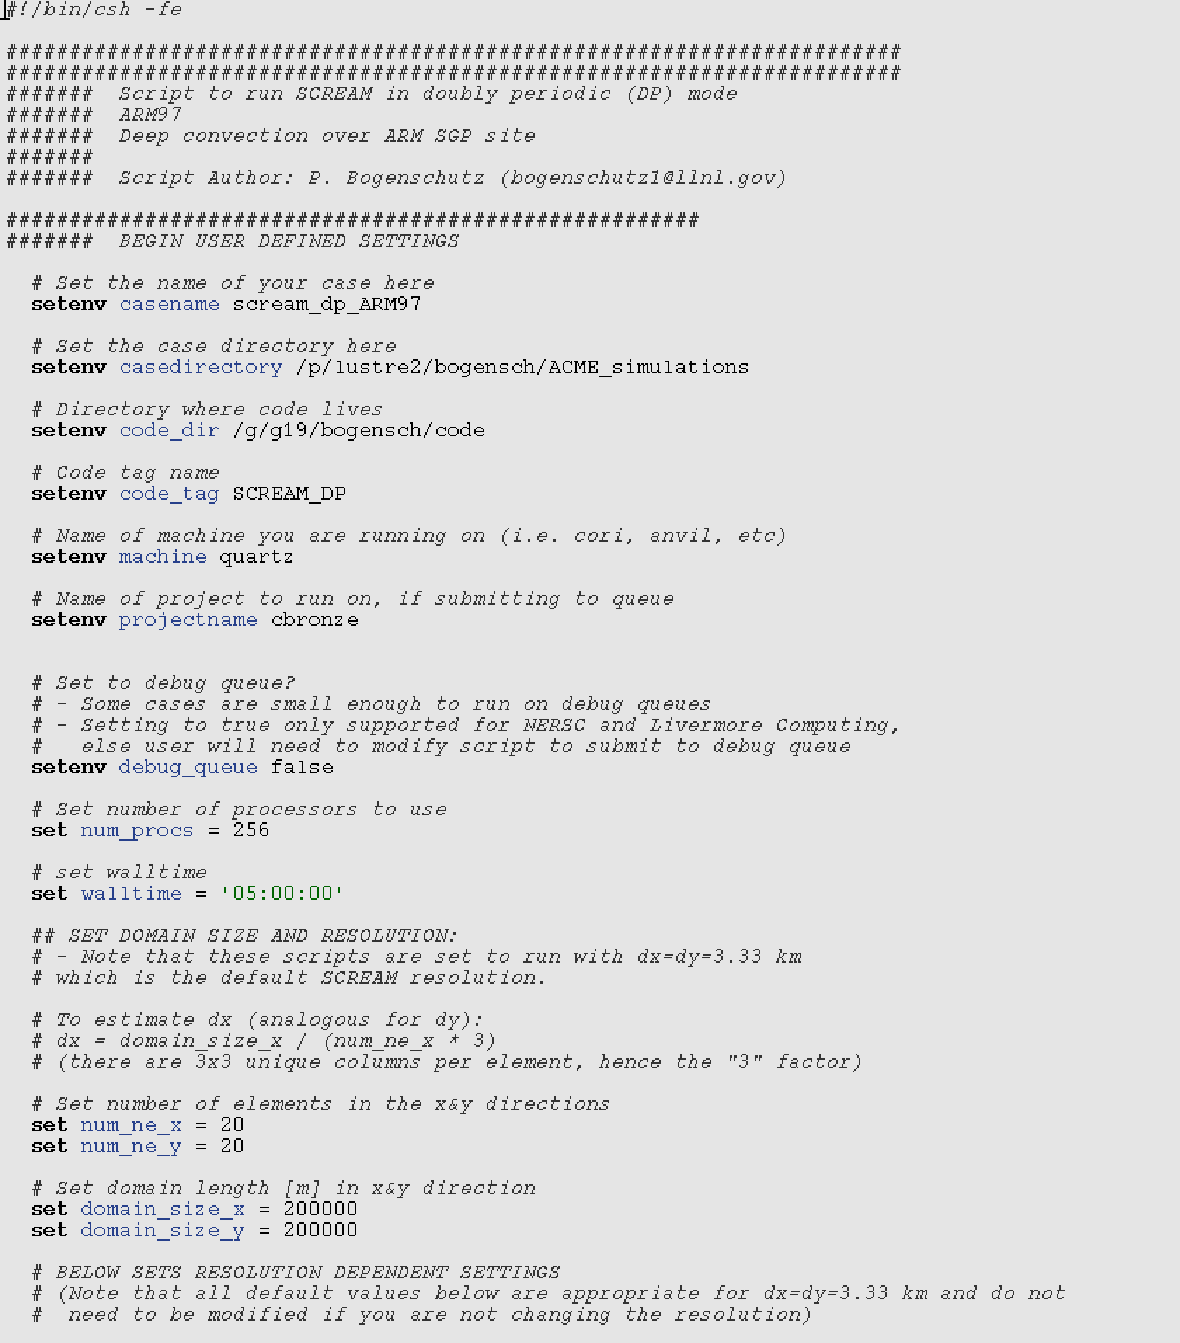
Running DP-SCREAM
User/machine specific information
1) Users need the most up-to-date SCREAM repo
2) Users will checkout the SCM/DP-SCREAM script repo from Github
Each case will have a script
Each case set up to run dx=dy=3.3 km by default
User has complete freedom to modify this!
Processor and wall time settings
Setting domain and resolution

Slide 12
What kind of cases can I run?!
Continuous forcing:
- ARM SGP site from 2004-2015
- Darwin, Australia: summer seasons 2004-2007
- GOAMAZON: 2014-2015
Boundary Layer Cases:
DYCOMS-RF01 and RF02 (marine Sc)
BOMEX and RICO (marine trade Cu)
ATEX (Cu under Sc)
ARM shallow Cu (continental Cu)
RACORO (continental low clouds)
MPACE, MPACE-B, ISDAC (mixed phase arctic clouds)
GABLS (stable boundary layer)
Deep Convection Cases:
GATE, GATE-IDEAL, TOGA-COARE, DYNAMO (AMIE, Revelle, North Sounding), TWP-ICE (maritime deep convection)
ARM97, ARM95, MC3E (continental deep convection)
LBA (shallow to deep transition, continental)
SPARTICUS (cirrus cloud)
Radiative Convective Equilibrium (RCE)
Coming Soon:
- Cold air outbreak (COMBLE)
- Southern ocean clouds (SOCRATES)
- Others needed? Let me know!
*Case contributors: Shuaiqi Tang, Shaocheng Xie, Cheng Tao, Yunyan Zhang, Peter Bogenschutz

Slide 13
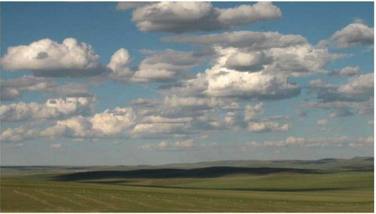
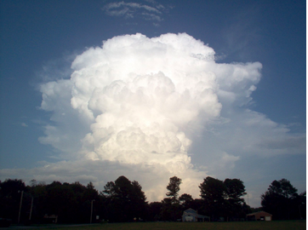
Rapid Feedback by DP-SCREAM
Cost of a boundary layer cloud case
50 km x 50 km horizontal domain size
At dx=dy=3.3 km to run for one simulated day: 4 minutes on ONE node
Compared to E3SM SCM cost of: 2 minutes on ONE node
Cost of a deep convection case
Generally requires larger domain size (200 km x 200 km)
At dx=dy=3.3 km to run for one simulated day: 4 minutes on 6 nodes
Cost of one simulated day of SCREAMv0:
One simulated day: ~ 5 hours on 1536 nodes
*machine used is cori-knl for all timings

Slide 14
DP-SCREAM Scientific Application
DP-SCREAM allows the user to determine the domain size and resolution on the fly
Changing resolution in global models requires time consuming generation of many input files
Thus, we can use DP-SCREAM to assess the horizontal resolution sensitivity of SCREAM
Is SCREAM scale aware (i.e. is it theoretically valid to run SCREAM at resolutions other than ~3 km)?
Is SCREAM scale insensitive (i.e. does the answer change when resolution changes)?

Slide 15
DP-SCREAM Horizontal Resolution Experiments
CASE | Regime | Run Duration | Horizontal domain size
GATE | Deep Cu | 20 d | 200 x 200 km
ARM97 | Deep Cu | 8 d | 200 x 200 km
DYCOMS-RF01 | Marine Sc | 6 hr | 50 x 50 km
MPACE-B | Mixed-phase | 12 hr | 50 x 50 km
RICO | Shallow Cu | 24 hr | 50 x 50 km
* In the interest of time, will focus on results from DYCOMS-RF01 and ARM97 today
RED cases run with dx = dy = 500 m, 1.5 km, 3 km, 5 km
GREEN cases run with dx = dy = 100 m, 500 m, 1.5 km, 3 km, 5 km
All cases and resolutions are all run with the EXACT SAME code and tunable parameters.

Slide 16
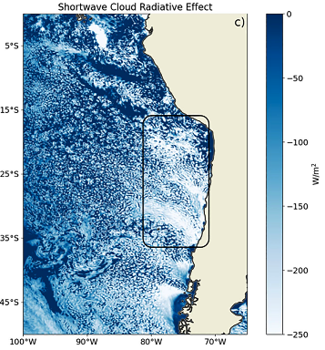
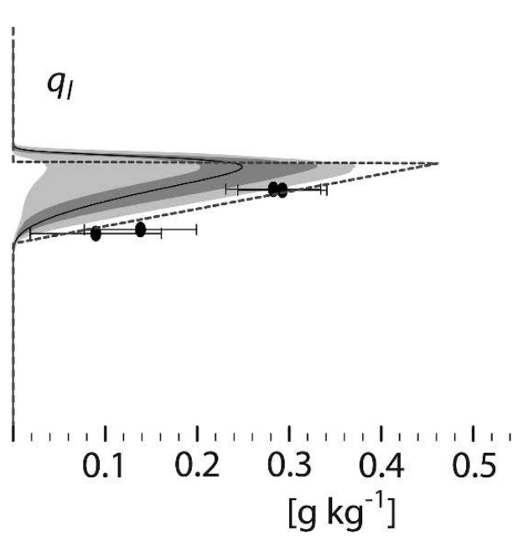
Marine Stratocumulus Case
DYCOMS-RF01: Marine stratocumulus capped by a particularly strong inversion.
LES intercomparison: Stevens et al. (2005)
SCREAMv0 does a particularly good job with marine Sc.
These clouds are primarily SGS at 3km
What about when resolution changes?
Stevens et al. (2005) LES intercomparison
SCREAMv0 (Caldwell et al. 2021)

Slide 17
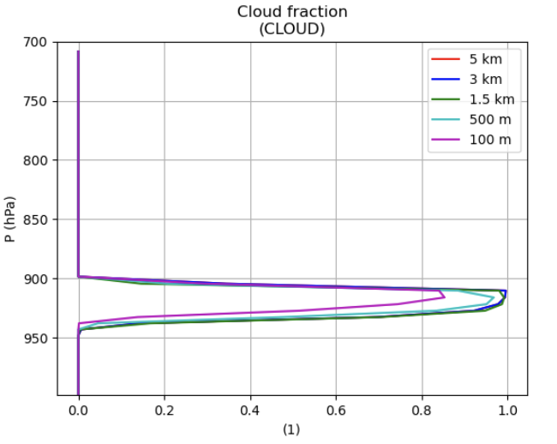
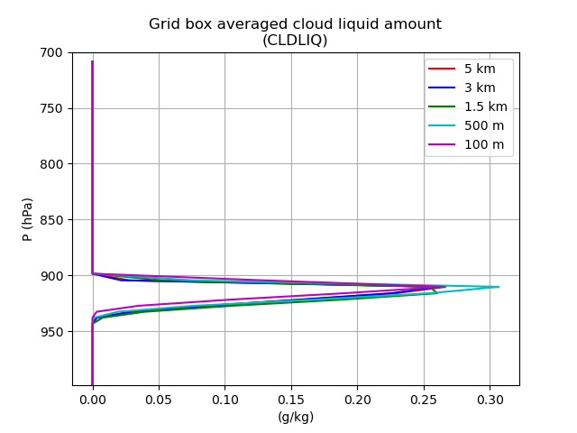
DYCOMS-RF01: Marine Stratocumulus Example of Scale Sensitivity
Stevens et al. (2005) LES intercomparison
900 hPa
1000 hPa
Running with SCREAM’s 128 vertical layers, which is still considered too coarse for marine Sc clouds (Bogenschutz et al. 2021; Lee et al. 2021).

Slide 18
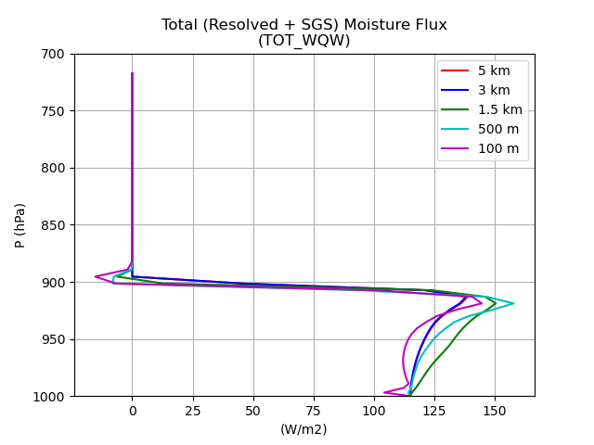
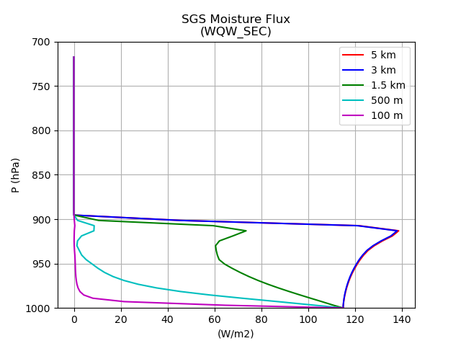
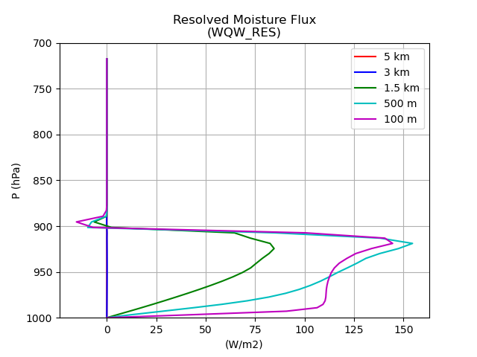
DYCOMS-RF01: Turbulence Across Scales Example of Scale Awareness
Parameterized from SHOC
Resolved by dynamics

Slide 19
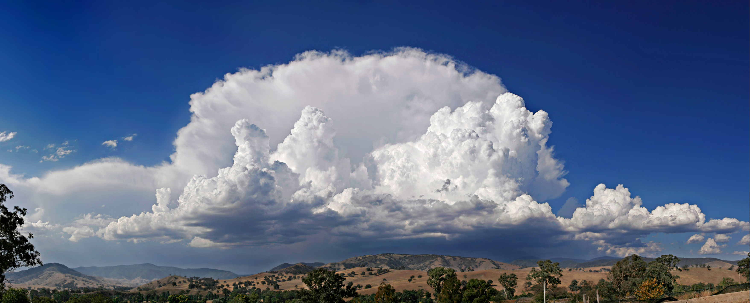
Continental Deep Convective Case
ARM97 case
Deep convection over land as observed at the ARM Southern Great Plains (SGP) Site
27 day case widely used for SCMs and CRMs
Here we focus on an 8 day subset from an active period
Run with prescribed surface fluxes (could be interactive)
Khairoutdinov and Randall (2003)
Period of focus

Slide 20
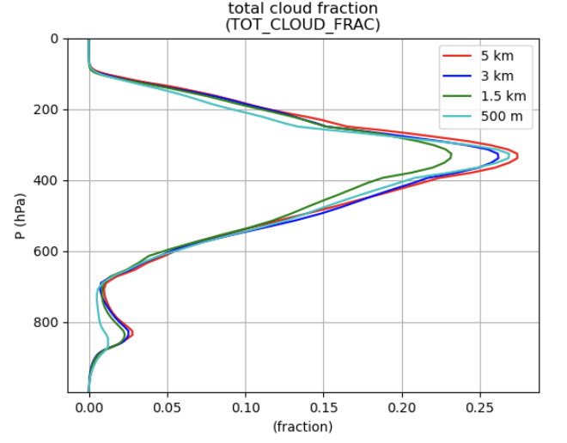
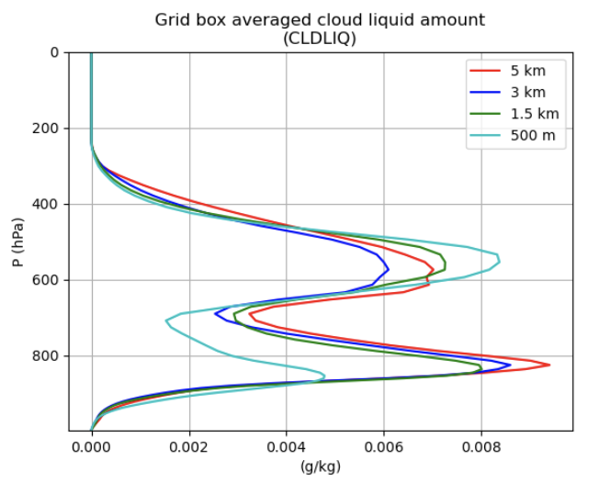
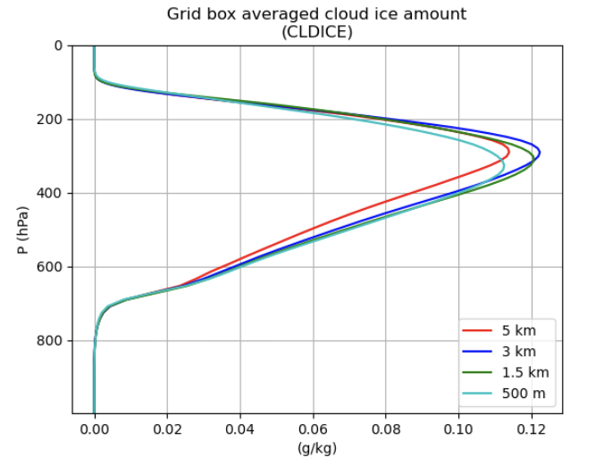
ARM97: Continental Deep Convection
Cloud Profiles
Result averaged from an 8-day active period starting on June 23, 1997

Slide 21
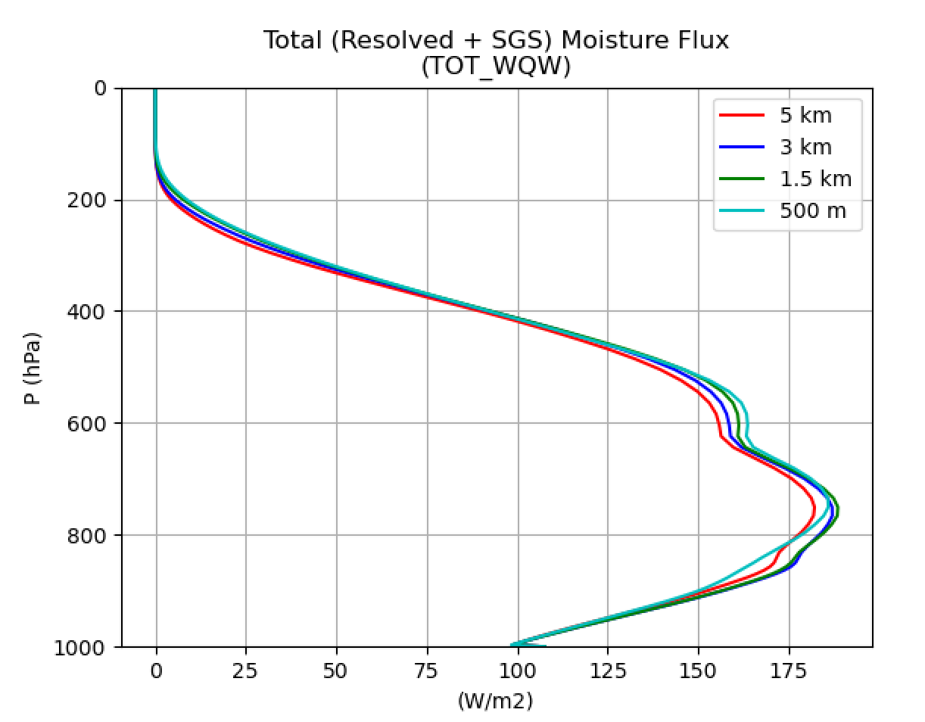
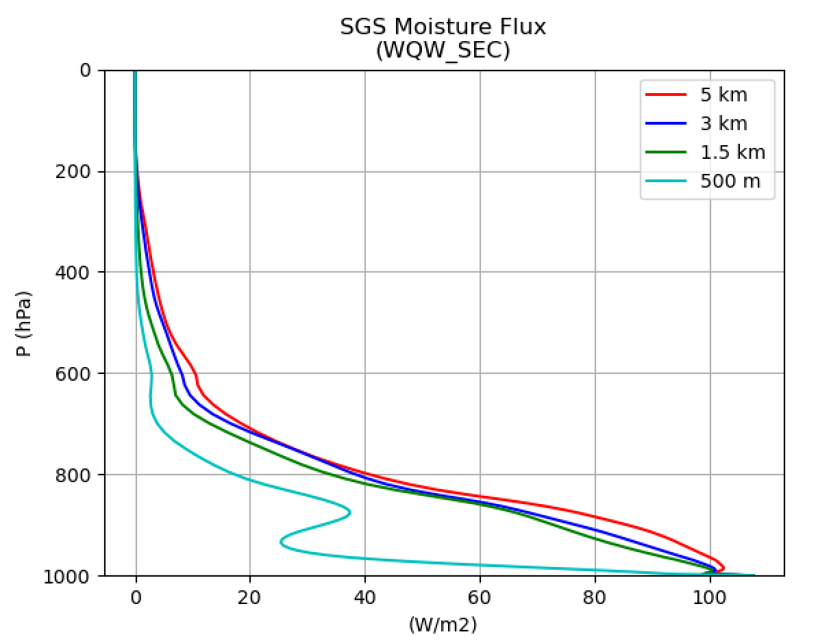
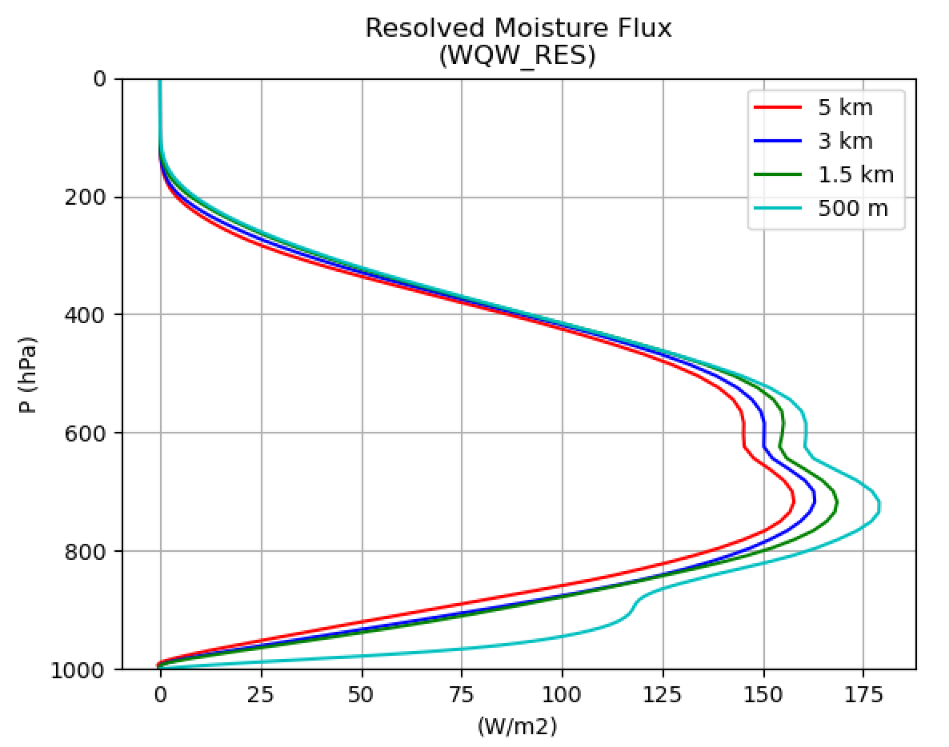
ARM97: Continental Deep Convection
Parameterized from SHOC
Resolved by dynamics
Result averaged from an 8-day active period starting on June 23, 1997

Slide 22
Summary
DP-SCREAM represents an “efficient” configuration of SCREAM that can be used for model development, debugging, and analysis.
Using DP-SCREAM we determine that SCREAM is a scale aware model
We can run SCREAM at fine resolutions without the need of making structural changes (or “swapping” out parameterization).
SCREAM is reasonably scale insensitive at the kilometer scale, but exhibits sensitivity outside of these bounds
Tuning may be required for very high resolution runs.

