Slide 1
E3SMv2 Water Cycle
Model and Simulation Campaign
Part 2: v2 Low resolution ocean and sea ice results
Luke Van Roekel, Chris Golaz, and the entire Water Cycle Group
2022-01-20 E3SM All-hands Webinar
Special Thanks To: Andrew Roberts, LeAnn Conlon, Mat Maltrud, Karthik Balaguru

Slide 2
Outline
Overview
Ocean
V2 code changes
Observational comparison
Sea ice
V2 code changes
Observational comparison
Influence of Aerosol forcing on OHC
AMOC update

Slide 3
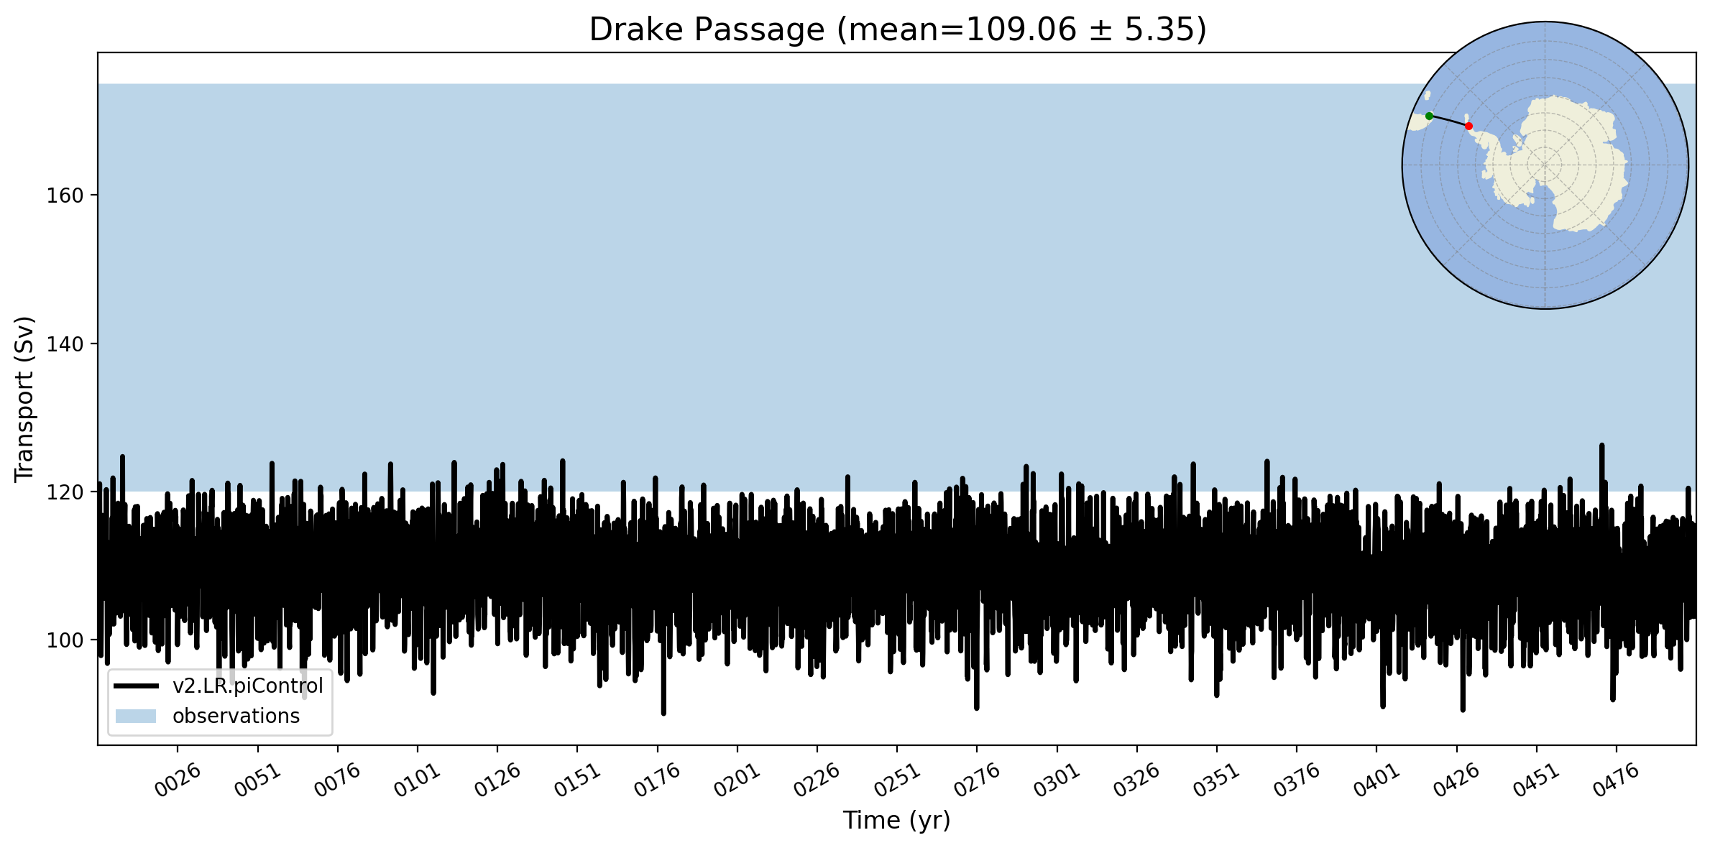
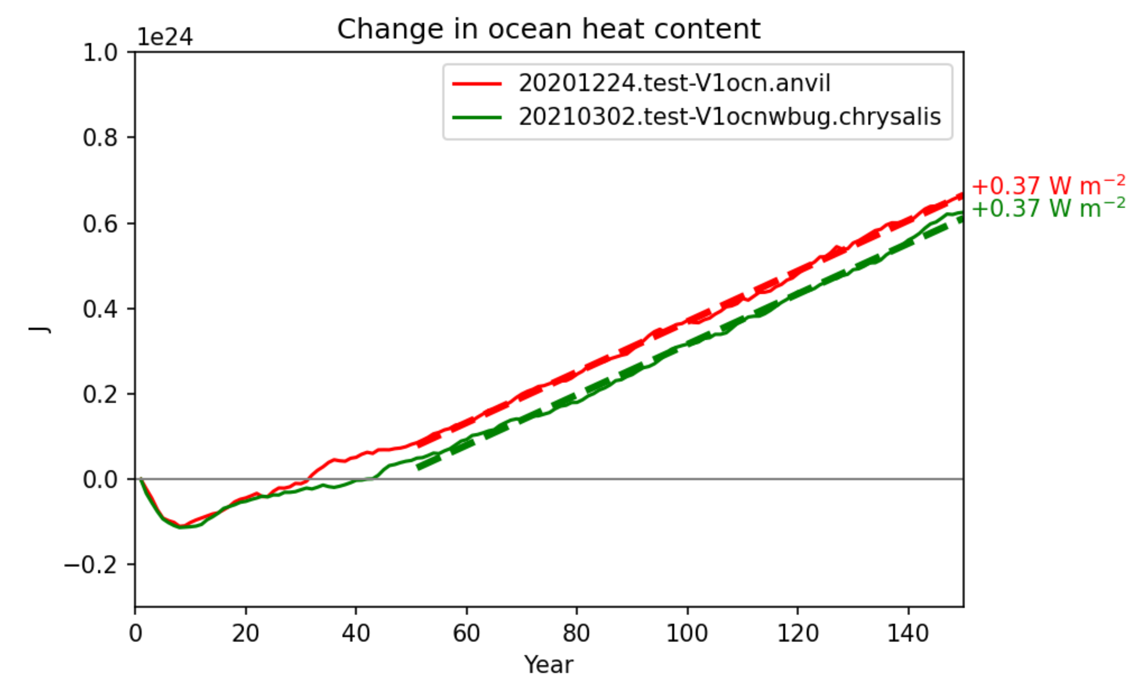
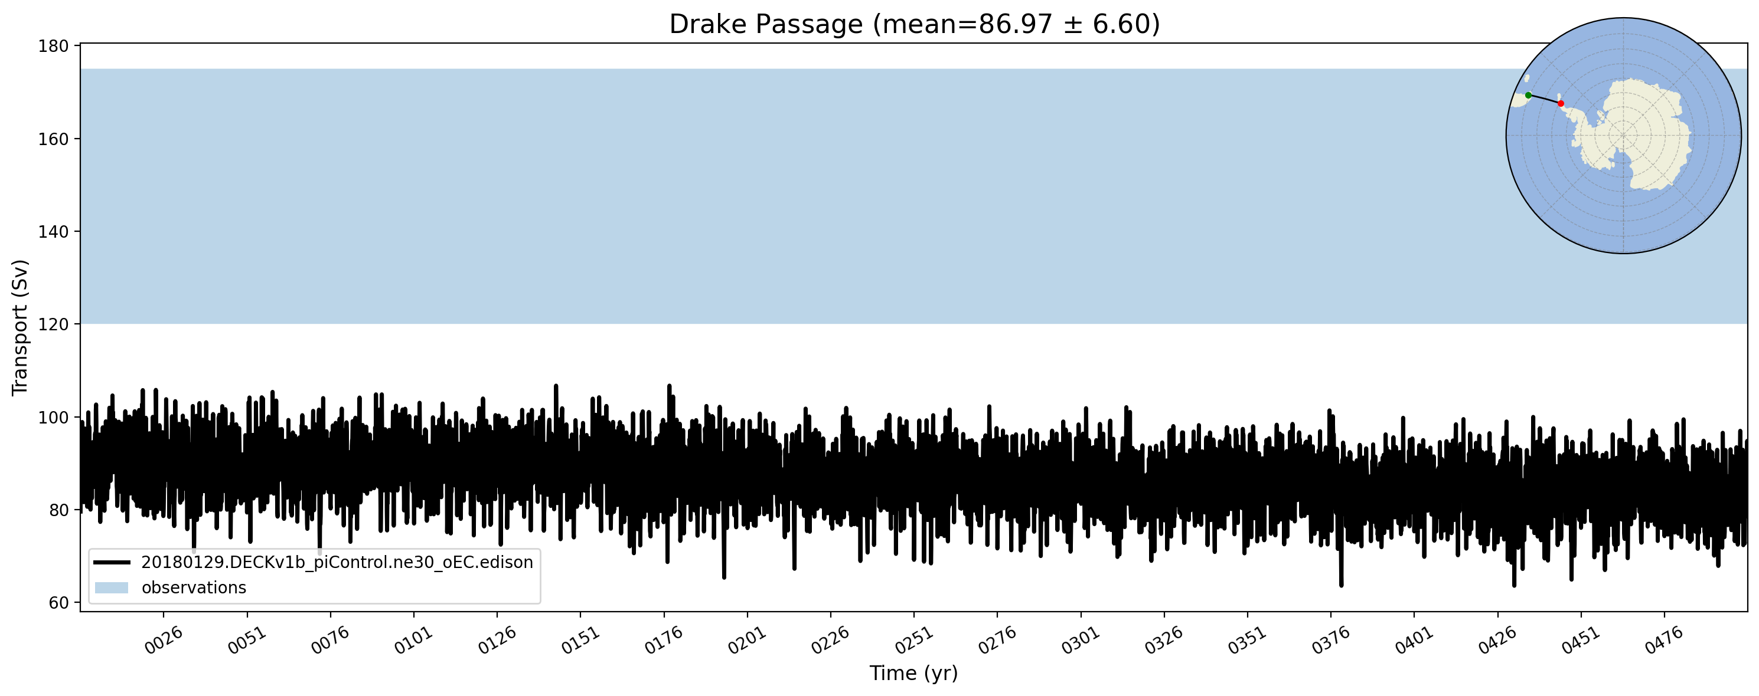
E3SM-Ocean v2
E3SMv2
Fixing the Advection bug
Reduced GM parameter
E3SMv1
Added Redi isopycnal mixing
Spatially variable GM options
Improved Energy Conservation
Notes:
Note that these are things we added, but didn’t utilize them all. Discovered some bugs in trying to conserve energy and we also developed new scripts to track energy and water conservation.
In the figure, we have the same global rate of increase, however the patterns change a lot, next slide.

Slide 4
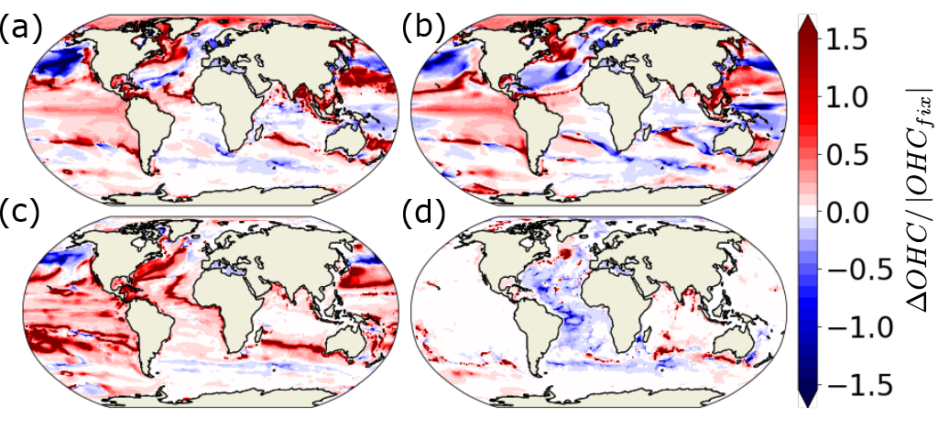
Influence of the Advection Bug
Change in OHC between two companion runs (Bug fix – with bug)
0-Bottom
0-700m
700-2000m
2000m-Bottom
Notes:
Comparison to data is in progress.

Slide 5
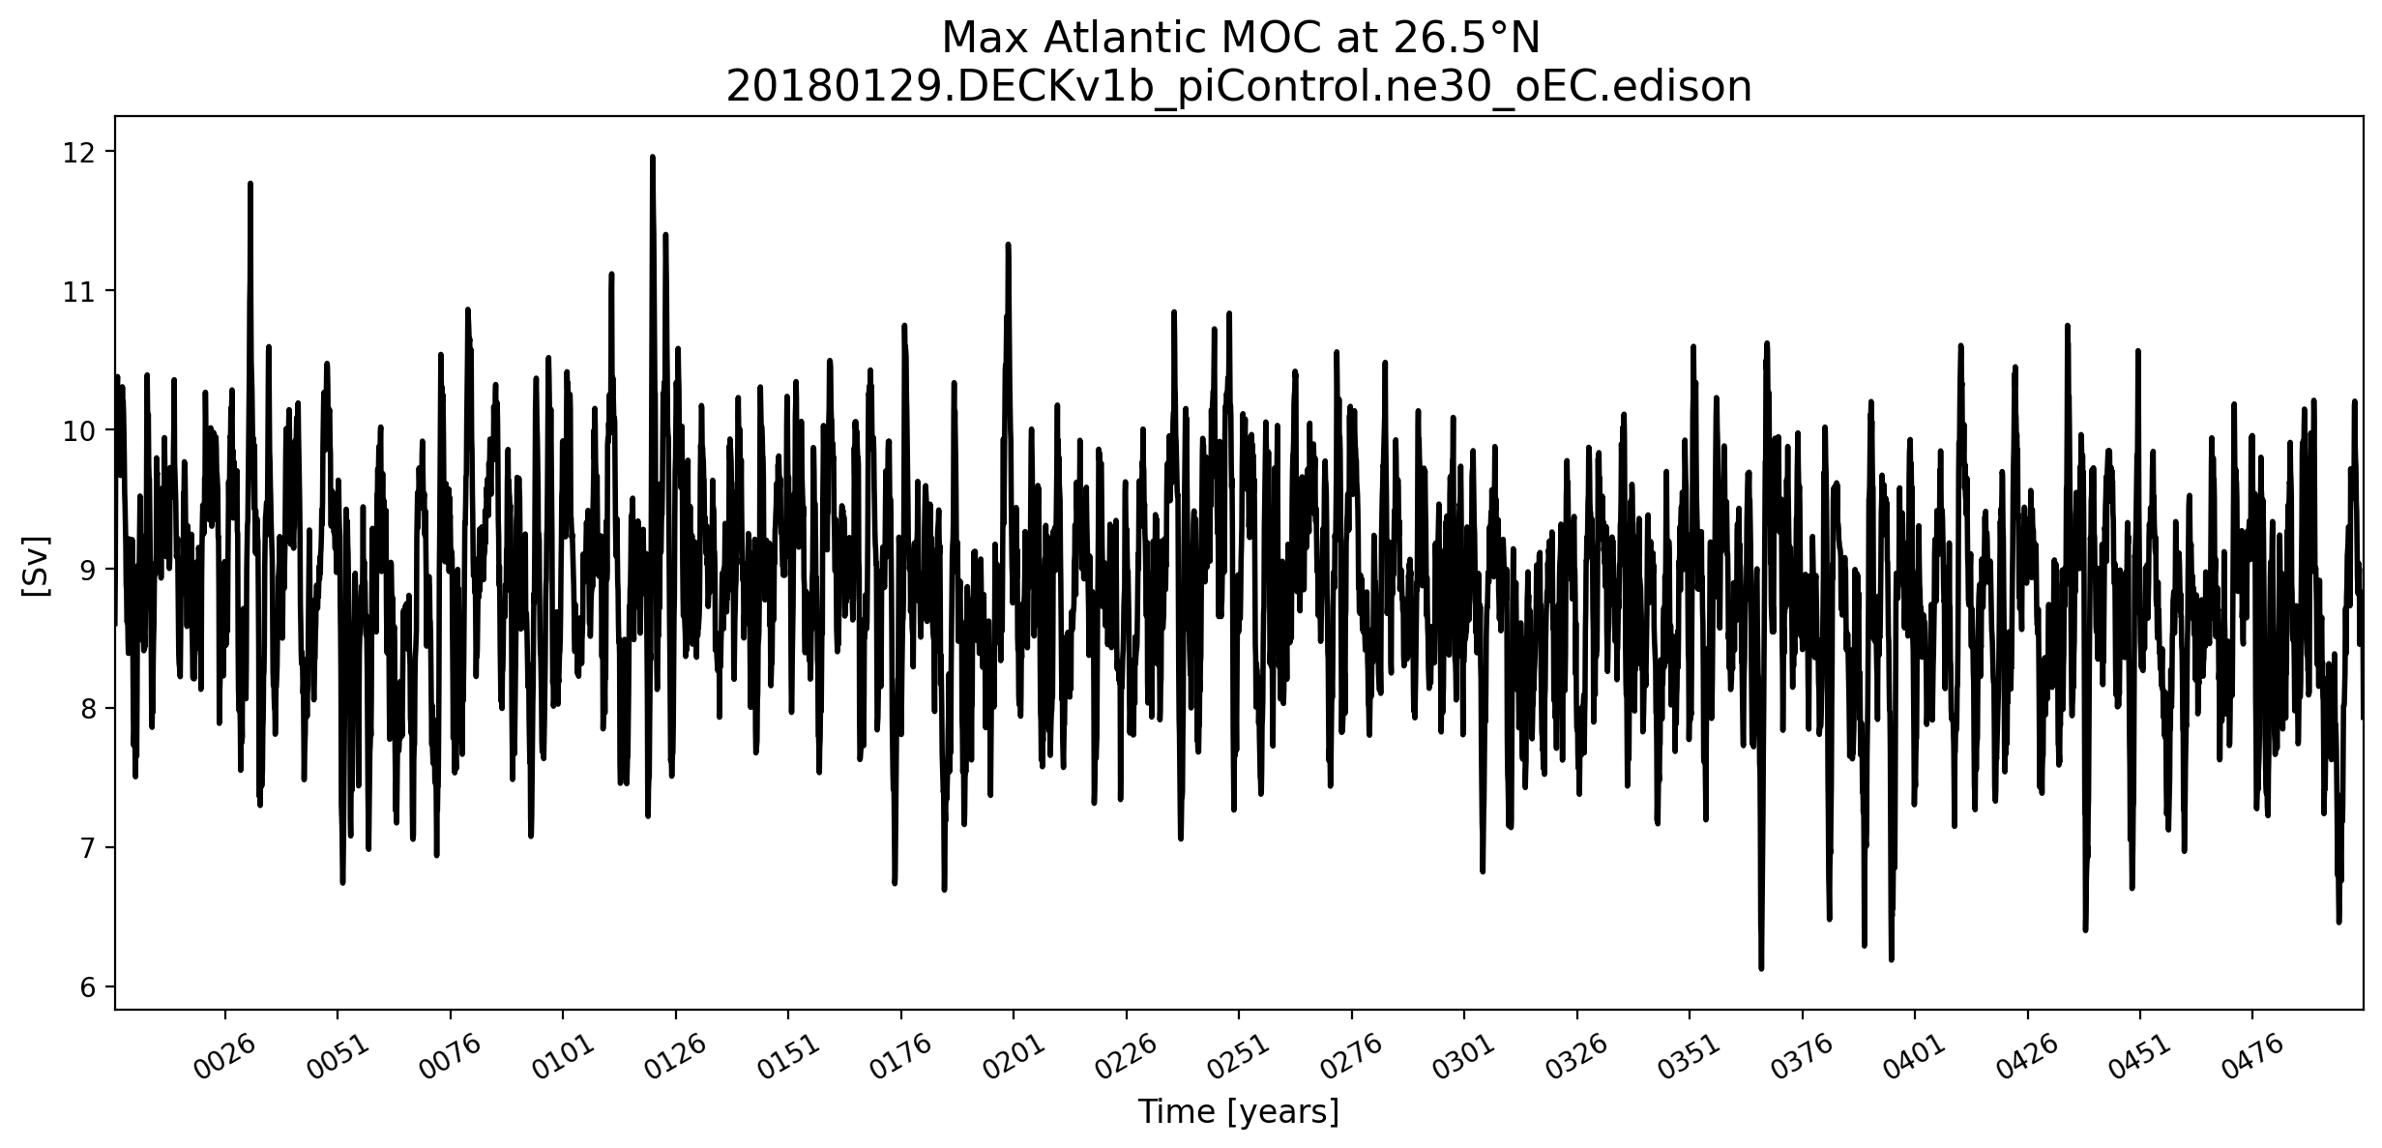
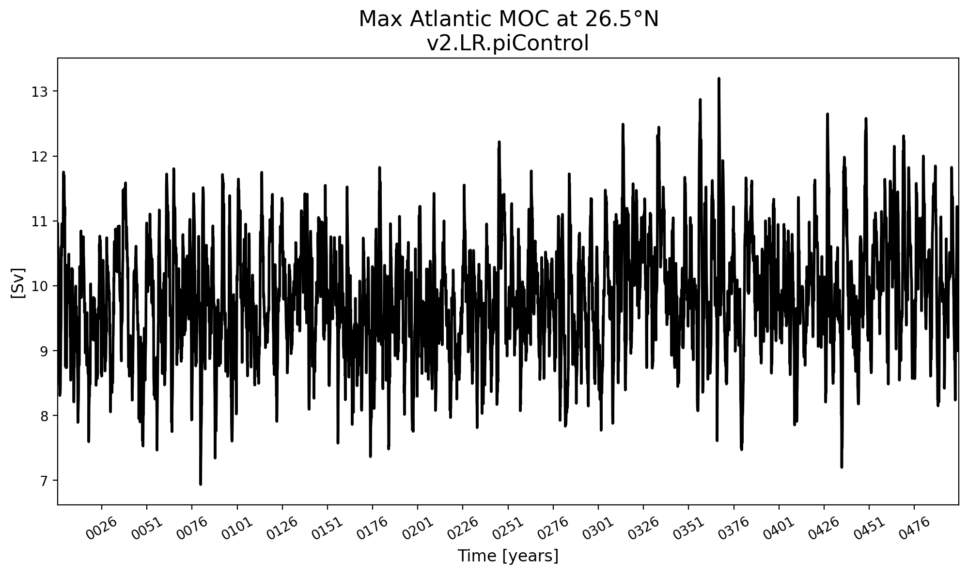
E3SMv2 (Bottom) vs E3SMv1 (Top)
~9 Sv
AMOC slightly improved
Sea surface salinity bias also improved
~10 Sv
Likely due to GM tuning

Slide 6
E3SMv2 (Bottom) vs E3SMv1 (Top)
SST better in regions, but worse in global average
ENSO, more seasonally locked, less longer term variability

Slide 7
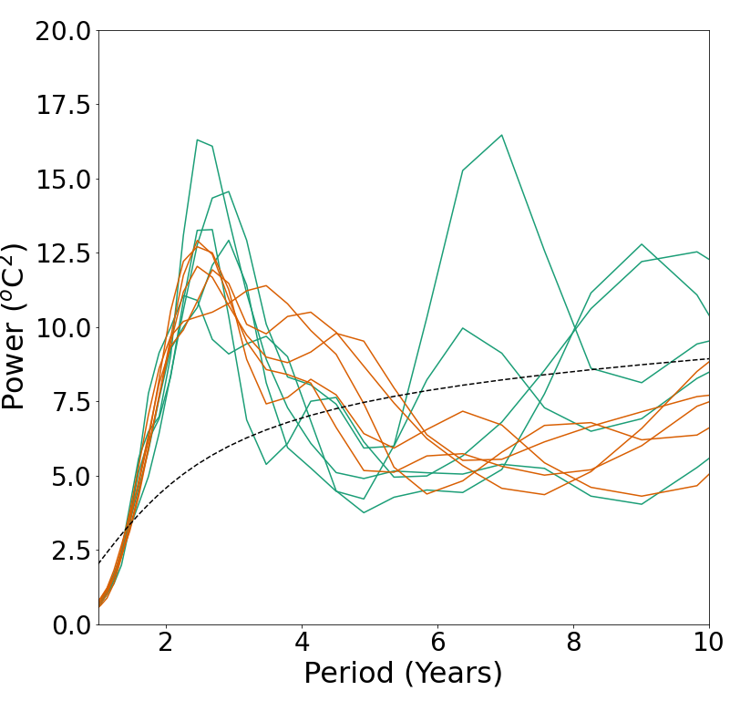
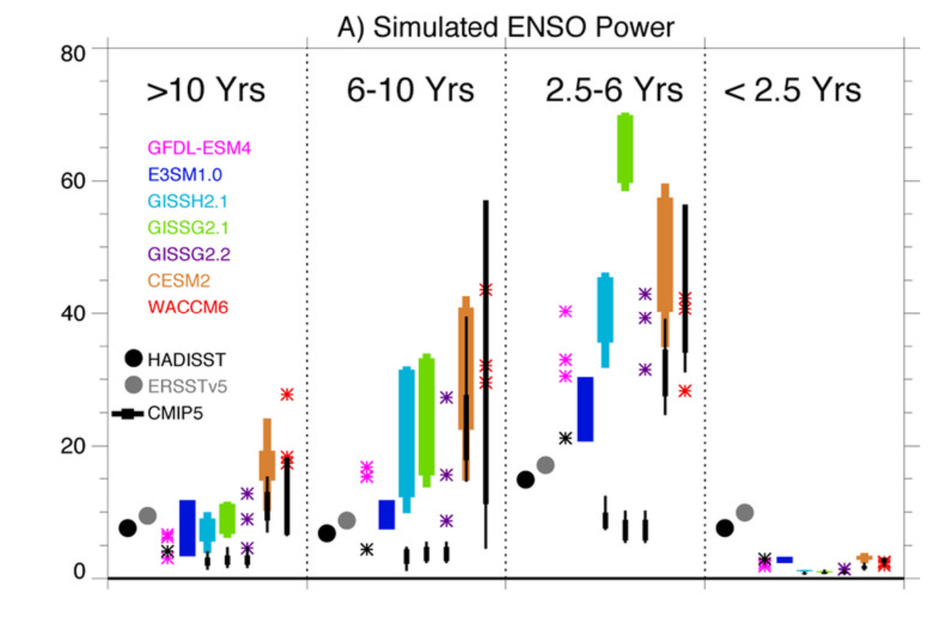
ENSO
E3SMv2
Green = piControl
Orange = historical
Orbe et al. (2020)
The wavelet analysis here confirms the shift in peak power in v2
Less long term period power except for a few chunks of the piControl
ENSO still reasonable.

Slide 8
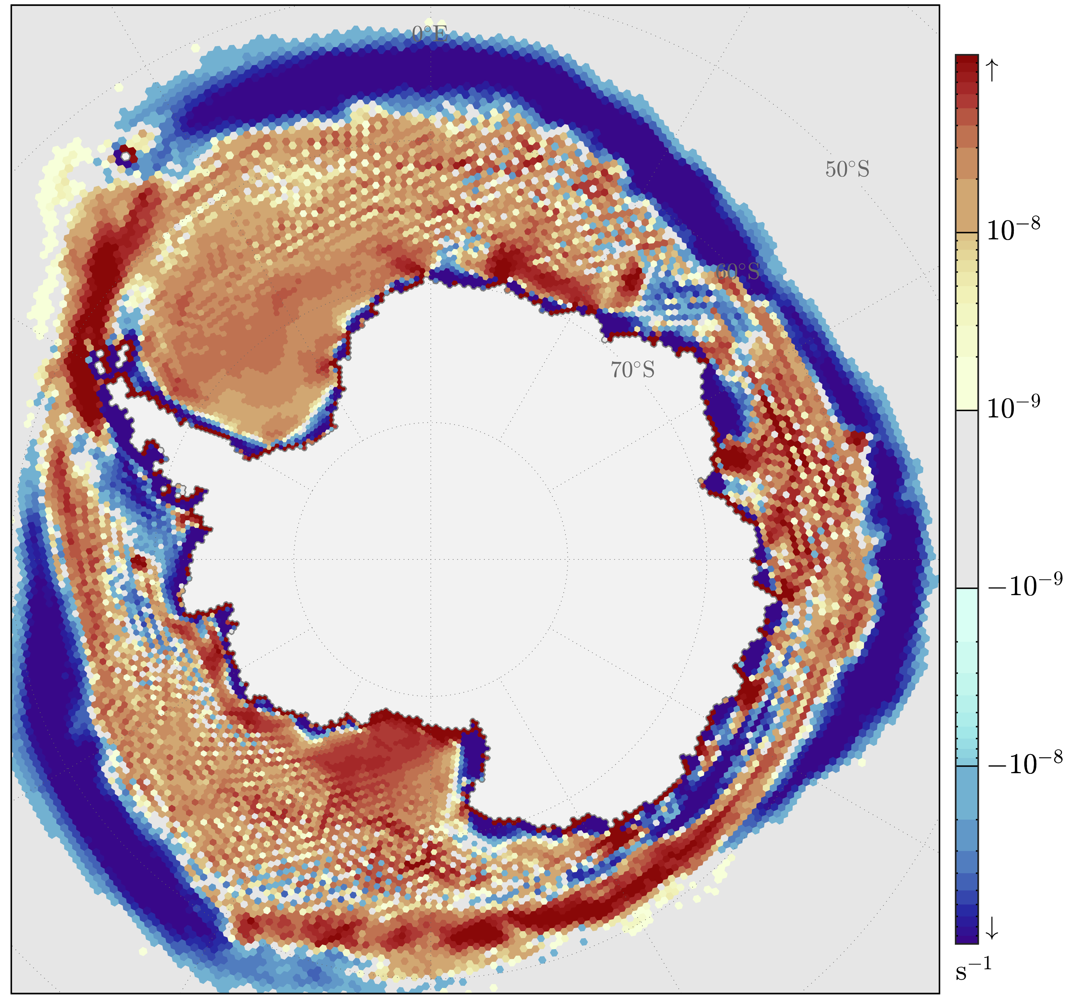
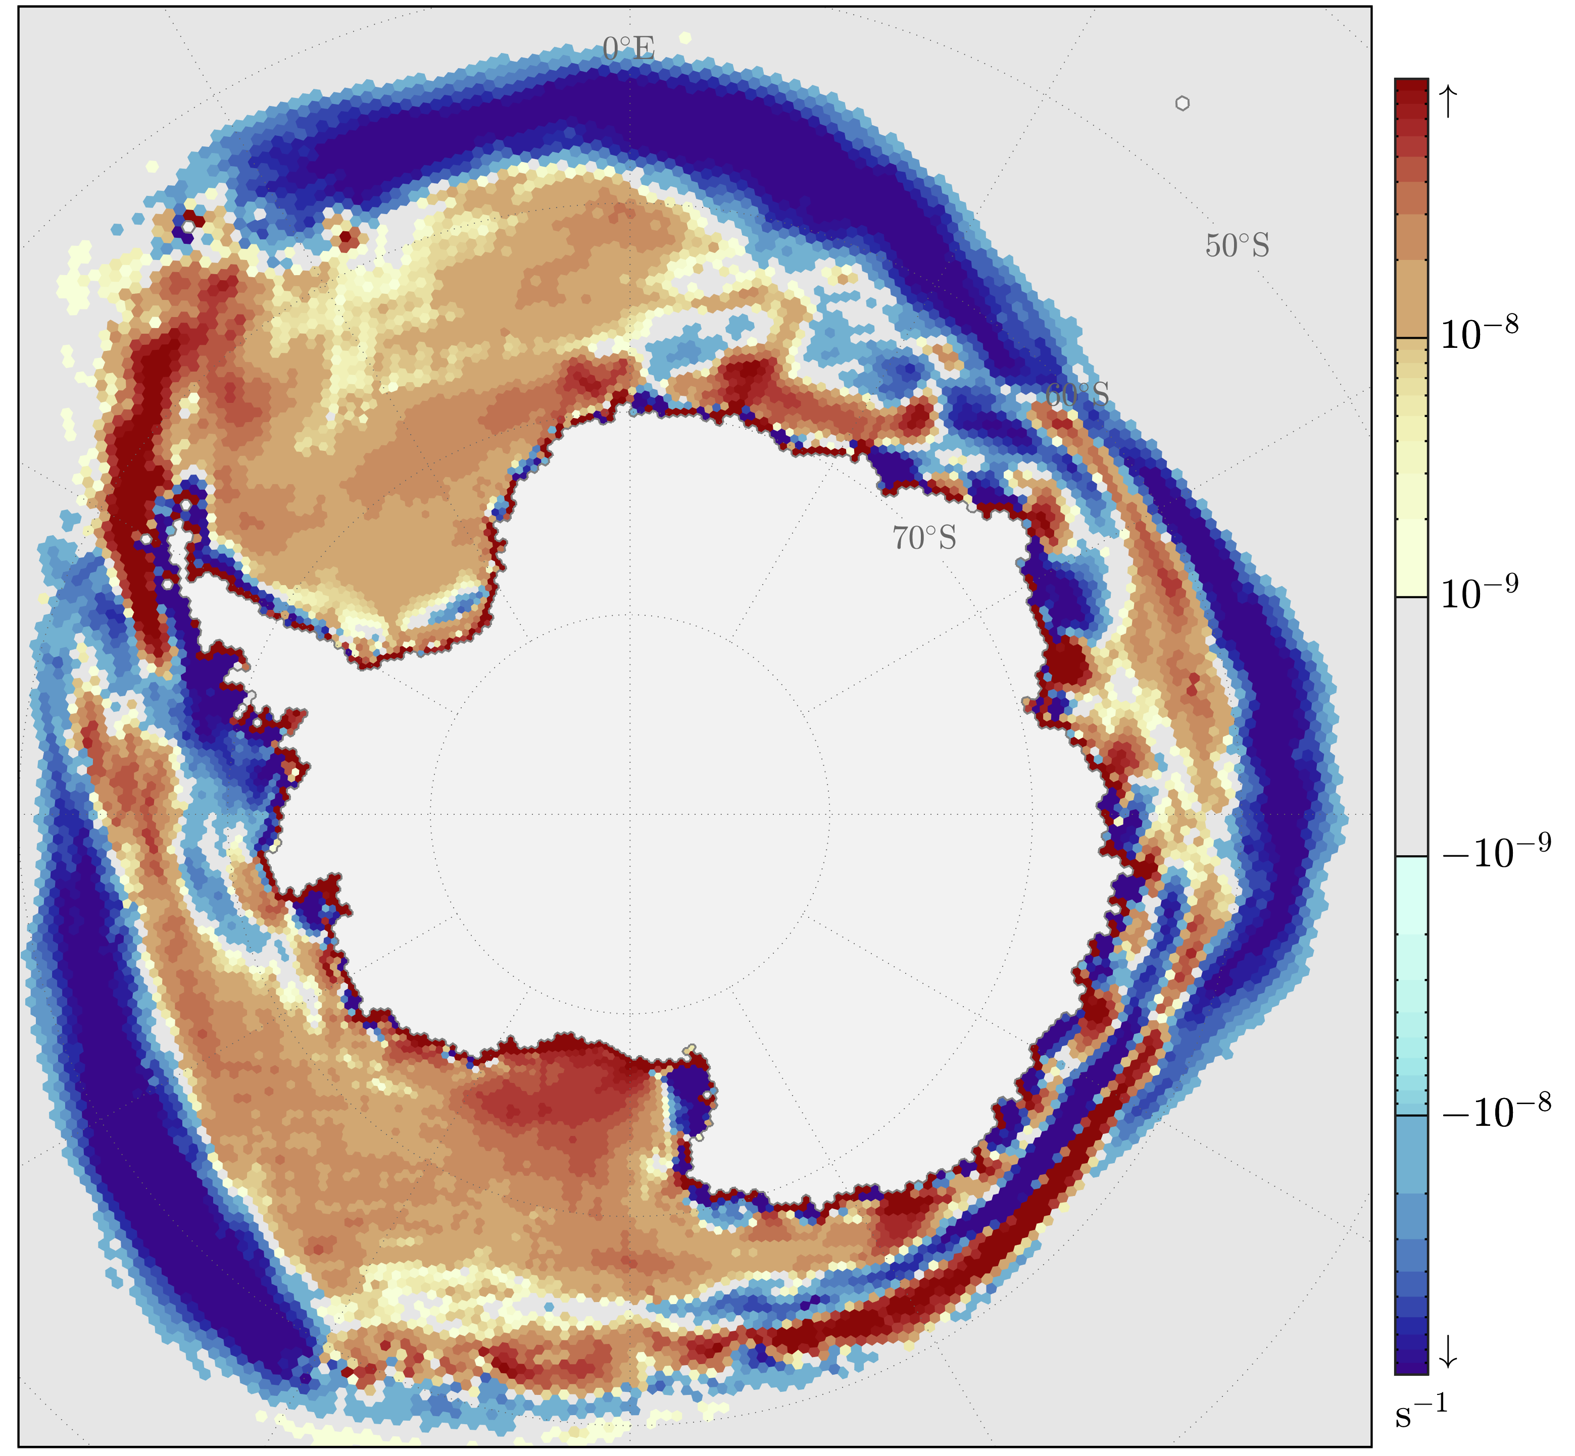
V2 Sea Ice Improvements
V1
Homogenization of snow radiative transfer over land and sea ice
SNICAR_AD
Sophisticated snow morphology over sea ice
Including 5 snow layers instead of 1
Ice basal temperature consistent with mushy-layer thermodynamics
Consistent with the equation of state of sea ice
True high-frequency (30 minute) ice-ocean coupling
Removed a daily filter in sea surface height between ice and ocean
Numerical noise removed in ice-ocean flux terms and ice deformation
See figure on right
Fixed frazil leak in ocean coupling with sea ice mushy-layer
V2 has net zero average PI ice-ocean mass and freshwater exchange budget
V2
Courtesy of A. Roberts
200-year PI September average
Sea Ice Divergence
Notes:
Note the noise was an artifact of the advection bug.

Slide 9
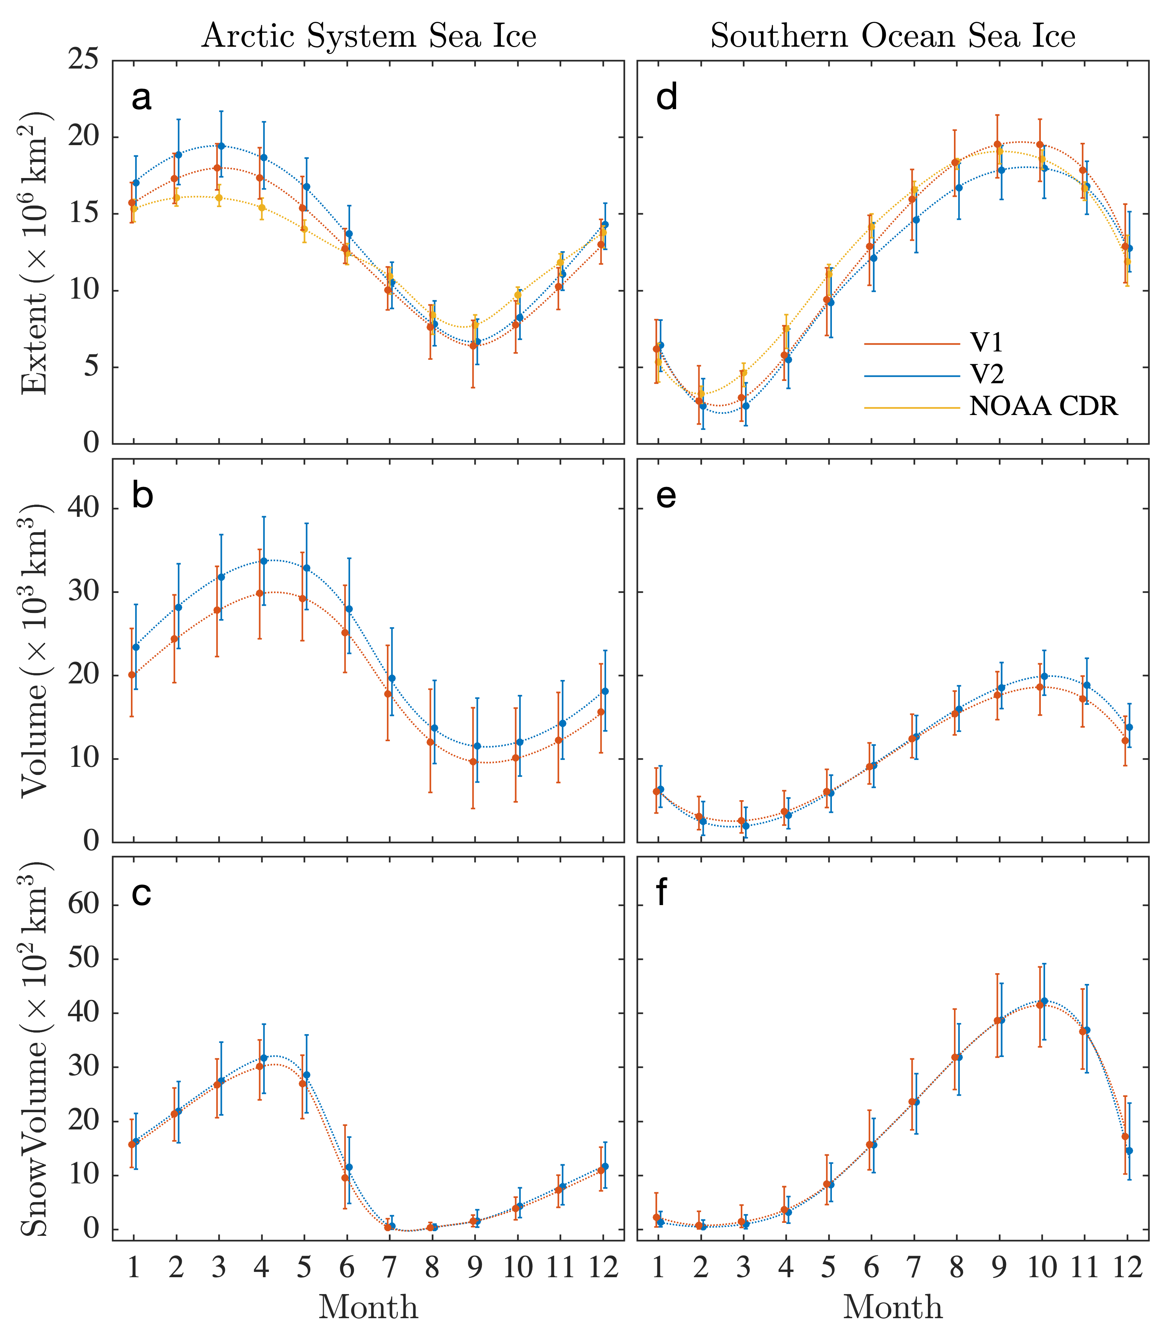
Sea ice Climatology V1 to V2
Did these V2 improvements have an impact?
Northern Hemisphere
Deteriorated bias in annual extent amplitude, significant and unrealistic increase in March sea ice extent.
Significant increase and improvement in sea ice volume from fixed frazil ice coupling, spanning all seasons.
No significant change in snow volume
Southern Ocean
Diminished annual extent amplitude, now consistently less than observations.
No significant changes in sea ice volume
No significant change in snow volume
200 year PI Climatology [CDR is 1979 to 1999 Climate Data Record Reference]
Notes:
Sea ice changes appear to be a bit of a mixed bag. Some improvements and some degredations. But on balance the sea ice are strong improvements given the many bug fixes.

Slide 10
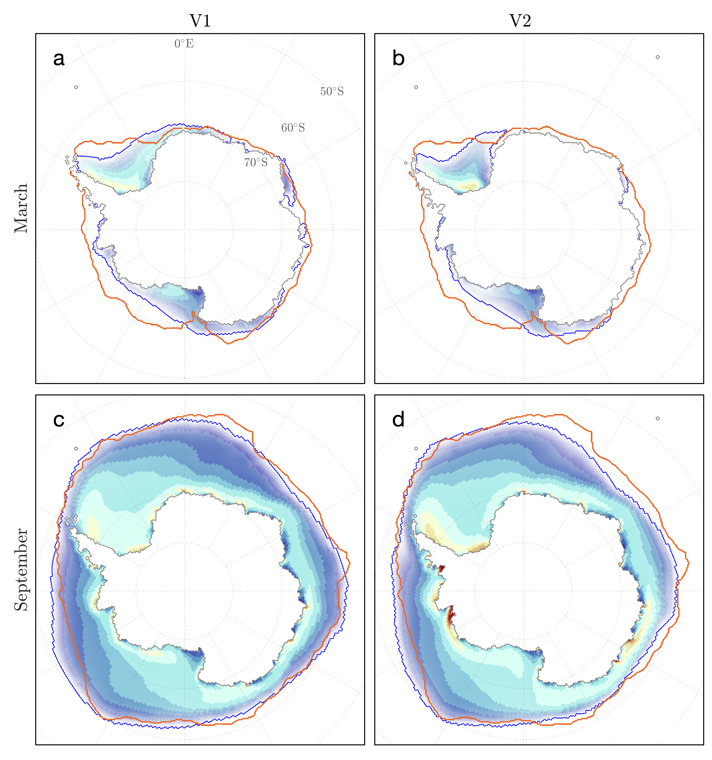
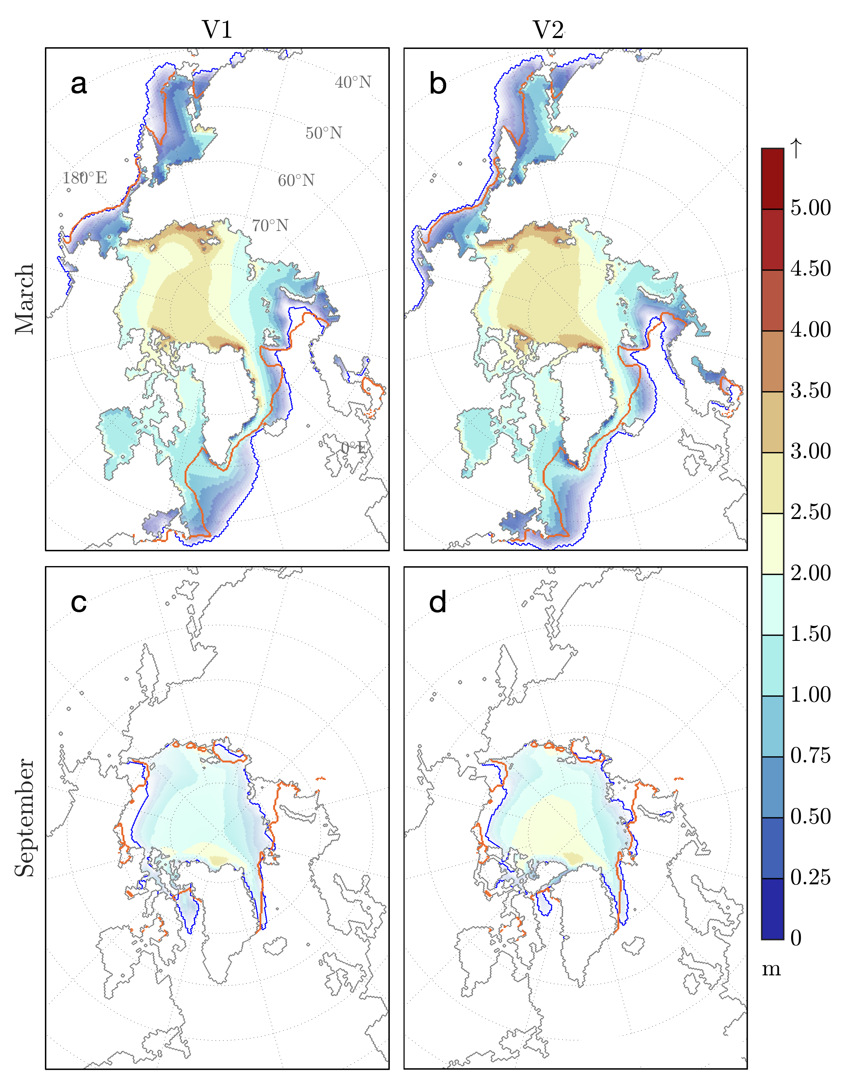
Sea ice Climatology V1 to V2
Frazil bug correction offered the largest improvement
Model Ice Edge
1979-1999 Observed
for reference
Courtesy of A. Roberts
Lack of build-up against archipelago related to atmospheric resolution
Notes:
Output compared to 1980's observationally-derived, prior to altimetry (Bourke and McLaren 1992) –
Build up on archipelago is better in v2, but still much weaker than observed – atmospheric resolution. The sea ice maximum in the beaufort gyre is too strong and should build up against the archipelago.
Boxes of are due to changes by frazil and are good by far. Especially in the arctic where it’s often not appreciated that >3m thick ice is quite common downstream of polynya production, but shows up on many field campaign papers from voyaged dotted around the Antarctic coast.

Slide 11
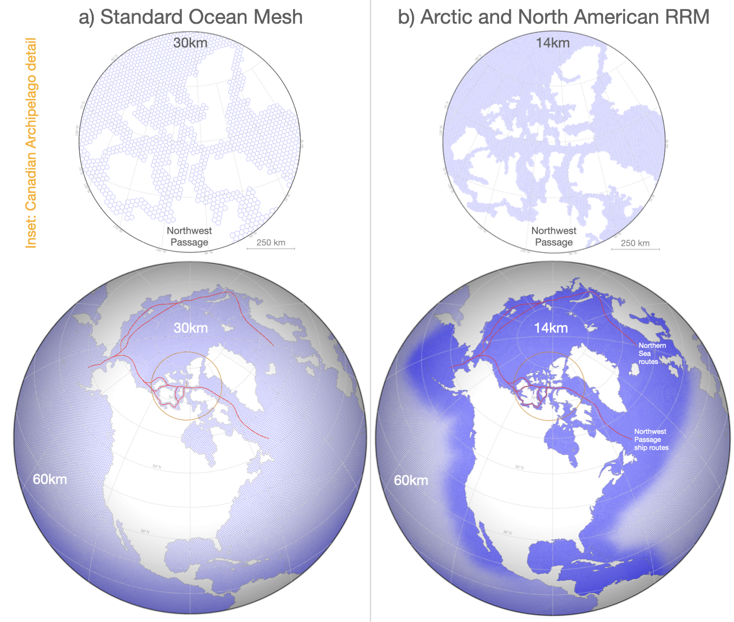
Impact of standard atmospheric resolution in polar regions
Zonal ∇SSH
Meridional ∇SSH
14km ice-ocean
14km ice-ocean
Indirect impact of 110km atmospheric resolution on sea surface height gradient state variable passed between sea ice and ocean at 14km resolution
Courtesy of A. Roberts
Notes:
The SSH imprint, I had thought, was due to SSH filtering. However, it’s stayed there when we removed that. It is mainly prevalent close to coastal boundaries, suggesting issue with land-sea ice fluxes combining at the boundaries. When the North American atmospheric grid is used, these issues go away. I first looked into this because we had an identical issue in RASM when we first put that together. Having a land grid cell with no snow, and a sea ice grid cell with snow, ends up greatly increasing the influx of radiation to the sea ice - one example of the problem.

Slide 12
Composite configurations
Treating single-forcing simulations as linear perturbations from the piControl, we can recompose them with alternate strengths:
Modulate strength of GHG response (proxy for TCR/ECS) and aerosol related to create alternate composite configurations.
Applicable to any field; linear approximation holds well.
Baseline
Modulate GHG response
Modulate aerosol response
Keep the rest unchanged
From Chris Golaz all hands webinar. November 2021
Notes:
Not sure how much needs to be said here, can just recap again to show decomposition.

Slide 13
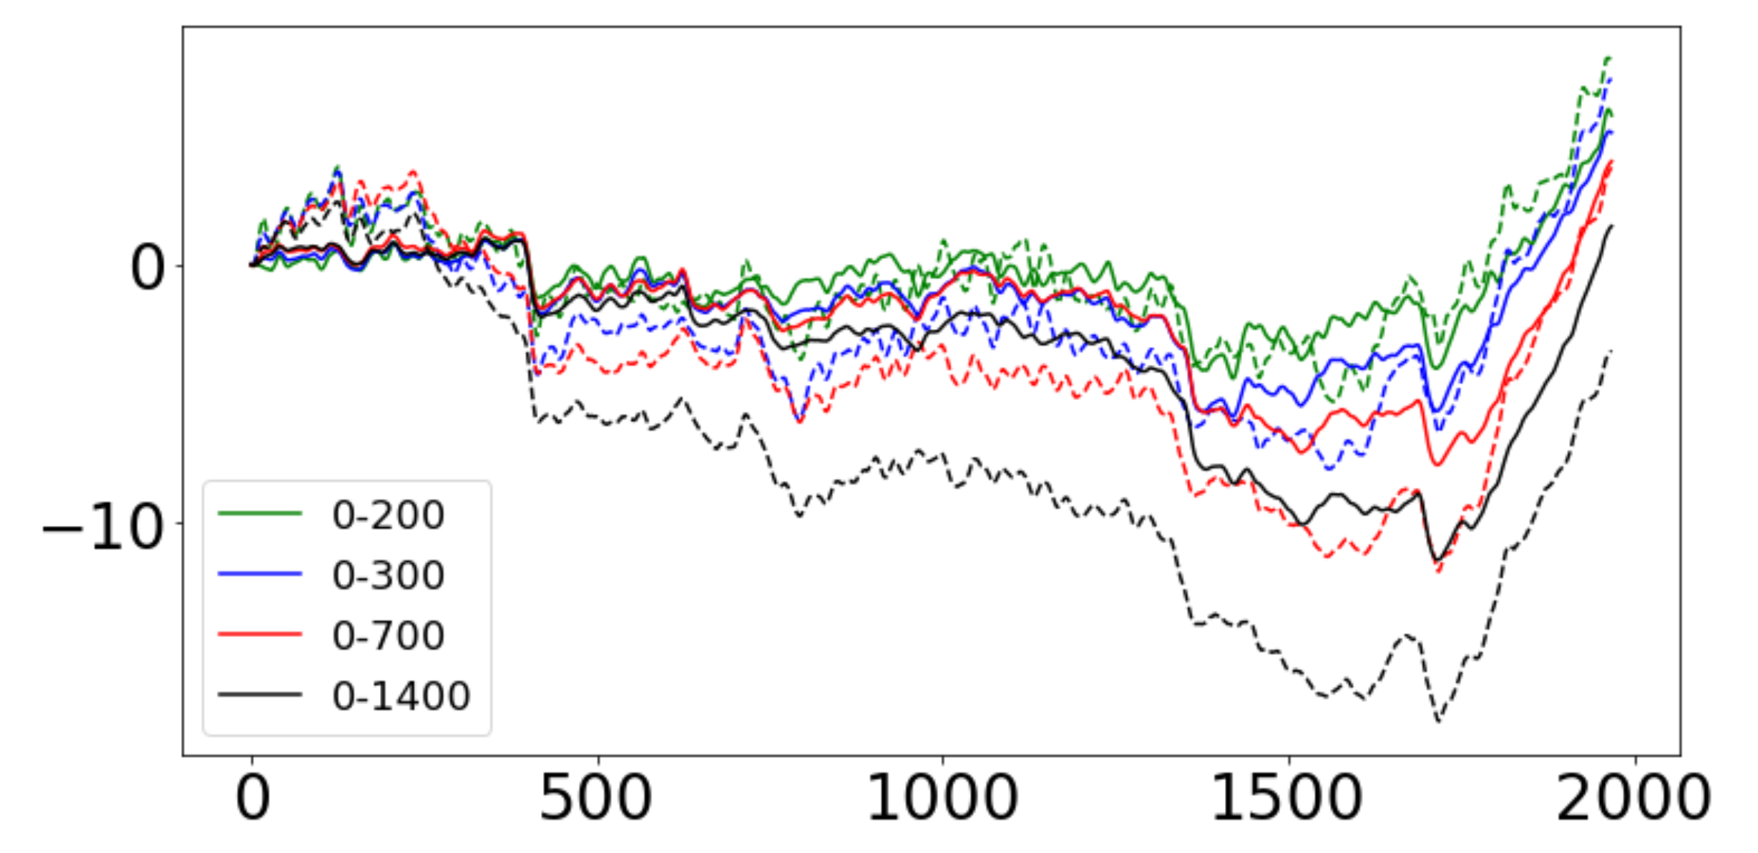
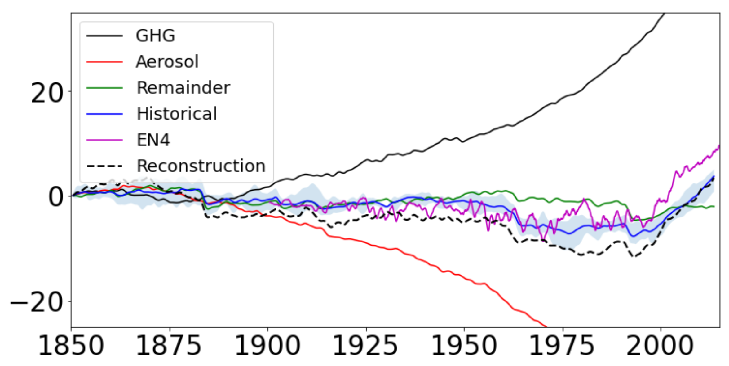
Ocean Heat Content
Following the analysis shown by Chris Golaz in November.
Linearity (dashed) works well in upper 300m
Interesting 0-700 matches well in late 20th century
Reanalysis (EN4; magenta) match pretty well in 0-700 until late 20th century.
Ocean warming slows relative to data

Slide 14
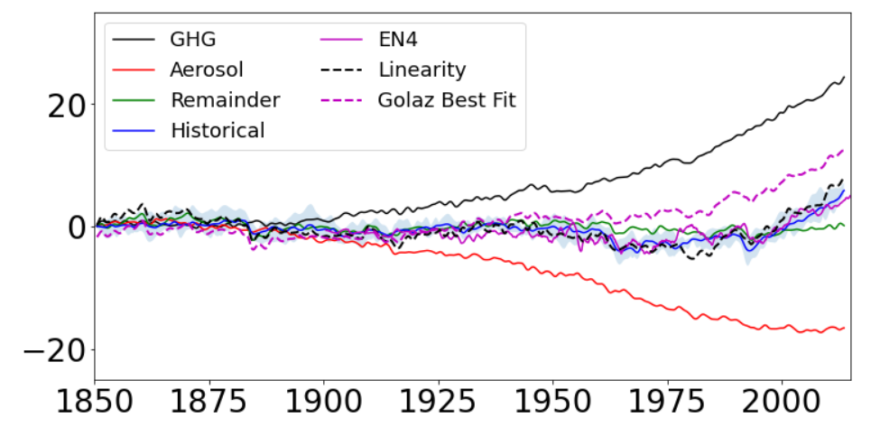
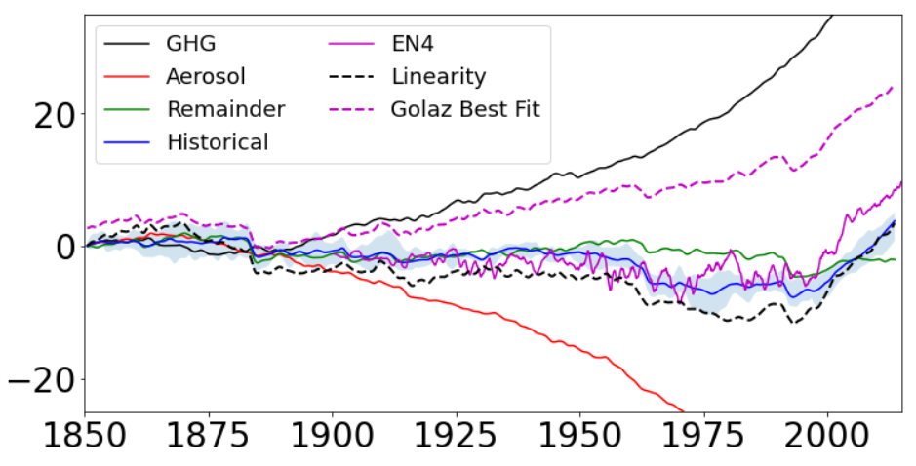
OHC composite analysis
0-200m
0-700m
The reduction in aerosol forcing and GHG worsens comparison to observations (dashed pink)
Also examined: sea surface salinity biases and AMOC for reduced aerosol forcing
SSS had limited change, AMOC virtually no change
Notes:
GHG run has more reduced AMOC at end of 20th century

Slide 15
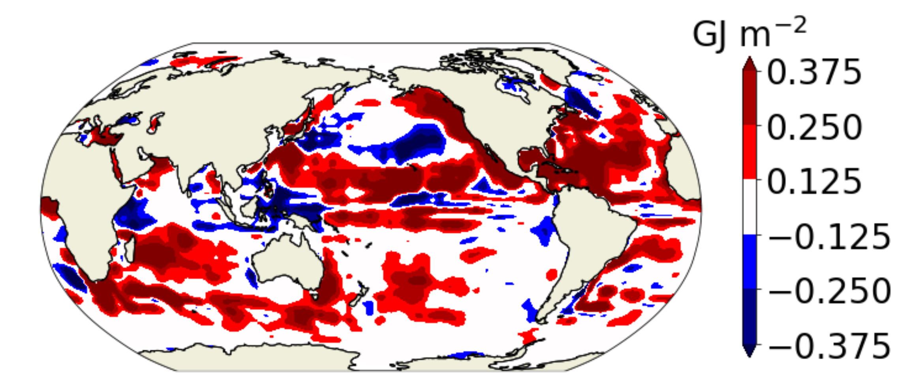
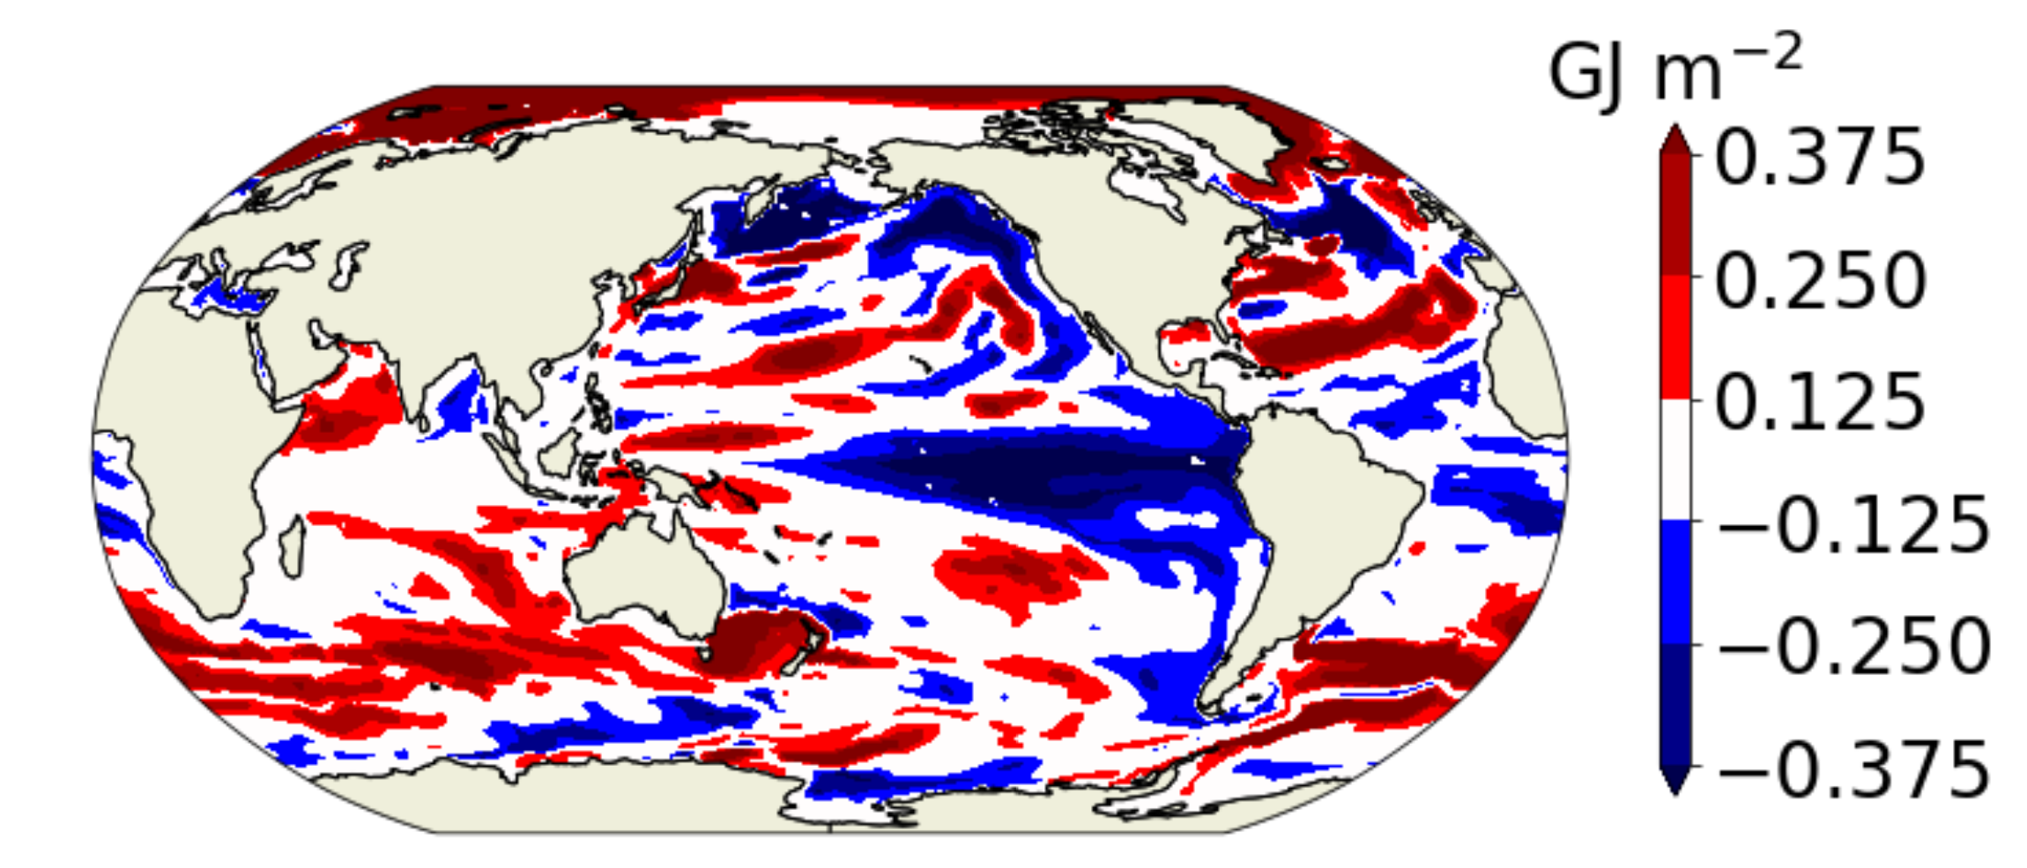
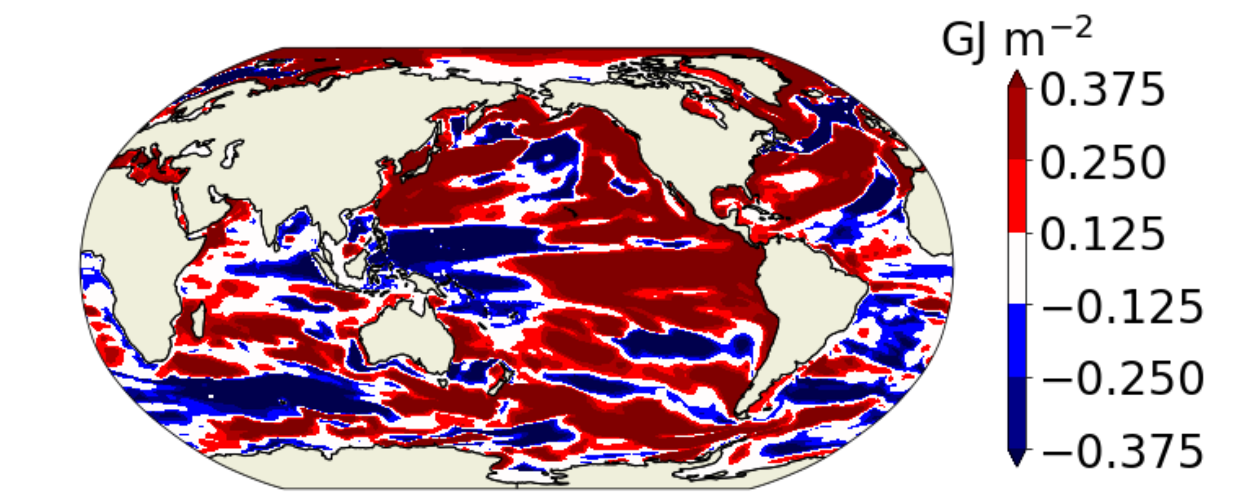
Composite analysis 2D maps (0-200m)
EN4
Historical Mean
Good timeseries agreement with data is due to compensating biases
Reducing aerosol forcing improves OHC in some regions
But certainly not the only factor in biases
Composite – reduced Aerosol

Slide 16
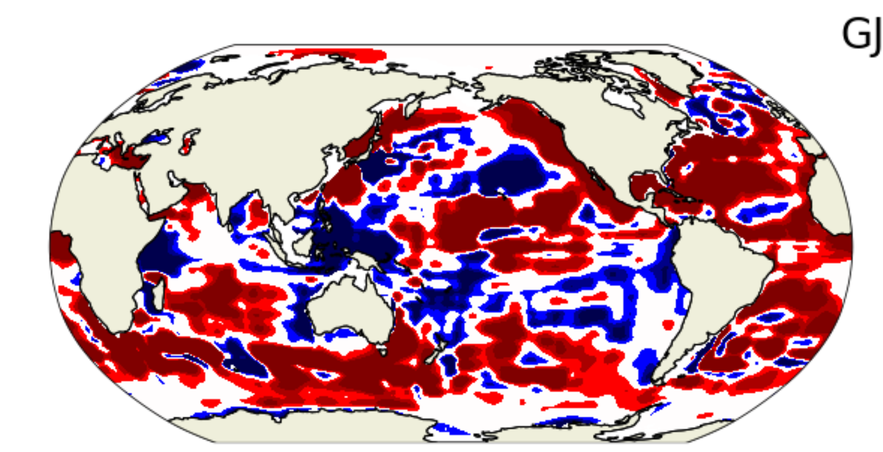
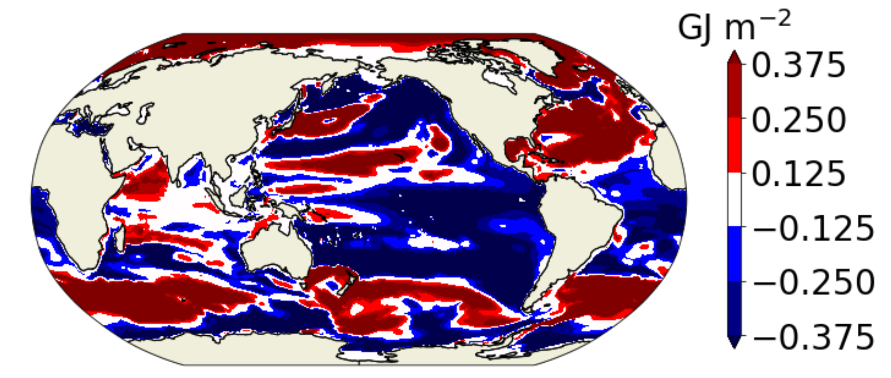
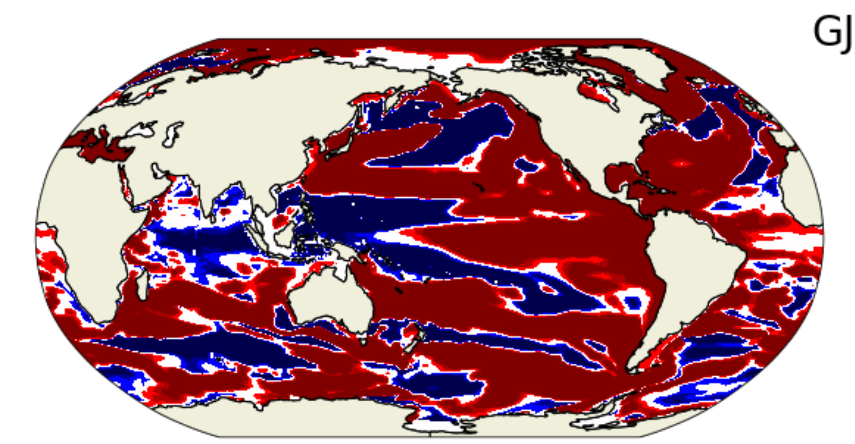
Composite analysis 2D maps (0-700m)
EN4
Historical Mean
Similar regional impacts through these depths
The OHC average is taken over the period linearity holds well
Composite – reduced Aerosol

Slide 17
AMOC update
New Format: smaller focused team, meeting frequently.
Known Knowns
AMOC at high resolution is robust
Missing or poorly represented physics?
Variable resolution has not helped more than a Sv
Various SORRM iterations, WC meshes
Tuning rudimentary GM has given 1-2 Sv
Changing Redi parameters
Helps in some ways but yields other, much larger biases
Known Unknowns
Why is MPAS so sensitive to surface freshwater forcing at low resolution?
Likely a combination of factors

Slide 18
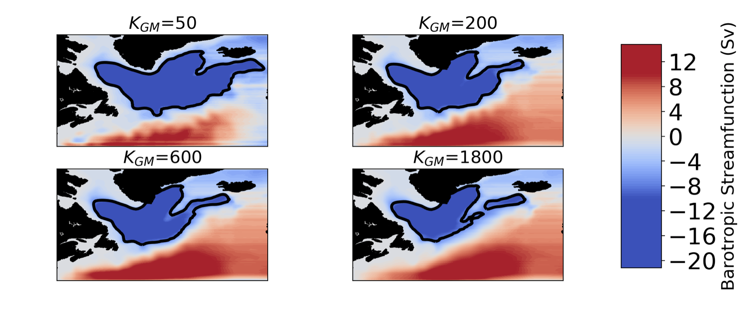
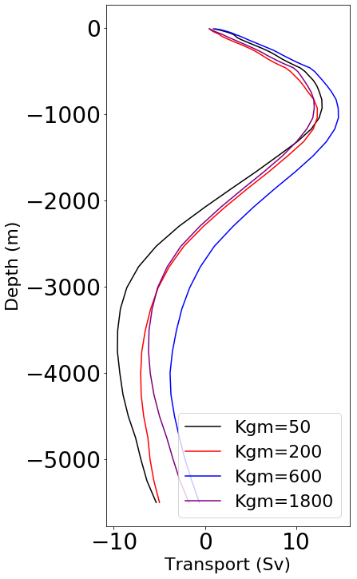
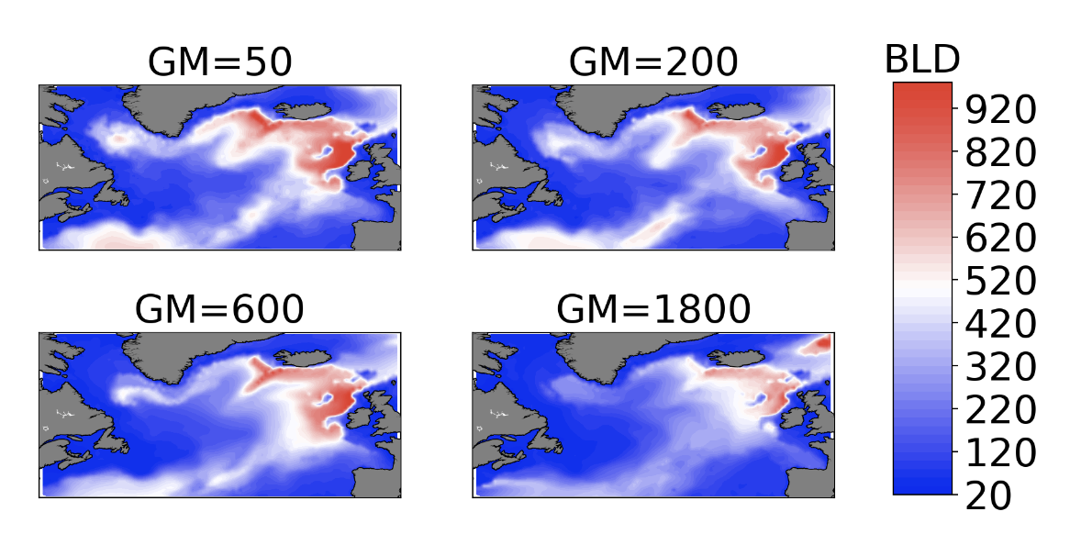
GM
GM Analysis
Salinity
Subpolar gyre improves with lower Kappa
BLD improves but response saturates
AMOC does not respond as expected
Analysis from L. Conlon

Slide 19
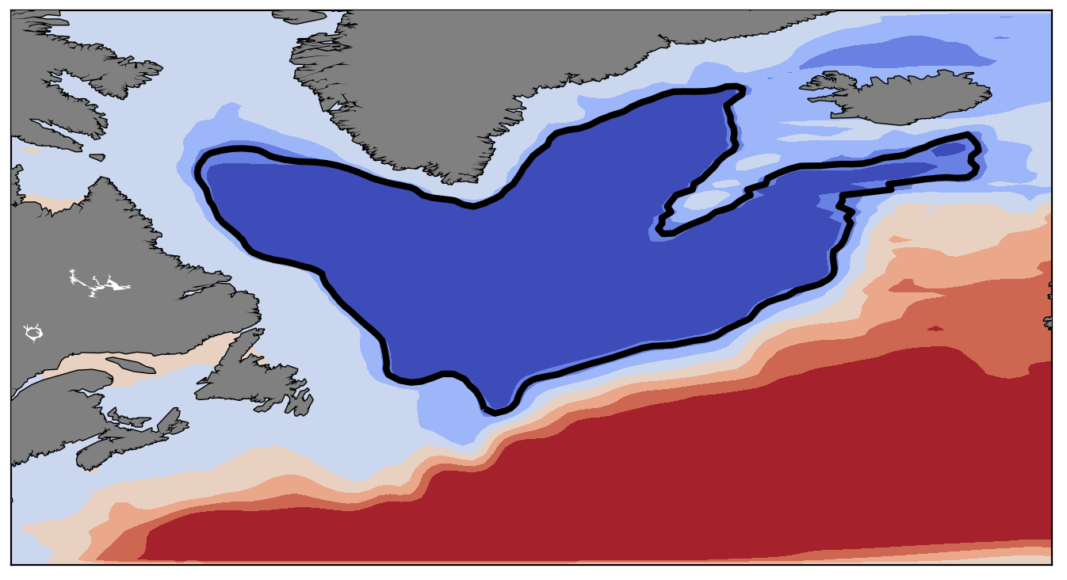
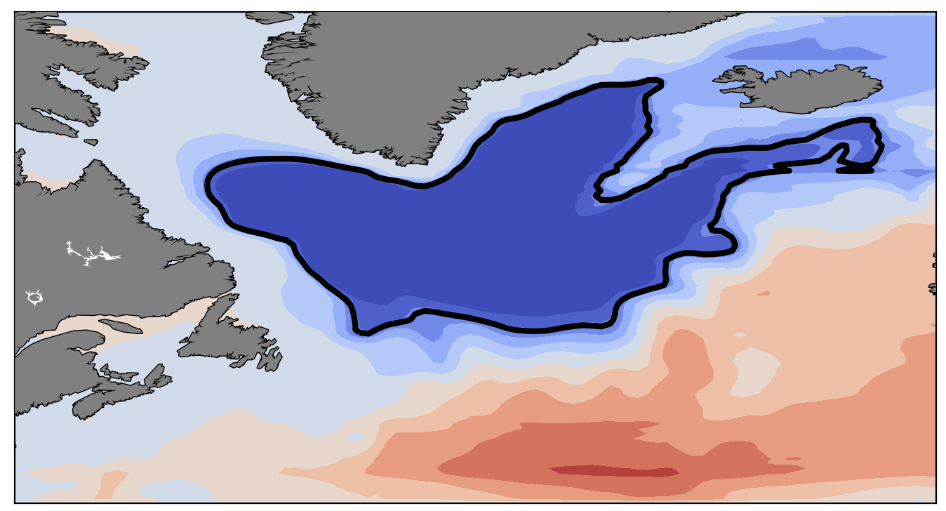
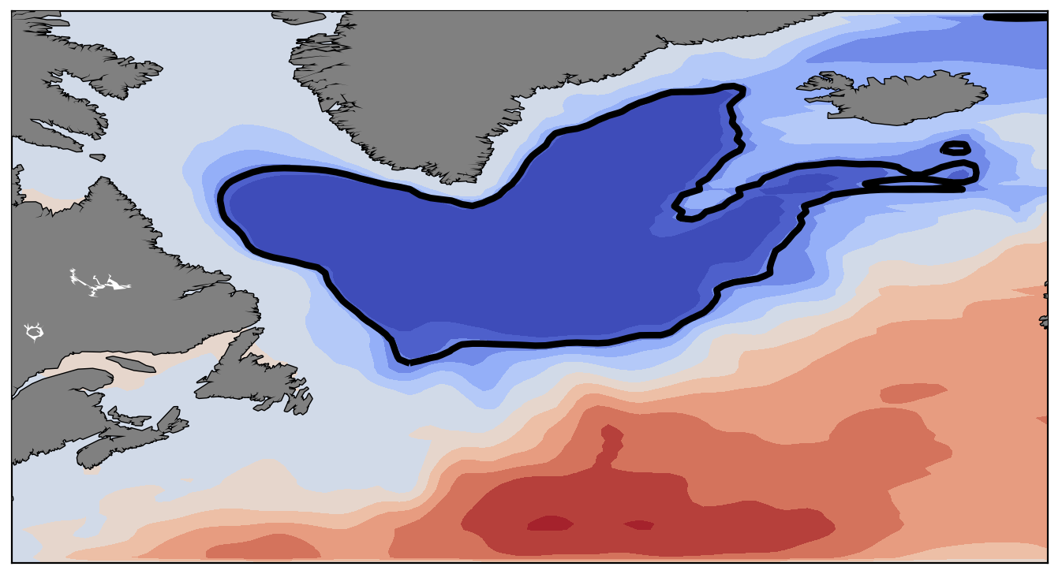
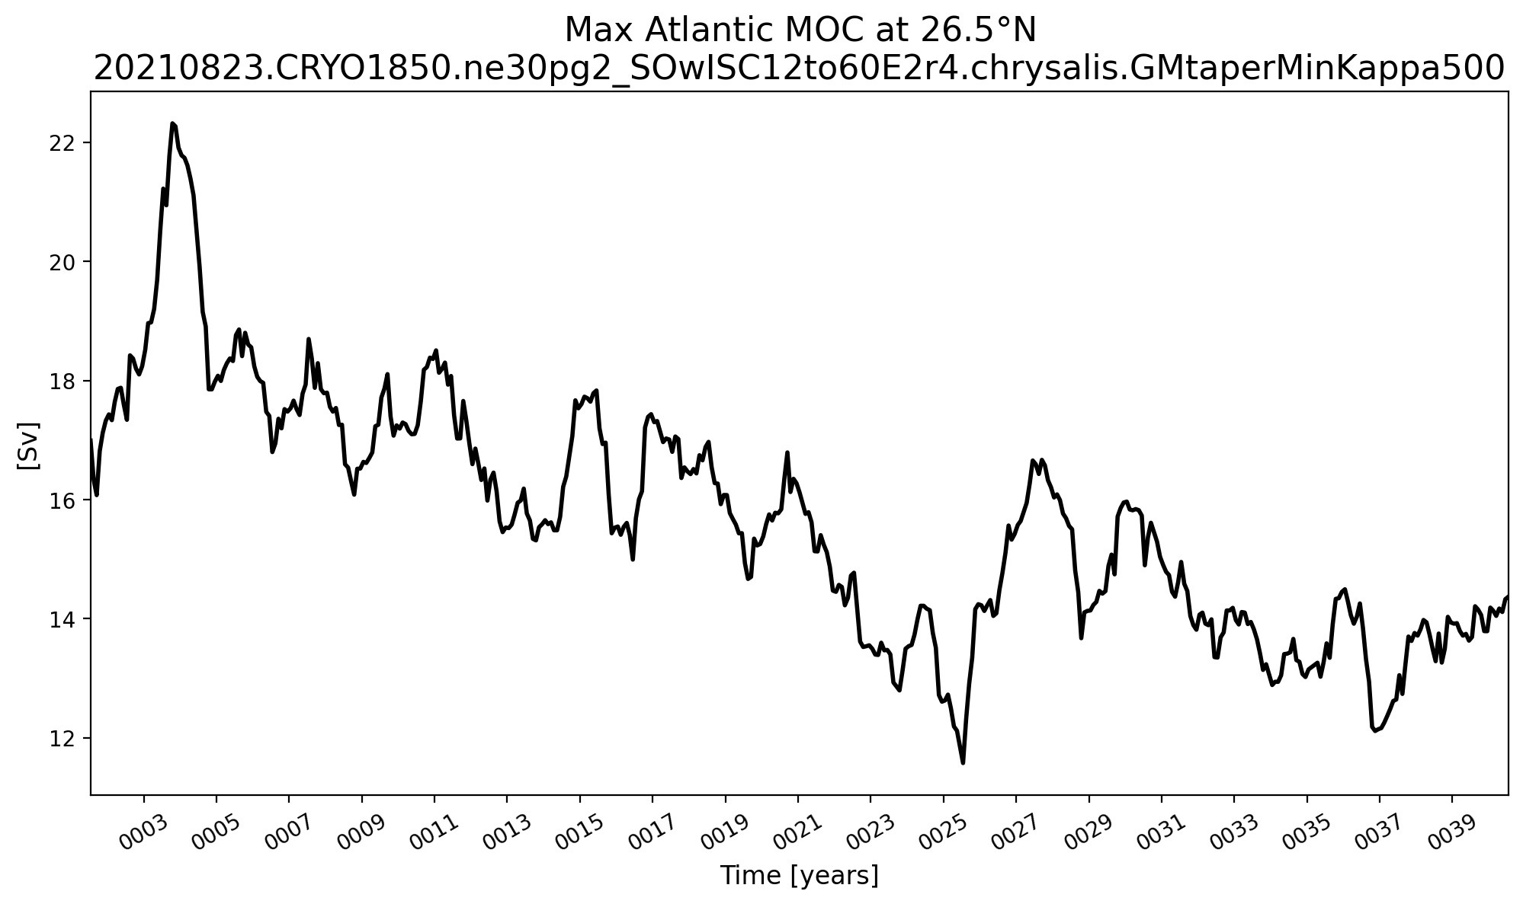
GM (Visbeck)
1
2
3
3
GM is spatially variable.
Subpolar gyre looks good (above)
AMOC still declines (left)
Likely a combination of northward salinity transport and subpolar gyre
2
1
Analysis from L. Conlon

Slide 20
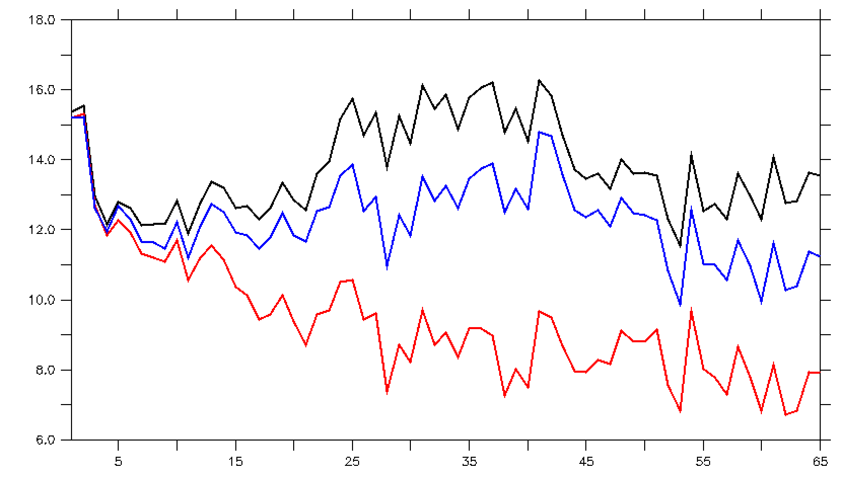
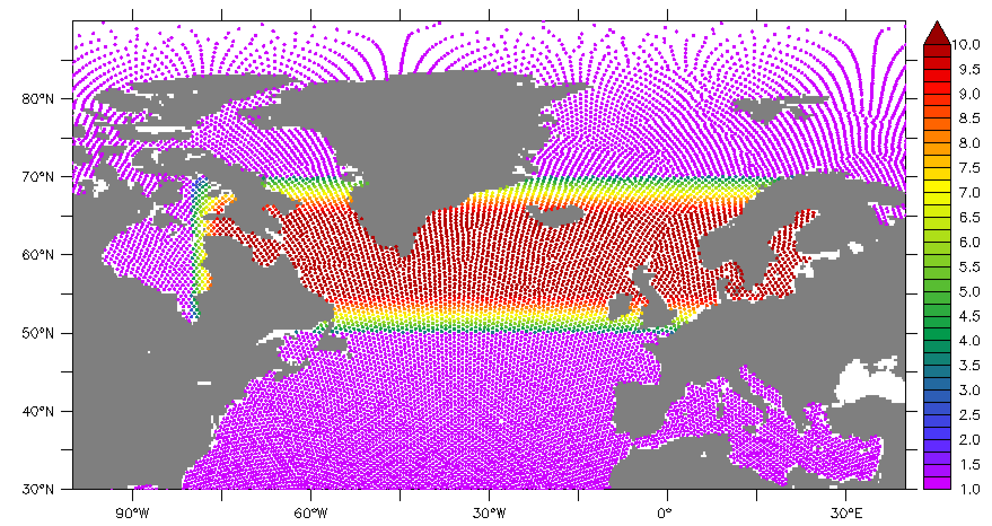
Influence of SSS restoring
Three cases
Standard 1 year restoring everywhere (red)
Increase to 36.5 days everywhere (blue)
1 year everywhere except 36.5 days in North Atlantic (black)
Strong restoring in the N. Atlantic greatly improves AMOC
Global strong restoring slightly less effective
Compensating bias eliminated?
Analysis from M. Maltrud

Slide 21
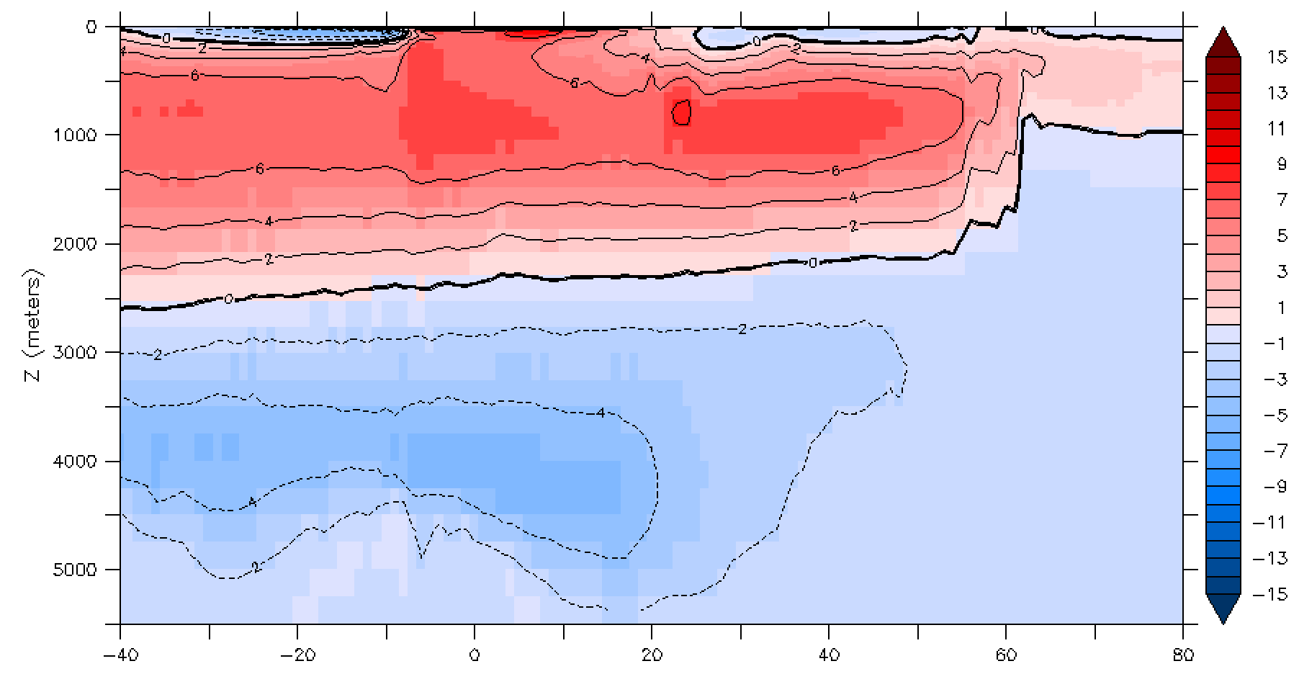
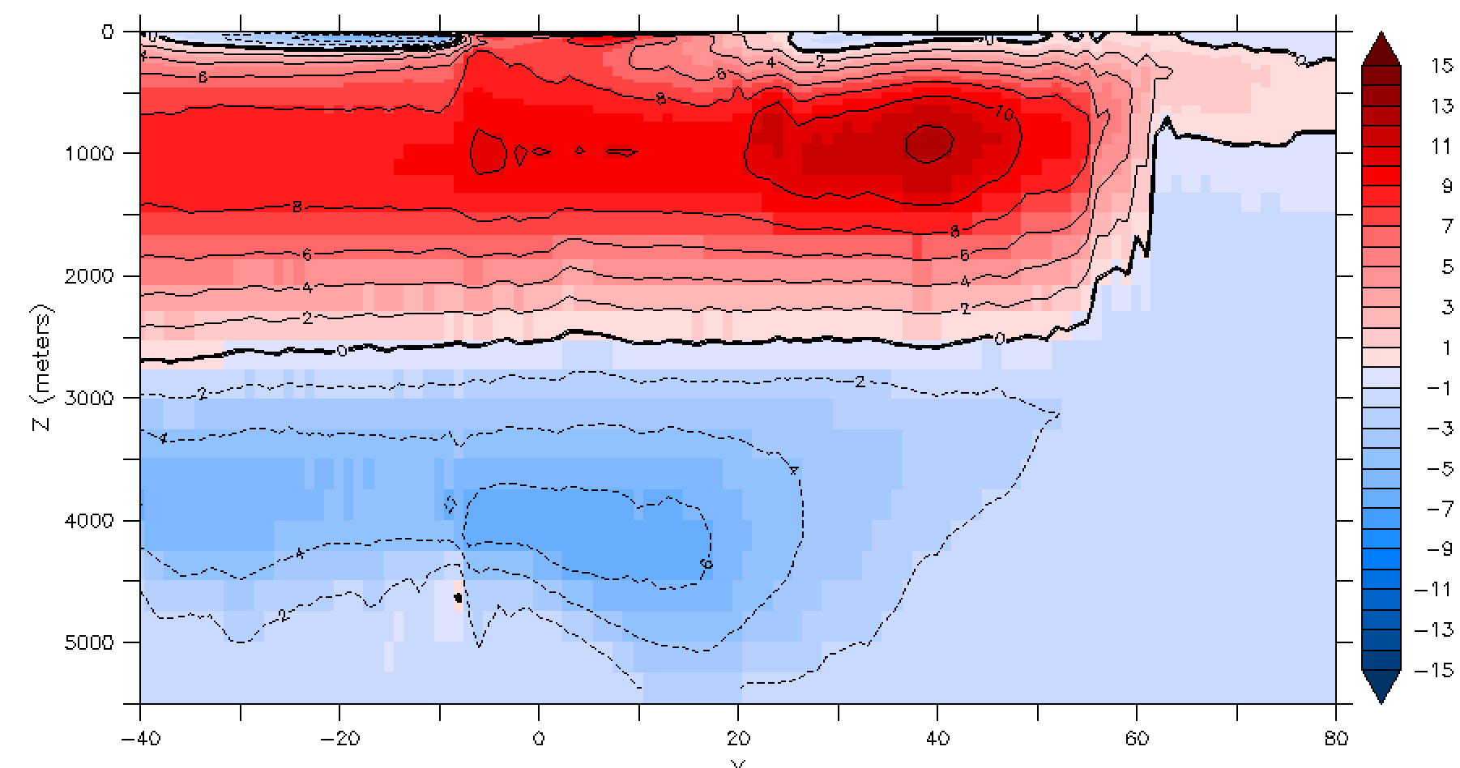
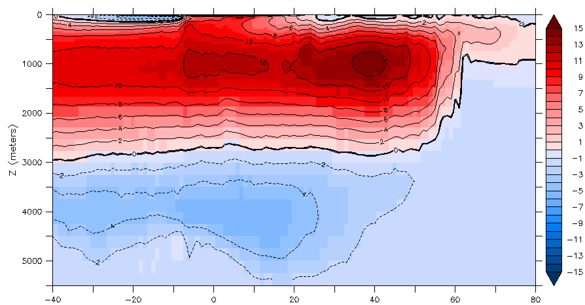
Analysis from M. Maltrud
Years 61-65 average Atlantic Meridional Stream Function
Enhanced everywhere
Standard
Enhanced NAtl
This result is quite exciting for LR, but remember G-case only here

Slide 22
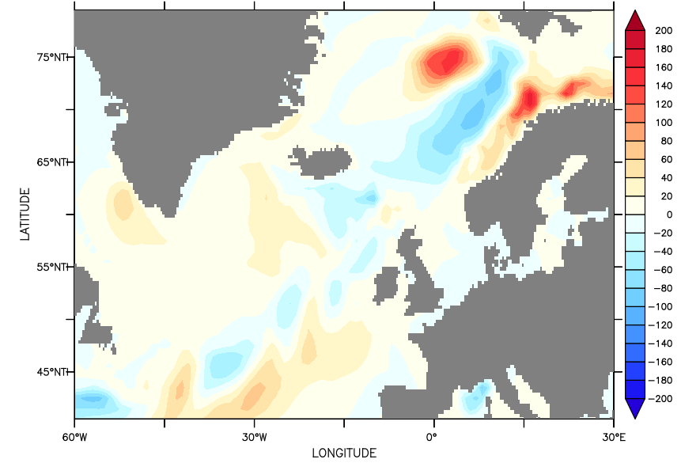
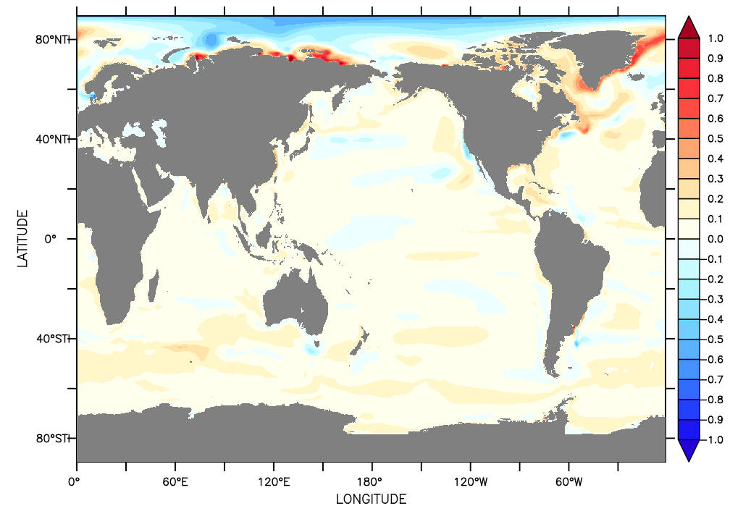
Ocean Freshwater
The likely candidates
Vertical Mixing
Redi Mixing
Given high resolution has robust AMOC, Redi seems more likely.
Left – change in salinity from increasing Redi
Above – change in MLD from increasing Redi
Some hints that improving Redi could improve AMOC
Analysis from K. Balaguru

Slide 23
Summary and Next Steps
v2 Ocean looks quite similar to v1
Some regional improvements, some slight degradations
V2 Seaice
Numerous fixes and improvements. Improved sea ice volume with some degradations in extent
OHC
Global timeseries matches reanalysis well in upper ocean
Due to compensating biases
Reducing aerosol impact improves some regional OHC biases but exacerbate others.
AMOC
Good progress being made
Critical question – why is the ocean model so sensitive to high latitude freshwater forcing?
Notes:
Under AMOC mention the improved low res / high res comparison, starting from the same point and looking for deviations.

