Slide 1
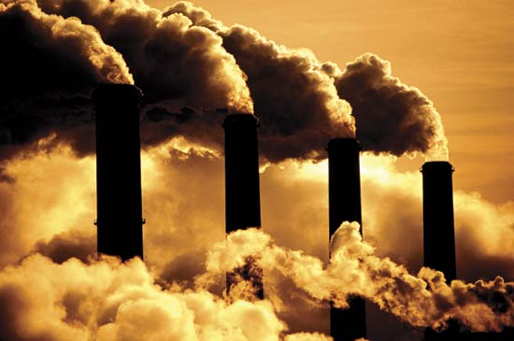


Development and evaluation of computationally efficient treatments of secondary organic aerosol (SOA) for E3SM
Human systems
Biosphere
Clouds/radiation
Aerosol processes overlooked in climate models could greatly affect climate forcing
Manish Shrivastava
Sijia lou, Richard easter, hailong wang, yang yang, po-lun ma, scot martin, john shilling, alla zelenyuk, jose jimenez, Pedro campuzano jost, qi zhang, Philip Cameron smith, Christiane Schulz, Johannes Schneider, Manvendra dubey
Lou, Shrivastava et al. 2020, journal for advances in modeling earth systems
Notes:
Secondary organic aerosols are key components of atmospheric fine particles throughout the globe. They are complex because they are not directly emitted but formed by many processes through reactions of thousands of organic species in the atmosphere. Current climate models have very simplistic treatment of SOA processes.
We held a workshop at PNNL sponsored by DOE ASR program to highlight aerosol processes overlooked in climate models. In this talk I am going to tell you about some of those key missing processes. I would like to acknowledge all my co-authors and the DOE Atmospheric Systems Research Program for funding

Slide 2
What are secondary organic aerosols (SOA)?
Primary organic aerosol (POA): Directly emitted
Secondary organic aerosol (SOA): Formed by chemical reactions of volatile organic compounds (VOCs) and gas to particle conversion of products
Each SOA particle is made of thousands of organic compounds
SOA is ubiquitous in the atmosphere
SOA is a vital link connecting natural, anthropogenic and wildfire emissions to aerosols, radiation and clouds
Riipinen et al. 2011

Slide 3
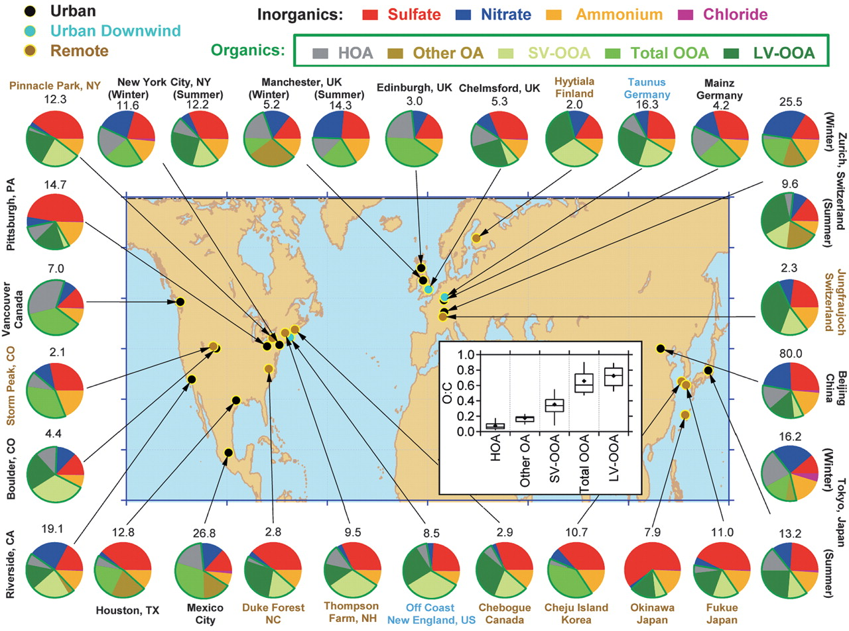
Aerosol Mass Spectrometer (AMS) measurements around the world: SOA (green) is ubiquitous
In the Northern Hemisphere SOA concentrations are similar to or greater than sulfate
Jimenez et al. 2009, Science

Slide 4
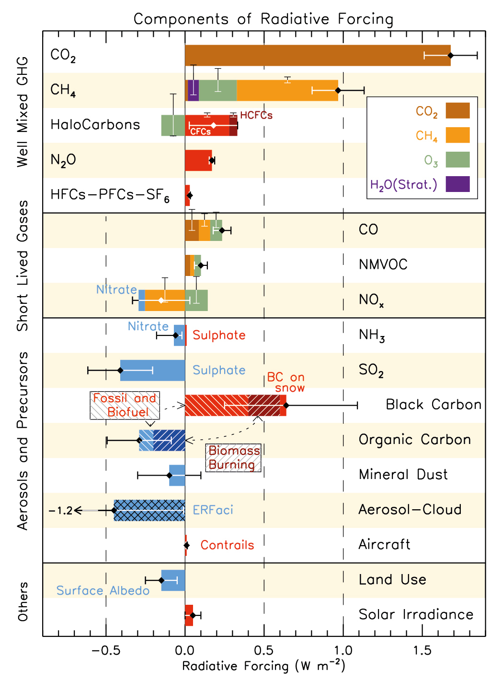




IPCC Radiative forcing bar chart: Does not include SOA
Organic carbon (OC) radiative forcing is -0.3 Wm⁻²
SOA not included because formation depends on variety of uncertain factors
There is tremendous complexity and uncertainty in the processes involved in SOA formation (IPCC, 2013)
Myhre et al. 2013, IPCC Fifth Assessment
SOA could change global cloud forcing by ~20% with large regional variations
Primary

Slide 5
Anthropogenic emissions interact with biogenic VOCs through atmospheric chemistry making SOA
Anthropogenic and biogenic emissions interact through a variety of pathways that affect SOA, and its impacts on clouds and radiative forcing.
Global Earth System Models do not include most of these SOA formation pathways
This could bias the estimated PD-PI radiative forcing
Shrivastava et al. 2017, Reviews of Geophysics

Slide 6
Chemical oxidation reactions can be both sources and sinks : Adding functional groups, or fragmenting carbon backbone
Decreasing volatility
Functionalization
O
+
.OH/O₂
R1
R2
R1
R2
C* µg m⁻³
0.1
10.0
Increasing volatility
Fragmentation
O
+
C
R2
R1
R2
.OH/O₂
R1
O
C* µg m⁻³
10.0
100.0

Slide 7
Southeast USA field measurements show monoterpene fragmentation products increase with aging in presence of NOx
Zhang et al. 2018, PNAS

Slide 8
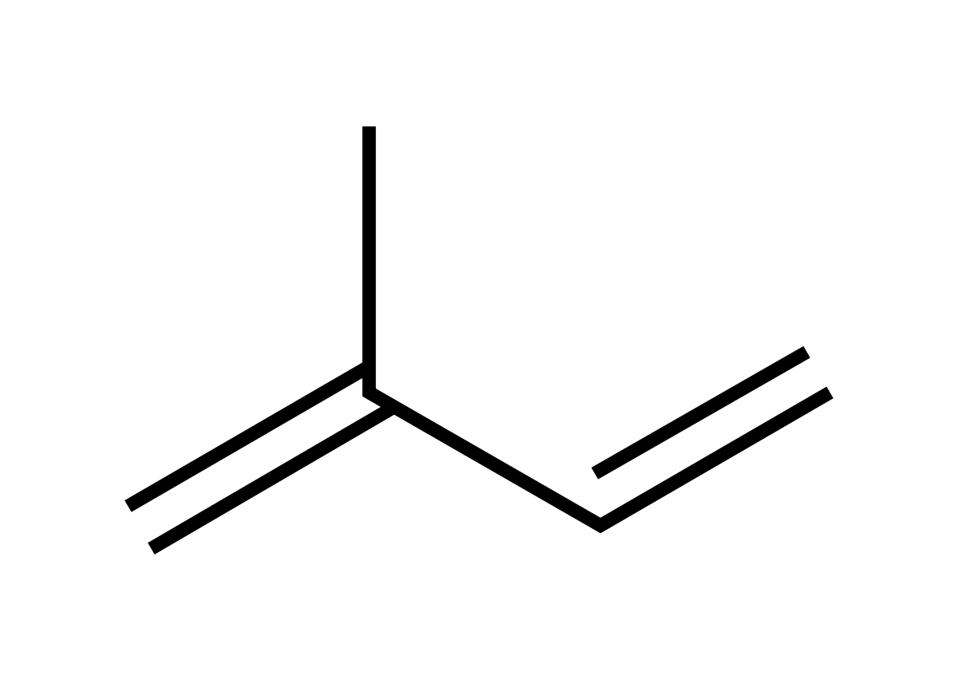
Photolysis is an important sink of SOA found by laboratory measurements
UV light
Isoprene SOA decreases by upto 80% within 10-12 hours upon exposure to UV light in PNNL smog chamber measurements (Zawadowicz et al. 2020)
⋅OH
⋅OH
⋅OH
SOA particle

Slide 9
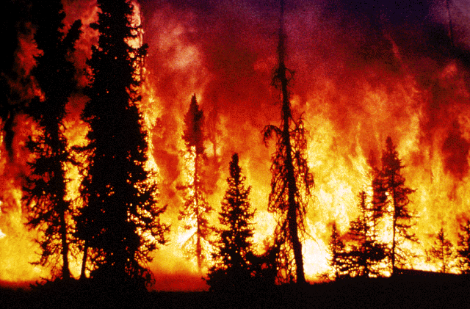
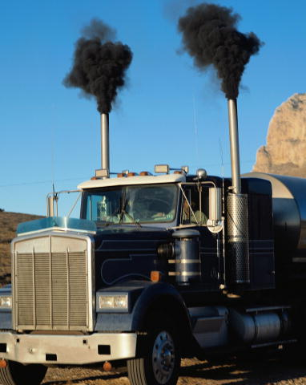
New SOA model developments in E3SM
Parameterize multigenerational gas-phase chemistry of thousands of organic compounds with a few lumped species with the volatility basis-set (VBS) approach
SOA precursors are from biogenic, biomass burning and energy-related emissions
Included fragmentation reactions in addition to functionalization
Included particle-phase oligomerization and photolysis of SOA
Volatilities of thousands of organic compounds represented by fixed decadal intervals (VBS)

Slide 10
Making SOA treatments computationally efficient
Added 8 gas-phase species to explicitly simulate multigenerational chemistry of SOA precursors
At each time step gas-particle partitioning is calculated dynamically between semi-volatile gases and particle phase species within the MAM4 modes
At the end of the time step all SOA particle-phase species are lumped together as a single non-volatile species assumed to be form oligomers within the particle
Only a single SOA species is advected in each mode thus reducing the number of transported particle-phase species
All SOA sources biogenic, biomass burning and fossil-related are lumped together
This results in considerable computational savings compared to our previous implementation in CESM (Shrivastava et al. 2015)

Slide 11
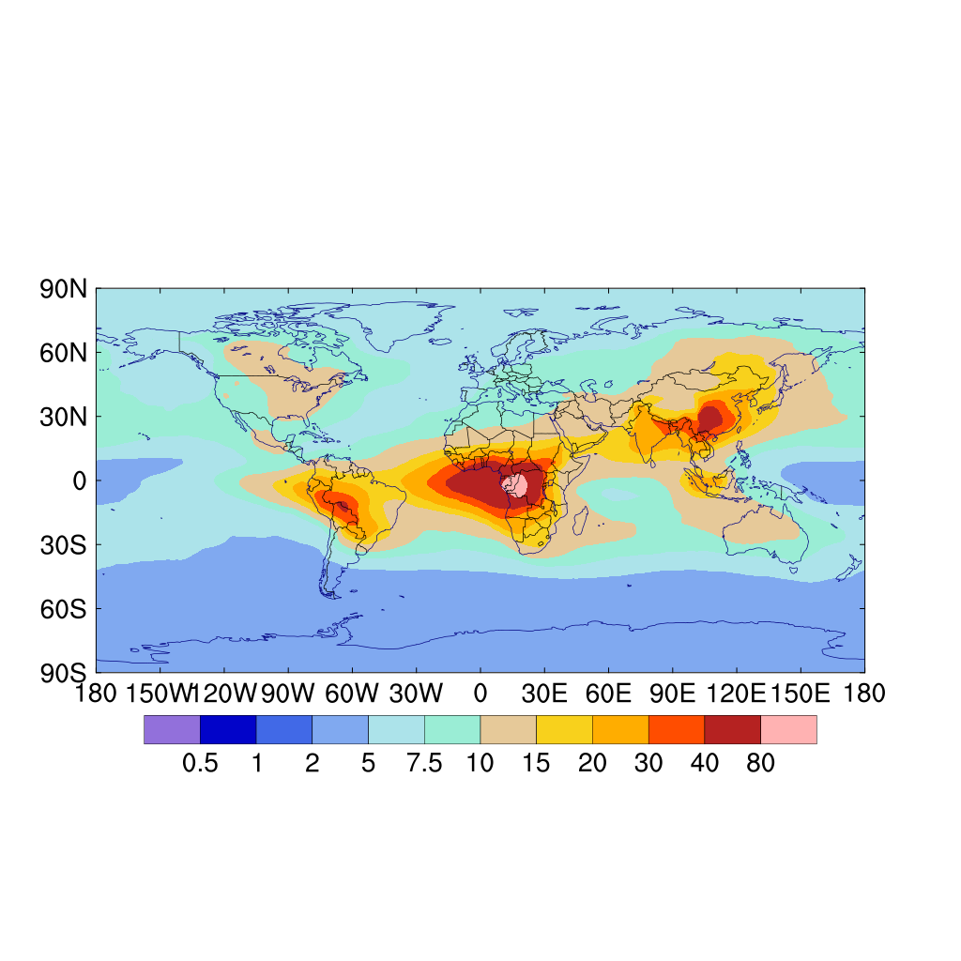
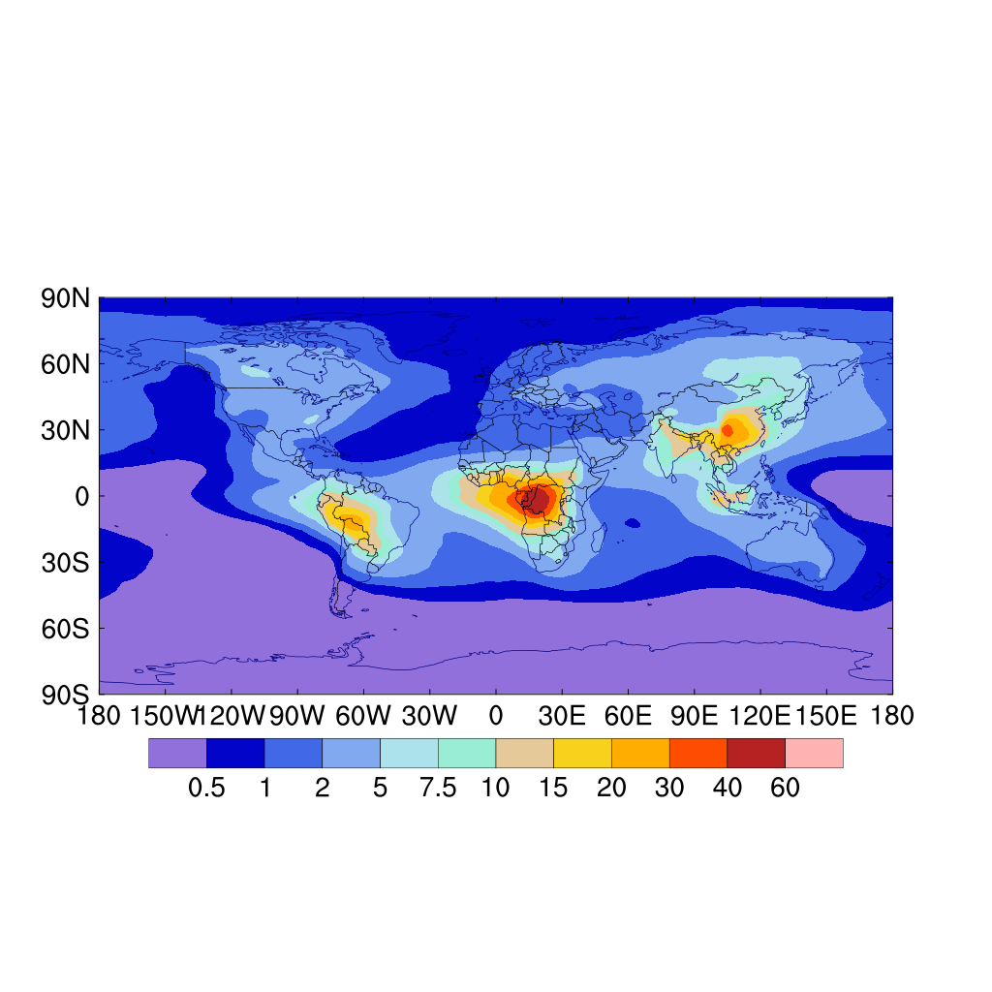
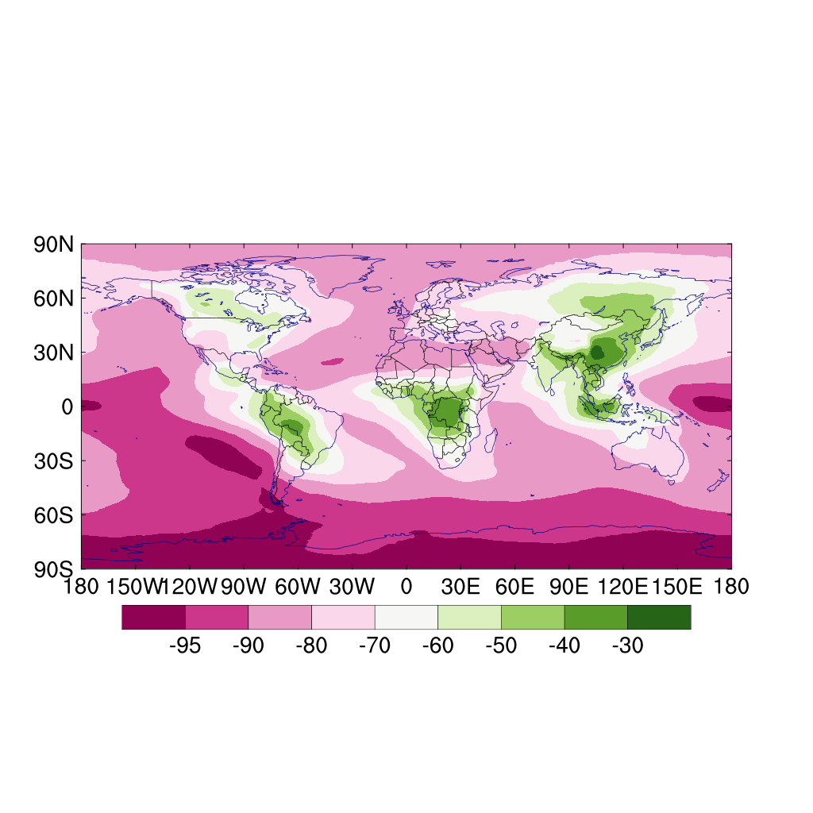
Particle-phase photolysis is an important sink of SOA
(a) Photolysis off
(b) Photolysis on
(b-a)/a x100 %
mg m⁻²
mg m⁻²
%
Lou, Shrivastava et al. 2020, JAMES
Particle-phase photolysis decreases SOA by 30-50% over source regions
Stronger (80-90%) decreases are seen over remote oceanic regions and high altitudes

Slide 12
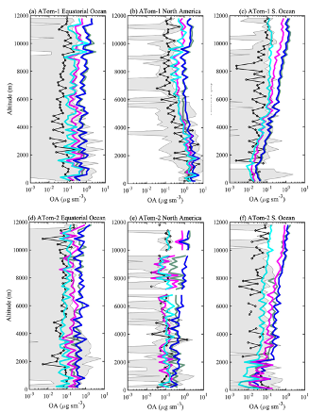
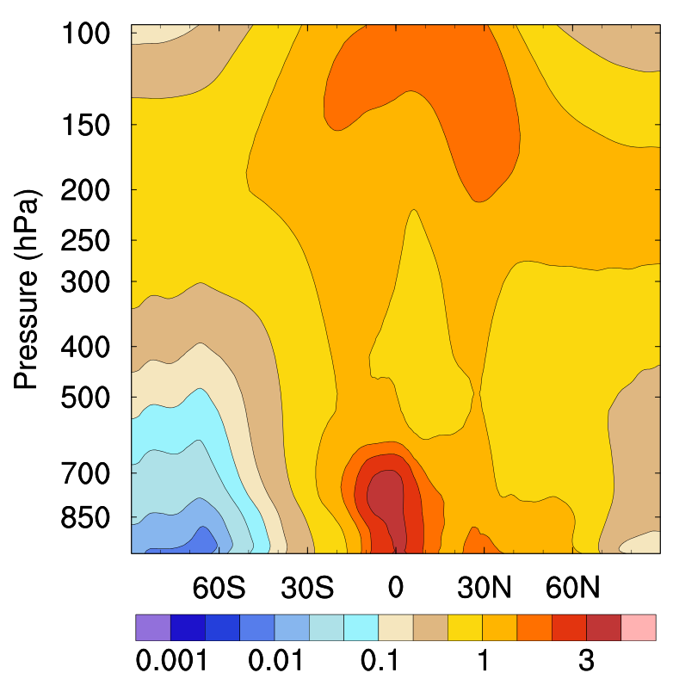
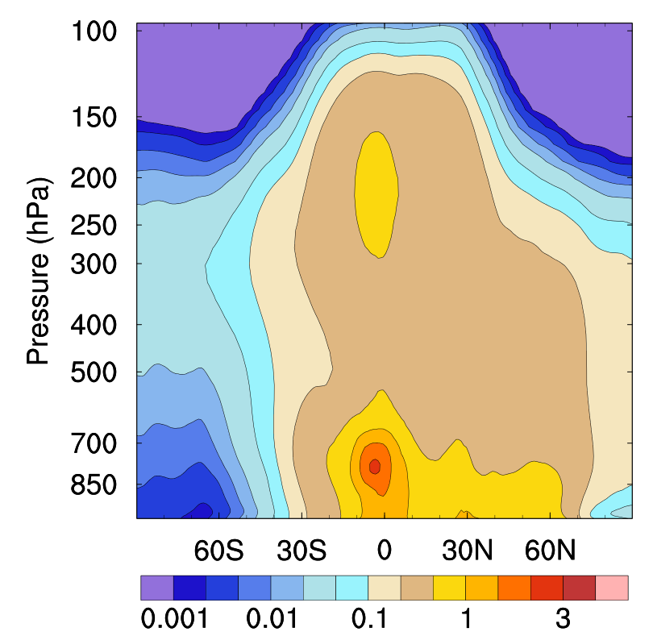
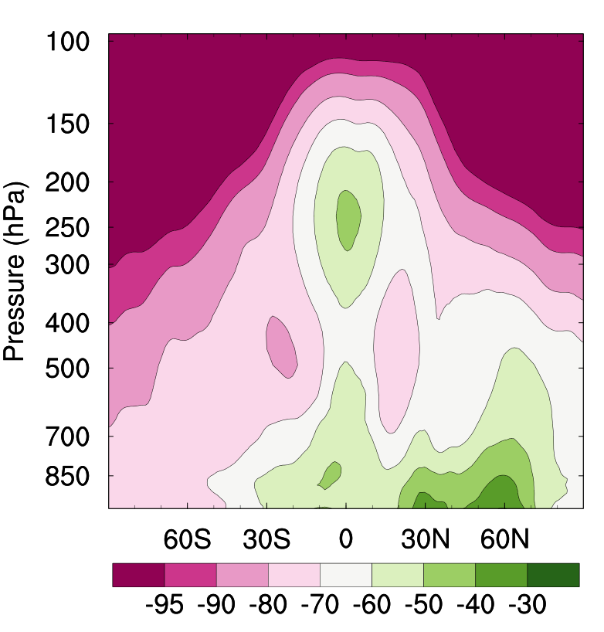

Photolysis is an important sink of SOA needed to explain aircraft measurements mainly above 5km altitude
Observed
Photolysis ON
Photolysis OFF
(a) Photolysis OFF
(b) Photolysis ON
(c) (b – a)/ a $×$ 100%
Southern Ocean
Lou, Shrivastava et al. 2020, JAMES
Including photolysis improves simulated SOA vertical profiles significantly compared to Atom2016 aircraft measurements
At high altitudes (above 5 km), wet removal is not efficient
Photolysis is needed to explain observations at high altitudes

Slide 13
Photolysis decreases CCN more strongly at high altitudes
(a) Photolysis off
(b) Photolysis on
(b-a)/a x100 %
Lou, Shrivastava et al. 2020, JAMES
Photolysis decreases CCN concentrations by 10-30% near surface and 50-70% at high altitudes

Slide 14
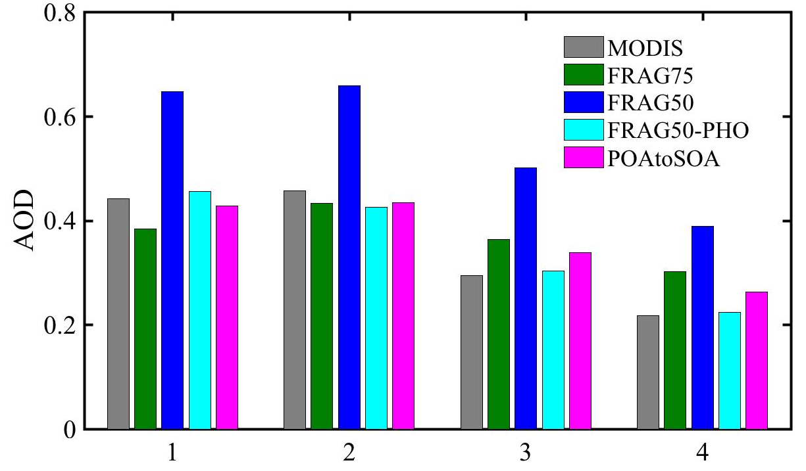
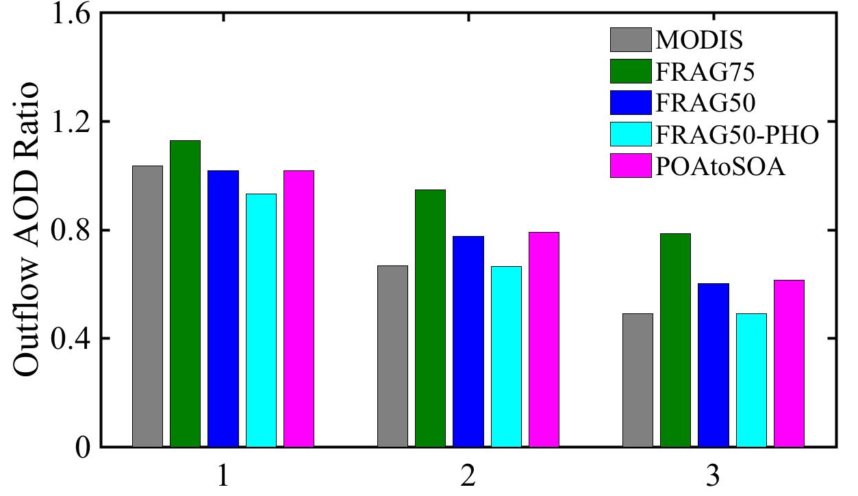
Satellite AOD over African biomass burning outflow dominated by organic aerosols: SOA model evaluation
Absolute AOD
Stronger SOA source (low fragmentation) and a strong sink (photolysis) needed to explain both absolute AOD and Outflow/Source AOD ratios
Outflow AOD/Source region AOD ratio
Lower fragmentation and photolysis of SOA agrees best with MODIS

Slide 15
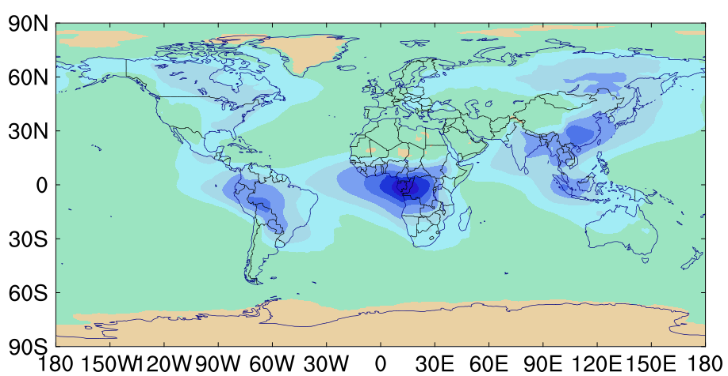
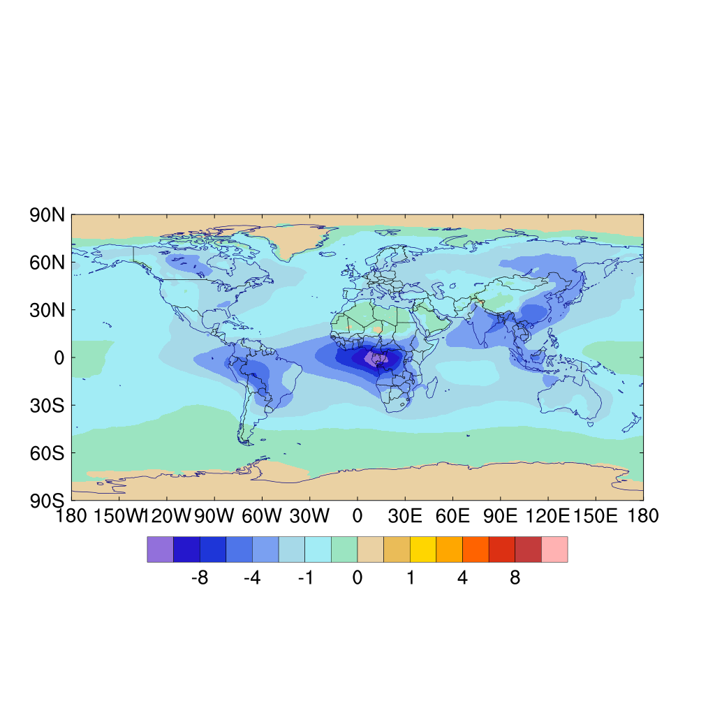
Simulated SOA direct radiative forcing at the top of atmosphere
DRE= -0.67 W m-2)
IPCC radiative forcing of organic carbon is (-0.3 W m⁻²)
IPCC estimates do not include SOA
This study: DRE (radiation diagnostics in PD) for SOA alone is -0.67 W m⁻²
DRF of SOA (PD-PI) with photolysis is -0.1 W m⁻²
DRF of SOA when photolysis is turned off is -0.4 W m⁻²
Photolysis decreases DRF of SOA by a factor of 4
-10 -8 -6 -4 -2 -1 -0.5 0
Lou, Shrivastava et al. 2020, JAMES

Slide 16
Key Takeaways and Modeling Implications
We developed a computationally efficient framework that enables explicit coupling of SOA processes with energy and land use changes
Both stronger SOA sources (functionalization) and stronger sinks (photolysis) needed to explain SOA distributions
Vertical profiles of SOA measured by aircraft are key to constraining SOA processes in models
Satellite AOD in regions dominated by biomass burning provides valuable constraints
PD-PI effective radiative forcing of SOA decreases by a factor of four from -0.4 to -0.1 W m⁻² when we include the photolysis of SOA
Accurately representing key SOA chemical processes in global models is essential for understanding their interactions with clouds and radiative forcing

Slide 17
Ongoing and Potential Future Developments
Currently ongoing as part of NGD atmospheric physics: Coupling new SOA treatments to E3SM-MOSAIC that includes nitrate aerosols in addition to sulfate
Other Potential developments (depending on support/approval):
Include the treatment of phase state of SOA (solid, liquid, glassy)
Phase state affects both SOA formation and cloud microphysical properties, not included in current models
Represent interactions between sulfate and SOA chemistry in aqueous aerosols and clouds
Treat light absorbing components of SOA (brown carbon) and evaluate their role in aerosol-radiation and aerosol-cloud interactions

