Slide 1
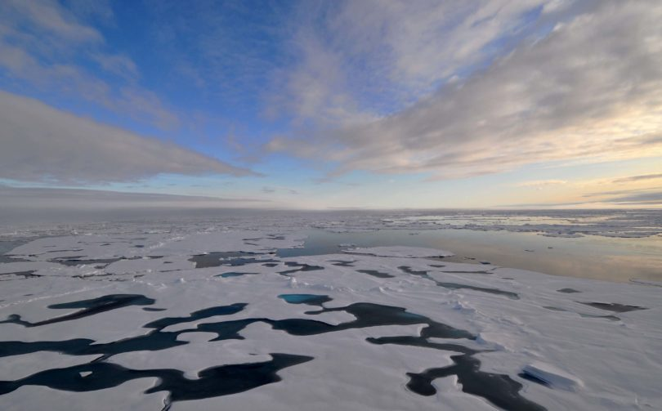

Antarctic dense water formation in coastal
and open-ocean polynyas in E3SM-HR
Hyein Jeong*, A. Turner, A. Roberts, M. Veneziani, S. Price, X. Asay-Davis,
L. Van Roekel, W. Lin, P. Caldwell, J. Wolfe, and A. Mametjanov
*now at Hanyang University, South Korea
(manuscript to be submitted to The Cryosphere)
Notes:
I’m going to present this work on behalf of Heyin Jeong who used to be a postdoc at LANL until approximately a year ago, when she moved back to South Korea working as a researcher at Hanyang University. This is part of a manuscript that is ready to be submitted to The Cryosphere journal, and listed here are all the co-authors of that paper.

Slide 2
Polynyas
Areas of open water (or very thin sea-ice) surrounded by the winter ice pack (and the coast in the case of coastal polynyas)
Important for:
  dense and bottom water formation
  carbon sequestration
  biological production
2/17
Notes:
So what exactly are polynyas and why we care about them. Polynyas are areas of open water or very thin sea-ice surrounded by the winter ice pack on all sides, in the case of open ocean polynyas, and by winter ice on one side and the coast on the other side, in the case of coastal polynyas. This is a picture from an older paper by Arrigo and Van Dijken that shows the location of 37 coastal polynyas around the Antarctic continent, to which I have added the location of 3 open ocean polynyas: the Weddell and Maud Rise polynyas in the Weddell Sea and the Cosmonaut polynya in east antarctica. Polynyas are important for…..

Slide 3
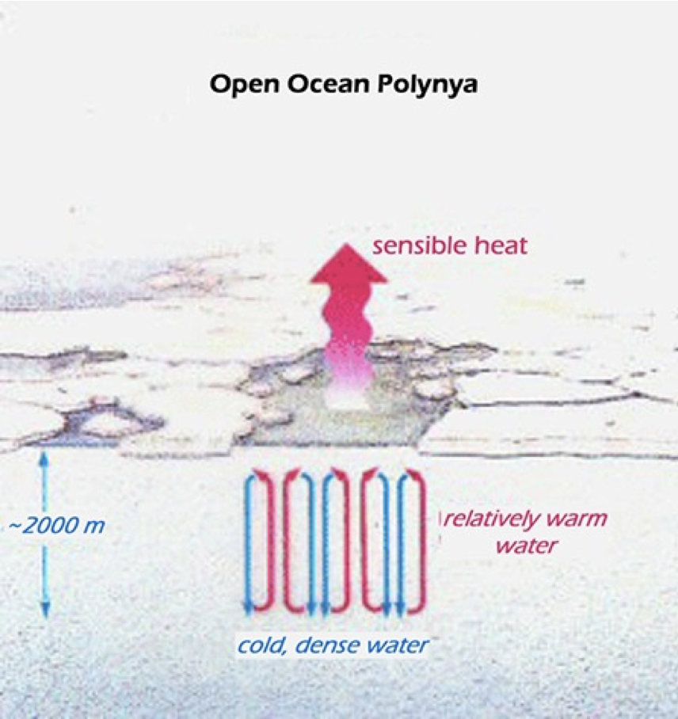
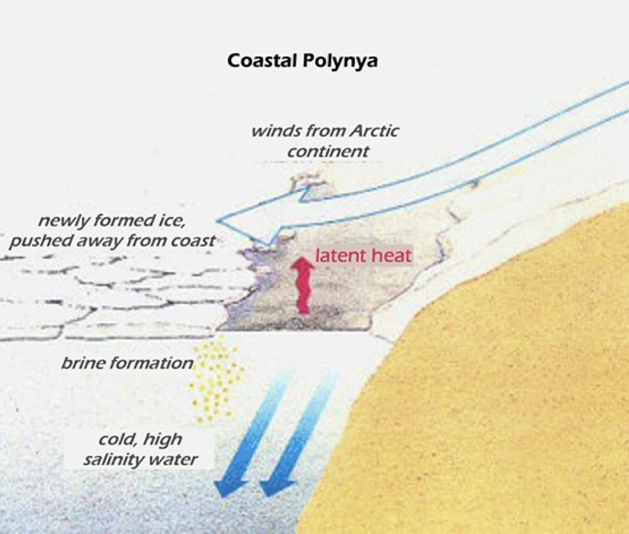
3/17
Notes:
What are the processes behind polynya formation? Coastal polynyas are atmosphere-driven: typically, burst of strong katabic winds off of the continent push sea-ice offshore, making the ice-free area near the coast continuously available for sea-ice formation ➔ continuous brine rejection, strong exchanges of latent heat fluxes with the atmosphere and formation of cold, very saline waters (Antarctic Bottom Waters).
Open ocean polynyas are driven by the ocean rather than the atmosphere: there is typically a convection process within the water column that brings relatively warmer and saltier waters towards the surface. The saltier/densier water at the surface creates a positive feedback, sea-ice forms around this area of deep convection and the ocean transfers sensible heat with the atmosphere.

Slide 4
Outline
How coastal and open ocean polynyas are represented in E3SM-HR (and E3SM-LR)
Dense and bottom water formation associated with the modeled polynyas in E3SM-HR
Some conclusions
4/17

Slide 5
Coastal polynyas
Characterized by areas at the coast with strong katabatic winds and high latent heat flux loss to the atmosphere
Prominent sea ice production and well represented sea ice volume in coastal polynyas
5/17
Notes:
Coastal polynyas in E3SM-HR. Upper panel shows latent heat flux exchange in color and surface wind streamlines from an annual average of model results, second panel shows mean sea ice production in m/year during the freezing season: you can see the polynyas signal.
Third panel is a comparison of accumulated sea ice volume in coastal polynyas between the model (pink curve) and a satellite observational product (grey line). You can see that polynyas form in the right locations, coinciding with regions of strong katabatic winds coming down the Antarctic continent and of high latent heat flux loss to the atmosphere. Polynya sea ice production is generally in good agreement with observations, aside from a few cases when we underestimate sea ice formation in the model.

Slide 6
Accumulated sea ice volume in each polynya for E3SM-HR E3SM-LR and obs
E3SM-LR shows very little polynya area or accumulated sea ice volume over the 13 coastal polynyas
Big improvement in E3SM-HR, with remaining differences likely due to impact of land-fast sea-ice, which is not (yet) reproduced in the model
6/17
Notes:
We can see this more clearly here, where accumulated sea ice volume vs total polynya area is plotted for each signle costal polynya using E3SM-HR data (red dots), E3SM low-resolution data (blue dots) and observations (grey dots). In most cases the HR simulation does a much better job, while in some other cases there is not much difference between the HR and LR simulations, and these comprise the polynyas that form against land fast ice rather then the continent.
Mean coastal polynya area and accumulated sea ice volume during the March to October freezing season for each of the 13 polynyas.

Slide 7
Open ocean polynyas
In E3SM-HR, OOPs occur frequently (18 of the 30 total simulation years)
Various types of OOPs: Maud Rise, Weddell Sea, and ‘Embayments’
Similarly to other models, once an OOP occurs, it tends to re-occur in subsequent years because of the ventilation of salty/high density waters
7/17

Slide 8
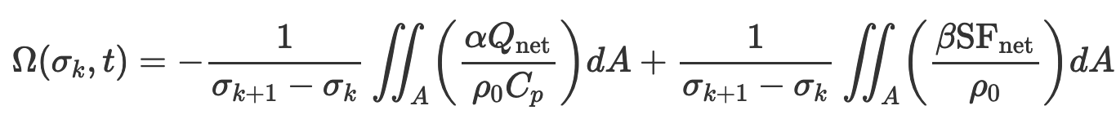
Deep and bottom water formation
Water Mass Transformation from surface fluxes analysis
Heat flux exchange with the atmosphere
WMT (Sv)
How much water is transformed from density 𝞂_{k} to 𝞂_{k+1} due to surface fluxes
Freshwater flux exchange with the atmosphere and due to sea-ice melting/forming
Density bin
8/17
Notes:
Thirty-year mean WMT rate during freezing season simulated by E3SM-HR. Strong positive WMT rate in latitude and longitude space. High-density transformation rate at 28.2 kgm⁻³ neutral density level in E3SM-HR is entirely due to WMT over the Weddell Sea, rather than on the continental shelf. Releasing Surface heat flux from the ocean to the atmosphere contribute the high density transformation rate.

Slide 9
Deep and bottom water formation
Water Mass Transformation from surface fluxes analysis
Upper CDW
Lower CDW
& AABW
Surface & Mode Waters
AAIW
9/17
Notes:
Thirty-year mean WMT rate during freezing season simulated by E3SM-HR. Strong positive WMT rate in latitude and longitude space. High-density transformation rate at 28.2 kgm⁻³ neutral density level in E3SM-HR is entirely due to WMT over the Weddell Sea, rather than on the continental shelf. Releasing Surface heat flux from the ocean to the atmosphere contribute the high density transformation rate.
To summarize:
1) AABW is formed in OOPs mostly because of heat loss to the atmosphere (with some sea ice melting contribution); heat loss in these region is also mostly responsible for the formation of upper CDW;
2) No bottom water is formed on the shelf; instead sea ice formation (brine rejection) is responsible for the formation of upper CDW and intermediate waters on the shelf.

Slide 10
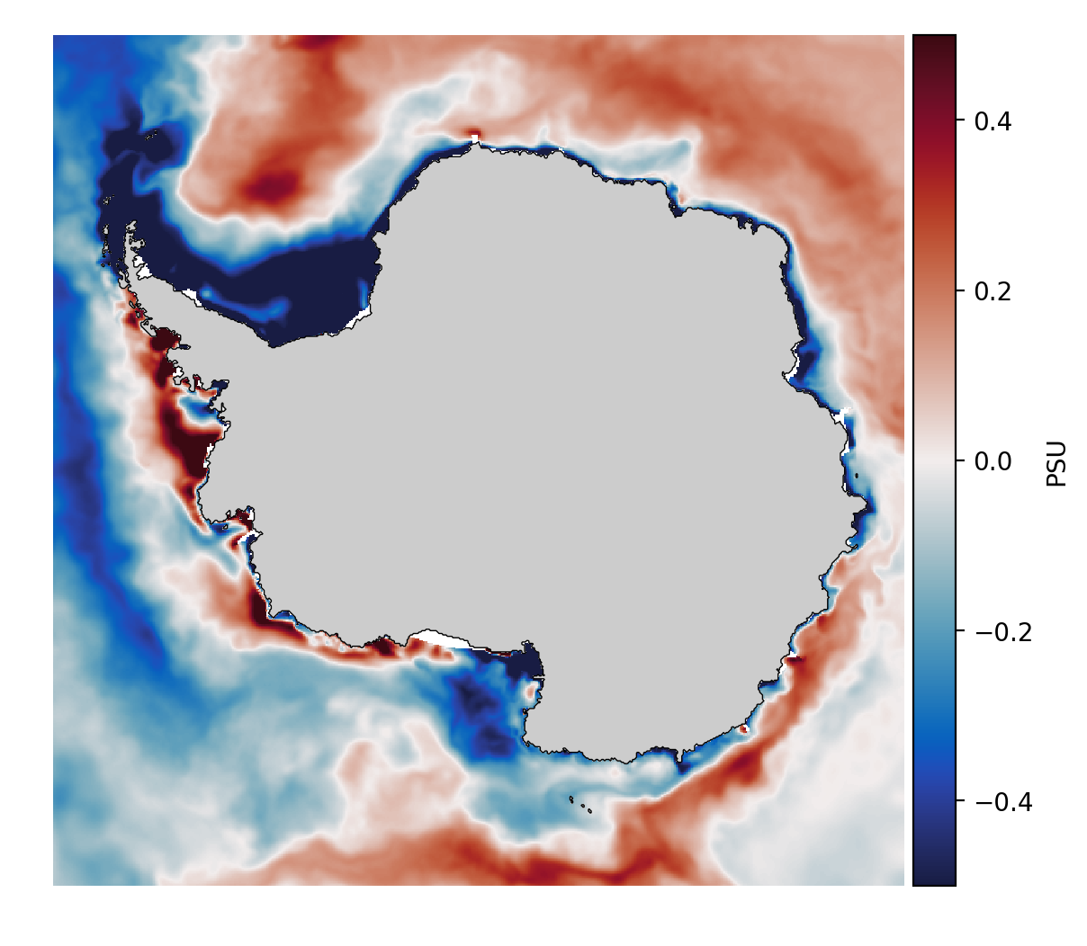
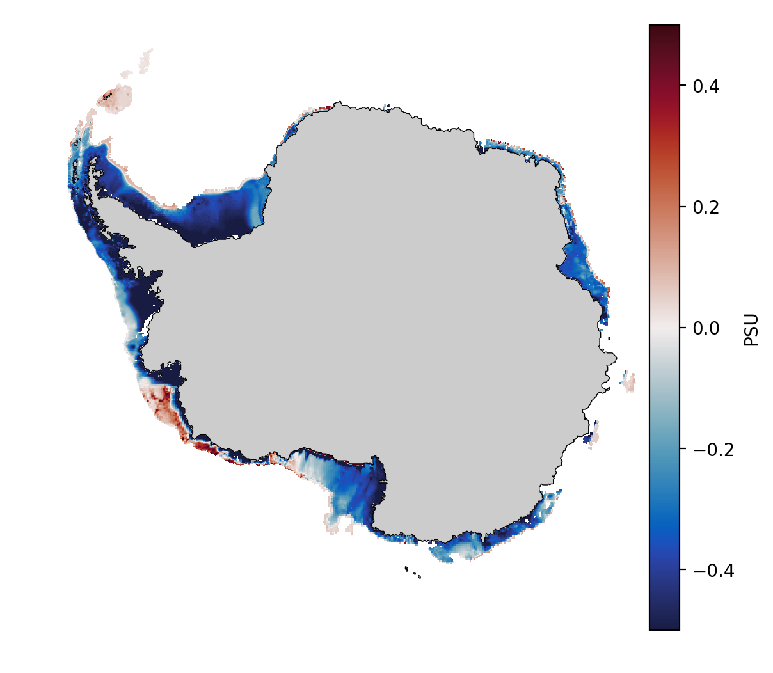
Water formation in OOP regions behaves as expected
But why doesn’t dense bottom water form in coastal polynyas?
  A look at hydrography/stratification on the shelf
SSS (annual)
model-SOSE
Sea Floor S (annual)
model-Schmidtko_obs
Ambient shelf water is too fresh/buoyant
10/17

Slide 11
Possible reason for fresh shelf
11/17
Notes:
The model tends to be fresher and slightly colder than observations at the surface in winter, spring and fall. The largest discrepancies with WOA18 climatology is found in summer when SSS is ~1.2 psu fresher than WOA18 values.

Slide 12
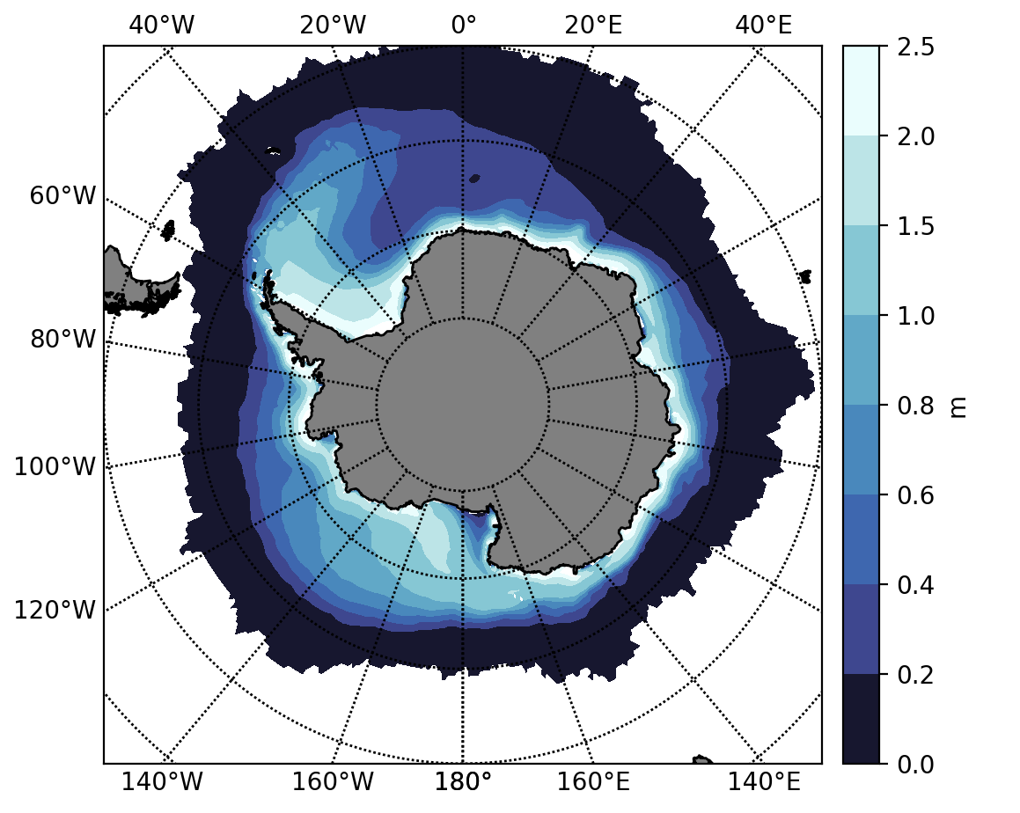
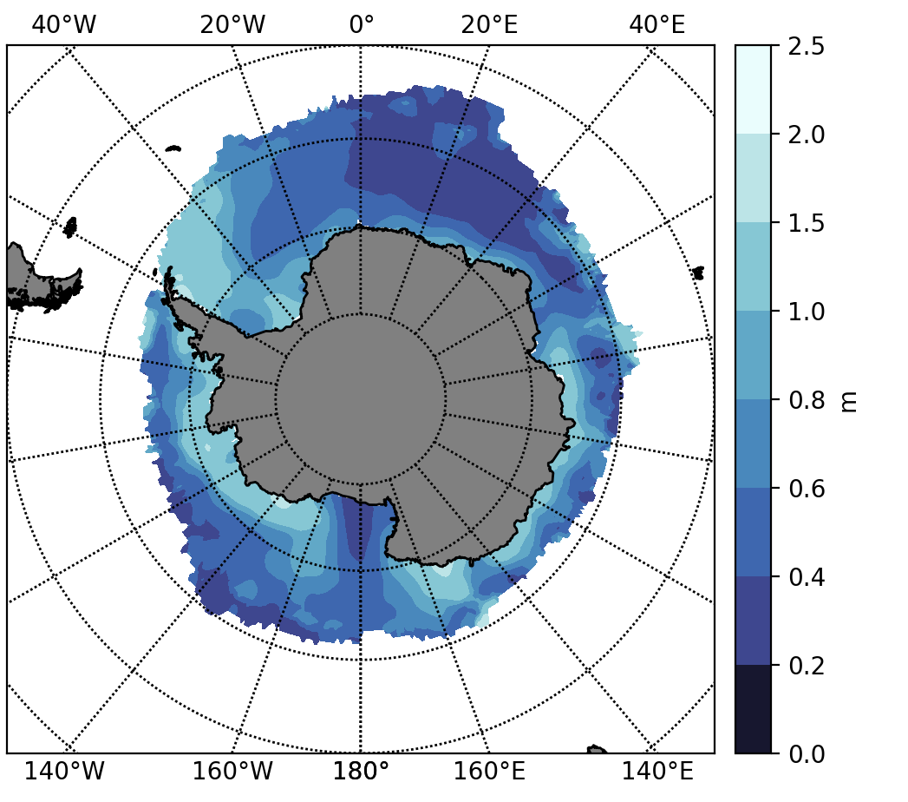
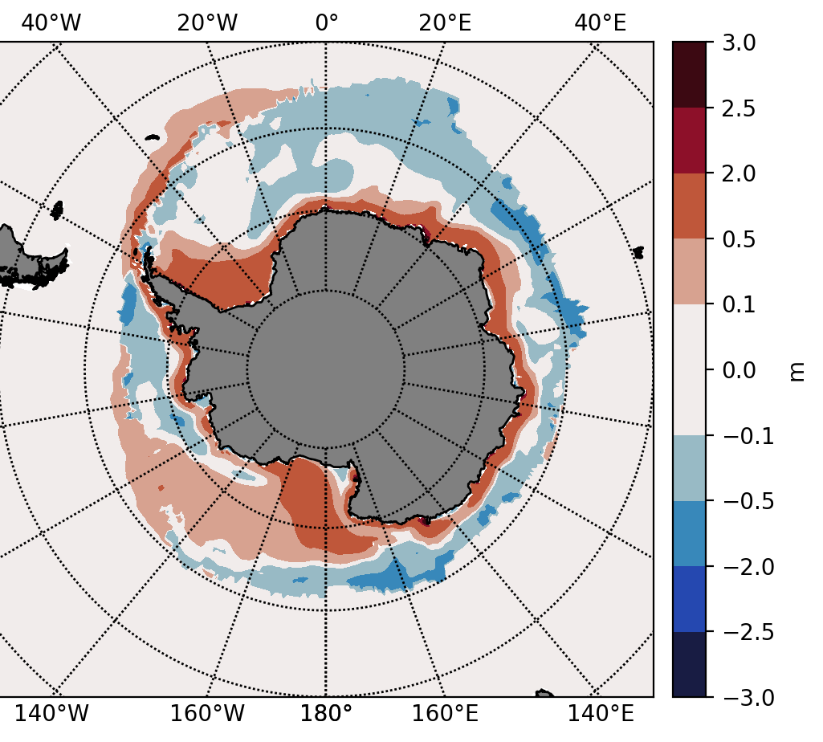
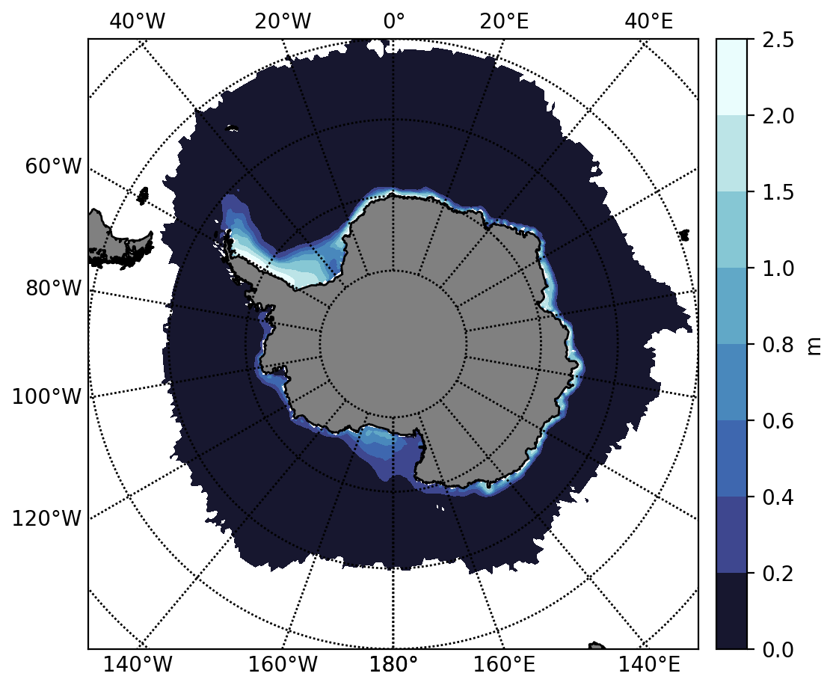
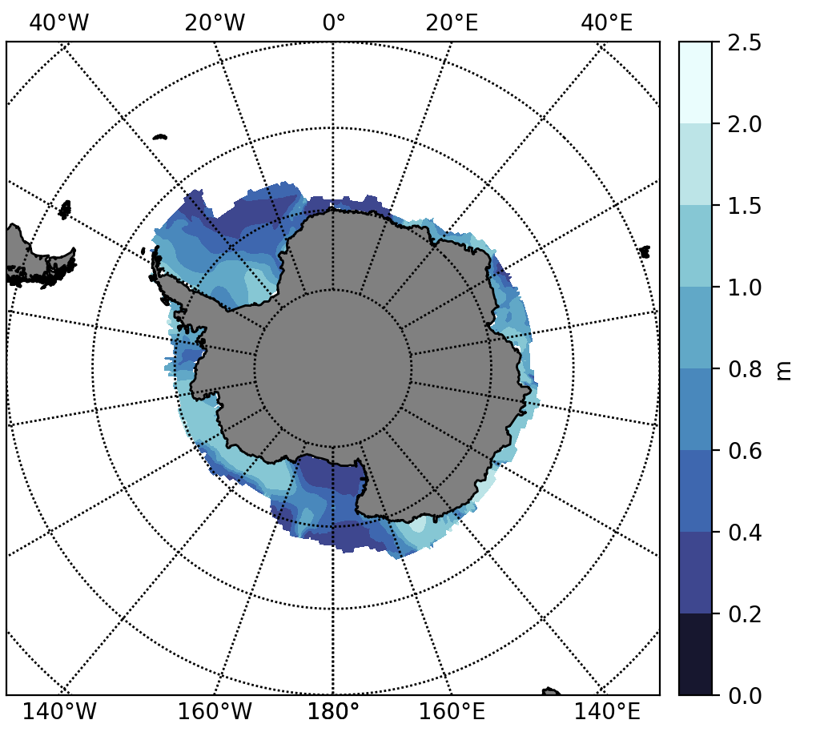
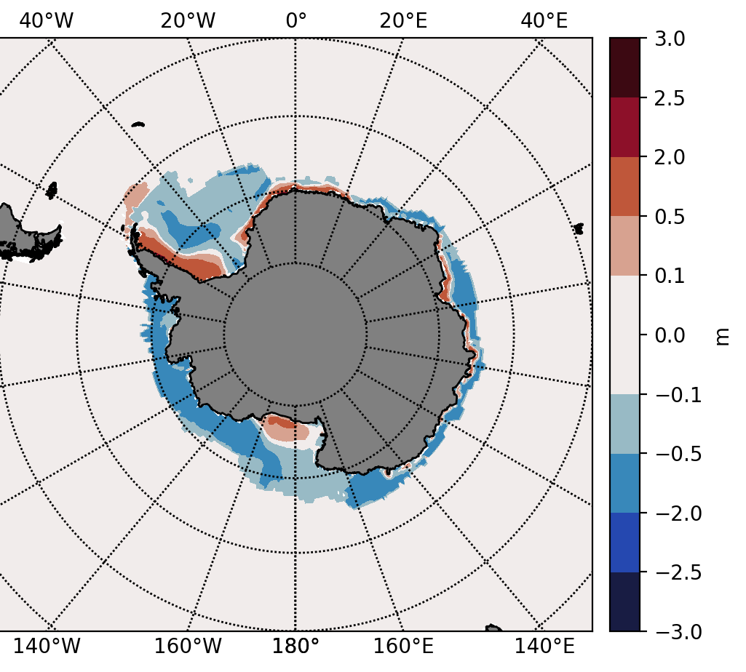
Sea-ice thickness
Oct-Nov (late winter/early spring)
E3SM-HR
Obs (IceSat)
Model-Obs
Feb-Mar (late summer)
12/17
Notes:
E3SM-HR’s simulated sea ice extent (SIE) is much less than that from SOSE
However, sea ice volume (SIV) is similar or even slightly larger than SOSE’s SIV
This is likely the result of sea ice build up on the continental shelf in E3SM-HR: enhanced poleward surface Ekman transport prevents sea ice from moving to lower latitudes

Slide 13
  A look at surface winds
E3SM-HR has stronger surface winds than ERA5, not only along the Antarctic continental shelf, but also in the interior Southern Ocean
13/17
Notes:
Annual mean atmospheric winds from ERA5 and E3SM-HR, Annual mean sea-surface ocean currents from SOSE and E3SM-HR.

Slide 14
Possible consequences of strong surface zonal winds
Weddell gyre circulation intensified ➔ conductive to formation of OOPs
Enhanced Ekman transport from the stronger polar easterlies could push sea-ice against the coast
Formation of strong Antarctic Slope Current (ASC)
14/17
Notes:
Annual mean atmospheric winds from ERA5 and E3SM-HR, Annual mean sea-surface ocean currents from SOSE and E3SM-HR.

Slide 15
Dense-shelf type
(35ºW meridional section)
Zonal winds are stronger than ERA5 just off the shelf, producing a strong ASC (Note: burst of katabatic winds are not represented in annual average of meridional winds shown here)
“V-shaped” isohaline (constant-salinity) contours barely visible in SOSE and absent in E3SM-HR
This is again indicative of a missing high-salinity dense water mass on the shelf
15/17
Notes:
Dense-shelf ASC simulated by E3SM-HR

Slide 16
Some conclusions
E3SM-HR is able to reproduce the major Antarctic coastal polynyas and several occurrences of open-ocean polynyas in the Weddell Sea.
The densest water masses (AABW) are formed within the OOPs, rather that on the continental shelf within coastal polynya regions as is typically observed. We hypothesize that the biases in salinity on the shelf make the ambient waters too fresh to be transformed into dense waters. Excessive sea ice accumulated at the coast in key locations during winter may be responsible for the overly fresh shelf in spring and summer.
Overly strong atmospheric polar easterlies in the model also lead to a strong Antarctic Slope Front and possibly a Ekman transport against the coast that doesn’t favor sea ice movement offshore.
16/17

Slide 17
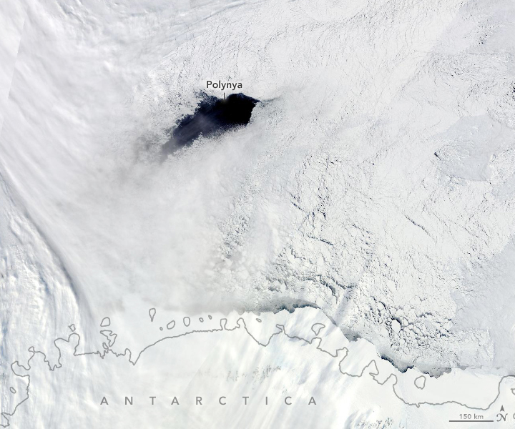
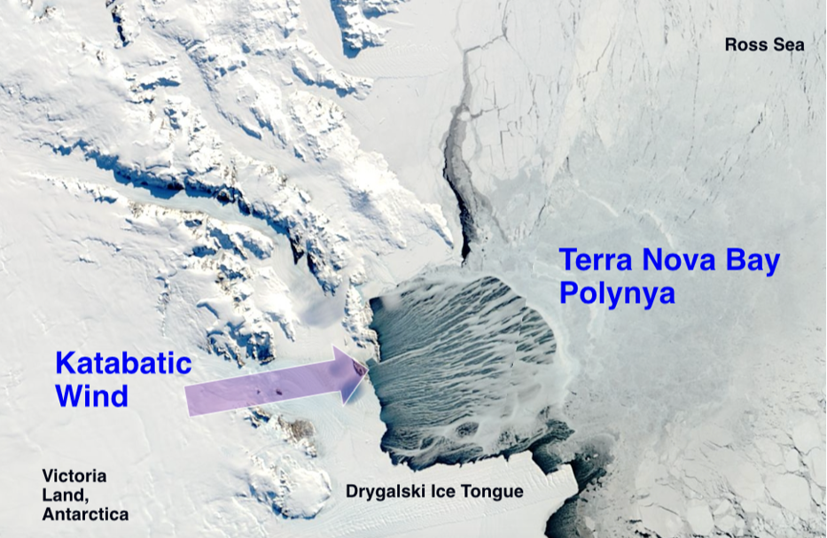
Professional animation made for the entry to the SuperComputing21 Scientific Visualization & Data Analytics Showcase by a team of LANL & U. of Texas at Austin scientists (Abram, Petersen, Samsel, Zeller, Conlon, Kurtakoti, Palmstrom, Patchett, Roberts)
Maud Rise Polynya
NASA Earth Observatory
Thank you
Image Credit: Lamont-Doherty Earth Observatory
17/17

Slide 18
Additional slides

Slide 19
Open-ocean polynyas
The 2017 Maud Rise Polynya
E3SM-LR does not exhibit OOPs at any point in the simulation
E3SM-HR does produce MRPs
Decreased sea ice concentration (SIC) in OOPs
Release of sensible heat from the ocean to the atmosphere, allowing for dense-water formation
Fig3. Observed and simulated OOPs

Slide 20
Fresh-shelf type (12ºW)
Fresh-shelf : Low salinity on the shelf and strong easterly winds at the coast and offshore
E3SM-HR simulates an ASC that is almost twice as strong as that simulated by SOSE
The stronger ASC is associated with easterly winds that are 2ms⁻¹ stronger than in ERA5
Fig7. Fresh-shelf ASC simulated by E3SM-HR

Slide 21
Warm-shelf type (72ºW)
Warm-shelf : slightly upward sloping isopycnals, which enable easier onshore transport of warm, intermediate depth CDW
E3SM-HR shows more similar to the fresh-shelf type, with downward tilted isohalines and a weak westward flowing ASC at the shelf break
Possibly related to model easterly winds that are twice as strong as those in ERA5
Fig9. Warm-shelf ASC simulated by E3SM-HR

Slide 22
Hydrographic characteristics
: Weddell Sea
Hydrographic characteristics by comparing OOPs and non-OOP years
In OOP years compared to non-OOP, warm and saline deep water masses are transported to the upper ocean, causing further heat transfer to the atmosphere from the ocean surface
The air-sea interaction in the OOP cools the ocean surface and this cold surface water sinks toward the deep ocean via deep convection
Fig12. Hydrographic characteristics on Weddell Sea

Slide 23
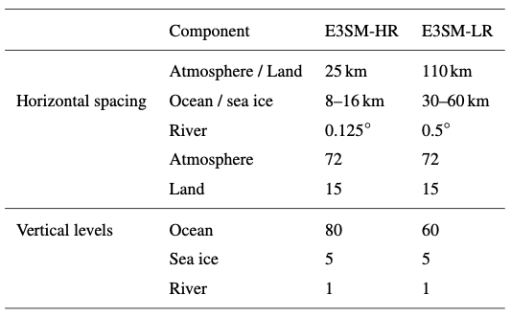
Data and methodology
E3SM-HR and E3SM-LR
Table 1. Horizontal and vertical resolution of E3SM-HR and E3SM-LR.

Slide 24
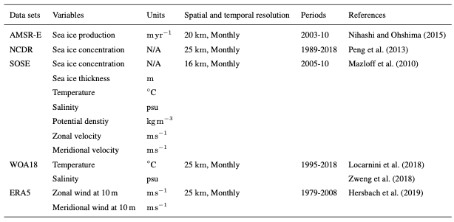
Data and methodology
Atmosphere, ocean, and sea ice state estimates
Table 2. Atmosphere, ocean, and sea ice state estimation datasets.

