Slide 1

ELM-FATES Updates: Impacts of dynamic vegetation and plant demography in E3SM
July 22st, 2021
Jennifer Holm, Ryan Knox, FATES Modeling team
E3SM All Hands Meeting

Slide 2
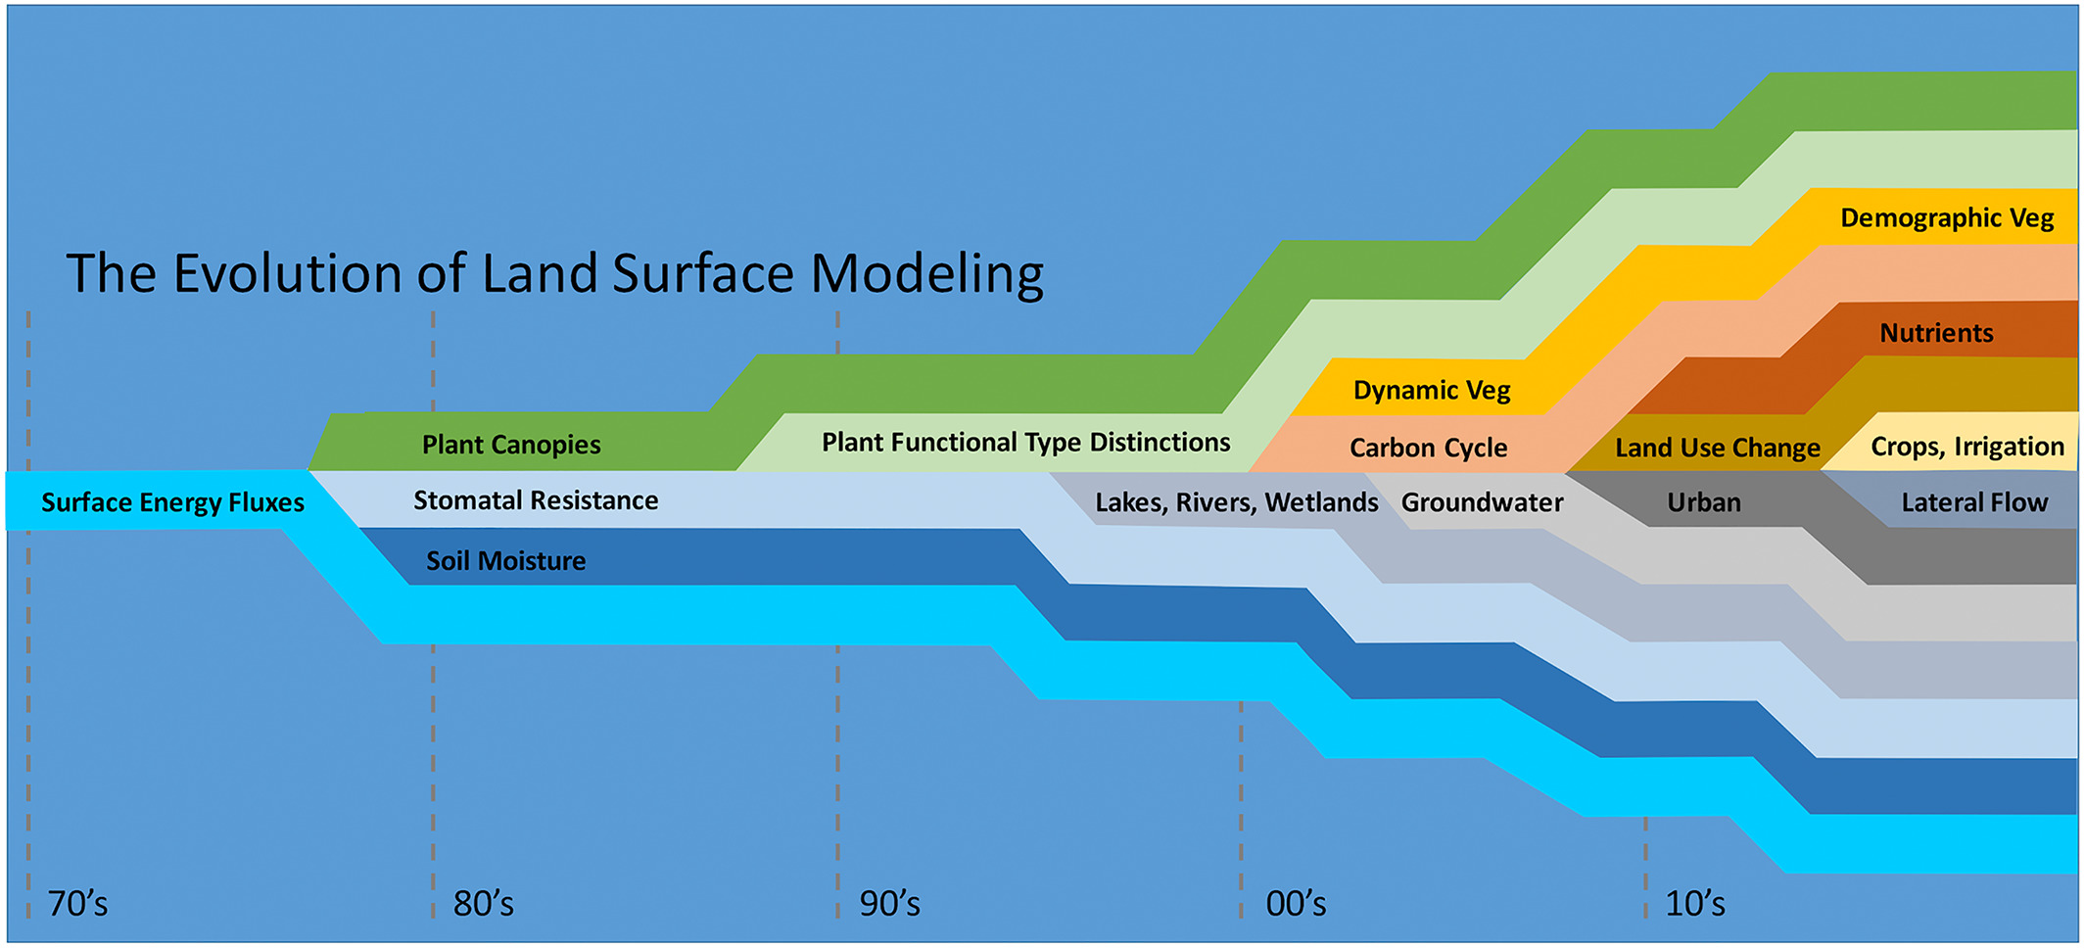

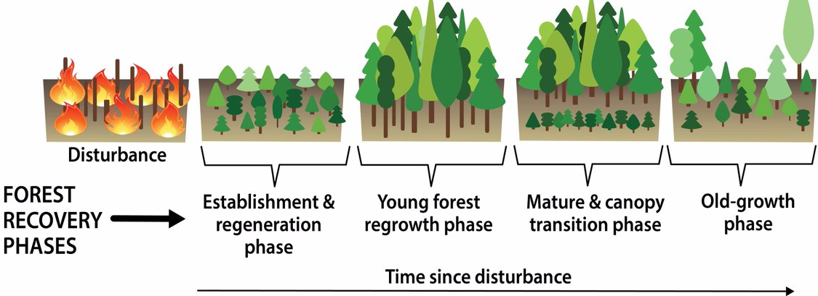
Fisher and Koven, 2020
“Big Leaf” Model (sunlit and shaded leaf)
vs.
Notes:
Absence of “gaps” and disturbance processes in big-leaf models. Therefore inability for trees to regenerate under what would look like a closed canopy, no structure to the forest and canopy.

Slide 3
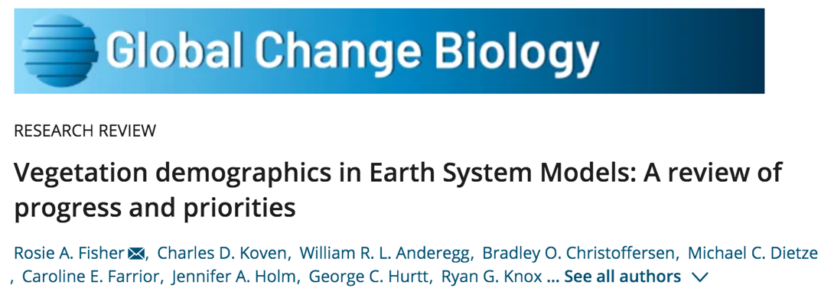
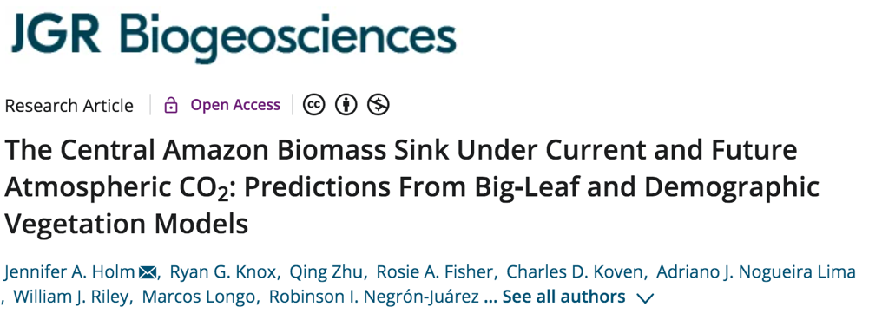
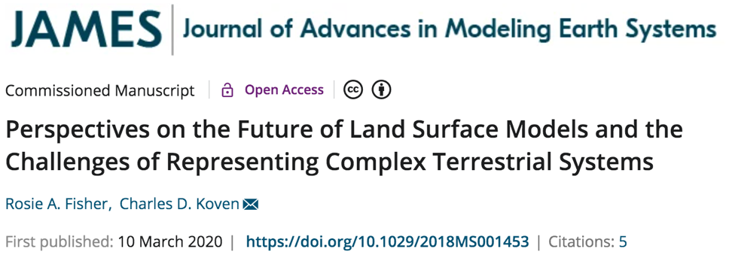

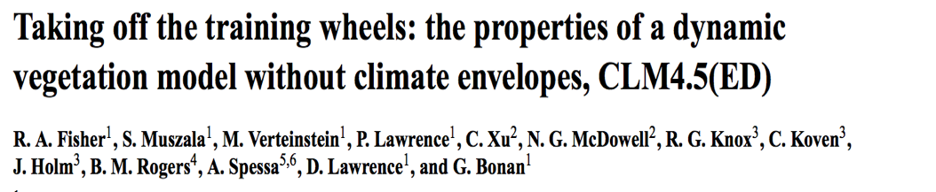
Motivation: Why have plant demography & dynamic vegetation?
“We demonstrate that VDMs are comparable to non-demographic (i.e., “big‐leaf”) models but also include finer scale demography and competition that can be evaluated against field observations.”
“Land surface processes mediate the majority of the impacts of climate on human societies and ecosystems, and accurate representation of land surface processes is critical for our understanding of how climate and climate change actually affect living systems.”
“A major motivation of this development is to allow the prediction of biome boundaries directly from plant physiological traits via their competitive interactions.”

Slide 4
ELM-FATES –> A Vegetation Demographic Model
(E3SM Land Model - Functionally Assembled Terrestrial Ecosystem Simulator)
FATES
Fast processes
ELM
Photosynthesis
Canopy radiation
Respiration
NPP
Hydraulics
Energy Balancing
Soil carbon, water
Soil biogeochemistry
Subsurface hydrology
Land use drivers
everything else
Slow processes
Physics and BGC Interface
Stem growth
Turnover
Carbon storage
Allometry
Cohort splitting
Supported by DOE’s NGEE-Tropics & E3SM
Fisher et al. 2015, Geosci. Model Dev.

Slide 5
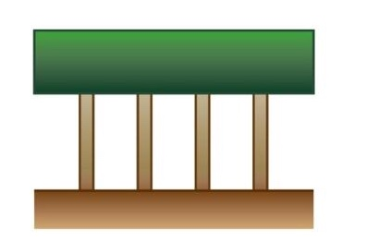

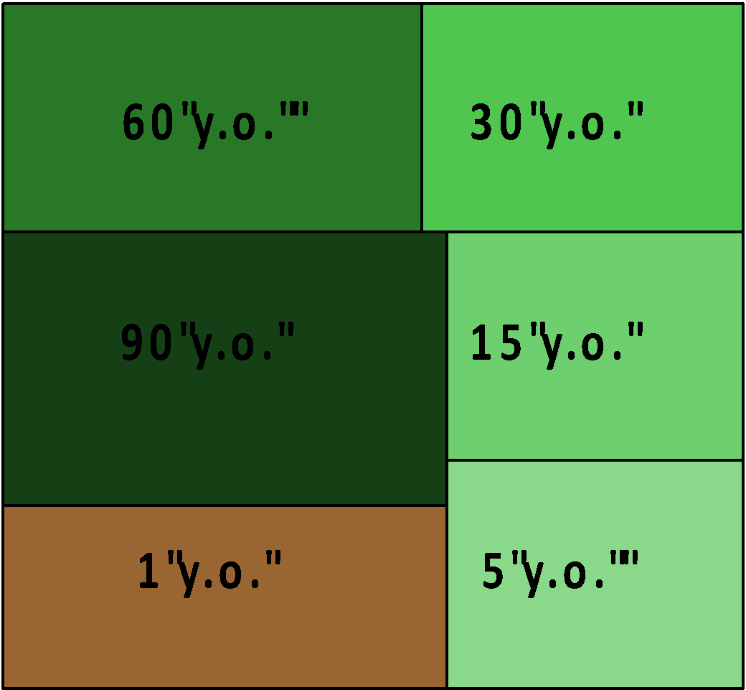
Benefits of ecosystem demography connected to global land models
ELM
ELM-FATES
Heterogeneity in light availability due to varying size and age structure of forest
Competition (for light, water, nutrients), exclusion & coexistence
“Big-Leaf” vegetation
“Cohort” Vegetation
Ecosystem based on different “cohorts” of vegetation, existing on multiple time-since-disturbance “patches”
Multiple Time-Since-Disturbance “Patches”
90 years
Recovery after Disturbance (fire, land use, mechanistic mortality)
5 years
1 year
Plant distribution emerges from trait filtering

Slide 6
“Modeling the Central Amazon forest carbon sink under rising CO₂”
Holm et al. 2020, JGR-Biogeosciences (E3SM special issue)
2 dynamic vegetation models
  ED2
  ELM-FATES
  Dynamic plant competition in a vertical light environment
  Mechanistic mortality, size and age structured
  Highly resolved demography
2 ‘big-leaf’, biogeochemical models
  CLM5 (N cycle)
  ELMv1-ECA (N & P cycle)
  Nutrient competition on plant growth
  Fixed mortality
  Coarse, unstructured vegetation
Quasi-factorial experimental design:

Slide 7
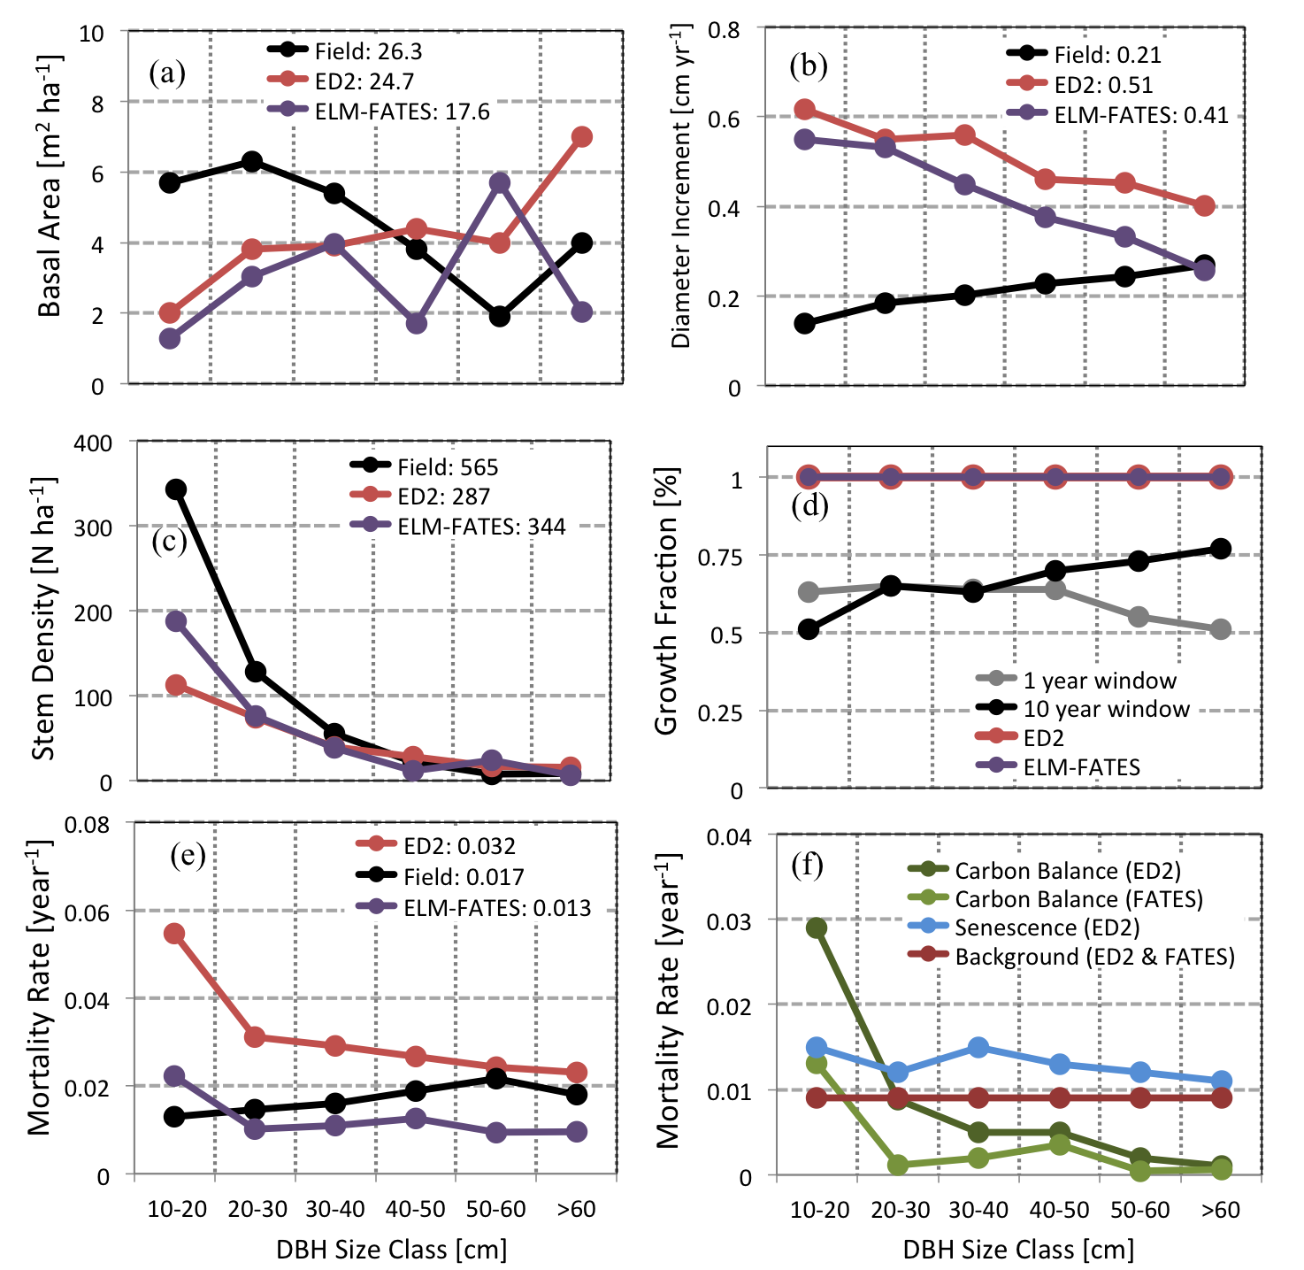
Long-term biomass response to rising CO₂ (out to 2100)
ED2 and ELM-FATES = large carbon sinks.
However C-only versions of big-leaf models similar or larger than VDMs.
  Vegetation demography and competition reduced this sink to more realistic predictions while including fine-scale demography.
ELMv1-ECA with P competition has lowest CO₂ response.
Challenge in capturing observed neutral biomass in ALL models. Continual increase in biomass accumulation.
Improvement in how plant mortality is modeled.
Δ Biomass [Mg ha⁻¹)
Holm et al. 2020 JGR-Biogeosciences
(See also Needham et al. 2020, GCB)
Notes:
Vegetation Demography Models are beneficial because they can be informed by census data.

Slide 8
Current carbon allocation (%)
Long-term change in C allocation with rising CO₂ (2100 minus 2000)
CLM5 C-only
VDMs have lower aboveground wood allocation, but much higher coarse root. Scaled with aboveground.
All models have low leaf allocation
ELMv1-ECA = forests are strongly P limited. Switch in allocation to fine roots.
Increase in NUE and PUE, due to continually increasing NPP.
Holm et al. 2020 JGR-Biogeosciences

Slide 9
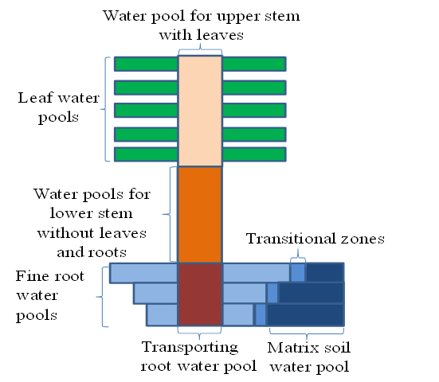
Land/Energy NGD: Plant Hydraulics
ELM-FATES Hydro Model
Introduction of continuous plant hydrodynamics while plants dynamically grow and compete in ELM-FATES.
Tracks water transport through new recruits, growth, and mortality of plants.
Testing of plant-ecosystem water balance, plant mortality due to water stress and hydraulic failure, and shifts in vegetation due to water availability.
Some current work (Yilin Fang): update from 1D to 2D Newton Solver to be able to solve all water fluxes, in multiple soil layers simultaneously.
Stomatal conductance
Water pools for lower stem & plant storage
Solve water fluxes in soil layers at the same time!
Soil layer 1
Soil layer 2
Soil layer 3

Slide 10
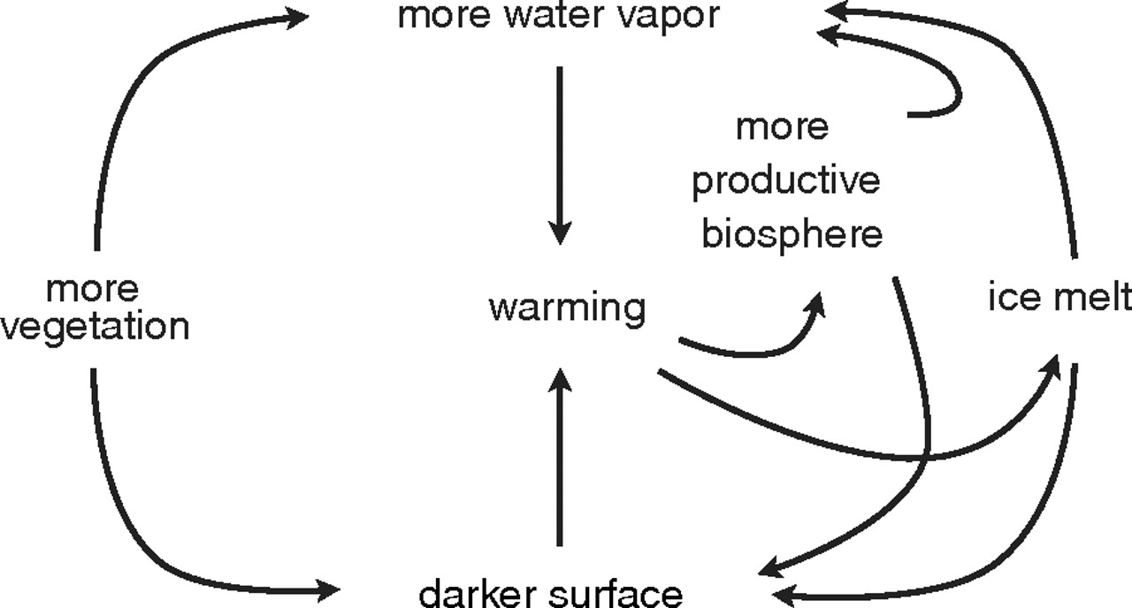
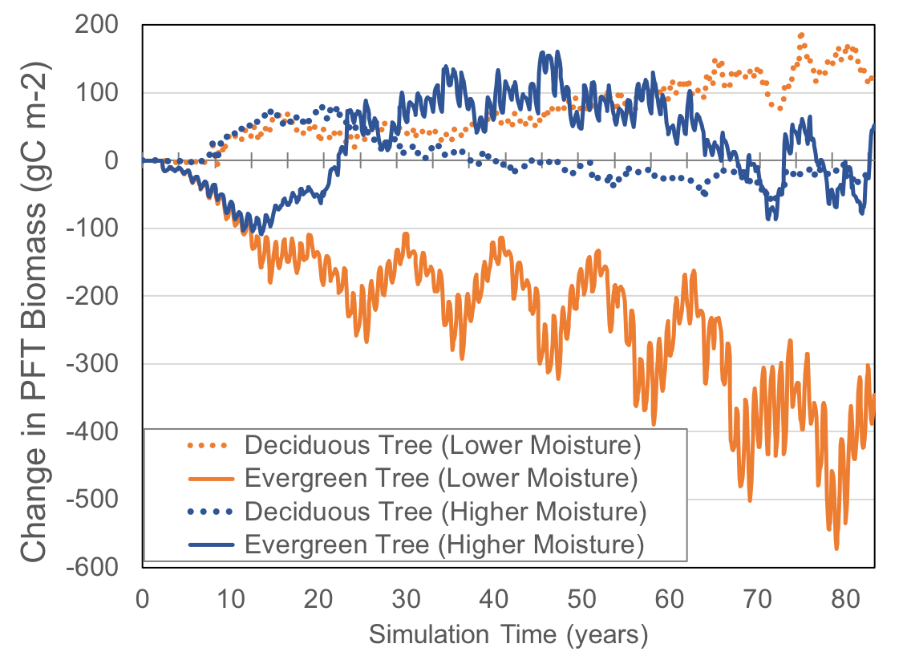
Land/Energy NGD: Plant Hydraulics
more water vapor
FATES-Hydro: Shift in vegetation type with +40% higher soil moisture (i.e. permafrost thawing) or -40% lower soil moisture scenarios (i.e. warming)
more productive biosphere
1) more vegetation
warming
ice melt
darker surface
(Swann et al. 2010)
Motivation:
Deciduous forest cover is expanding.
Leads to more water uptake, higher transpiration rates, and decrease in biomass.
Leads to land-climate feedbacks, and increased warming.
Successfully capturing decrease in evergreen trees and increase in deciduous trees with drying (orange) as seen in observations.
Over time increase in shrub biomass when plant hydraulics accounted for, even under both hydrology scenarios.
(Holm et al. in prep)

Slide 11
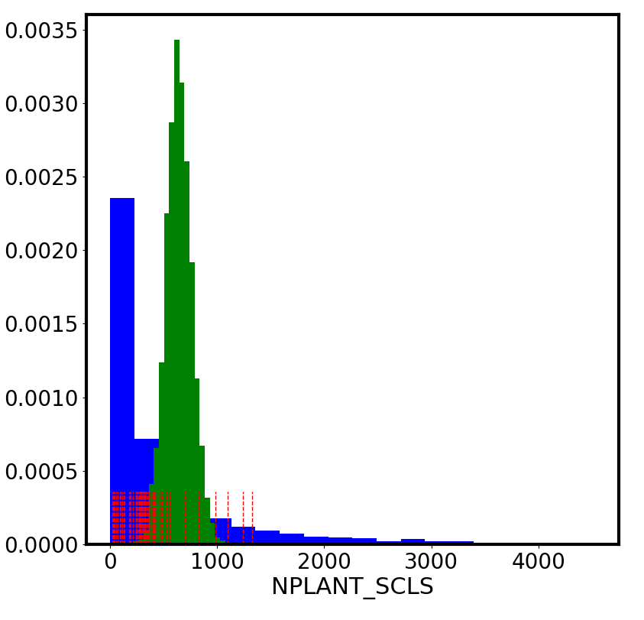
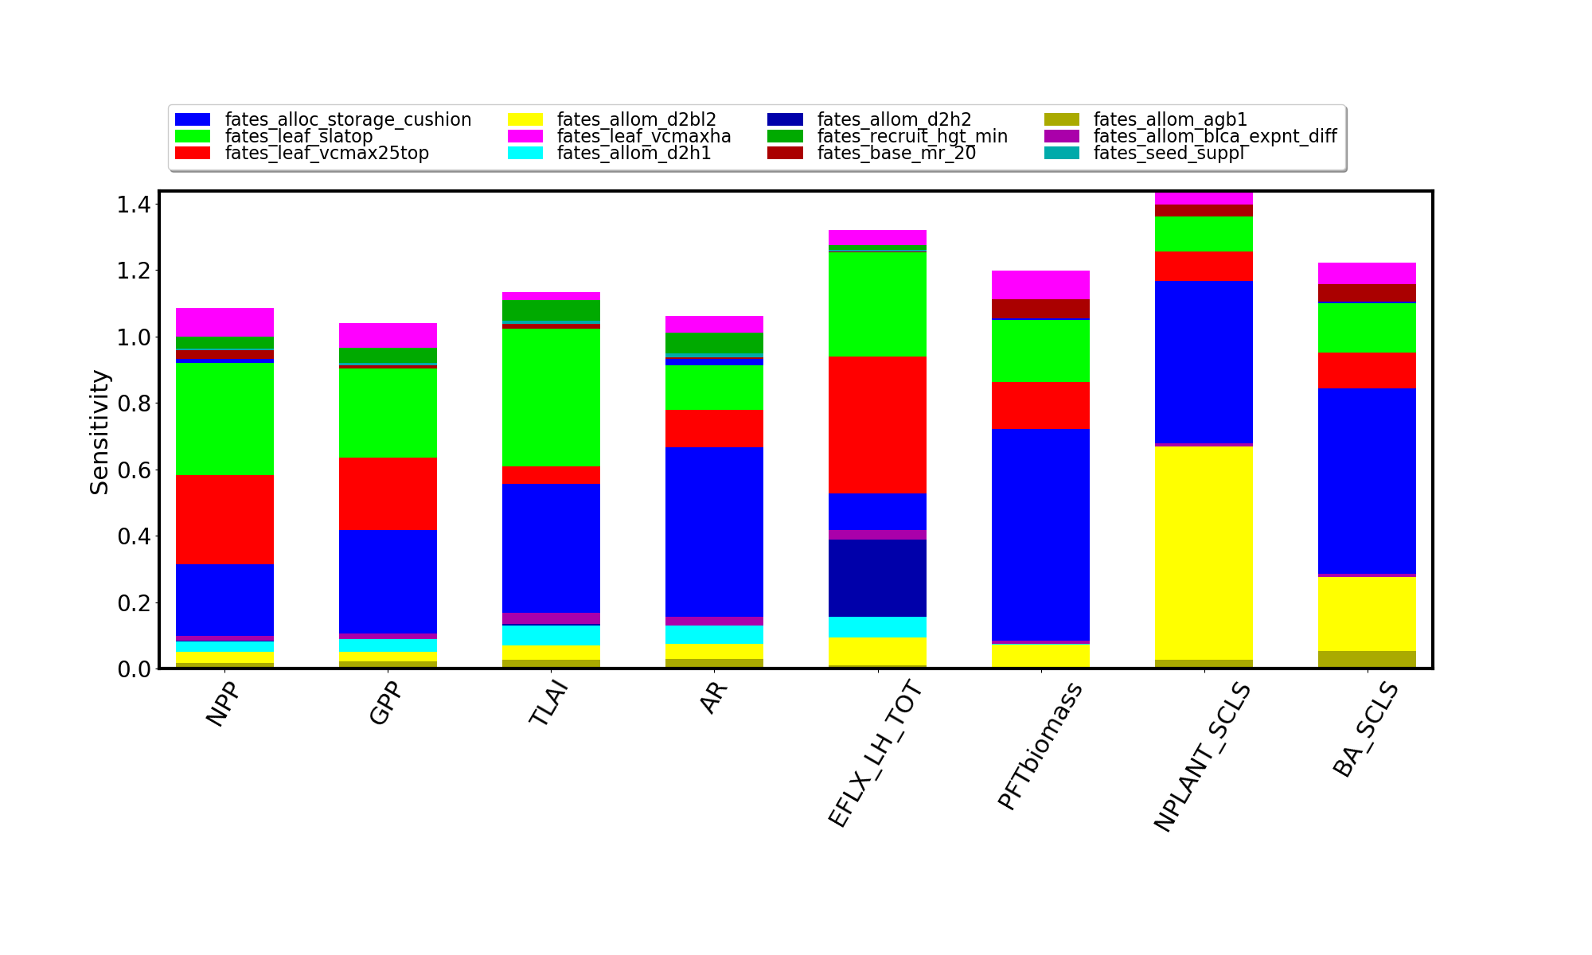
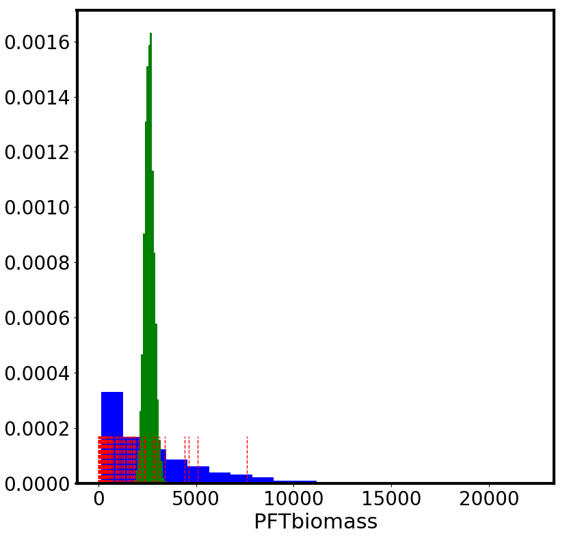
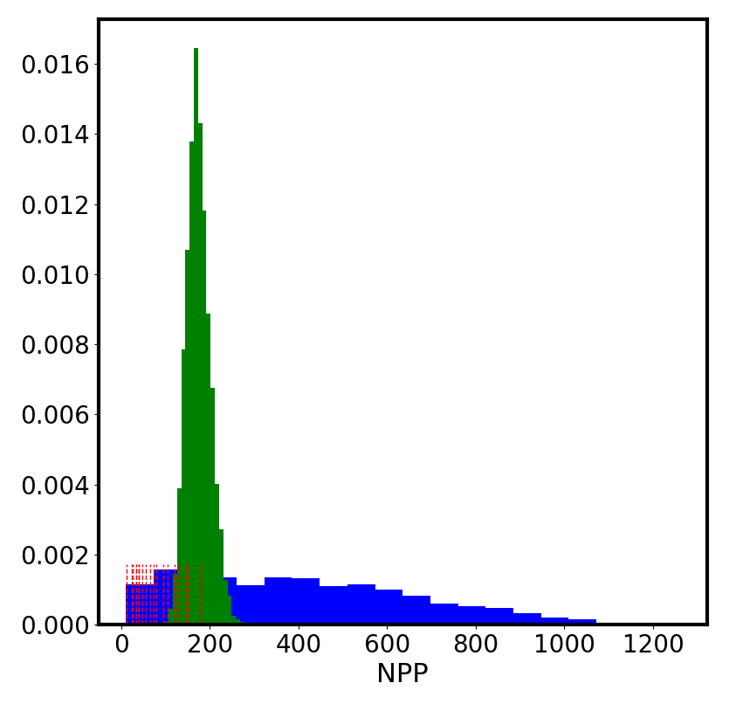
UQ and sensitivity analysis of FATES and PFT parameterization (Holm, Dan Ricciuto, Khachik Sargsyan)
Example of model calibration and UQ analysis for boreal forest conifer PFT
Top 12 parameters that contribute to the largest uncertainty in ELM-FATES results.
Red – field data
Blue – ELM-FATES ensemble results
Green – calibrated ELM-FATES results based on field data
Frequency
Number of stems (N ha-1)
Plant Biomass
Net Primary Productivity (gC/m2/yr)

Slide 12
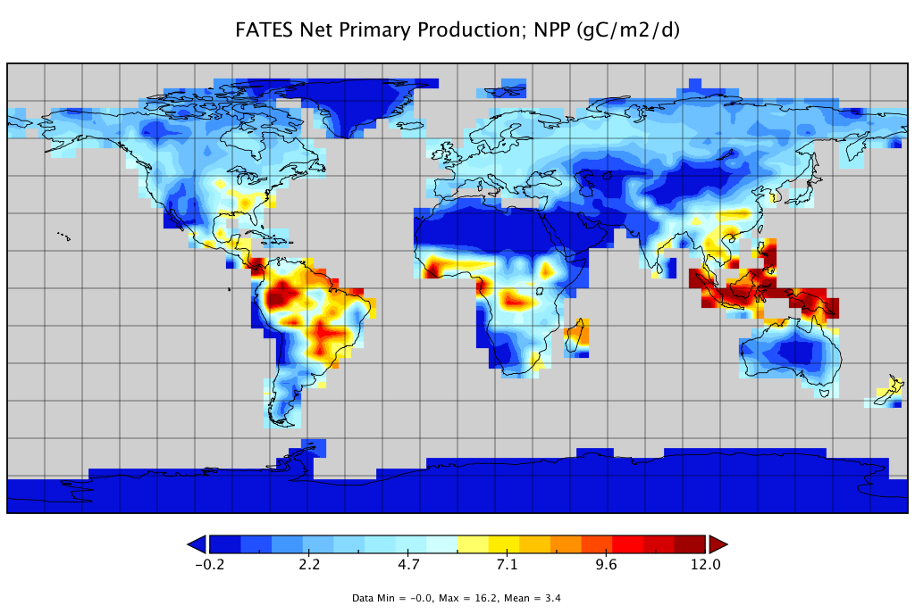
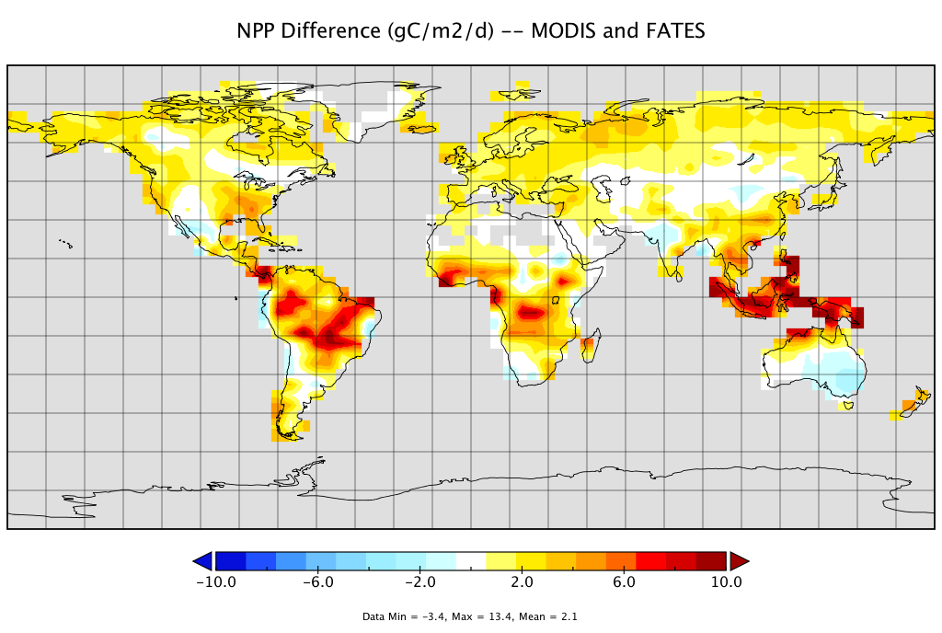
Net Primary Productivity ELM-FATES (gC m⁻² d⁻¹)
Global ELM-FATES Simulations with plant demography and dynamic trait-based competition.
Coarse global simulations for initial testing.
13 PFTs
Mean 3.4 (gC /m2/d)
High NPP bias in ELM-FATES compared to MODIS
Mean +2.1 (gC /m2/d)

Slide 13
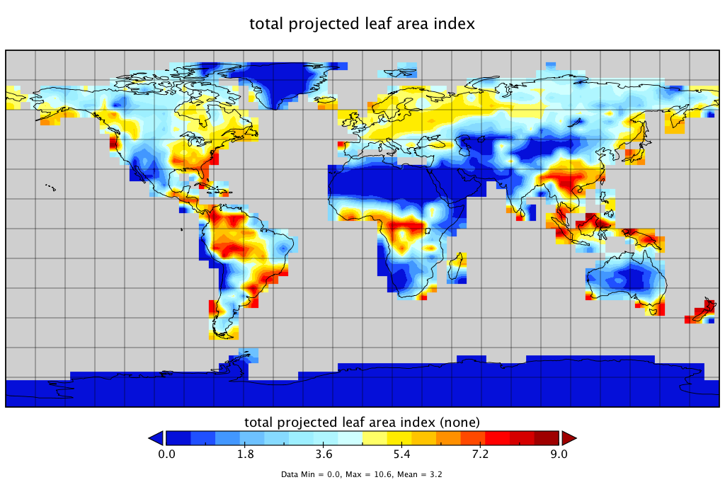
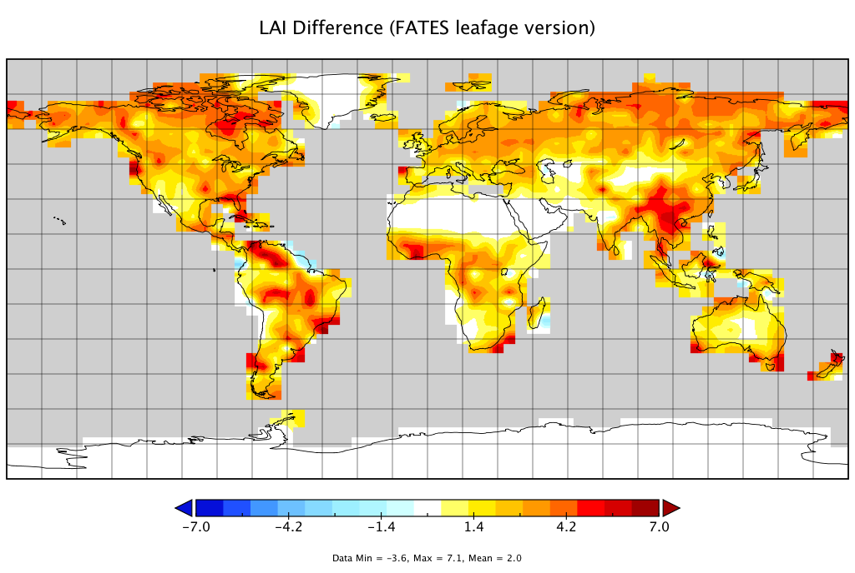
Leaf Area Index ELM-FATES
Over-productive canopies and vegetation in ELM-FATES compared to MODIS.
But what about compared to ELM-CNP ‘big-leaf’ version?
Global Mean 3.2
Also high LAI bias in FATES compared to MODIS
Global Mean 2.0

Slide 14
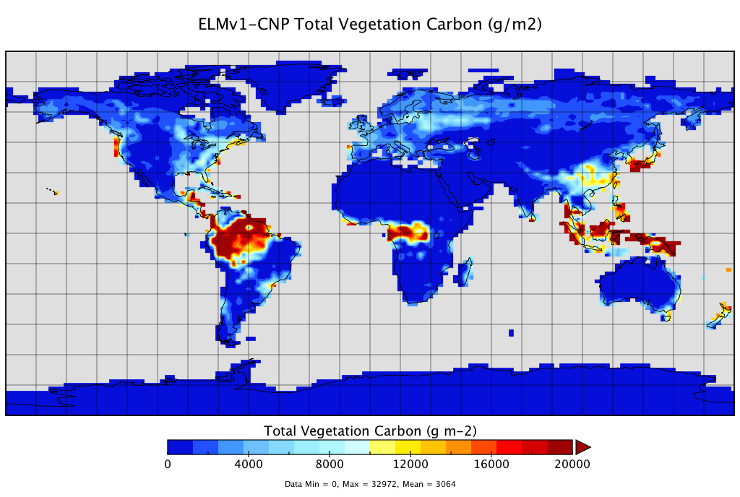
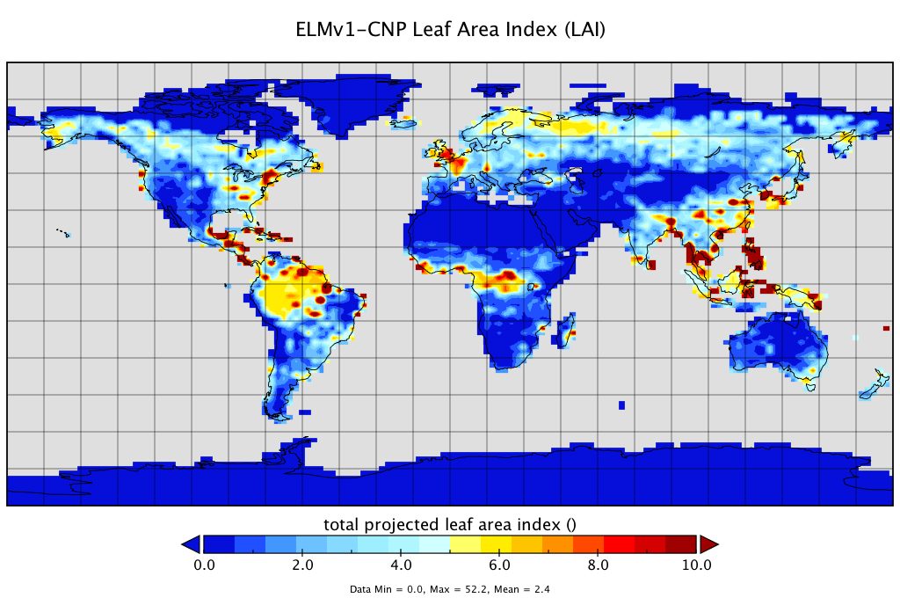
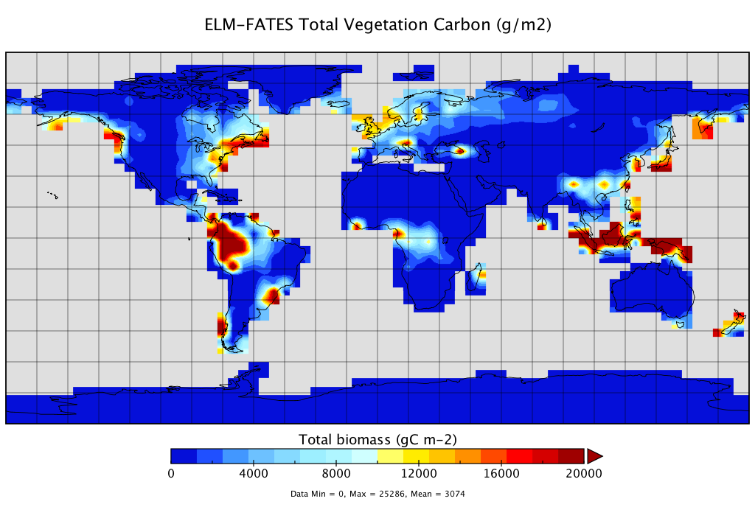
ELMv1 (Big-Leaf) Total Vegetation Carbon (g/m2)
ELMv1 (Big-Leaf) Leaf Area Index (LAI)
ELMv1 ‘big-leaf’ version from Zhu et al. 2019 JAMES
Big-leaf
vs.
VDM
Global Mean 3064
Global Mean 2.4 vs. MODIS 2.1
ELM-FATES Total Vegetation Carbon (g/m2)
ELM-FATES Leaf Area Index (LAI)
Global Mean 3074
Global Mean 3.2 vs. MODIS 2.1

Slide 15

Global averages of fluxes and stocks good in ELM-FATES, but what about PFT distribution with no climate envelopes and emergent behavior from competition and disturbance?

Slide 16
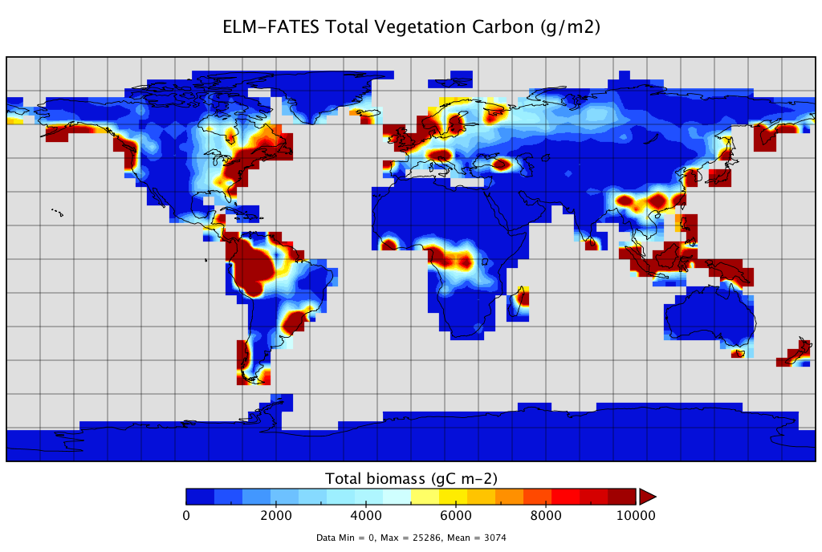
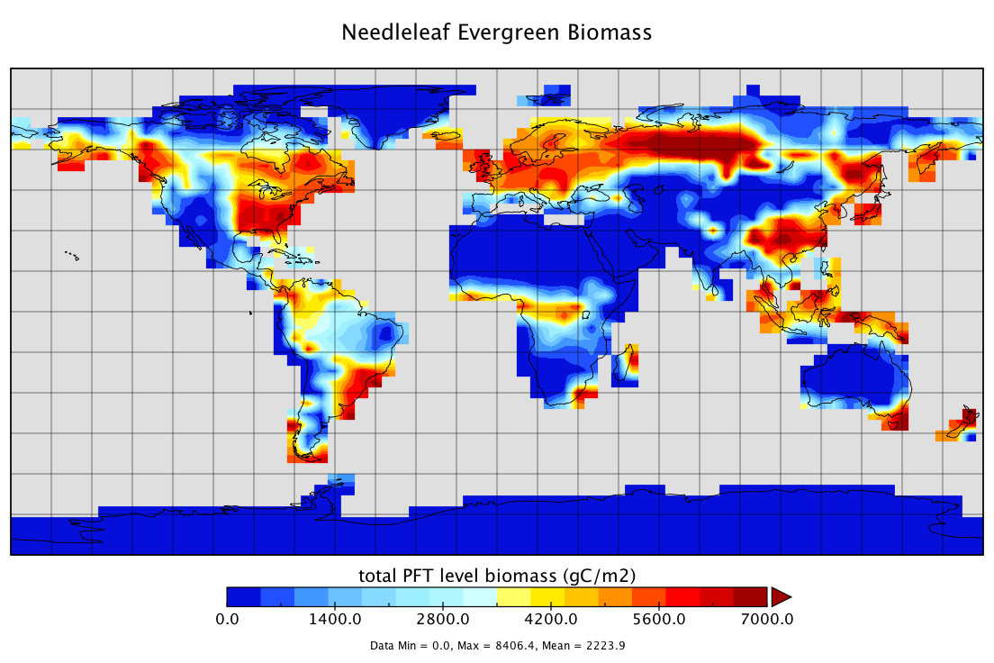
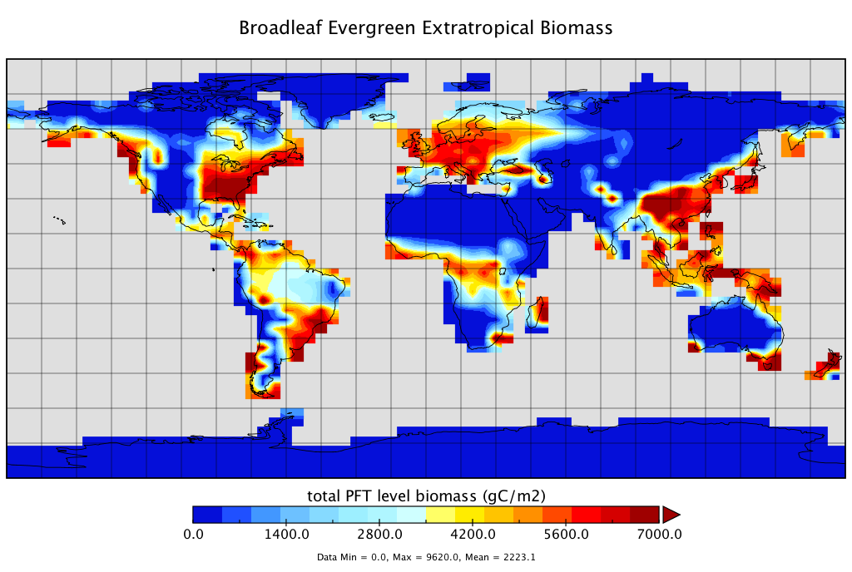
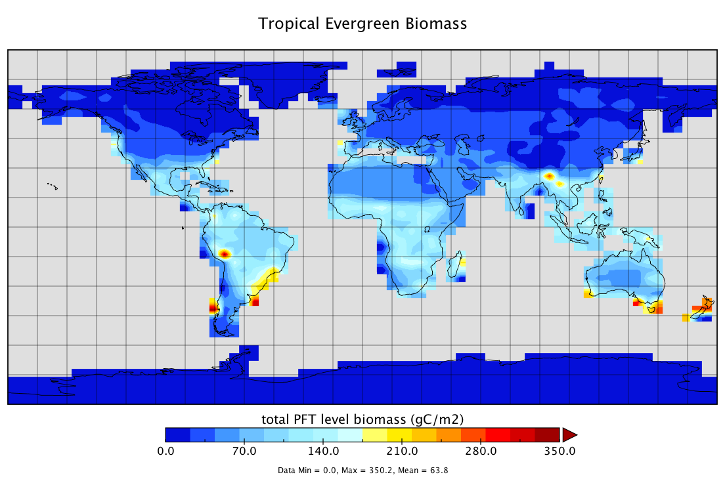
Global distribution of dynamic PFTs in ELM-FATES (baseline case)
Total vegetation biomass in default ELM-FATES (top figure)
Very productive extra-tropical evergreen trees taking over (both needleleaf and broadleaf), in a lot of places even in the tropics.
As a result low survival of tropical trees and other PFTs.
New parameterization: adjusting parameters that are related to strategies of leaf production vs. allocation to storage.
Needleleaf Evergreen Tree Biomass
Broadleaf Evergreen Extratropical Biomass
Tropical Evergreen Tree Biomass
Very high biomass!
Low biomass!

Slide 17
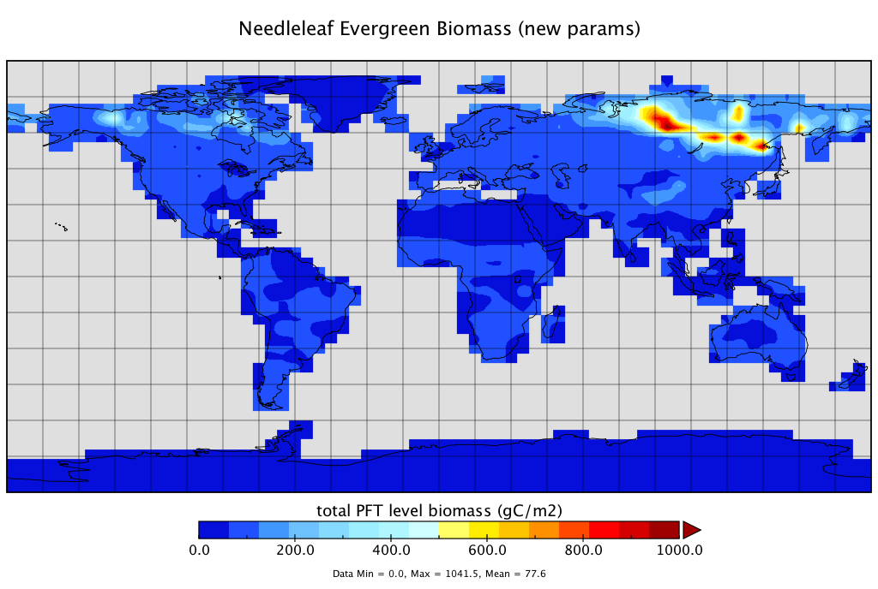

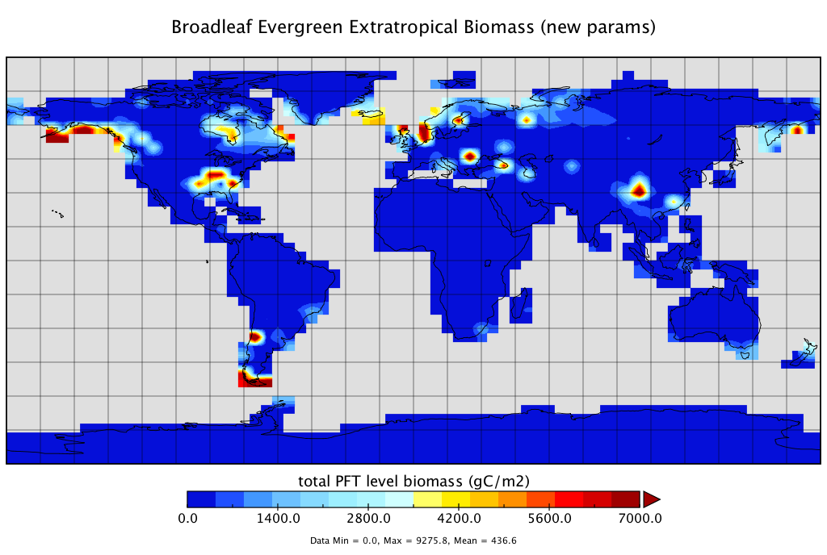
Parameterization updates improved global distribution of vegetation types, based on trait competition and tradeoffs
Needleleaf Evergreen Tree Biomass
Decrease in non-tropical needleleaf evergreen trees, but maybe too much.
Decrease in leaf productivity.
More testing needed here.
Very high biomass!
Broadleaf Evergreen Extratropical Biomass

Slide 18
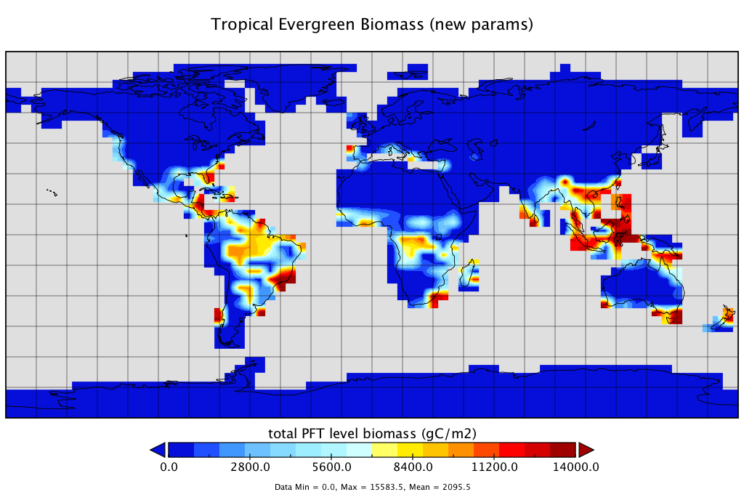
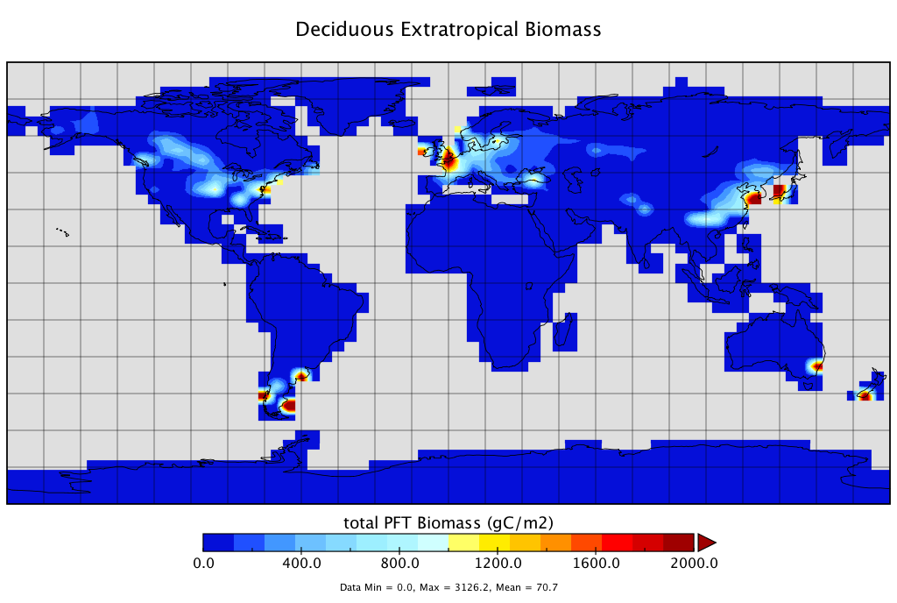
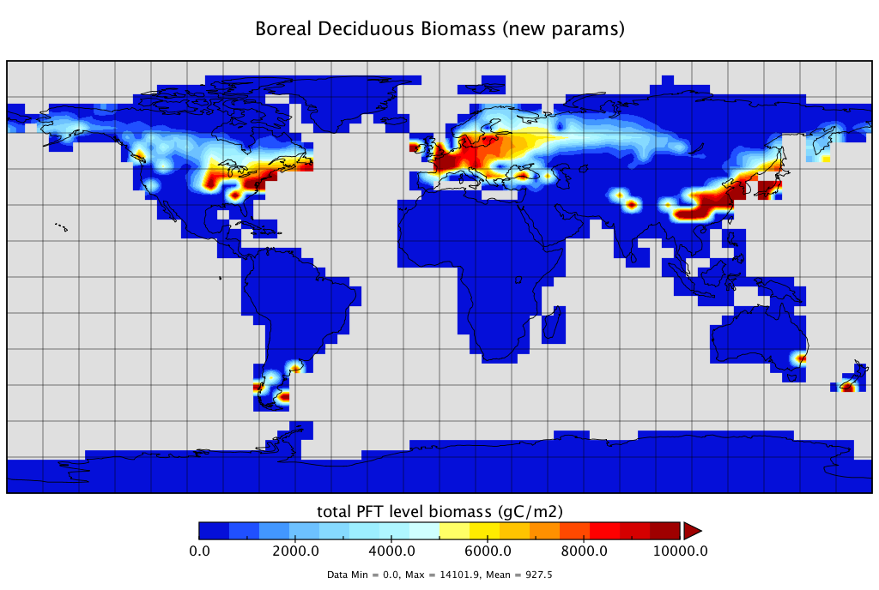
Parameterization updates improved global distribution of vegetation types, based on trait competition and tradeoffs
Tropical Evergreen Tree Biomass
Tropical Evergreen Biomass (new parameters)
New parameterization
Very different scales, and realistic values here.
Central Amazon: ~16 kgC/m2
ELM-FATES: 10 kgC/m2
Low biomass!
Cold-Deciduous Biomass
Cold-Deciduous Biomass (new parameters)
Low biomass!

Slide 19
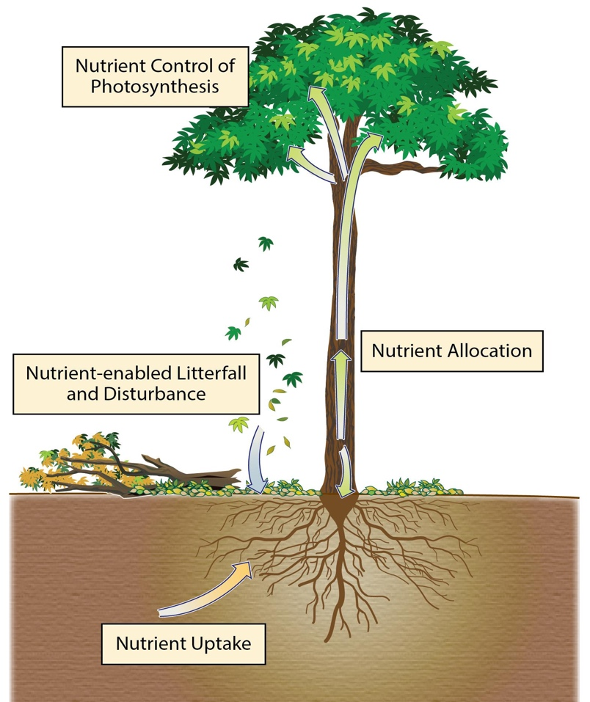
Nutrient-Enabled ELM-FATES (New feature!)
Developed to be a stand-alone flexible module to efficiently test alternative representations of carbon-nitrogen-phosphorus competition:
Plant nutrient acquisition coupled with ELM’s soil BGC.
Allometry-aware allocation of C-N-P (PARTEH).
Add litter fluxes from FATES plants to ELM’s soil BGC.
Testing different approaches of plant nutrient needs during “spin-up” of soil and plant BGC interactions.
Pull Request (4325) for nutrient cycling in FATES in review: https://github.com/E3SM-Project/E3SM/pull/4325.
Nutrient Controls of Photosynthesis
Nutrient Allocation to plant organs
Nutrient-enabled Litterfall and Disturbance
Nutrient Uptake
Phosphorus Sorption (NGT)
Phosphorus sorption

Slide 20
FATES Nutrient Flow: ELM Soil to FATES Plant and Back Again
Fragmented Decomposition Pool (ELM)
Litter
(N, P)
Seed Pool
(N,P)
Leaves (N,P)
Fine Root (N,P)
Sapwood (N,P)
Structure (N,P)
Reproductive (N,P)
Storage /Substrate
(N,P)
Nutrient Gain (N,P)
Allocation
Competitive Nutrient Competition (ELM)
Acquisition
Knox et. al. (In Prep)

Slide 21
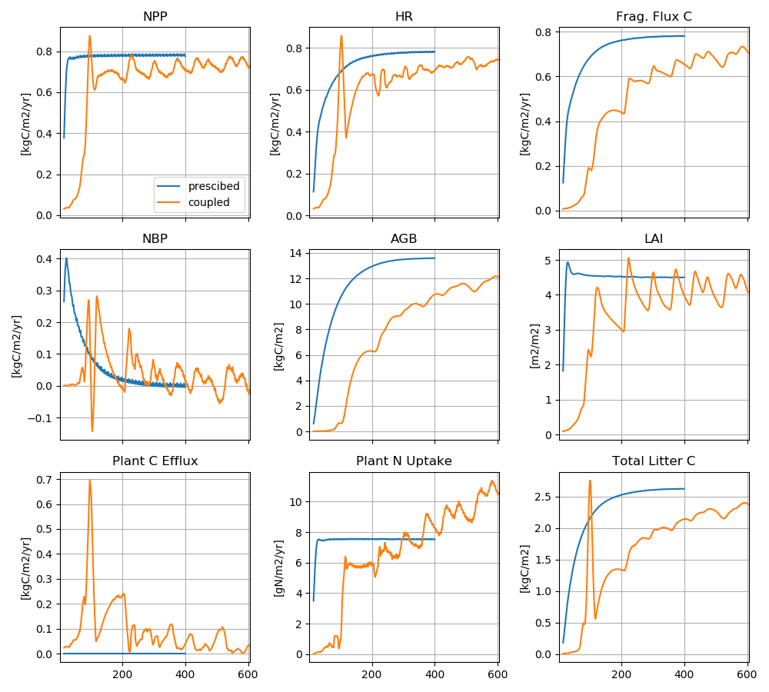
Coupled CNP vs. Uncoupled (c-only)
Decomposition in soil model is accelerated (i.e. rate constants increased).
FATES plants initialized at year-0 with an arbitrary number of seedlings.
Supplemental N is provided for a short number of years to “kick-start”.
Supplemental P is always provided to all competitors (evaluating N-limitations only here).
Knox et. al. (In Prep)

Slide 22
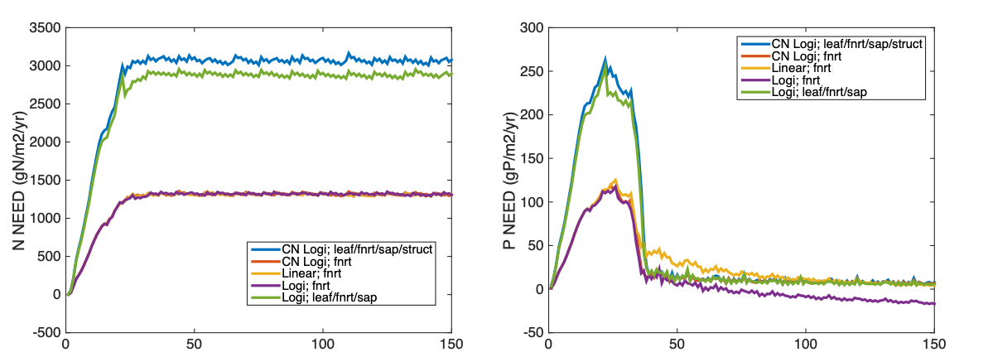
Summary and next steps:
Carbon-only version of global ELM-FATES predicts “ok” globally averaged carbon stocks and fluxes, however overly-productive vegetation poor regional distribution, but:
  Parameterization of extra-tropical PFTs substantially improved regional distribution of plant types.
  Dynamic plant hydraulics and water stress (in boreal site) substantially lowered biomass.
  Interactions with soil and plant BGC (N limitation) lowered all major forest metrics (NPP, LAI, biomass, litter C).
ELM-FATES Default vs. ELM-FATES Hydro
Field Data (2700 g/m2)
ELM-FATES Hydro and water stress
Integration of nutrient cycling between ELM and FATES in complete and testing underway:
  Underway: testing different theories of plant’s nutrient needs based on plant storage capacity/needs, and regulating demand.
  Underway: finalizing leaf nutrient constraints on photosynthesis
FATES and Land-Use Land-Cover Change
  Global wood harvesting occurring via logging module and newly created secondary forest patches.
Spin-Up Simulation Years
Spin-Up Simulation Years

Slide 23






Thanks!
jaholm@lbl.gov, rgknox@lbl.gov
Lawrence Berkeley National Laboratory
Some FATES or VDM related references:
Holm et al. 2020, JGR-Biogeosciences
Koven et al. 2020, Biogeosciences
Negron-Juarez, Holm, et al. 2020, Biogeosciences
Fisher and Koven 2020, JAMES
Needham et al. 2020, GCB
Fisher et al. 2015, Geosci. Model Dev.

