Slide 1
Updates on E3SM Energy/Land Next Generation Development (NGD)
Ben Bond-Lamberty
on behalf of the NGD team
June 8, 2021

Slide 2
Overall BGC Timeline
Spin-Up
Coupled Simulations and Paper Writing
v1
NGD Development
BGC Testing and Integration
Spin-Up
Coupled Simulations and Paper Writing
v2
NGD Development
BGC Testing and Integration
v3
Phase 2 Start
Today
Phase 3 Start

Slide 3
Overall BGC Timeline
Spin-Up
Coupled Simulations and Paper Writing
v1
NGD Development
BGC Testing and Integration
Spin-Up
Coupled Simulations and Paper Writing
v2
NGD Development
BGC Testing and Integration
v3
Phase 2 Start
Today
Phase 3 Start

Slide 4
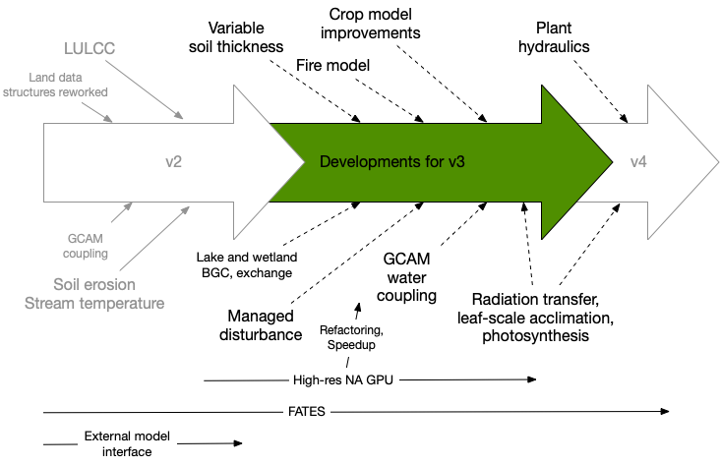
Energy/Land NGD overview

Slide 5
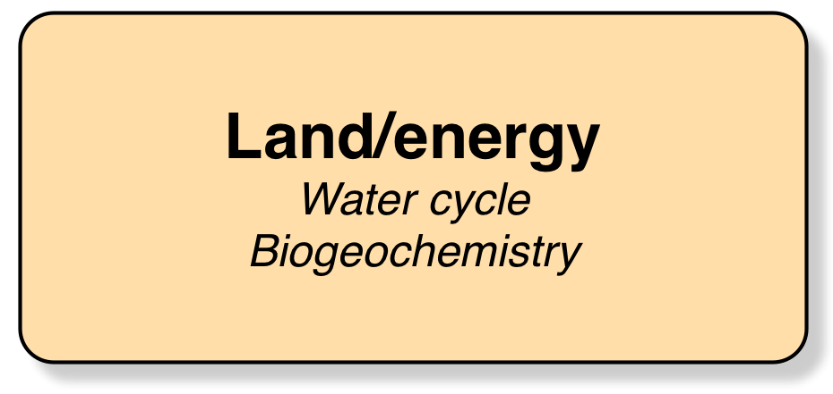
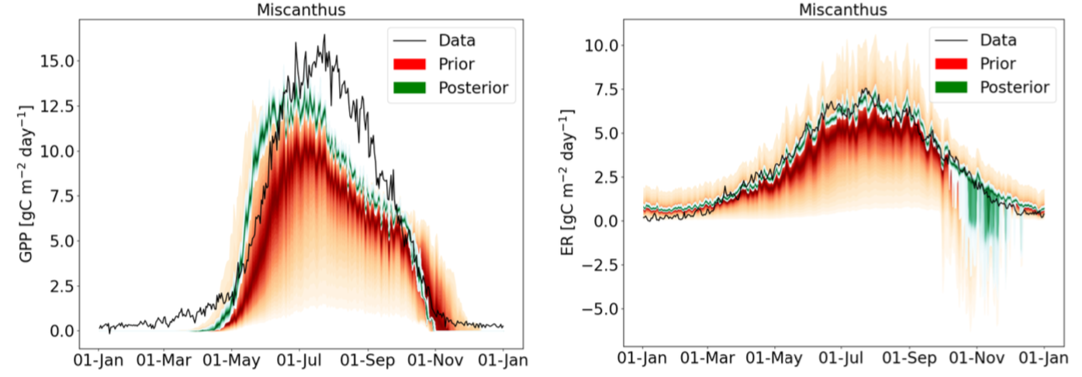
Modeling perennial bioenergy crops
Eva Sinha et al.: currently finalizing manuscript for submission to GMD over the next two months.
A pull request will be submitted by the end of June.
Notes:
Perennial crop modeling added to ELM.
􏰀 Observational data from the UIUC Energy farm for Miscanthus and switchgrass was used for model calibration.
The parameters associated with leaf CN allocation, specific leaf area, and leaf senescence were the most sensitive parameters for both GPP and ER.
􏰀 ER was also highly sensitive to temperature sensitivity for maintenance respiration.
1

Slide 6
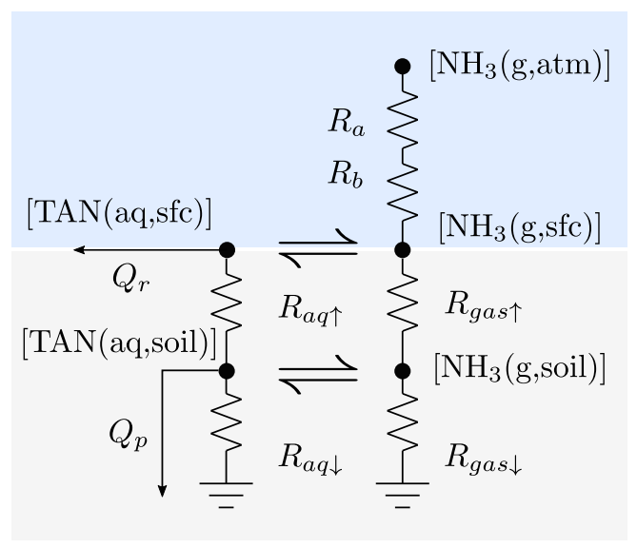
Other crop model and LULCC developments
Wrapping up work on integrating FAN (mechanistic model for ammonia volatilization)
Adding new crop types to ELM
  Rice
  Sugarcane
  Winter wheat
Ability to prescribe global wood harvest-area from ELM to FATES
  Approved for merging into master
  FATES has also been updated to utilize this new data
Vira et al. (2020)
Notes:
Perennial crop modeling added to ELM.
􏰀 Observational data from the UIUC Energy farm for Miscanthus and switchgrass was used for model calibration.
The parameters associated with leaf CN allocation, specific leaf area, and leaf senescence were the most sensitive parameters for both GPP and ER.
􏰀 ER was also highly sensitive to temperature sensitivity for maintenance respiration.
1

Slide 7

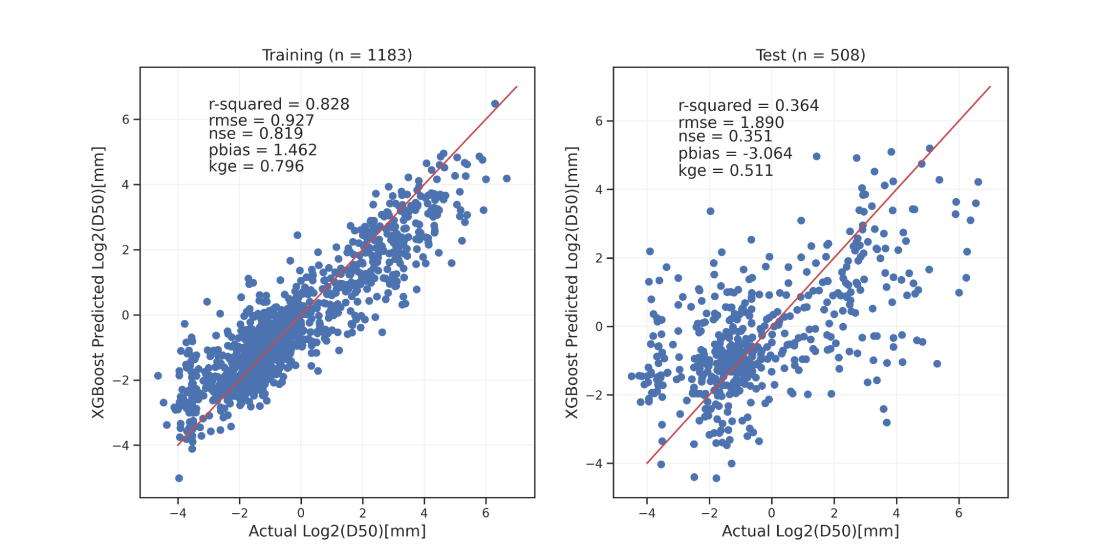
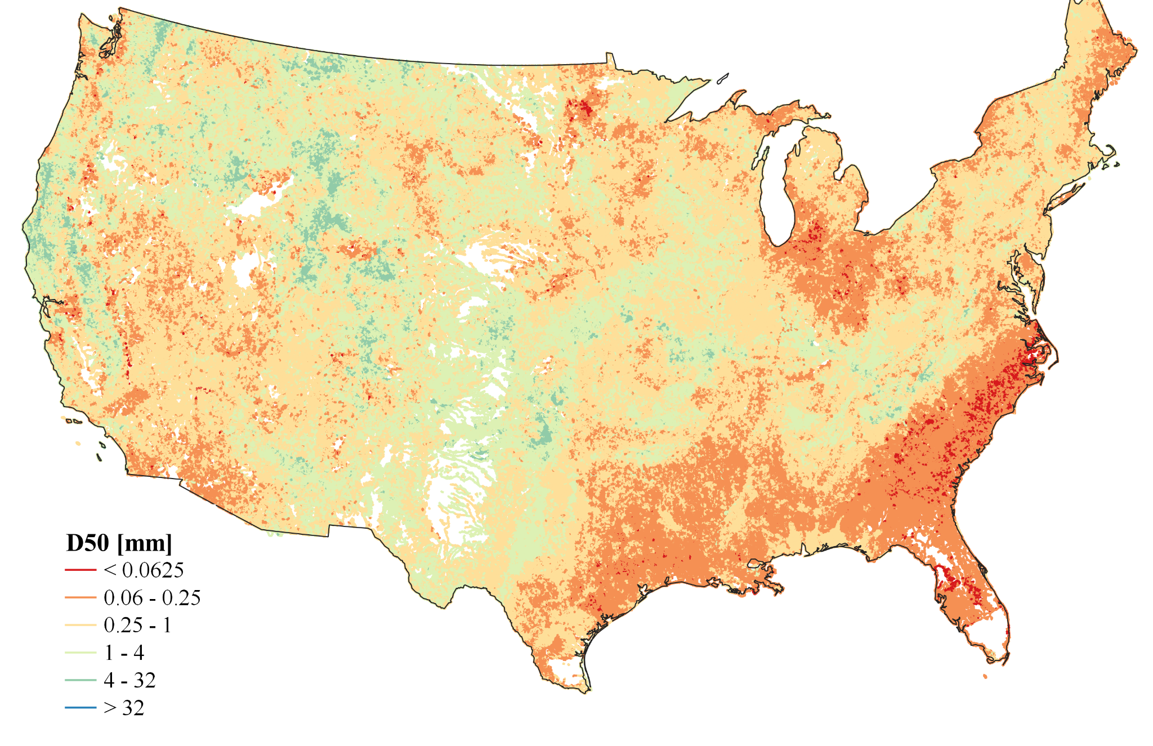
MOSART and related developments
Couple MOSART with inland lakes and reservoirs (Li group, U-Houston)
  MOSART-sediment, -carbon, -lake
  Significantly improved the parameterization of MOSART-sediment
  Incorporated the representation of POC and DOC leaching from ELM (into rivers), and riverine POC/DOC/DIC processes
  New global lake geometry dataset
  Accepted WRR; in revision JGR-Atmospheres
  National map ESSD ms in prep (Abeshu et al.)
Machine-learning method to establish a predictive model for median river-bed sediment particle size (D50) from existing land datasets
Notes:
MOSART-sediment. We will submit our new manuscript on sediment particle size dataset by early June. We will then submit our revised MOSART-sediment modeling paper to JGR-Atmospheres or JAMES by early July. Both manuscripts document the parameterization, development and validation of MOSART-sediment over the contiguous U.S.
We plan to issue the PR for MOSART-sediment by December 2021.
MOSART-carbon. We plan to complete and submit our 1st paper on MOSART-carbon (with a focus on DOC) by October, which document the development and validation of MOSART-carbon over the contiguous U.S.
We plan to issue the PR for MOSART-carbon by April 2022.
MOSART-lake. We plan to complete and submit our 1st paper on MOSART-lake in late September, which documents the development and validation of MOSART-lake globally.

Slide 8
MOSART and related developments
ELM-Erosion (Tan, PNNL)
  Tan et al. (2021), Increased extreme rains intensify erosional nitrogen and phosphorus fluxes to the northern Gulf of Mexico in recent decades, ERL, 16, 054080.
E3SM-LakeBGC
  Predicting the evolution of soil erosion and lake methane emissions and evaluate their impacts on global carbon cycle
Notes:
Figure 1. Schematic of the E3SM lake biogeochemical (E3SM-LakeBGC) model. The E3SM-LakeBGC model represents (1) methane (CH₄) production in sediment from decomposition of both terrestrial and aquatic derived organic matters (POM), (2) CH₄ oxidation in the water column, and (3) CH₄ transport through both diffusion and ebullition.

Slide 9
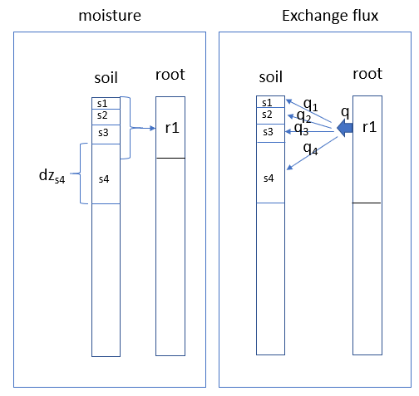
Other hydrology-related work
Development of VSFM to simulate plant hydraulics
  Standalone tightly coupled plant hydraulics and soil hydrology model; site-level testing
Global watershed dataset
  Manuscript comparing watershed-based and grid-based representations of land surface properties
BeTR soil BGC and methane emissions from lakes and wetlands
Improve numerical stability of FATES-HYDRO
  Smoothing function option for the soil water retention curve and an option to aggregate root layers
Notes:
Gautam Bisht
Teklu Tesfa
Jinyun Tang
Publishing Tang and Riley (2021), which examines how three essential plant root nutrient acquisition mechanisms—activity of nutrient acquiring proteins, maintenance of nutrient stoichiometry, and energy expenditure for these processes—are considered in existing modeling paradigms.
Yilin Fang
As part of the PR, aboveground biomass difference caused by HYDRO 30 years in the spinup have been quantified. Biomass is reduced in the tropics when HYDRO is active.

Slide 10

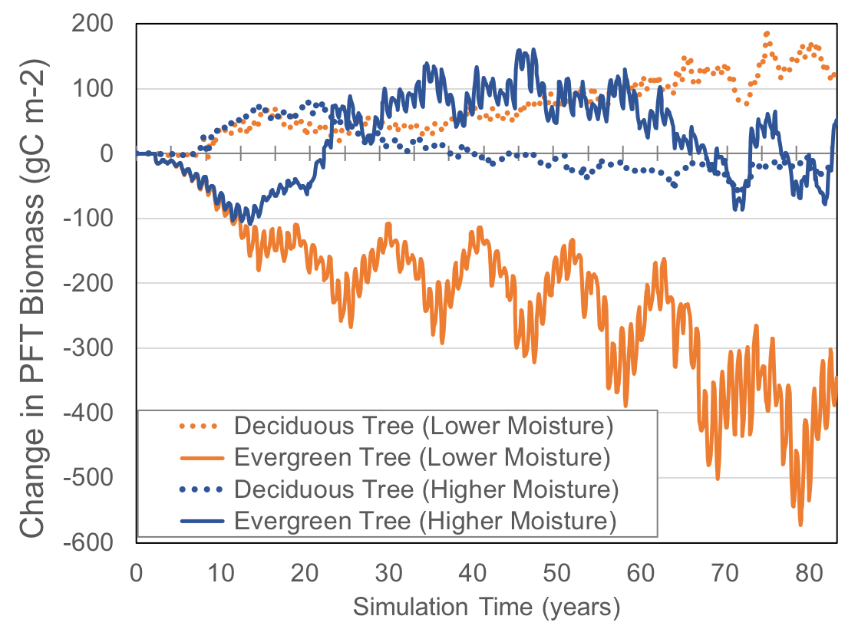
ELM-FATES
ELM-FATES predicts shifts in plant functional types
(evergreen vs. deciduous dominance based on emergent trait competition) due to soil hydrology changes
  Shrubs increase with plant hydraulics
More global simulations using ELM-FATES-hydro
  Compare and contrast against simulations with no dynamic plant hydraulics
Notes:
Jennifer Holm, Ryan Knox
One major finding is that with plant organs now dynamically competing for water, and thus plant growth subject to water stress, aboveground biomass decreased by ~60% compared to non-FATES-Hydro simulations; a potentially important factor in curbing the overly productive default version of FATES.
Figure 2. Change in plant functional type (PFT) biomass in an Alaska boreal forest due to soil moisture increasing or decreasing by 40% from control conditions using ELM-FATES. Deciduous trees (dotted orange line) increase under lower soil moisture conditions, at the expense of evergreen trees (solid orange line).

Slide 11
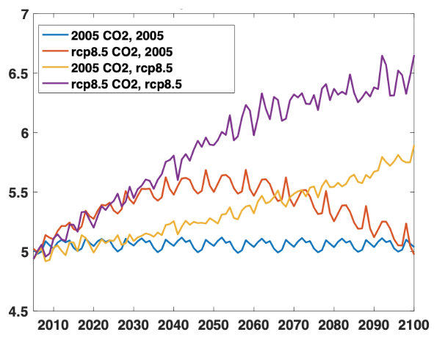
Other vegetation dynamics work
Leaf to canopy model
  Two leaf-to-canopy scale improvements to ELM’s vegetation physiology
  Leaf-to-canopy scale SIF model
  Functional form and parameterization of maintenance respiration (in review)
Photosynthesis acclimation
  Integrated photosynthesis acclimation to both temperature and CO₂ into the E3SM big leaf model
    Diverse impacts of warming and CO₂ enrichment on photosynthetic activity
climate
climate
climate
climate
Vcmax
Notes:
For example, the acclimation of photosynthesis to rising CO2 theoretically decreases the demand of rubisco enzyme and thus the leaf nitrogen content. The amount of nitrogen (N) that is saved by photosynthesis acclimation could potentially alleviate the progressive N limitation and help build more vegetation biomass under enriched CO2 conditions.

Slide 12

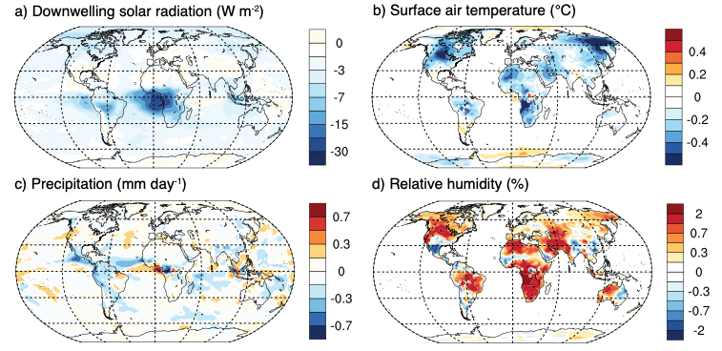
Improving and simplifying the ELM fire model
Fine tuned surrogate wildfire model captures inter-annual variation and seasonality of burned area 2001-2010
  Zhu et al. “Building a machine learning surrogate model for wildfire activities within a global earth system model.” In review GMD, https://gmd.copernicus.org/preprints/gmd-2021-83/
Fire aerosols effects on climate and GPP
  Xu et al. “The influence of fire aerosols on surface climate and gross primary production in the Energy Exascale Earth System Model.” Under review at J. Climate
Notes:
Fire aerosol has 1) cooling effect at global scale; 2) reduce precipitation at tropical ecosystems 3) enhance surface diffusive radiation flux 4) ~3 PgC/yr decline in GPP
improved fire-associated aerosol emissions in the Energy Exascale Earth System Model (E3SM) using the Global Fire Emissions Database version 4s (GFED4s) and AERONET aerosol optical depth (AOD) observations during 1997-2016. We distributed fire emissions from the surface through the upper troposphere using smoke plume heights derived from MISR satellite observations. Fire aerosols enhance GPP by increasing surface relative humidity (and by reducing tropical temperatures), but in many areas these gains are offset by decreases in PAR (Figure 6; Xu et al. 2021, in review).

Slide 13
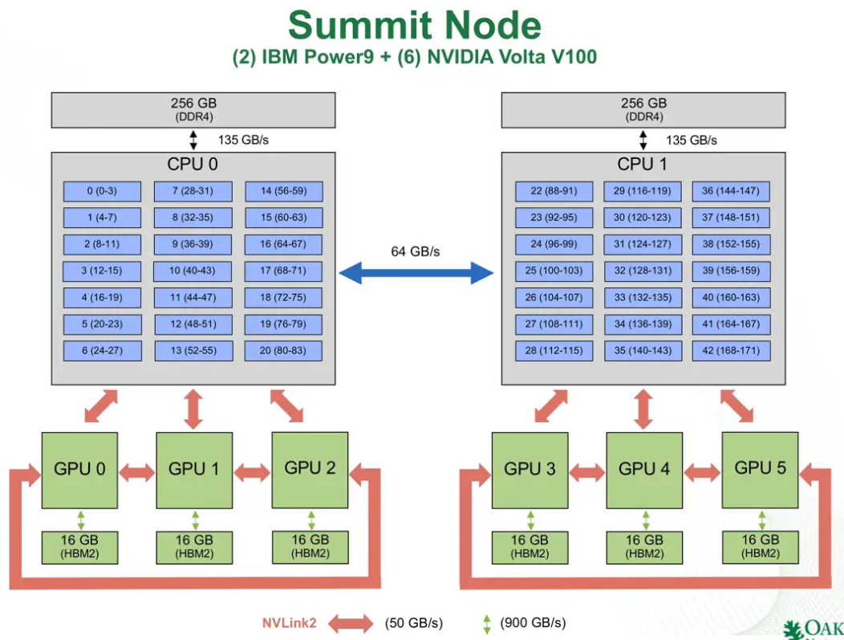
Exascale ELM
Ported entire ELM code base to run on NVIDIA GPU hardware using OpenACC
Extensive testing, bfb behavior
Refactoring and cleanup
  CPU model: ~5% speedup; some subroutines that do a lot of repetitious work have their time cut in half
  Reduced memory footprint has increased the number of gridcells accommodated on a single device from ~900 to ~3800.
Each Summit node has 6 NVIDIA Volta V100 GPUs. We have 1 ELM MPI task per GPU, so 6 MPI tasks per node.
(Dali Wang’s 2020 poster)

Slide 14
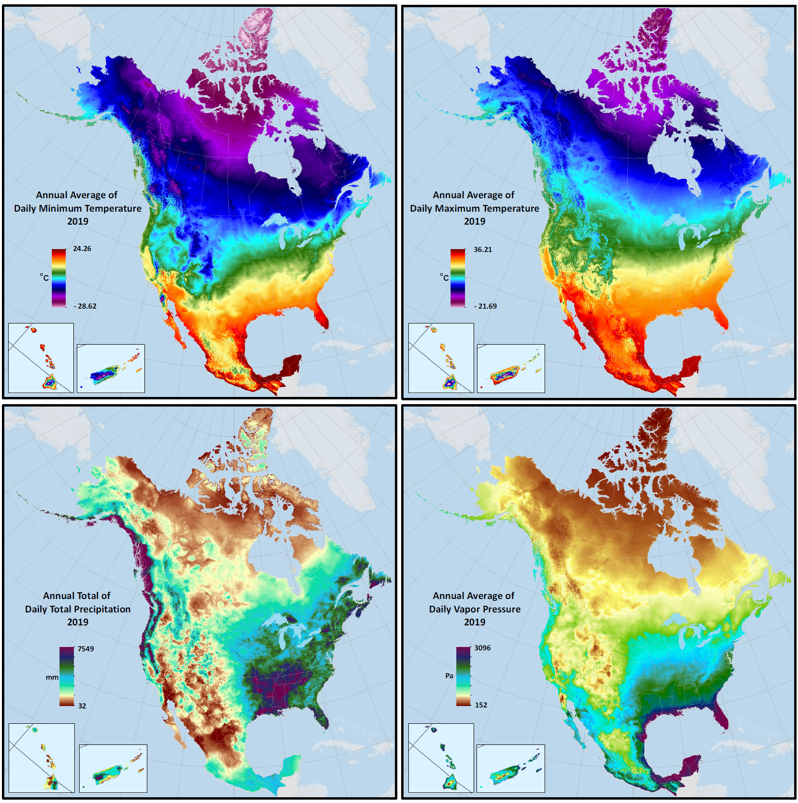
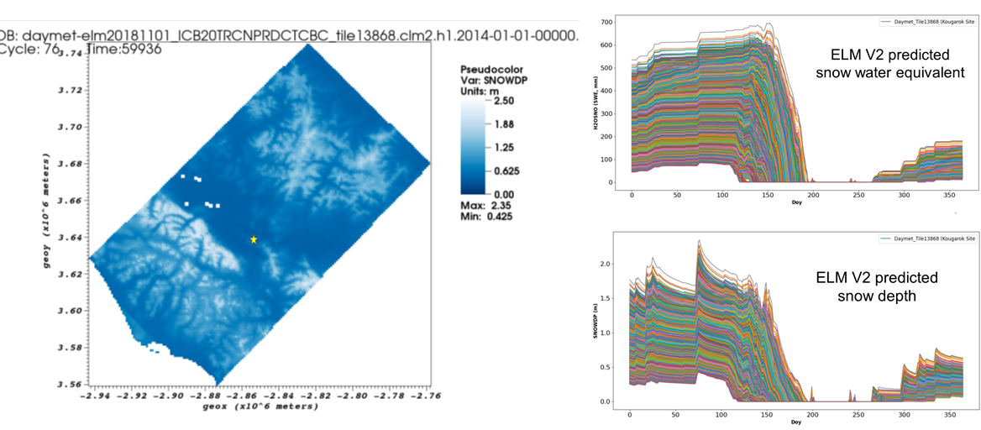
Climate datasets
High-resolution (1 km) datasets over North America are in place and regional subsets have been tested with offline ELM v1 simulations
ELM v1 output (snowpack) for a 2° x 2° region in Alaska
Thornton et al., Nature Scientific Data, 2021
Notes:
We have evaluated the temporally-downscaled version of these daily data through applications over large subsets in Alaska. Three regional subsets, each consisting of about 20,000 1km gridcells, have been run in fully-active BGC mode through spinup and 20th century transient simulations. We chose the Alaska regions because the low station density there means these regions are on the high end of input data uncertainty, and so can serve as a worst-case scenario for assessing data quality. We also have resources available from collaboration with the NGEE Arctic project to evaluate these simulations against snowpack observations from remote sensing platforms. An example of the model outputs for mid-season snowpack and associated time series for one of these subregions is shown in Figure 1.

Slide 15
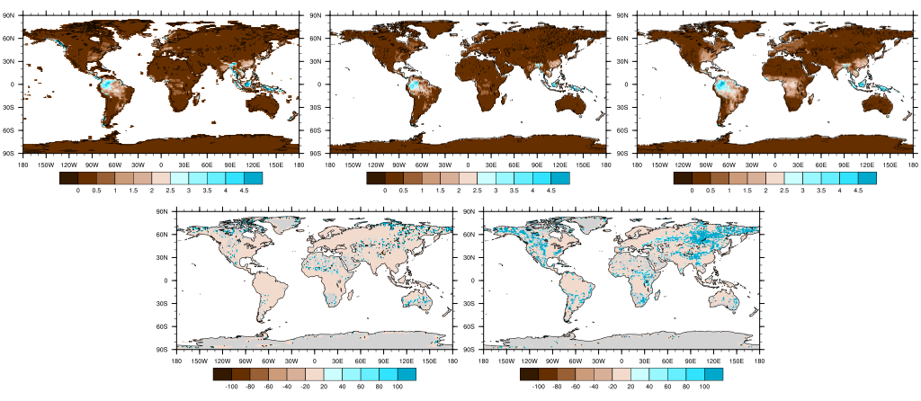
Variable soil depth and annual mean baseflow
VARSOIL_GRC_NE30
VARSOIL_GRC_0.5DEG
VARSOIL_TOPO_0.5DEG
RELATIVE DIFFERENCE
(%)
Large relative changes in baseflow are more prevalent throughout mountainous areas with topounits.
Other fluxes like from surface runoff are minimally affected.
(top row) The baseflow in ELM offline simulations: VARSOIL_GRC_NE30 (grid cell mean variable soil thickness on the v1 NE30 grid), VARSOIL_GRC_0.5DEG (grid cell mean variable soil on the 0.5º tri-grid), and in VARSOIL_TOPO_0.5DEG (variable soil on topounits). (bottom row) The relative difference in baseflow between VARSOIL_GRC_0.5DEG and VARSOIL_GRC_NE30 and between VARSOIL_TOPO_0.5DEG and VARSOIL_GRC_0.5DEG.
Notes:
Michael Brunke, Xubin Zeng and U-AZ colleagues —
The code to finalize variable soil thickness with bug fixes and the addition of code to allow variable soil thickness with CTC. The PR is pending approval.
A number of preliminary simulations have been run to test the performance of variable soil thickness represented on multiple topographic units (topounits). Baseflow is found to be higher; additional changes come about with the representation of variable soil thickness on multiple topounits. Surface runoff is largely unaffected because of our tuning at locations where the soil column is made shallower.
Removed negative lake runoff by introducing a virtual lake water storage term in ELM, which does not affect any water and energy balances for offline and coupled models (Figure 1a–1d below). Importantly, our lake water storage physically makes sense, correlating well with observed lake water level in the Lake Michigan and Great Salt Lake ((Figure 1e and 1f).

Slide 16
Thank you!

