Slide 1
The E3SM Biogeochemistry Group Update
Kate Calvin, Susannah Burrows, Jennifer Holm
(on behalf of the whole E3SM BGC team)

Slide 2
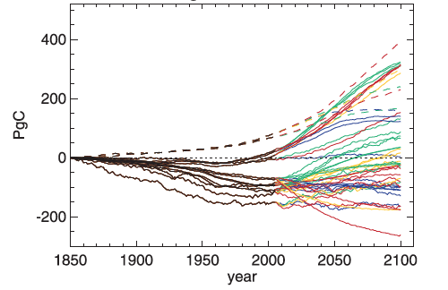
Goal: Understand Earth system variability and change and its interactions with biogeochemical cycles
The RCP8.5 results in:
Increased air temperature,
Soil drying in North America,
Increased forest fires in the US, and
Permafrost thaw.
These changes could reduce terrestrial carbon storage and ocean carbon uptake.
Nutrient availability limits biological CO₂ uptake in both land and ocean.
Land models that included nitrogen limitations tended to have weaker terrestrial carbon uptake.
Large uncertainty in future terrestrial carbon across models in CMIP5.
The land sink is substantially modified by human-driven land use change (e.g., conversion of forests to crops).
Change in Vegetation Carbon
Source: Jones et al. (2013)

Slide 3
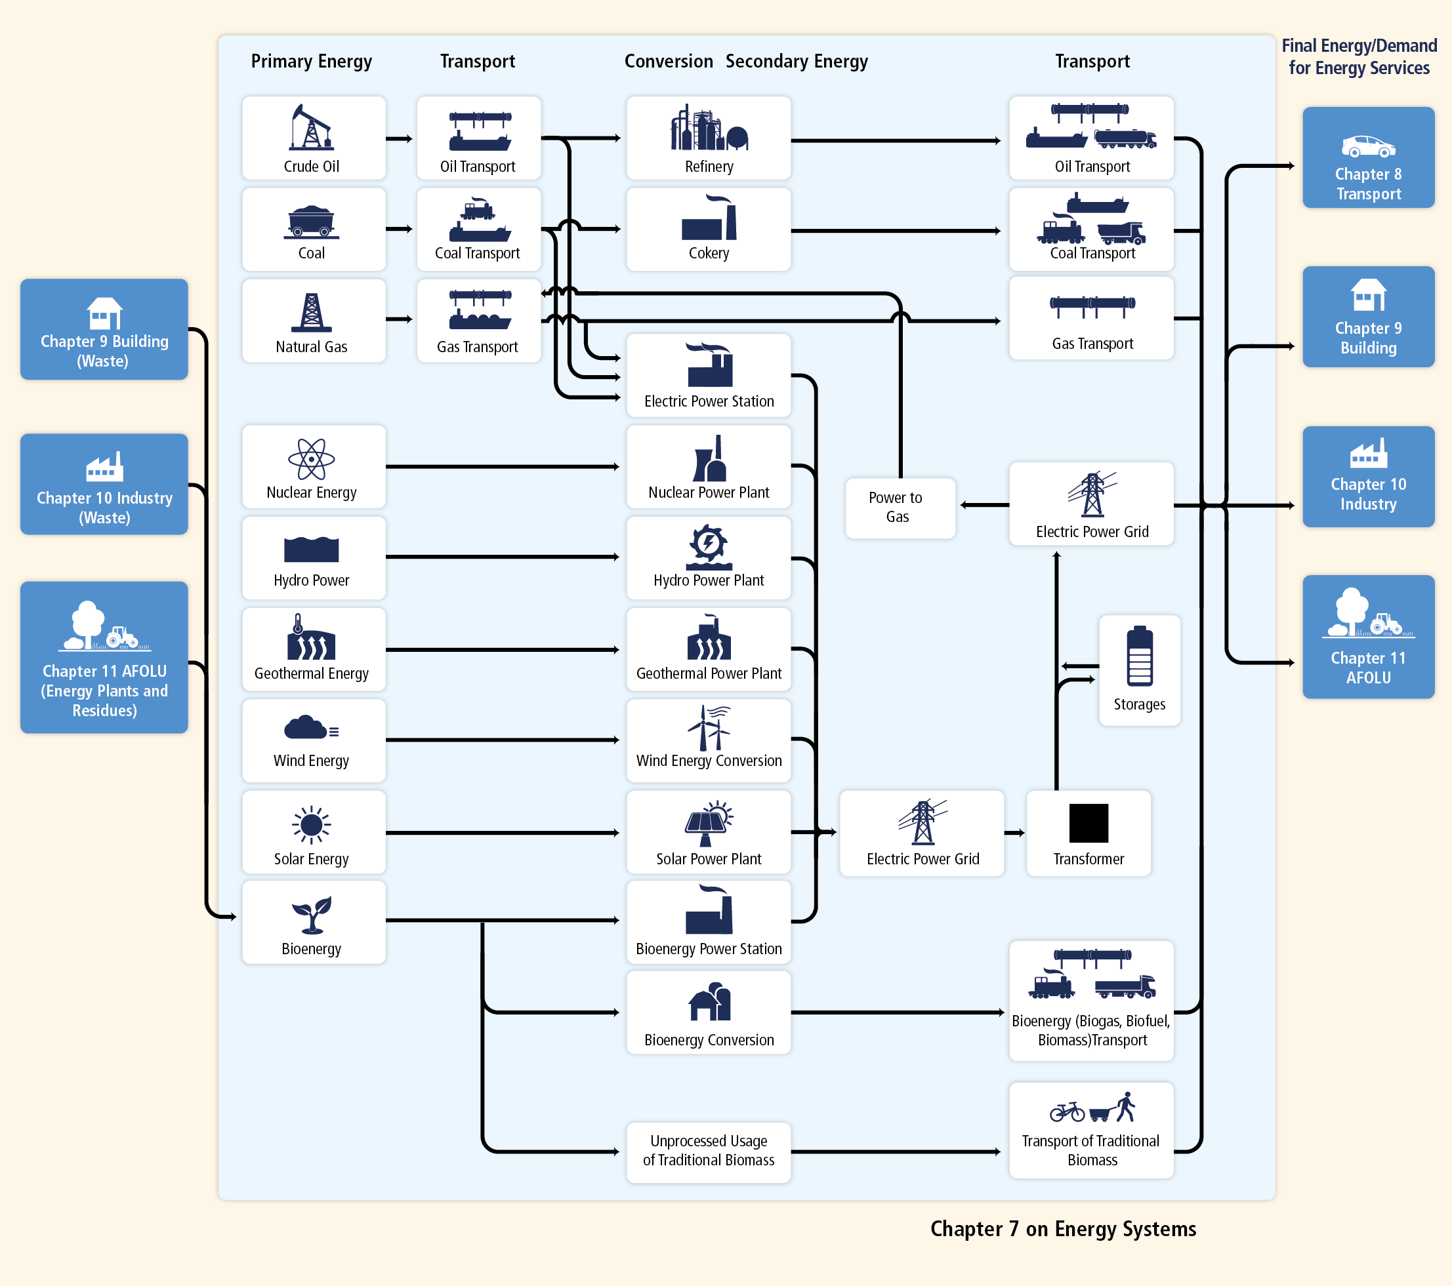
Goal: Simulations, predictions, and projections to support DOE’s energy mission
The Energy System
Earth system changes have implications for energy, including:
Increases in energy use for air conditioning,
Changes in electricity generation (thermoelectric, hydropower, wind, and solar),
Changes in crop yields and bioenergy potential,
Energy system disruptions (e.g., power outages).
How do the biogeochemical cycles interact with other Earth system components to influence energy-sector decisions?
Source: IPCC AR5 WG3 Ch7

Slide 4
Overall BGC Timeline
Spin-Up
Coupled Simulations and Paper Writing
v1
NGD Development
BGC Testing and Integration
Spin-Up
Coupled Simulations and Paper Writing
v2
NGD Development
BGC Testing and Integration
v3
Phase 2 Start
Today
Phase 3 Start

Slide 5
V1 Simulations and Analysis

Slide 6
Simulation Plan
Overarching science question:
How do the biogeochemical cycles interact with other Earth system components to influence energy-sector decisions?
V1 Science Question:
What are the effects of nitrogen and phosphorous on climate-biogeochemistry interactions, and how sensitive are these interactions to model structural uncertainty?

Slide 7
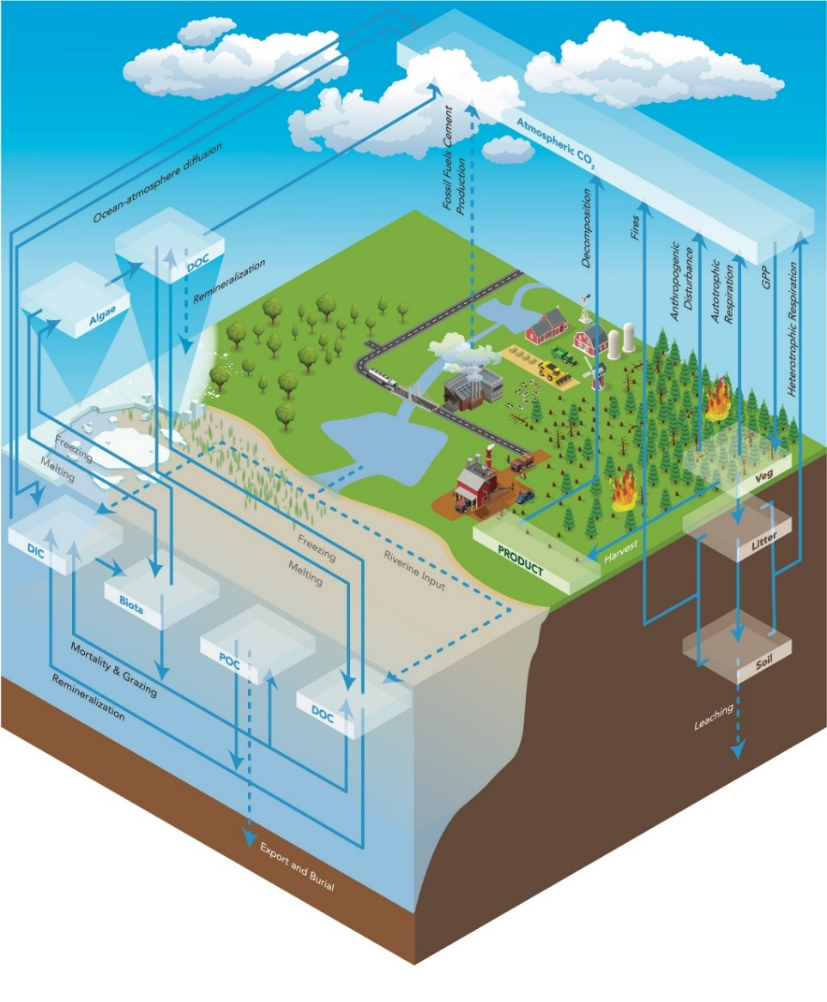
Documenting Carbon and nutrient cycles in the E3SM v1 BGC model
Approach:
Evaluate the model using observational benchmarks.
Characterize ecosystem-climate responses in a standard set of simulations, including quantifying the effects of structural uncertainty and nutrient limitations.
Results:
The evaluation showed significant improvements to the land-based carbon cycle compared to previous models. Important biases were identified in the ocean carbon cycle, which will be improved in future versions of E3SM.
E3SMv1.1-BGC allows researchers to model the Earth’s carbon cycle and how it interacts with land use and energy systems.
Burrows, et al., 2020. “The DOE E3SM v1.1 biogeochemistry configuration: description and simulated ecosystem-climate responses to historical changes in forcing,” Journal of Advances in Modelling Earth Systems, 12, e2019MS001766. https://doi.org/10.1029/2019MS001766 .
Notes:
We’ve done ~3500 years of simulation with this model.

Slide 8
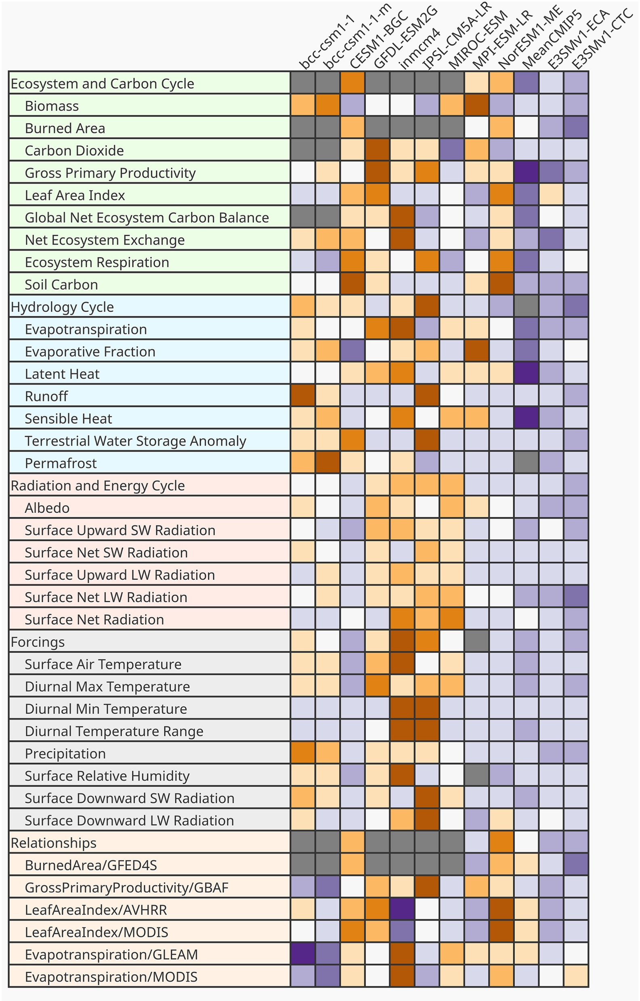
ILAMB global benchmarking for the v1 land model
Overall, both CTC and ECA simulations perform better than most CMIP5 models across a range of metrics.
Link to interactive output:
https://doi.org/10.6084/m9.figshare.11097356.v2
Source: Burrows et al. (2020)

Slide 9
E3SMv1.1 ocean had unrealistically low carbon uptake
MODEL (BDRD-hist, 1977-2006)
OBS (World Ocean Atlas)
Red colors are fluxes out of ocean (outgassing)
Blue colors are fluxes into ocean (uptake / sink)
Total ocean carbon uptake since 1850:
Benchmark: 150 ± 20 PgC/yr (Le Quéré et al., 2018)
E3SMv1.1-BGC: ∼93 PgC/yr
Source: Burrows et al. (2020)

Slide 10
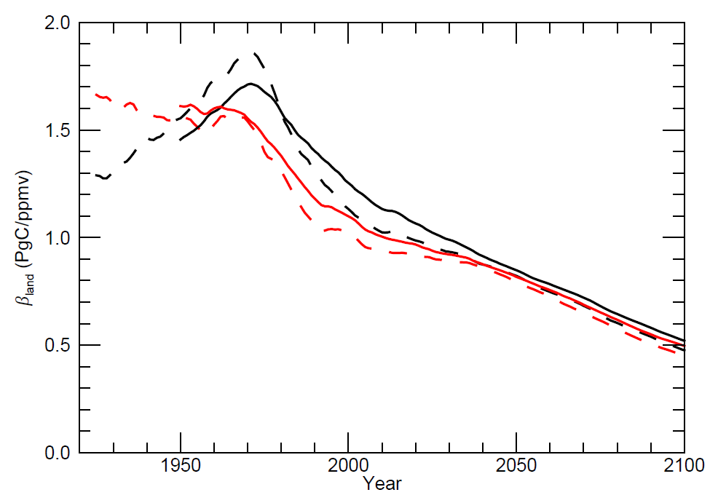
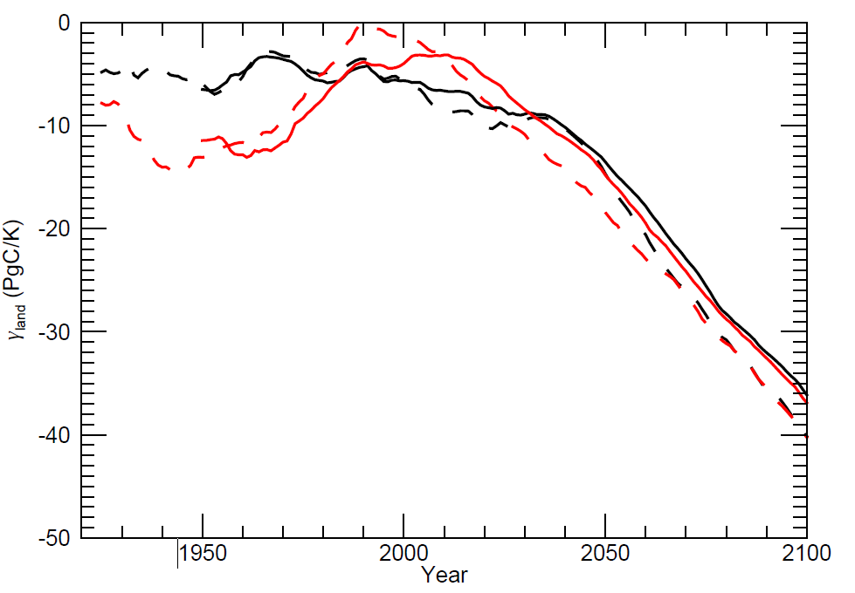
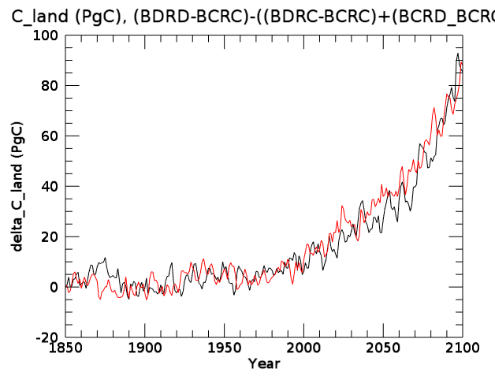
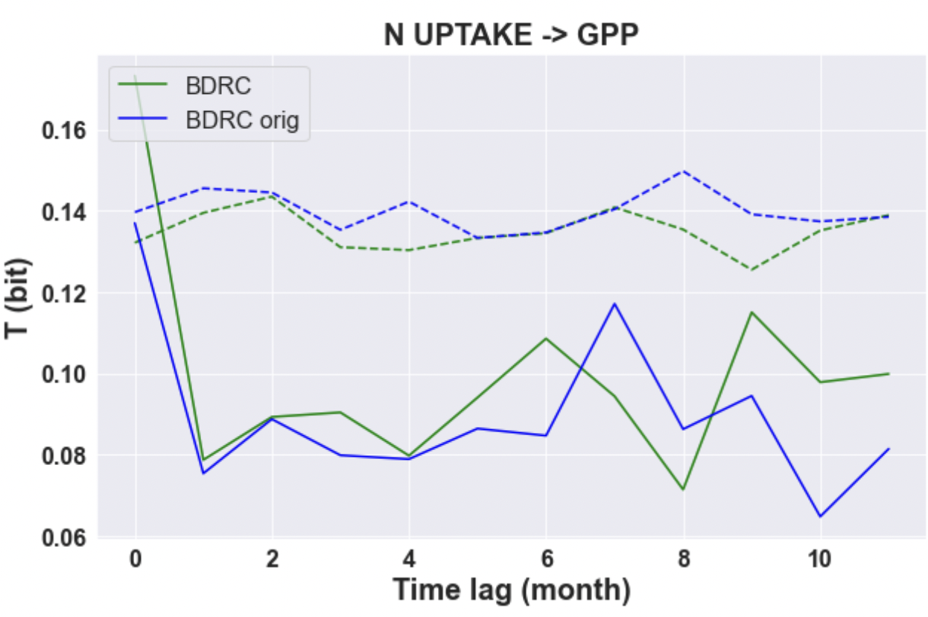
Quantifying the implications of phosphorous on the carbon cycle
Thornton et al. (in prep) – Using CTC
CN
CNP
Interaction effect
Effect of CO₂ on terrestrial carbon
Effect of climate on terrestrial carbon
Zhu et al. (in prep) – Using ECA
Nutrient limitations on the carbon cycle:
Any 1850 legacy effect in beta and gamma?
Compare black and blue lines to show starting from 1850 vs. restarting from 2030
Causality figure: strong N uptake impacts for BDRC, when restarting from 2030 BDRD

Slide 11
V2 Simulation Campaign

Slide 12
Science Questions
Overarching Question:
How do the biogeochemical cycles interact with other Earth system components to influence energy-sector decisions?
V2 Question:
What are the implications of different energy futures for the biogeochemical cycle through changes in land use land cover, water availability, and extreme events?

Slide 13
The v2 BGC Model
The v2 BGC model starts from the water cycle version:
Includes all physics and performance updates from the WC group (see Chris’ talk last week)
Two different model versions: low res and RRM
Start from the tunings provided by WC
We include active biogeochemistry in the atmosphere, land, ocean, and sea ice:
Enables us to model the carbon cycle and its interactions with climate
Required for our science questions

Slide 14
The v2 BGC Model: Key differences from v1
Ocean: Improvements in ocean physics (from water cycle) and improved river nutrients will hopefully reduce biases in carbon fluxes. Supercycling implemented to improve model performance.
Land: Model configuration with CTC nutrient cycling. We are evaluating some additional changes to the land model, including irrigation water management, inundation, subgrid topography, and plant hydraulics.
Dynamic vegetation and demography via FATES and crops for offline simulation and hypothesis testing
Atmosphere: The BGC v2 simulations will include prognostic CO₂ (instead of prescribed CO₂ concentrations). This requires more spin-up of the land/ocean components and biases in carbon fluxes matter more.
Energy: GCAM will be coupled to E3SM.

Slide 15
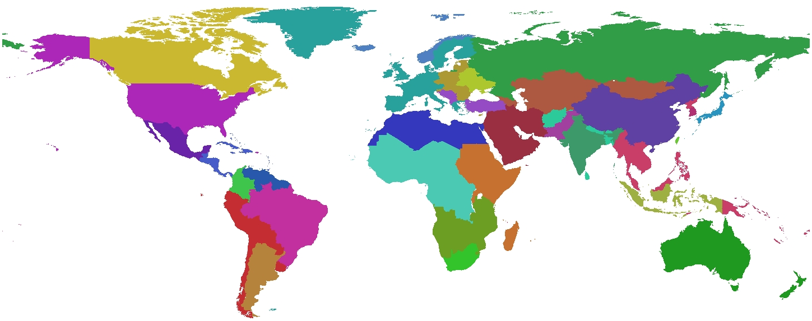
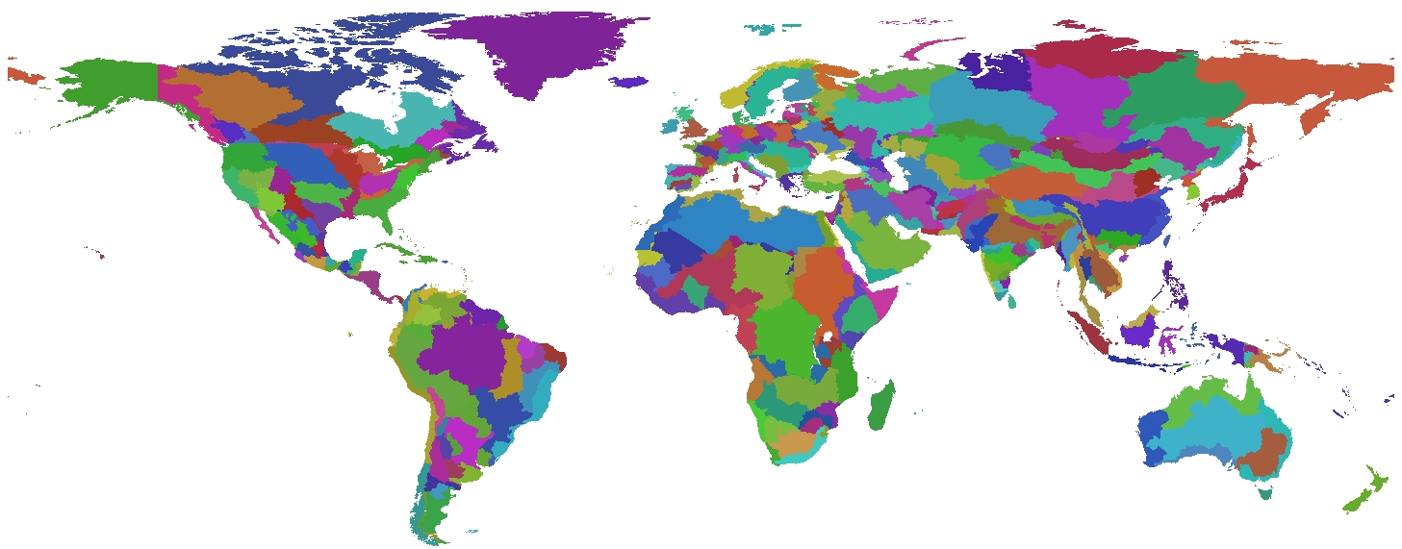
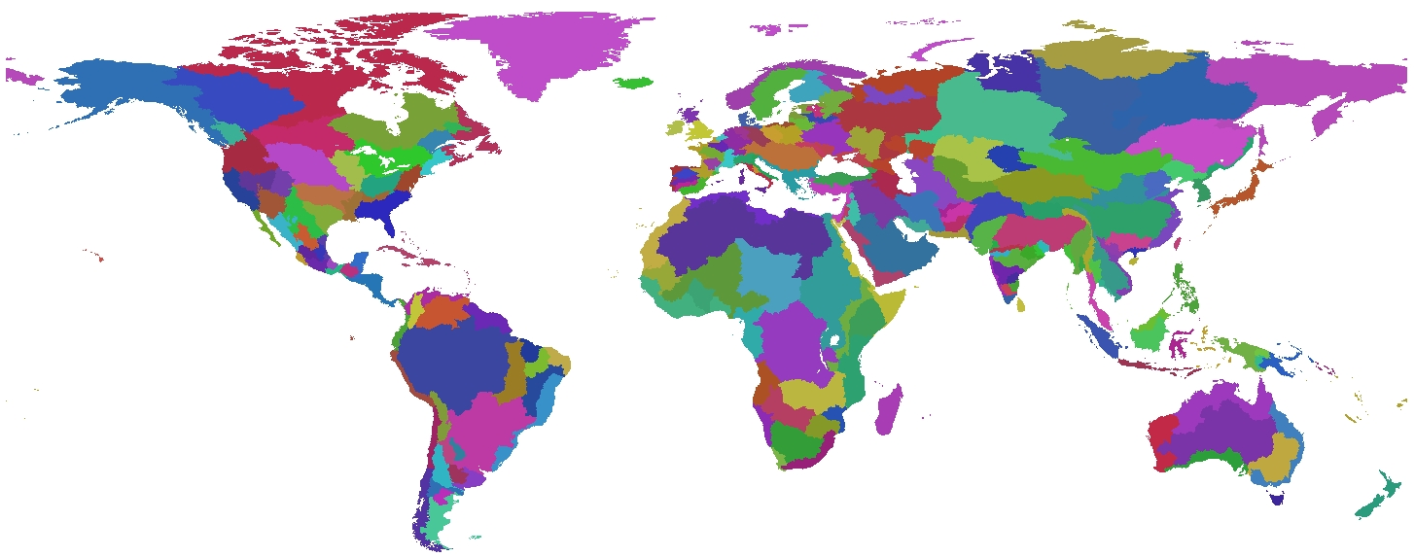
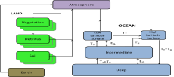
The Global Change Analysis Model (GCAM)
Global Coverage
GCAM is a global model linking Economy, Energy, Land, Water, and Climate systems
Used to examine the effect of technology, policy, and climate on the economy, energy system, agriculture and land-use, and climate
Anthropogenic emissions of 24 greenhouse gases and short-lived species: CO₂, CH₄, N₂O, halocarbons, carbonaceous aerosols, reactive gases, sulfur dioxide.
Runs through 2100 in 5-year time steps. Can be run at 1-year time steps.
Open source: https://github.com/jgcri/gcam-core
Documentation available at: http://jgcri.github.io/gcam-doc/
32 Energy & Economy Regions
384 Land Regions
235 Water Basins
Reduced-Form ESM (Hector)

Slide 16
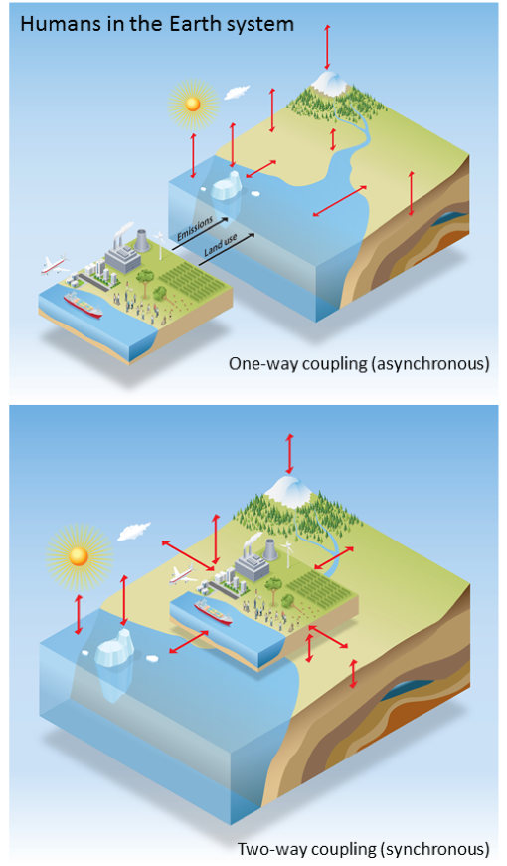
Simulation Plan:
BGC Simulation Modes
Two simulation modes:
One-way coupling (CMIP-like)
Two-way coupling, with human-Earth system interactions

Slide 17
Simulation Plan
Fossil Fuel CO₂ Emissions
Cropland and Forest Cover

Slide 18
Simulation Plan
To understand the effect of model features and forcing factors, we will perform a series of land-only, ocean-only, and coupled model sensitivity experiments, including simulations:
With different initial conditions,
With and without FATES (offline land model only),
With and without explicit crops, and
With and without RRM.

Slide 19
Spin-Up Timeline
Planning 3000 years of offline, low res ocean spin-up
Low Res Ocean
Ocean
RRM Ocean
We may need to iterate between coupled spin-up and uncoupled.
Low Res Land
Low Res Land + Atm
Land
RRM Land
RRM Land + Atm
Two spin-up modes (with and with accelerated decomposition)
We will have to do some minor retuning of the model once BGC is active
Low Res Coupled
Coupled
RRM Coupled
Today
Jan 2022
July 2022
Notes:
Land spin-up
Step 1: AD spin-up for 200-250 years (FATES will need 100-200 more years of AD)
Step 2: Regular spin-up. For v1 this was roughly 600 years, but we will continue until equilibrium conditions met

Slide 20
BGC v2 Spin-Up Plans
Equilibrium Criteria:
Ocean:
Carbon flux of less than 10 PgC / century (long-term average of 0.1 PgC yr⁻¹)
Land:
Global carbon flux of less than 10 PgC / century (long-term average of 0.1 PgC yr⁻¹)
Fewer than 5% of grid cells are out of C balance by more than 1 g C·m⁻²·year⁻¹

Slide 21
Overall BGC Timeline
Spin-Up
Coupled Simulations and Paper Writing
v1
NGD Development
BGC Testing and Integration
Spin-Up
Coupled Simulations and Paper Writing
v2
NGD Development
BGC Testing and Integration
v3
Phase 2 Start
Today
Phase 3 Start

Slide 22
Looking ahead to Phase 3 and v3
Given the time required for spin-up, the Phase 3 proposal will likely be submitted before spin-up is complete.
We are working on demonstrations of the v2 model that can be completed prior to having the coupled model spin-up complete.
Potential v3 science:
The BGC team has been coordinating with the NGDs and making plans to evaluate relevant aspects of the v2 model (e.g., CH₄, FATES, crops) in anticipation of v3 science.

Slide 23
Thank you!

