Slide 1


Quantifying and reducing uncertainty in the E3SM land model using surrogate modeling
Daniel M. Ricciuto (ORNL)
Khachik Sargsyan (SNL-CA)
Peter Thornton (ORNL)
Dan Lu (ORNL)
E3SM all hands presentation
May 27, 2021

Slide 2
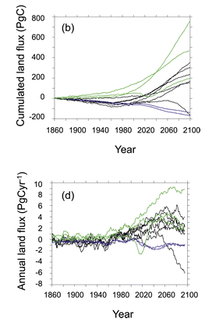
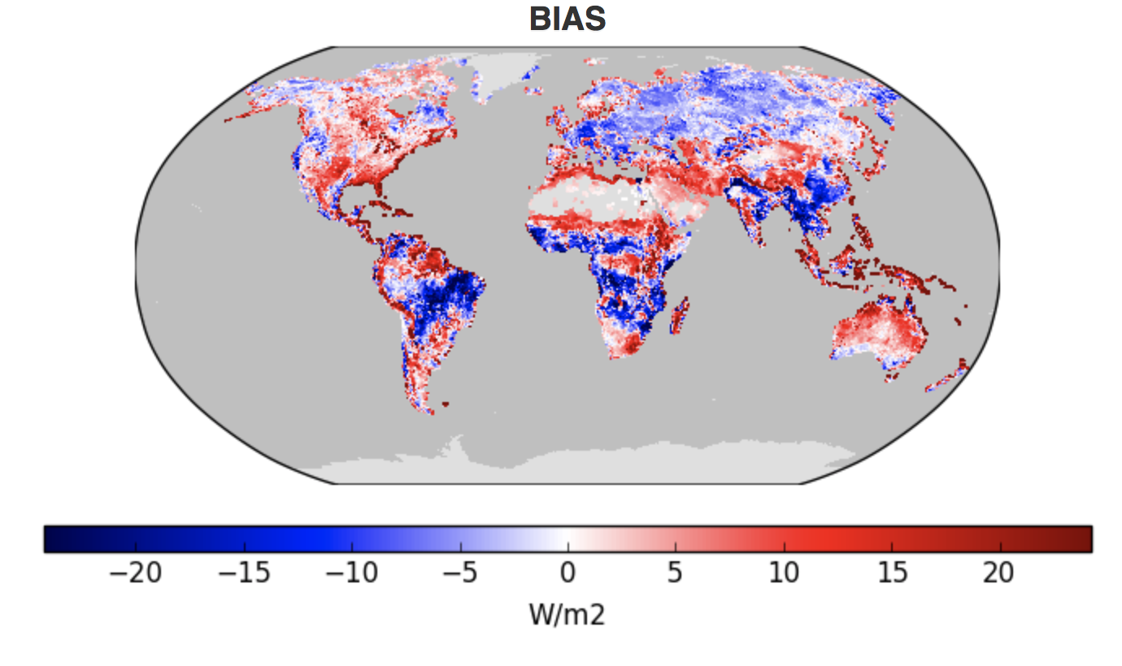
Overview and motivation: LSMs
Uncertainty from Multi-model ensembles
Large spread in outputs
Many quantities of interest
Little formal uncertainty quantification (UQ)
  Expensive model evaluation
  High dimensionality
UQ challenges in E3SM :
What processes drive uncertainty?
What accounts for the key differences among models?
Can model calibration using observations (e.g. satellite data) reduce uncertainty?
Friedlingstein et al (2014)
Notes:
Paper containing original image:
http://journals.ametsoc.org/doi/abs/10.1175/JCLI3800.1

Slide 3
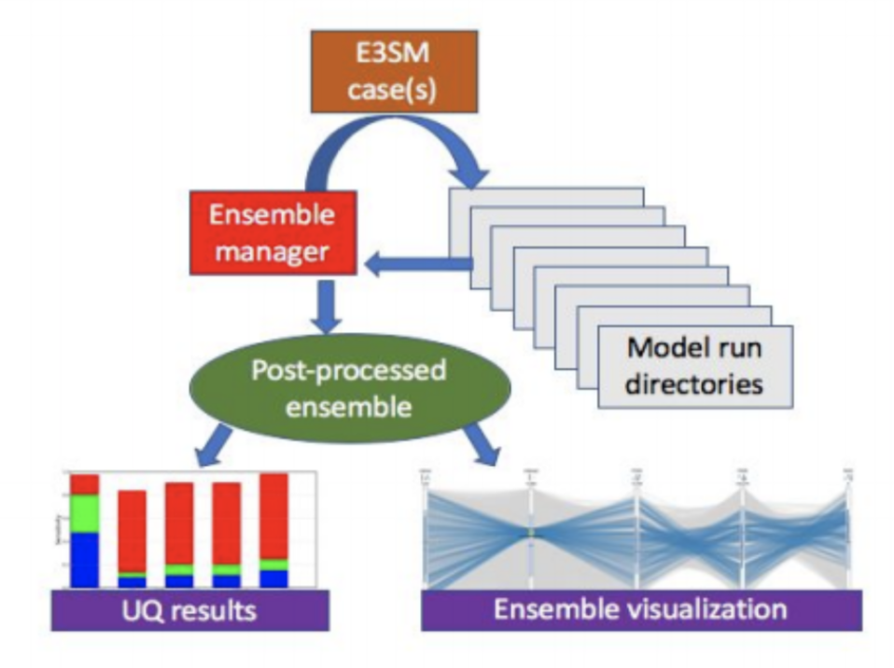
The case for large ELM ensembles
Needed to understand parametric uncertainty
High dimensionality (uncertain parameters)
Can be used to construct surrogate models, which enable UQ methods
  Sensitivity analysis
  Parameter calibration
Surrogate model
Single gridcell UQ: Uses mpi-serial version of ELM with mpi4py in the offline land-model testbed (OLMT) to run up to 10k ensemble members
  Ongoing tasks: ELM-FATES, crop, default ELM
Global UQ: Generally smaller ensembles (100-200), low resolution

Slide 4
A global ELM ensemble
Focused on GPP (gross primary productivity)
  Primary input for land C-cycle,
  strong coupling with transpiration
10 parameters analyzed using 275 ensemble members (1.9x2.5 resolution), satellite phenology

Slide 5
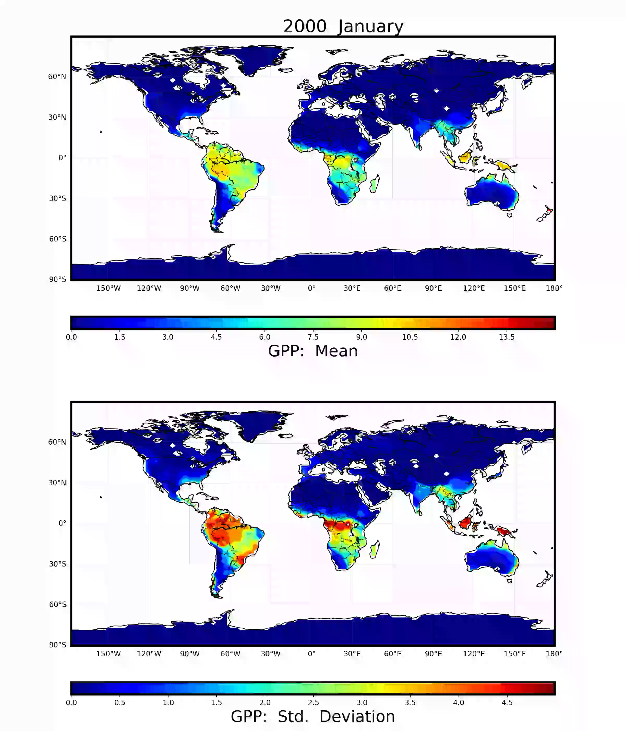
GPP (gC m⁻² day⁻¹) ensemble

Slide 6


Goal: create a surrogate model
Surrogate model is a “good-enough” approximation of the full model
over a range of parameter variability.
… otherwise called
Metamodels
Response surfaces
Emulators
Low-fidelity model
Black Box
$$Y=f(λ;x, t, …)$$
Uncertain input
parameters
Operating conditions,
forcings, indexed QoIs
Surrogate models are needed for computationally intensive tasks:
Parameter estimation
Optimization
Experimental/computational design
Forward uncertainty propagation
$$f\left(λ;x, t, …\right)≈f_{surr}(λ;x, t, …)$$

Slide 7

Curse of dimensionality hits twice!
Black Box
$$Y=f(λ;x, t, …)$$
Uncertain input
parameters
Operating conditions,
forcings, indexed QoIs
Challenge:
High-d input: large number of
uncertain parameters
High-d output: large number of
QoIs over high-res grid
Sensitivity analysis to select the
most important parameters
Principal component analysis to
reduce dimensionality
Fix:
Notes:
What helps on the left is that only a few parameters matter at a time
What helps on the right is that there are correlations among QoIs and grid

Slide 8
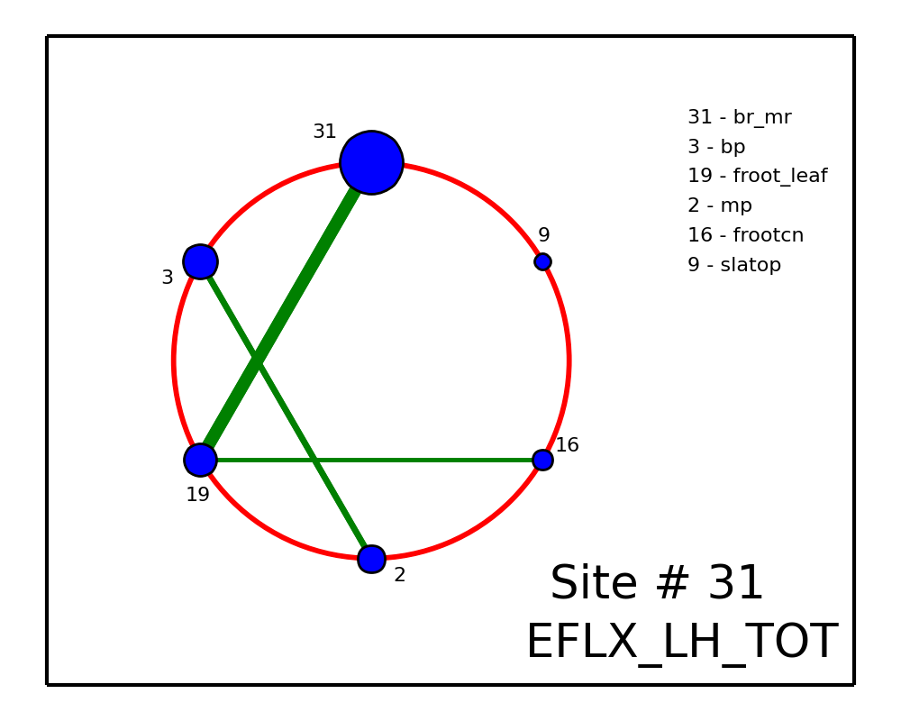
Global Sensitivity Analysis (GSA) enables parameter selection
  … otherwise called Sobol indices, variance-based decomposition
  Attribute fractions of output variance to input parameters
Param 1
Param 2
P 3
Param 4
Param 5
i.e., how much output variance
would reduce if a given parameter
is fixed to its nominal value
also generalizes to joint sensitivities:
joint parameter impact to a given QoI

Slide 9
Sensitivities of global average GPP

Slide 10

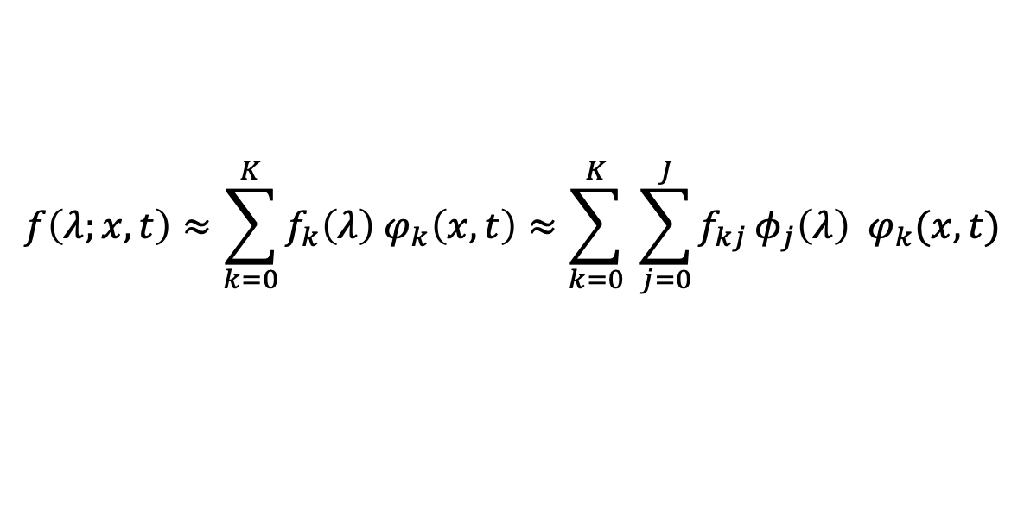
Spatio-temporal surrogate model via Karhunen-Loève and Polynomial Chaos
$$f\left(λ;x, t\right)≈\sum_{k=0}^{K}{f_{k}\left(λ\right){ φ}_{k}\left(x,t\right)}≈\sum_{k=0}^{K}{ \sum_{j=0}^{J}{f_{kj}}φ_{j}\left(λ\right) φ_{k}(x,t)}$$
KL
PC
$$f_{surr}(λ;x, t)$$
Karhunen-Loève (KL) expansion is essentially a continuous version of
principal component analysis
Polynomial chaos (PC) expansion is essentially a polynomial regression
with respect to uncertain parameters

Slide 11
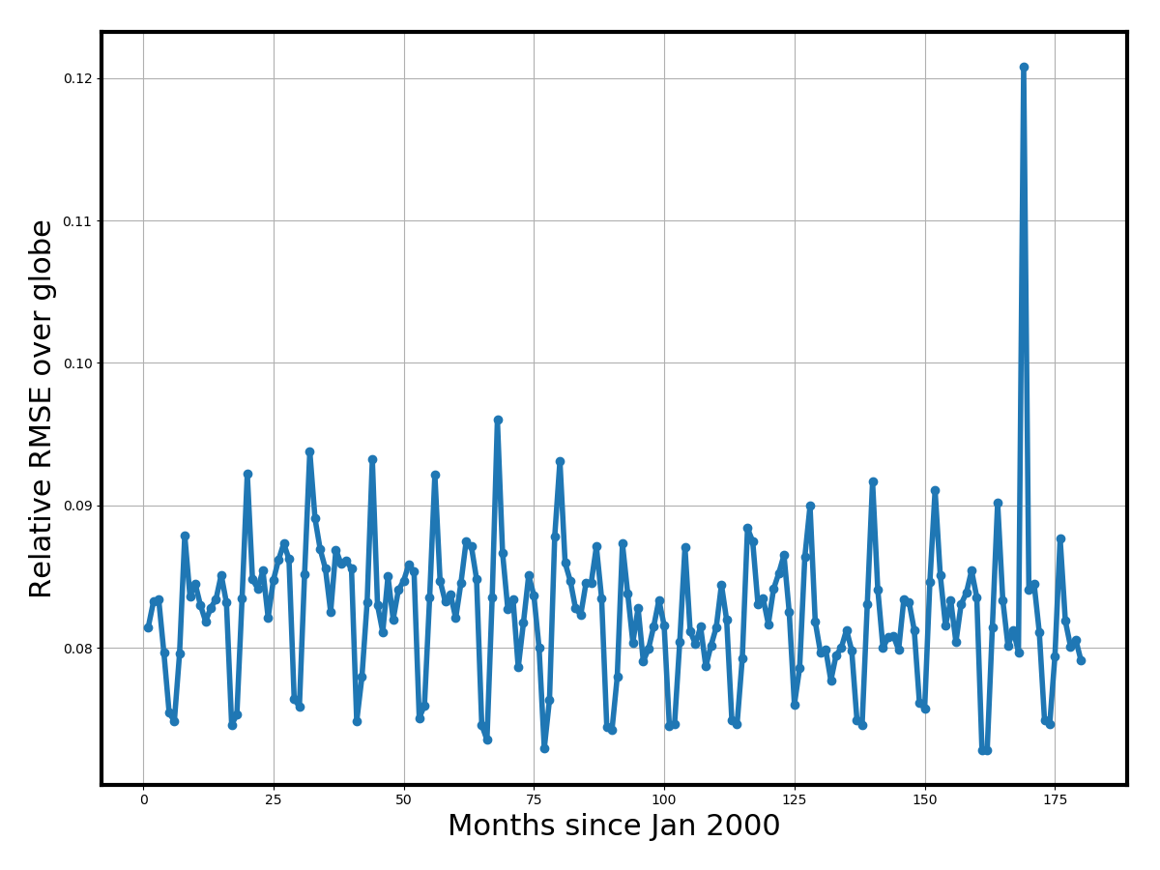
Spatio-temporal KL-PC surrogate
is globally within 10% accuracy
3183 land cells over 180 months is > 500,000 outputs
Instead of 500K surrogates, we build about 2K surrogates,
one for each eigen-component
End result: a single surrogate,
resolved in space and time,
with about 10% relative error
compared to true ELM
Surrogate ELM is extremely cheap
to evaluate and is being used
online to calibrate the parameters
Room to improve: neural networks!!

Slide 12
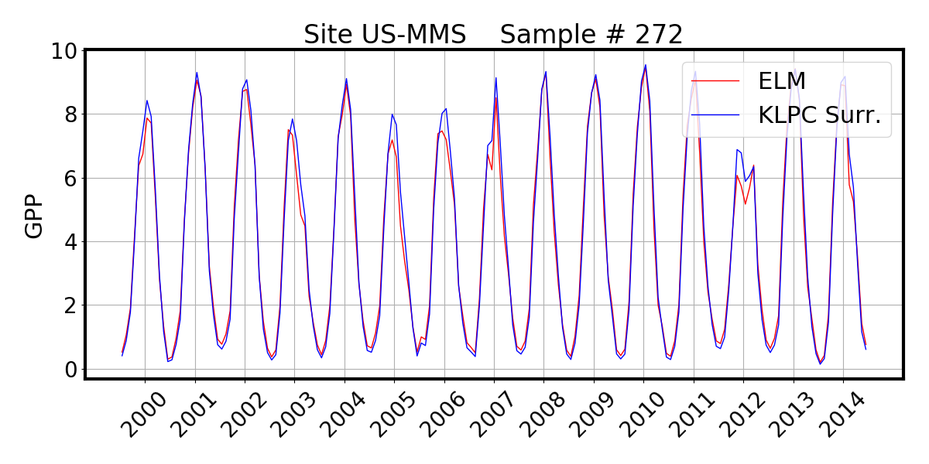
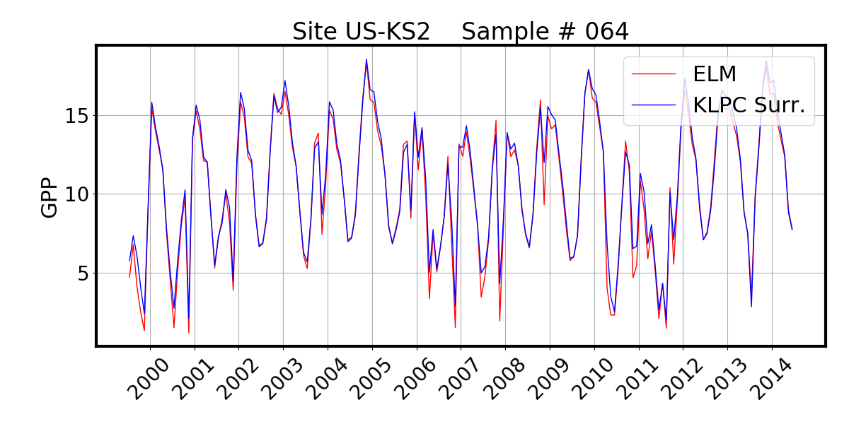
ELM vs Surrogate:
accuracy can be improved with higher order KL or PC

Slide 13
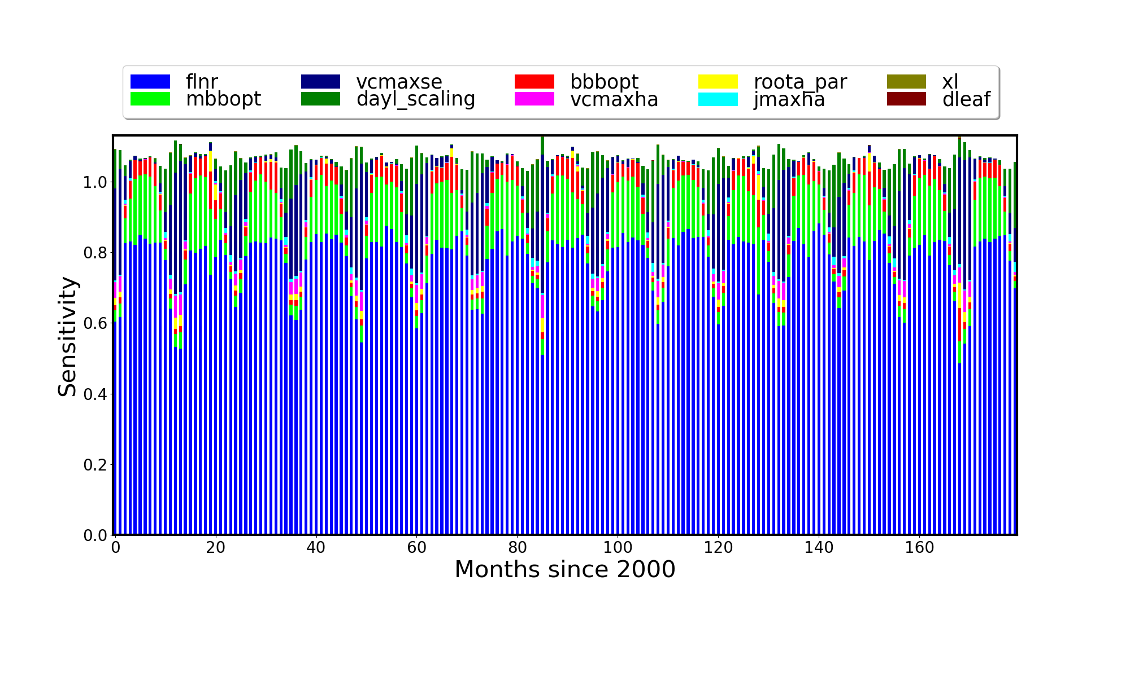
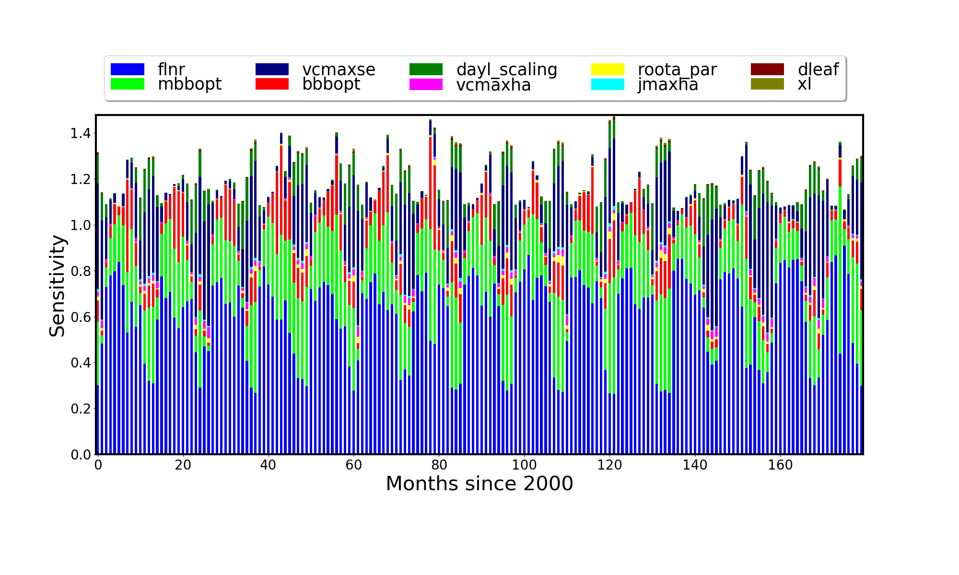
Gridcell-level sensitivities
Site US-Ha1
Deciduous forest
Massachusetts, USA
Site US-Fpe
Grassland
Montana, USA
Notes:
Higher water limitation in Montana leads to increased importance of stomatal parameters, which regulate transpiration.

Slide 14
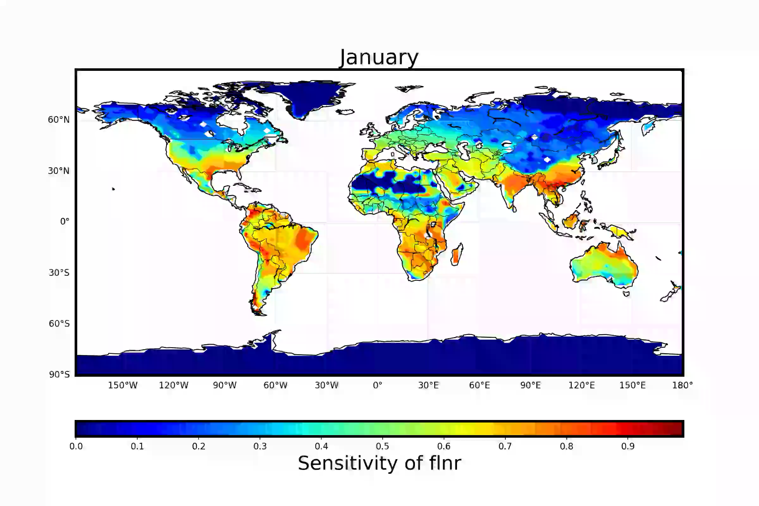
Sensitivity to flnr
(fraction of leaf N in RuBisCO)
Notes:
Important nearly everywhere there is active vegetation

Slide 15
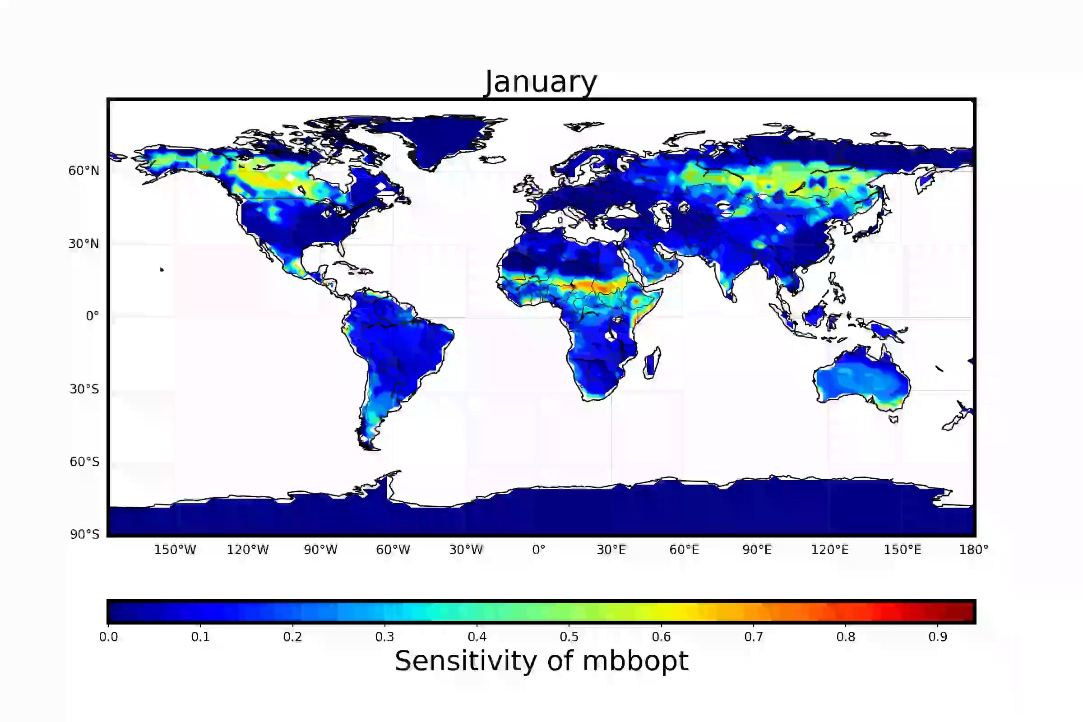
Sensitivity to m_{BBopt}
(stomatal slope)
Notes:
More important over dry and/or cold regions

Slide 16
Constraining ELM with FLUXNET
FLUXNET towers measure CO₂, water, energy fluxes
FLUXCOM: A gridded GPP benchmark upscaled from FLUXNET network using meteorology, remote sensing
In this study: 96 high-quality sites selected for calibration
This analysis focuses on calibration at multiple gridcells, but methodology can be used to calibrate gridded observations/benchmarks (e.g. FLUXCOM)

Slide 17
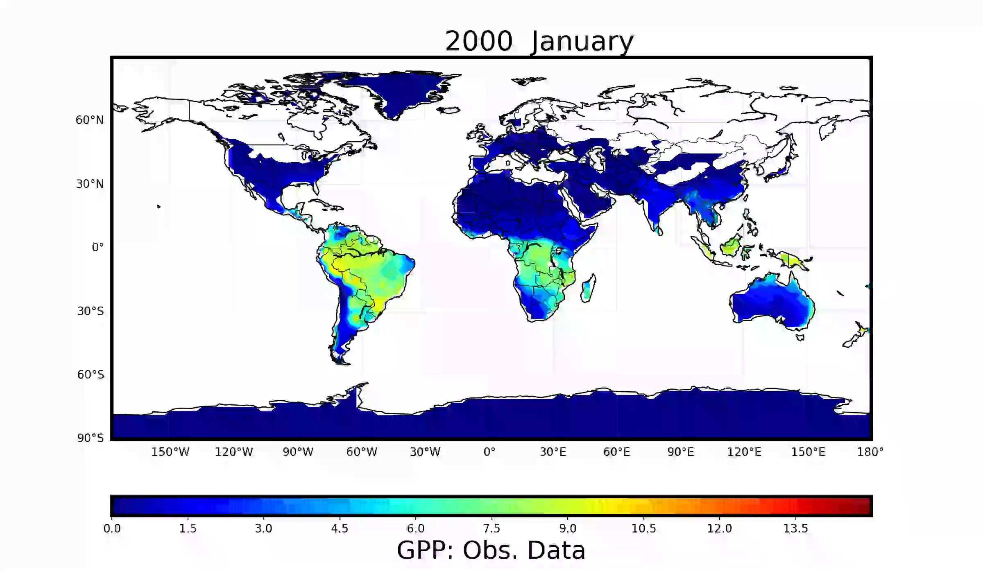
FLUXCOM data, visualized

Slide 18
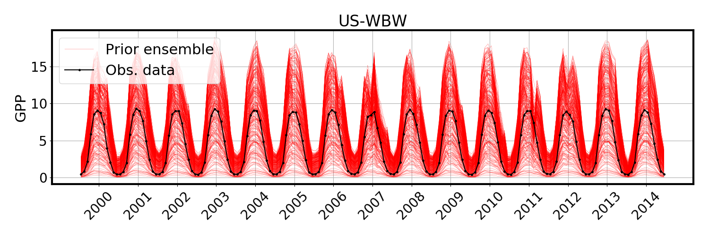
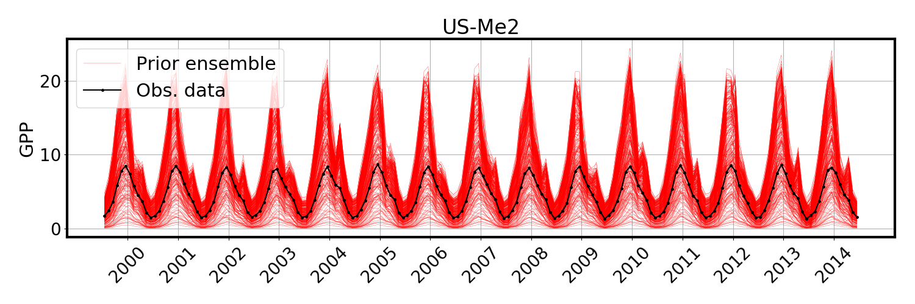
Model ensemble with GPP data
Deciduous forest, Tennessee, USA
Evergreen forest, Oregon, USA

Slide 19
Bayesian approach is main tool for parameter calibration
Bayesian inference allows incorporation of various sources of uncertainty
Markov chain Monte Carlo (MCMC) for building posterior PDFs
  Ugly high-dimensional parameter PDFs, but advanced MCMC methods are available
Requires many online evaluations of the model
  This is why we needed the surrogate!
Predictive uncertainty decomposition augmented with surrogate error and observational noise, and model structural error
Param 1
Param 2
Param 4
Surr. error
Data noise
Model str. error
Prediction variance

Slide 20
Calibration with Embedded
Model Structural Error
Model structural error embedding approach [Sargsyan et. al., 2015, 2018]
    Embedded, but not intrusive, i.e. black-box
    Meaningful extrapolation to full set of QoI predictions
    Disambiguation between model error and data noise
    Removes parameter biases and overfitting

Slide 21
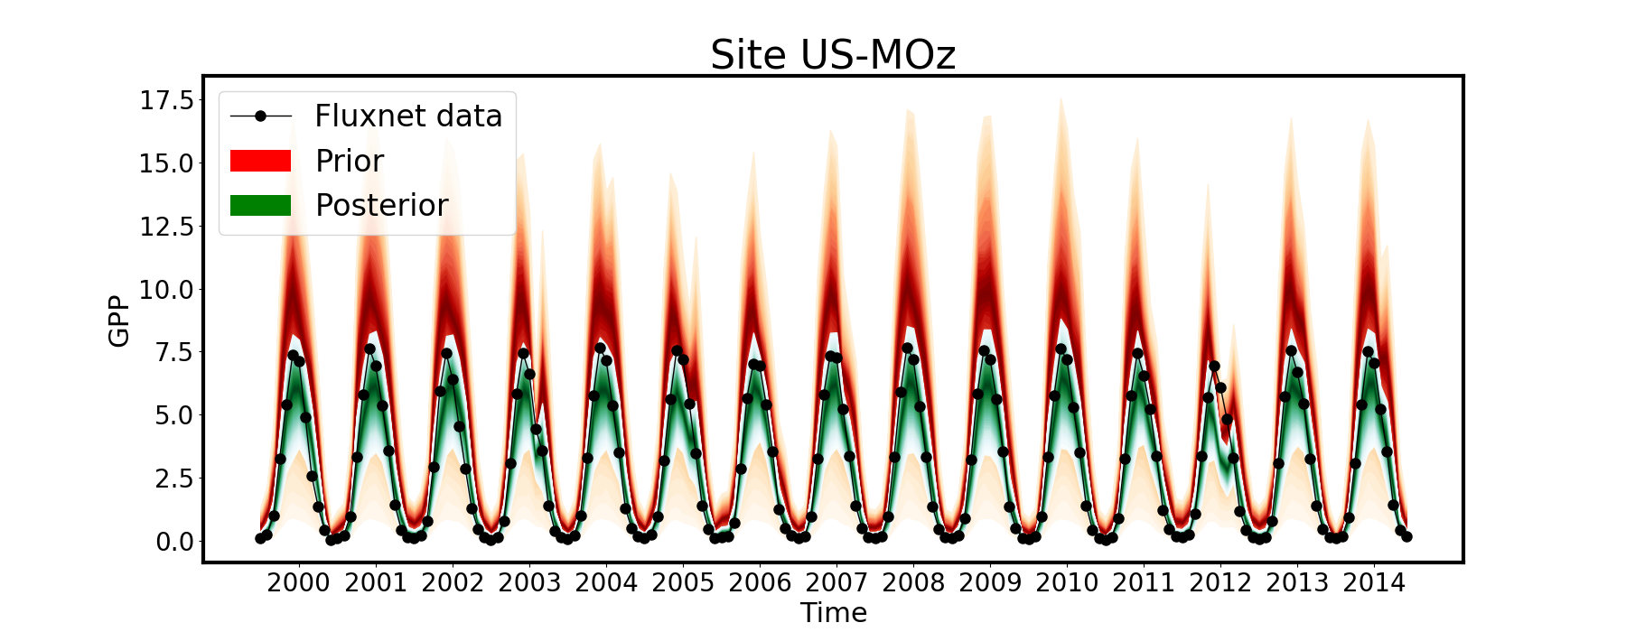
Prior vs posterior predictions…
Uncertainty reduction: zoom in the parameter space regions relevant to obs. data
Deciduous forest, Missouri, USA

Slide 22
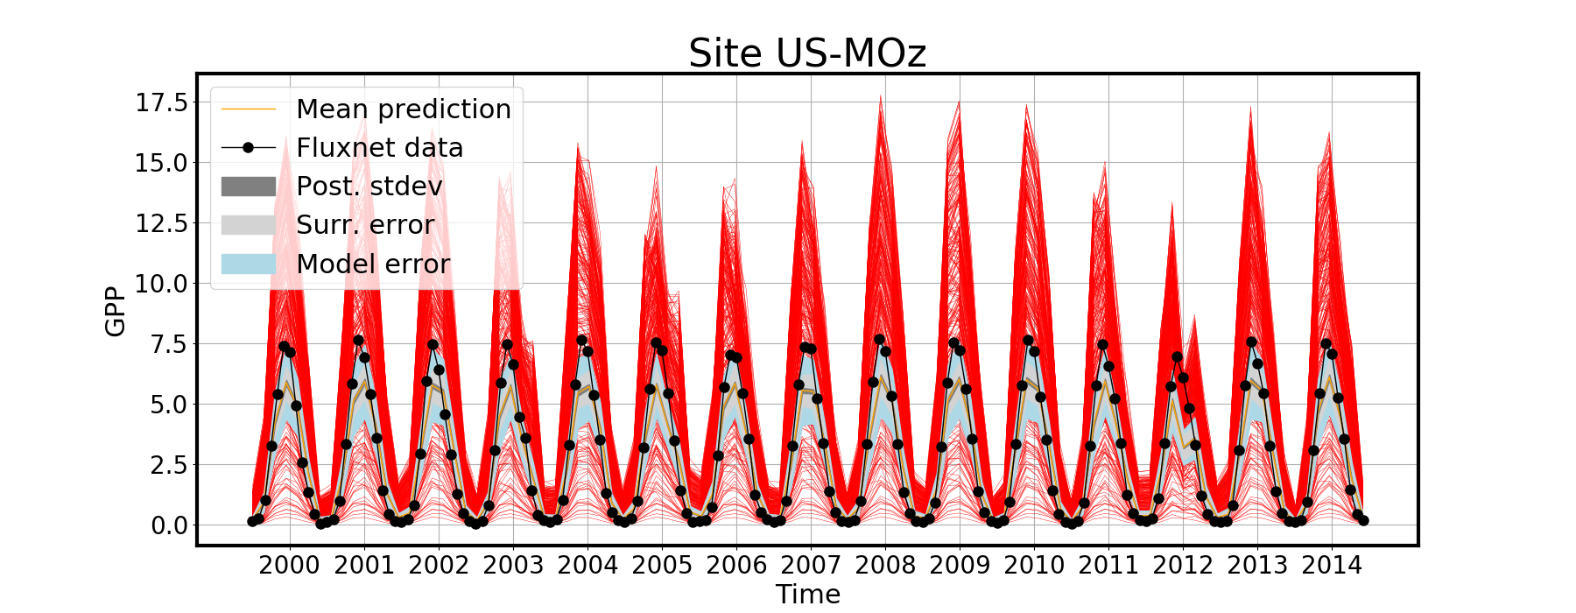
… with uncertainty decomposition
Model structural error is usually the largest contributor of predictive variance

Slide 23
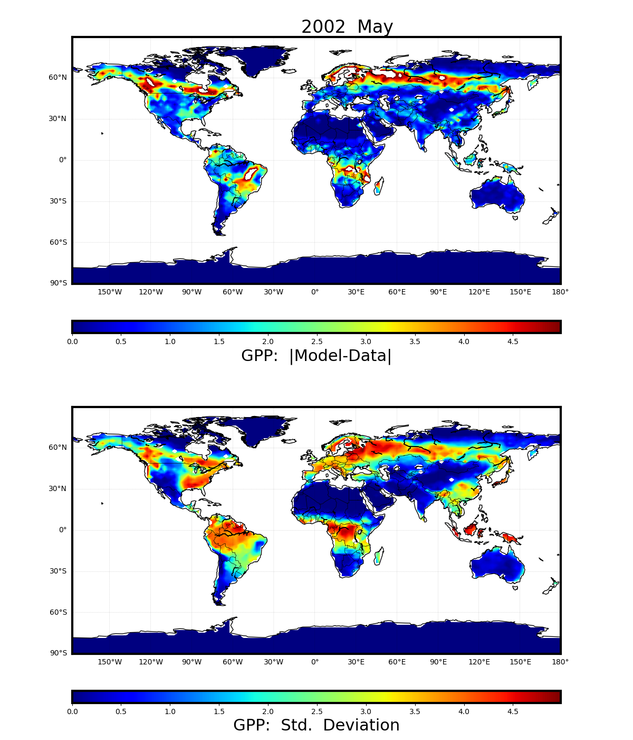
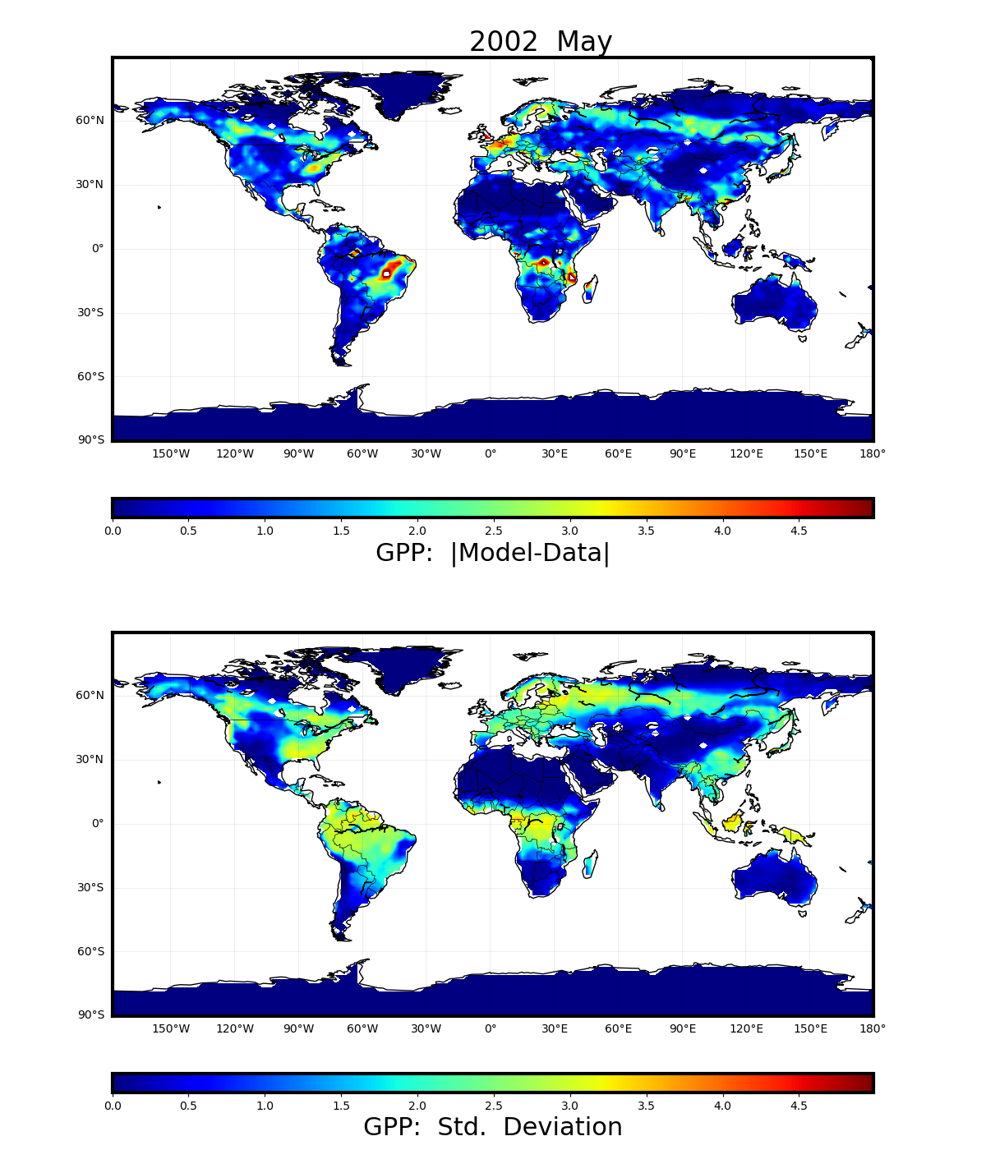
Calibration reduces predictive mean error and predictive standard deviation
Prior
Posterior
Notes:
Calibrated three most sensitive inputs (flnr, mbbopt, vcmaxse) using
45 Western Hemisphere sites; used for posterior prediction globally

Slide 24
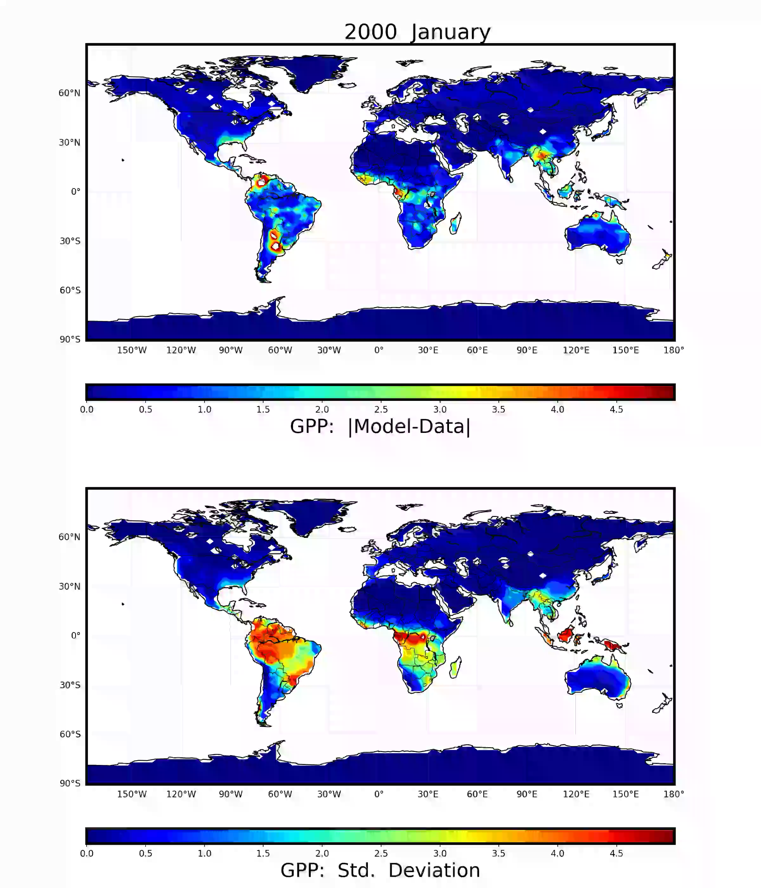
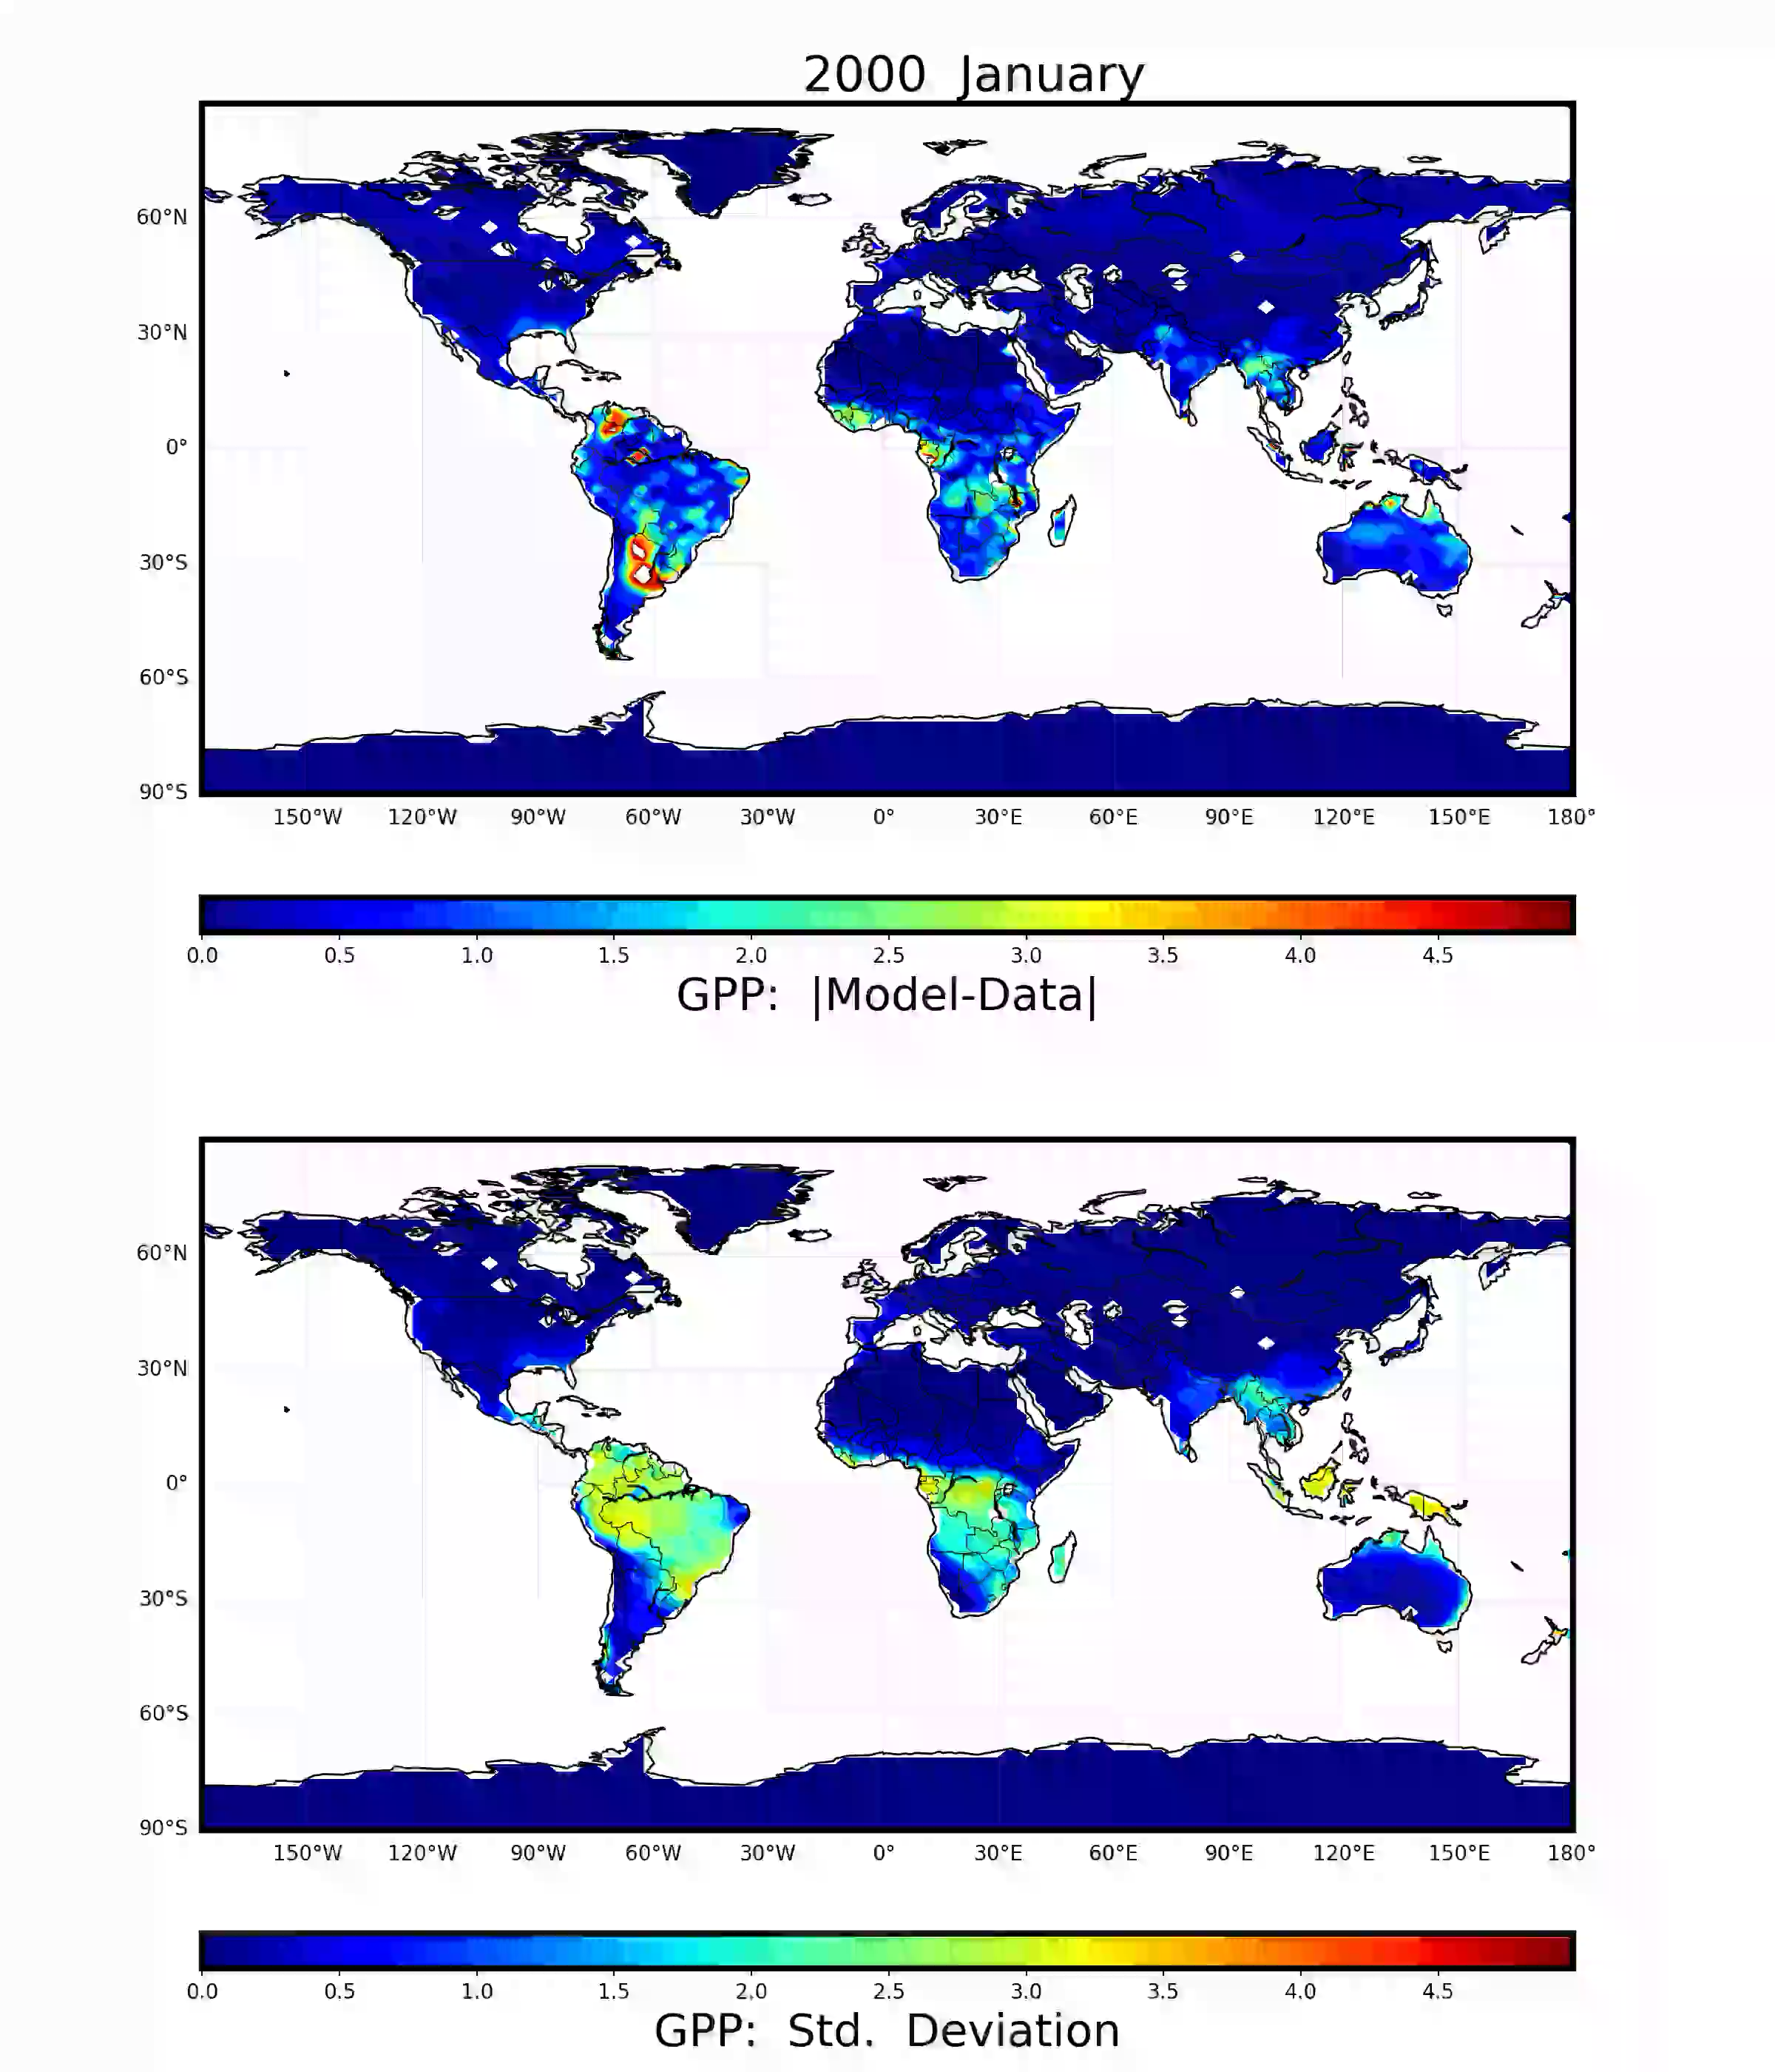
Calibration reduces predictive mean error and predictive standard deviation
Prior
Posterior
Notes:
Calibrated three most sensitive inputs (flnr, mbbopt, vcmaxse) using
45 Western Hemisphere sites; used for posterior prediction globally
(REPLACE POSTERIOR VIDEO)

Slide 25
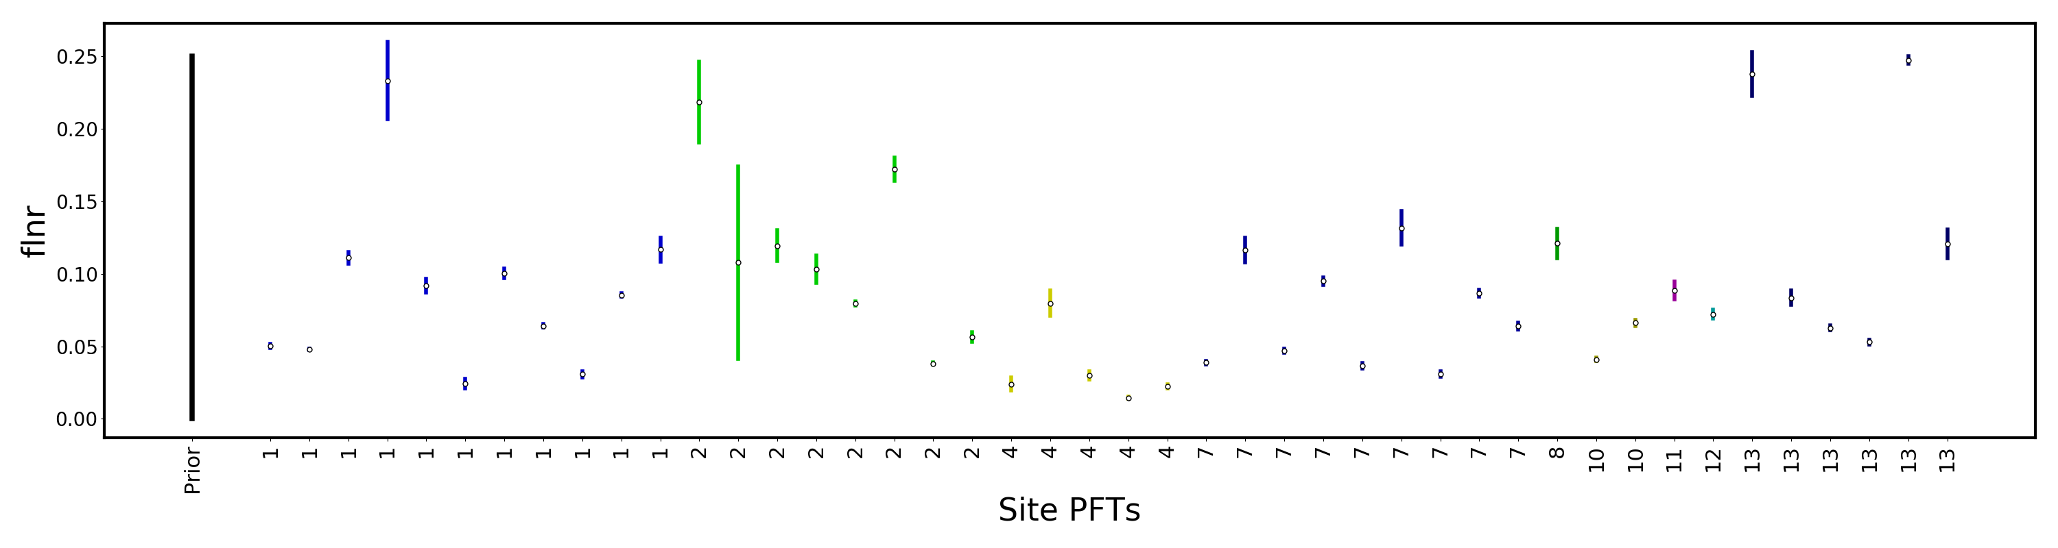
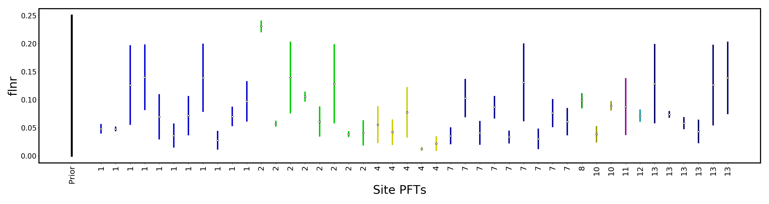
Calibrated parameter values across FLUXNET sites
Without model error: Overfitting, i.e. high variability in flnr across sites within and across PFTs
With model error: fair representation of unknown flnr (still narrower than prior!)

Slide 26
Summary
Constructed spatio-temporal surrogate to approximate ELM
  Karhunen-Loève + Polynomial Chaos expansions
  Surrogate is orders of magnitude less expensive than ELM
  Global sensitivity analysis or variance decomposition is a free bi-product
  Bayesian calibration using online evaluation of the surrogate
  Embedded model structural error provides the missing uncertainty component
  Reduction of predictive uncertainty in light of FLUXCOM data
  Full decomposition of predictive uncertainty
Build a global land-model calibration framework
  Construct ensembles with land biogeochemistry active (higher expense)
  Determine sensitive parameters for land variables that couple to Earth system
  Engage with ILAMB to prioritize datasets to be used to integrate with ELM
  Find best parameters to use in future offline and coupled experiments
Param 1
Param 2
Param 4
Surr. error
Data noise
Model str. error
Next:

