Slide 1
COMPASS Overview
Ian Kraucunas, COMPASS PM
Vanessa Bailey, COMPASS-FME PI
Rob Hetland, COMPASS-GLM PI
Peter Thornton, COMPASS Coupled Modeling Coordinator
E3SM Webinar 1 April 2021

Slide 2
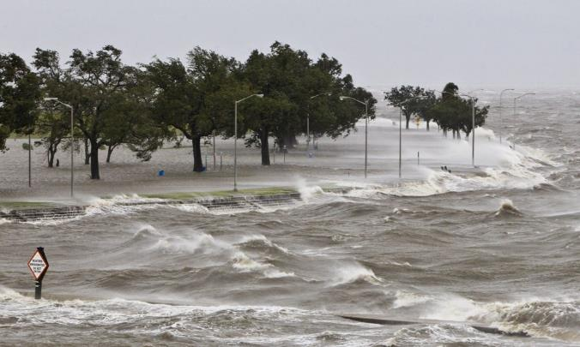
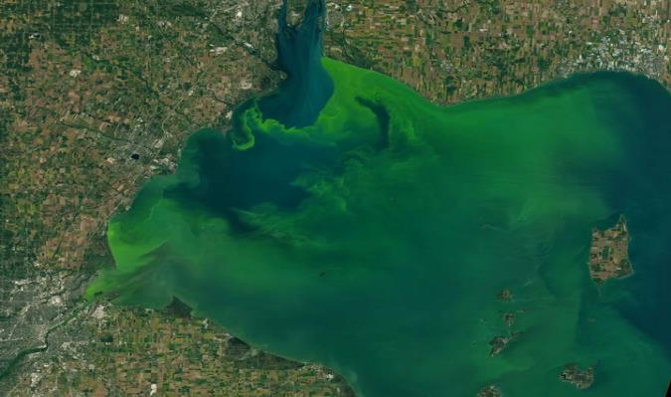
Coastal regions are facing a wide range of changes and challenges
Climate warming
Regional hydrology
Extreme weather events
Ecosystem shifts (e.g., invasive species)
Land use and land cover change
Shoreline evolution
Air and water pollution
Water quality (e.g., harmful algal blooms)
Aging infrastructure
Energy system changes
Transportation impacts

Slide 3
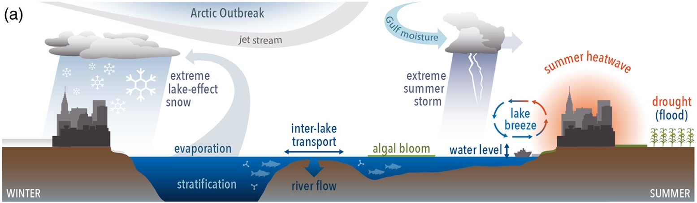
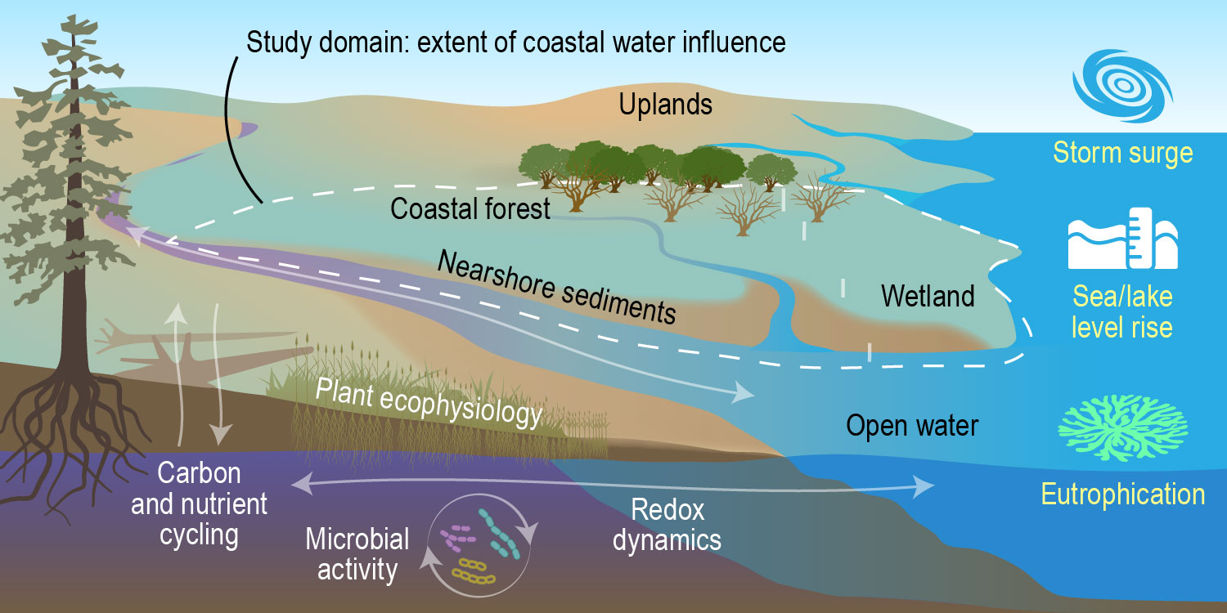
We have identified key knowledge gaps in coastal systems that DOE is well positioned to address
Mechanistic understanding of fundamental processes governing carbon and nutrient cycling in coastal systems
Coupling of processes in predictive frameworks across scales
Enhanced representation of land–lake–atmosphere interactions
Enhanced representation of nutrient removal and transport in watershed models
Representation of coastal processes in Earth system models
From Sharma et al., 2018
Notes:
To address these challenges and advance our understanding of coastal systems, we have identified several important knowledge gaps. The gaps span reaction sale processes up to regional scale:
gaining a mechanistic understanding of the processes that govern carbon and nutrient cycling
Coupling these processes into hierarchical models that cross scales
Within the Great Lakes region – there is a need for enhanced representation of land-lake-atmosphere interactions
An improving our understanding of nutrient flow at regional scales.
Finally, ultimately getting an enhanced representation of coastal processes in E3SM

Slide 4
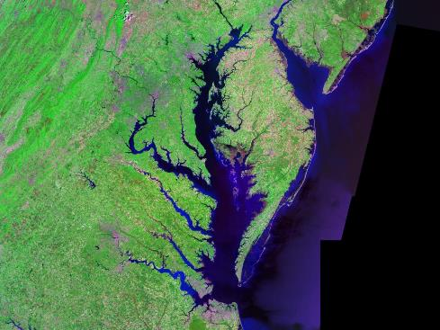
Two study regions offer complementary and contrasting characteristics
Mid Atlantic region
Great Lakes region
Saline to freshwater tidal, sea level rise
Largest freshwater lake system, annual ice
Heavily modified by humans, experiencing natural system change, home to existing research that can be leveraged

Slide 5
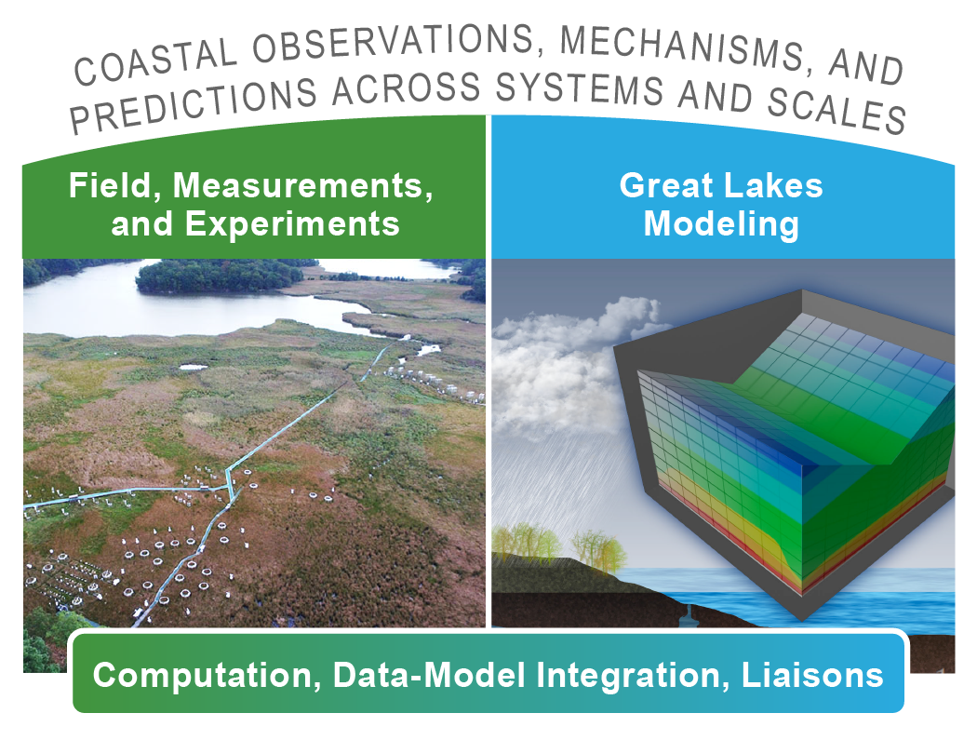
COMPASS aims to dramatically enhance predictive understanding of coastal systems, including their response to short- and long-term changes
Two pilot studies, one focused on measurements and one focused on modeling
Cross-cutting capabilities, including new computational resources for DOE coastal science and liaisons to other projects
DOE PM: Dan Stover, ESS
DOE PM: Renu Joseph, EESM
Notes:
With that in mind, our vision is to enhance our predictive understanding of coastal systems targets some of the biggest uncertainties in projecting the evolution of coastal environments.
Under the COMPASS umbrella, we will launch 2 pilot studies aims at giving us a multiscale view of coastal processes. One pilot will focus on field observations and experiments to gain mechanistic understanding of the Dynamic array of coupled physical, chemical, biological, human processes. The second pilot study will focus on building multiscale models at watershed to regional scales looking at important processes such as precipitation, agriculture, water use and lake-land-atmosphere interactions.
Key COMPASS elements
Overarching science questions
Great Lakes Modeling Pilot Study
Field, Measurements and Experiments Pilot Study
Foundational resources
Coordinated team

Slide 6
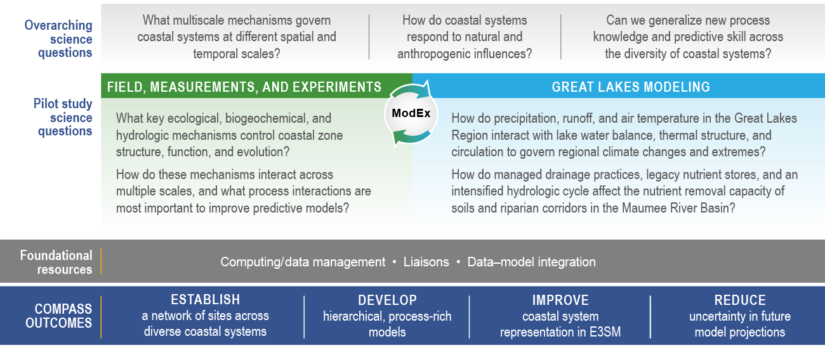
COMPASS aims to dramatically enhance predictive understanding of coastal systems, including their response to short- and long-term changes
Notes:
With that in mind, our vision is to enhance our predictive understanding of coastal systems targets some of the biggest uncertainties in projecting the evolution of coastal environments.
Under the COMPASS umbrella, we will launch 2 pilot studies aims at giving us a multiscale view of coastal processes. One pilot will focus on field observations and experiments to gain mechanistic understanding of the Dynamic array of coupled physical, chemical, biological, human processes. The second pilot study will focus on building multiscale models at watershed to regional scales looking at important processes such as precipitation, agriculture, water use and lake-land-atmosphere interactions.
Key COMPASS elements
Overarching science questions
Great Lakes Modeling Pilot Study
Field, Measurements and Experiments Pilot Study
Foundational resources
Coordinated team

Slide 7
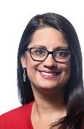
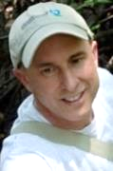
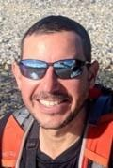
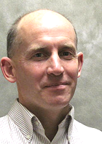


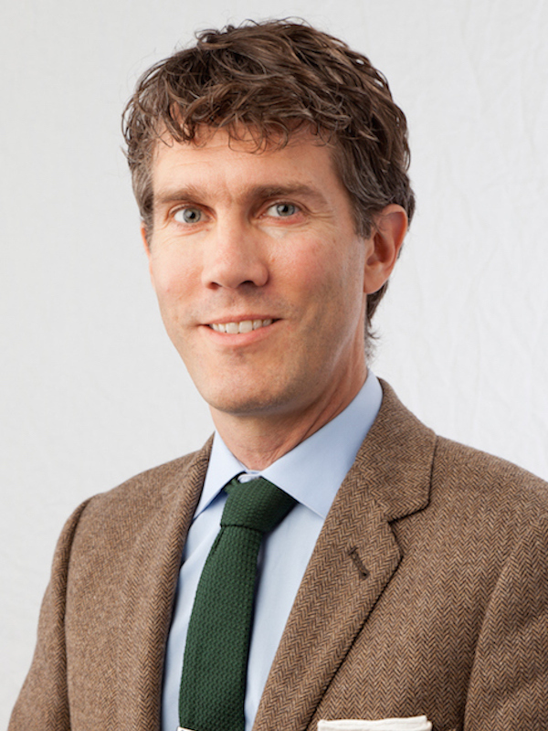



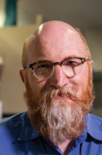


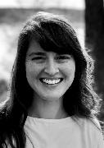
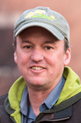
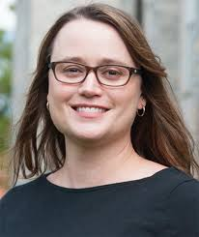
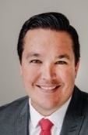




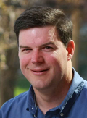
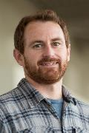
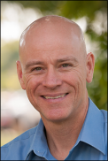
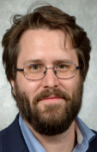

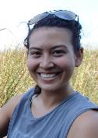

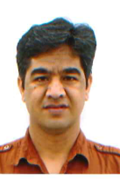




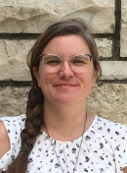

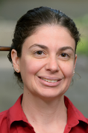
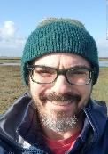

A multidisciplinary team brings expertise and proven experience for achieving our goals
Field, Measurements, and Experiments
COMPASS project management and cross project scientists
Great Lakes Modeling

Slide 8
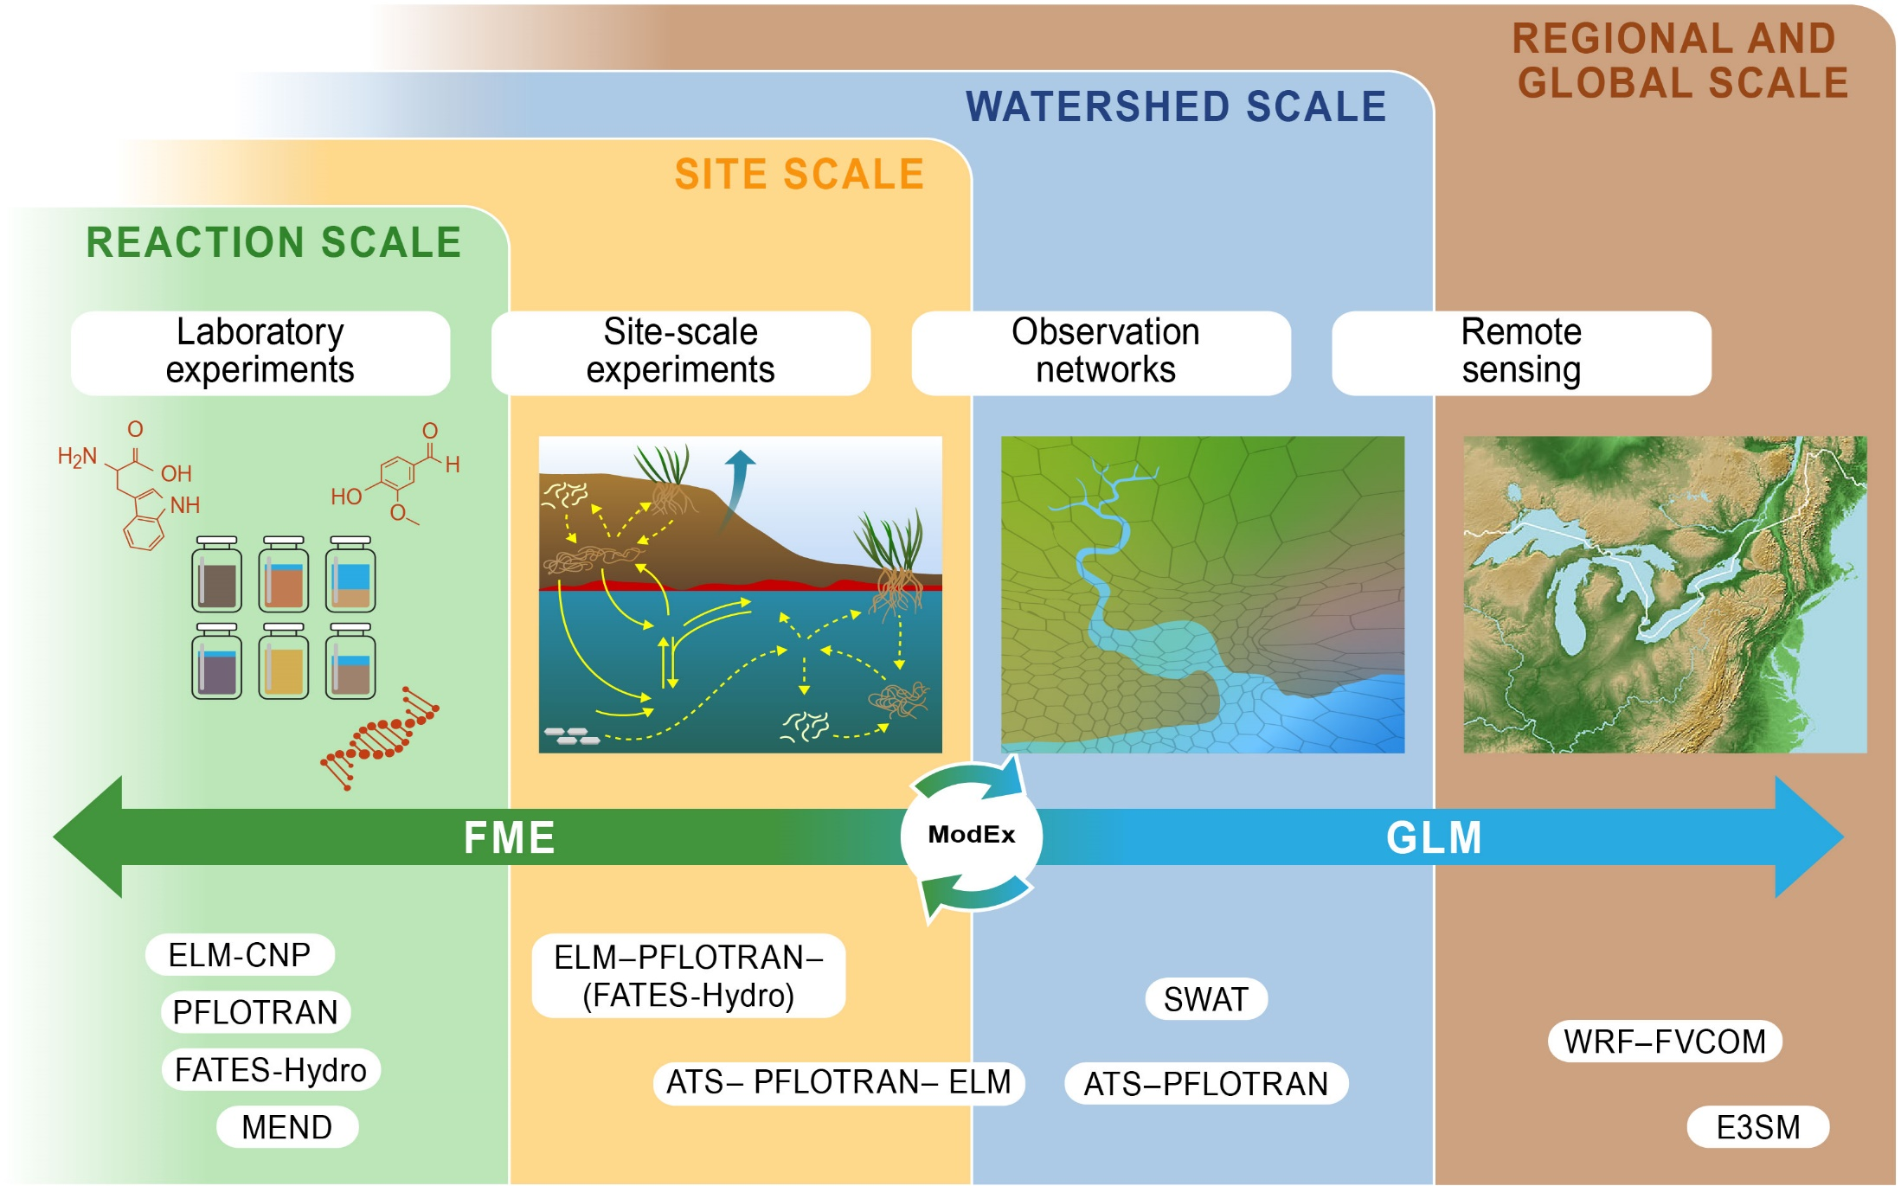
Our two pilot studies span reaction to regional scales and are linked through ModEx
Notes:
Address C1Q3, C1Q4

Slide 9
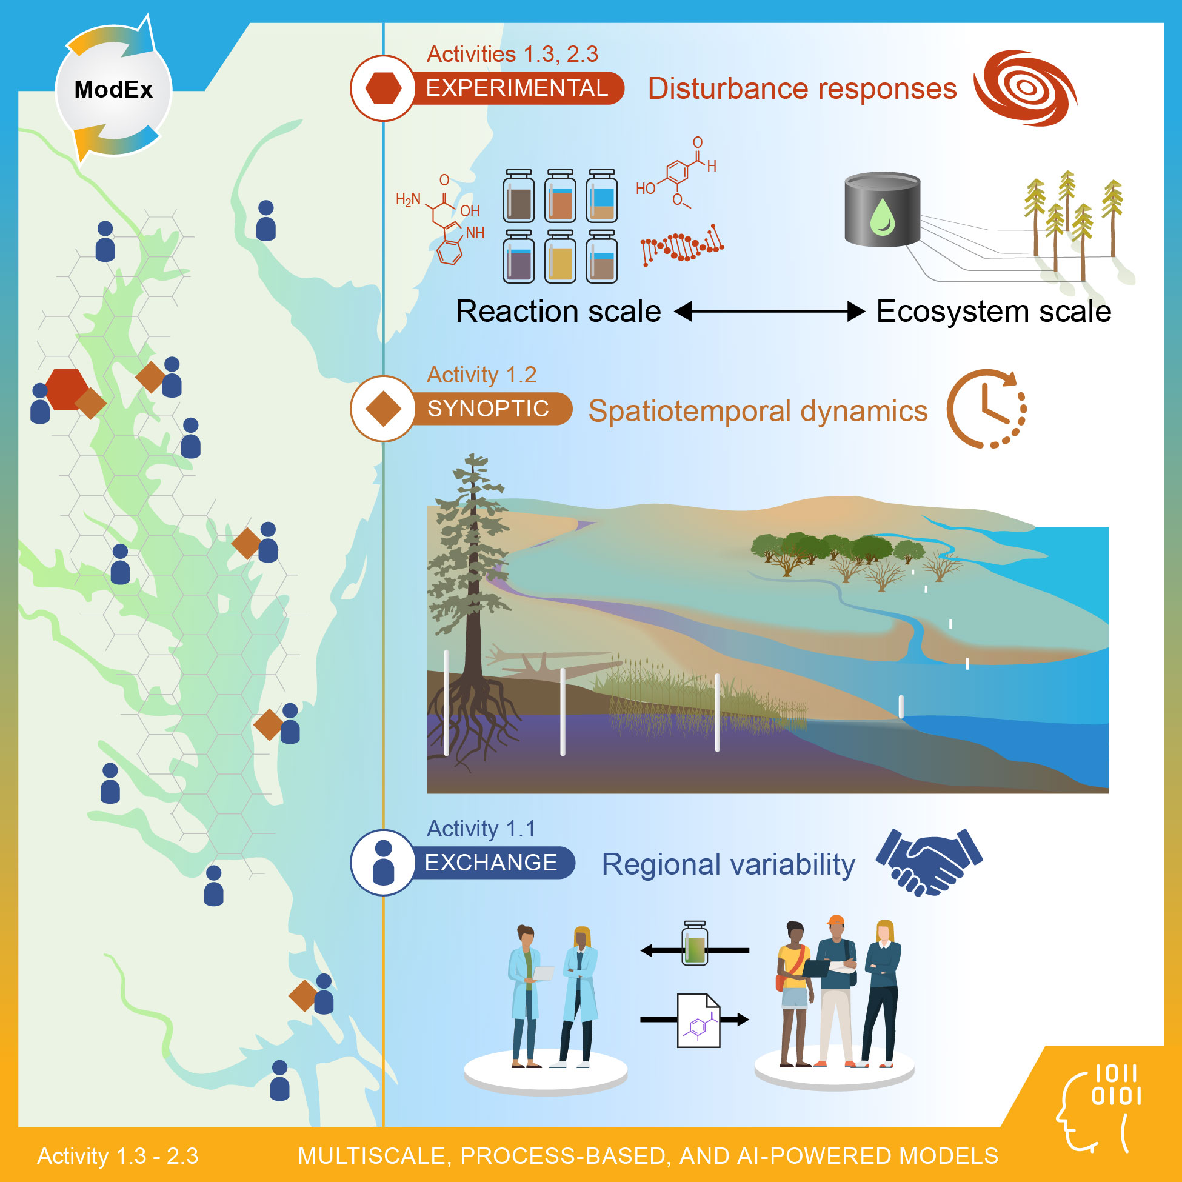
COMPASS-FME (Field, Measurements, Experiments) focuses on the transformations and fluxes of carbon and nutrients across reaction to site scales
Science Questions:
1. What are the fundamental mechanisms that control the structure, function, and evolution of coastal terrestrial–aquatic interfaces?
2. How do these fundamental mechanisms interact across spatial scales, and what interactions are most important to improving predictive models?
Notes:
We focus on a subset of sites in the Chesapeake Bay and Western Lake Erie Basin during this pilot study; these two regions present an opportunity to compare and contrast fresh- and saltwater coastal TAI, as Pat will expand on after the break.
There has been a lot of work in these regions, however, this study specifically targets improving the multiscale predictive understanding of coastal systems, representing these systems in hierarchical models from reaction to site scales.
This guides a need to make measurements and develop mechanistic understanding of processes that occur across the entirety of the interface between the coastal water boundary to the landward extent of the coastal water influence.
Thus the FME study works across the water-wetland-upland gradient where the interactions of water, soil, and vegetation govern biogeochemistry and microbial function emerge.
This includes controls on either side of the interface: plant and soil gradients that support microbial function, interactions between surface and ground waters that alter redox dynamics, and changes in the aquatic end member such as sea or lake level and storm surges and seiches.
NEXT SLIDE, Please

Slide 10
COMPASS-FME seeks a robust mechanistic understanding of coastal terrestrial–aquatic interfaces, with a focus on the transformations and fluxes of carbon and nutrients across reaction to site scales,
We will understand the interactions of soils, waters, and plants, as well as the emergent biogeochemistry to inform multiscale, hierarchical models at select sites in the Chesapeake Bay and Lake Erie regions
COMPASS-FME will leverage existing capabilities and data, including coordination with the ongoing ICoM project in the mid-Atlantic region
Notes:
We focus on a subset of sites in the Chesapeake Bay and Western Lake Erie Basin during this pilot study; these two regions present an opportunity to compare and contrast fresh- and saltwater coastal TAI, as Pat will expand on after the break.
There has been a lot of work in these regions, however, this study specifically targets improving the multiscale predictive understanding of coastal systems, representing these systems in hierarchical models from reaction to site scales.
This guides a need to make measurements and develop mechanistic understanding of processes that occur across the entirety of the interface between purely aquatic and purely terrestrial systems from open water to the landward extent of the coastal water influence.
Thus the FME study works across the water-wetland-upland gradient where the interactions of water, soil, and vegetation govern biogeochemistry and microbial function emerge.
This includes controls on either side of the interface: plant and soil gradients that support microbial function, interactions between surface and ground waters that alter redox dynamics, and changes in the aquatic end member such as sea or lake level and storm surges and seiches.

Slide 11
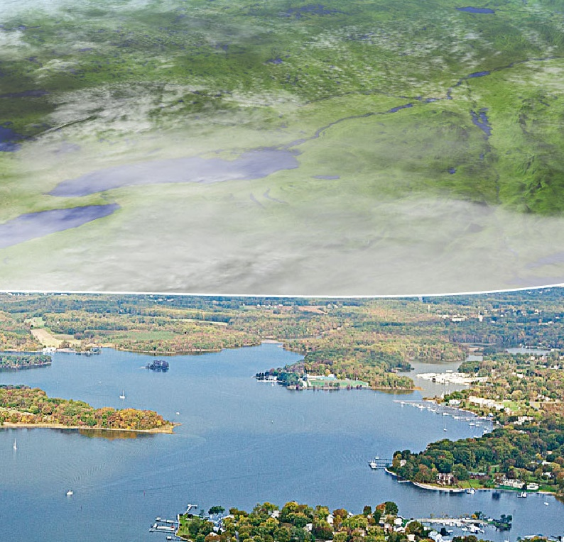
COMPASS-FME Outcomes & Future Work
FME Pilot Study Outcomes:
A prototype high-resolution coastal TAI module with coupled processes important to coastal ecosystems
Improved knowledge of mechanisms that control fluxes and transformations of carbon and nutrients across TAIs
Improved fine-scale representations of these mechanisms in integrative models
FME Future Work:
  Modeling disturbance impact
  Research in new coastal regions
.
Notes:
While we focus on a Pilot 2-year study, we are clear that this is part of an important foundation for next steps by us, or the community
We are targeting 3 important outcomes of this research.
A prototype high-resolution coastal module for coupled processes important to the coastal TAI ecosystems studied in this pilot study
This is informed by the resolution of mechanisms that control the fluxes and transformations of C and nutrients across coastal TAI. This includes understanding the impact and importance of redox processes, shifts between aerobic and anaerobic metabolisms, and sensitivities to changing water chemistries, whether via seawater or lake water intrusion or nutrient runoffs from land and feedbacks to the lake/estuary water qualities
These mechanisms will be translated into both scale- and domain-specific models and into fully-coupled integrative models
Through the research plan, we will also get benchmarking data sets that will endure as a community resource, and a network of coordinated field sites and research partnerships that will support longer-term research goals in both regions.
The longer-term research opportunities would include:
expanding the scope of the disturbance research particularly in the Great Lakes Region, but disturbance is an important test of our predictive capabilities
We also want to learn more about the generalizability of the prototype module. This includes expanding the coverage in the two study regions, but would also be strengthened by the addition of new coastal regions that fill gaps in the understanding of coastal terrestrial-aquatic interfaces to truly improve the representation of coastal terrestrial-aquatic interfaces in E3SM.
to achieve a robust understanding of coastal TAIs by quantifying how fundamental mechanisms propagate across reaction, site, and regional scales and by incorporating this understanding in a representative, scalable, flexible, and process-rich coastal ecosystem modeling framework.

Slide 12
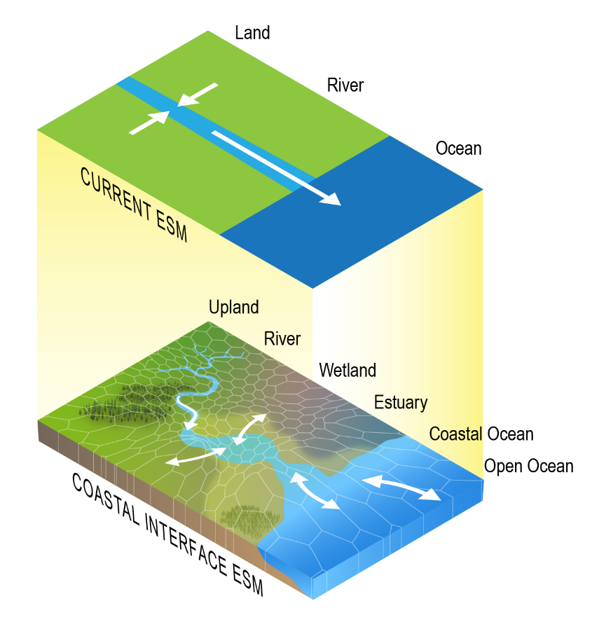
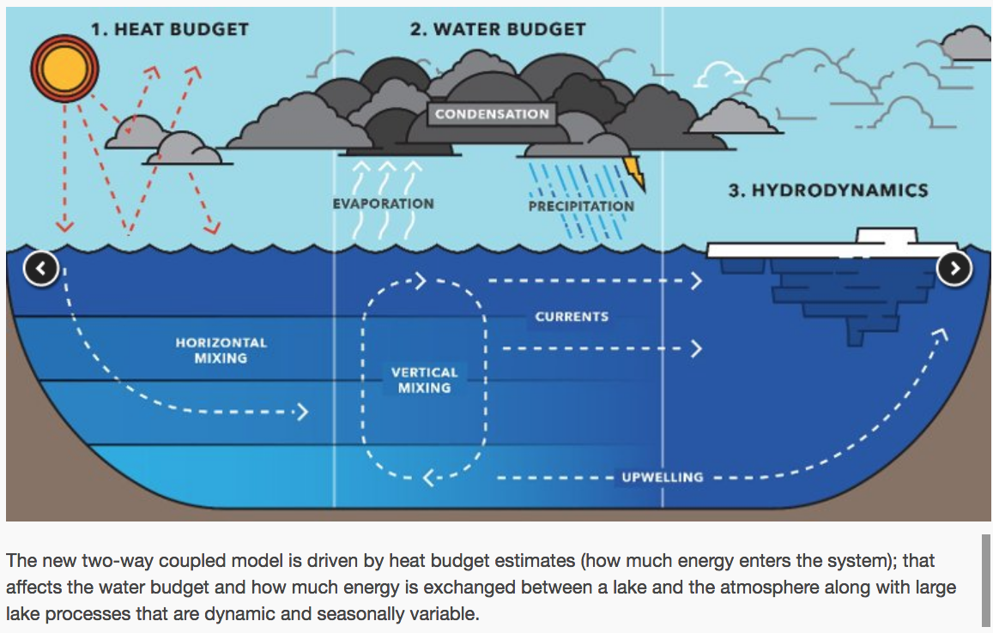
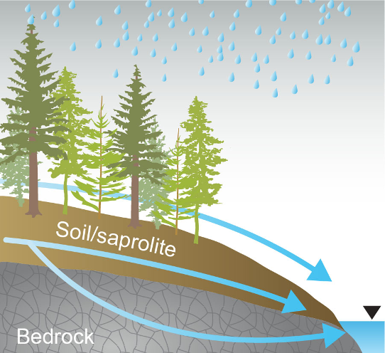
COMPASS-GLM addresses three major knowledge gaps
How atmosphere–land–lake interactions affect regional climate and extreme events
How specific watershed processes and features affect nutrient removal and transport
How to best represent coastal processes in E3SM and other ESMs
MTU News, 2016
Ward et al., 2020
Notes:
We have identified three specific areas where DOE in general, and our team in particular, has the potential to make unique and important contributions to Great Lakes research through integrated modeling and analysis that addresses specific knowledge gaps:
First, enhancing representations of atmosphere–land–lake interactions is critical for improving predictions of regional climate and extreme events and for assessing the potential impacts of anthropogenic influences in regions with large freshwater lake systems.
Second, enhanced watershed-scale modeling, informed by measurements and mechanistic studies, is needed to improve understanding of how intensified hydrologic cycling, land use change, riparian vegetation, and specific watershed features interact to affect nutrient removal and transport.
Third is the representation of coastal processes in Earth system models, which is still in its infancy. There are several activities underway in other DOE projects to improve the representation of coasts in E3SM, DOE’s flagship Earth system model, but further enhancements will be needed to accurately represent atmosphere–land–lake interactions, nutrient transport, and other key freshwater lake and coastal processes in E3SM.

Slide 13
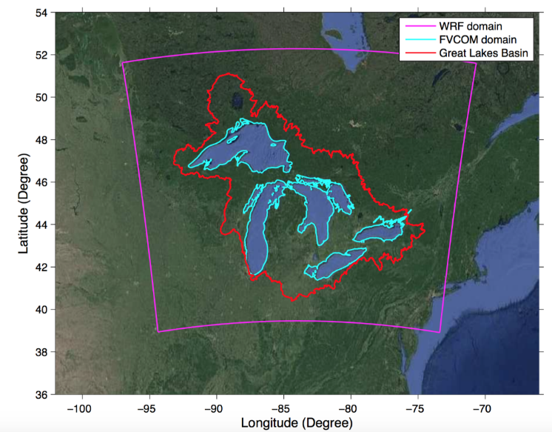
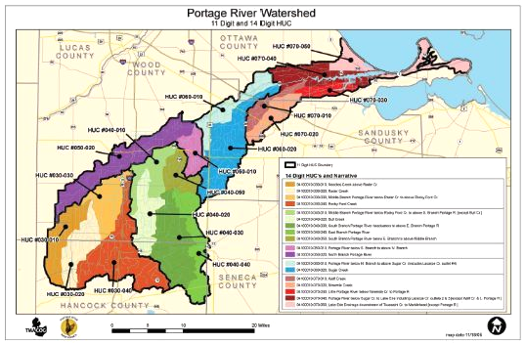
COMPASS-GLM will enhance predictive understanding of freshwater coastal systems at regional to watershed scales
How do precipitation, runoff, and air temperature in the Great Lakes Region interact with lake water balance, thermal structure, and circulation to influence regional climate changes and extremes?
How do managed drainage practices, legacy nutrient stores, and hydrologic intensification affect nutrient removal and transport in the Portage River watershed?

Slide 14
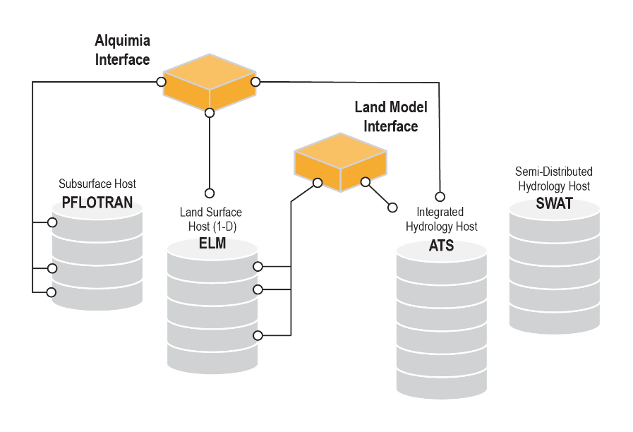
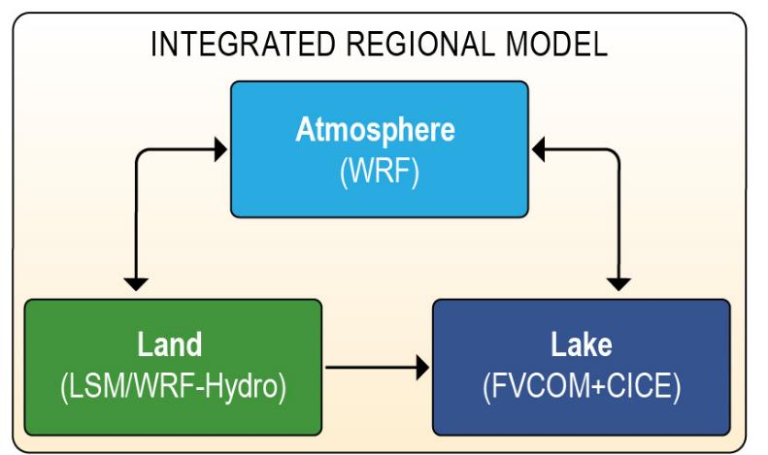
COMPASS-GLM will enhance predictive understanding of freshwater coastal systems at regional to watershed scales
How do precipitation, runoff, and air temperature in the Great Lakes Region interact with lake water balance, thermal structure, and circulation to influence regional climate changes and extremes?
How do managed drainage practices, legacy nutrient stores, and hydrologic intensification affect nutrient removal and transport in the Portage River watershed?

Slide 15
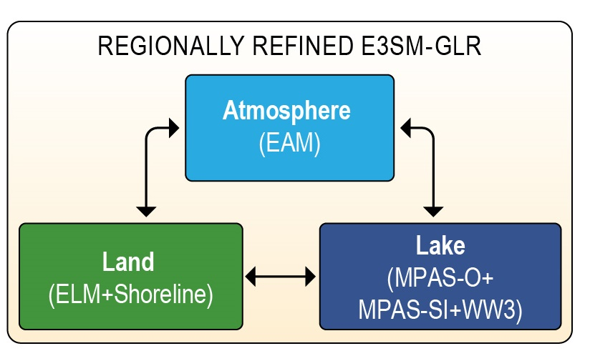
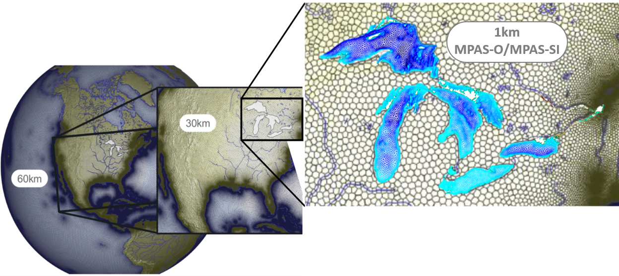
Future work:
Extend E3SM to lake regional climate modeling
Leverage regional grid refinement and other ongoing efforts
Develop MPAS-O and Sea Ice modules for the Great Lakes at ~1 km resolution
Improve ELM+MPAS-O coupling (ICoM) to resolve key freshwater coastal processes
Improve ELM-ATS coupling to improve nutrient delivery to lake
Regional- and watershed-
scale modeling useful for
guiding E3SM-GLR
development
Notes:
E3SM currently considers inland lakes as a simple parameterization within the ELM land model, which limits the fidelity of E3SM’s regional climate projections in the GLR. We see an opportunity for DOE to develop a new regional refinement in the next generation of E3SM, namely, an “E3SM-GLR” that couples MPAS-O, MPAS-SI, and ELM with the E3SM Atmosphere Model (EAM). Such a capability could resolve an unprecedented number of processes and feedbacks affecting regional climate in a consistent global modeling framework. Our proposed work with the WRF+FVCOM-based regional modeling system could serve as a benchmarking tool for developing a new and unique 3-D hydrodynamic lake model capability for E3SM, and our efforts would also provide scientific insights to guide E3SM-GLR development. In addition, we could combine these advances with those under development or consideration in E3SM, ICoM, recent DOE Early Career Awards, and other DOE projects

Slide 16

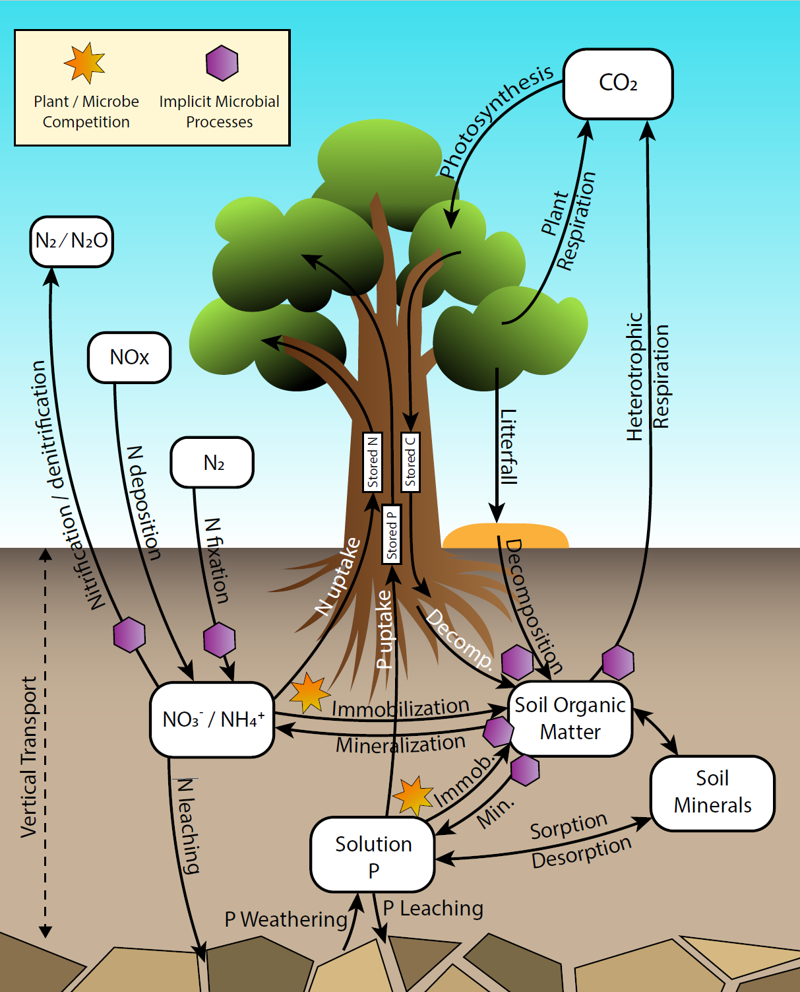
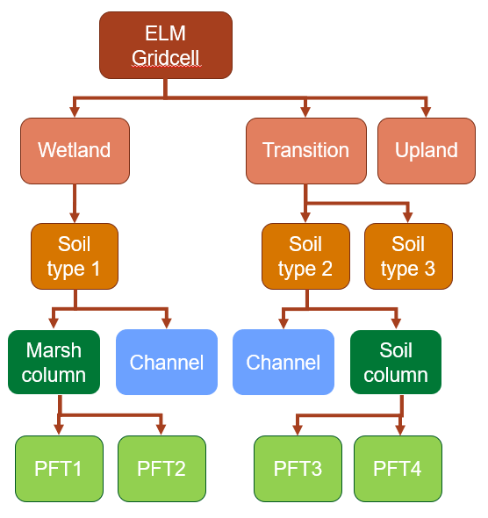
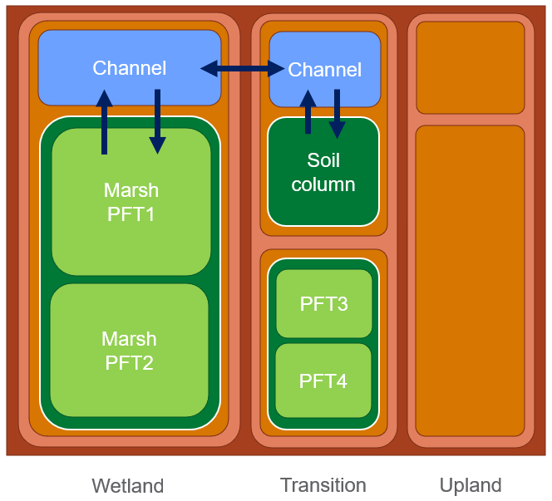
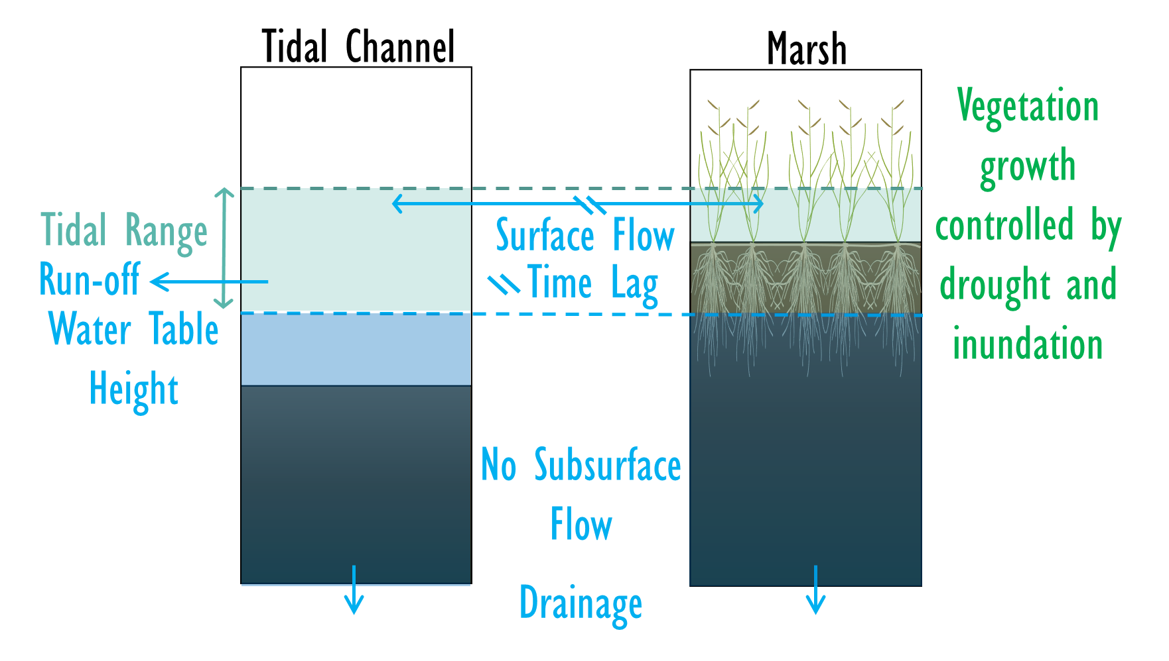
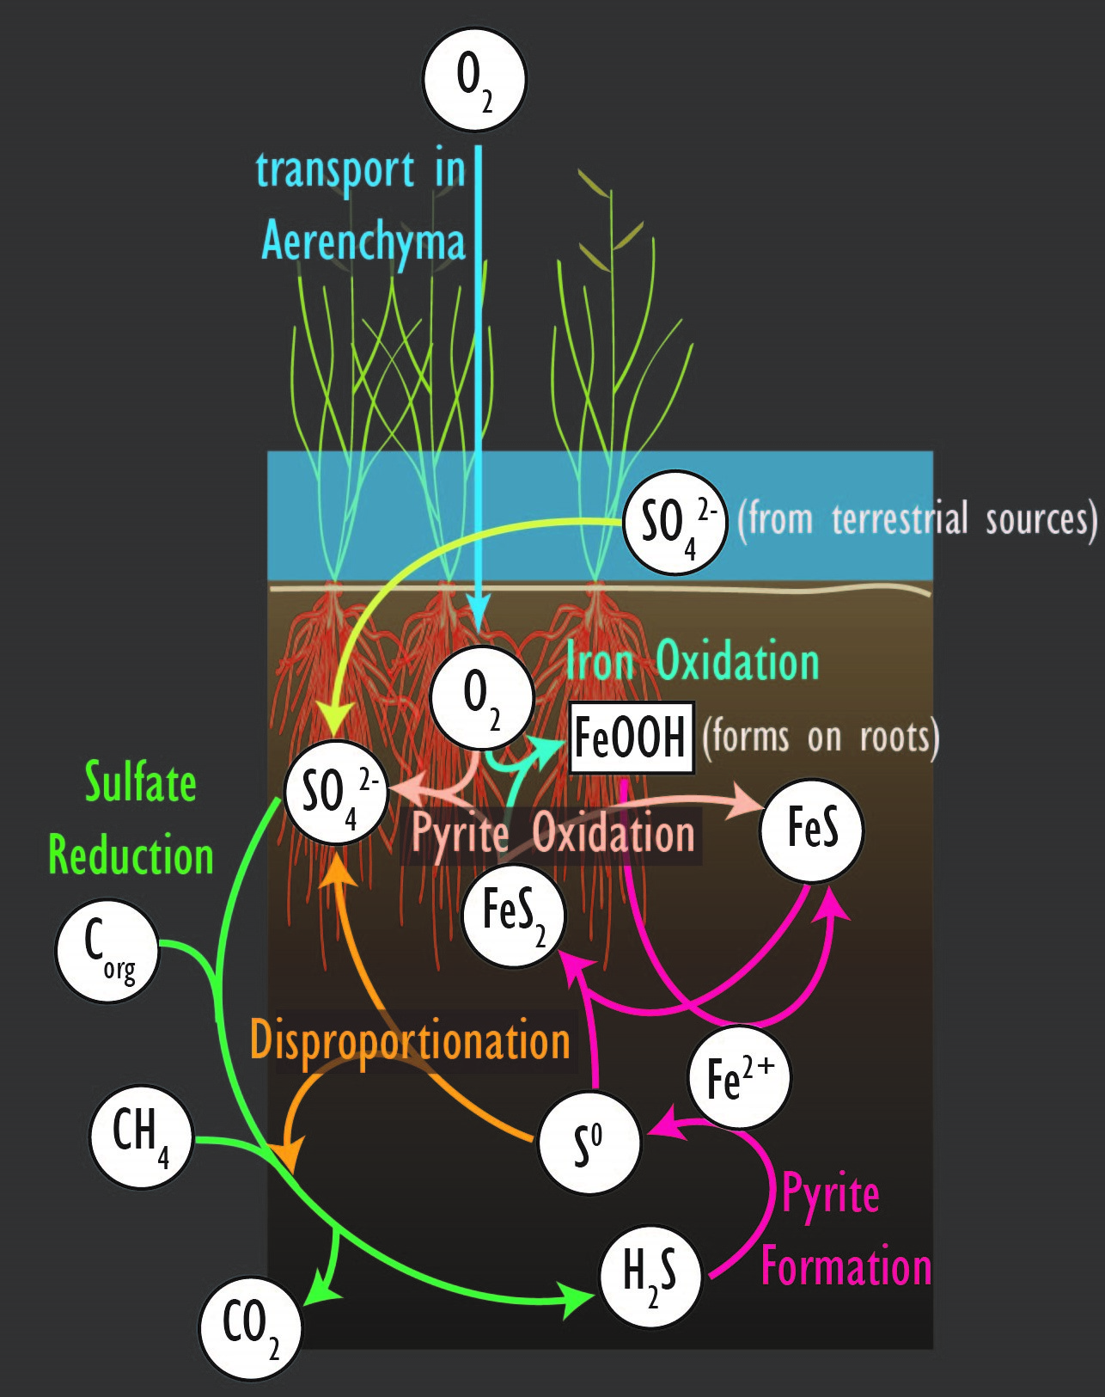
Example roadmap for COMPASS parameterization in E3SM
Baseline Model: E3SM Land Model v2
COMPASS ModEx
New parameterization
Repository integration: ELMv3
1
2
3
4

Slide 17
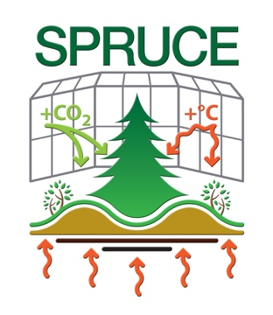
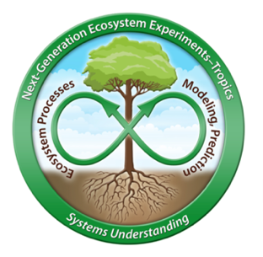

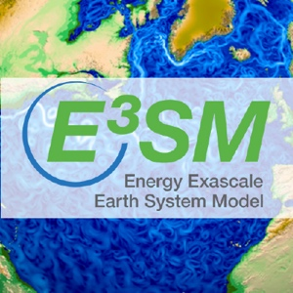


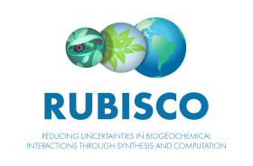
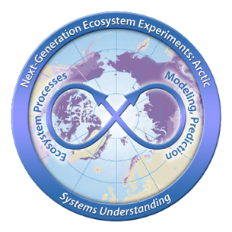
COMPASS Liaison roles and responsibilities
  Take ownership of COMPASS deliverables that intersect with other projects
  Coordinate new code development and new data collection
  Track code and data repositories maintained by collaborating projects
  Provide periodic updates across COMPASS and related projects
  Organize annual multi-project collaboration events at COMPASS all-hands meetings
  Engage in key working meetings with collaborating projects

Slide 18

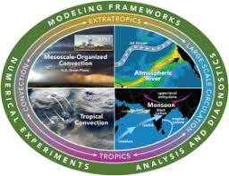



We will leverage and coordinate with other BER-funded projects
Examples:
Similar components and regional experimental design to ICoM
Leveraging the IDEAS-Watersheds software ecosystem and ExaSheds machine learning approaches
ELM-ATS integration facilitates interactions with COMPASS-FME and sets the stage for longer-term integration with E3SM
COMPASS is establishing technical liaisons with several other BER projects to facilitate model developing, leveraging, & coordination

Slide 19
COMPASS will also deliver a mid-scale, high-performance computing resource configured for coastal system science
Shortage of mid-scale/production computing resources for BER scientists
  NERSC allocations consistently a small percentage of proposed
Received input from BER ESS Cyberinfrastructure Working Group, COMPASS and ICoM team members
  Mechanistic parallel simulations on a modest number of cores (tens to thousands)
  Ensembles of those simulations within SA/UQ and ML workflows
  Data analytics and machine learning that can leverage GPGPUs
Plan for 30% of allocations open to BER coastal science projects (allocation process still being worked out but probably something NERSC-like)
Bids are in, but timeline likely delayed due to global chip shortage
Notes:
Allocation and management
70% to COMPASS researchers; remaining to other BER costal researchers
Leverage EMSL expertise to provide a user interface for allocation, coordination, and user support
Report system availability, utilization, user affiliation and engagement metrics quarterly to BER
Data based upon survey of COMPASS researchers and other BER coastal modelers
Heterogeneous system configured to support:
A software infrastructure suited to codes needed for coastal modeling
Integration of models with experimental data; automated data collection, storage and sharing

Slide 20
Thank you

