Slide 1
E3SMv1.1 Biogeochemistry simulation campaign – overview of configuration and historical simulations (JAMES, 2020)
Susannah M. Burrows, Mathew Maltrud, Xiaojuan Yang, Qing Zhu, Nicole Jeffery, Xiaoying Shi, Daniel Ricciuto, Shanlin Wang, Gautam Bisht, Jinyun Tang, Jon Wolfe, Bryce E. Harrop, Balwinder Singh, Lee Brent, Tian Zhou, Philip Cameron-Smith, Nathan Collier, Min Xu, Elizabeth C. Hunke, S. M. Elliott, A. K. Turner, Hongyi Li, Hailong Wang, Jean-Christophe Golaz, Ben Bond-Lamberty, Forrest M. Hoffman, William J. Riley, Peter E. Thornton, Kate Calvin, L. Ruby Leung.
Notes:
Goal of this talk: give a high-level introduction / overview of the E3SMv1 biogeochemistry model and historical simulations.

Slide 2
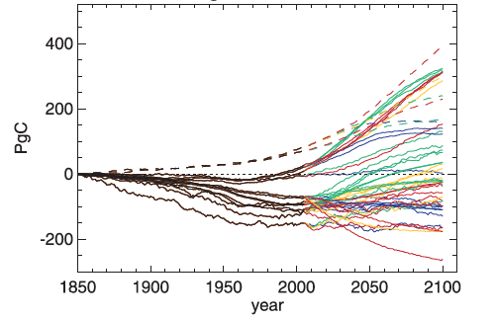
Motivation: There is large uncertainty in future changes in terrestrial and ocean carbon.
Changes in carbon varied dramatically across models in CMIP5.
Land models that included nitrogen limitations tended to have weaker terrestrial carbon uptake.
These results suggest that model structure and nutrient limits matter for prediction of future climate.
Change in Vegetation Carbon
Source: Jones et al. (2013)

Slide 3

Two pathways for carbon cycle- climate feedbacks
Concentration-carbon feedback
Climate-carbon feedback
Progressive nutrient limitation hypothesis:
Nutrient limitations reduce the response of ecosystem growth and carbon uptake to increases in atmospheric CO₂ (Luo et al., 2003)
Notes:
“Concentration-carbon feedback”: Increased atmospheric CO₂ concentration directly causes a response of land and ocean ecosystems, which in turn changes rate of CO₂ uptake.
Mainly due to ”fertilization effect”: increased photosynthesis (negative climate feedback)
“Climate-carbon feedback”: Climate changes resulting from CO₂ increase impact land and ocean ecosystems, which in turn changes rate of CO₂ uptake.
Mainly due to temperature and precipitation changes, and their impacts on photosynthesis, plant respiration, soil respiration, abundance and distribution of vegetation.

Slide 4
Simulation Plan
V1 Science Question: What are the effects of nitrogen and phosphorous on climate-biogeochemistry interactions, and how sensitive are these interactions to model structural uncertainty?

Slide 5
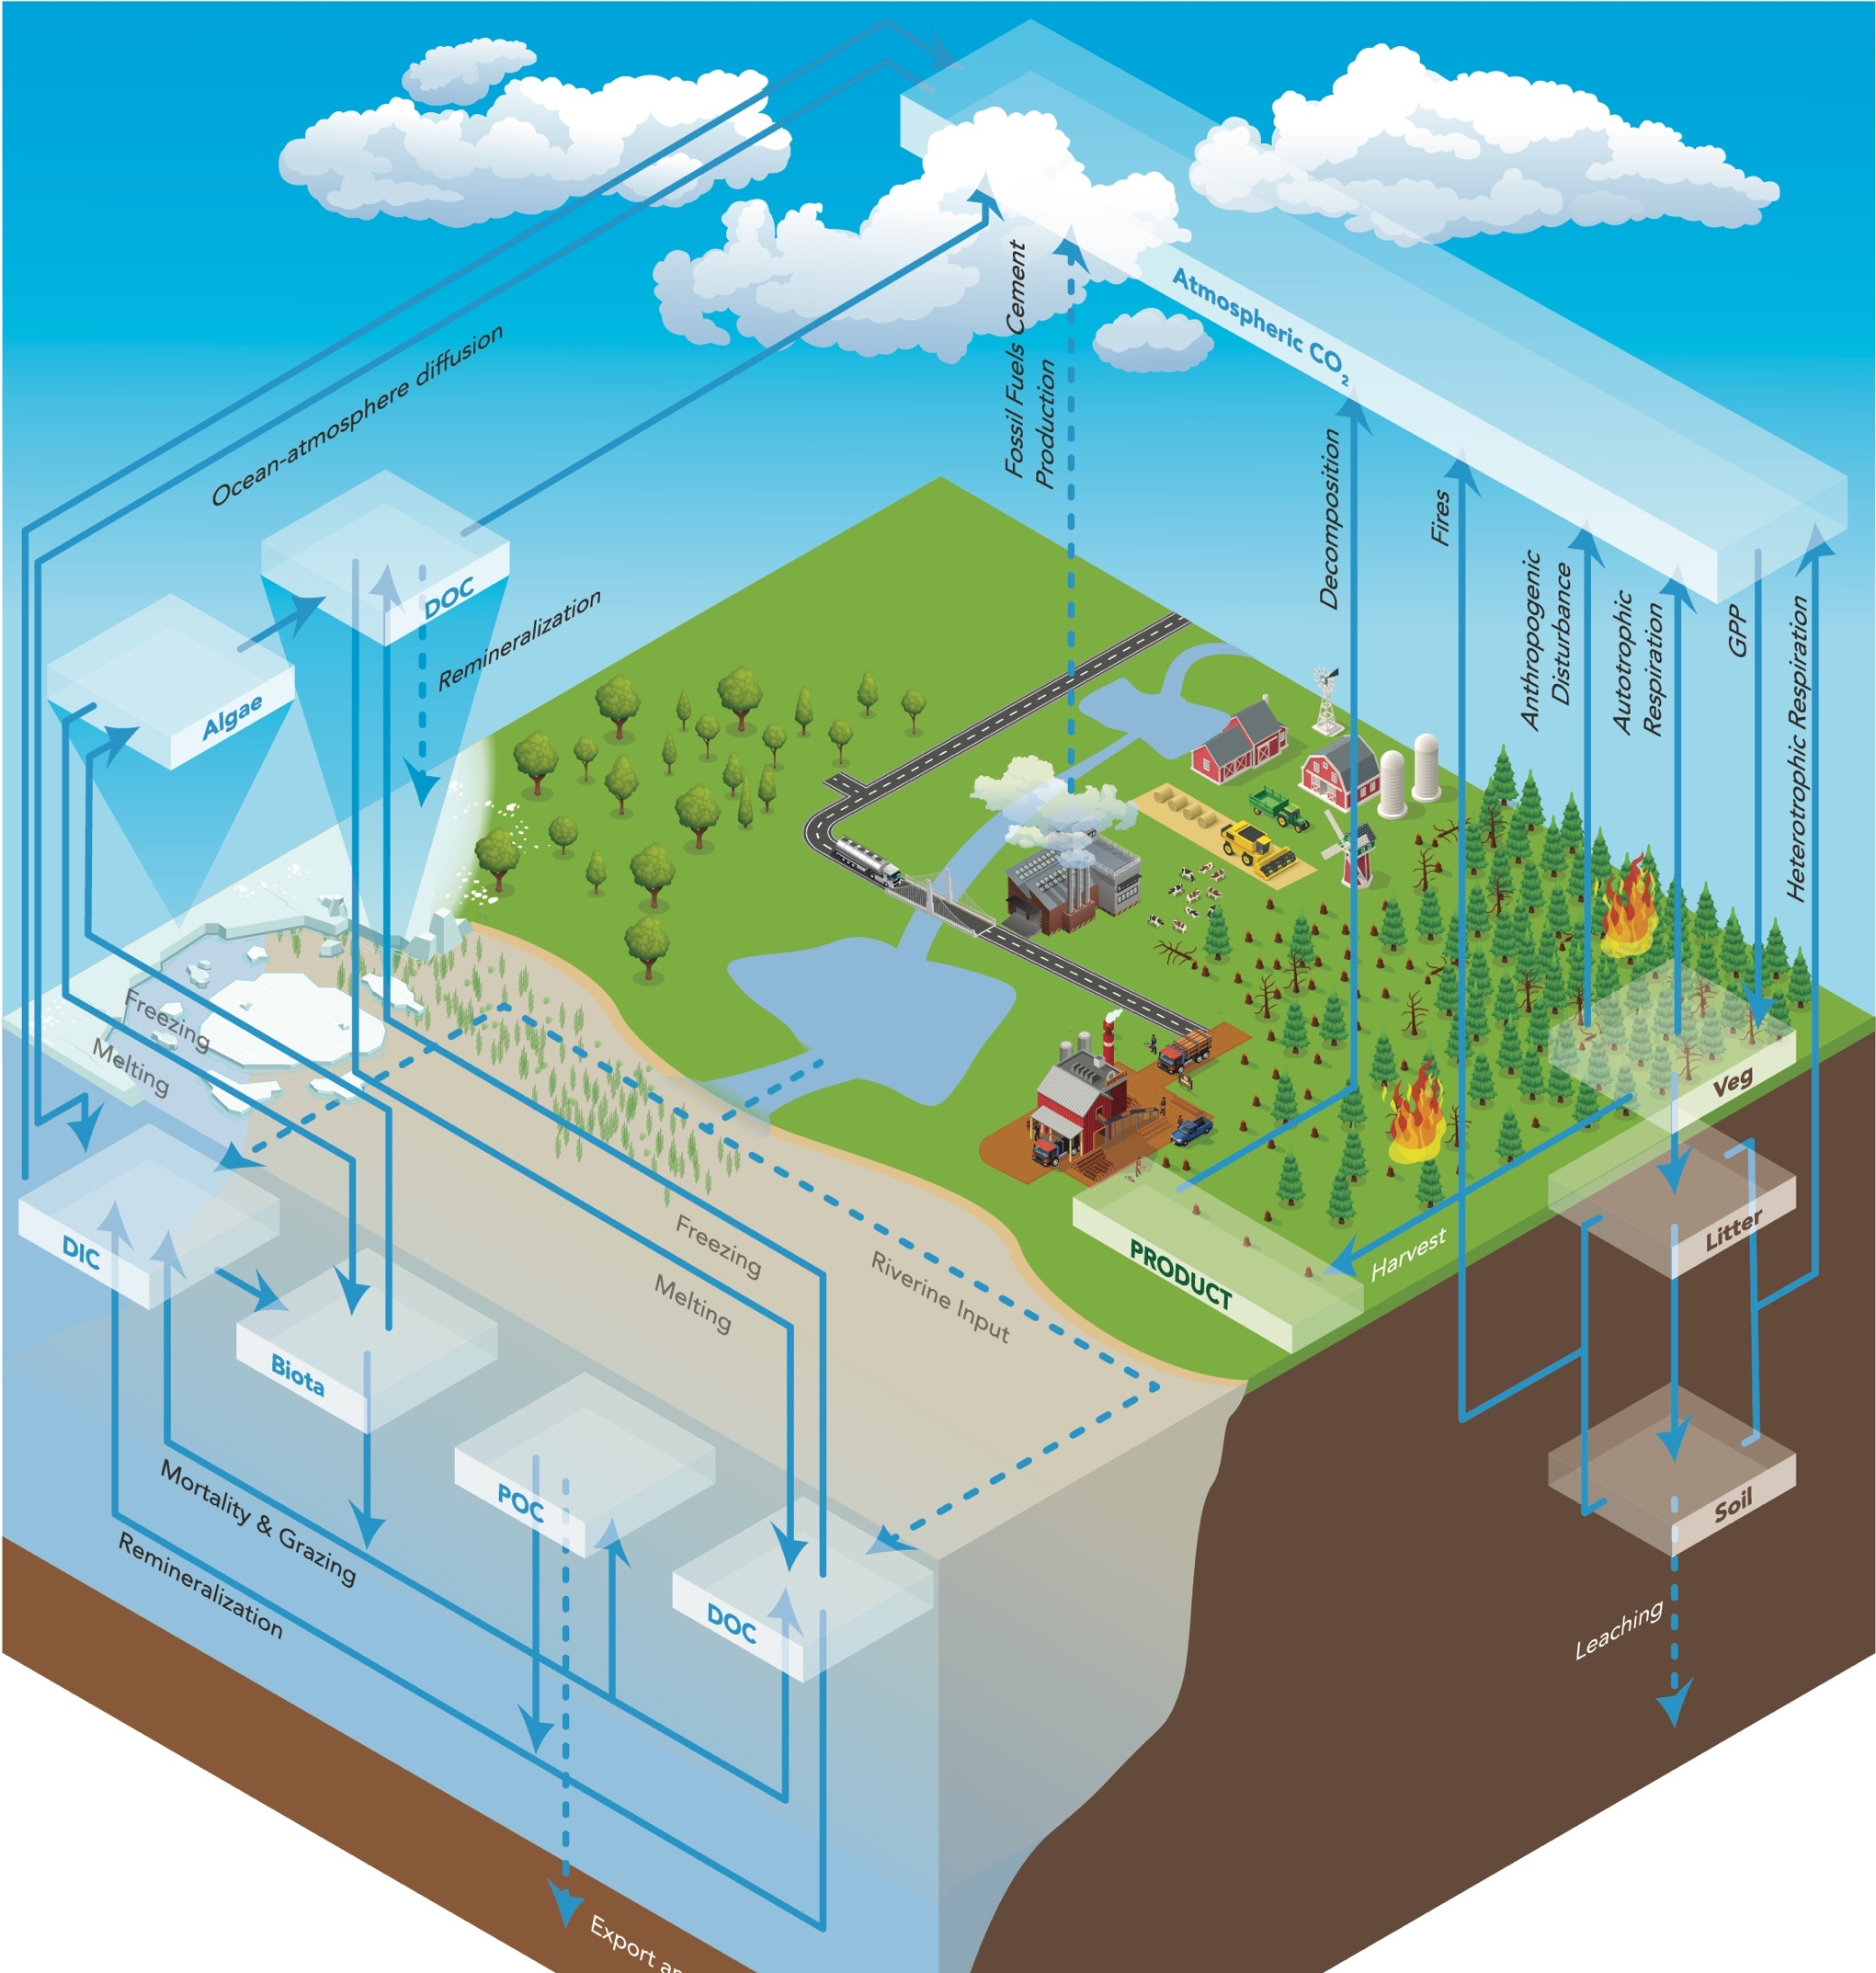
The E3SMv1.1 BGC model configuration
Terrestrial:
  Two approaches to soil biogeochemistry (CTC and ECA), both including N and P limits on C uptake
Ocean/ice:
  Based on the Biogeochemical Elemental Cycling model (BEC), including N, P, Si, Fe
  Includes ocean-ice biogeochemical interactions

Slide 6
Simulation plan
 | CO₂ input to radiation (greenhouse effect) | CO₂ input to carbon cycle (fertilization effects) | Non-CO₂ climate forcings (LULCC, aerosols…) | Reason
Fully-coupled (BDRD-hist) |  |  | historical | Simulates the fully-coupled system
Biogeochemically-coupled (BDRC-hist) |  |  | historical | Isolates the carbon-cycle response to CO₂ (ferlizization)
Radiatively-coupled (BCRD-hist) |  |  | historical | Isolates carbon-cycle response to climate change
CO₂ constant (BCRC-hist) |  |  | historical | Isolates effect of non-CO₂ historical forcings
All forcings constant (CNST-forcing) |  |  | constant | Control for model drift in absence of forcings

Slide 7
Land biogeochemistry: high-level results

Slide 8
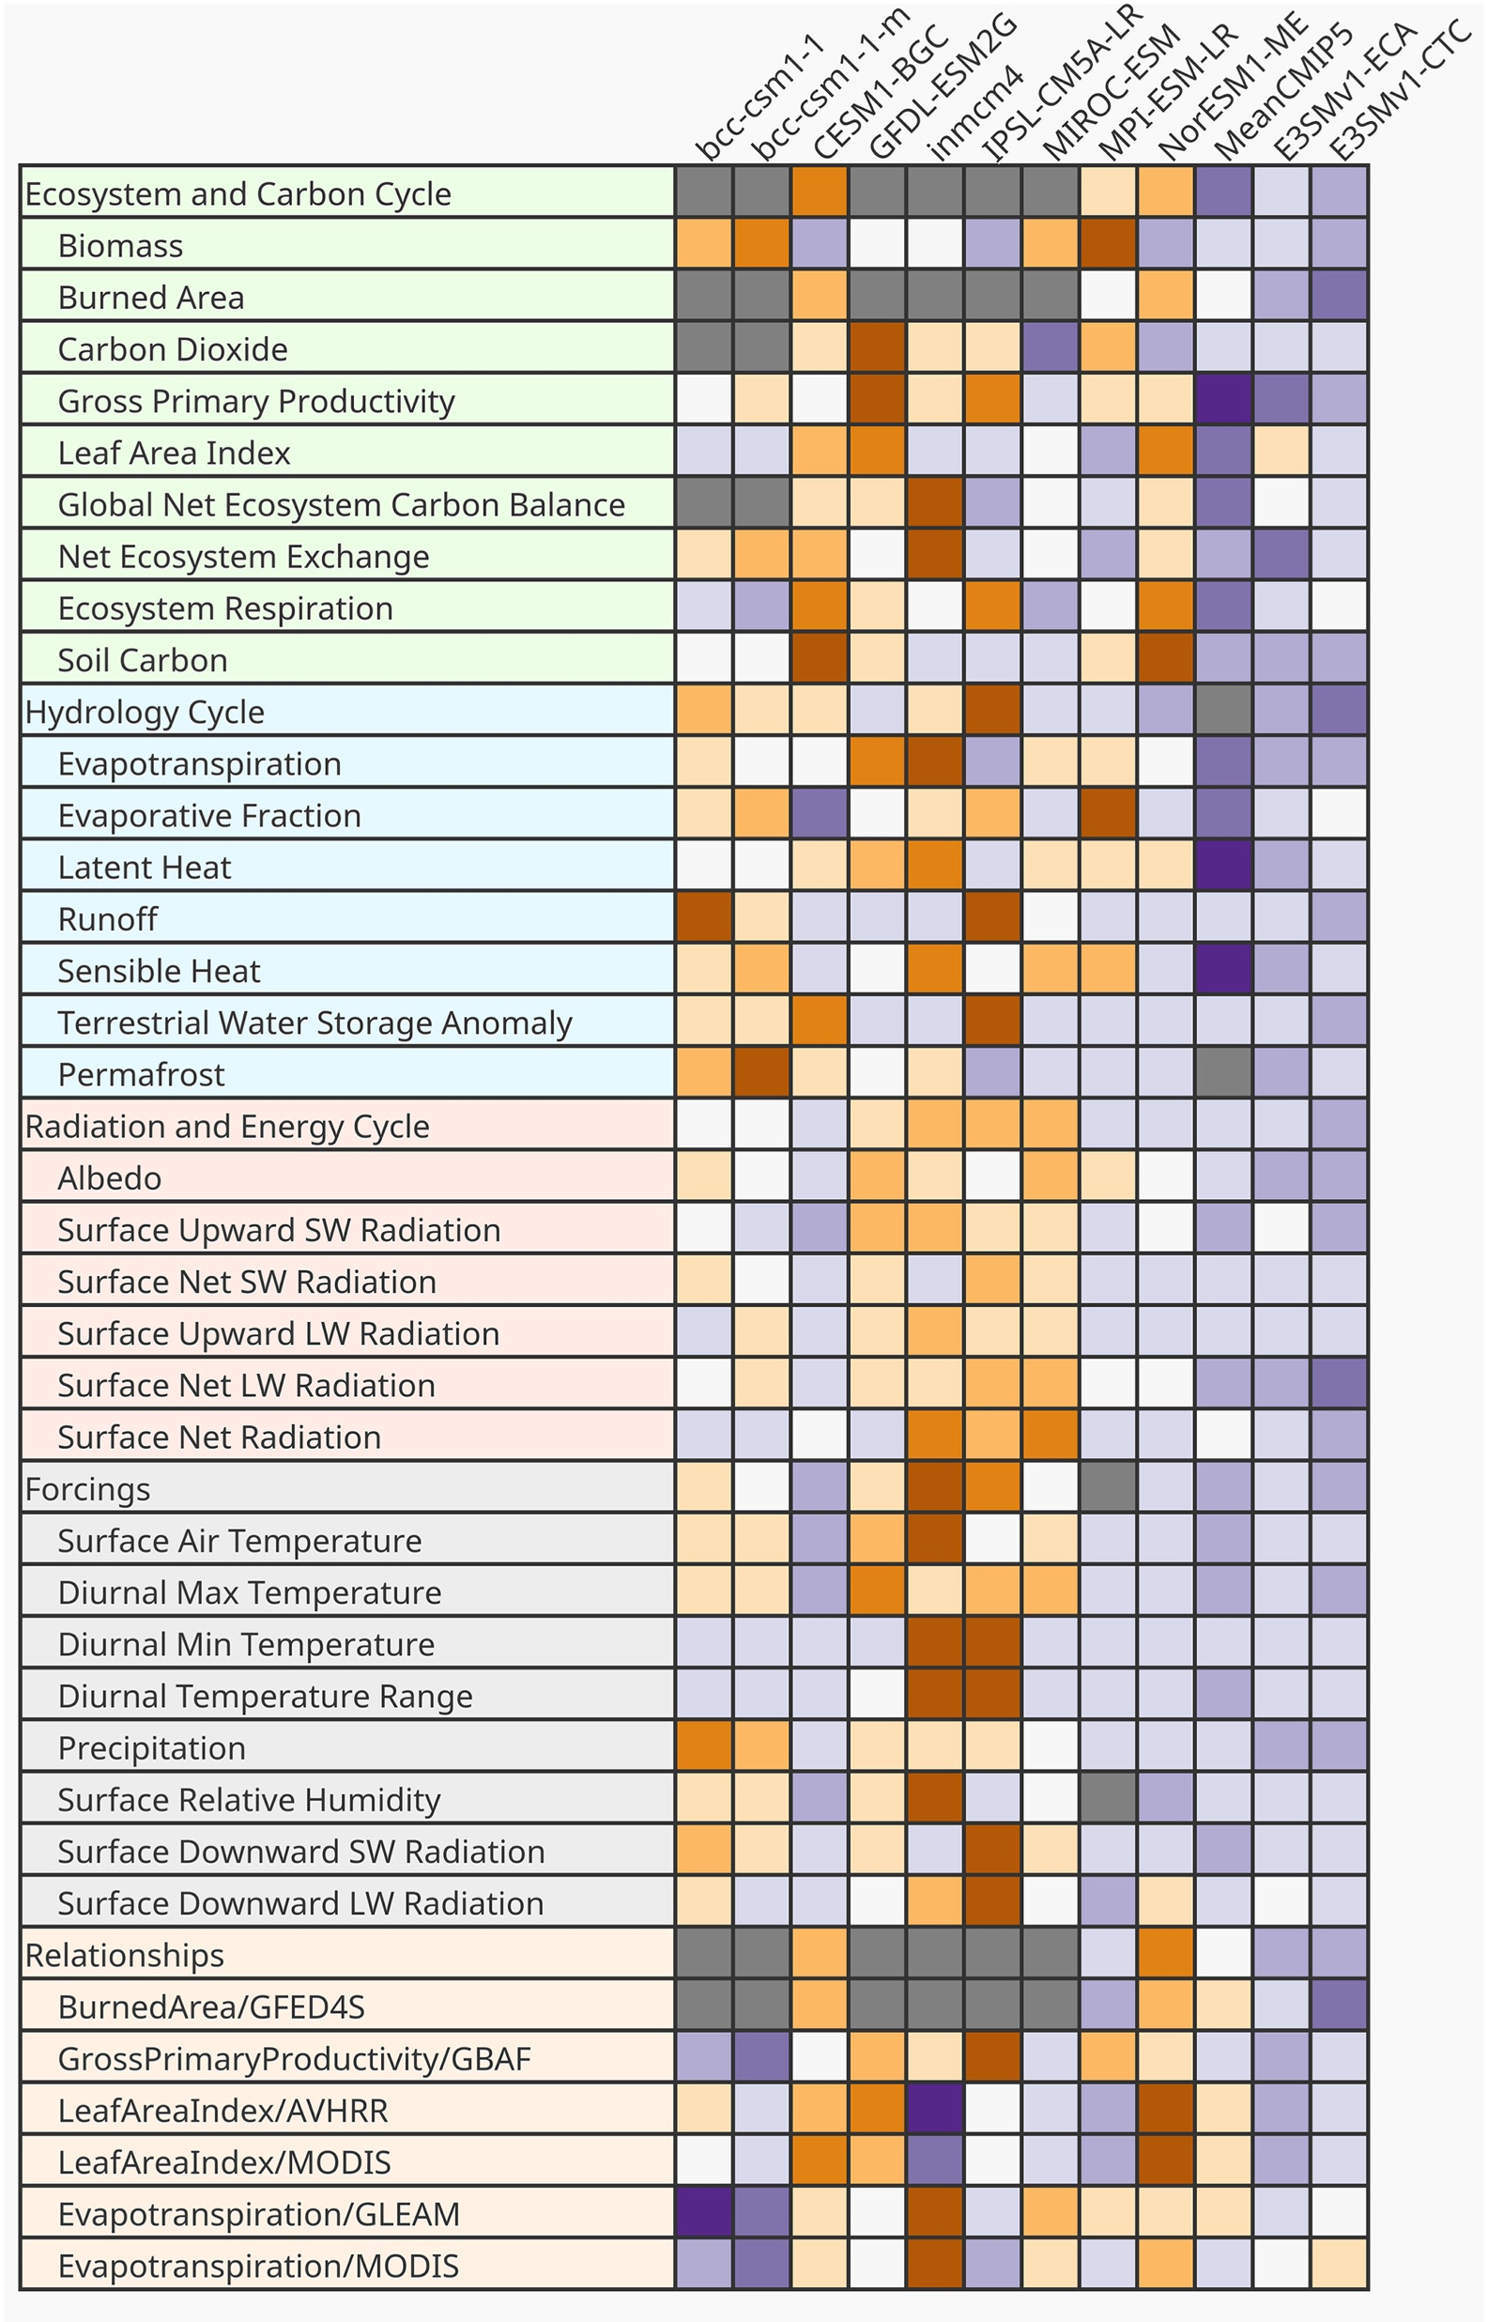
ILAMB global benchmarking for land model
Overall, both CTC and ECA simulations perform better than most CMIP5 models across a range of metrics.
Link to interactive output:
https://doi.org/10.6084/m9.figshare.11097356.v2

Slide 9
Response of plant growth (GPP) to carbon fertilization effect is similar in CTC and ECA
Anomalies in globally-integrated
Gross Primary Productivity (GPP)
Red and blue lines show the signal of carbon fertilization, causing increased plant growth and increased CO₂ uptake.

Slide 10
Impacts of CO₂ increase on GPP
Constant CO₂
(BCRC-hist)
Physiological response
(BDRD – BCRC)
GPP is highest in tropical forest ecosystems (as expected)
Radiative response
(BCRD – BCRC)
Full effect
Notes:
GPP is highest in tropical forest ecosystems (as expected)
CO2 fertilization increases GPP globally, with effects concentrated in tropics (upper right)
CO2 radiative effect increases GPP at high latitudes (where growth is limited by colder temperatures) but decreases GPP in the tropics. This is reasonable considering:
Temperatures are already warm in this region (so not limiting)
Sensitivity to drought, dependence on water availability from precipitation and deep soil water
Combined effect leads to increased GPP across the globe.

Slide 11
Total loss of carbon from land since 1850 is comparable to observational estimates in default (CTC) configuration
Change in total land ecosystem carbon (TEC) since 1850
Purple, orange: Land carbon declines over the 20th century due primarily to deforestation.
Blue, red: In biogeochemically-coupled simulations, increased plant growth partly compensates.
Arrows indicate approximate range of observationally-based estimates (Khatiwala et al., 2013).
Total loss of carbon is much lower in ECA, due to stronger phosphorus limitation.
Notes:
Biogeochemical influence of transient CO₂ concentration dominates for GPP, NEE, TEC, vegetation carbon
ECA (dashed lines) exhibits drift in TEC in CNST-forcing scenario; this is due to the disequilibrium (by design) of the P soils in the initial state
Observational benchmarks for historical loss of TEC over the period 1850 – ca. 2000 are about 50 PgC; the CTC BDRD case is quite close to this. The ECA BDRD case loses 2-3x too much carbon over the historical period, compared with observational benchmarks.
CTC stores more carbon in soils below 1 m and ECA produces more woody debris. These differences may have consequences for carbon cycle feedbacks, particularly over longer time scales and in future scenarios.

Slide 12
Ocean / sea ice BGC: high-level results

Slide 13
Net CO₂ flux from ocean to atmosphere (mmol/m²/yr), present-day
MODEL (BDRD-hist, 1977-2006)
OBS (World Ocean Atlas)
Red colors are fluxes out of ocean (outgassing)
Blue colors are fluxes into ocean (uptake / sink)
Total ocean carbon uptake since 1850:
Benchmark: 150 ± 20 PgC/yr (Le Quéré et al., 2018)
E3SMv1.1-BGC: ∼93 PgC/yr

Slide 14
Ocean surface Chl-a – too little biomass
MODEL (BDRD-hist, 1977-2006)
OBS (SeaWIFS satellite, 1997-2010)
Log(ocean surface Chl-a) (mg/m³)
Possible sources of bias:
Lack of parameterized lateral mixing along isopycnal surfaces (Redi mixing).
Biases in riverine nutrient inputs.
Ocean mixed-layer depth biases, which lead to too-little overturning of nutrients in regions like the North Atlantic.
Coastal underprediction is partly a resolution issue.
These issues are being addressed in v2 developments.
Notes:
Anoxia probably the main cause of widespread anoxia in subsurface oceans, which limits microbial decomposition processes
Bias is especially notable in the following regions:
Coastal regions; resolution issues and missing coastal processes may both play a role here
North of 35N; this is likely due to the having too little nitrate and phosphorus, caused by a deficiency in deep overturning
Most biases likely due to problems in the ocean physics...

Slide 15
Carbon cycle – Climate feedback analysis

Slide 16
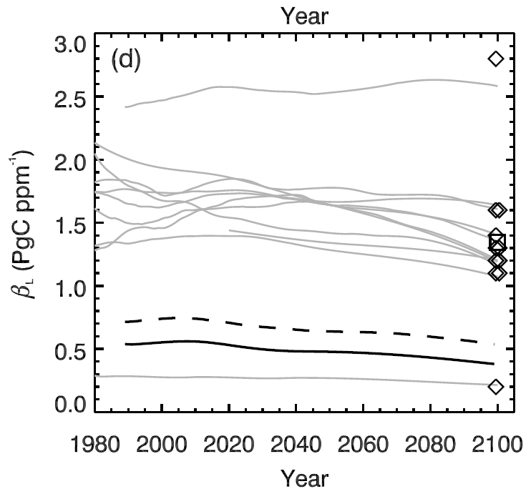
E3SM land CO₂ – climate feedbacks are comparatively weak (~expected)
Beta (Response of CO₂ uptake to CO₂ concentration, PgC/ppmv)
E3SM v1 BGC estimate
Differences:
Different physical climate
Different land model
  Physics and BGC
Active P cycle
E3SM is using dynamic LULCC
Plotted on data from Thornton et al. 2009

Slide 17
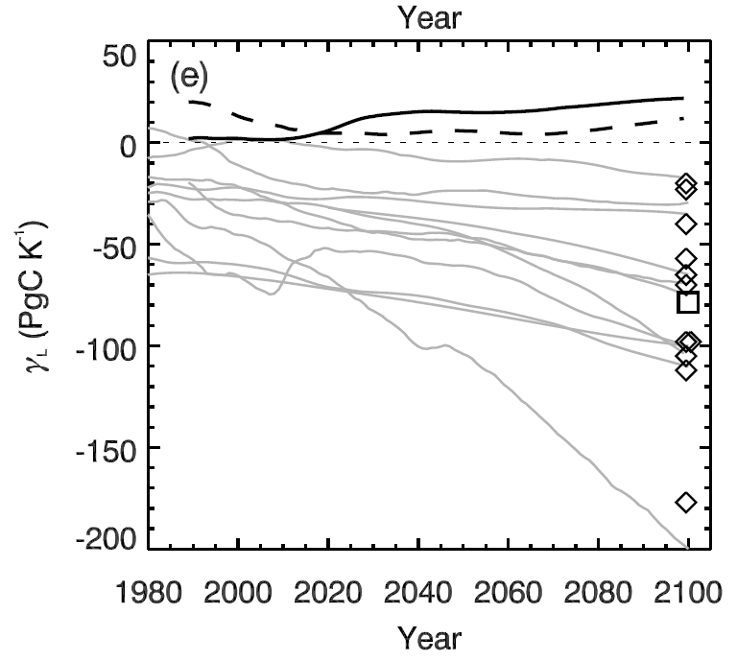
E3SM land CO₂ – climate feedbacks are comparatively weak (~expected)
Gamma (Response of CO₂ uptake to temperature, PgC/K)
Differences:
Different physical climate
Different land model
  Physics and BGC
Active P cycle
E3SM is using dynamic LULCC
E3SM v1 BGC estimate
Plotted on data from Thornton et al. 2009

Slide 18
Summary / Outlook
Conducted E3SMv1.1-BGC historical simulations with two land model configurations.
  Both perform well on ILAMB land model observational benchmarks
  Structural differences occur in nutrient limitation and nutrient pools
  Both configurations have comparatively weak carbon-climate feedbacks, supporting the hypothesis that such feedbacks are weaker in models where nutrient limitations are represented
Ocean carbon cycle: several sources of bias were identified, which are being addressed for v2.
Additional papers published / in progress will describe responses to future scenarios, land nutrient limitations and structural uncertainties, sea ice biogeochemistry, and feedbacks on atmospheric dynamics

Slide 19
Thank you!

