Slide 1

Conservation of dry air, water, and energy in CAM and its impact on tropical rainfall
v
and EAM!
Bryce Harrop¹
Mike Pritchard², Hossein Parishani², Andrew Gettelman³,
Samson Hagos¹, Peter Lauritzen³, Ruby Leung¹,
Jian Lu¹, Kyle Pressel¹, Koichi Sakaguchi¹
¹PNNL
²UC-Irvine
³NCAR
Notes:
Stock image of cloud formations

Slide 2
Regional energy and precipitation budgets linked to create diagnostic and predictive measures of rainfall changes.
Boos & Korty (2016)
Energy flows away from centers of tropical deep convection. Both the flow of energy and the rainfall distribution shift with some climate features like ENSO.

Slide 3


Tried closing the energy budget in CAM, but came up short
The energy budget isn’t closing in my CAM runs. What’s wrong?
Did you include the adjustment energy tendency?
No. What is that?

Slide 4
Closing the energy budget requires accounting for the column-energy tendency from a mass adjustment routine
Adjustment column-energy tendency
W/m²

Slide 5
Closing the energy budget requires accounting for the column-energy tendency from a mass adjustment routine
Adjustment column-energy tendency
W/m²
This is what
we will explain

Slide 6
The three big questions that we are going to answer here
What is the adjustment process and why does it produce an energy tendency?
What impact does this energy tendency have on the simulated hydrologic cycle?
How can we make things better?

Slide 7
The three big questions that we are going to answer here
What is the adjustment process and why does it produce an energy tendency?
What impact does this energy tendency have on the simulated hydrologic cycle?
How can we make things better?
An inconsistency in how water is treated in the energy budget
Dramatic changes to tropical rainfall variability
Fix the inconsistency with a more rigorous energy budget

Slide 8
The three big questions that we are going to answer here
What is the adjustment process and why does it produce an energy tendency?
What impact does this energy tendency have on the simulated hydrologic cycle?
How can we make things better?
An inconsistency in how water is treated in the energy budget
Dramatic changes to tropical rainfall variability
Fix the inconsistency with a more rigorous energy budget

Slide 9
CAM and EAM use a fixed hydrostatic pressure thickness to compute mass of each vertical layer, which is the sum of dry air and vapor
CAM/EAM level
DRY AIR
Layer mass =
(1)
Total Mass (fixed)
WV
Assumed fixed during physics
(1)

Slide 10
Vapor mass can change during the physics, which breaks dry air conservation
CAM/EAM level
DRY AIR
DRY AIR
(1)
Total Mass (fixed)
(2)
WV
WV
(1)
(2)
Precipitation
occurs
*after physics (m_{v})

Slide 11
To avoid spurious dry mass changes, total mass changes to match water vapor mass change
CAM/EAM level
Adjustment
DRY AIR
DRY AIR
DRY AIR
(1)
Total Mass (fixed)
Total Mass (adjusted)
(2)
WV
WV
WV
(3)
(1)
(2)
(3)
Precipitation
occurs
*after physics (m_{v})
*after adjust (m_{t})
This adjustment happens after all of the physics parameterizations have been called.

Slide 12
CAM (and EAM) tracks column-energy budget for conservation purposes
Assumptions
Column-integrated
Hydrostatic balance
Sum over k levels
Enthalpy
Kinetic Energy
Surface Geopotential

Slide 13
Simple example:
Ignore kinetic energy for an oceanic column
Assumptions
Column-integrated
Hydrostatic balance
Sum over k levels
Enthalpy

Slide 14
Heating/Cooling is applied to the “total mass” which is held fixed at its initial value during the physics parameterizations
Changes during physics
Changes during adjustment

Slide 15
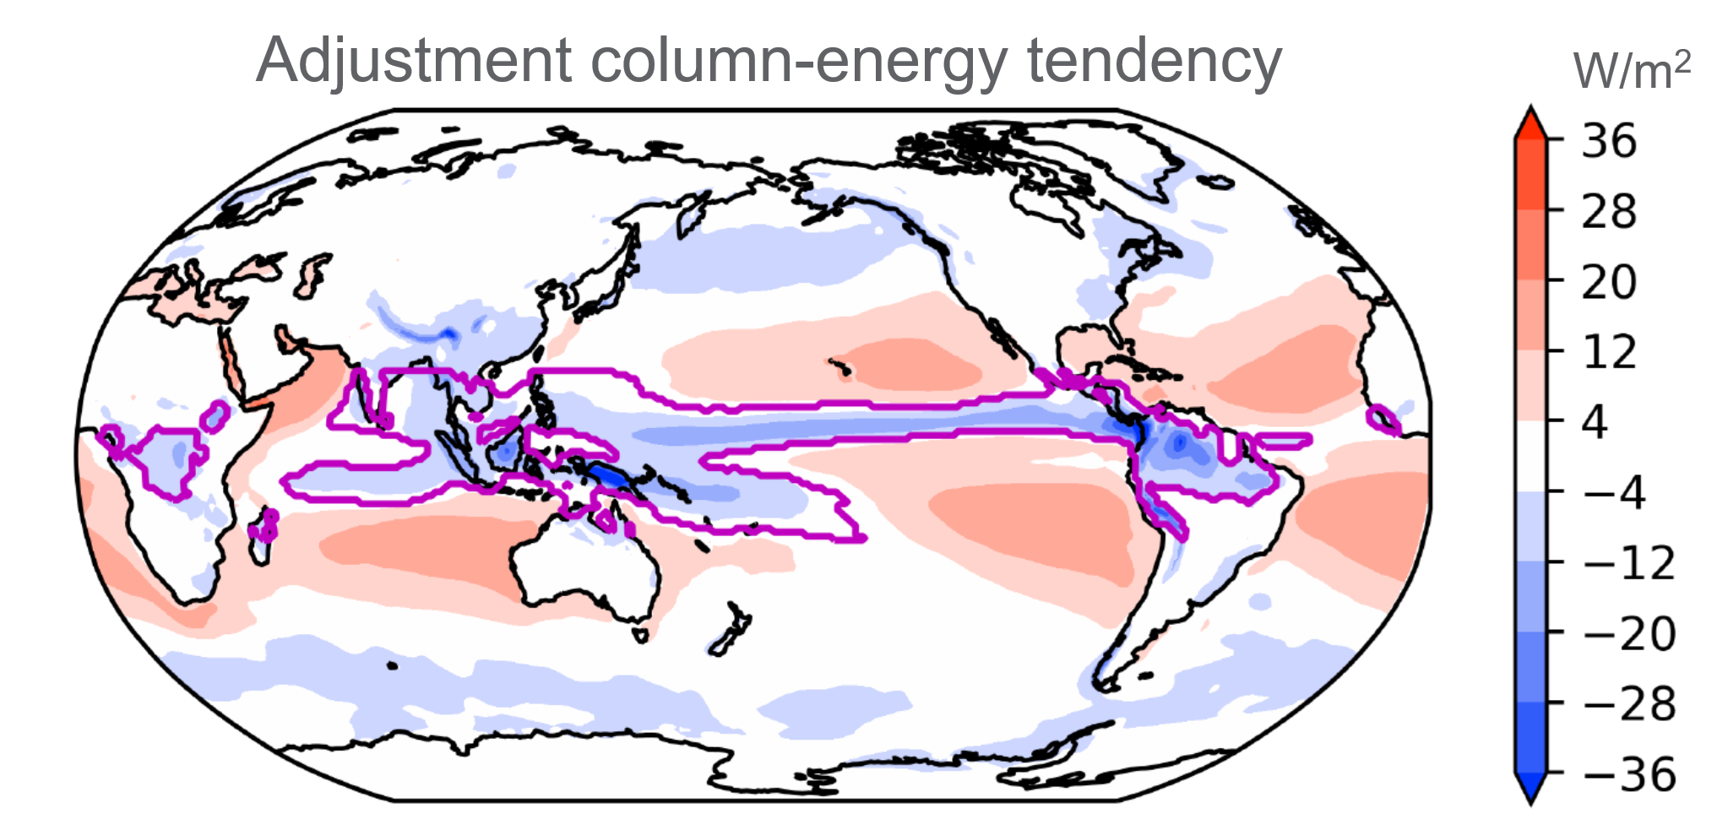
Water vapor is included in the mass used for our energy expression. It has internal, potential, and kinetic energy, just like the dry air. The inconsistency appears when water vapor changes phase. Because we do not keep track of liquid or ice in the energy expression, we throw away the energy associated with any water vapor that has condensed during the physics timestep, creating the adjustment energy tendency.

Slide 16
The preceding interpretation sounds nice, but “sounds nice” isn’t science. Let’s verify it.
If the adjustment energy tendency really represents untracked energy associated with water, we can verify it by calculating offline budgets of missing energy fluxes associated with water:
  Full surface enthalpy flux
  Change in thermal and potential energy of hydrometeors as they fall
Surface Missing Enthalpy flux (SMH)
Latent heat flux
(accounted for in model)

Slide 17

Hydrometeors warm up as they fall
Rain starts up high and cold, i.e., with a large potential energy and small thermal energy
As they fall…
…potential energy goes into heating atmosphere.
…atmosphere loses energy to heat hydrometeors.
Rain ends up low and warm, i.e., with a small potential energy and large thermal energy

Slide 18
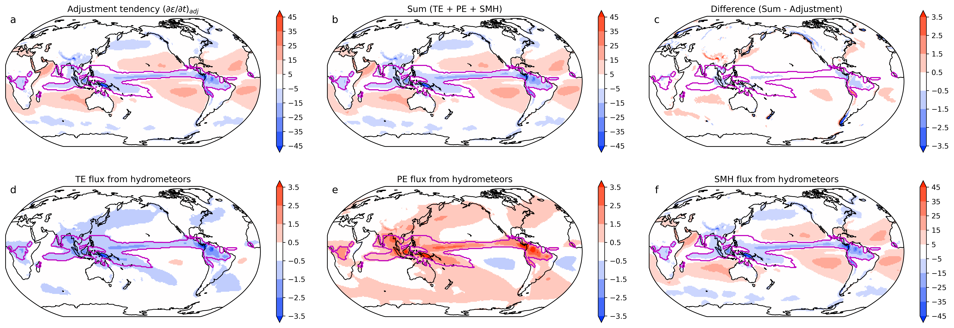
The missing terms sum up to be approximately equal to the adjustment energy tendency
Note that the colorbar limits aren’t all the same.
45
45
3.5
-3.5
-3.5
-45
Atmosphere losing heat to rain as it falls
Atmosphere gaining heat from friction with rain
Surface missing enthalpy flux

Slide 19
The missing terms sum up to be approximately equal to the adjustment energy tendency
Note that the colorbar limits aren’t all the same.
45
45
3.5
-3.5
-3.5
-45
Atmosphere losing heat to rain as it falls
Atmosphere gaining heat from friction with rain
Surface missing enthalpy flux

Slide 20
The three big questions that we are going to answer here
What is the adjustment process and why does it produce an energy tendency?
What impact does this energy tendency have on the simulated hydrologic cycle?
How can we make things better?
An inconsistency in how water is treated in the energy budget
Dramatic changes to tropical rainfall variability
Fix the inconsistency with a more rigorous energy budget

Slide 21
An easy first test on whether any of this matters is to simply “give back” the energy lost
CAM/EAM level
DRY AIR
DRY AIR
The experimental adjustment “gives back” the energy thrown away when water vapor condenses by retroactively assuming that heating and cooling is only applied to dry air plus uncondensed water vapor.
WV
WV
Energy associated with the mass lost during adjustment is given back to the atmosphere.

Slide 22
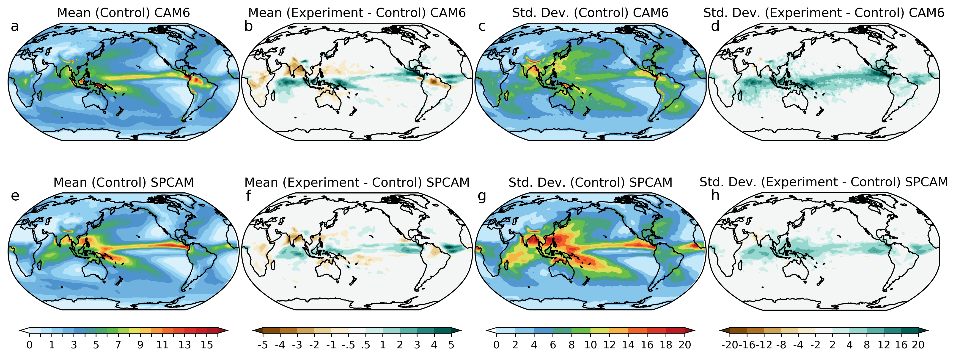
Tested in both parameterized-convection CAM6 and SPCAM. Responses are similar

Slide 23
Large increases in daily rainfall variability across the Tropics

Slide 24
Increase in strength of MJO between Experiment and Control similar to the increase between SPCAM and CAM.
Notes:
The increase in variability is realized, in part, as an increase in known convective wave modes, as seen here. It is worth noting that the increase in MJO strength moving to an energy-conserving adjustment in CAM6 is as large as the increase in MJO strength when moving from CAM6 to SPCAM! I want to pump the brakes a little though, because the point of this experiment is to demonstrate whether the simulated climate is sensitive to the energy formulation. I am not advocating for this as a fix. In truth, I actually think this energy-conserving adjustment is the wrong way to handle energetics in CAM.

Slide 25
The three big questions that we are going to answer here
What is the adjustment process and why does it produce an energy tendency?
What impact does this energy tendency have on the simulated hydrologic cycle?
How can we make things better?
An inconsistency in how water is treated in the energy budget
Dramatic changes to tropical rainfall variability
Fix the inconsistency with a more rigorous energy budget

Slide 26
Surface missing enthalpy flux is reminiscent of our old friend, the IEFLX fixer
Surface Missing Enthalpy flux (SMH)

Slide 27
Surface missing enthalpy flux is reminiscent of our old friend, the IEFLX fixer
Surface Missing Enthalpy flux (SMH)
IEFLX needed because EAM and MPAS-Ocean don’t compute surface enthalpy flux the same way

Slide 28
We can compute a more rigorous version of surface enthalpy flux for water
Surface Missing Enthalpy flux (SMH)
IEFLX needed because EAM and MPAS-Ocean don’t compute surface enthalpy flux the same way
What should the surface enthalpy flux for water actually be?
Surface Missing Enthalpy flux (SMH)
Surface enthalpy flux for water can be expressed in other equivalent forms

Slide 29
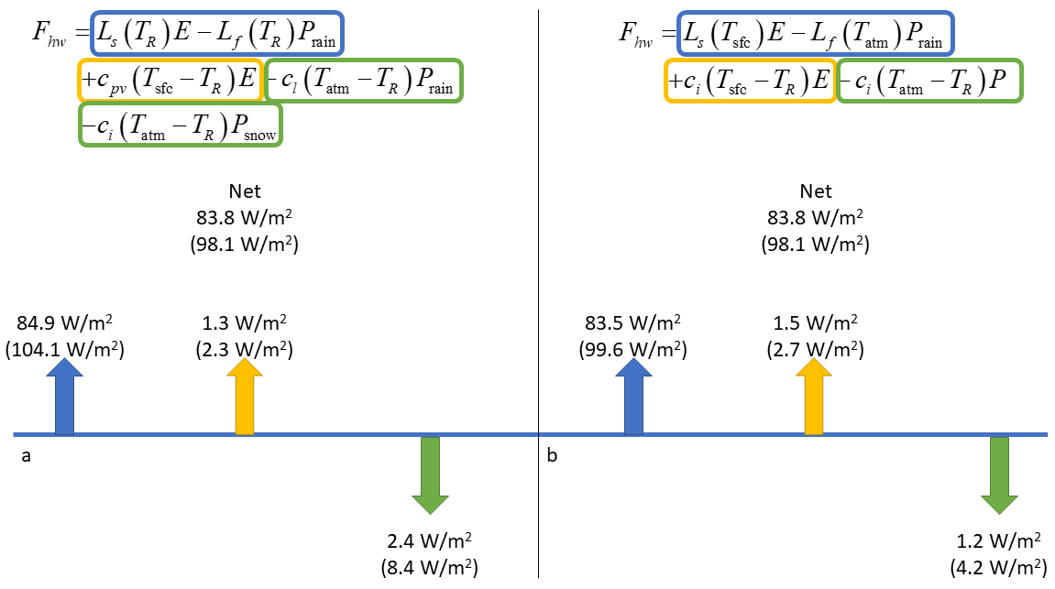
Different surface enthalpy flux formulations show pitfalls of simplifying assumptions
IEFLX takes a ~1 W/m² overestimate in surface enthalpy flux (from ocn -> atm) and makes it 0.4 W/m² worse… oops

Slide 30
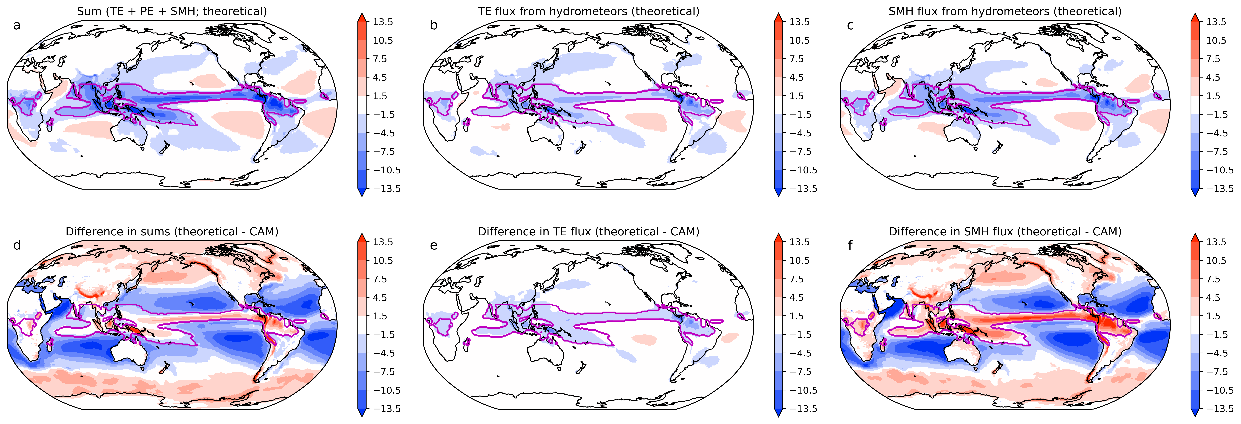
The “better” version is significantly different from the CAM version
Atmosphere losing heat to rain as it falls
Surface missing enthalpy flux
Top row uses the rigorous enthalpy treatment from the previous slides. Bottom row shows the difference between this rigorous treatment and what we computed before using expressions that were consistent with the CAM6 energy framework.

Slide 31
What do we takeaway from all of this?
In CAM/EAM, water vapor has energy, but liquid and ice do not. This leads to spurious energy sinks when vapor changes phase
This problem is exposed during a mass adjustment routine, giving it the energy tendency shown
This energy error has profound impacts on the hydrologic cycle, motivating a need to address this issue
We can go in one of three directions:
  Remove water vapor from the mass in the energy equation and make it a dry mass energy budget
  Live with the inconsistency but pass the adjustment energy tendency to the surface so that the coupled model is balanced
  Include all phases of water in the energy budget and use the correct surface enthalpy fluxes for all components

