Slide 1

Assessing and Improving the Numerical Solution of Atmospheric Physics in E3SM
Color Code
Atmospheric Science
Applied Math
Software/HPC
Hui Wan¹
(PI)
Carol S. Woodward²
(Co-PI)
Ross Dixon³
Huan Lei⁵
Jing Li¹
Vince Larson⁴
Phil Rasch¹
Balwinder Singh¹
Panos Stinis¹
Chris Vogl²
Xubin Zeng³
Shixuan Zhang¹
¹PNNL, ²LLNL, ³U. Arizona, ⁴U. Wisconsin – Milwaukee, ⁵Michigan State U.
Notes:
Stock image of cloud formations

Slide 2
Scope
To identify and address numerical issues in physics parameterizations and process coupling
Background and Motivation
Parameterization development in atmospheric GCMs
Typical foci on conceptualization of understanding + handling of spatial scales
Accuracy of time integration usually considered a secondary issue
General intention to use longest possible time steps; pervasive use of ad hoc “fixes” like clipping, limiters etc.
Changes in shortwave cloud forcing in response to 4K SST increase
(EAMv0, 1º resolution)
Disconcerting findings in recent years
Sensitivities to numerical choices in E3SM and similar models, both global and regional, at traditional and much higher resolutions
Substantial numerical errors/uncertainties in model predictions
Need to understand the root causes of the artifacts and then address them

Slide 3
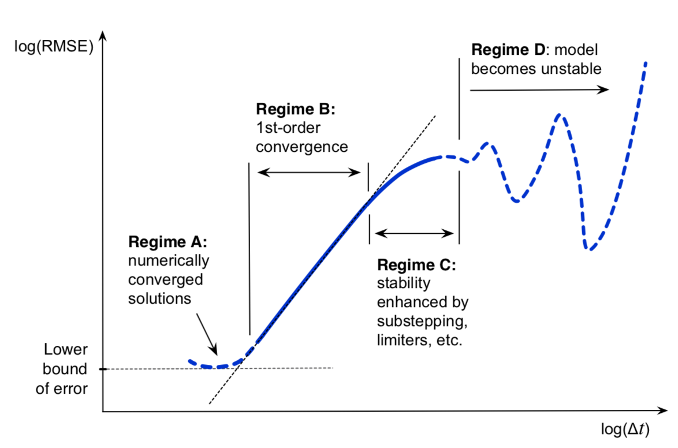
Time-step Convergence
Theory
Reality
With CAM5/EAMv0 physics (ca. 2014)
With EAMv1 physics (ca. 2018)
Regime B: the asymptotic regime:
Wan et al. (2020, JAMES, doi:10.1029/2019MS001982)
1 h global simulations. See Wan et al. (2015, JAMES, doi:10.1002/2014MS000368 )
p is expected to be 1 for EAM
Note contrast between dynamical core and full model

Slide 4
Slower-than-expected Convergence Rates
Time-stepping error and
solution self-convergence
Computational scientists’ comments
Model/code not doing what it is supposed to do
Limited accuracy gain from future reduction of time step size in high-resolution models
Actual
Desired
Weather and climate modelers’ comments
Parameterizations are empirical/pragmatic and complex
Is 1st-order convergence achievable and relevant?

Slide 5
Phase 1
Solution self-convergence in 1-h simulations with simplified cloud physics
“Proof-of-concept” period ended in Jan 2020
Focused on a hierarchy of models simpler than, but still relevant for, the full EAM
Key insights
Inconsistencies as a major cause of slow convergence
  between numerical choices (both spatial and temporal)
  between numerical methods and the model’s continuous formulation
  between assumptions made for the continuous formulation
Zonal and annual mean cloud fraction simulated with CAM4 physics suite
Resolving convergence issues is important
  More consistent representation of the intended physics
  Substantial impact on long-term climate (see figures)
  Also relevant for stochastic problems (more on this later)
Convergence testing is useful for HPC applications
  E.g., assessing correctness of single- or mixed-precision simulations
(Zhang et al., 2019, JAMES, doi:10.1029/2019MS001817)
Wan et al. (2020, JAMES, doi:10.1029/2019MS001982)
Vogl et al. (2020, JAMES, doi:10.1029/2019MS001974)

Slide 6
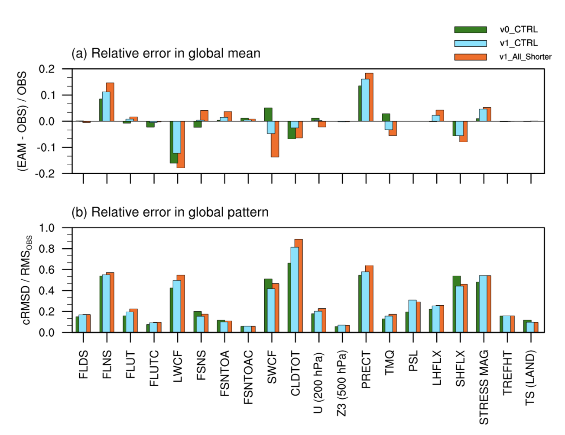
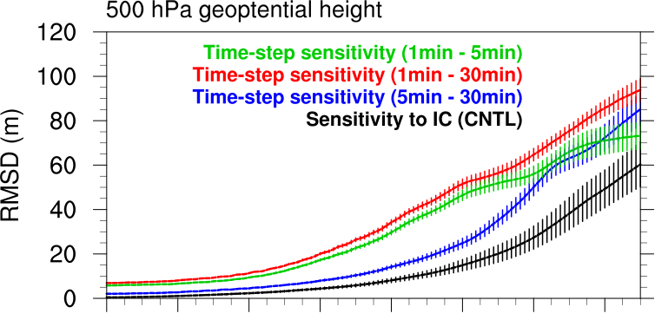
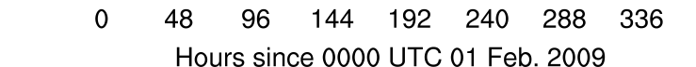
Phase 2
Focused shifted to the “real” EAM
Continue to use a model hierarchy and convergence testing as tools for evaluation and development
EAM Results are Sensitive to Parameterization Time Steps
10-year Mean Climate of EAMv0 and v1
15-day ensemble hindcasts with EAMv0-FV
Sousa, Zeng, Zhang et al., in preparation
Wan et al. (2020, GMD Discussion, doi: 10.5194/gmd-2020-330)

Slide 7
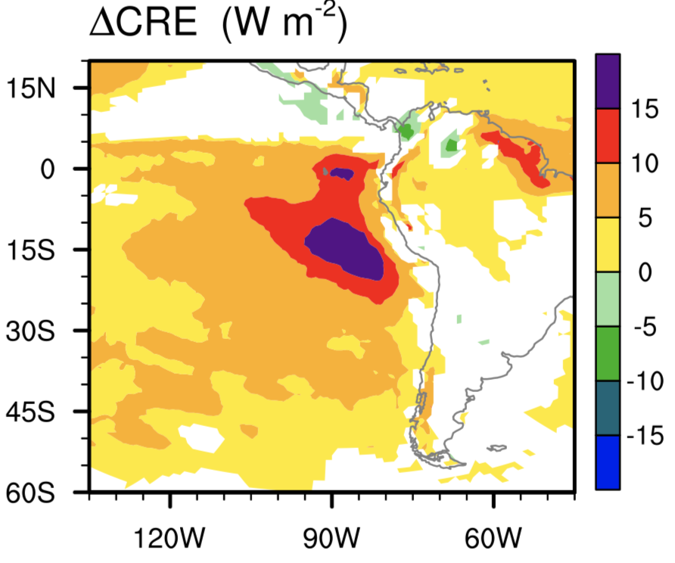
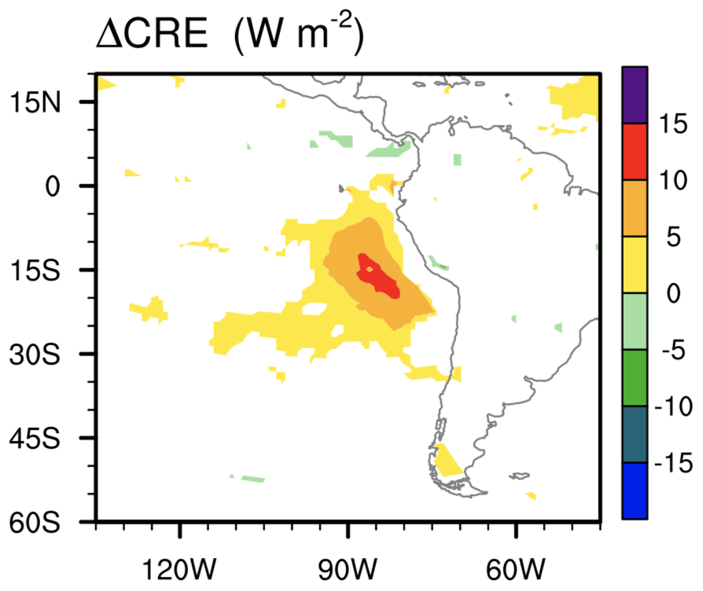

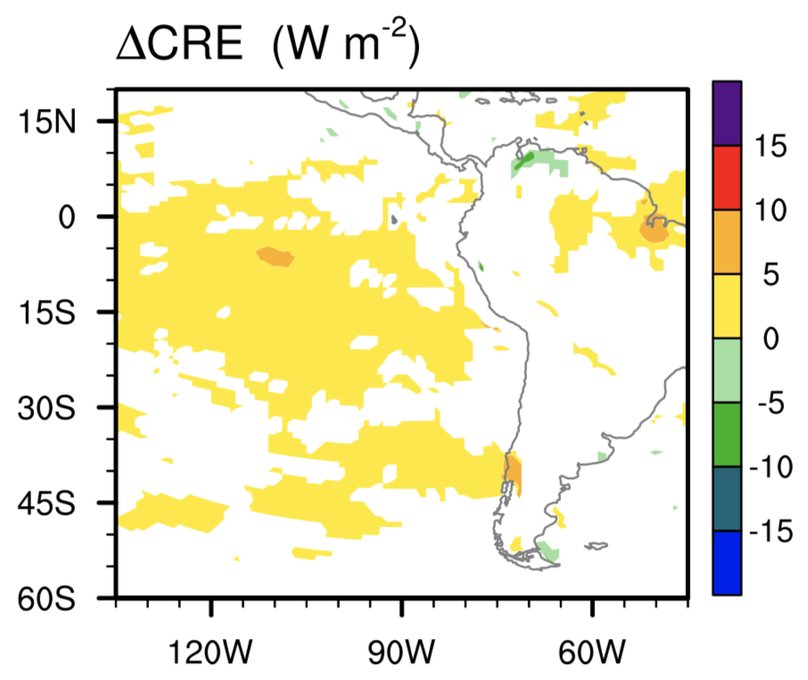
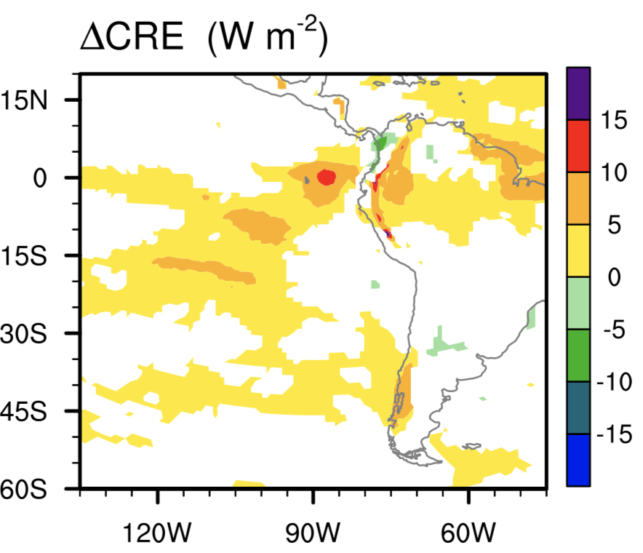
Quantifying and Attributing Time-step Sensitivities
All major step sizes
Process coupling
Shown are changes in 10-year mean total cloud radiative effect (CRE) caused by factor-of-6 step size reduction
Deep convection and interaction with dynamics etc.
Shallow cumulus and stratiform cloud macro/microphysics
See also: Wan et al. (2020, GMD Discussion, doi: 10.5194/gmd-2020-330)

Slide 8
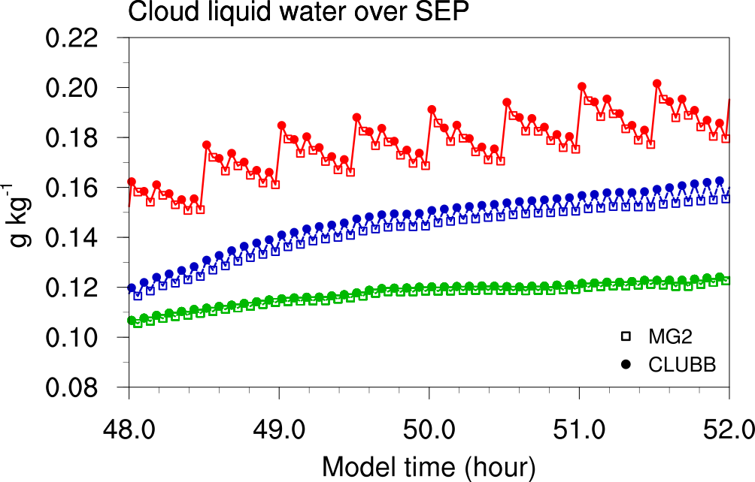
… then Understanding the Root Cause and Improving Time Integration
All major step sizes
Process coupling
5-h Time series of lower-atmosphere cloud water content of Peruvian statocumulus
Original
Revised
Reference simulation using smaller ∆t
Deep convection and interaction with dynamics etc.
Shallow cumulus and stratiform cloud macro/microphysics
Manuscript in preparation

Slide 9
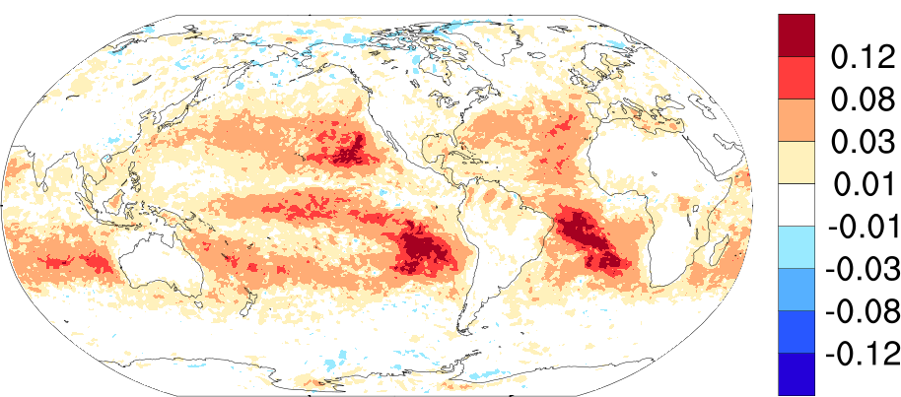
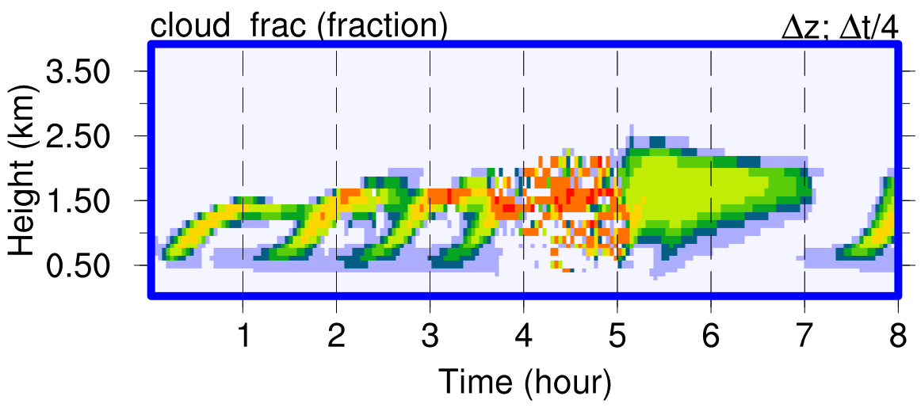
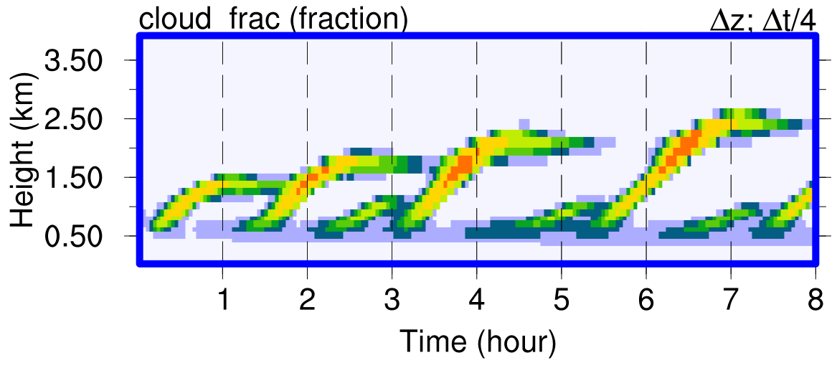
Improving Accuracy and Convergence of Individual Parameterizations
CLUBB as an example
SON low-cloud fraction changes due to a simplification in the discretization
Cloud fraction in single-column simulations RICO (trade cumulus)
Original CLUBB
With new upwinding for
Vogl and Zhang et al., in preparation

Slide 10
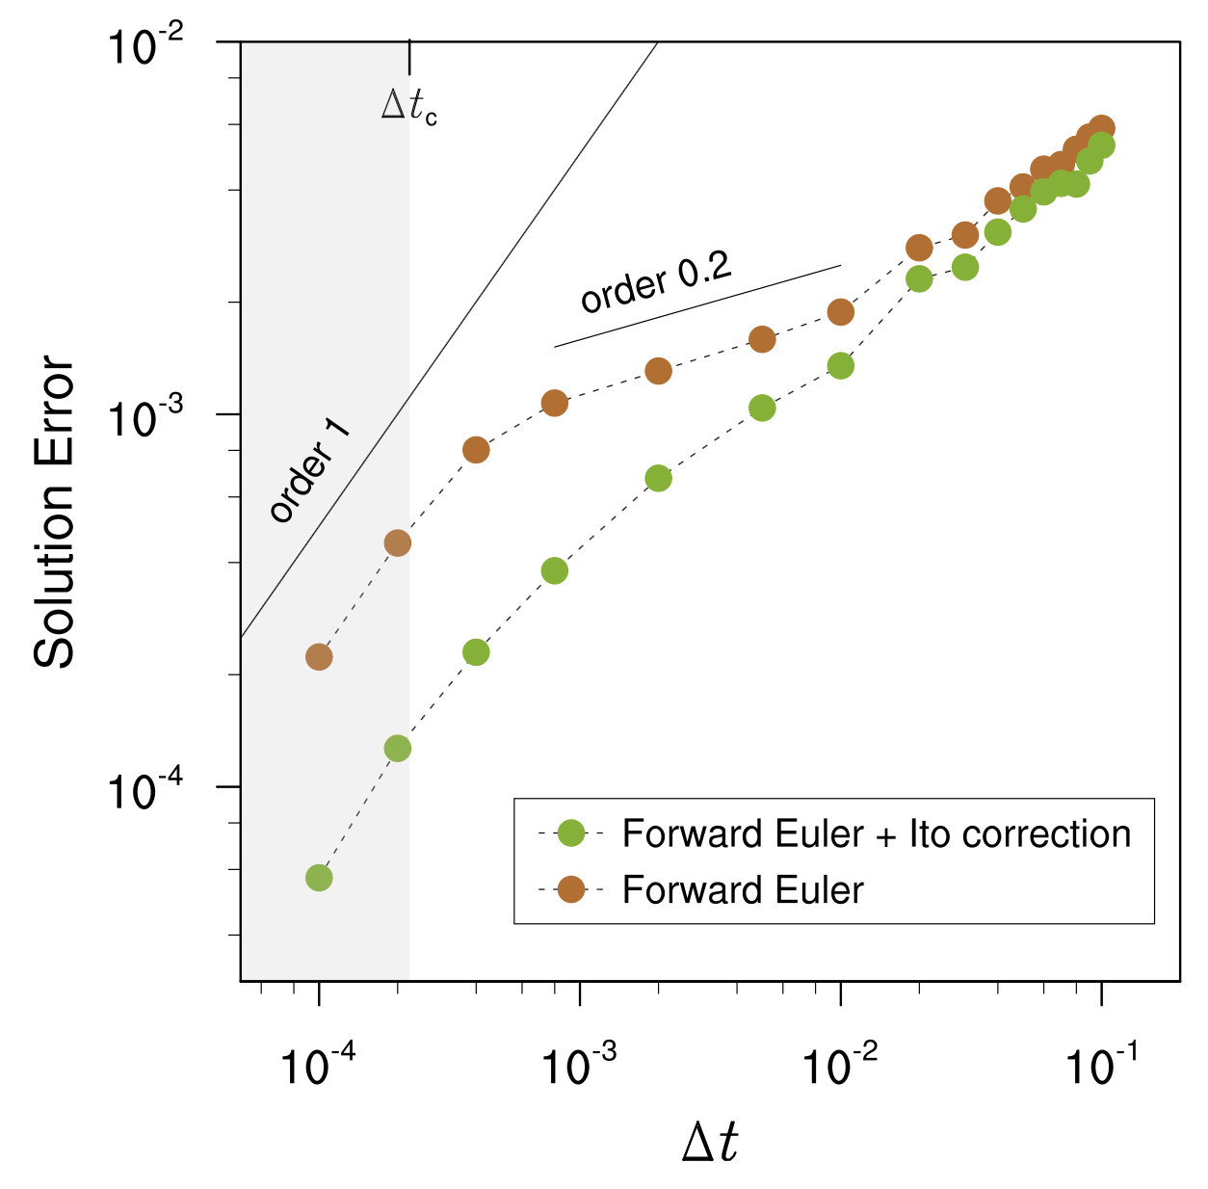
Stochastic Parameterizations
Our work
Generalized Itô correction for noise of any color
Demonstrated benefit in a 1D problem
Currently working on a 2D atmosphere model
Plan to identify opportunities to contribute to E3SM’s stochastic parameterization development
Concept of convergence still applies
Naïve application of schemes designed for deterministic problems can cause large errors
Itô correction can improve accuracy without requiring intrusive changes to legacy codes of deterministic problems
Ensemble-mean time-stepping error calculated against true solution
Example from Hodyss et al. (2014, MWR): Intensity of hurricane Isaac (2012) measured by max. surface wind speed
Ensemble hindcasts using Euler forward method for stochastic term
Control (deterministic)
Ensemble hindcasts using Euler forward + Itô correction
See also: Stinis et al. (2020, MWR, doi: 10.1175/MWR-D-19-0178.1)

Slide 11
Concluding Remarks
Numerical artifacts in physics parameterizations are an important source of model error
Improving numerical accuracy and convergence can
  Improve the representation of intended physics
  Benefit upcoming versions of E3SM (high-resolution, stochastic)
Close collaboration between atmospheric scientists and computational scientists is needed
Parameterized physics is a huge amount of equations and code. Engagement of more developers would help speed up this effort.

