Slide 1
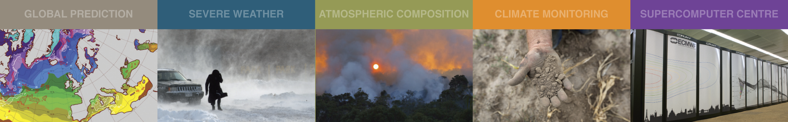
A baseline for global weather and climate simulations at 1 km resolution
Nils P. Wedi
European Centre for Medium-Range Weather Forecasts (ECMWF)

Slide 2
Outline
Performance, Portability and Complexity evolution of the Integrated Forecasting System (IFS)
Towards increasing realism with storm-scale resolving simulations
A first digital twin prototype: a global seasonal simulation with 1.4 km grid-spacing on Summit

Slide 3
(Schulthess et al, 2019)
ECMWF’s progress in degrees of freedom
(levels x grid columns x prognostic variables)
Notes:
The progress in the degrees of freedom (vertical levels x grid
columns x prognostic variables) of the ECMWF operational global atmosphere model in
comparison to the projected 18 months doubling according to Moore’s law, adjusted
(P^3/4) to account for the change in time-resolution also required in a 3-dimensional
dynamical system when increasing spatial resolution. ECMWF’s actual progress up to 2018
follows Moore’s law closely, also thanks to the numerical methods employed. As illustrated,
the ambitious goal of reaching a 1 km horizontal resolution with 180 levels in 2030 requires
a faster progress than Moore’s law. The numbers indicate the average grid-point distance in
kilometers and the corresponding spectral resolution and levels used.

Slide 4
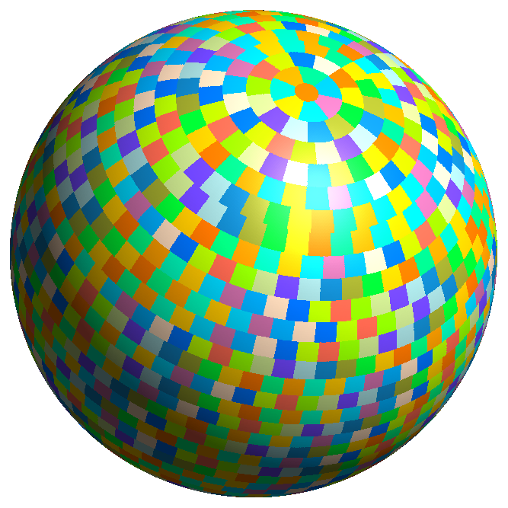
Spectral transform based model at global average 1.4 km grid spacing
6,599,680 points x 137 levels x 10 vars
at ~9km ~ 9 Billion points or ~100TB/day
TCo7999 L137
256,800,000 points x 137 levels x 10 variables at ~1,4km
352 billion points x 960 pp steps == ~100TB/simulated month
Summit SIMULATION

Slide 5
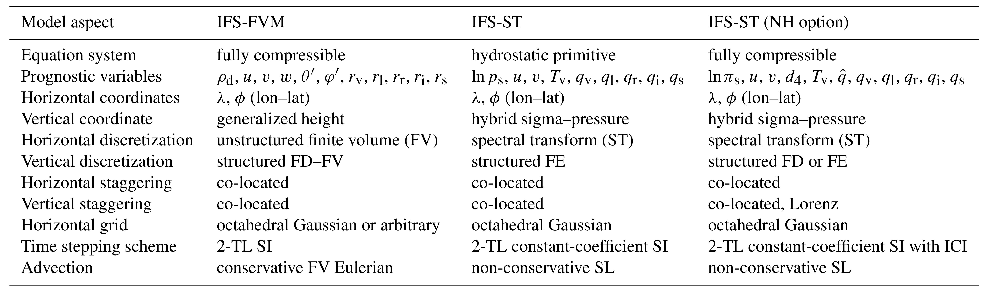
IFS dynamical core options at ECMWF
C. Kuehnlein et al 2019
| currently operational |
The Finite-Volume Module of the IFS (IFS-FVM) provides complementary features, e.g. local computational patterns and predominantly nearest neighbour, non-hydrostatic, complex and steep orography, conservation, mesh adaptation.

Slide 6
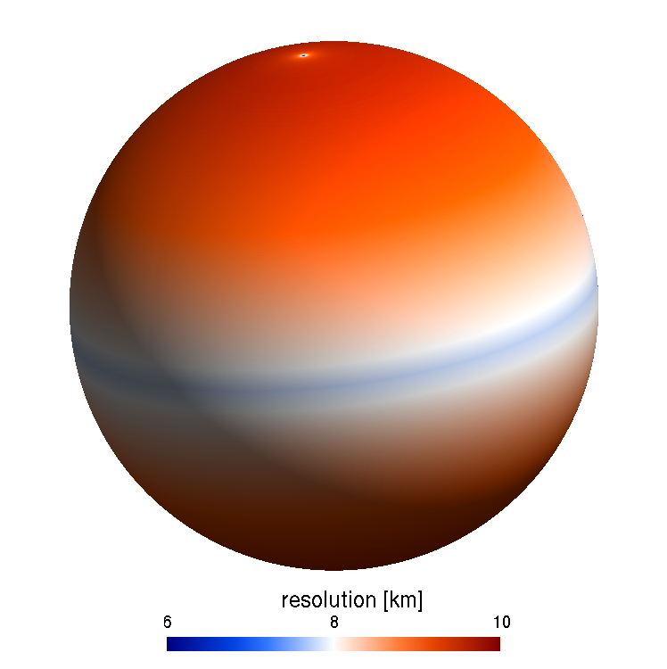
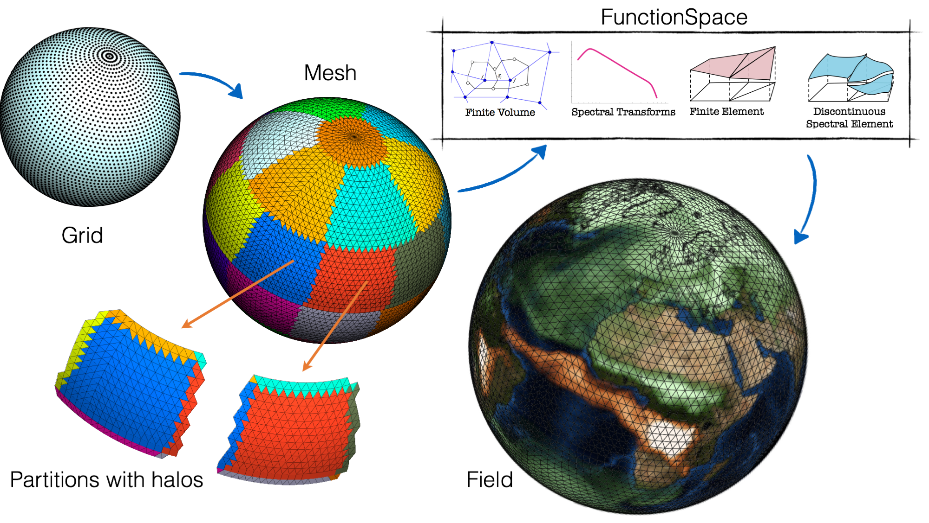
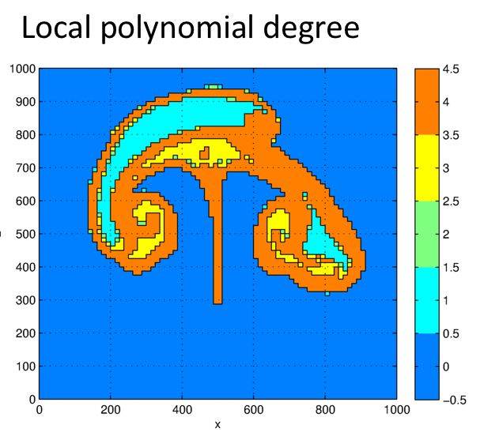
A ”non-disruptive” evolutionary approach in dynamical core development
Continue improving IFS-ST core algorithms
Cubic octahedral grid (efficient and more scalable)
Fast LT algorithm
Continue improving SL advection & its TL/AD
Non-intrusive introduction of Atlas library in IFS
Flexible data structures to facilitate future developments
Capability to link CPU to GPU host
Mathematical operators, grid generation & multiple grids capability
Code modularity to enable seamless use of heterogenous architectures (CPU/GPU)
Developing NH FVM on same O-grid advantageous for finest resolutions:
Low communication (compact stencil) and scalability
Steep slope Mass conservation and good accuracy
As resolution keeps increasing the “triple crossing point” is reached:
NH formulation is advantageous
FVM more efficient and more adaptive via DSL than IFS-ST
FVM delivers the same quality of forecasts
FVM operational
Target: Octahedral grid O8000
The next 10 years …
Atlas mesh generation and flexibility
through alternative function spaces
DG
Michail Diamantakis

Slide 7
Atlas: a library for NWP and climate modelling
Deconinck et al. 2017

Slide 8
Performance and portability
M. Lange, O. Marsden, B. Reuter
Structure and components necessary for the transition of the IFS to separate
applied science from hardware sensitive code level

Slide 9
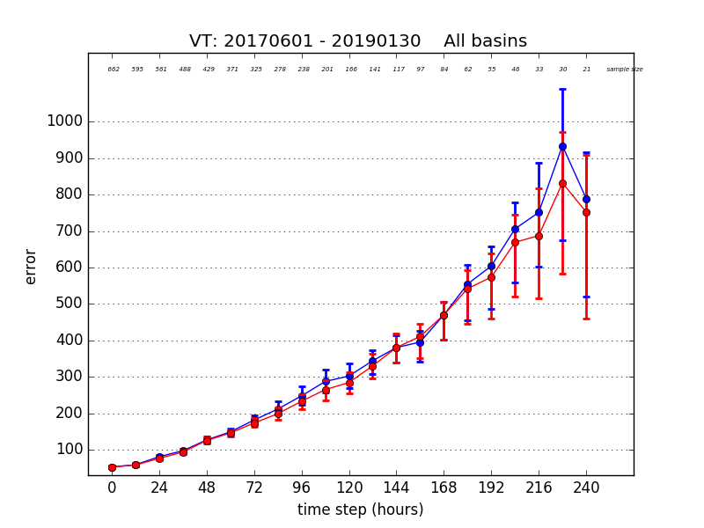
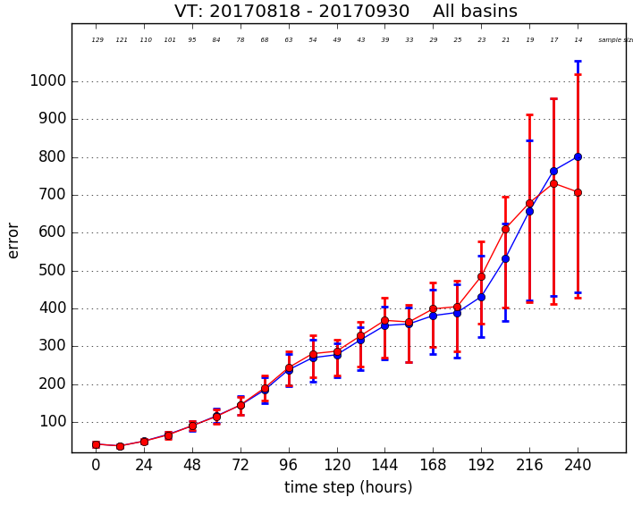
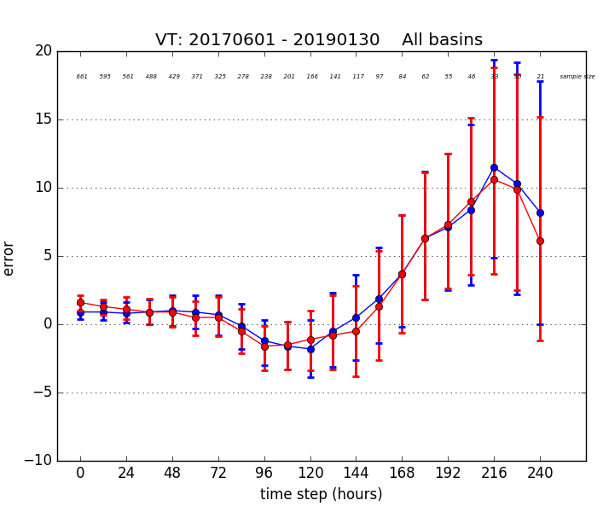
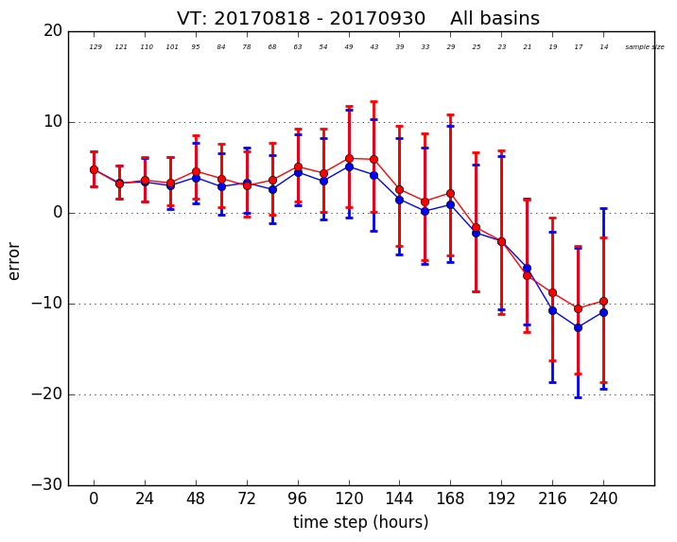
Single versus double precision tropical Cyclone error measures
46r1
45r1
single
double
(km)
mean position error
(hPa)
mean intensity error
Vana, Dueben et al, 2017

Slide 10









ECMWF Scalability Programme
DIGITAL TWINS

Slide 11
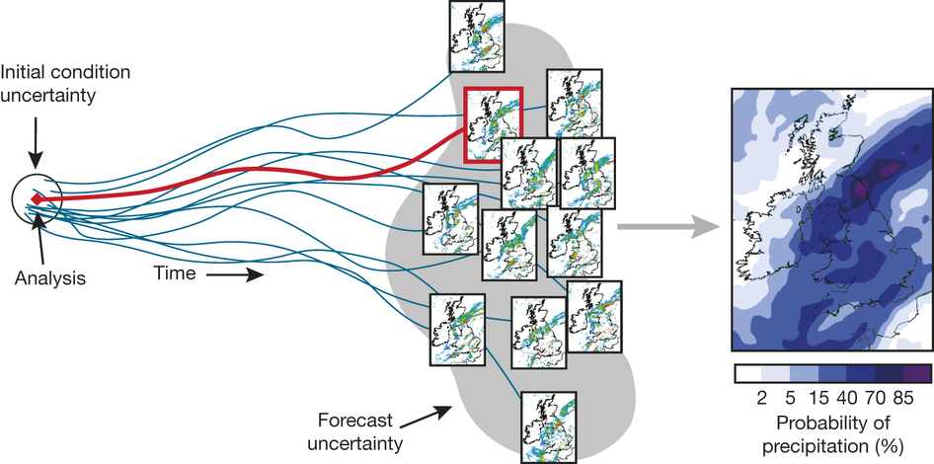
Ensemble of assimilations and forecasts
EDA – 50 members
ENS – 50 members

Slide 12
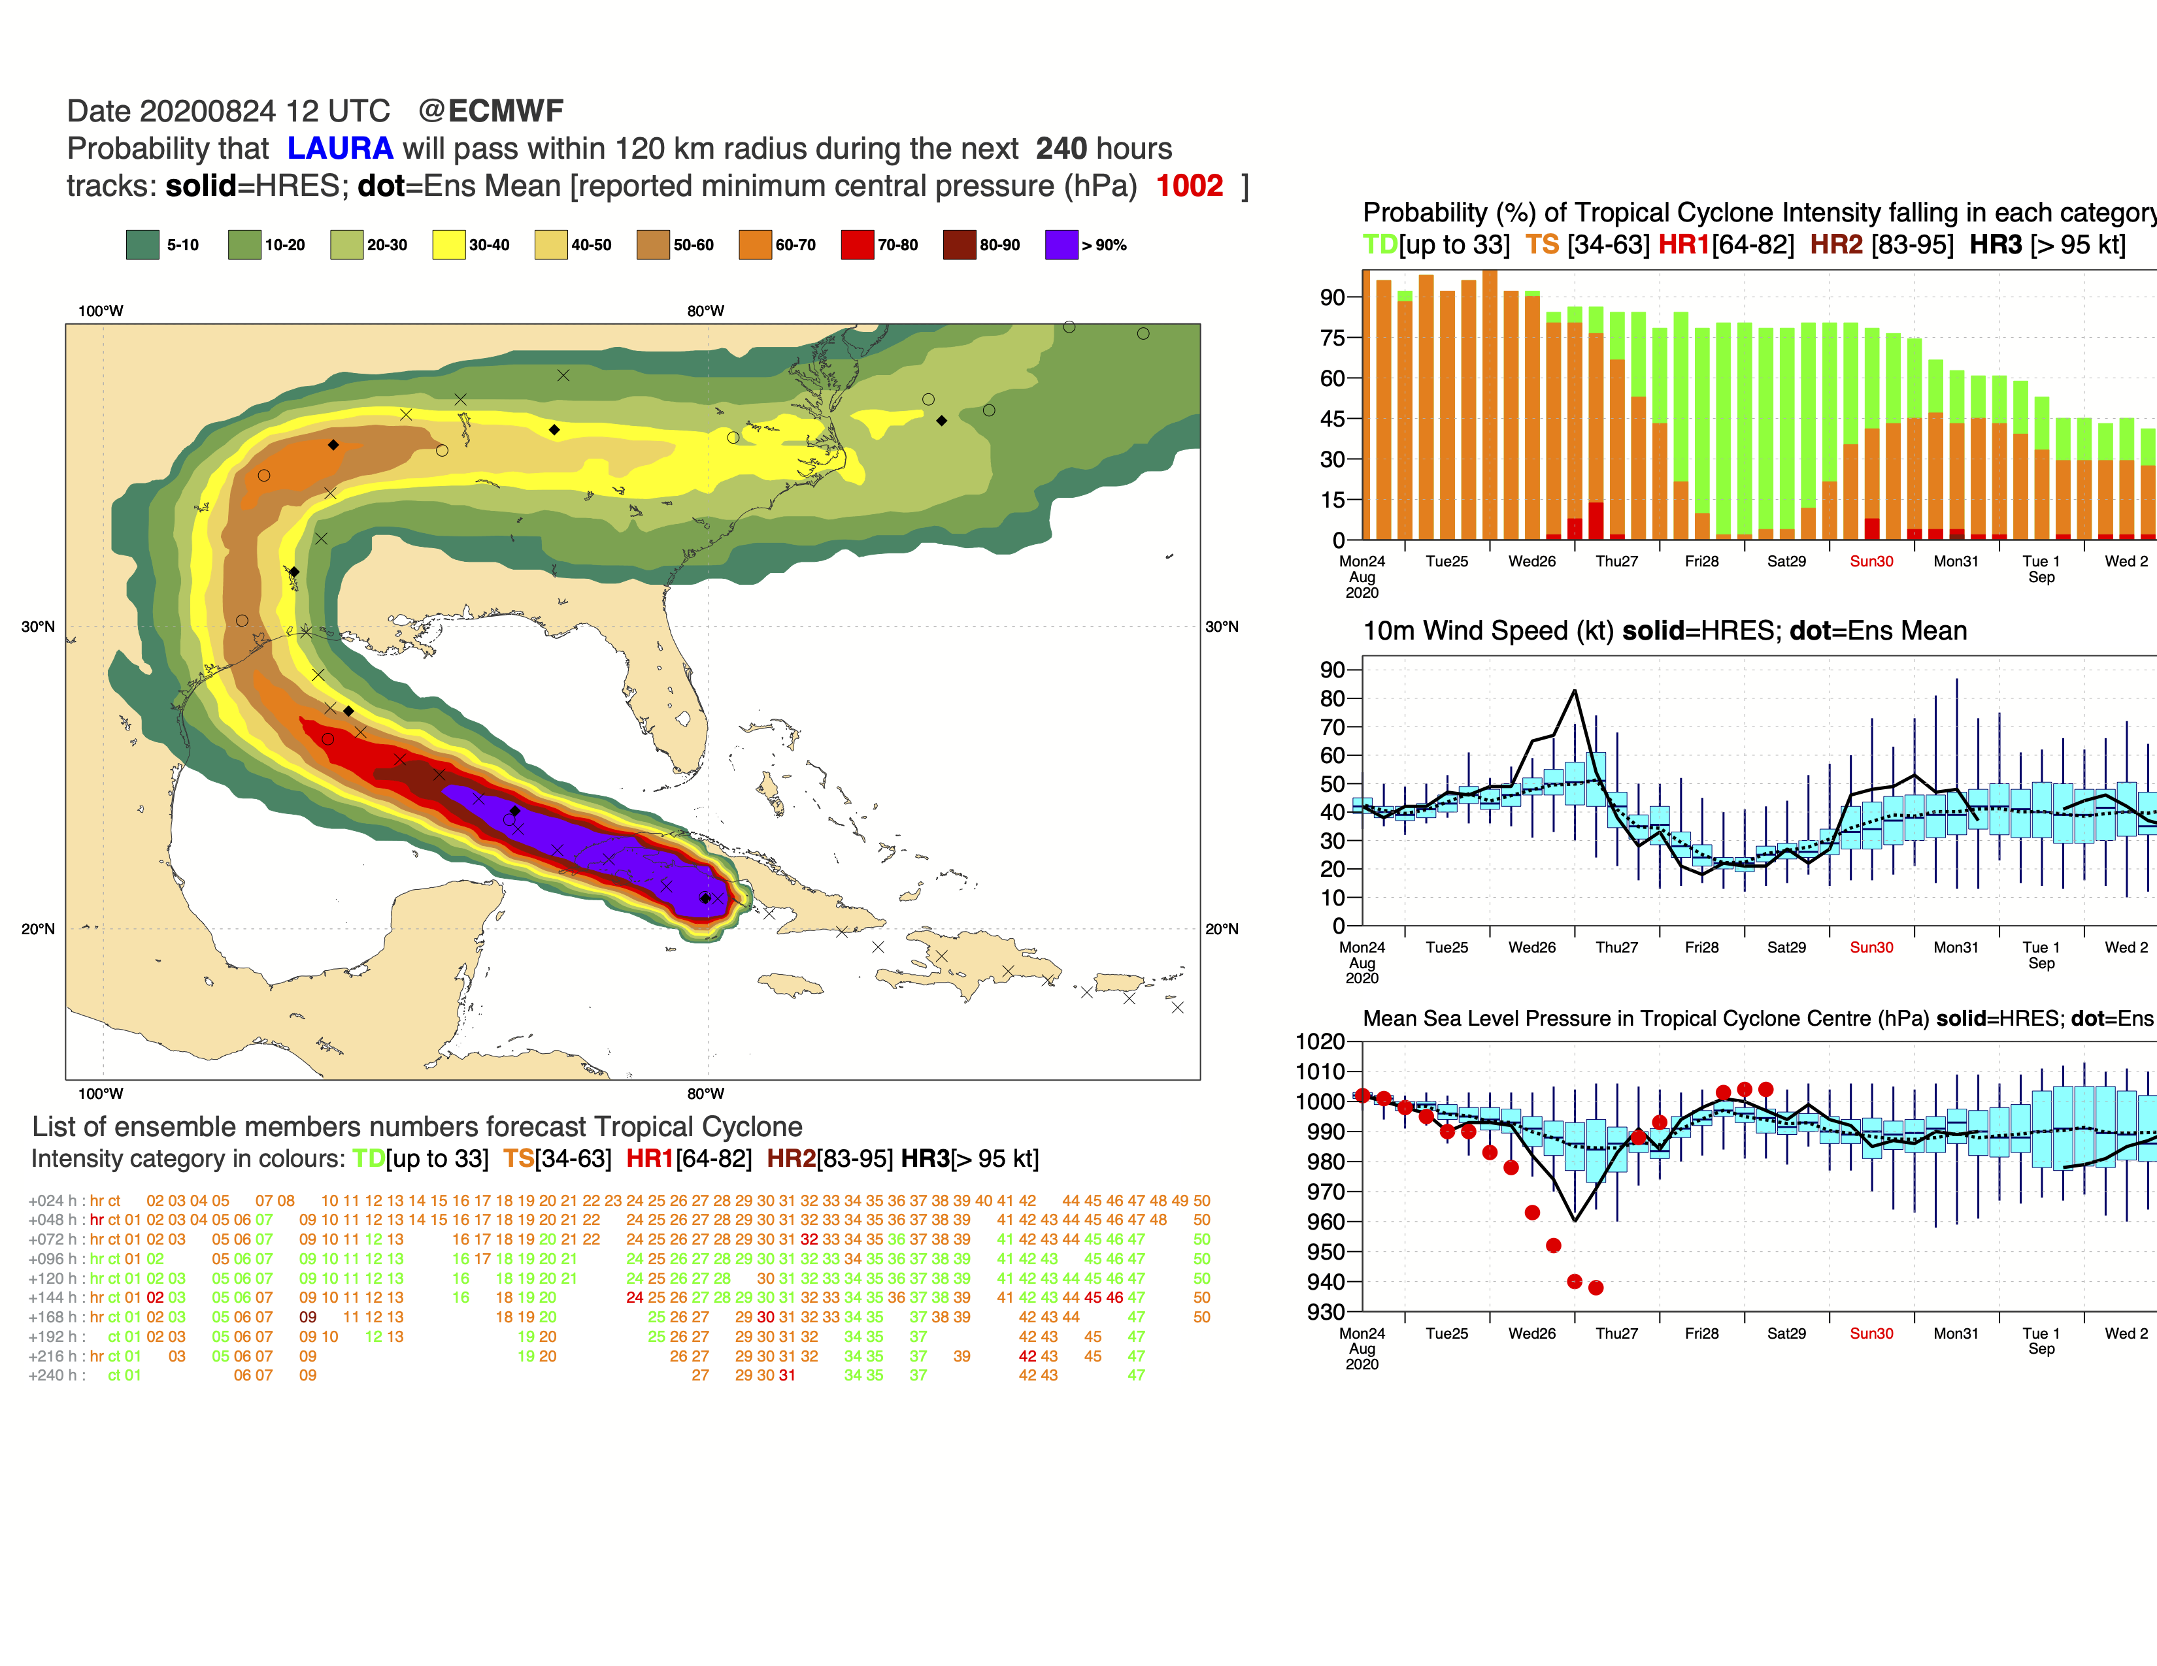
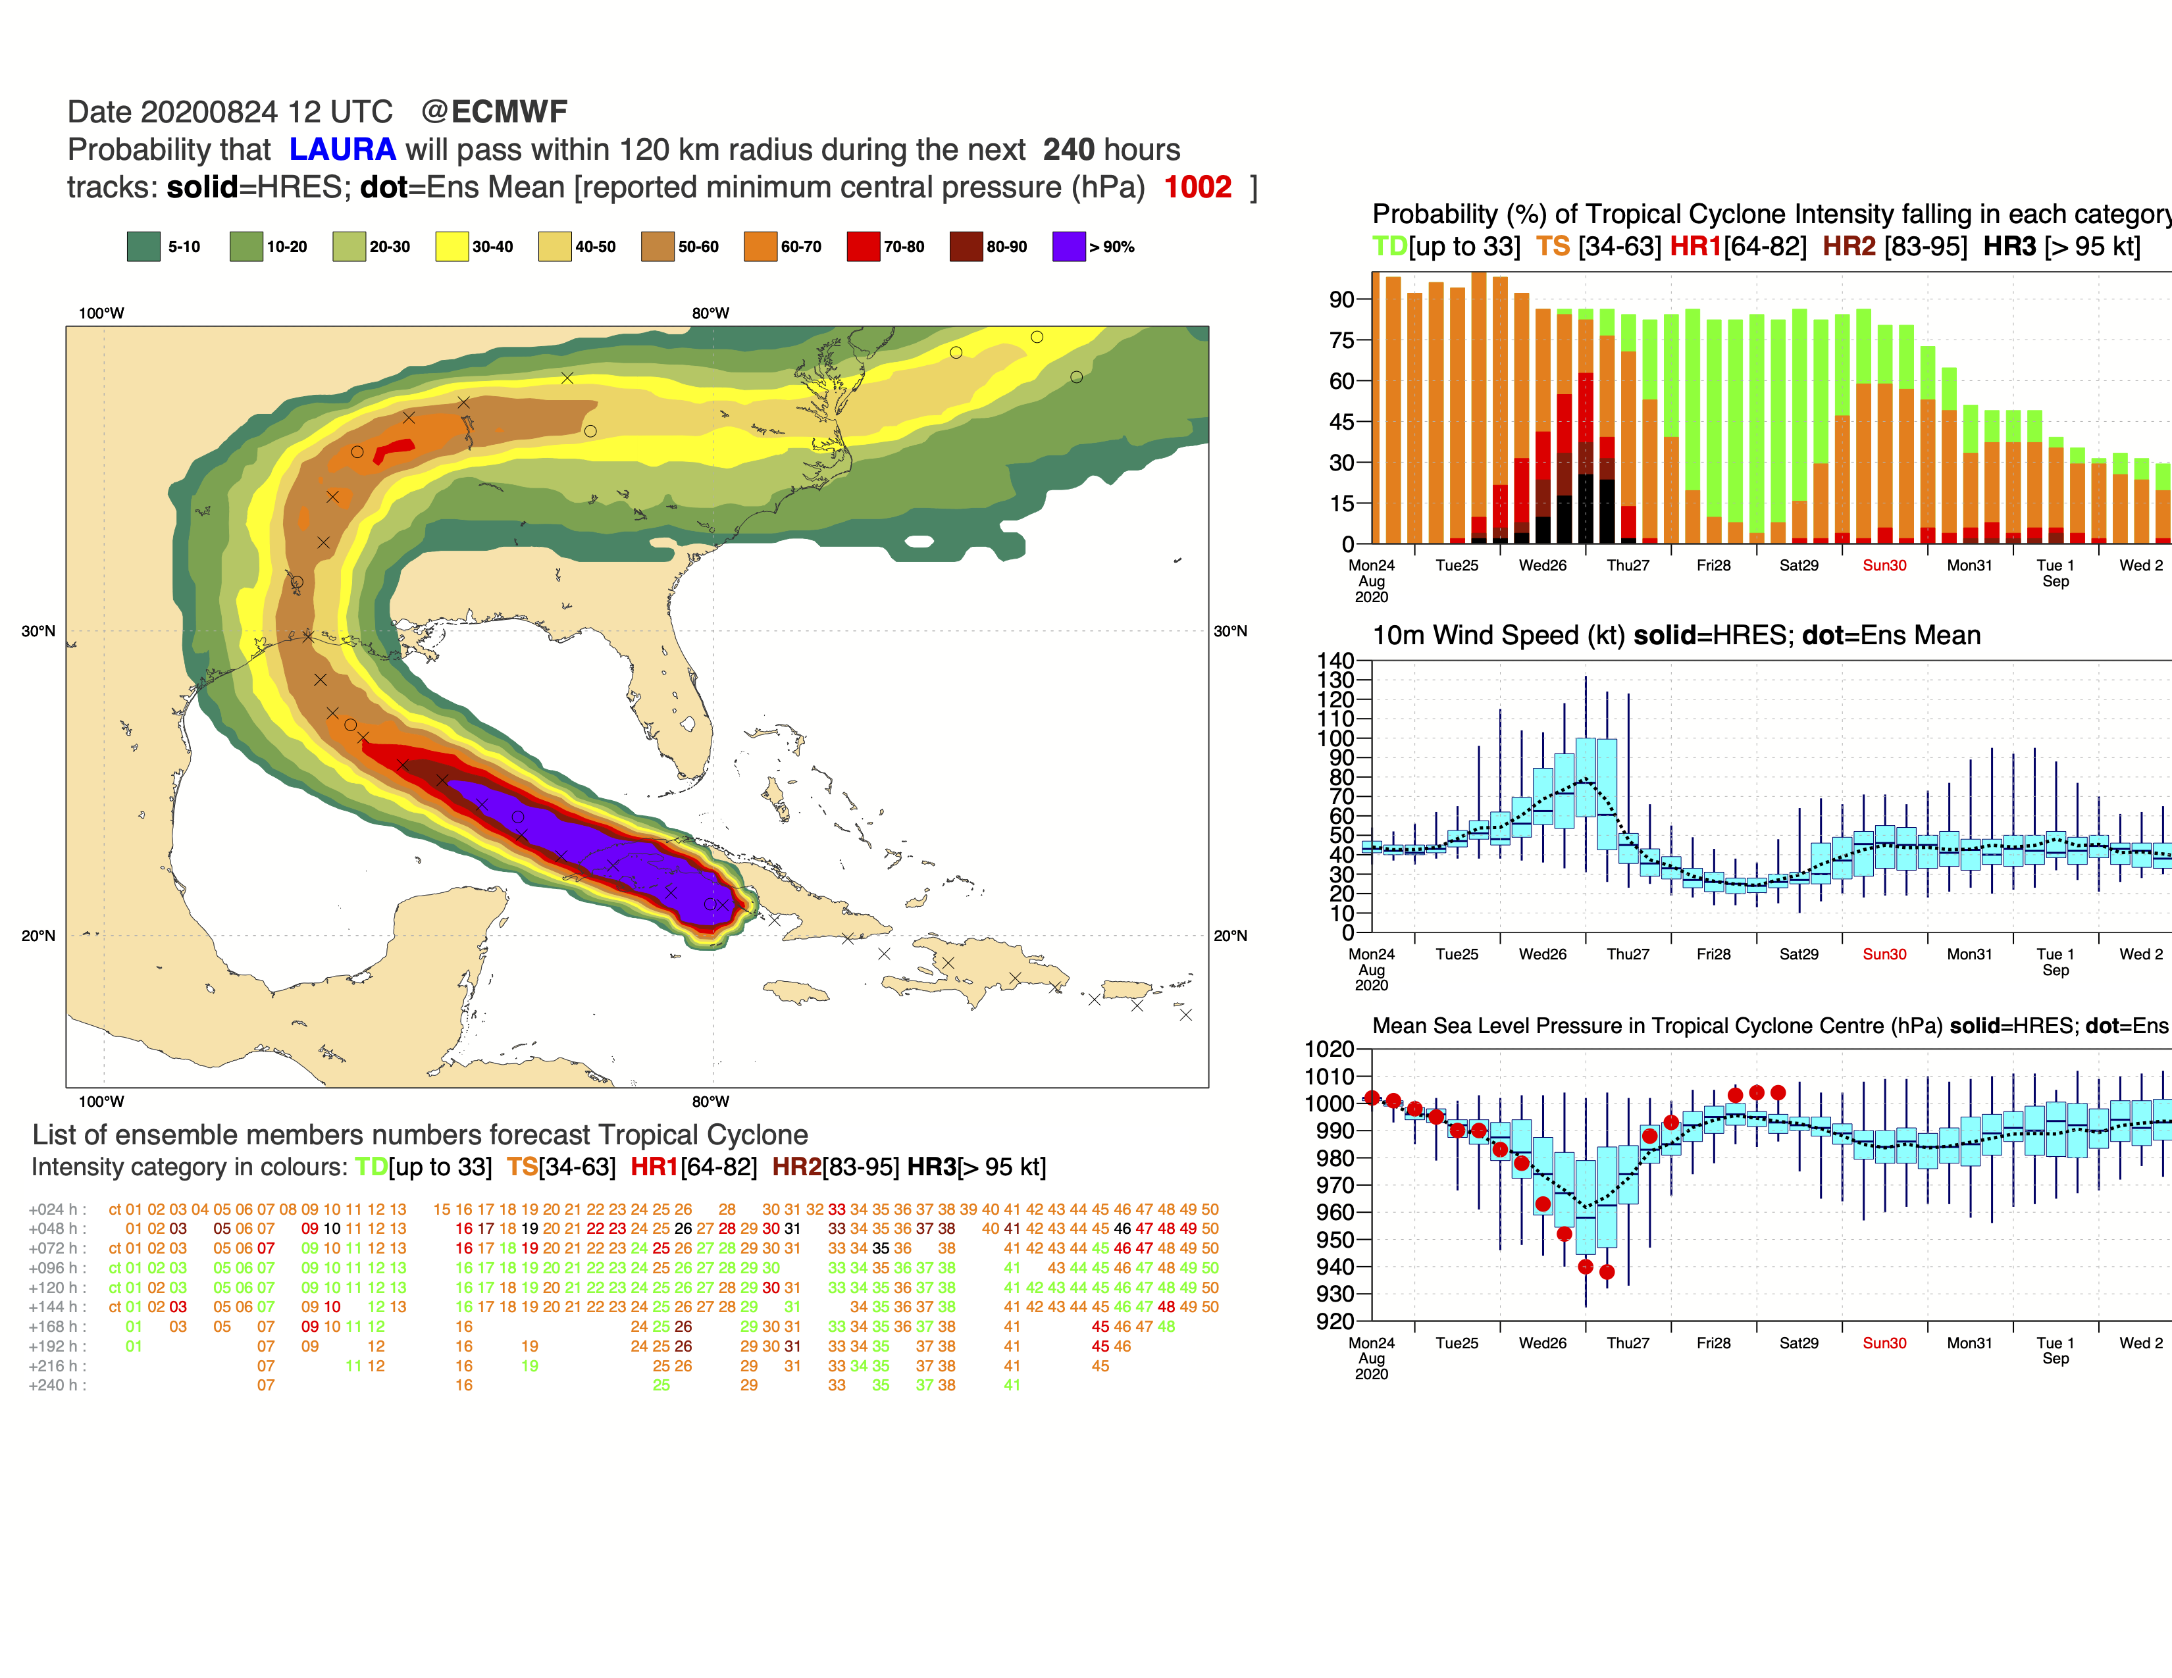
Oper, Tco639L91
Oper, Tco1279L137
Crosses : observed position
Circle : ensemble mean
Diamonds : Oper HRES
Red dot : observed core pressure
Solid black line : Oper HRES
Box plot : ensemble distribution
Troical Cyclone Laura
Simon Lang

Slide 13
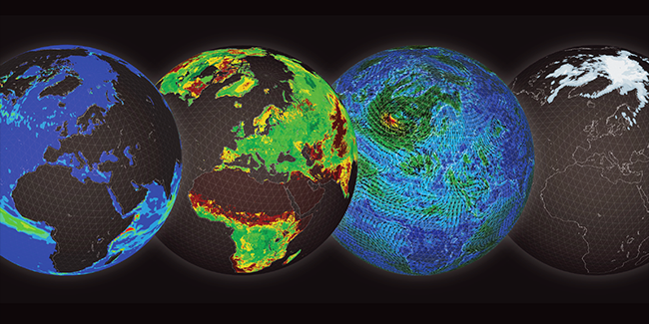
Ocean – Land – Atmosphere – Sea ice

Slide 14
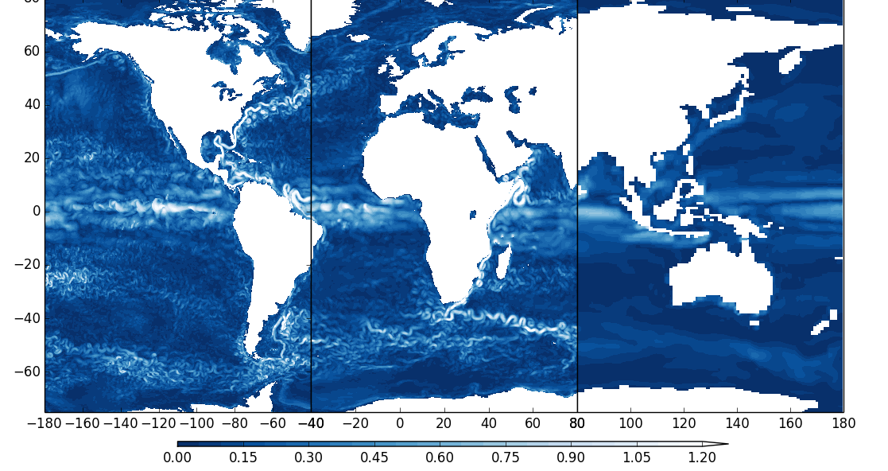
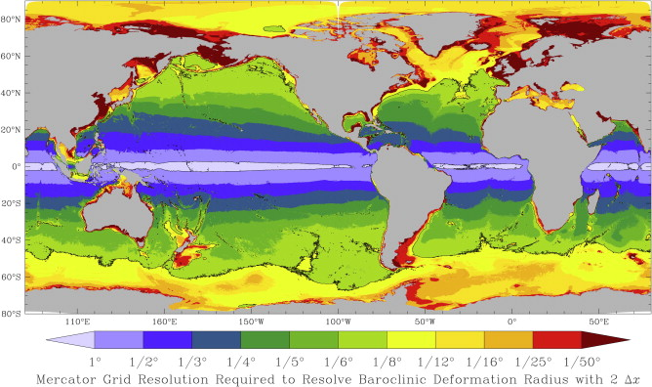
Ocean model - resolution
1/12°
1/4°
1°
Hewitt et al. (2017)
Hallberg (2013)

Slide 15
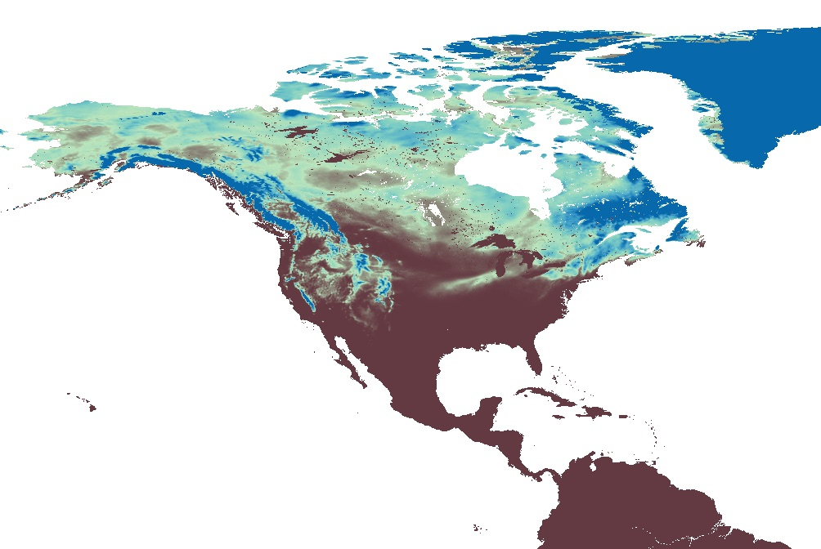
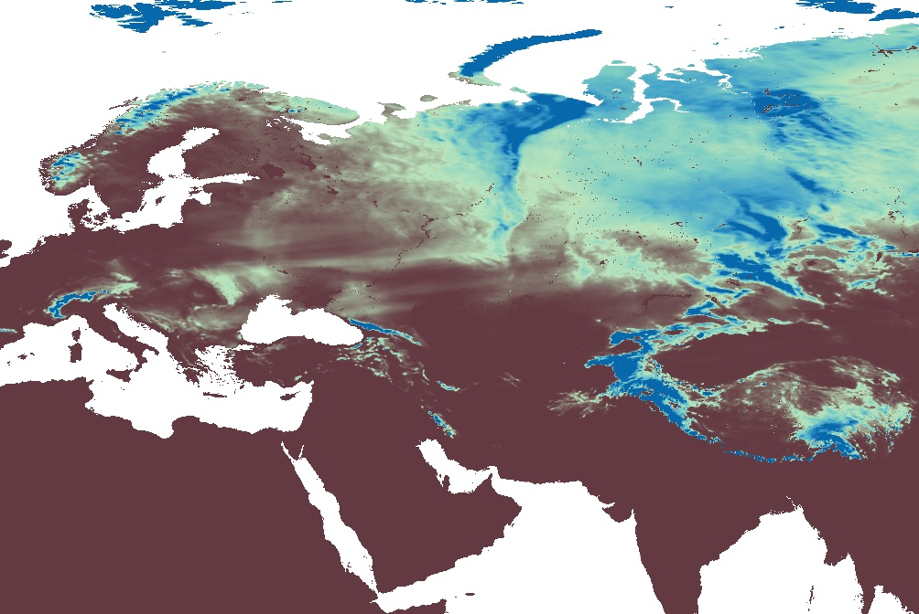
Increased realism in water cycle reservoir representation at 1km
Ioan Hadade, Gabriele Arduini, Souhail Boussetta, Joey McNorton, Margarita Choulga, Gianpaolo Balsamo, et al.
The Offline Surface Modelling (OSM) increased performance allows to run the surface at 1km at ECMWF
Increased realism of
Land use and land cover (use of ESA-CCI)
Coastal areas and lakes (use of GSWE)
Snow over orography & catchment hydrology
Urban areas
Prerequisite for improved analysis of
skin temperature
anthropogenic emissions
Resolution | Configuration | Performance SYPD
9km (HRES & ERA5Land) | TCo1279 | ~ 8
1km (VHRES) | TCo7999 | ~ 1
VHRES 1 km – US snow depth
VHRES 1 km – Eurasia snow depth

Slide 16
A. Agusti-Panareda, G. Balsamo et al
Key aspects for Numerical methods:
- Horizontal and vertical resolution at the scale of emission sources ( 100m - 1km )
- Transport uncertainty and tracer conservation
- Cost of many advected tracers and shape preservation (e.g. monotonicity, positivity, thresholds)

Slide 17
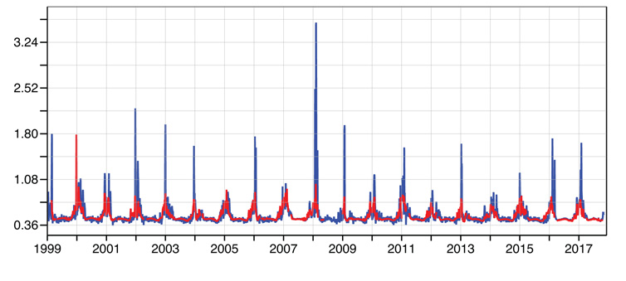
Improvements to NWP systems in the Stratosphere: better reanalysis & monitoring
Much better representation of Sudden Stratospheric Warming events, due to changes in the Semi-Langrangian scheme (Diamantakis, 2014)
NH winter SSWs
ERA-Interim
ERA5
Standard deviation of MW radiances observed vs simulated temperature fields of ERA-Interim (blue) and ERA5 (red) using satellite channel (noaa15) peaking around 5hpa.
T. McNally, A. Simmons
Notes:
NWP systems are also used to produce modern reanalysis such as ERA-INTERIM or ERA5, which represent the best reconstruction of the past state of the atmosphere obtained by blending model and observations though the data assimilation processes. As NWP improved, reanalysis also improved. This plot illustrates that SSW events which are some of the key events taking place at high latitudes in NH winter, are much better reproduced in ERA5 than ERA interim. What is shown here the standard deviation of differences between MW radiances observed and simulated from temperature fields of ERA-Interim (blue) and ERA5 (red) from a satellite channel (noaa15) peaking around 5hpa.

Slide 18
Towards increasing realism with storm-scale resolving simulations
The ECMWF Cubic Octahedral (ECO1280) Nature Run (Ross Hoffman, Tanya Peevey, S. Malardel, …)
  https://www.cira.colostate.edu/imagery-data/ecmwf-nature-run/
DYAMOND: the DYnamics of the Atmospheric general circulation Modelled On Non-hydrostatic Domains
  Stevens et al, 2019 https://progearthplanetsci.springeropen.com/articles/10.1186/s40645-019-0304-z
DYAMOND II (ongoing)
  Simulation period Jan – Mar 2020 (40 days), shadowing EURECA campaign, including coupled simulations
    IFS at 4km coupled to NEMO
    IFS at 4km coupled to FESOM2
    Additional: NH-IFS with Arome and IFS physics at 2.5km
Global simulations of the atmosphere at 1.4 km grid-spacing with the Integrated Forecasting System (Dueben, Wedi, Saarinen, Zeman, JMSJ 2020)
  First runs on PizDaint (Europe’s biggest computer), NH-IFS and H-IFS comparisons

Slide 19
INCITE awards computing time on the 2nd largest supercomputer in the world (Summit, top500 June 2020) at the Oak Ridge Leadership Computing Facility (OLCF), Oakridge, Tennessee, US
~4600 nodes:
2 x ibm_power9 (42 cores)
6 x NVIDIA V100 GPUs
512 GB DDR4 memory
1.6 TB NVMe
96 GB HBM2 (GPU only)
  Motivations:
  - Push accelerator readiness
  - Status and capability of the IFS model
  - Comparison of dynamical cores
  - Explicitly simulating deep convection
  - Explore impact on longer time scales
  - Support for OSSEs
This research used resources of the Oak Ridge Leadership Computing Facility, which is a DOE office of
Science User Facility supported under contract DE-AC05-00OR22725.

Slide 20
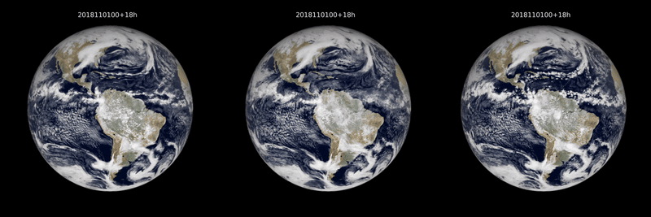
3-hourly accumulated radiative fluxes at the top of the atmosphere
1.4 km
9 km
9 km w/o deep
A baseline for global weather and climate simulations at 1 km resolution
Nils P. Wedi1, Inna Polichtchouk1, Peter Dueben1, Valentine G. Anantharaj2, Peter Bauer1, Souhail Boussetta1, Philip Browne1, Willem Deconinck1, Wayne Gaudin3, Ioan Hadade1, Sam Hatfield1, Olivier Iffrig1, Philippe Lopez1, Pedro Maciel1, Andreas Mueller1, Sami Saarinen1, Irina Sandu1, Tiago Quintino1, Frederic Vitart1
(JAMES, 2020, avail online)

Slide 21
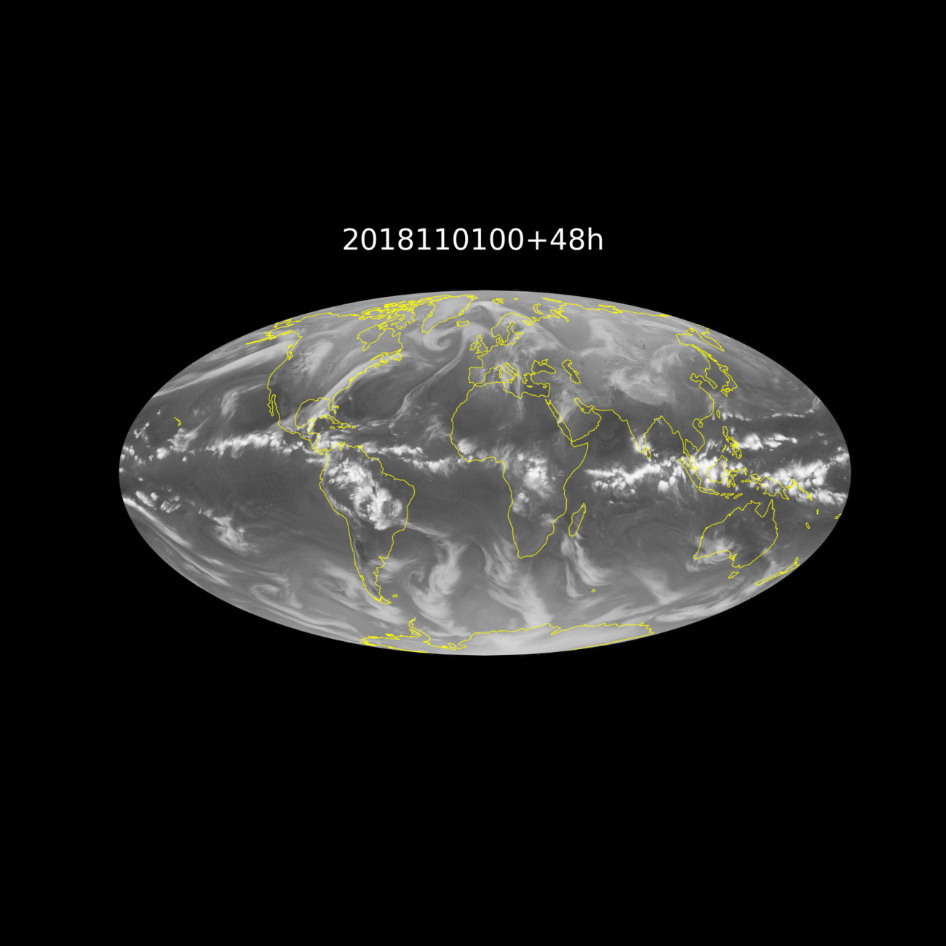
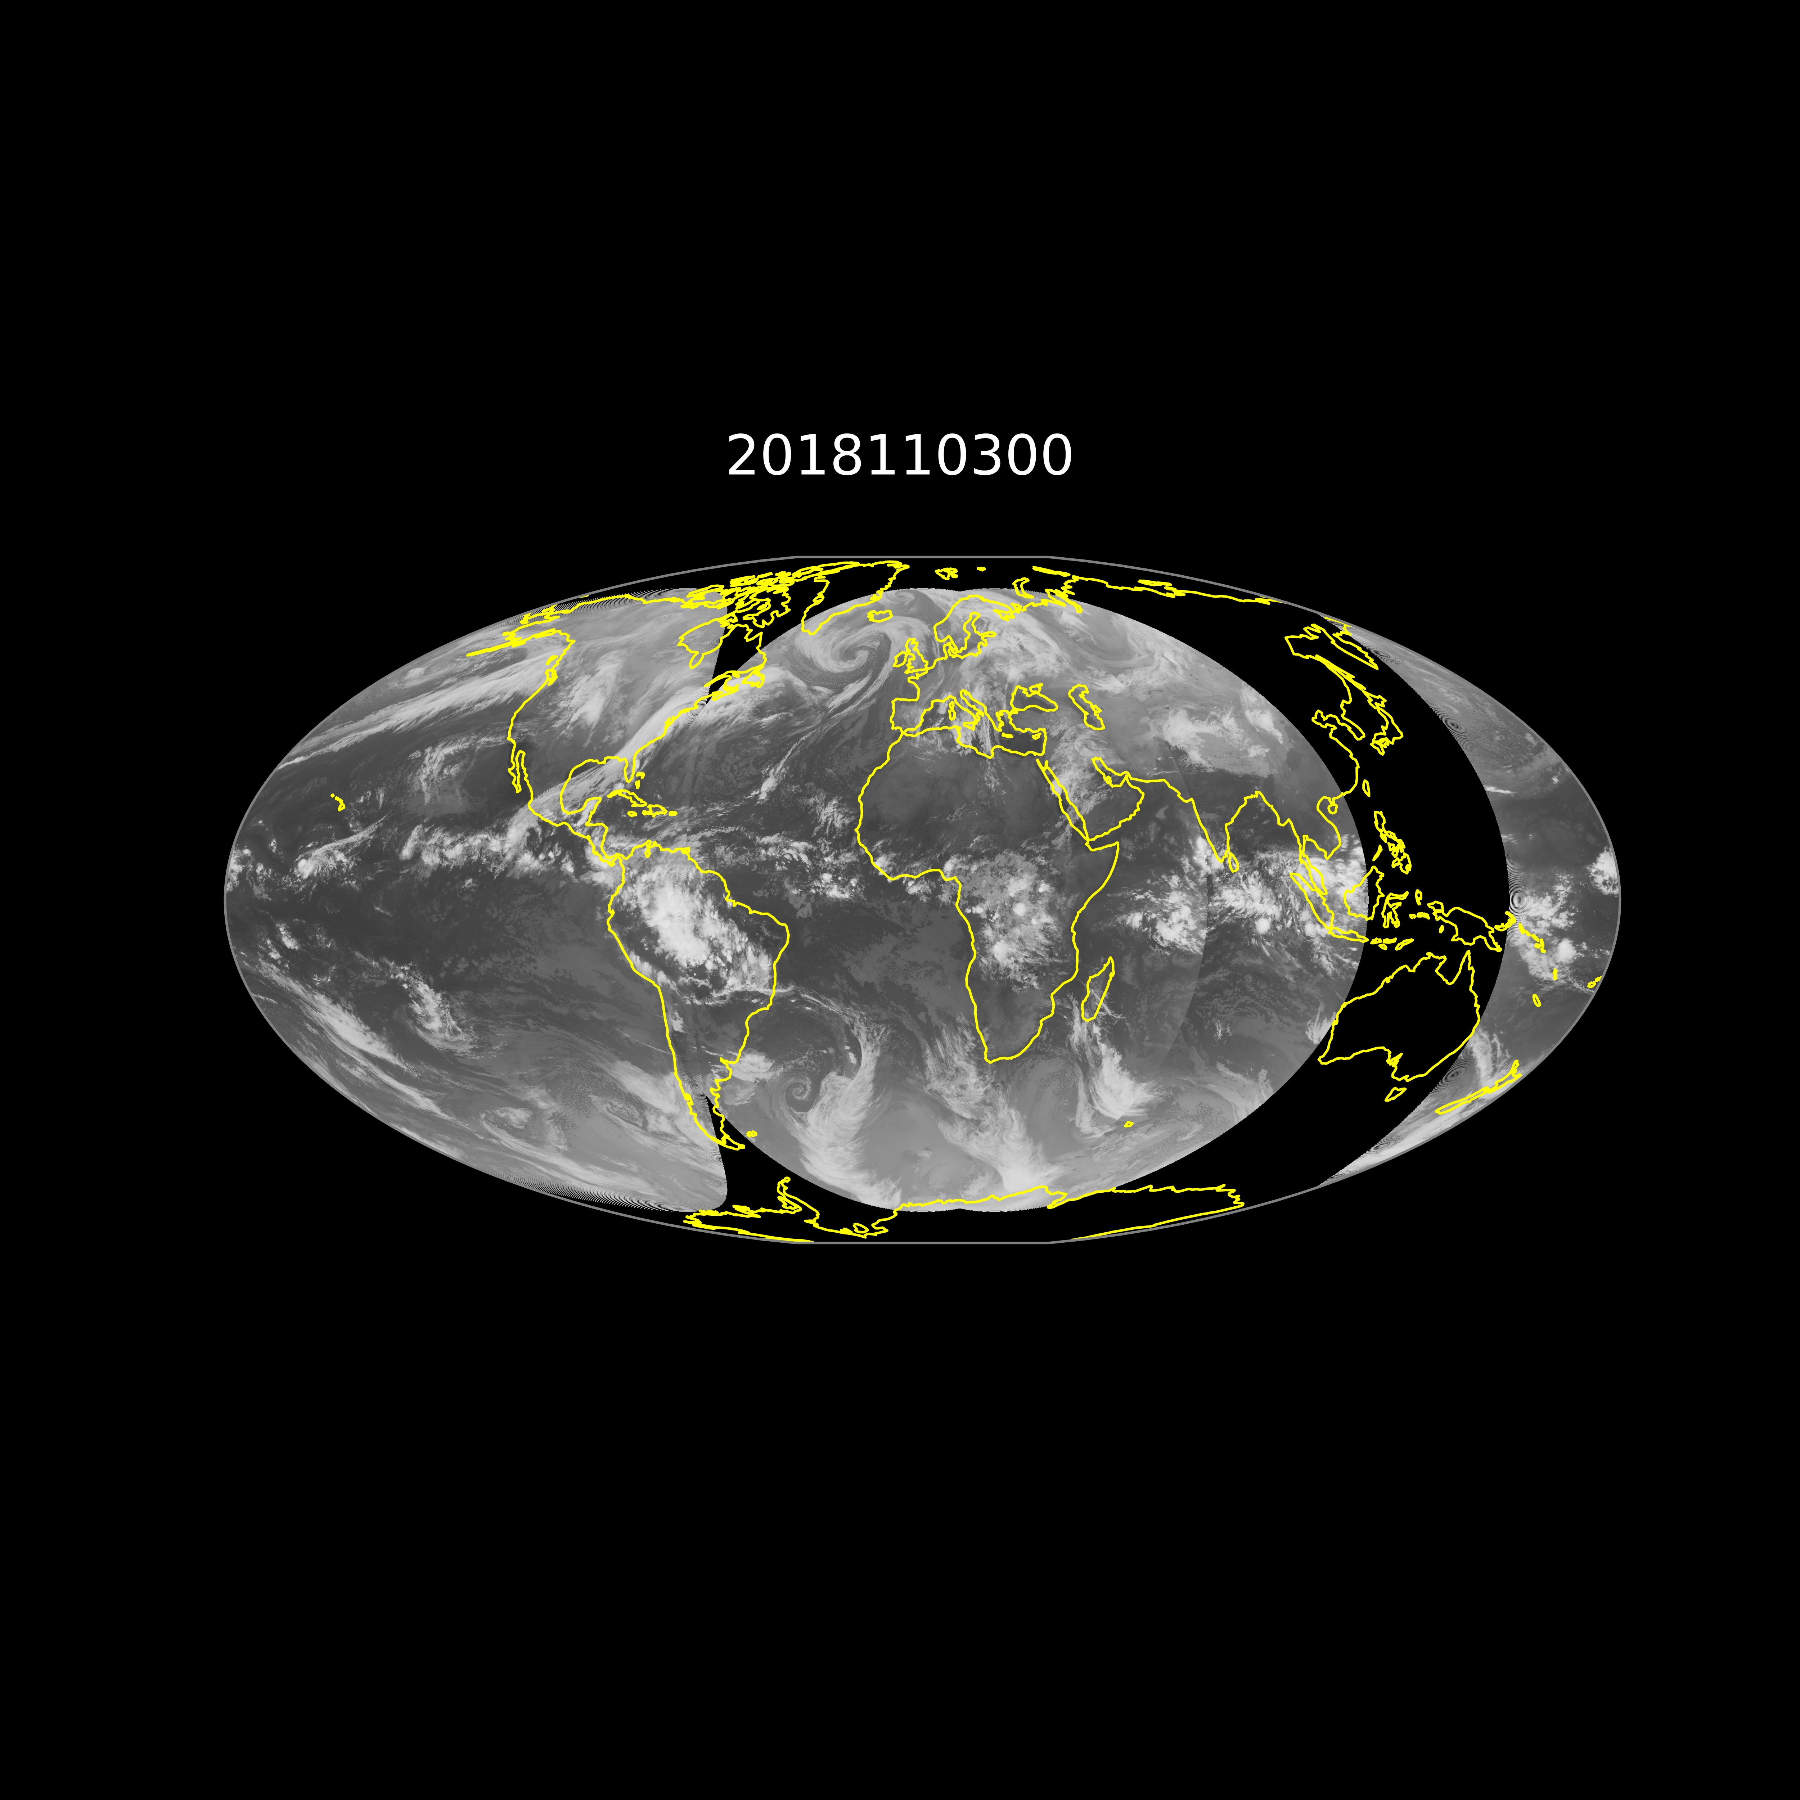
1.4 km
Meteosat-8, Meteosat-11 and GOES-15
Philippe Lopez & Cristina Lupu
Notes:
Indeed combining multi-instrument and multi-channel satellite information is an important aspect of data assimilation but
Also efforts on improving Earth observations in near-real time.

Slide 22
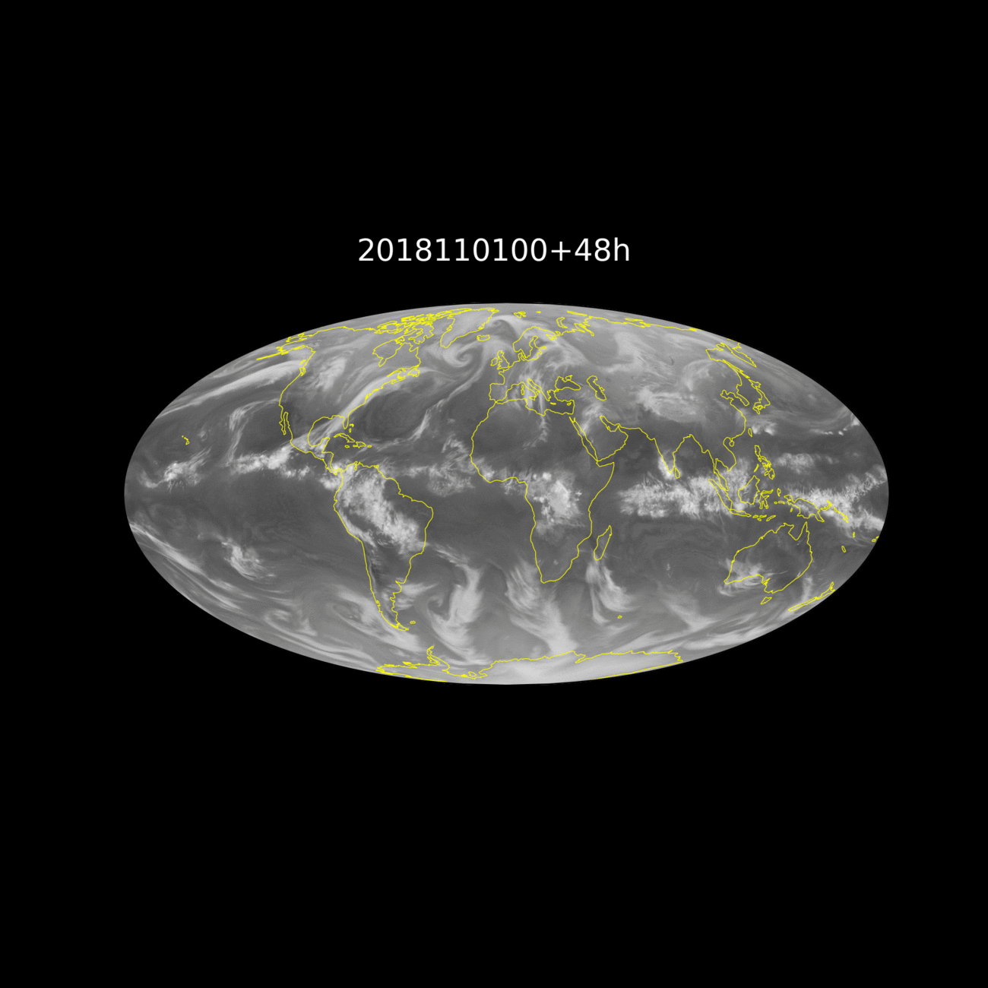
9 km
Meteosat-8, Meteosat-11 and GOES-15
Philippe Lopez & Cristina Lupu

Slide 23
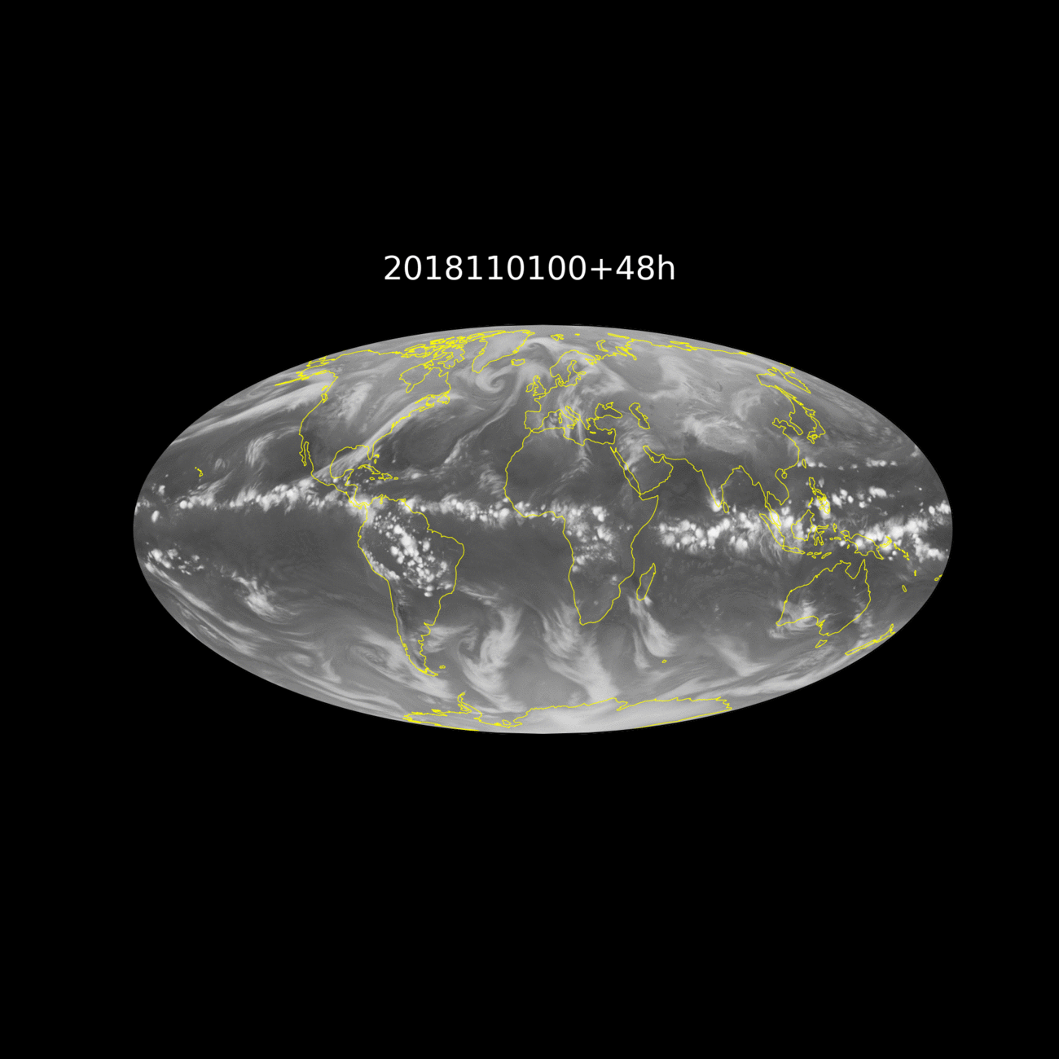
9 km w/o deep
Meteosat-8, Meteosat-11 and GOES-15
Philippe Lopez & Cristina Lupu

Slide 24
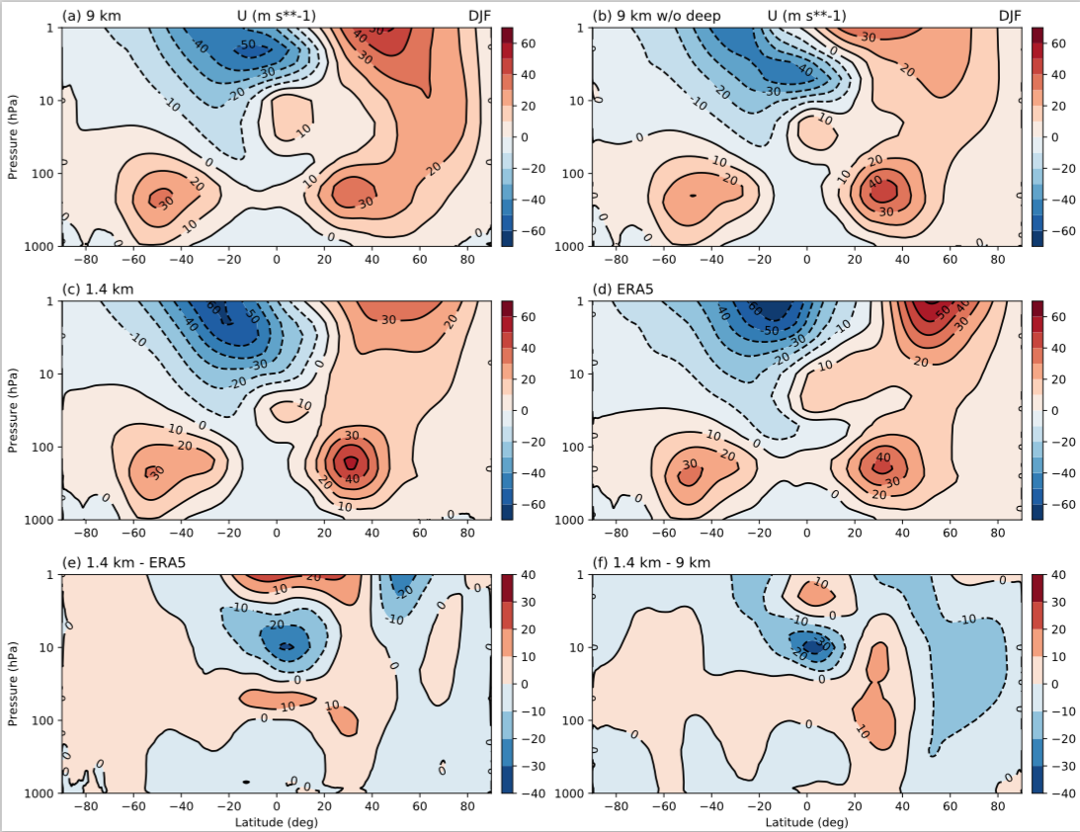
Zonal-mean zonal wind

Slide 25
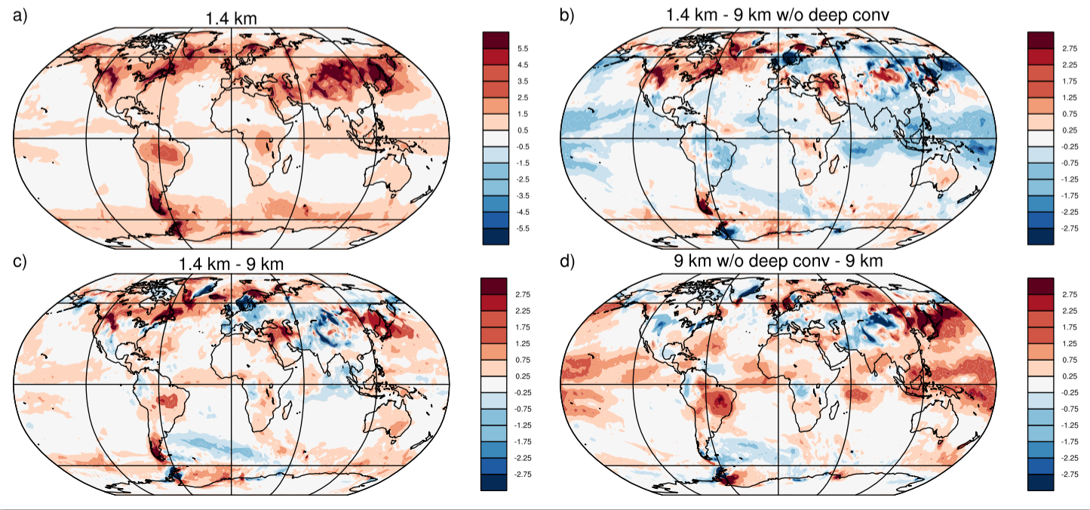
And what you don’t see in the satellite pics …
Zonal-mean absolute gravity wave momentum flux [mPa], computed from the total wave numbers 42-1279 for November 2018 at 50 hPa enhanced in convectively active regions, visibly much stronger with explicitly simulated convection at 9 km grid spacing.

Slide 26
Summary
The spectral transform method continues to be competitive for global models at km-scales
A first digital twin prototype has been presented with a global seasonal simulation at 1.4 km grid-spacing on Summit
Advancing numerical methods continues to be a key contribution towards time and energy efficiency and towards realising the ambitious goal of routine global km-scale data assimilation and prediction of the coupled Earth System
Big data handling, unsupervised learning, and near-real time tailored impact sector interaction (e.g. Energy,Health,Hydrology,Biodiversity) forms an integral part of future km-scale coupled model development

Slide 27
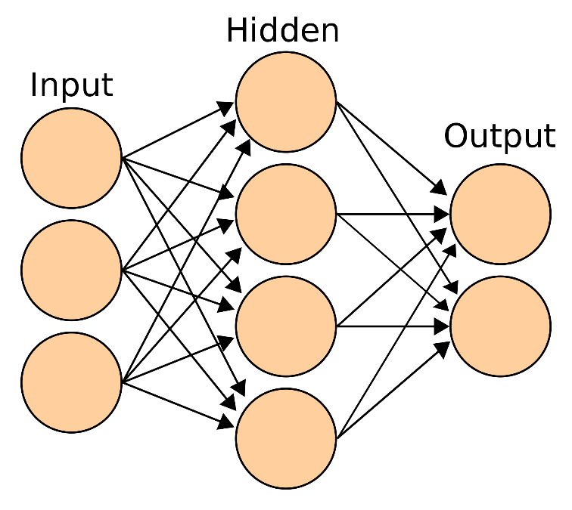
Machine learning at ECMWF
P. Dueben
Neural Networks can learn from input/output pairs to emulate a non-linear process.
Neurons have weighted connections to each other and the weights are trained to produce the optimal results.
There are plenty of model components in Earth System models that show non-linear behaviour that can serve as applications for neural networks.
Figure copied from www.wikipedia.org
Observation processing:
Real-time quality control of observations
Detection of unrealistic weather situations and discrepancies between products
Bias correction
Feature detection to reduce data volume
…
Numerical modelling:
Emulation for efficiency
Emulation for portability
Emulation for generation of TL/AD code
Estimation of model bias in data assimilation
Improvement of parametrisation schemes
…
Post-processing:
Real time adjustments
Bias correction
Local Downscaling
Feature detection
Uncertainty quantification
Error correction for seasonal predictions
…

Slide 28
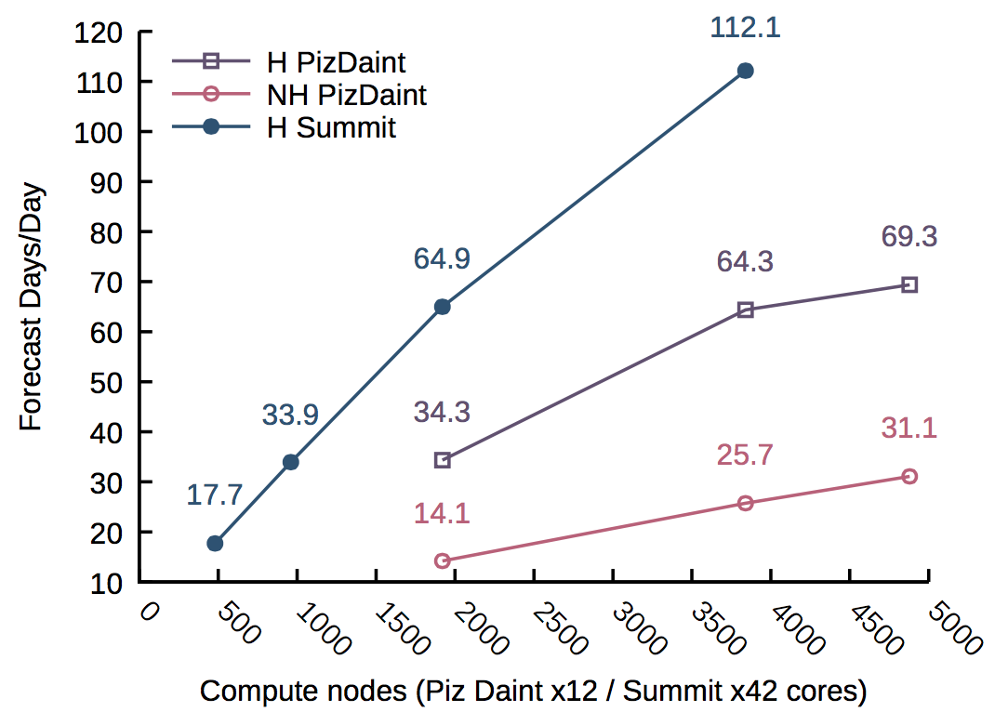

Strong scaling at 1.4 km
This research used resources of the Oak Ridge Leadership Computing Facility, which is a DOE office of
Science User Facility supported under contract DE-AC05-00OR22725.

Slide 29
GPU Spectral transform dwarf
Andreas Mueller, based on initial work by
Alan Gray and recently also Wayne Gaudin (NVIDIA)
Choices: PGI, GNU,XL
MPI/OpenMP/OpenACC/cuLibraries
At 2.9km resolution, less
than 1s per time-step fits
operational needs.
This research used resources of the Oak Ridge Leadership Computing Facility, which is a DOE office of
Science User Facility supported under contract DE-AC05-00OR22725.

