Slide 1
Physically Regularized Machine Learning Emulators of Aerosol Activation
Sam Silva, Po-Lun Ma, Joseph Hardin, Daniel Rothenberg, Balwinder Singh
Notes:
Stock image of cloud formations

Slide 2
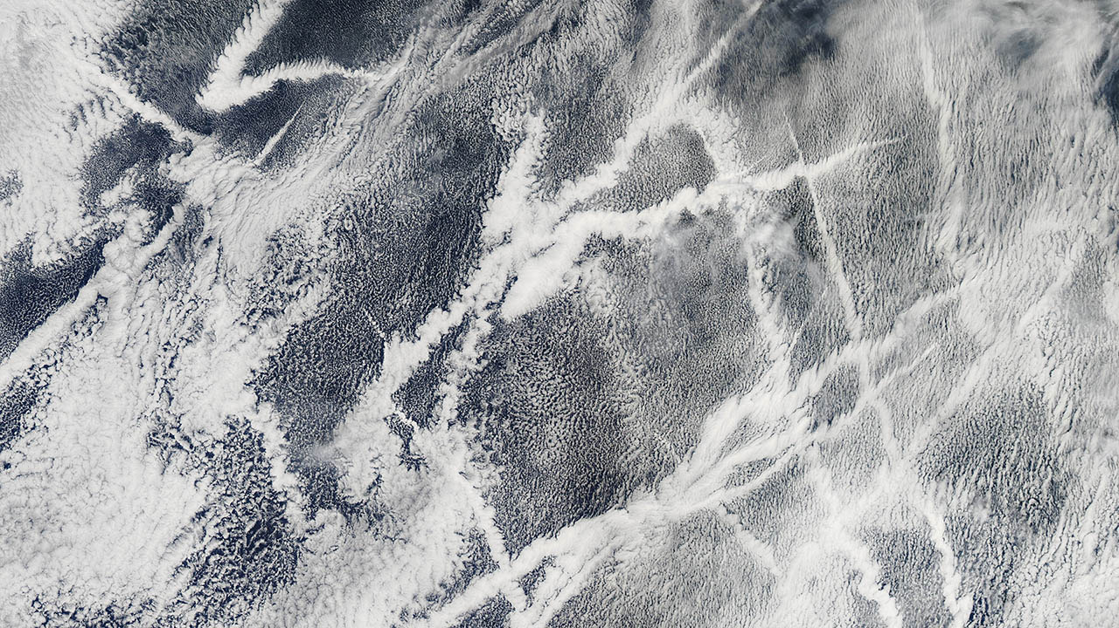
Aerosol activation is a critical component of aerosol cloud interactions
Numerical simulations that explicitly resolve these processes are too computationally expensive to routinely use in Earth System Models
Existing parameterizations (e.g. ARG, 2000) are skillful and fast, but have known limitations
How can we develop high quality emulators?

Slide 3
Can we develop useful machine learning emulators of this process?
Training Strategy
Test a variety of M.L. regression methods
Target: Numerical parcel model activation fraction predictions
Input: Aerosol and Meteorological Parameters
Training dataset: 20,000 realizations L.H.S.
Assessment
Objective skill scores: R² & MSE
Comparison with existing ARG scheme

Slide 4
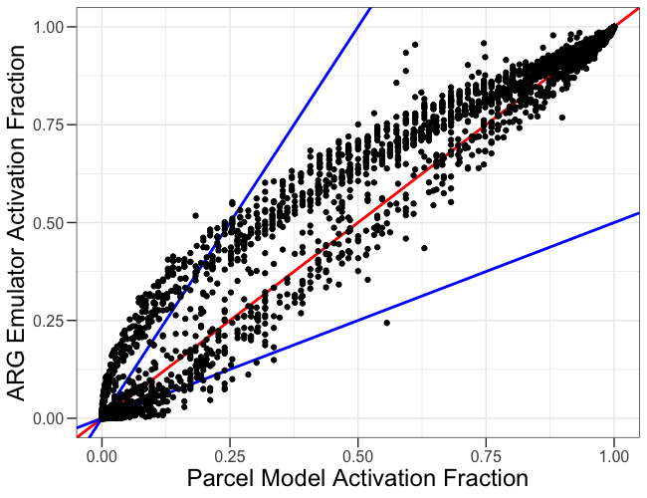
Base parameterization skill is reasonably good.
ARG Scheme

Slide 5
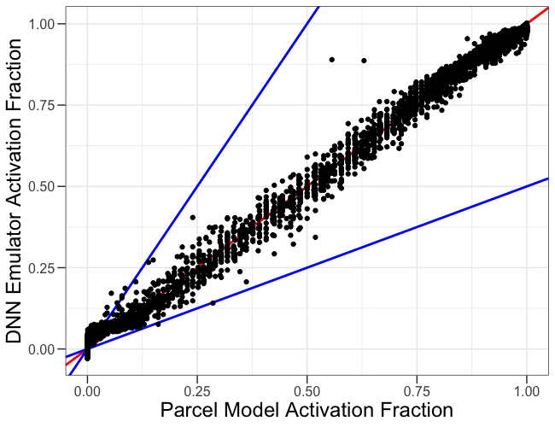
Machine learning methods can provide a potential path forward
Base DNN
ARG Scheme
How can we improve accuracy further?
Note: we’ve tried other M.L. emulator methods as well (e.g. Ridge, XGBoost).

Slide 6

Physical regularization offers a potential simple emulator constraint with known physics.
Regularization – “the process of adding information in order to solve an ill-posed problem or to prevent overfitting"
Inputs
Machine Learning
Prediction:
𝐴𝑐𝑡𝐹𝑟𝑎𝑐
Physically Naïve
+
Inputs
Machine Learning
Prediction:
𝐴𝑐𝑡𝐹𝑟𝑎𝑐
$${ActFrac}_{ARG}$$
Physically Regularized
Also: residual learning | bias correction | augmentation

Slide 7
Adding physical information improves emulator predictive skill
Base DNN

Slide 8
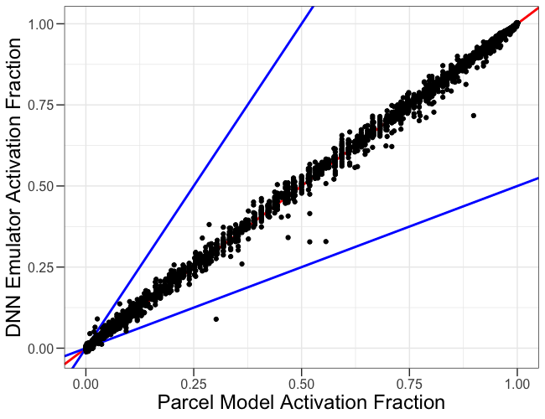
Adding physical information improves emulator predictive skill
Base DNN
ARG-Regularized DNN

Slide 9
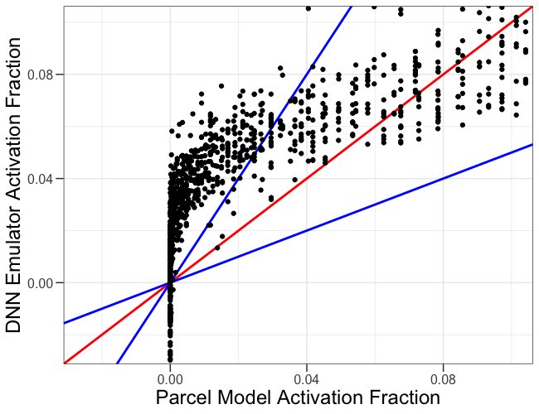
Edge case performance improves drastically with physical information
Base DNN

Slide 10
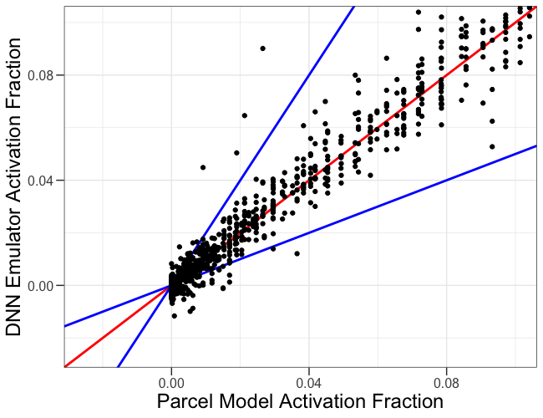
Edge case performance improves drastically with physical information
Base DNN
ARG-Regularized DNN

Slide 11
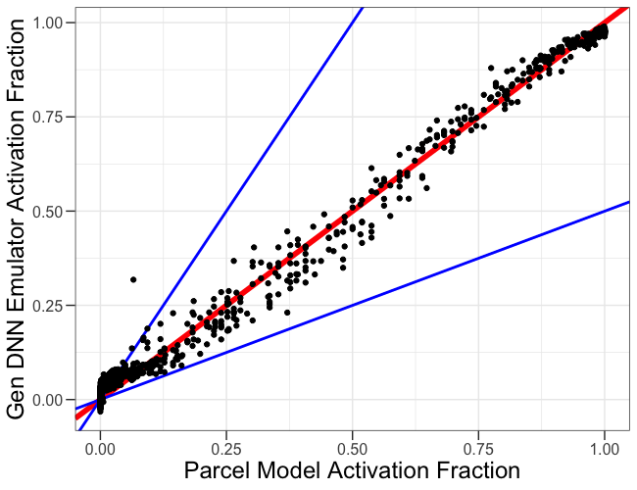
Physical Regularization improves emulator generalizability in +4K test case
Base DNN

Slide 12
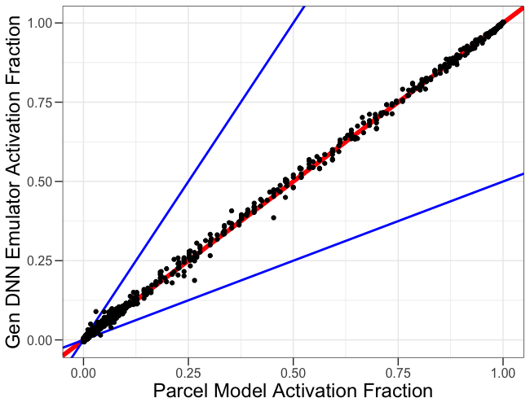
Physical Regularization improves emulator generalizability in +4K test case
Base DNN
ARG-Regularized DNN
What does this look like in a real Earth System Model?

Slide 13
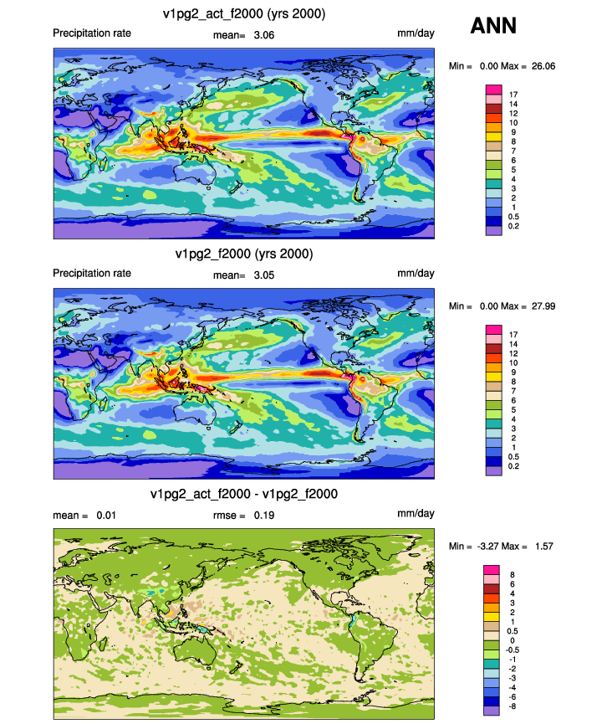
Base DNN activation runs smoothly in E3SM. We don’t crash in a real Earth System simulation!
Precipitation Rate – Annual Average
mm day⁻¹
Base DNN
E3SM

Slide 14
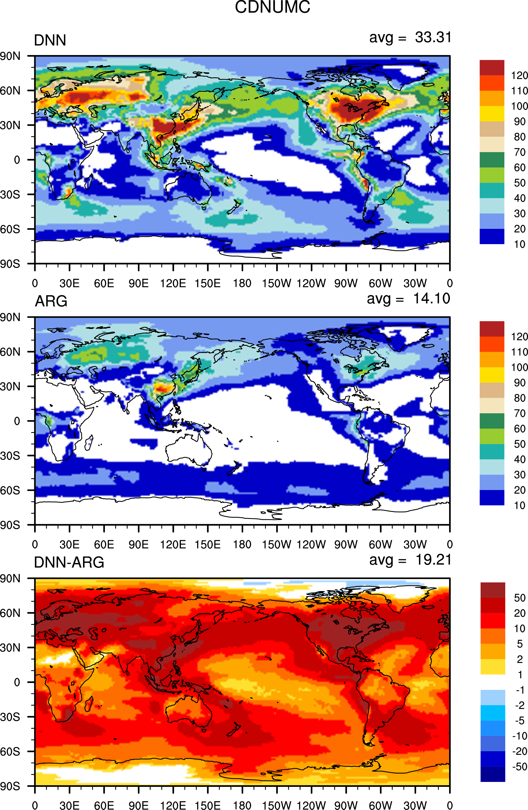
DNN performance in a E3SM leads to way too many cloud droplets!
Column integrated droplet number concentration (x10⁹)
Base DNN
Likely Causes
Training data distribution
Low value overestimation
Lack of multiple size distribution treatment.
E3SM
Diff
Notes:
Single Mode Treatment
Overestimation
Sampling – comprehensive vs…
Framework makes this easy
Facilitate workflow

Slide 15
Lessons learned and future outlook
Physical regularization is a simple and effective strategy for improving emulator performance
It is important to carefully consider the use case of the emulator prior to design.
Next steps
  Address the cloud droplet overestimation behavior in the emulator

Slide 16
sam.silva@pnnl.gov

Slide 17
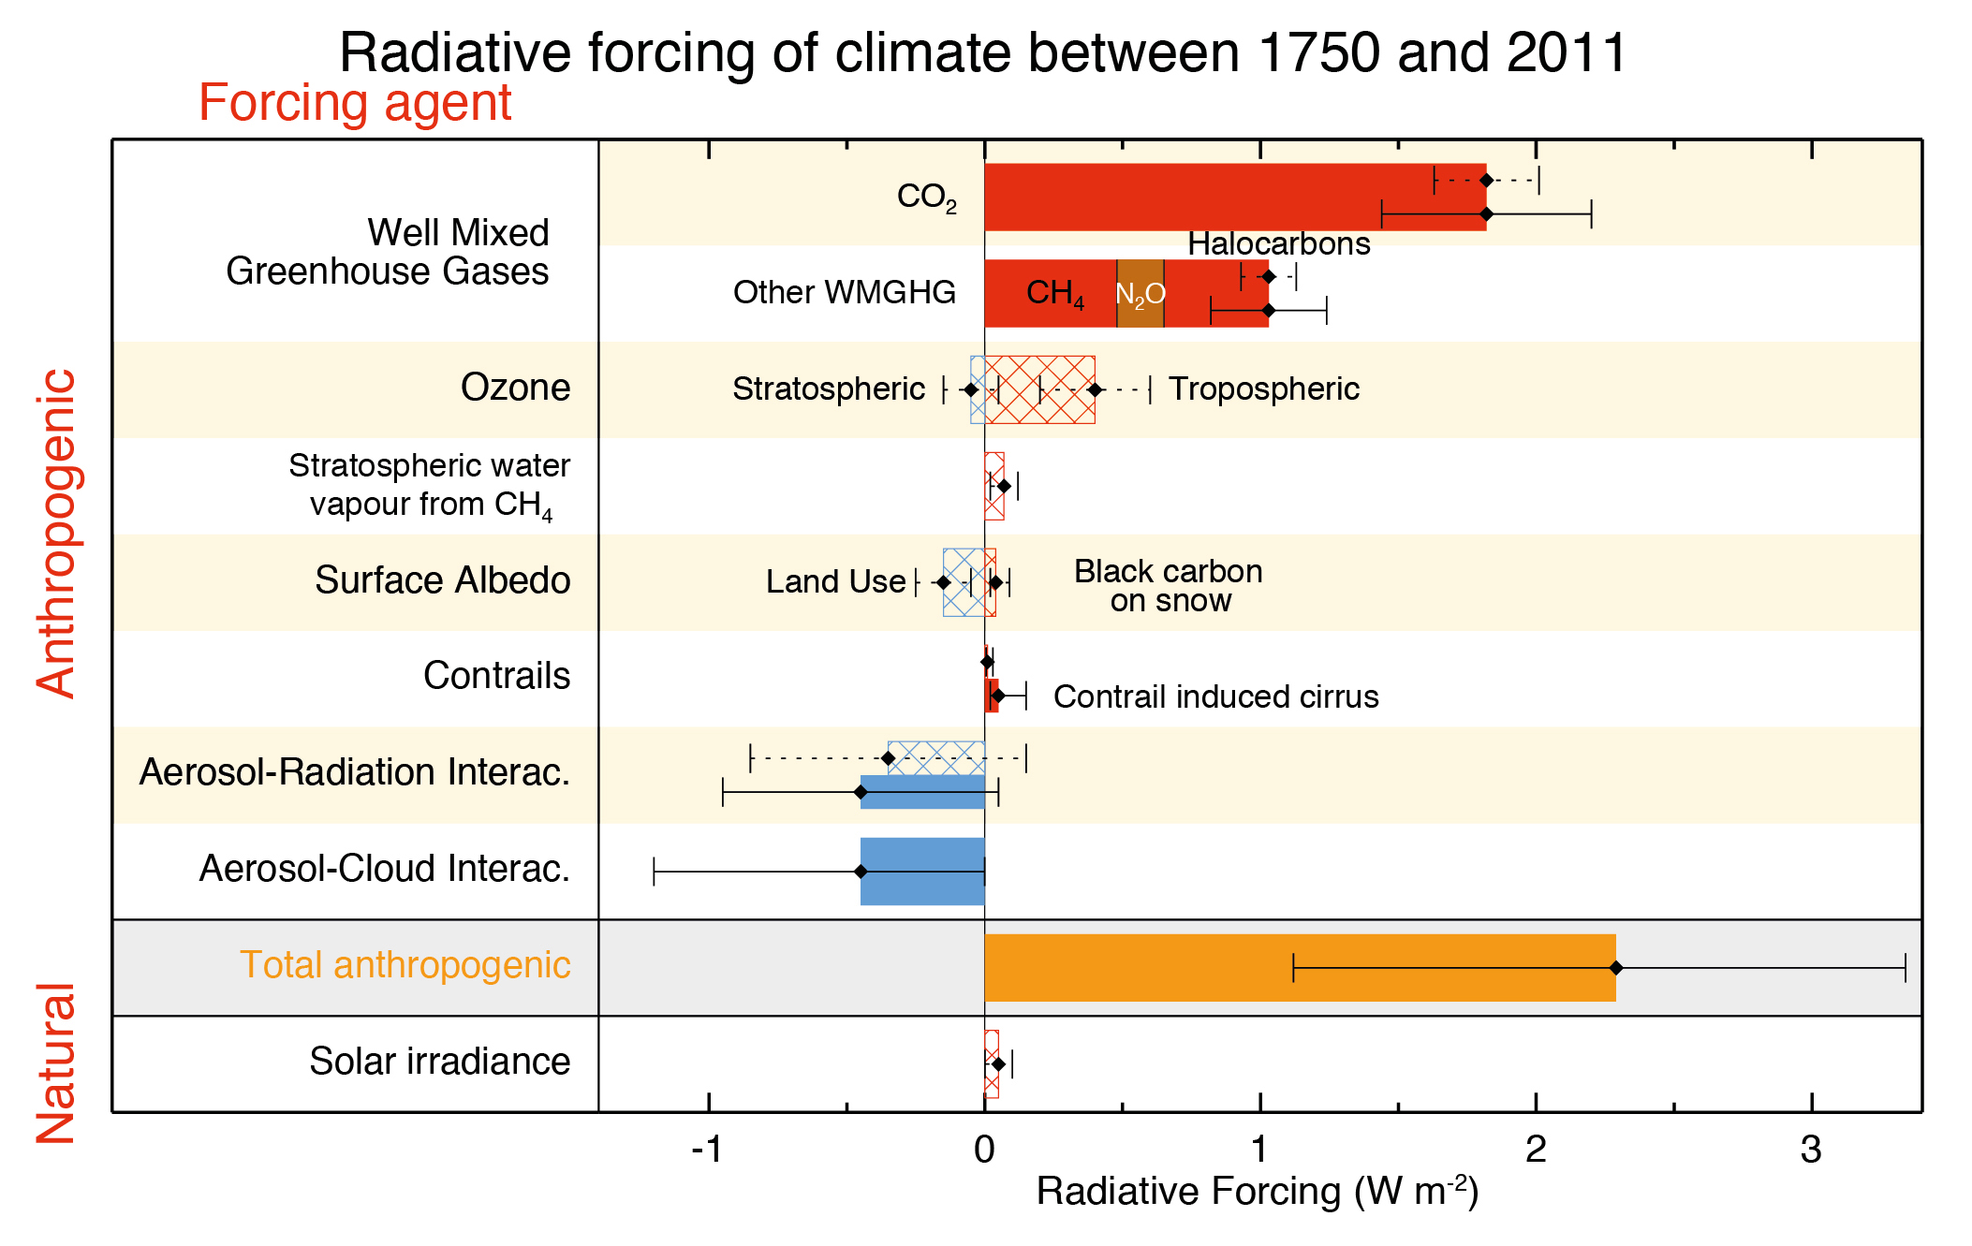
Aerosol-cloud interactions are a large uncertainty in the Earth System
(IPCC, 2013)

Slide 18
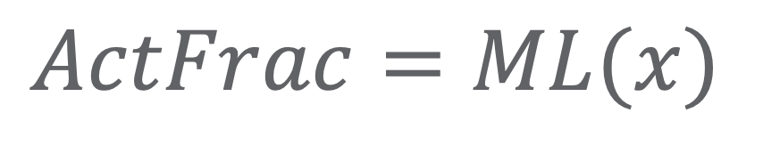
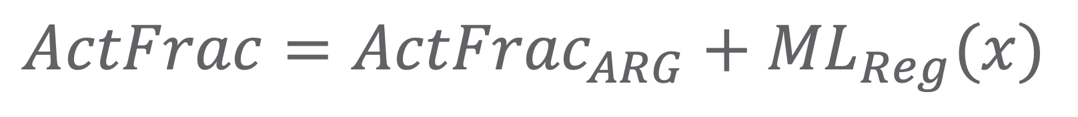
Physical regularization offers a potential simple emulator constraint with known physics.
Regularization – “the process of adding information in order to solve an ill-posed problem or to prevent overfitting"
$$ActFrac=ML(x)$$
$$ActFrac={ActFrac}_{ARG}+{ML}_{Reg}(x)$$

Slide 19
Hyperparameters and Training Space

Slide 20
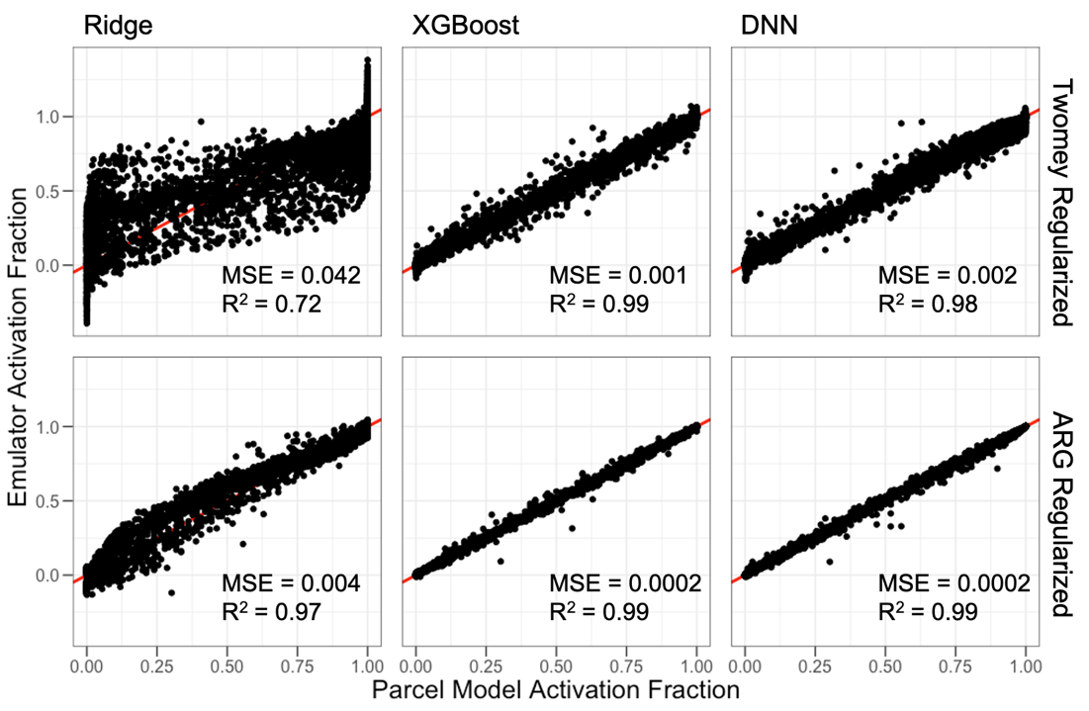
Adding physical information improves emulator predictive skill

Slide 21
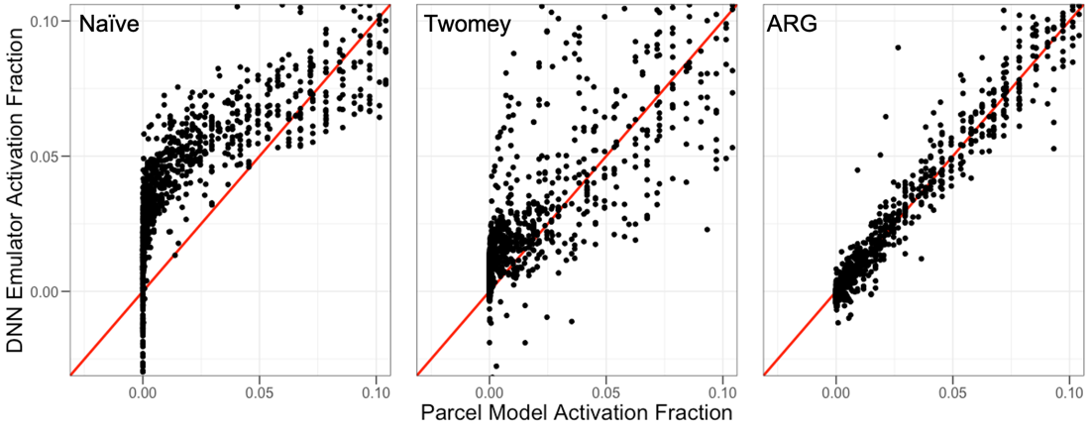
Edge case performance improves drastically with physical information

Slide 22
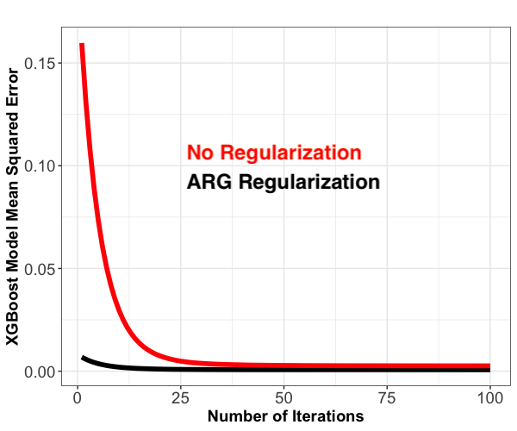
The impact of the regularization decreases with model complexity
Mean Squared Error
Model Complexity (here, Number of Trees)

Slide 23
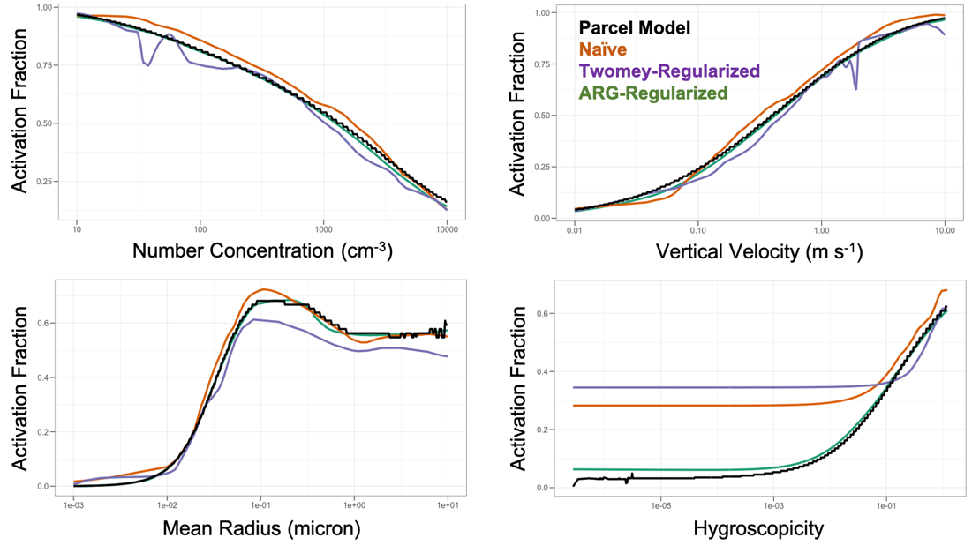
Low hygroscopicity is where the problem is

