Slide 1
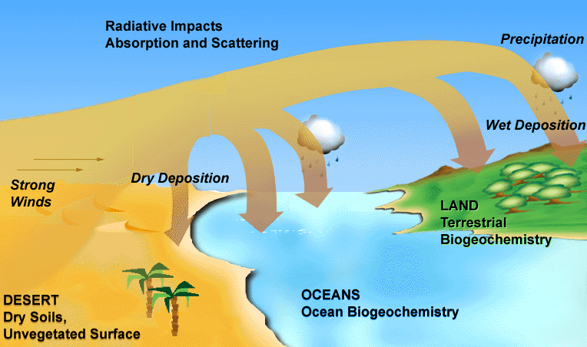
Atmospheric radiative and oceanic biological productivity responses to anthropogenic combustion-iron emission in the 1850-2000 period
Sagar Rathod¹, Douglas Hamilton², Longlei Li², Natalie Mahowald², Hitoshi Matsui³, Jeffrey Pierce¹, and Tami Bond¹
¹Colorado State University, Fort Collins, CO, USA
²Cornell University, Ithaca, NY, USA
³Nagoya University, Japan

Slide 2
Acknowledgements
Aerosol-Biogeochemistry-Climate Interactions Lab
Dr. Natalie Mahowald
Dr. Douglas Hamilton
Randerson Lab
Dr. James Randerson
Dr. Li Xu
Bond Research Group
Dr. Tami Bond

Slide 3
Plain-language summary
Aerosol-iron has dual climate interactions: absorbs radiation while in the air and promotes phytoplankton growth after falling on oceans.
Widely documented for dust and wildfire sources of iron but not for anthropogenic -- presented here.
Global mean direct radiative warming is about +0.03-0.1 W/m²
Ocean productivity by anthropogenic sources is 0.2-5 PgC/yr, converting to about 0.01-0.15 W/m² CO2-equivalent cooling.
Both impacts globally relatively smaller than natural sources, but are dominant over some regions.

Slide 4
This talk is divided into two parts.
Direct radiative effects of anthropogenic iron-containing minerals in the atmosphere.
Biogeochemistry of anthropogenic iron in the ocean.

Slide 5
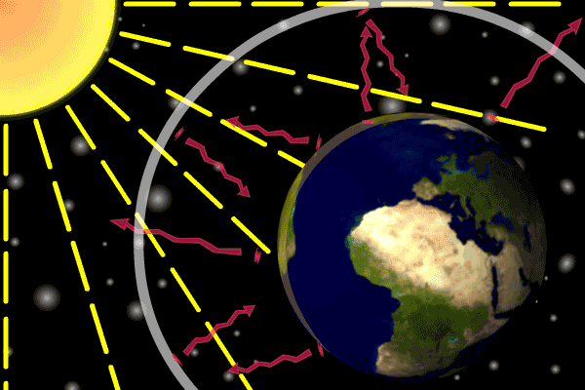
Part 1. Radiative effects of anthropogenic iron

Slide 6
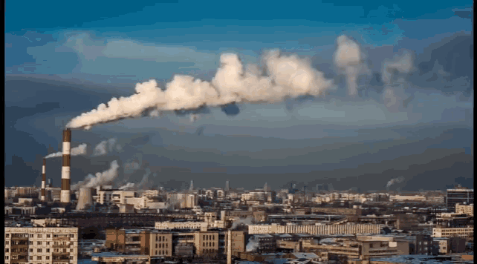
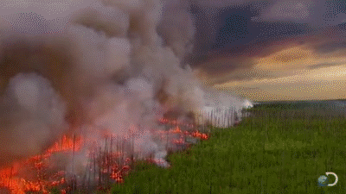
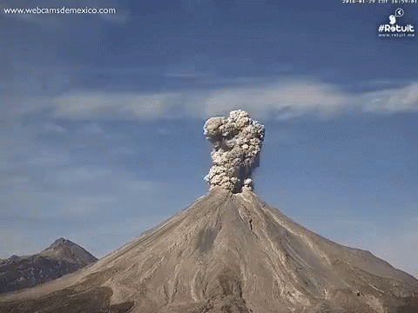
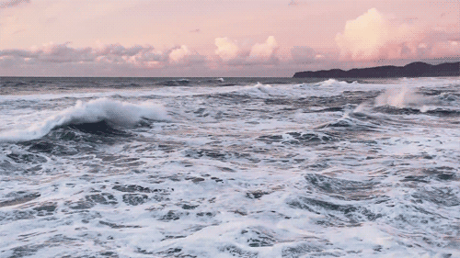
Many sources of iron

Slide 7
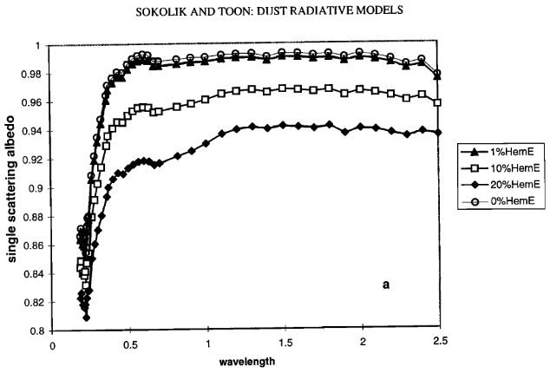
Iron oxides absorb 500nm incoming light
Sokolik and Toon, 1999

Slide 8
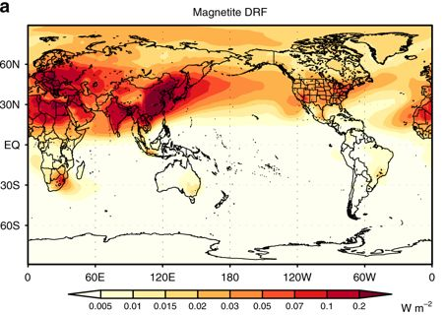
Studies show the anthropogenic iron oxide forcing to be regionally large.

Slide 9
Iron oxides are relatively newer in the climate assessment field.
Previous studies have incomplete inventories and a poor representation of emissions mineralogy.
We updated the inventories and developed a mineralogy basis for anthropogenic sources.

Slide 10
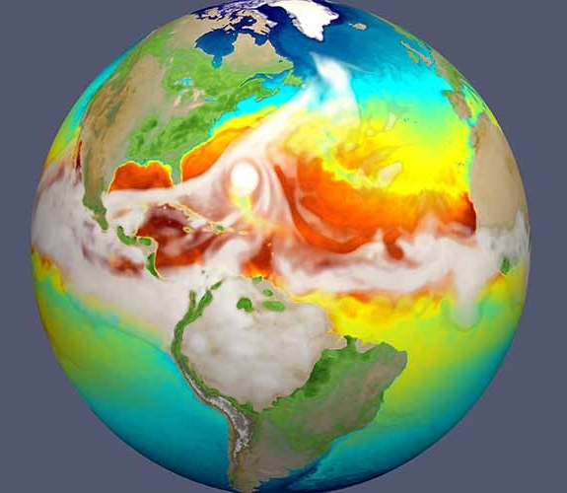
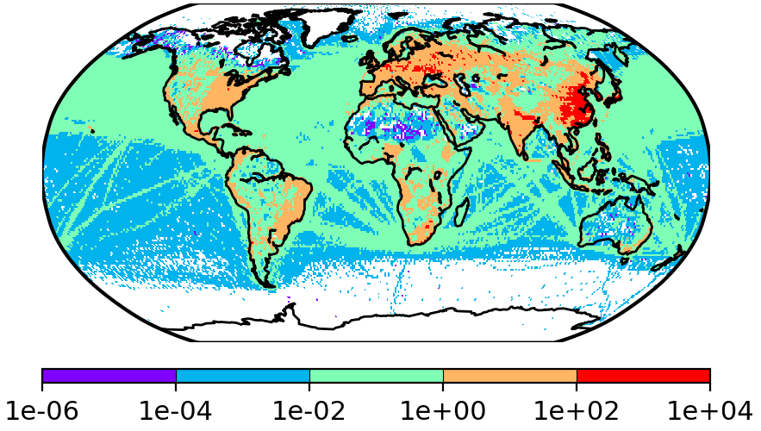
We estimated the radiative effects with a better inventory and a physically-based mineralogy representation.
Emissions → Model

Slide 11
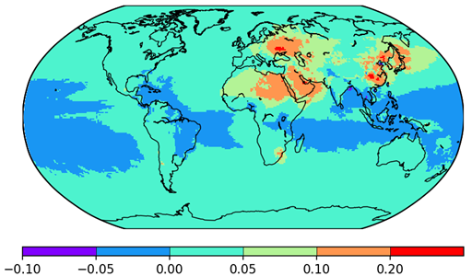
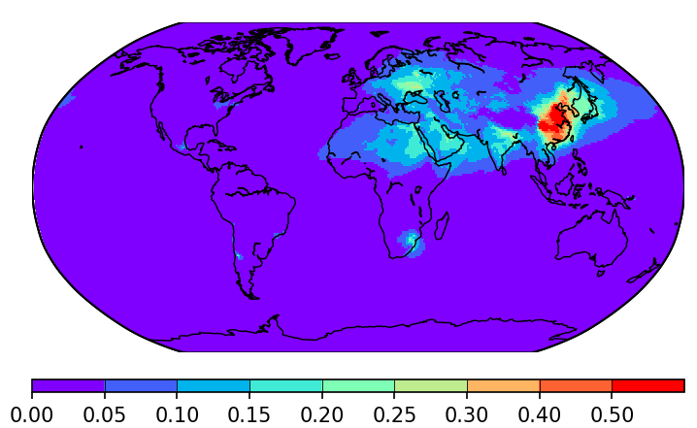
1850-2000 Direct Radiative Forcing
All minerals (cooling clays, warming oxides)
+0.015 W/m2
Only iron oxides
+0.03 W/m2

Slide 12
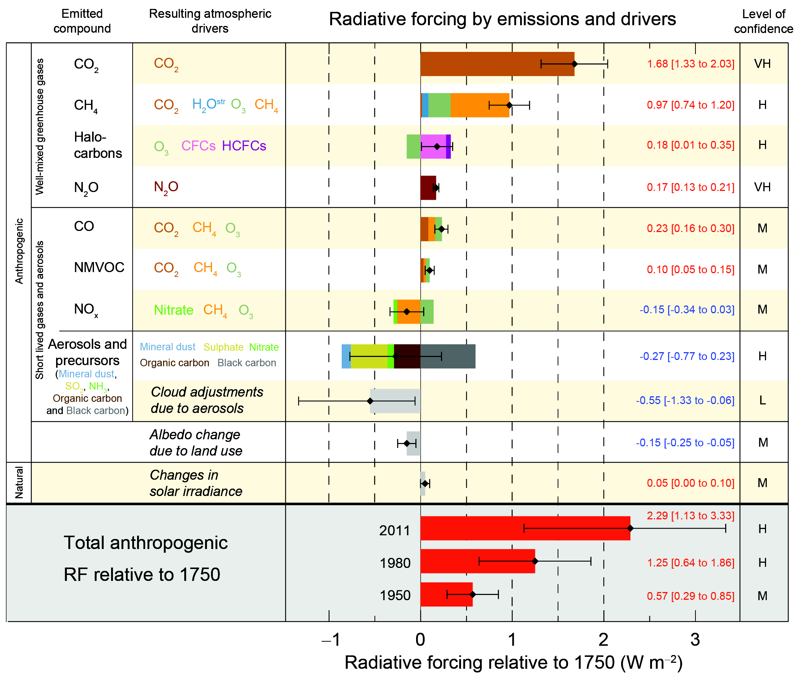
Putting the numbers into perspective
Iron oxides
--2% of CO2 direct forcing.
--10% in magnitude of all aerosol direct forcing.
--1.5% of ALL forcing.
These numbers are smaller than the uncertainties in each of those forcings.

Slide 13
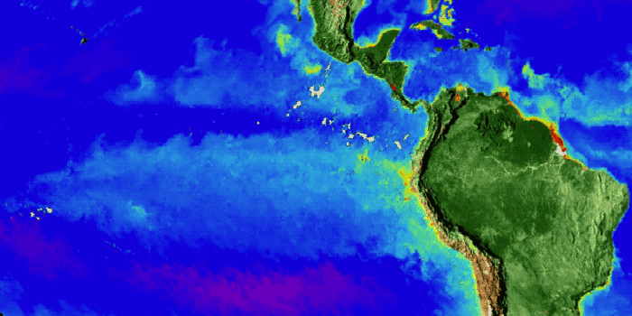
2. Oceanic biological productivity

Slide 14
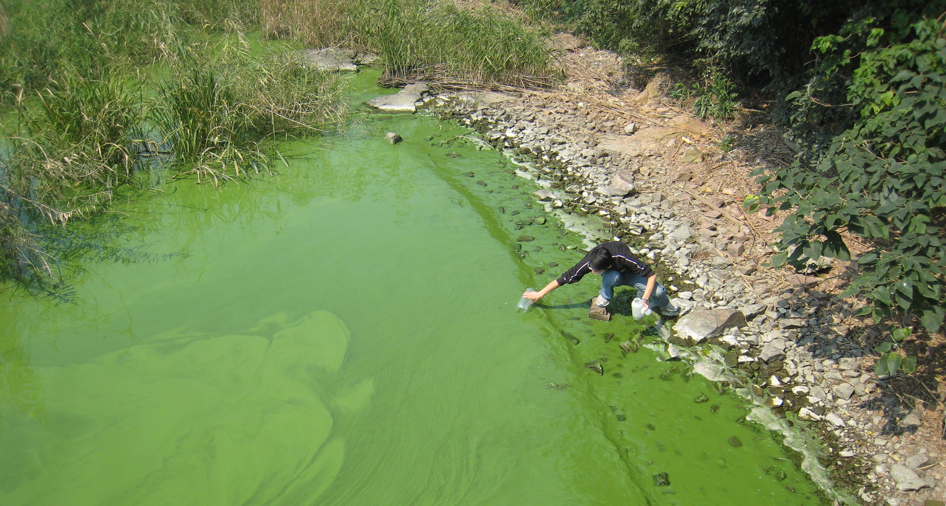
Phytoplankton growth in aquatic systems is limited by specific nutrient availability.
Example:
Eutrophication
All other nutrients present
No phosphorus and sometimes no nitrogen either.

Slide 15
Around 40% of the ocean region is iron limited for diatoms and phytoplankton growth.
Iron
Phosphorus
Nitrogen
Cobalt
Background = nitrate concentration in umol/kg
Moore et al., 2013
High nutrients, low chlorophyll (HNLC) regions

Slide 16
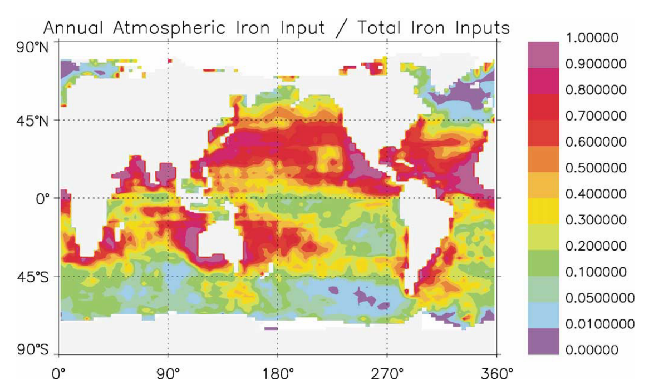
Atmospheric sources of soluble iron are dominant at many basins.
Moore et al., 2002

Slide 17
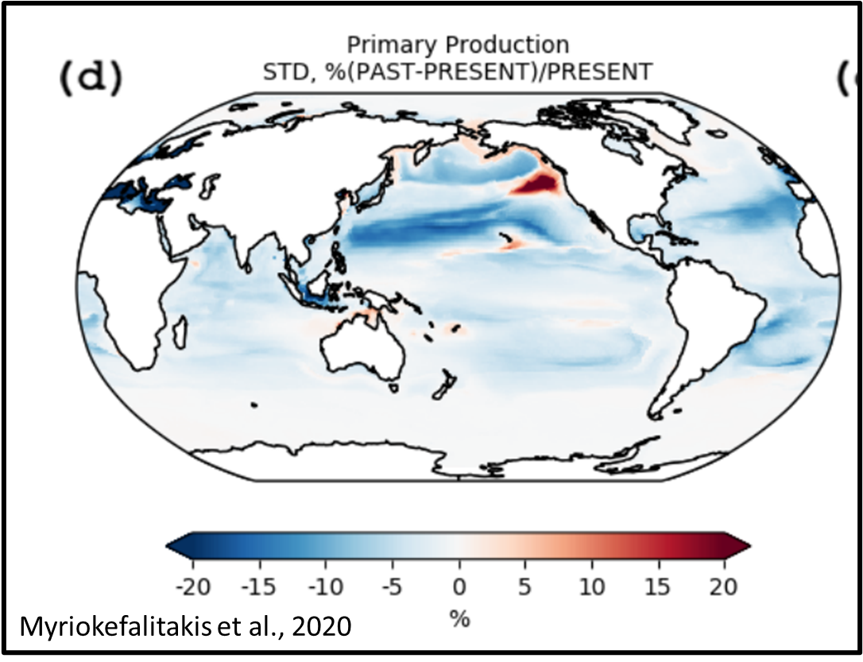
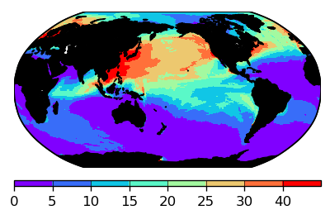
Anthropogenic sources contribute 20-40% of atmospheric soluble iron to North Pacific and North Atlantic Oceans.
AnthroSolFeDep * 100 / TotalSolFeDep

Slide 18
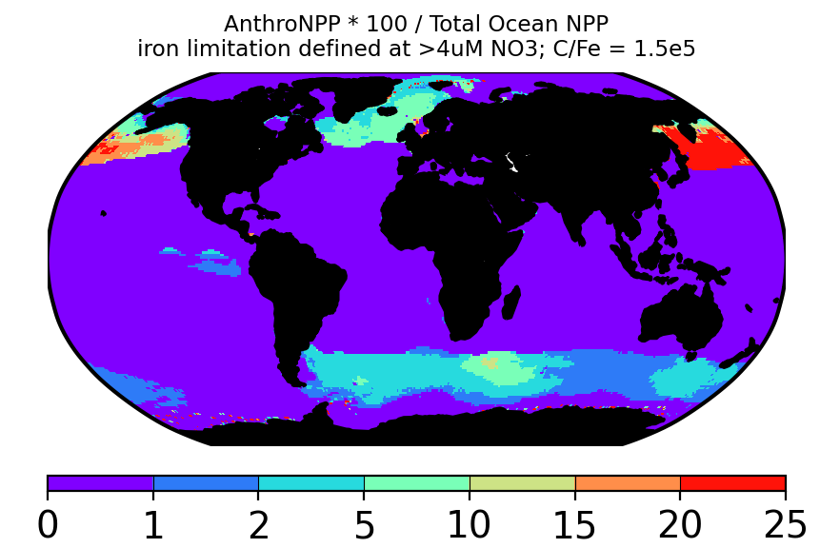
Present-day Anthropogenic NPP that is percentage of total ocean NPP
Global sum
0.8 Pg C/yr
Ocean NPP = 40-50 Pg C/yr
Anthropogenic sources probably cause about 15% of NPP over the North Pacific Ocean.

Slide 19
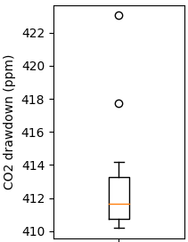
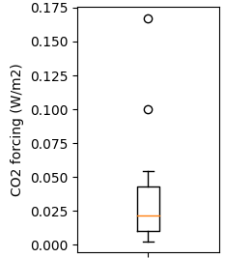
Oceanic impacts of anthropogenic soluble iron deposition over the 1850-2000 period.
Present-day CO2 concentration without this source deposition in the 1850-2000 period
Avoided CO2 forcing in the 1850-2000 period due to this source

Slide 20
Avoided CO2 forcing in the 1850-2000 period due to this source
The median is 1.5% of CO2 forcing.
Much smaller than the uncertainty?

Slide 21
Summary
Aerosol-iron has complex interactions in the climate system: absorbs radiation while in the air and promotes phytoplankton growth after deposition on oceans.
Both these interactions for anthropogenic sources are quantified here. Both of them are small globally but are dominant over some regions.

