Slide 1


Interactions between land use, fires and dust as drivers of global climate change
James Randerson, PI
UC Irvine
Natalie Mahowald, Co-PI
Cornell University
Co-Investigators:
Stijn Hantson and Li Xu
UC Irvine
William Riley and Qing Zhu
Lawrence Berkeley National Lab
10/27/20
E3SM Project Meeting
DOE Office of Science
Earth and Environmental Science Division

Slide 2
Proposal Objectives
Create globally gridded time series of roads, land fragmentation, livestock density, and agricultural practice for E3SM needed to improve linkages between fires, dust, and land use change
Improve the mechanistic representation of fire and dust in E3SM and the relationship between these processes and land use change
Create new fire and dust emissions time series in E3SM and evaluate using benchmarks in ILAMB
Examine the impacts of fire-dust-land use interactions on future atmospheric composition and climate feedbacks

Slide 3
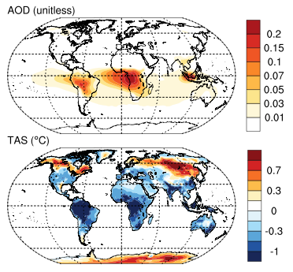
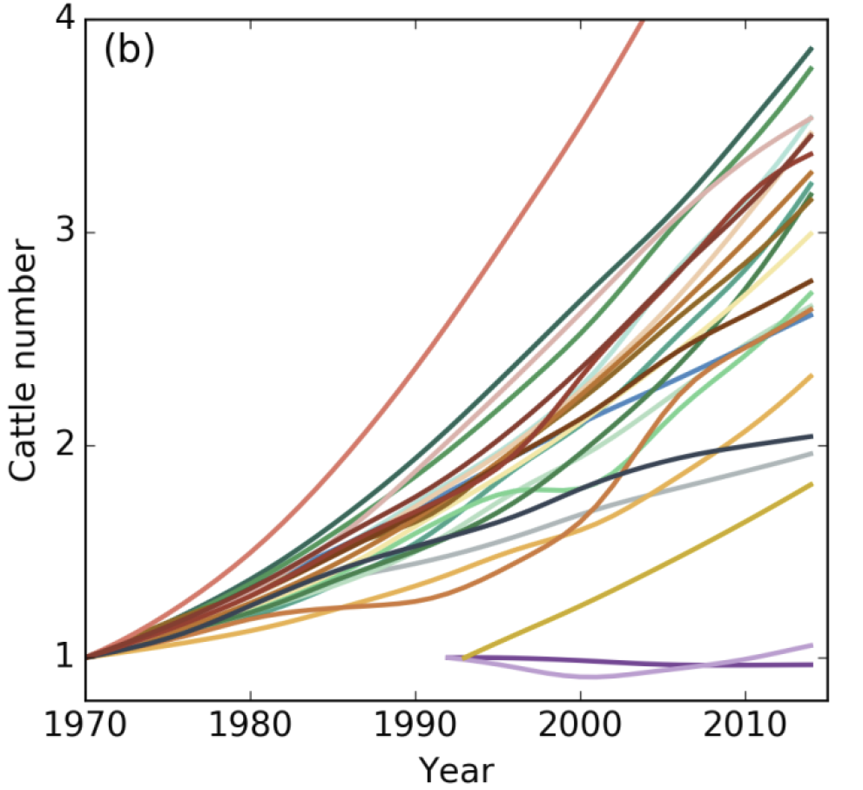
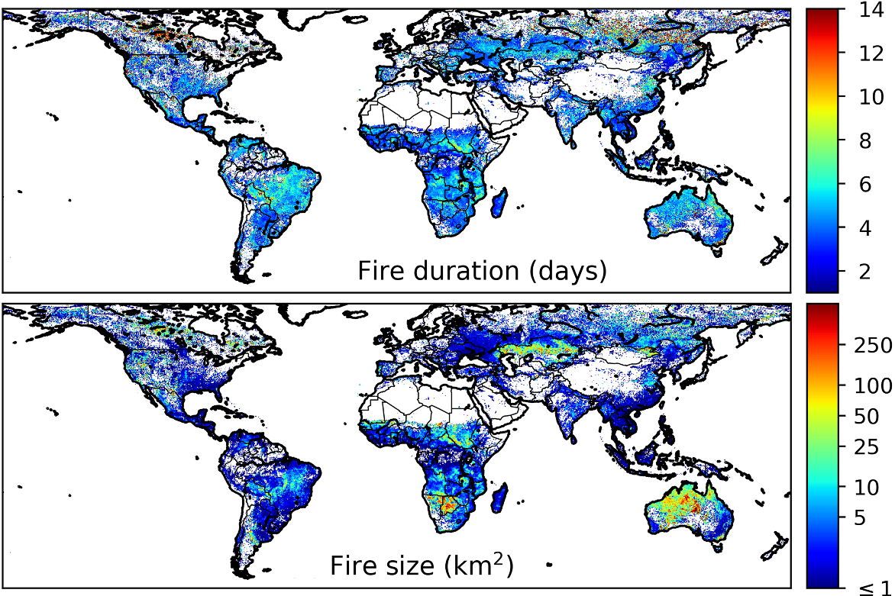
Proposed fire modeling improvements
Include key drivers:
Livestock, land fragmentation
Simulate pdfs of fire number, size, and duration
Improve atm. coupling

Slide 4
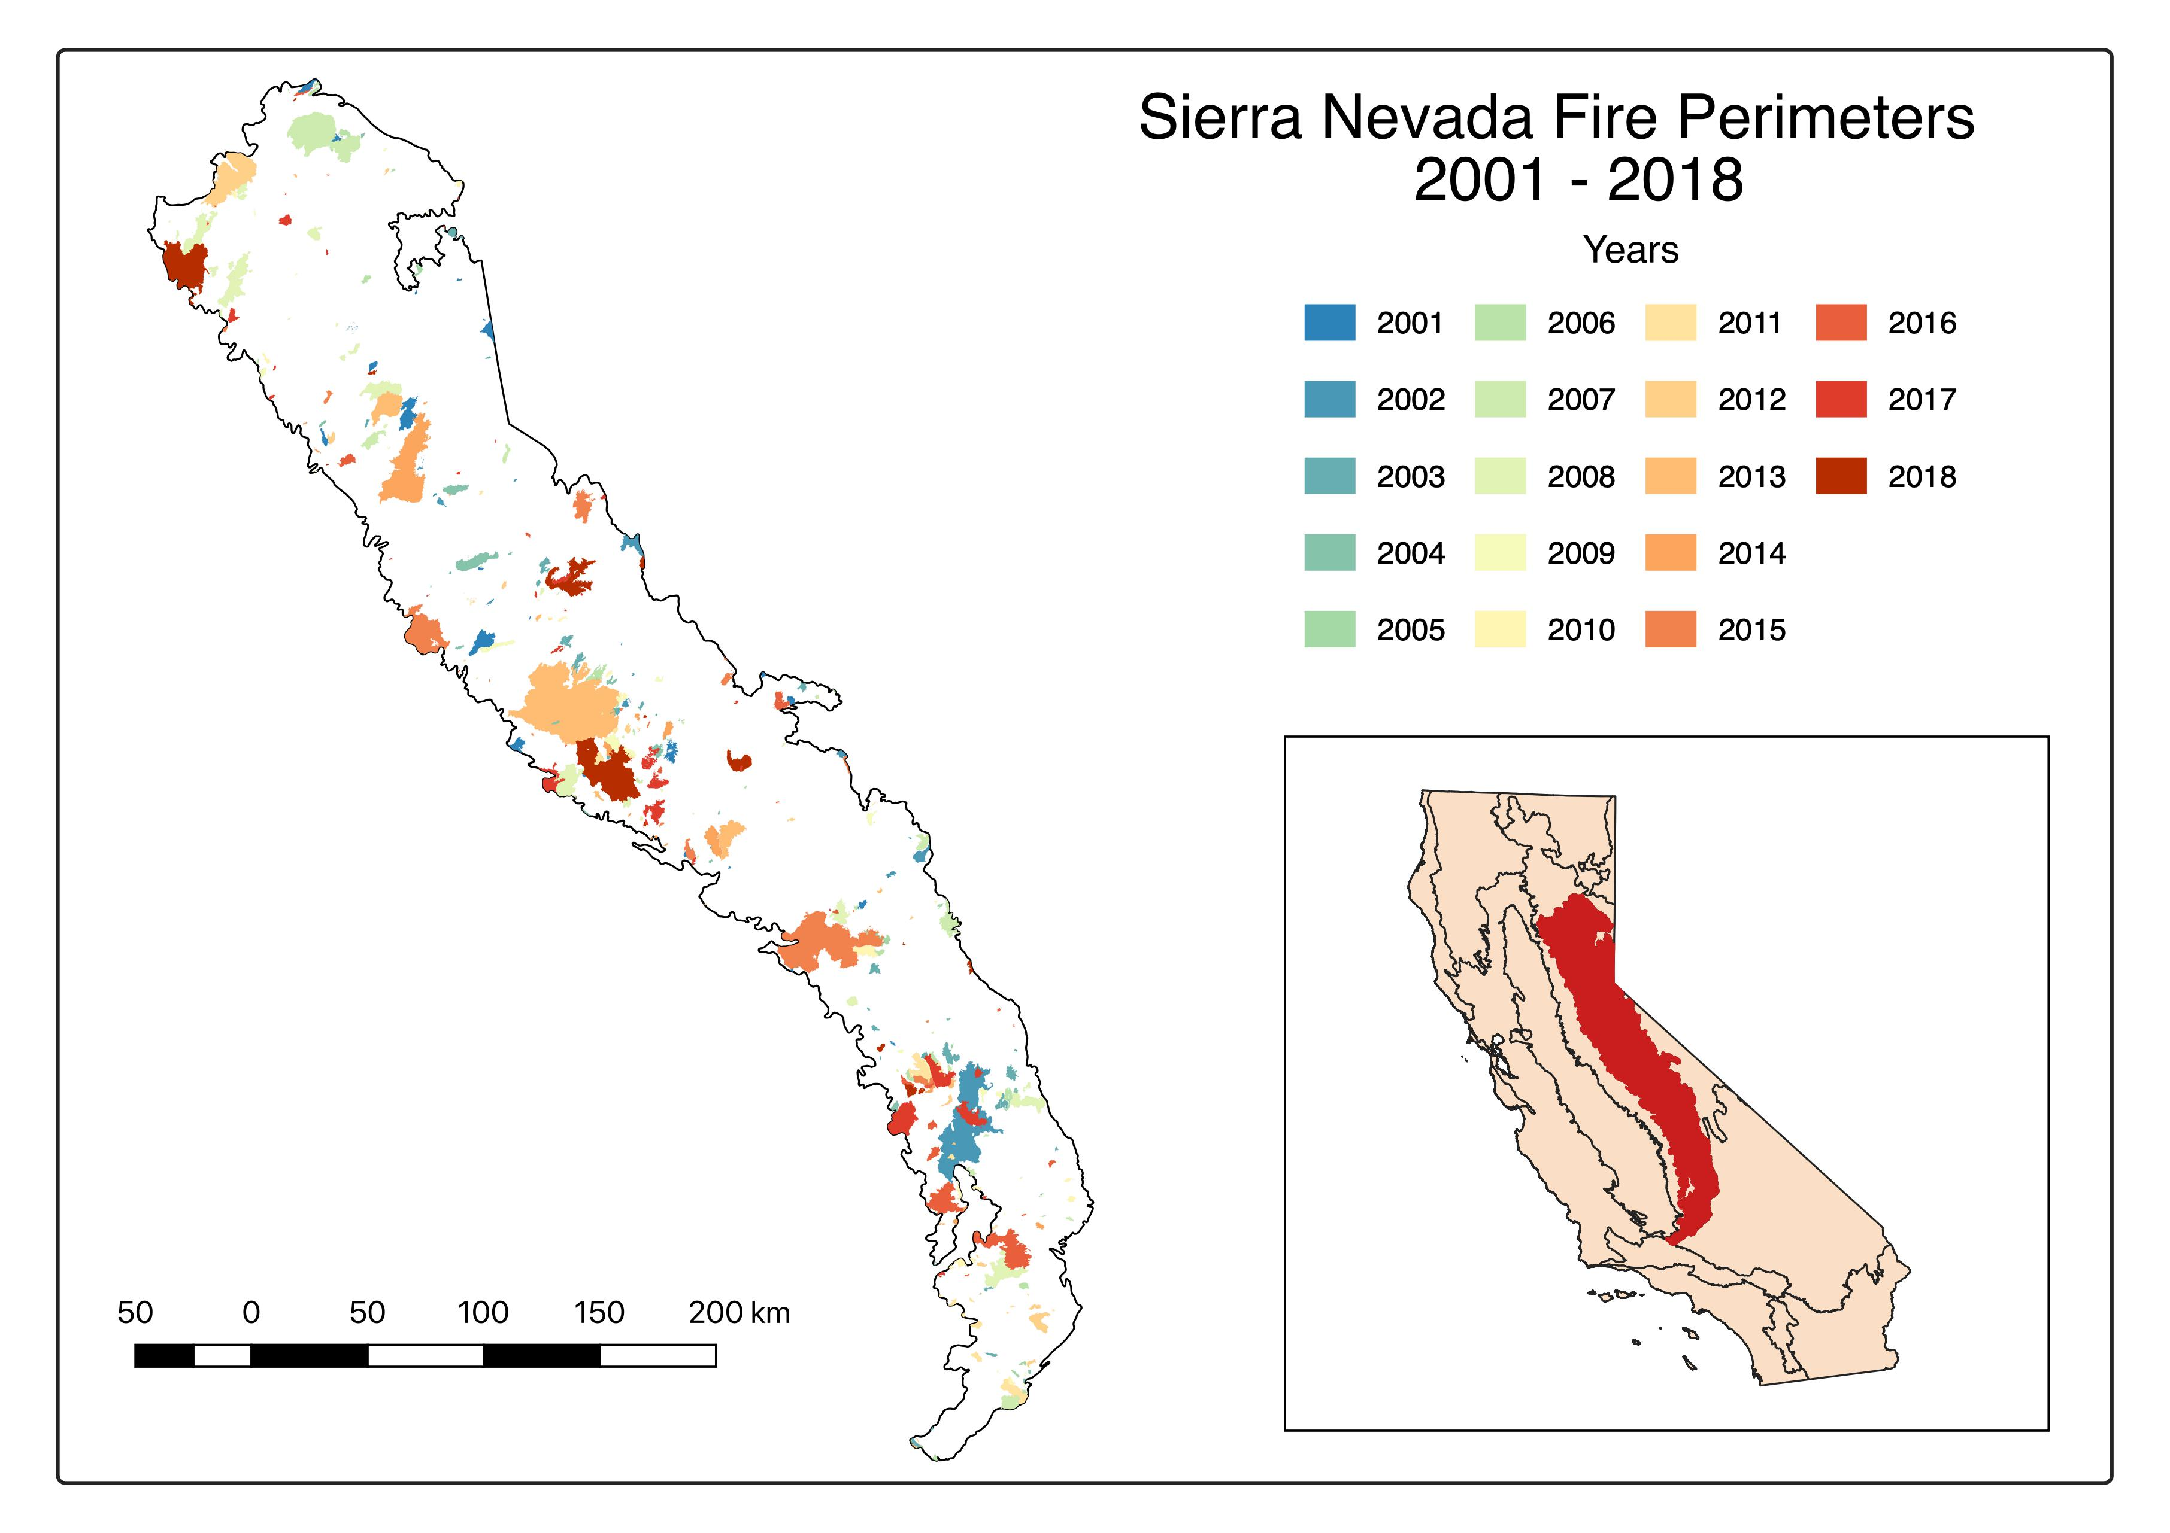

Temperature extremes and Sierra Nevada fires
Aurora Gutierrez, UCI

Slide 5
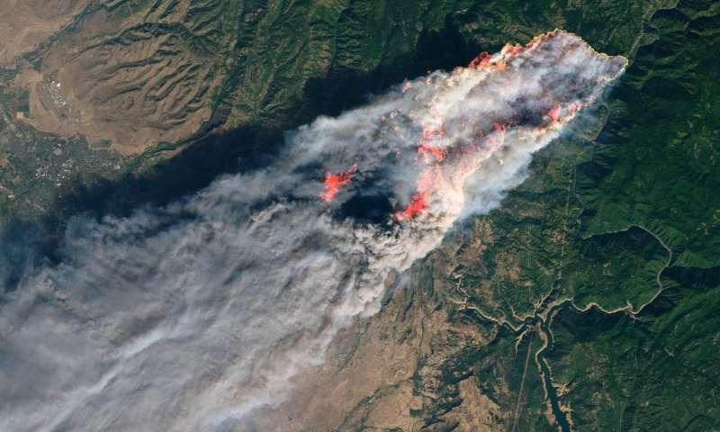
Camp Fire from Landsat8

Slide 6
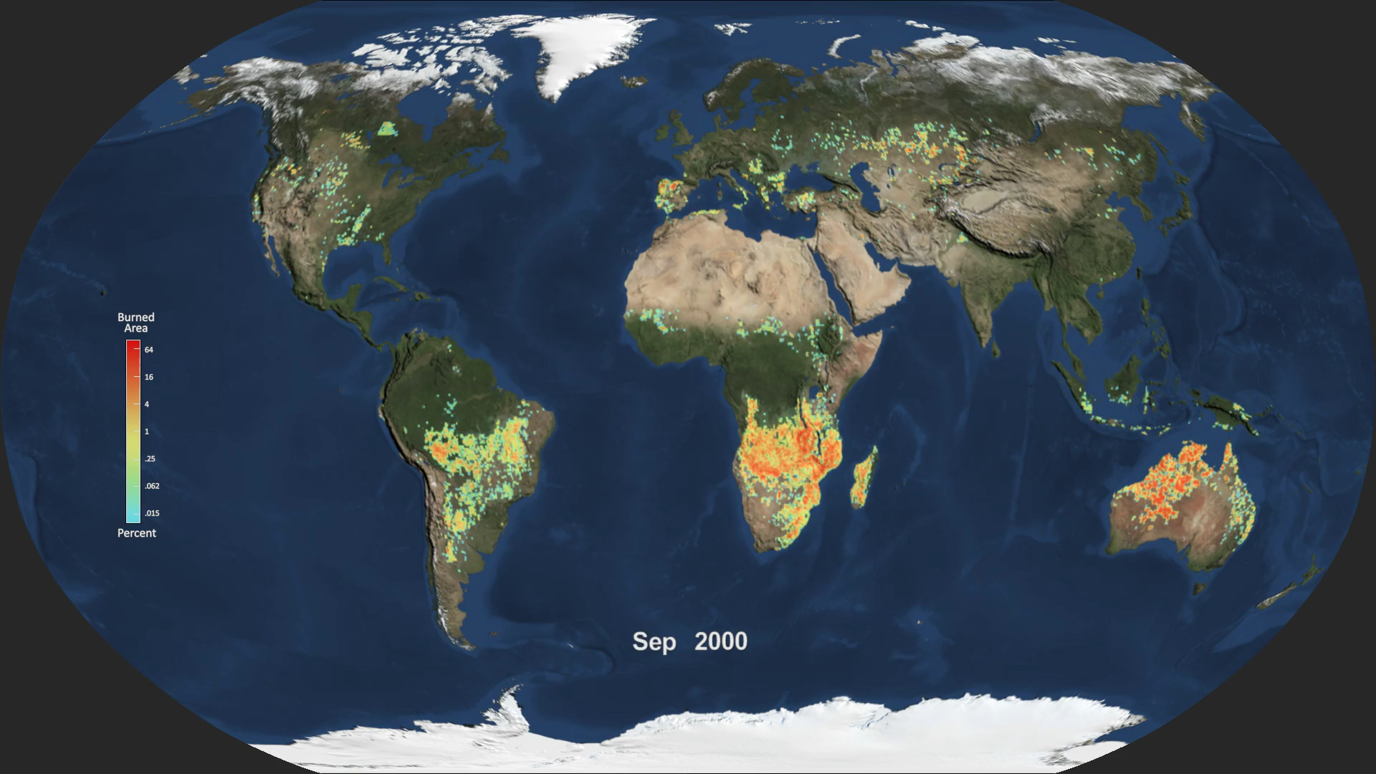

Slide 7
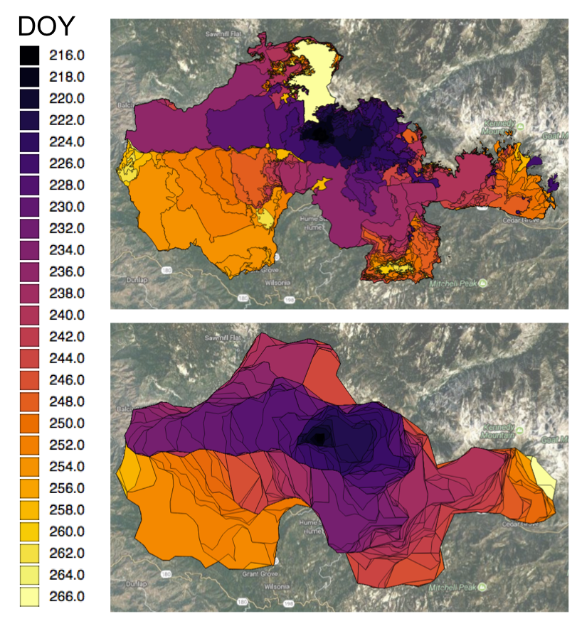
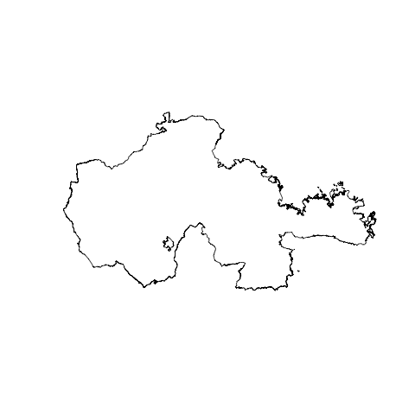
Rough Fire
Reference
VIIRS satellite –derived

