Slide 1
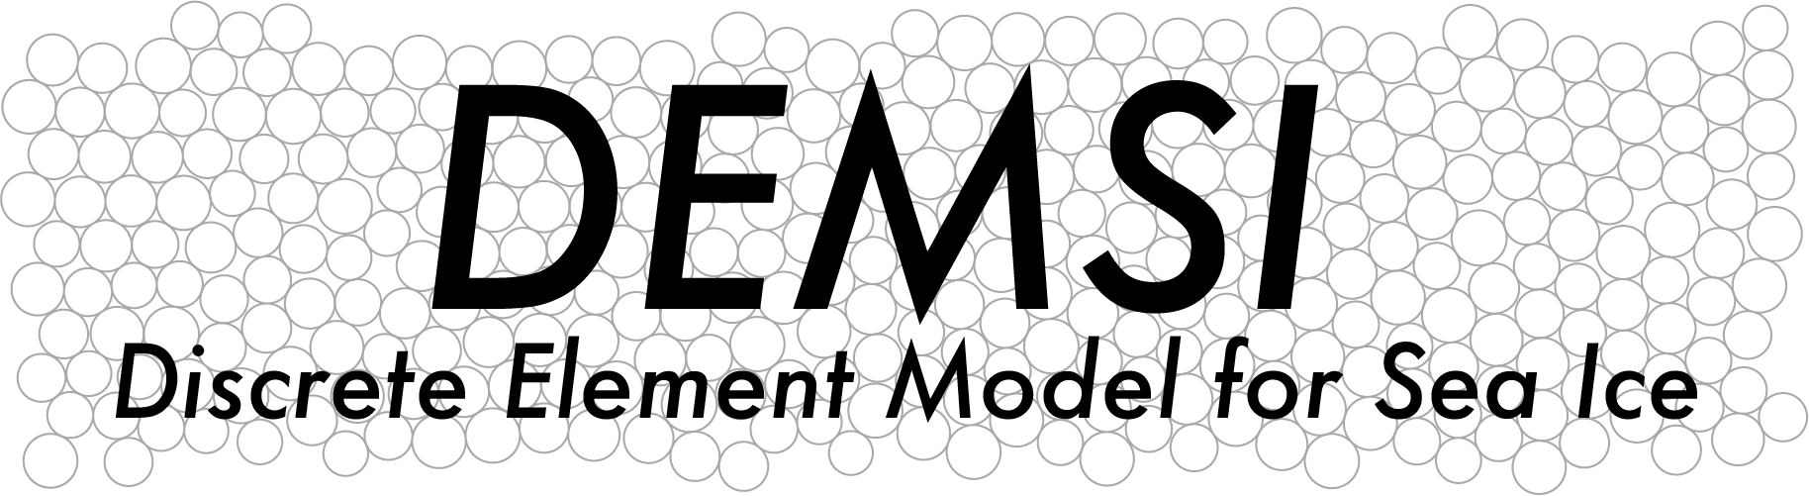

A Performance Portable Discrete Element Sea Ice Model
Kara Peterson, Svetoslav Nikolov, Dan Bolintineanu, Joel Clemmer
Sandia National Laboratories
Adrian Turner
Los Alamos National Laboratory
ESMD PI Meeting
October 29, 2020
SAND2020-11870 C

Slide 2
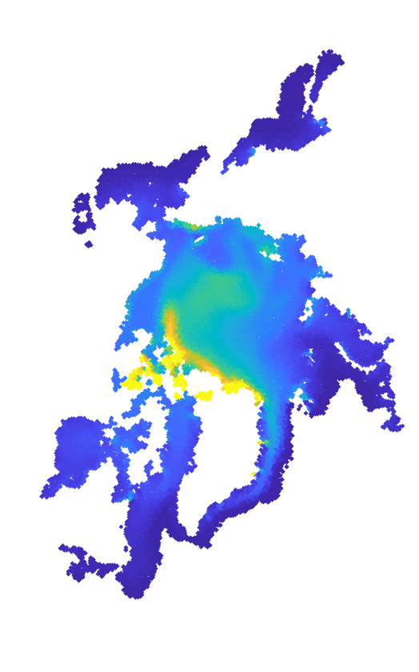
OVERVIEW
Our objective in DEMSI is to develop a computationally efficient, performance portable DEM sea ice model for Earth system modeling
This talk is a follow-on to plenary talk on DEMSI given by Adrian Turner
We will focus on highlights from the ASCR-funded work including
  Particle to grid interpolation for ocean/atmosphere coupling
  Particle to particle remap
  Preliminary performance
  Contact model calibration and validation

Slide 3
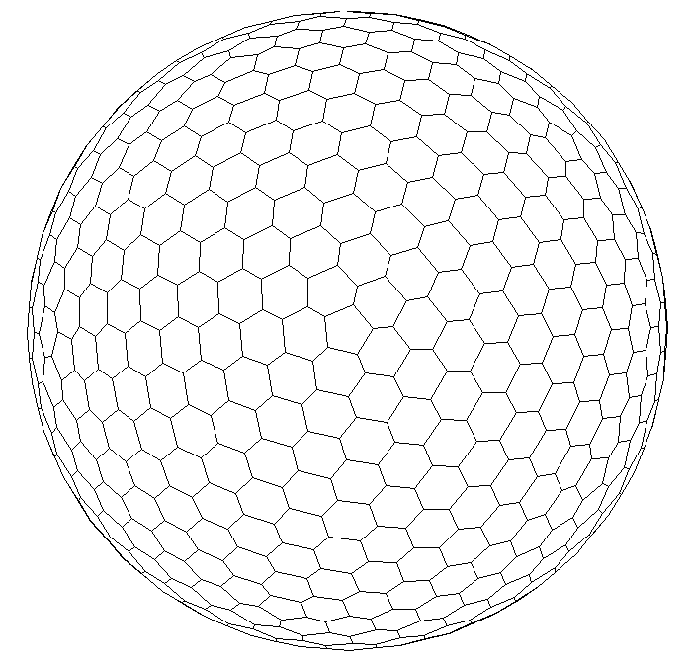
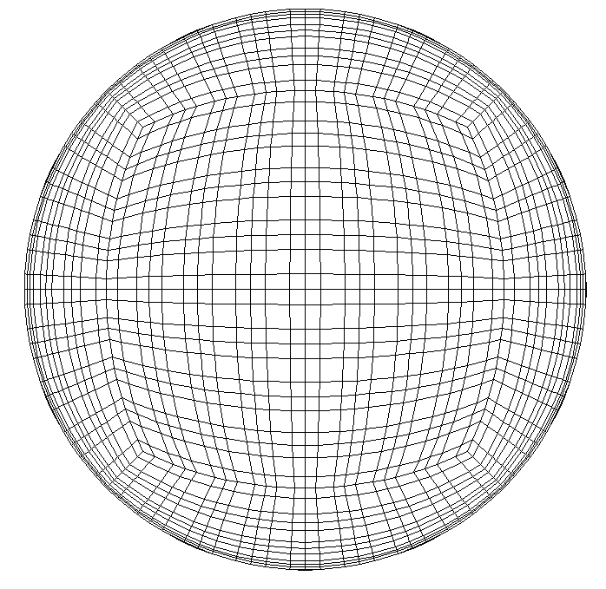
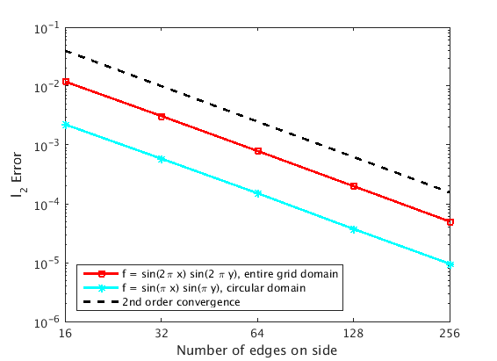
OCEAN/ATMOSPHERE COUPLING
MPAS-O Grid
EAM Grid
Incorporating Lagrangian sea ice model in E3SM requires particle to grid remapping capability
  Need to transfer fluxes between ice/ocean/atmosphere
  Requires conservation and bounds preservation
Implemented second-order moving least squares-based method with bounds preservation
Convergence plots for second-order MLS interpolation
Next Steps:
Extend remapping capability to MPAS-O and EAM grids
Opportunities to collaborate with CANGA project

Slide 4
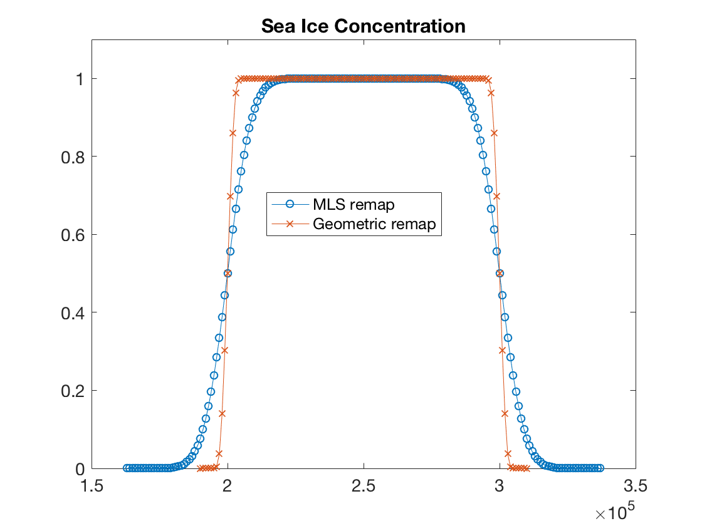
PARTICLE-TO-PARTICLE REMAPPING
Working with LANL on high-order particle-to-particle remap implementation
  To manage large deformations,
  To add new particles due to thermodynamic growth.
Requires accuracy, bounds preservation, and conservation
Challenges
  Gaps and overlaps for particle effective areas
  Relationships between tracers
Conserved Quantities
Total ice area:
Total ice volume:
Investigating both flux-based and MLS-based remap options using simple test cases for verification
Two methods:
Geometric remap with flux-based optimization for property preservation.
Moving least squares remap with mass-based optimization for property preservation.
Next Steps:
Comparison of efficiency and accuracy for remap methods.
Remap for bonds between particles.

Slide 5
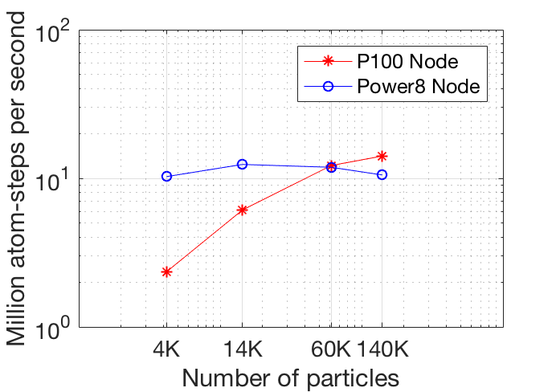
DEMSI PRELIMINARY PERFORMANCE
Contact model implemented with LAMMPS (https://lammps.sandia.gov)
  Computationally efficient providing high-performance baseline
Using Kokkos for performance portability
Performance plots for uniform stress test case with varying particle count
Strong scaling on CPU
Performance on Nvidia Tesla P100 GPU node versus Power8 node with eight Garrison dual socket cores
Number of particles:
Next Steps: Performance for Arctic basin test case and code optimization.

Slide 6
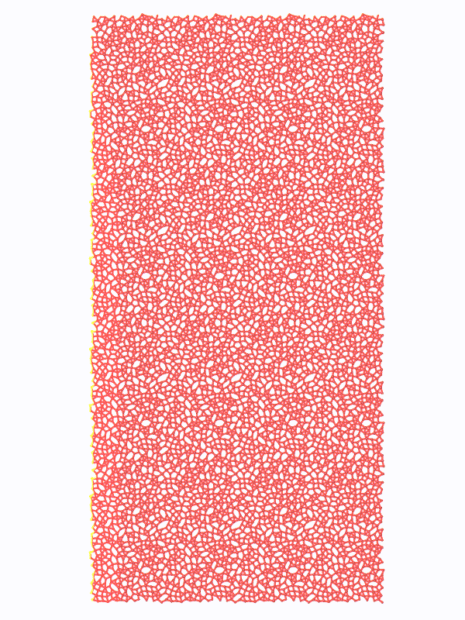

CONTACT MODEL CALIBRATION AND VALIDATION
Performing simple mechanical tests of sea ice contact model
  Contact model parameter study using uniaxial compression
  Brittle-like failure as E and h_{m} increase
  Consistent with results in the literature (Herman GMD 2016)
y
x
Varying bond thickness h_{m}
Varying modulus E
Next Steps:
Parameter sensitivity and calibration with DAKOTA
Comparison with experimental data and continuum sea ice models
Explore data-driven (machine learning) contact model

