Slide 1
MultiSector Dynamics and Linkages with ESMD
Bob Vallario
Program Manager
MultiSector Dynamics in
Earth and Environmental Systems Modeling
EMSD PI Meeting
October 27, 2020

Slide 2
Goal
Explore the complex interactions and potential co-evolutionary pathways within the integrated human-Earth system, including natural, engineered, and socioeconomic systems and sectors.

Slide 3
Strategic Objectives
Forces and Patterns. Reveal the combination of factors, varying by geographies, that contribute most significantly to patterns of development in transregional, regional, and sub-regional landscape evolutions, including interactions and interdependencies among natural and built environments and human processes and systems.
Stabilities and Instabilities. Identify the characteristics of interacting natural and built environments and human processes that lead to stabilities and instabilities across systems, sectors, and scales, and deliver new insights into the role of strong interdependencies, feedbacks, and compounding influences and stressors.
Foresight. Explore how development patterns, stabilities, instabilities, and systems resilience may evolve within multisector, multi-scale landscapes as a result of future forces, stressors, and disturbances… and reveal what pathways, characteristics, and risk profiles may emerge from both gradual and abrupt transitions.

Slide 4
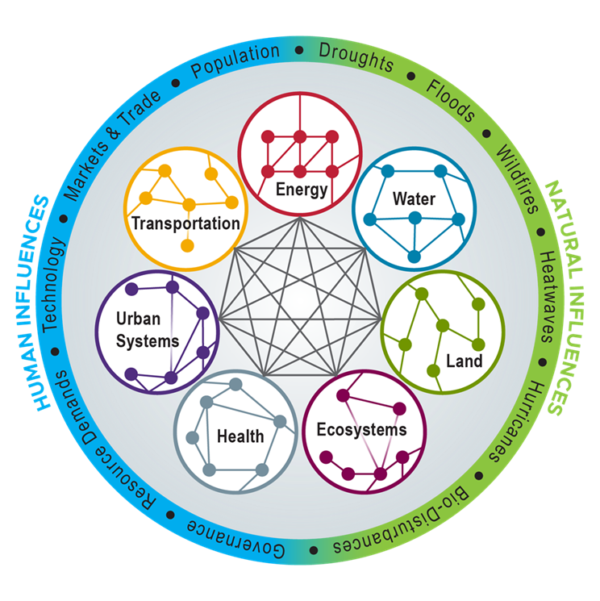
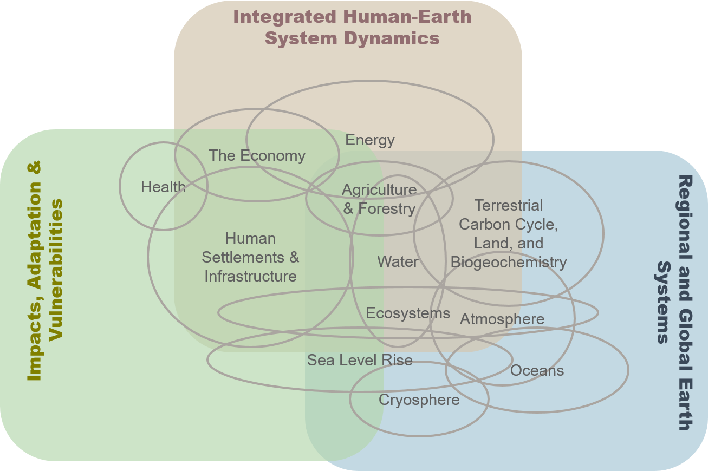
Somewhat iconic representations
Global Earth System Evolution
Regional Landscape Evolution
Regional to Global
Earth system drivers, impacts, and responses
Energy and land
Local to regional
MSD and complex landscape evolution
Multi-influence, multi-stressor
Sectors, infrastructures, regional economies, natural resources

Slide 5
MSD Research Priorities
Functional, collaborative community-of-practice and working group structure
Hierarchical frameworks and use-inspired tools (emulators, sensitivity research, etc.)
Distributed science mechanisms (i.e., open source models, software couplers, interoperability, modular methods, community data and computation
Complexity theory and science (networks, collective behavior, evolution and adaptation, pattern formation, systems theory, machine learning, etc.)
Scenario methods and development with implications for uncertainty framing/analysis, complex storylines, modeling experiments, and more.
Model resolution and fit-for-purpose process details across spatial and temporal scales (e.g., energy, water, land, economics, population, land use, technology
Significant coupled systems behaviors, such as found among energy, water, land and socioeconomic systems with non-linear responses, e.g., induced by extremes

Slide 6
MSD Major Projects: National Lab SFAs/ and Projects and University Collaborative Agreements
Partners (examples):
1. Integrated Multi-sector,
Multi-scale Modeling SFA (IM3)
2. Global Change Intersectoral
Modeling System SFA (GCIMS)
3. Integrated Coastal Modeling
(ICOM)*
4. Interdisciplinary Research for
Arctic Coastal Environments
(InteRFACE)*
5. Program on Coupled Human
Earth Systems (PCHES) CA
6. Integrated Global Systems
Modeling (IGSM) CA
7. HyperFACETS*
SFA PI: Jennie Rice
SFA PI: Mohamad Hejazi
PI: Ian Kraucunas
PI: Joel Rowland
CA PI: John Weyant/Karen Fisher-Vanden/Rob Nicholas
CA PI: Ron Prinn /John Reilly
* Collaborative program funding
CA PI: Paul Ullrich

Slide 7
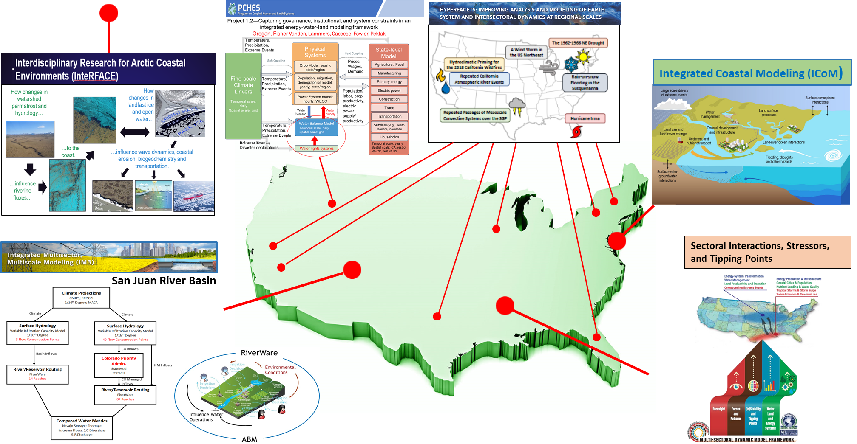
Some common geographies of interest

Slide 8
MSD and ESMD connections (examples)
Kate Calvin is Chief Scientist for MSD’s GCIMS SFA and Task Leader for E3SM
Co-support, with Renu in RGMA, Ruby Leung (E3SMs Chief Scientist) on HypeRFACETS
Fine scale work in IM3…e.g., work on perennial bioenergy crops for the Community Terrestrial System Model (CTSM), formerly the Community Land Model (CLM) now being adapted for ELM
Integrated Coastal Modeling (ICoM) project in the Mid-Atlantic region
Interdisciplinary Research for Arctic Coastal Environments (InteRFACE) project
Upcoming MSD Town Hall with Xujing as speaker/panelist on opportunities and connections within Earth and environmental systems sciences

Slide 9
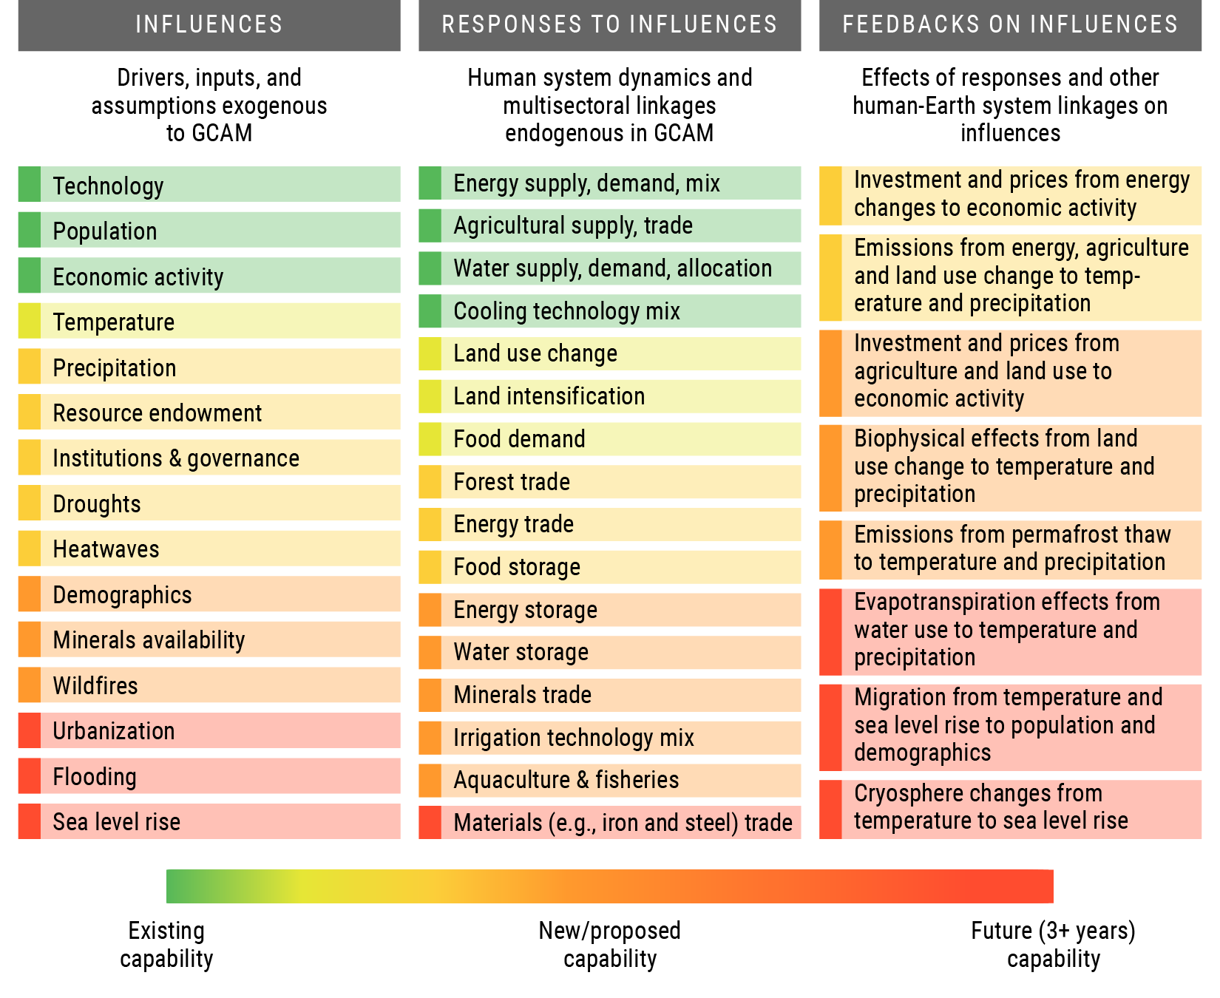
Focuses on long-term evolution of the coupled human-Earth system
An integrated framework to investigate the interplay between influences, responses, and feedbacks
Internally consistent, tightly coupled, computationally efficient framework
Regional to global spatial scales and seasonal to multidecadal timescales
Major research experiments:
Compounding Influences
Regional Teleconnections
Human Responses
Human–Earth System Feedbacks
gcims.pnnl.gov

Slide 10
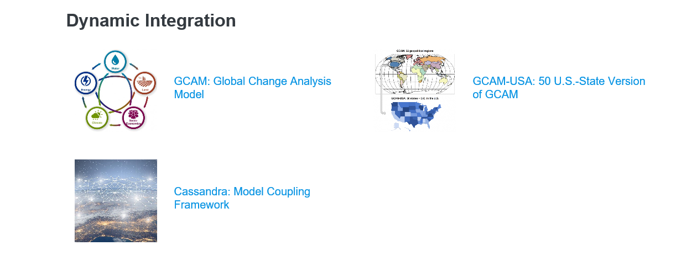
Models and Tools in GCIMs SFA

Slide 11
GCIMS SFA and the ESMD Connection
In general…the human systems in E3SM
GCAM (full version in coupled mode) – emissions and land use/land to E3SM with productivity from E3SM to MSD.
Eventual plans to link GCAM’s water components in E3SM (as well as GCIMS’ Tethys to downscale water demand)…currently use for offline diagnostics and analysis and use GCIM’s Hector to define the scenarios.
GCAM contributed 2 scenarios to CMIP6. E3SM has not run those two scenarios but in v2, with runs starting in 2021, the BGC group will be running GCAM-generated scenarios.
Other potential:
Exploring use of GCIM’s Demeter to downscale land demand
Exploring more feedbacks in E3SM v3 such as environmental influences on energy supply/demand.
climate emulators developed through GCIMS to help identify which scenarios are valuable to run in expensive Earth System Models. And more broadly for ESMs…potential for human-system emulators who can’t link GCAM directly (e.g., GCIMS experiment 1 relevance…for a temperature change of x, how much do emissions or land use change?)
GCIMs experiment 4 to explore uncertainty space and then run E3SM-GCAM for a subset of simulations to quantify potential error between the emulated response and the ESM response.

Slide 12
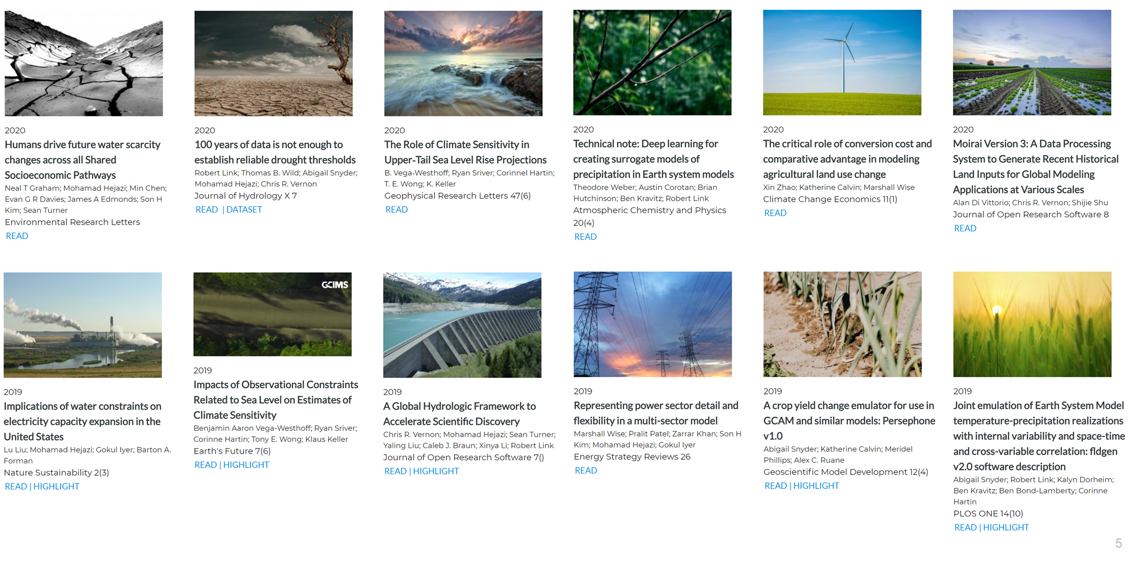
Recent Publications
GCIMS.PNNL.GOV
12

Slide 13
Develop flexible, open-source, integrated modeling capabilities that capture the structure and dynamic behavior of the multiscale interactions within and between human and natural systems.
Use these capabilities to study the evolution, vulnerability, and resilience of interacting human and natural systems and landscapes due to long-term influences and short-term shocks, from local to continental scales.
Explore how uncertainty in data, model structure, model parameters, multi-model coupling strategies, and spatial and temporal resolutions influence projections of human-natural systems evolution.
Natural Systems
Human Systems
Feedbacks
Feedbacks
Feedbacks
im3.pnnl.gov
13

Slide 14
IM3 Research and E3SM Spinoff

Slide 15
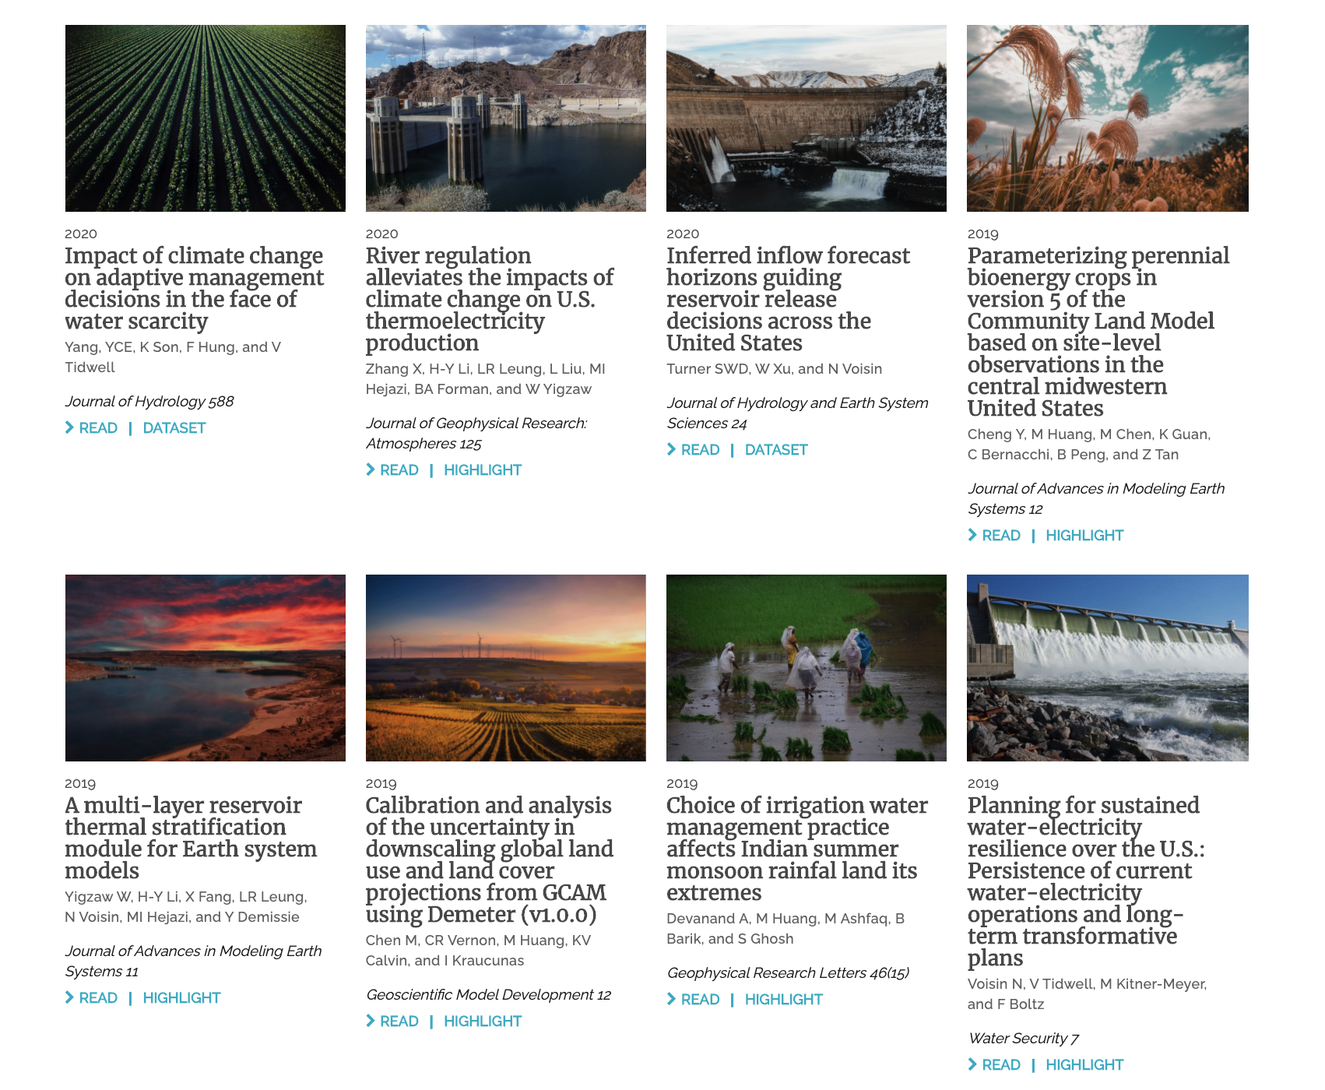
Recent publications
15

Slide 16
IM3 and GCIMS in Context
IM3 SFA
GCIMS SFA
Mechanistic understanding of stressors, vulnerabilities, resilience, and transformations in complex human-environmental landscapes consisting of sectors, infrastructures, resources, and the natural environment.
Local to Regional
Teaming with RGMA for fine-scale analyses of local/regional interactions/dynamics (e.g., Hyperfacets) and with SBR for Watersheds and IHTM
Physics based models as well as agent-based, decision-theoretic models
Integration and testing of best-in class component models (cross-agency)…and substitutability… within flexible, interoperable modeling frameworks
PNNL - Richland, WA led multi-institutional team
4 year history with rapidly growing domestic following, interagency interest/engagement, and emergence as a recognizable center of excellence
FY20 - $4.6 M
Focus
Scale
Focus-Relevant Partnerships
Model Structure
Methods
Leadership
History
Resources
Understanding human drivers, responses, and feedbacks in global Earth system evolution, with a focus on energy, water cycle, land, and biogeochemistry.
Regional to Global
Teaming with ESM for inclusion of humans in E3SM
Economic models with more detailed physical system emulators of energy, water, land, biogeochemistry, and climate components.
Single leadership class model (GCAM) and IHESD-developed components that are fit-for-purpose.
JGCRI (PNNL and UMD) – College Park, MD led multi-institutional team
25 + year development with major domestic and international following and model training program
FY20 - $4.5 M

Slide 17
Goal: To deliver a robust predictive understanding of coastal evolution that accounts for the complex, multiscale interactions among physical, biological, and human systems.
Pacific Northwest National Laboratory led multi-institutional team (LANL a strong participant)… >40% funding awarded by PNNL to others
Mid-Atlantic regional focus … existing DOE capabilities, complex systems interactions, extensive data, and converging interagency activities
$16.2M over three years ($5.4M/yr)
A “federated” approach spanning four distinct program areas within DOE’s CESD; requires foundational work in each area and substantial crosscut modeling work.
Informs potential follow-on observational and experimental work.
icom.pnnl.gov

Slide 18
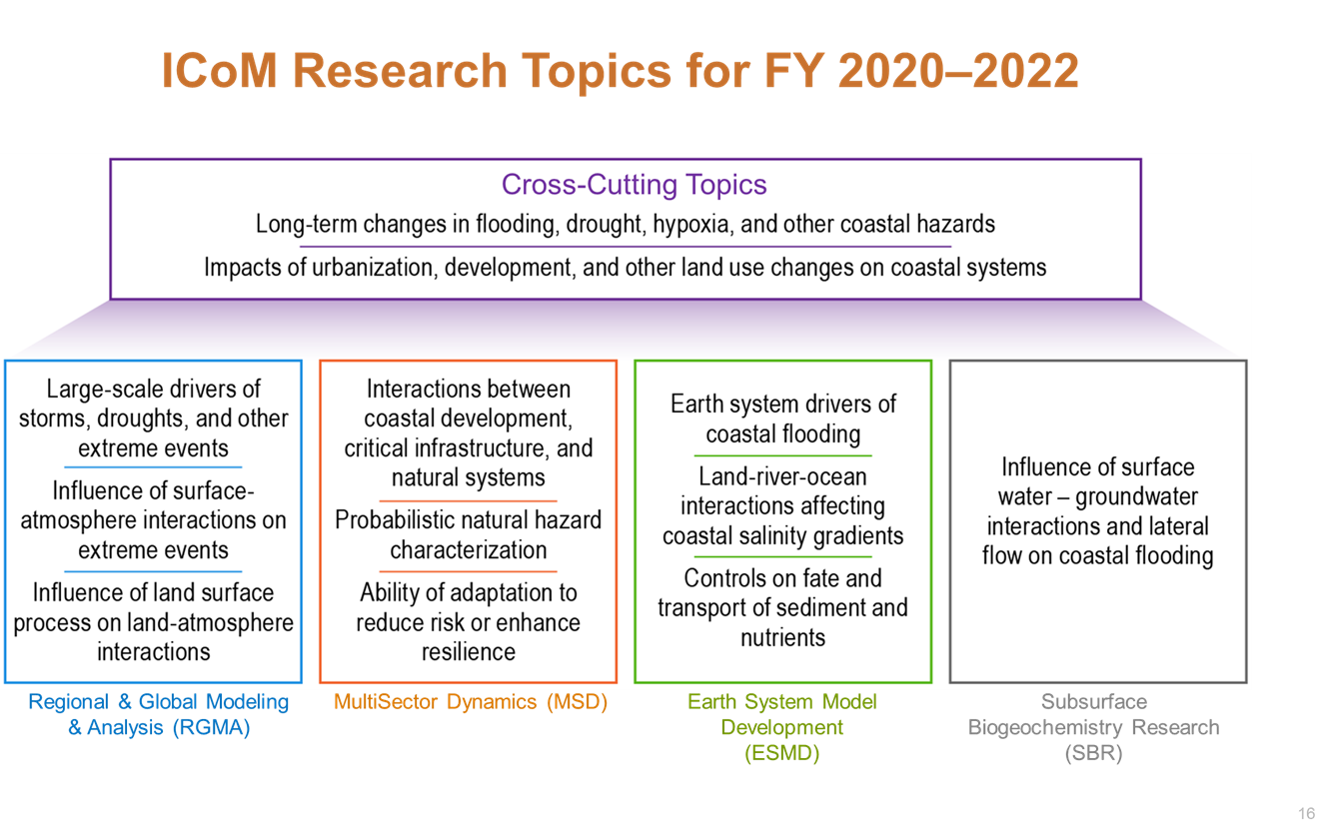
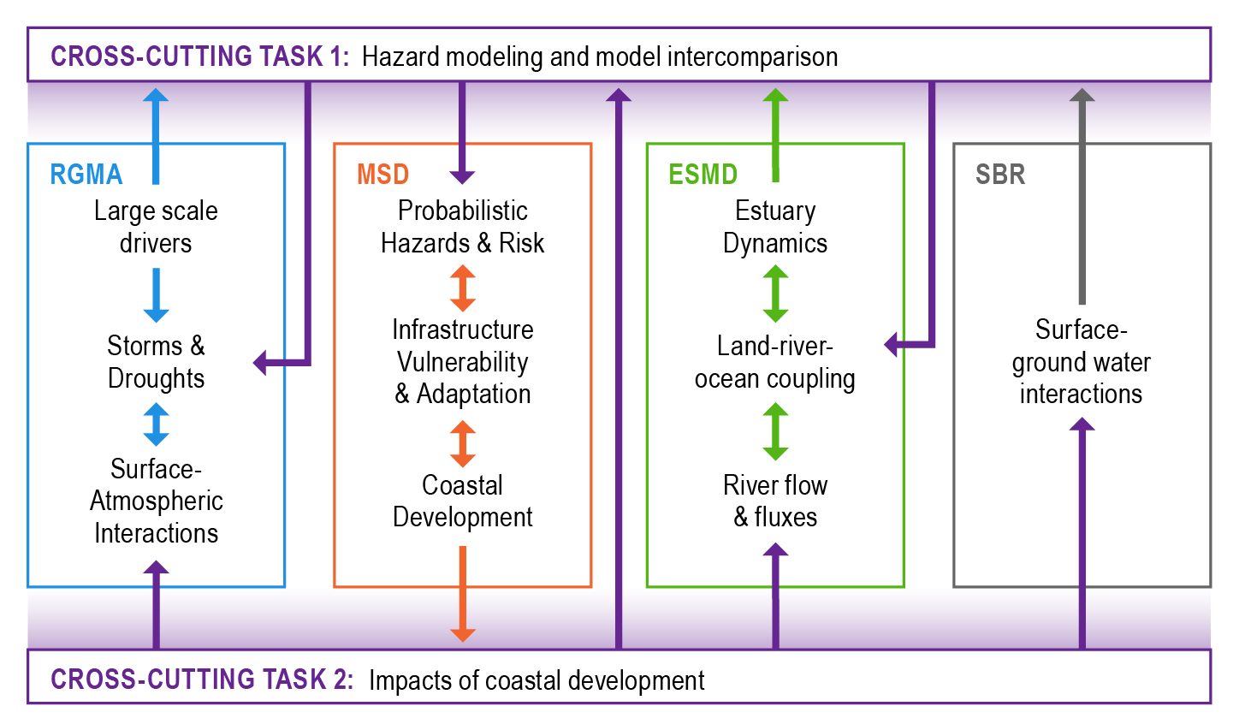
Project components and study region

Slide 19
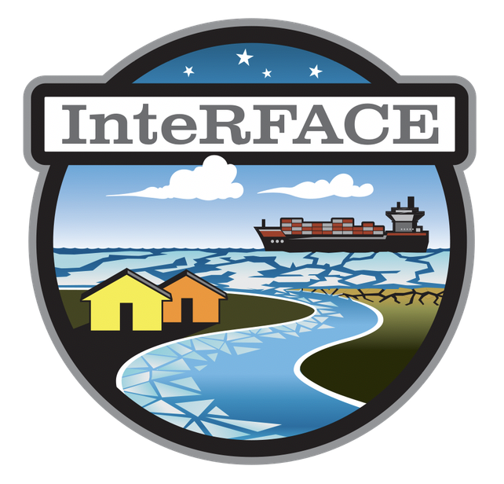
Enhance the understanding of interactions between natural and societal changes in the Arctic
Co-evolution of transportation, resources development, and human systems
Critical thresholds in this co-evolution and effects on the economy and communities
Links of Arctic evolution to broader global dynamics

Slide 20
Significant Environmental Influences on Oil and Gas Development in the Arctic
Warming air and water temperatures
Ecosystem change with potential for more conflict between subsistence, conservation, oil and gas activities, and ownership (rights)
Sea ice
Affects shipping and multiple forms of transportation, subsistence hunting activity, coastal erosion
Winds & storm inundation
Affects coastal erosion rates and storm inundation damages infrastructure, impacts to subsistence hunting activity, danger to housing and community infrastructure
Permafrost thaw
Industry and civil infrastructure damage, food security impacts, release of methane, disease potential
Coastal flooding
Infrastructure damage, transportation disruption, cultural dislocation (e.g. burial sites, sacred locations)

Slide 21
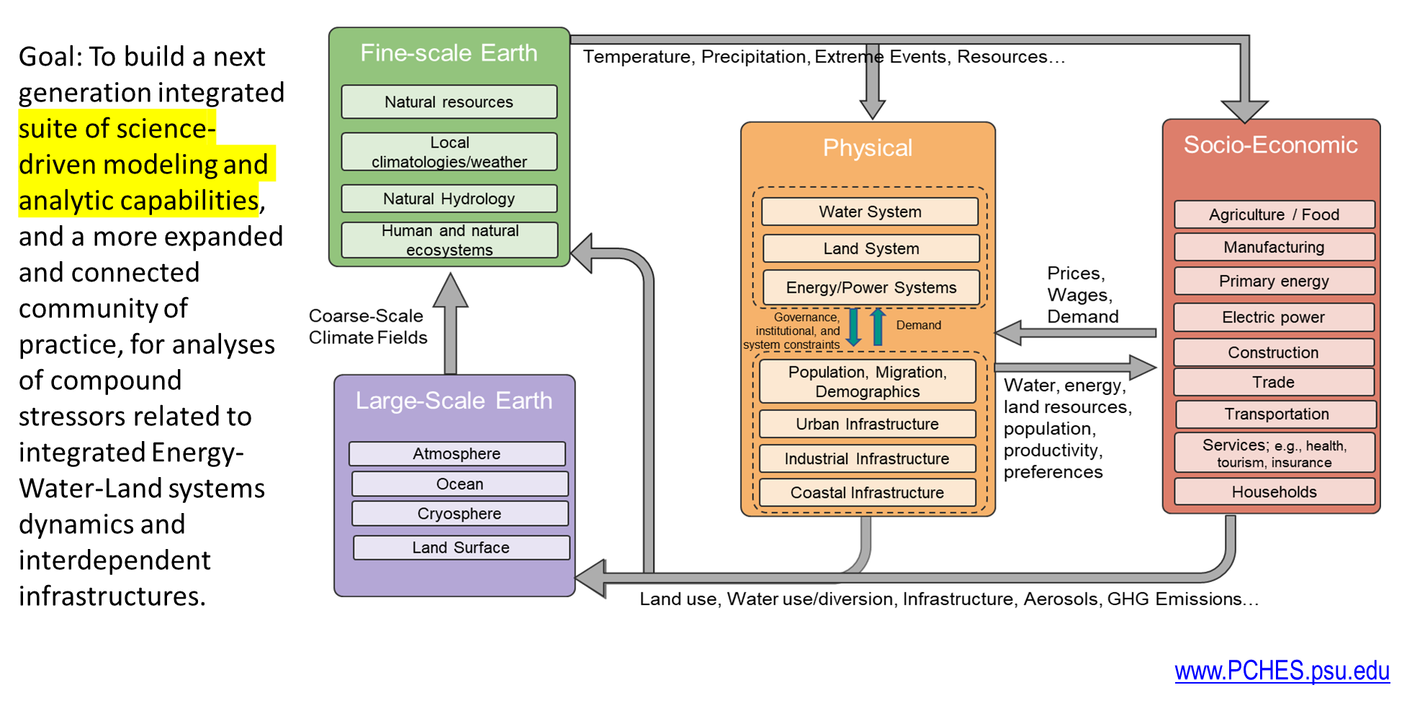
www.PCHES.psu.edu

Slide 22
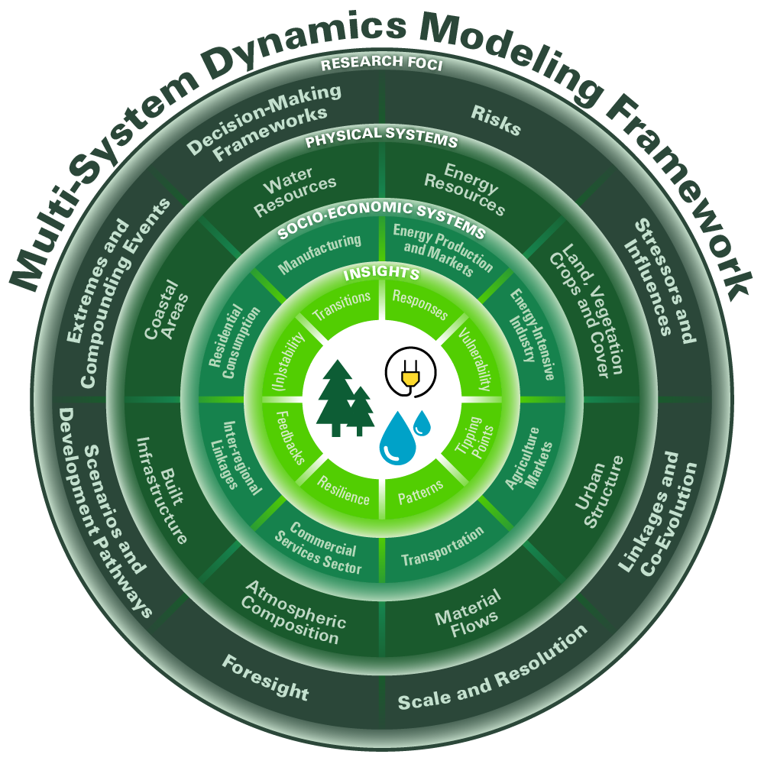
Goal: Develop a multi-system modeling framework to explore compounding stressors and tipping points at regional scales
Focus on:
Forces and patterns
Stabilities, instabilities, tipping points
Foresight and resilience
https://globalchange.mit.edu/research/research-projects/integrated-framework-modeling-multi-system-dynamics

Slide 23
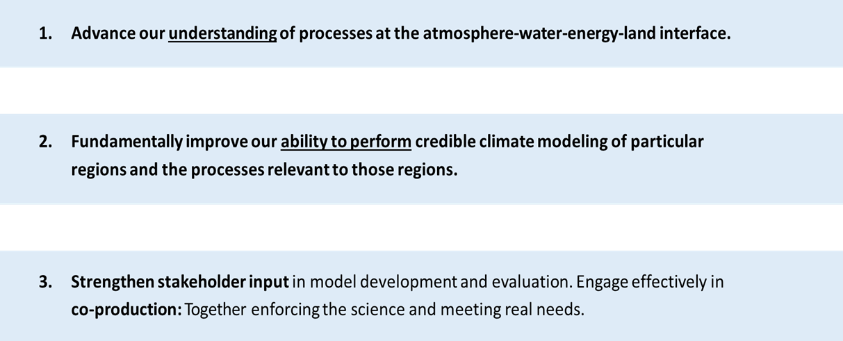
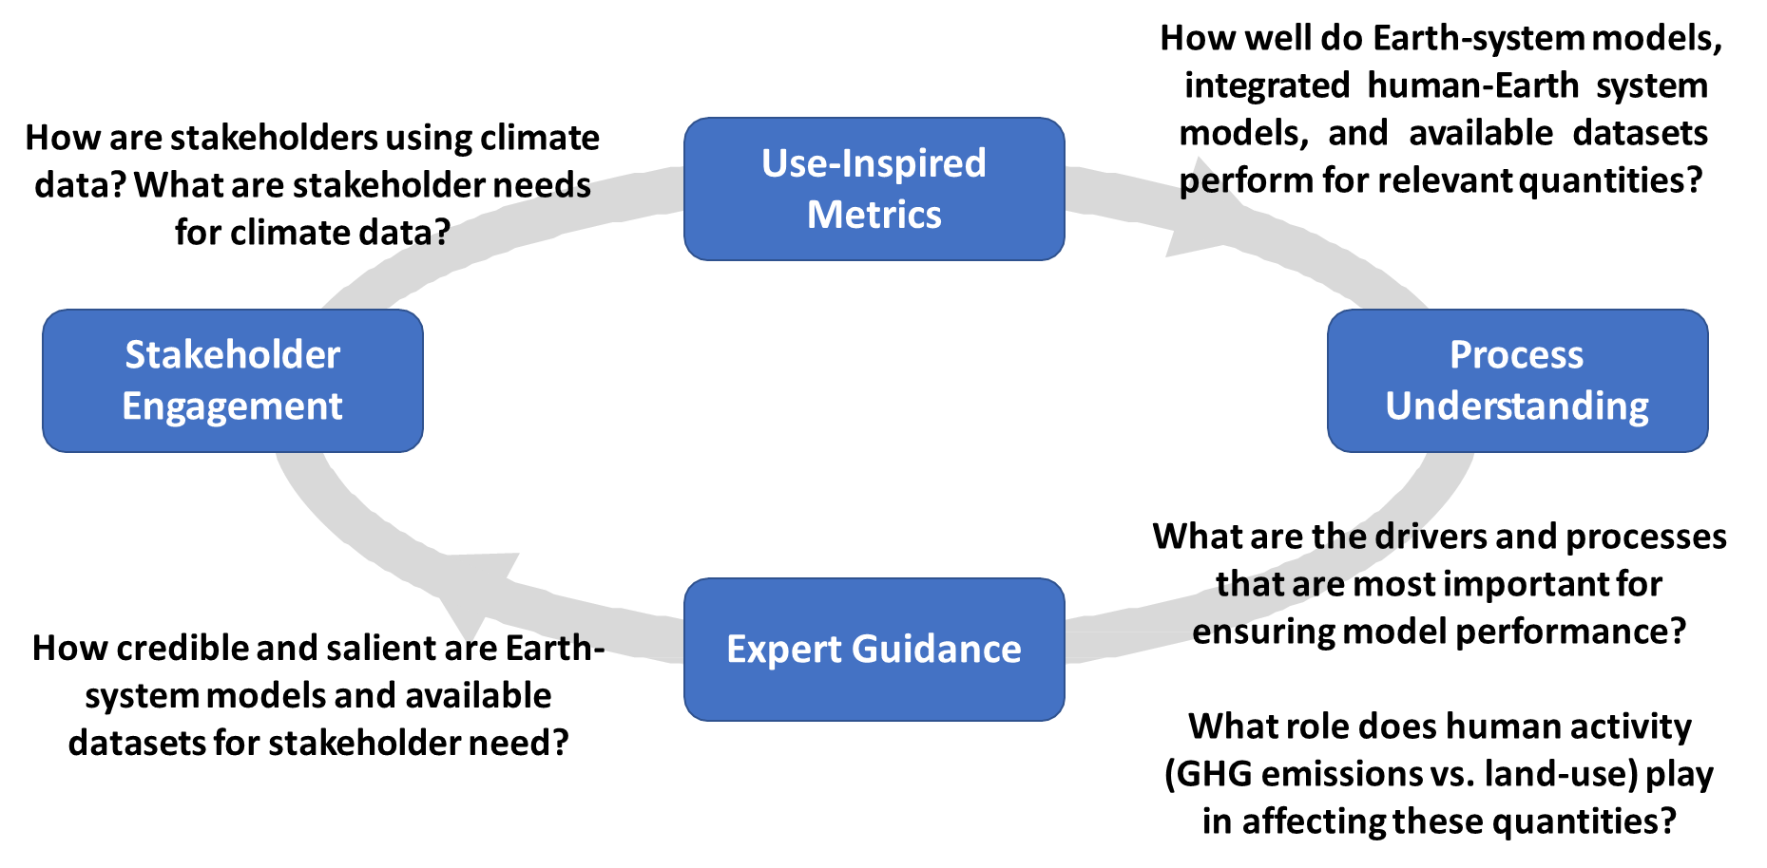
Goals
Process and Continuous Engagement
https://climate.ucdavis.edu/hyperfacets/

Slide 24
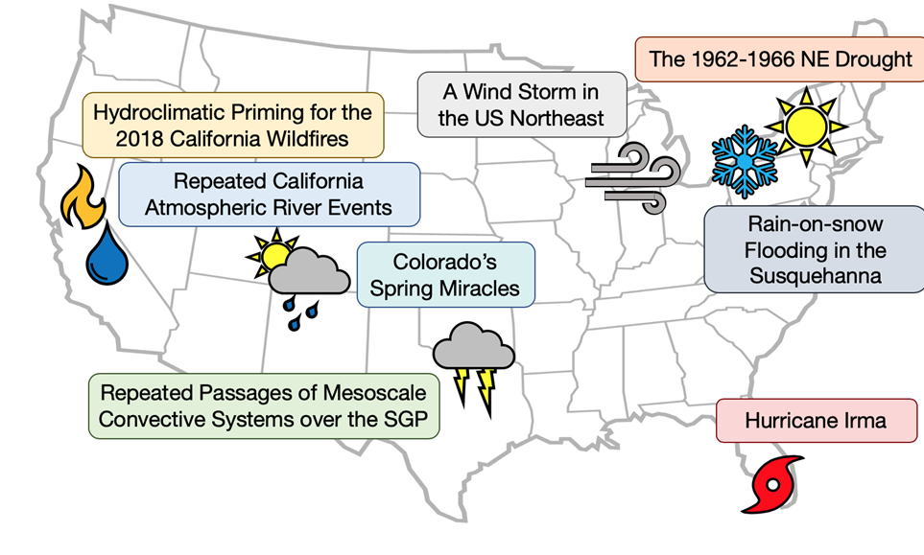
Study regions and storylines
Leverage ongoing stakeholder relationships in key case study regions.
Understand priorities and overlapping interests among stakeholders.
Understand needs
for planning and decision-making in each region.

Slide 25
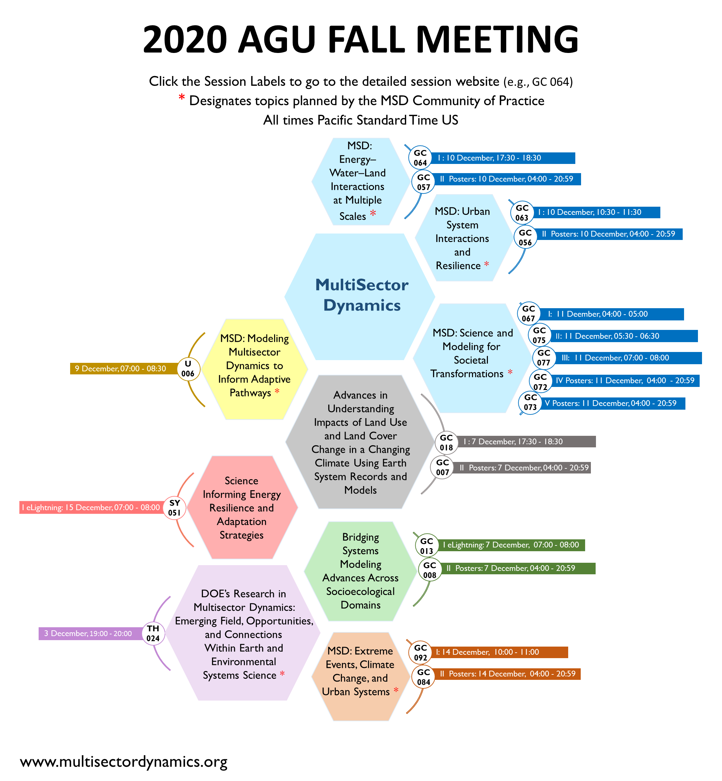
MSD direct funded and close affiliates comprise 10% of 2020 Global Environmental Change Section (GEC is 4th largest of AGU Sections)
Union Session
Xujing joining as speaker/panelist in MSD convened DOE Town Hall

Slide 26
https://climatemodeling.science.energy.gov/program/multisector-dynamics

