Slide 1
COMPASS-GLM Overview
Ian Kraucunas
On behalf of the COMPASS team

Slide 2
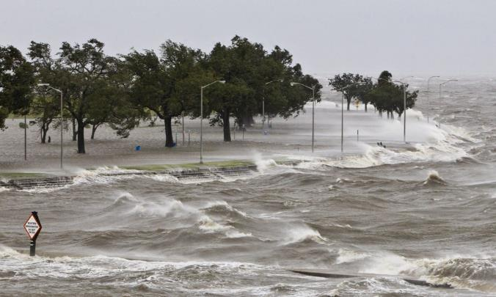
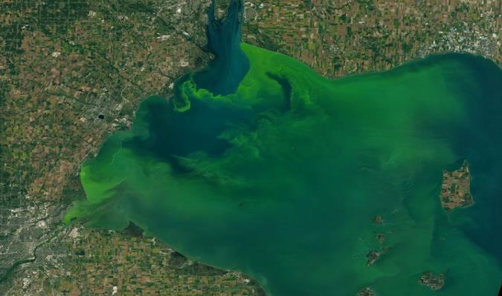
Coastal regions are facing a wide range of changes and challenges
Climate warming
Regional hydrology
Extreme weather events
Ecosystem shifts (e.g., invasive species)
Land use and land cover change
Shoreline evolution
Air and water pollution
Water quality (e.g., harmful algal blooms)
Aging infrastructure
Energy system changes
Transportation impacts

Slide 3
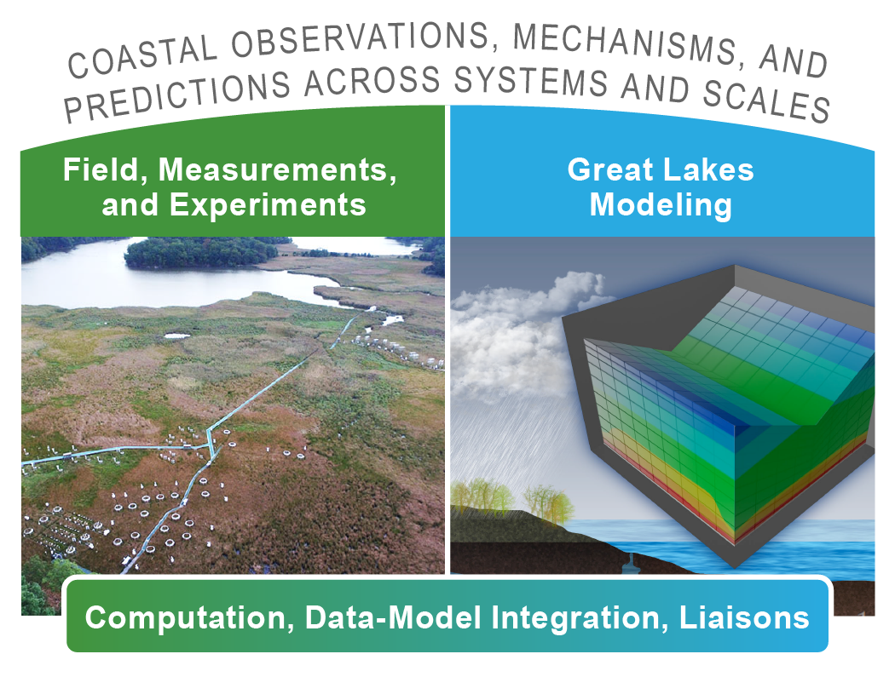
COMPASS will dramatically enhance predictive understanding of coastal systems, including their response to short- and long-term changes
Two major pilot studies, plus foundational capabilities
Proposal submitted 8/2020
Oral defense 9/2020
Provisionally accepted, pending review comments

Slide 4
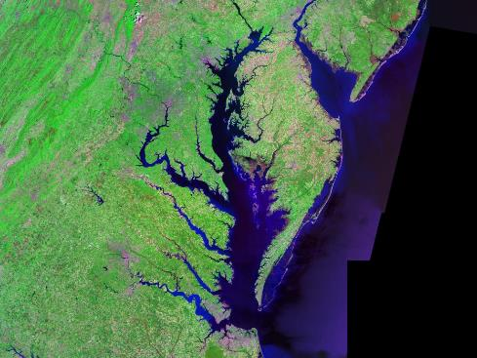
Two study regions offer complementary and contrasting characteristics
Mid Atlantic region
Great Lakes region
Saline to freshwater tidal, sea level rise
Largest freshwater lake system, annual ice
Heavily modified by humans, experiencing natural system change, home to existing research that can be leveraged

Slide 5
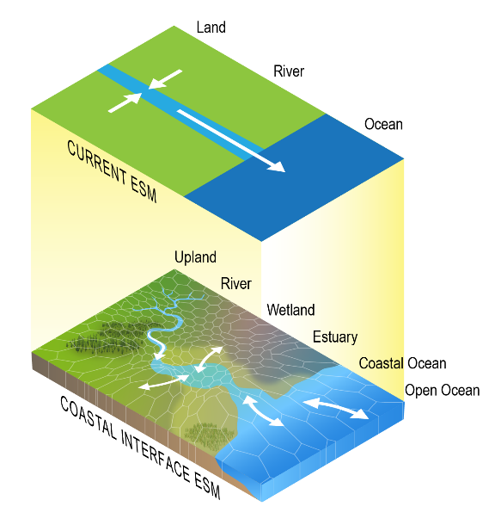
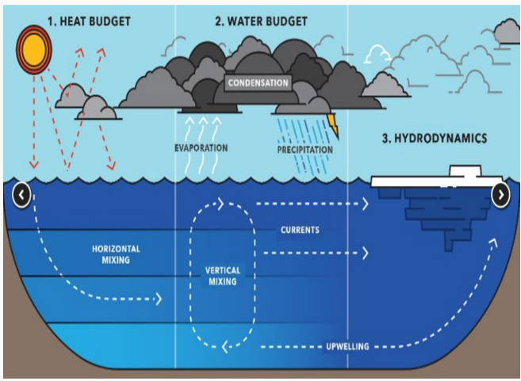
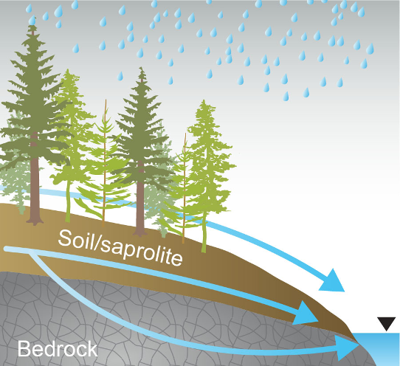
We have identified three major knowledge gaps for COMPASS-GLM to focus on
How atmosphere–land–lake interactions affect regional climate and extreme events
How specific watershed processes and features affect nutrient removal and transport
How to best represent coastal processes in E3SM and other ESMs
MTU News, 2016
Ward et al 2020

Slide 6
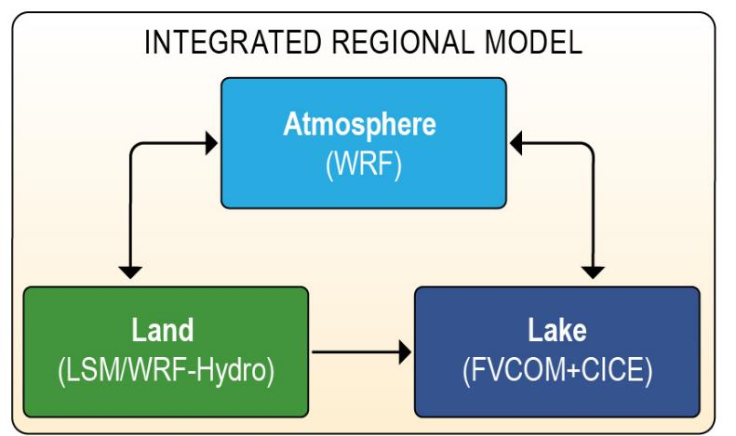
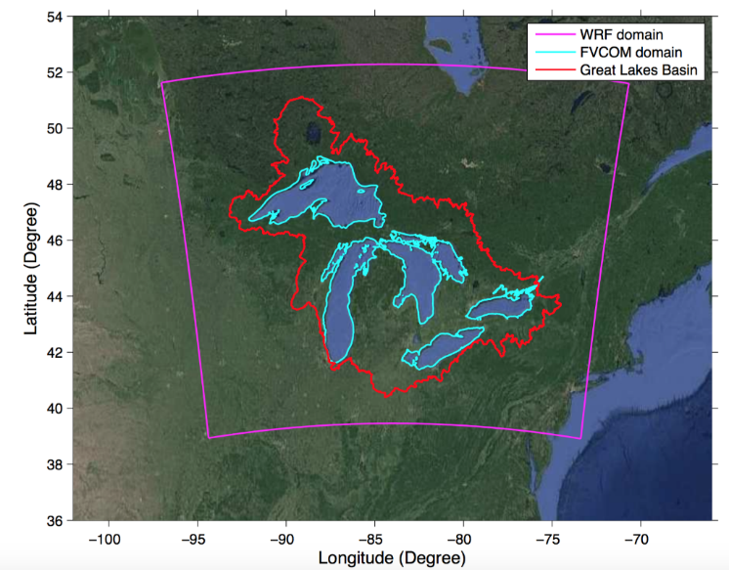
GLM Task One: Integrated Regional Modeling
How do precipitation, runoff, and air temperature in the Great Lakes Region interact with lake water balance, thermal structure, and circulation to influence regional climate changes and extremes?

Slide 7
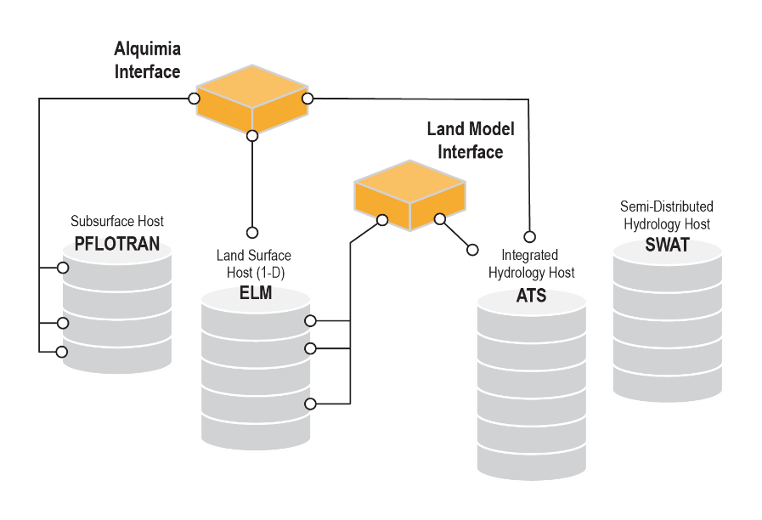
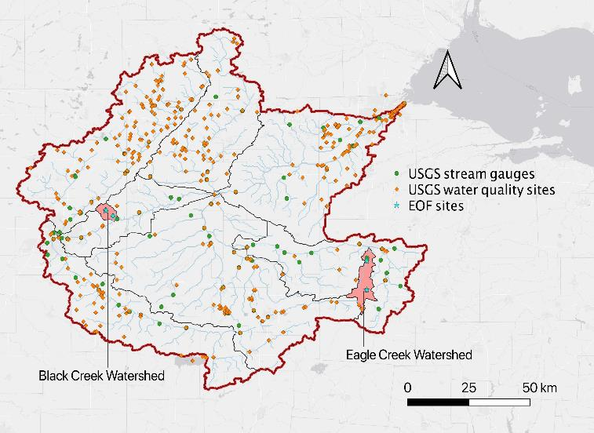
GLM Task Two: Watershed-scale Modeling
How do managed drainage practices, legacy nutrient stores, and hydrologic intensification affect the nutrient removal capacity of soils and riparian corridors in the Maumee River Basin?

Slide 8

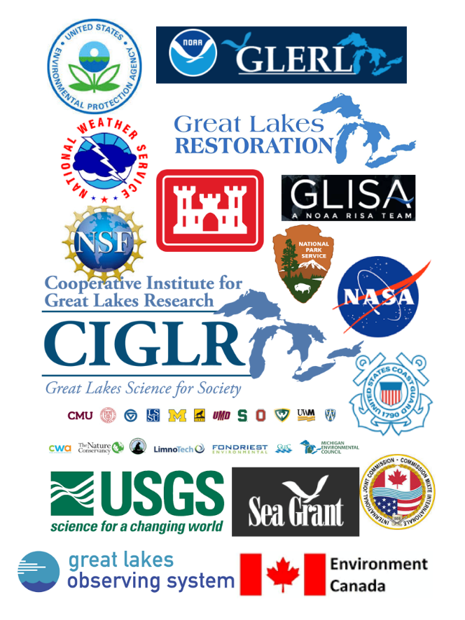
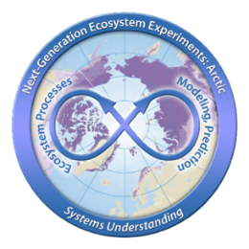



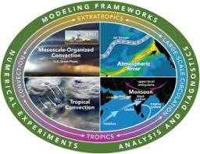



We will leverage and coordinate with many other activities both inside and outside BER

Slide 9
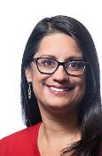
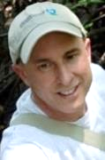
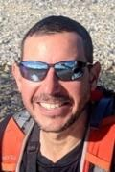
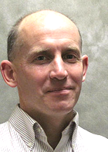



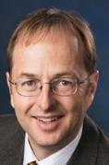
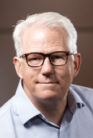

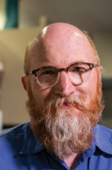


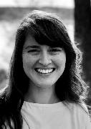
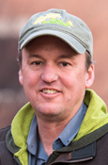
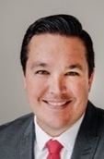




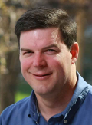
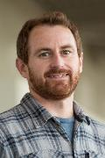
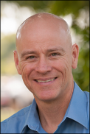
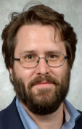

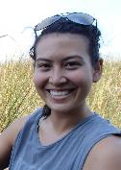

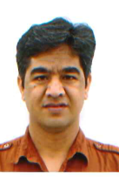


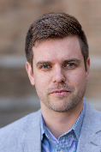

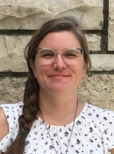

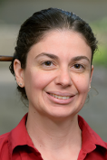
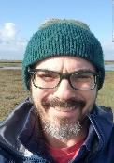

A multidisciplinary team brings expertise and proven experience for achieving our goals
Field, Measurements, and Experiments
COMPASS project management and cross project scientists
Great Lakes Modeling

Slide 10
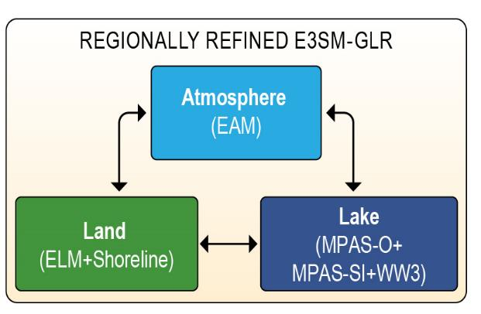
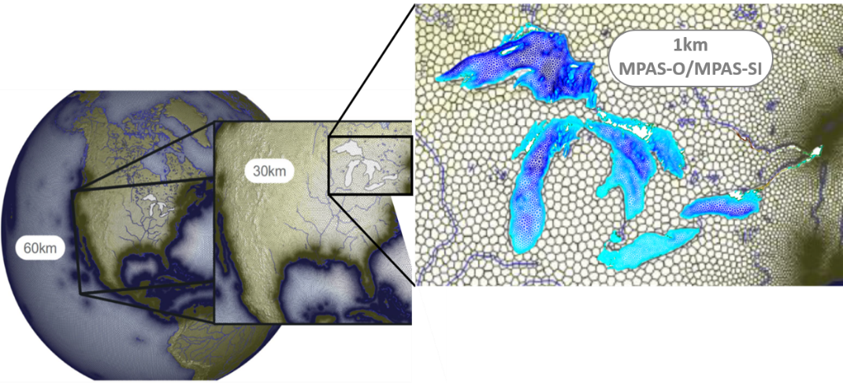
Future work: Extending E3SM to represent freshwater lake systems
Develop MPAS Ocean and Sea Ice modules for the Great Lakes at ~1 km resolution
Improve ELM+MPAS-O coupling (currently underway in ICoM) to resolve key freshwater coastal processes
Leverage regional refinement and other ongoing efforts (e.g., wave modeling)
Regional- and watershed-
scale modeling useful for
benchmarking and guiding
E3SM-GLR development
Notes:
E3SM currently considers inland lakes as a simple parameterization within the ELM land model, which limits the fidelity of E3SM’s regional climate projections in the GLR. We see an opportunity for DOE to develop a new regional refinement in the next generation of E3SM, namely, an “E3SM-GLR” that couples MPAS-O, MPAS-SI, and ELM with the E3SM Atmosphere Model (EAM). Such a capability could resolve an unprecedented number of processes and feedbacks affecting regional climate in a consistent global modeling framework. Our proposed work with the WRF+FVCOM-based regional modeling system could serve as a benchmarking tool for developing a new and unique 3-D hydrodynamic lake model capability for E3SM, and our efforts would also provide scientific insights to guide E3SM-GLR development. In addition, we could combine these advances with those under development or consideration in E3SM, ICoM, recent DOE Early Career Awards, and other DOE projects

Slide 11
Thank You

Slide 12
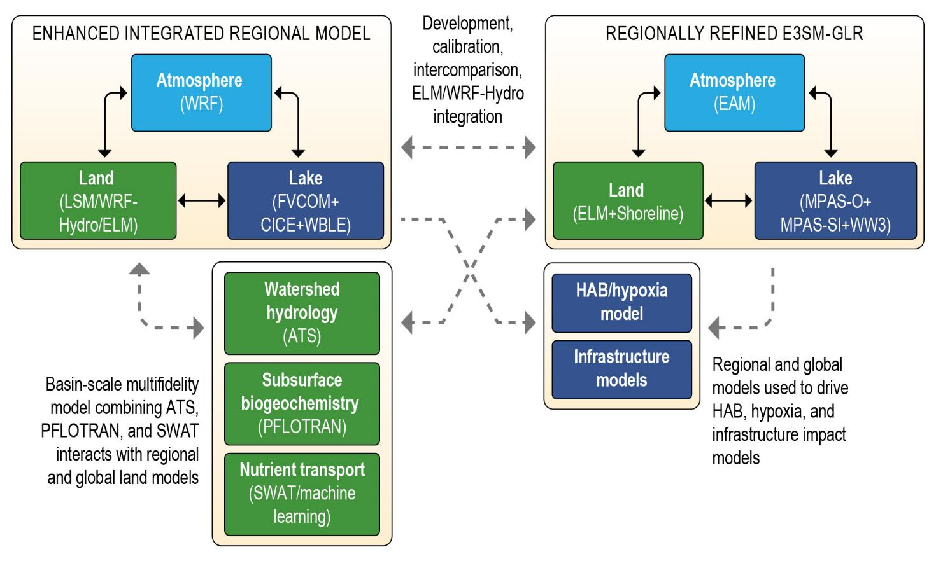
Future work: Coupling with infrastructure, biology/ecology, shoreline change, etc.

Slide 13
Our approach is to conduct coordinated pilot studies that span reaction to regional scales linked through data–model integration

Slide 14
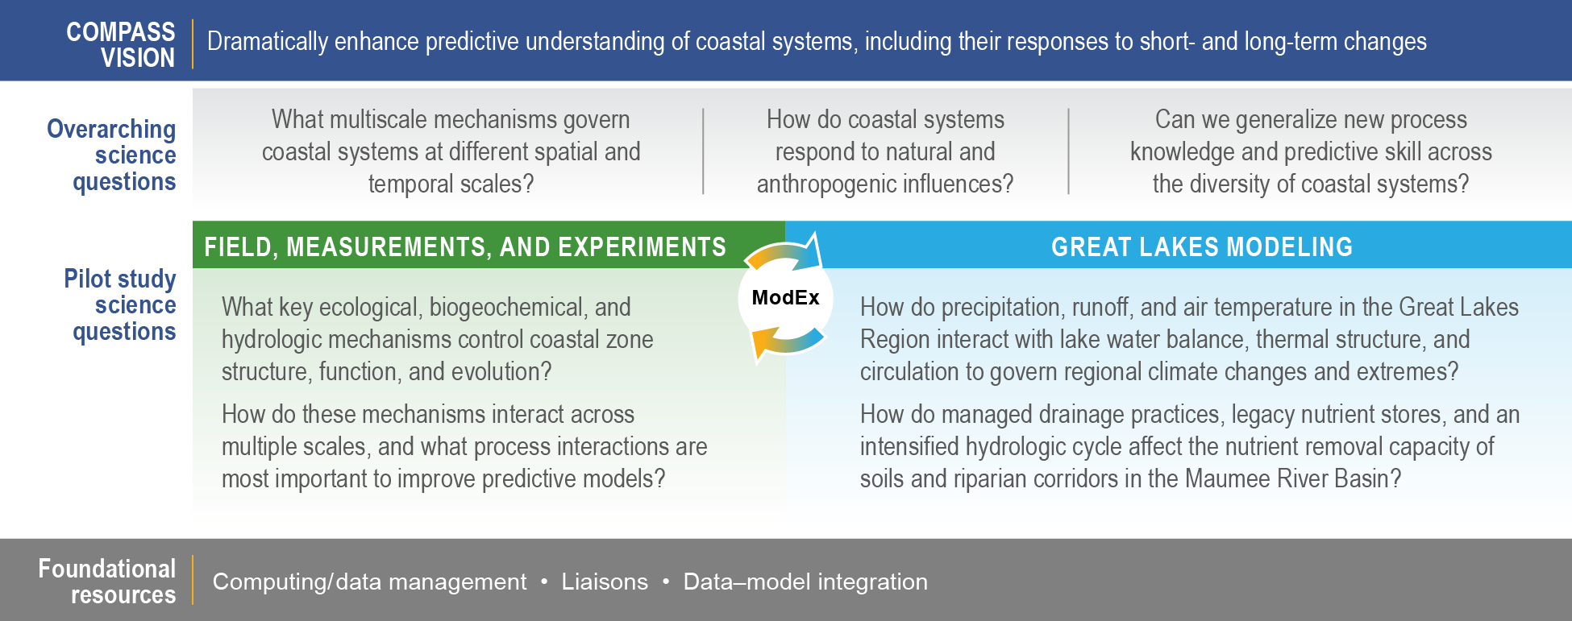
Our vision and overarching science questions address critical gaps in understanding

Slide 15
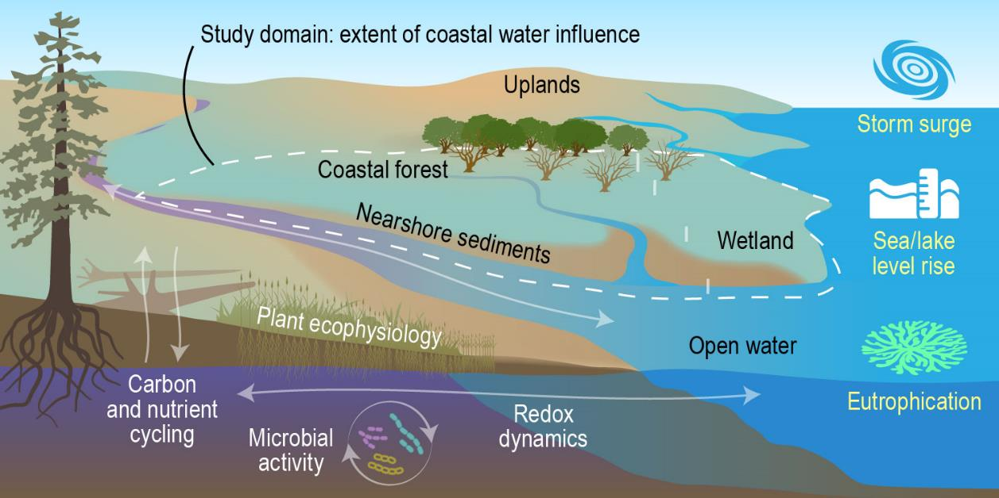
COMPASS-FME focuses on the transformations and fluxes of carbon and nutrients across reaction to site scales
We will understand the interactions of soils, waters, and plants, as well as the emergent biogeochemistry to inform multiscale, hierarchical models at select sites in the Chesapeake Bay and Lake Erie regions

Slide 16
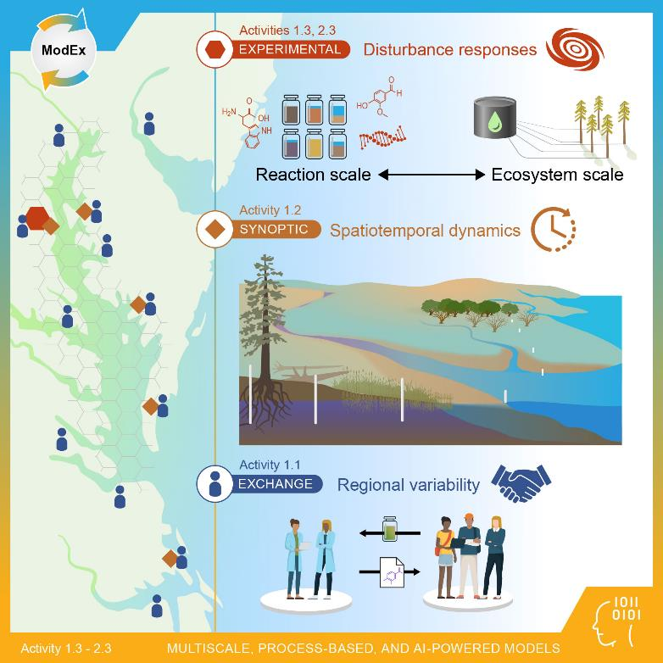
FME science questions are addressed through a hierarchy of measurement and modeling approaches
1. What are the fundamental mechanisms that control the structure, function, and evolution of coastal terrestrial–aquatic interfaces?
2. How do these fundamental mechanisms interact across spatial scales, and what interactions are most important to improving predictive models?
We will leverage existing capabilities and data and COMPASS foundational resources

Slide 17
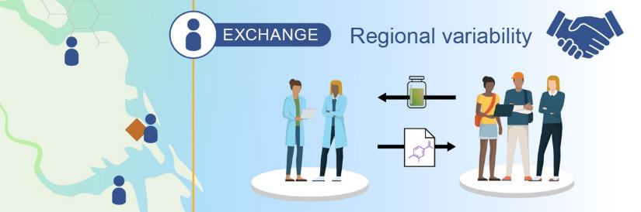



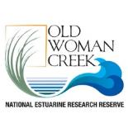


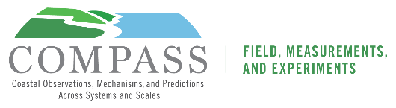

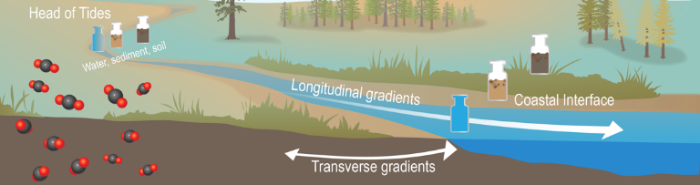

Our plans include outreach to and engagement with the broader scientific community
EXCHANGE – community-based science
Broad collaboration across institutions
Town Hall #1103855
Planned COMPASS workshops
Scientific sessions and town halls

