Slide 1
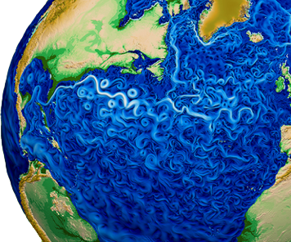
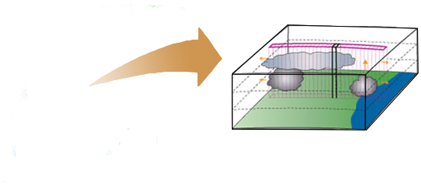
A Multiscale Modelling Framework for E3SM
-MMF
Energy Exascale
Earth System Model
Multiscale Modelling Framework
Walter Hannah¹ Dave Bader¹, Jungmin Lee¹, Matthew Norman², Sarat Sreepathi²,
Ruby Leung³, Kyle Pressel³, Chris Jones³, Guangxing Lin³, Mikhail Ovchinnikov³,
Mark Taylor⁴, Benjamin Hillman⁴, Andrew Bradley⁴, Chris Eldred⁴,
Xingqiu Yuan⁵, Nick Romero⁵, Mike Pritchard⁶
¹ Lawrence Livermore National Laboratory ² Oak Ridge National Laboratory ³ Pacific Northwest National Laboratory
⁴ Sandia National Laboratory ⁵Argonne National Laboratory
⁶UC Irvine
This work was performed under the auspices of the U.S. Department of Energy by Lawrence Livermore National Laboratory under Contract DE-AC52-07NA27344.

Slide 2
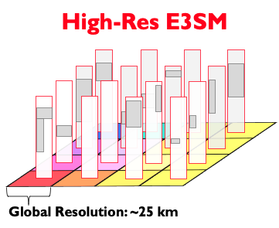
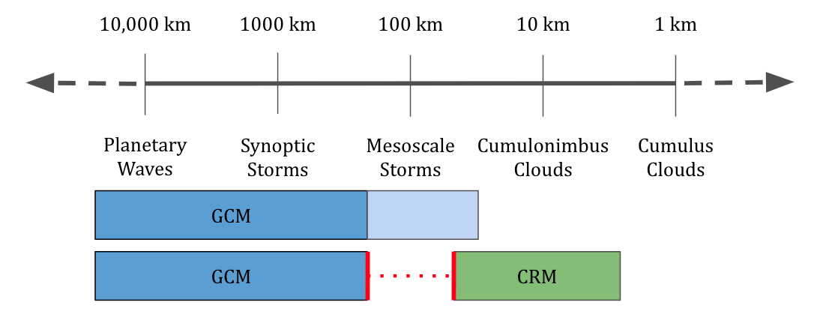
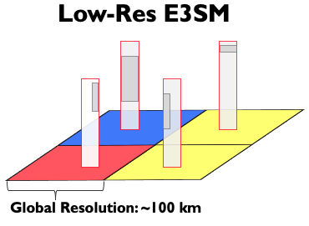
Enhancing the Resolved Scales

Slide 3
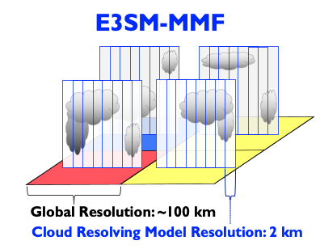
Enhancing the Resolved Scales

Slide 4
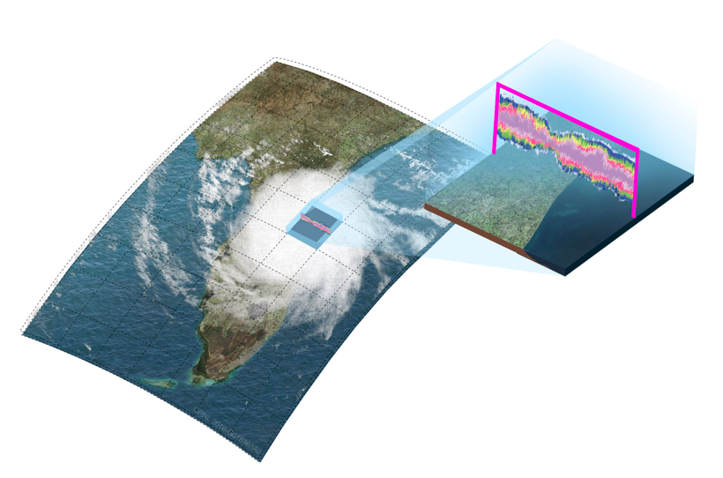
E3SM-MMF
The MMF couples a CRM to each column of the GCM to replace the parameterizations of:
Clouds
Microphysics
Turbulence
Radiation is also computed on the scale of convection so cloud-radiative feedbacks are more realistic
Semantics: “MMF” ≥ “super-parameterization”

Slide 5
MMF Pros and Cons
Promising
Explicit representation of clouds and cloud-radiative feedbacks
Explicit (3D) or semi-explicit (2D) moment feedback (i.e. CMT)
Semi-explicit cloud-aerosol feedbacks
MMFs have a history of improving convectively coupled phenomena (ex. MJO)
Mixed
The scale gap provides “computational leverage” that can be exploited for performance
Precipitation and turbulence statistics are sensitive to CRM domain size and grid
Problematic
Higher cost makes development/testing difficult, especially climate reproducibility
The scale gap stops small scale variance from being transported on the global grid

Slide 6
The Exascale Computing Project
We are focused on making E3SM-MMF viable for climate simulations by making it faster

Slide 7
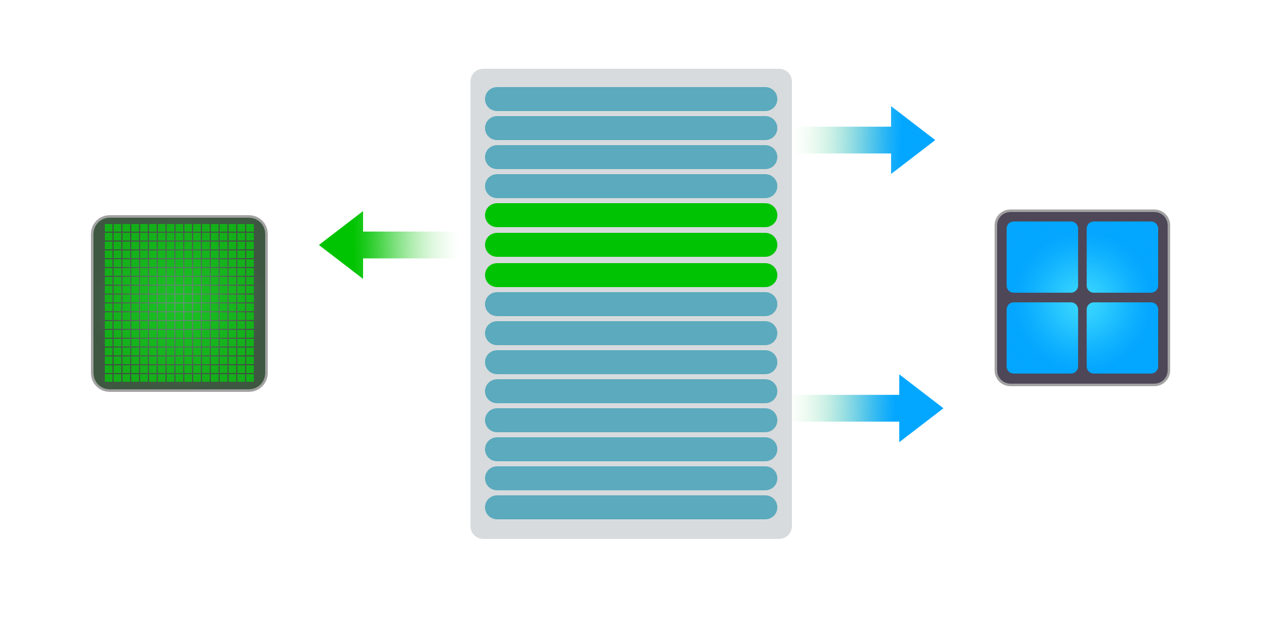
The Exascale Computing Project
We are focused on making E3SM-MMF viable for climate simulations by making it faster
Hardware Acceleration
The CRMs are independent so they can be offloaded to a GPU
Radiation can be similarly accelerated

Slide 8
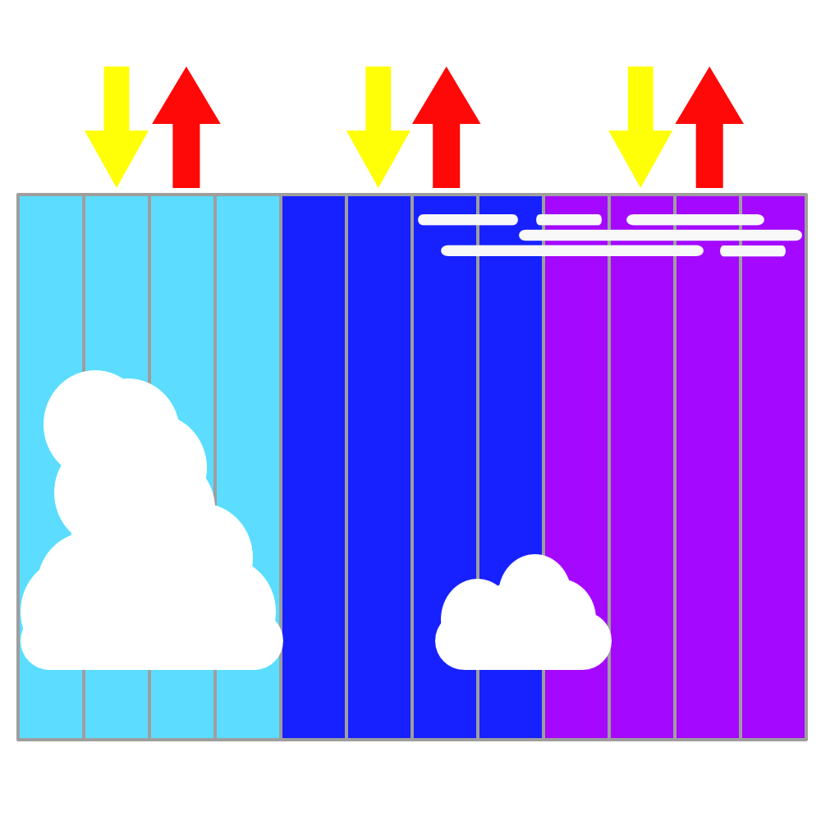
The Exascale Computing Project
We are focused on making E3SM-MMF viable for climate simulations by making it faster
Hardware Acceleration
The CRMs are independent so they can be offloaded to a GPU
Radiation can be similarly accelerated
Algorithmic Acceleration
The scale separation of the models can be exploited to reduce the number of CRM time steps
Radiation is done on groups of columns to reduce the workload, and aerosol optics are done once per physics column

Slide 9
Performance Portability Challenges
OpenACC vs C++ vs OpenMP
The ability to run on future hardware is crucial for the success of the MMF, and multiple versions of the CRM may be needed to maintain support across different architectures

Slide 10
Performance Portability Challenges
OpenACC vs C++ vs OpenMP
The ability to run on future hardware is crucial for the success of the MMF, and multiple versions of the CRM may be needed to maintain support across different architectures
OpenACC was used initially to run the Fortran CRM on GPUs, but this was problematic

Slide 11
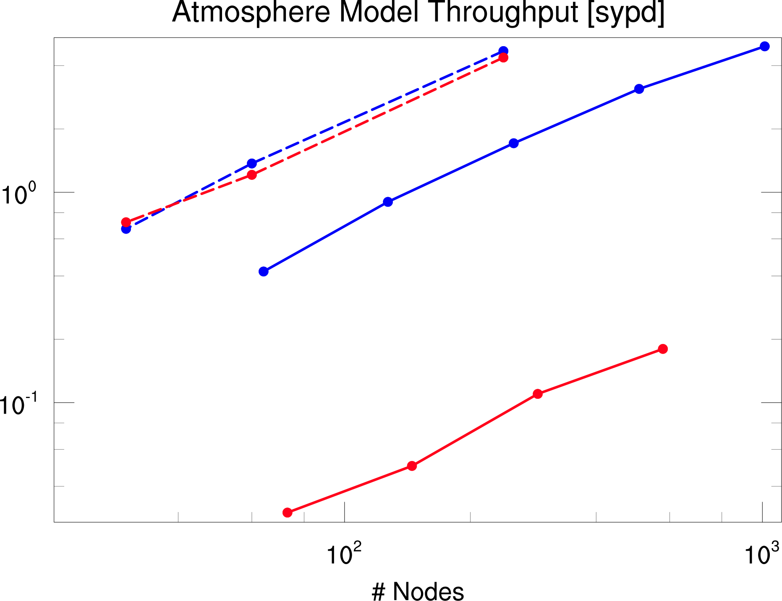
Performance Portability Challenges
OpenACC vs C++ vs OpenMP
The ability to run on future hardware is crucial for the success of the MMF, and multiple versions of the CRM may be needed to maintain support across different architectures
OpenACC was used initially to run the Fortran CRM on GPUs, but this was problematic
The CRM was rewritten in C++ and has good performance on Summit GPUs
GPU speed-up of 2D CRM (32x1) masked by radiation
GPU 2D
CPU 2D
GPU 3D
CPU 3D
~10-15x GPU speed-up of 3D CRM (32x32)

Slide 12
Performance Portability Challenges
OpenACC vs C++ vs OpenMP
The ability to run on future hardware is crucial for the success of the MMF, and multiple versions of the CRM may be needed to maintain support across different architectures
OpenACC was used initially to run the Fortran CRM on GPUs, but this was problematic
The CRM was rewritten in C++ and has good performance on Summit GPUs
An OpenMP version of the Fortran CRM is also being pursued
GPU speed-up of 2D CRM (32x1) masked by radiation
GPU 2D
CPU 2D
GPU 3D
CPU 3D
?
~10-15x GPU speed-up of 3D CRM (32x32)

Slide 13
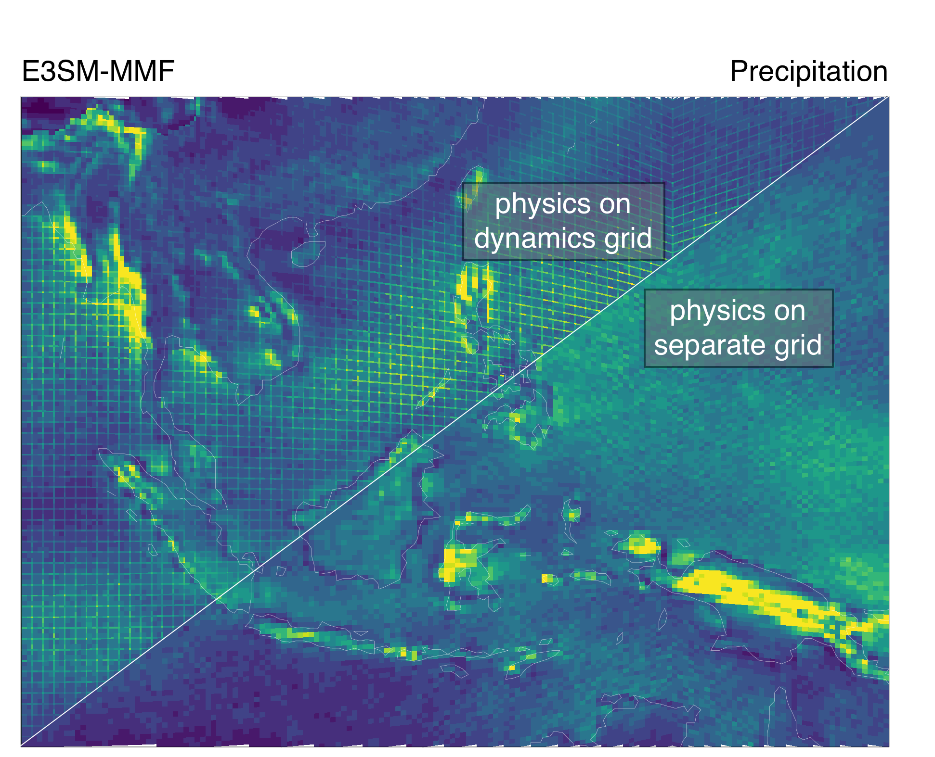
Early Problems (and Solutions)
The code was ported from SP-CAM and we immediately ran into problems using the SE dycor and finer vertical grid of E3SM
Instability in the CRM turbulence scheme
Enhanced “fog” bias due to thinner levels
Grid imprinting from spectral GLL grid
Resolved with turbulent CFL Resolved with stronger mixing Resolved with new FV physics grid
The grid imprinting problem motivated the new FV physics grid, which resolves the imprinting and improves performance

Slide 14
Feedbacks to E3SM
The unique problems we encountered with the MMF have led us to contribute to E3SM development:
Aquaplanet and RCE compsets
C++ and GPU porting of RRTMGP
Finite volume physics grid (i.e. physgrid)
New tool for hindcast initial conditions (i.e. HICCUP)
YAKL for performance portability (temporary alternative to Kokkos)

Slide 15
The Variance Trapping Problem
After we started running on the physgrid we started noticing oddly “stuck” pixels in animations on the native grid...
We also noticed some “checkerboard” noise was present in the precipitation climatology

Slide 16
The Variance Trapping Problem
GCM grid liquid water path
averaged over several days
The MMF coupling only considers the CRM domain mean, so smaller scales cannot be advected on the global grid
Convective circulations can become “trapped” at the largest scales locking the CRM in an active state
Large-scale dynamics causes downstream CRMs to become locked in a relatively quiescent state
Note that the issue is relatively “small” when compared to typical biases
CRM grid water vapor

Slide 17
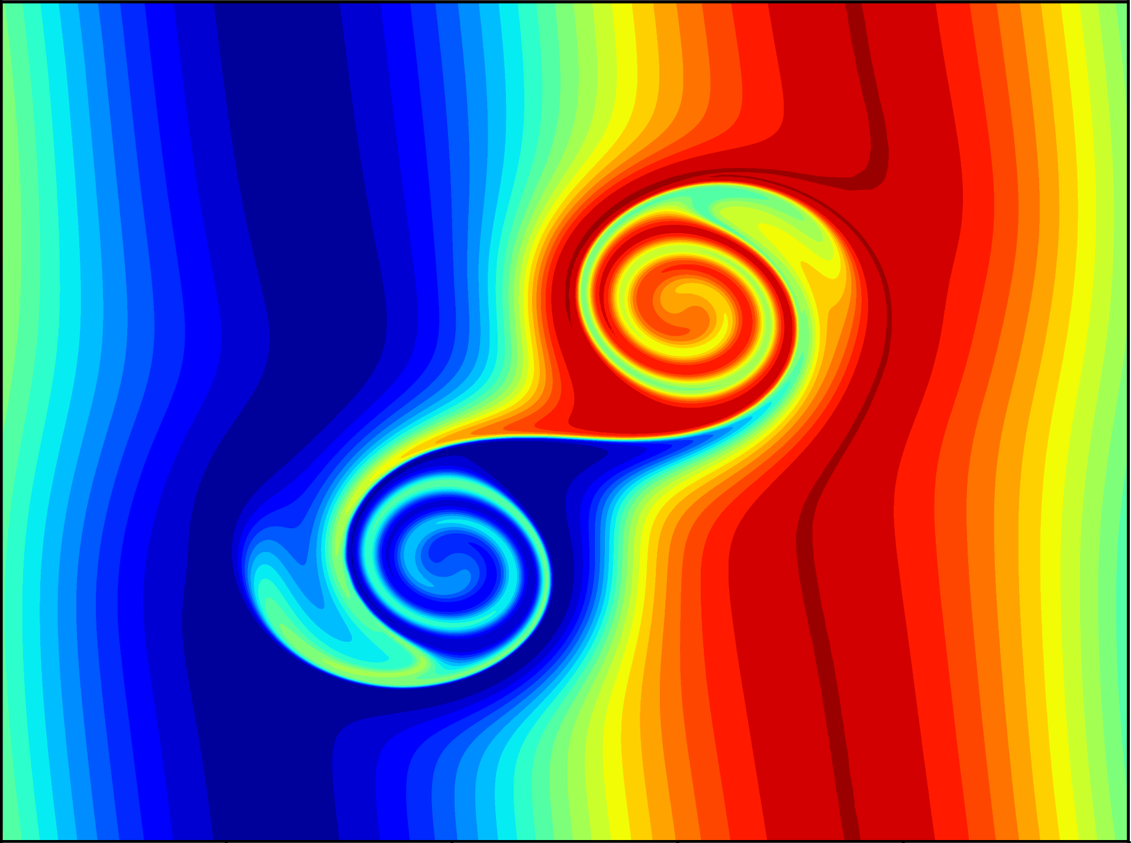
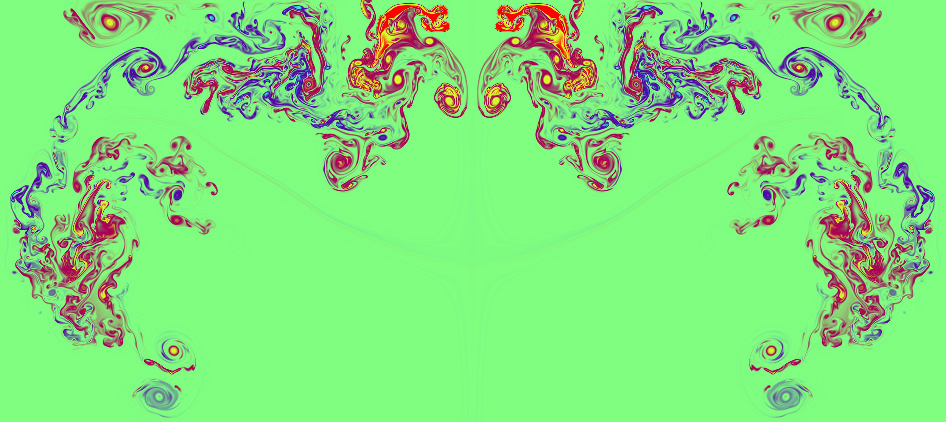
Future Plans - SAM, meet PAM
The current CRM code has diverged from SAM (now with more C++!), but we are also building a new CRM from scratch!
The Portable Atmospheric Model (PAM) will be written in C++
Optimized for MMF performance
New physics from SCREAM (P3/SHOC)
New dynamics
High-order finite volume using WENO methods
ADER time stepping for long time steps
Anelastic (potentially with Compressible option)
Standalone capability for testing, development, and science

Slide 18
Future Plans for Science
We have reproduced many previous MMF results and current efforts are focused on enhancing the MMF for climate experiments:

Slide 19
Future Plans for Science
We have reproduced many previous MMF results and current efforts are focused on enhancing the MMF for climate experiments:
Add P3+SHOC to CRM for comparison w/ SCREAM

Slide 20
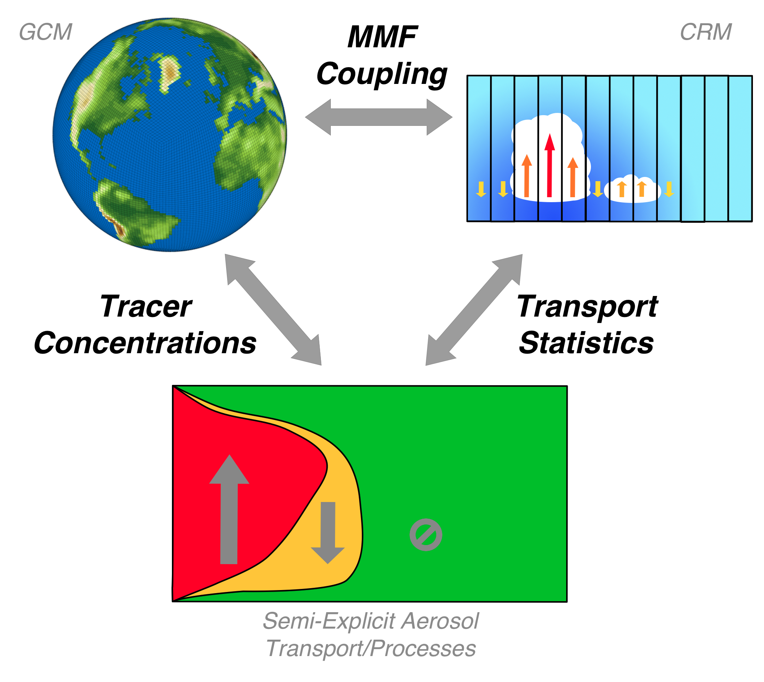
Future Plans for Science
We have reproduced many previous MMF results and current efforts are focused on enhancing the MMF for climate experiments:
Add P3+SHOC to CRM for comparison w/ SCREAM
Semi-explicit cloud-aerosol interaction (ECPP)

Slide 21
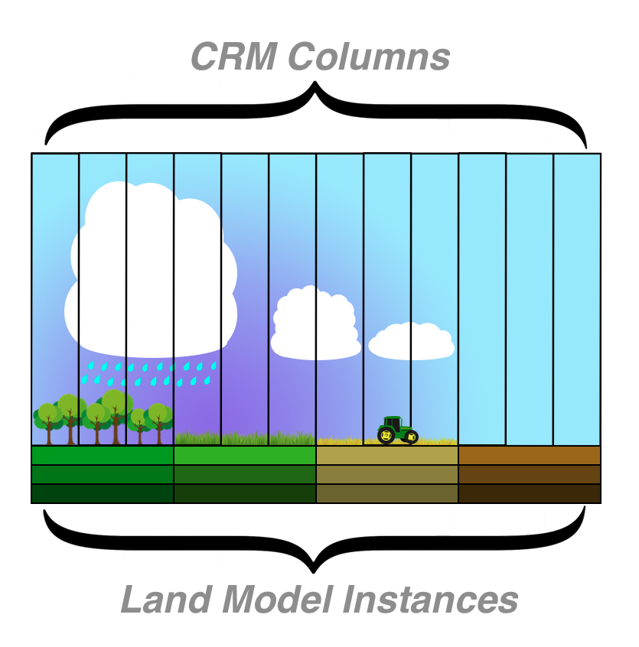
Future Plans for Science
We have reproduced many previous MMF results and current efforts are focused on enhancing the MMF for climate experiments:
Add P3+SHOC to CRM for comparison w/ SCREAM
Semi-explicit cloud-aerosol interaction (ECPP)
Direct Coupling between the CRM and land (MAML) with flexibility for land heterogeneity across CRM

Slide 22
Future Plans for Science
We have reproduced many previous MMF results and current efforts are focused on enhancing the MMF for climate experiments:
Add P3+SHOC to CRM for comparison w/ SCREAM
Semi-explicit cloud-aerosol interaction (ECPP)
Direct Coupling between the CRM and land (MAML) with flexibility for land heterogeneity across CRM
Tuning the CRM for coupled experiments

Slide 23
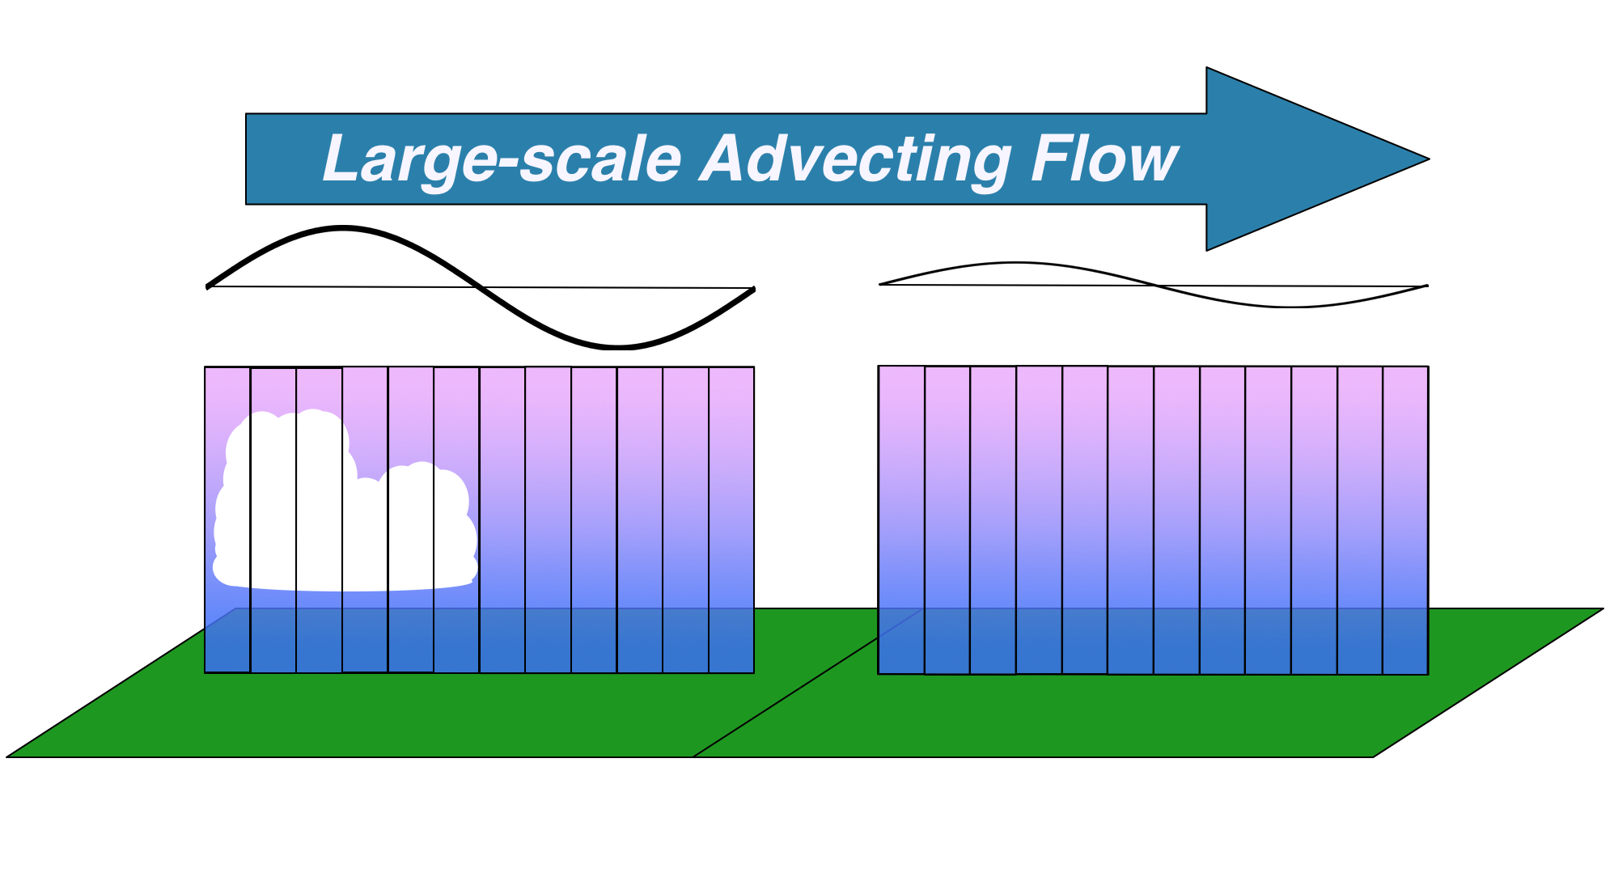
Future Plans for Science
We have reproduced many previous MMF results and current efforts are focused on enhancing the MMF for climate experiments:
Add P3+SHOC to CRM for comparison w/ SCREAM
Semi-explicit cloud-aerosol interaction (ECPP)
Direct Coupling between the CRM and land (MAML) with flexibility for land heterogeneity across CRM
Tuning the CRM for coupled experiments
CRM variance transport

Slide 24
In Summary...
E3SM-MMF will be viable for climate experiments in v4
The MMF approach is well suited for utilizing GPUs
Performance will be portable across current and upcoming DOE machines
Throughput is on par with traditionally parameterized models, which allows for multi-decadal experiments
Explicit convection can overcome long-standing parameterization issues

