Slide 1
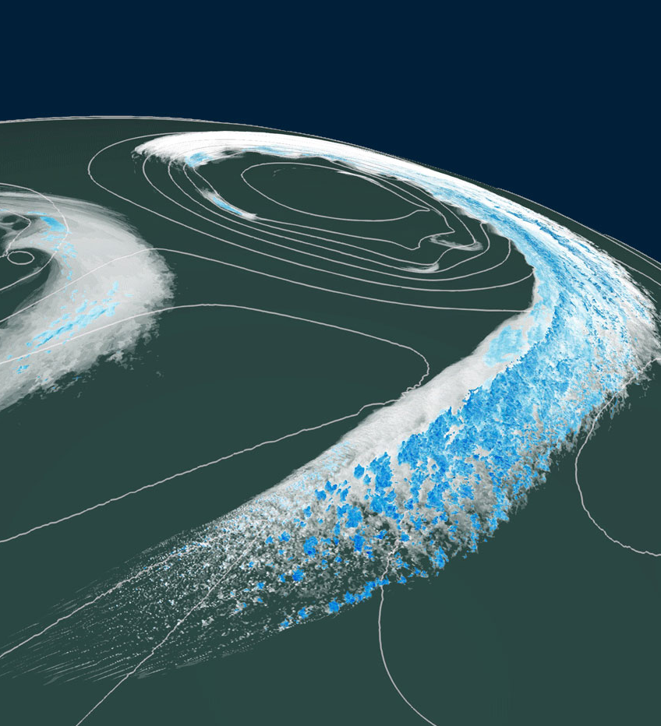
Learning how to forget
How high-level abstractions can help bridge the gap between productivity and performance.
Oliver Fuhrer, DOE ESMD/E3SM PI Meeting, 10/28/20

Slide 2
Who is Vulcan?
Vulcan was founded by Paul and Jody Allen, and is their
estate’s company and engine for philanthropic efforts.
Multiple tech4good projects focusing on
oceans, climate, conservation, and communities.
Vulcan Climate Modeling (VCM)
Pilot started June 2019, co-led by Chris Bretherton and Oliver Fuhrer
Main partners: NOAA GFDL in Princeton, CSCS and MeteoSwiss in Switzerland

Slide 3
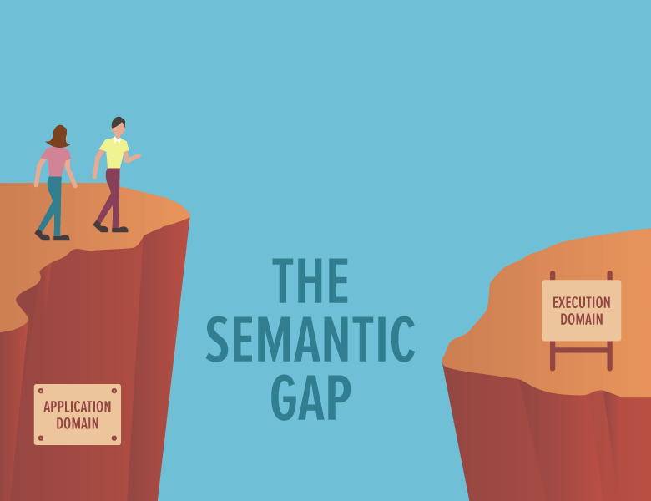


The Semantic Gap

Slide 4
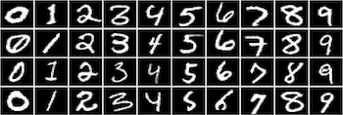
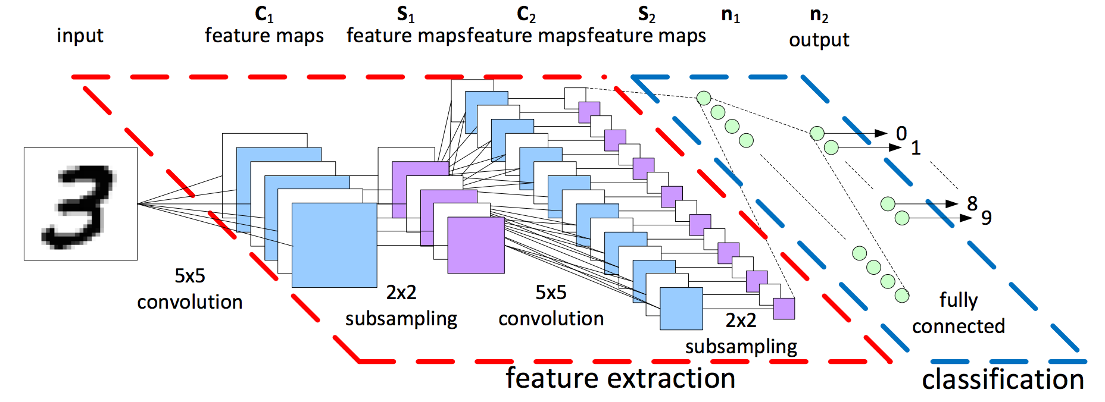
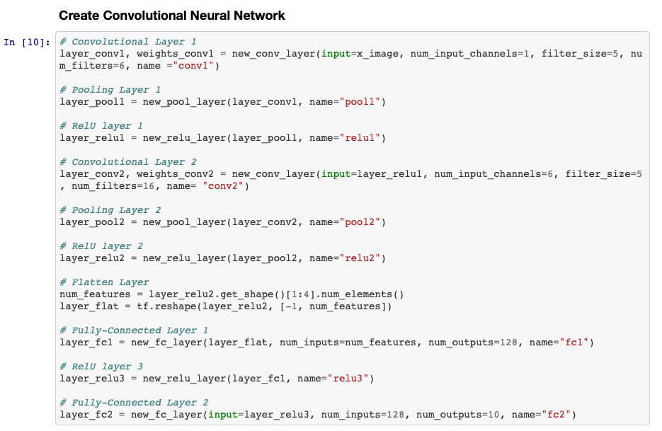
Machine Learning Scientist
Algorithm:
Convolution, Filter shape: (5,5,6), Stride=1, Padding=’SAME’
Max pooling (2x2), Window shape:(2,2), Stride=2, Padding=’Same’
ReLU
Convolution, Filter shape:(5,5,16), Stride=1, Padding=’SAME’
Max pooling (2x2), Window shape:(2,2), Stride=2, Padding=’Same’
ReLU
Fully Connected Layer (128)
ReLU
Fully Connected Layer (10)
Softmax
Implementation (Python + Tensorflow):

Slide 5

Climate Scientist
Implementation (Fortran + OpenACC):

Slide 6
Summary
Domain-specific languages have the potential for achieving a good balance between performance, portability and productivity (at the price of generality).
Optimizing for data-movement on different hardware targets can require a higher-level of abstraction in our codes.
No turn-key solutions, but we can build on existing tools and libraries.

Slide 7
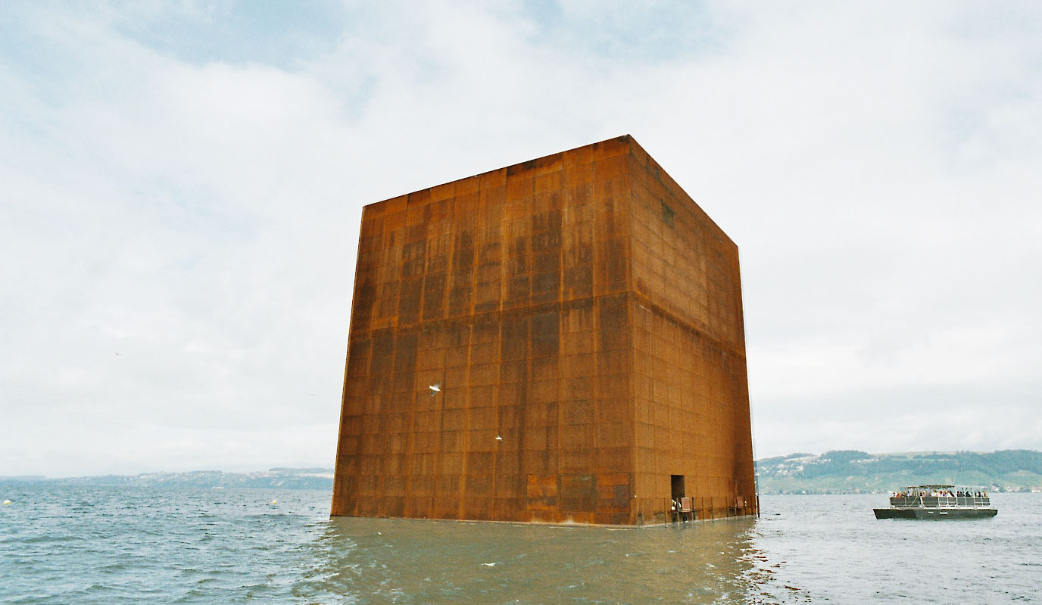

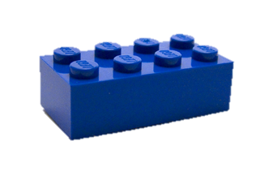
Experience with COSMO (since 2010)
(Fuhrer et al. 2014; Gysi et al. 2016)
350 kLOC of F90 + MPI + NEC directives
(“optimized code”)
C++ / DSL rewrite
Fortran +
directives
High-level C++ implementation
Separation of concerns
Domain-specific
library
(“performance portable”,
re-usable)

Slide 8
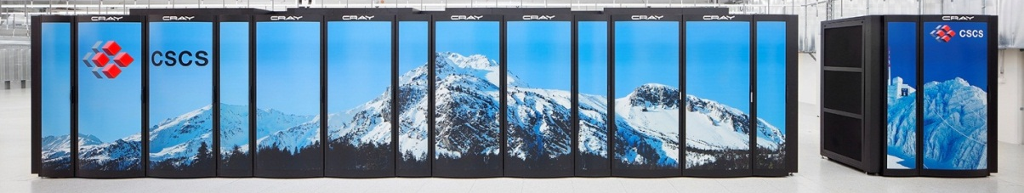
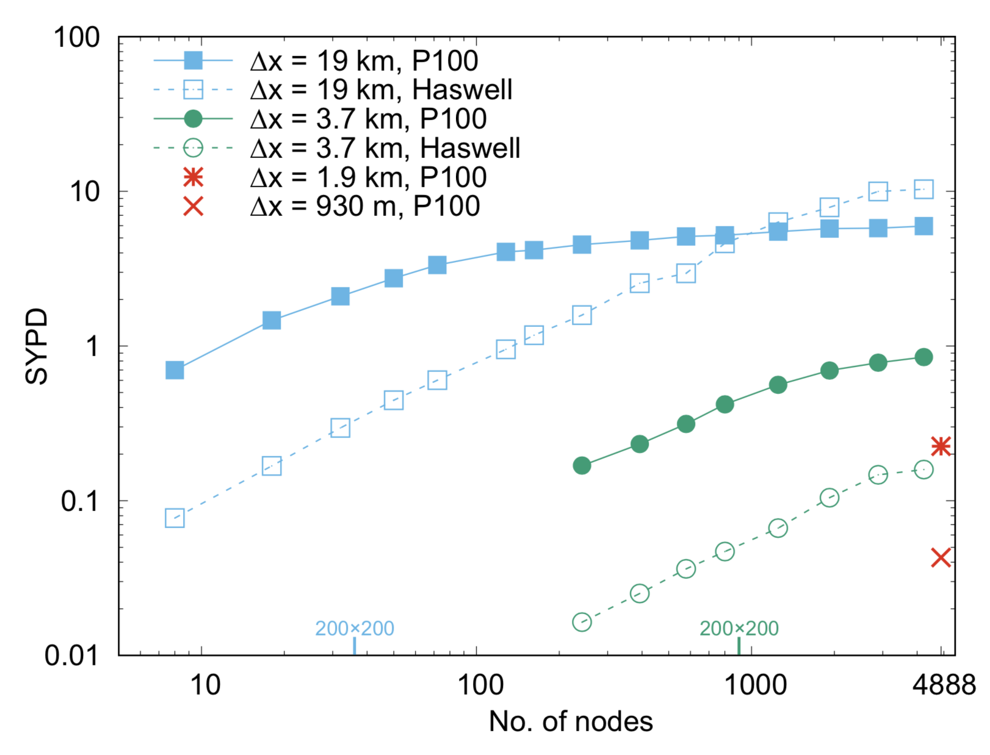
Near-global Simulations
(Fuhrer et al. 2018; Schulthess et al. 2019)
Feasible to port & run an uncoupled climate model on a modern, GPU-accelerated supercomputer.
In the linear scaling regime, GPU simulation is 3x faster and 7x more energy efficient.
GPUs need at least 128 x 128 x 80 to perform well. CPUs scale better.
Fast enough (0.25 SYPD) for AMIP-type simulations at 2 km grid spacing.
Strong Scalability (20 km, 4 km, 2 km, 1 km)
20 km
1
4 km
2 km
1 km

Slide 9
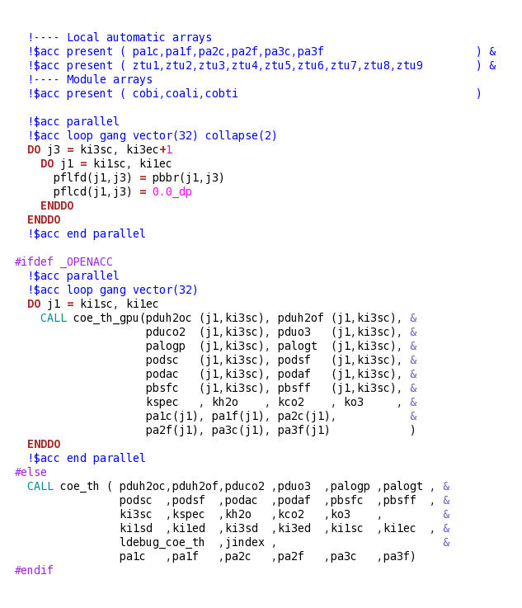
Fortran + X is worse!
Directives are not comments, they are code! (But some developers might ignore them.)
We’re adding hardware specific code to an already large code base!
We cannot achieve performance portability by adding more detail.

Slide 10
Templated C++ is a mixed bag
Increasing the level of abstraction improved the performance as well as the maintainability of the code base.
Investments into software can pay off more than investments into hardware.
A higher-level of abstraction opens up entirely new avenues to inspect, analyze and instrument the code.
Using a C++ library (e.g. GridTools C++) which abstracts kernels and schedule does not help with aggressive data-flow optimizations.
Heaviliy templated C++ is a programming model that is not readily adopted by domain scientists.
Other gotchas (e.g. boilerplate, debugging)
See also Schaer et al. 2019 MWR, Clement et al. 2019 SuperFri, Thaler et al. 2019,
Schulthess et al. 2019, Clement et al. 2018, Fuhrer et al. 2018, Lapillonne et al. 2017,
Leutwyler et al. 2016, Gysi et al. 2015, Cumming et al. 2014, Fuhrer et al. 2014,
Lapillionne et al. 2014

Slide 11
Taxonomy of Abstractions
Domain-specific
languages & abstractions
Kernels & Schedule
HPC programming
languages & libraries
(dragons live here…)
This talk!
on domain:
u[i+1] – 2 u[i] + u[i-1]
GridTools C++
Level of abstraction
for i = 1, ni
for j = 1, nj
for k = 1, nk
u[i+1,j,k] – 2 u[i,j,k] + u[i-1,j,k]
Kokkos
RAJA
C++, Fortran
MPI, OpenMP
OpenACC
!$acc parallel present(u)
!$acc loop vector collapse(3)
for i = 1, ni
for j = 1, nj
for k = 1, nk
u[i+1,j,k] – 2 u[i,j,k] + u[i-1,j,k]

Slide 12
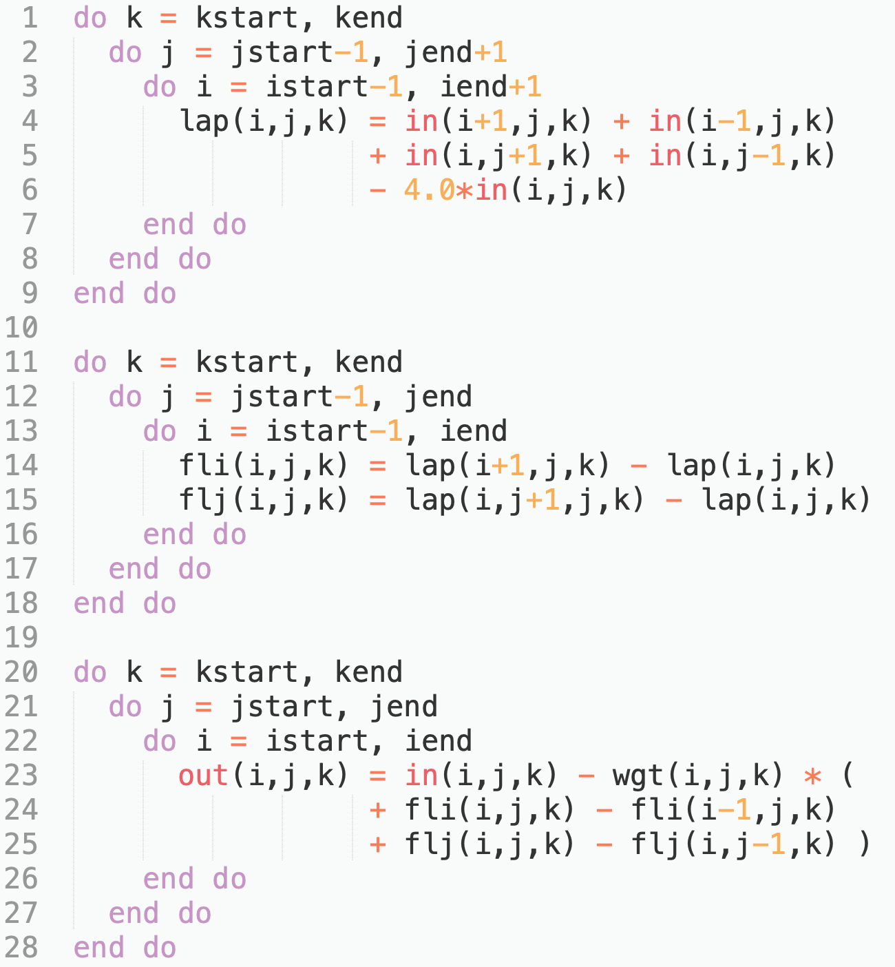
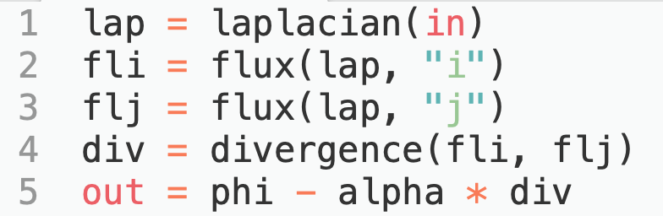
Horizontal Diffusion
x

Slide 13
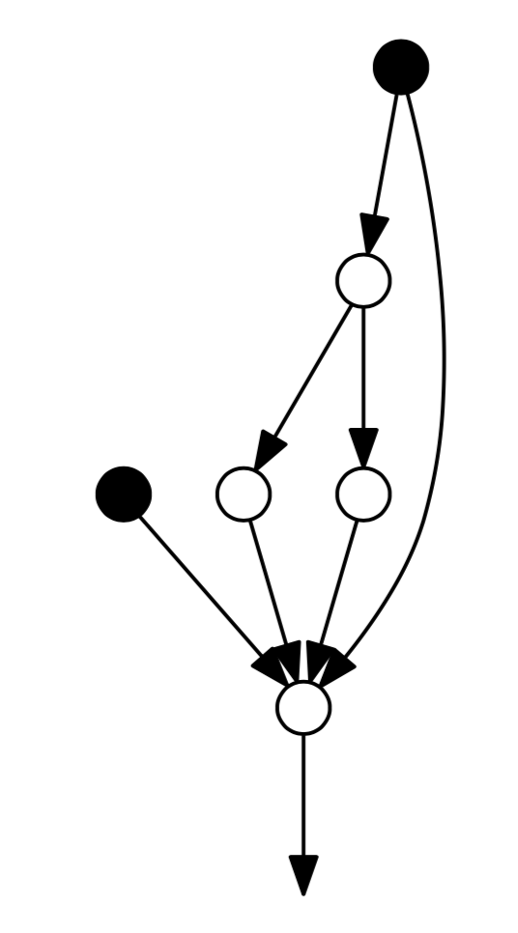
Data-flow graph
Already 10 reads/writes in a very simple operator!
in
lap
wgt
fli
flj
2 inputs
1 output
3 temporaries
(each 11 MB in memory)
out
(adapted from Gysi et al, 2015)

Slide 14
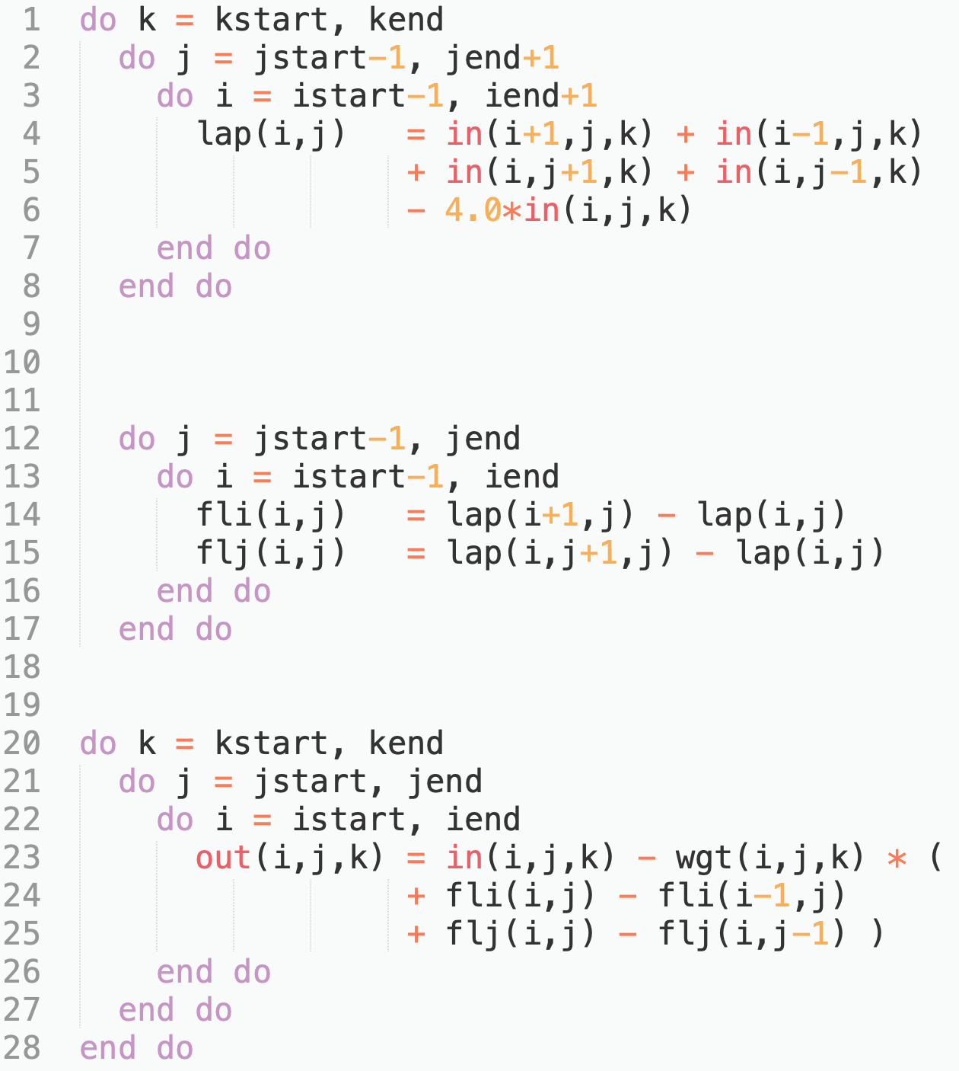
Data-locality optimization
``
in
L2 cache
lap
wgt
fli
flj
2 inputs
1 output
(each 11 MB in memory)
3 temporaries
(each 64 KB in memory)
out

Slide 15
Impact of hardware
???
in
Smaller
L2 cache
lap
???
wgt
fli
flj
???
out

Slide 16
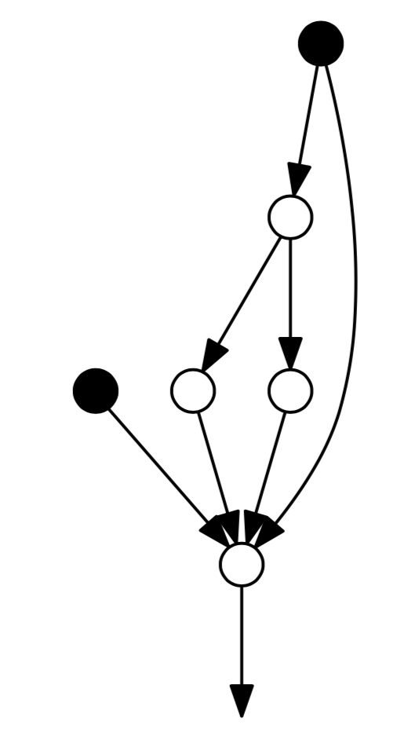
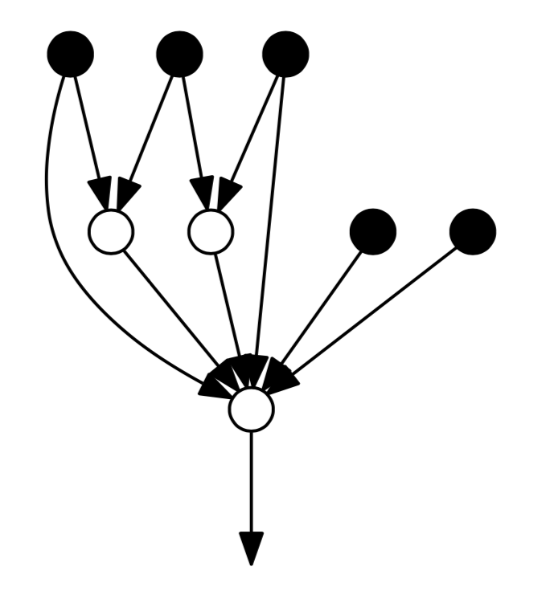
Loss of domain logic
Optimal partitioning of graph and code generation are challenging tasks
”Optimal” code (inlining, loop-fusion, reordering, over-computation, …) does not retain domain logic (operators), changes with hardware target and can be hard to read.
hordiff
u,v-update
div
u,v-update & div

Slide 17
So what can we do?

Slide 18
DSL in Python
User code (Python)
A domain-specific language (DSL) is a programming language with concepts tailored to a specific application domain
A compiler is responsible for transforming the high-level specification into code that runs on HPC cluster (code generation)
By sacrificing generality, we can improve productivity, performance, and portability.
User can specify execution backend
(e.g. Python, optimized CPU, optimized GPU, …)
Generate readable, efficient code by leveraging existing efforts (e.g. GridTools C++, Kokkos, Raja)
DSL frontend
DSL compiler
Checkers
Optimizers
Code generators
Python
GT C++, Kokkos, Raja, …
C++ compiler
CUDA compiler
…

Slide 19
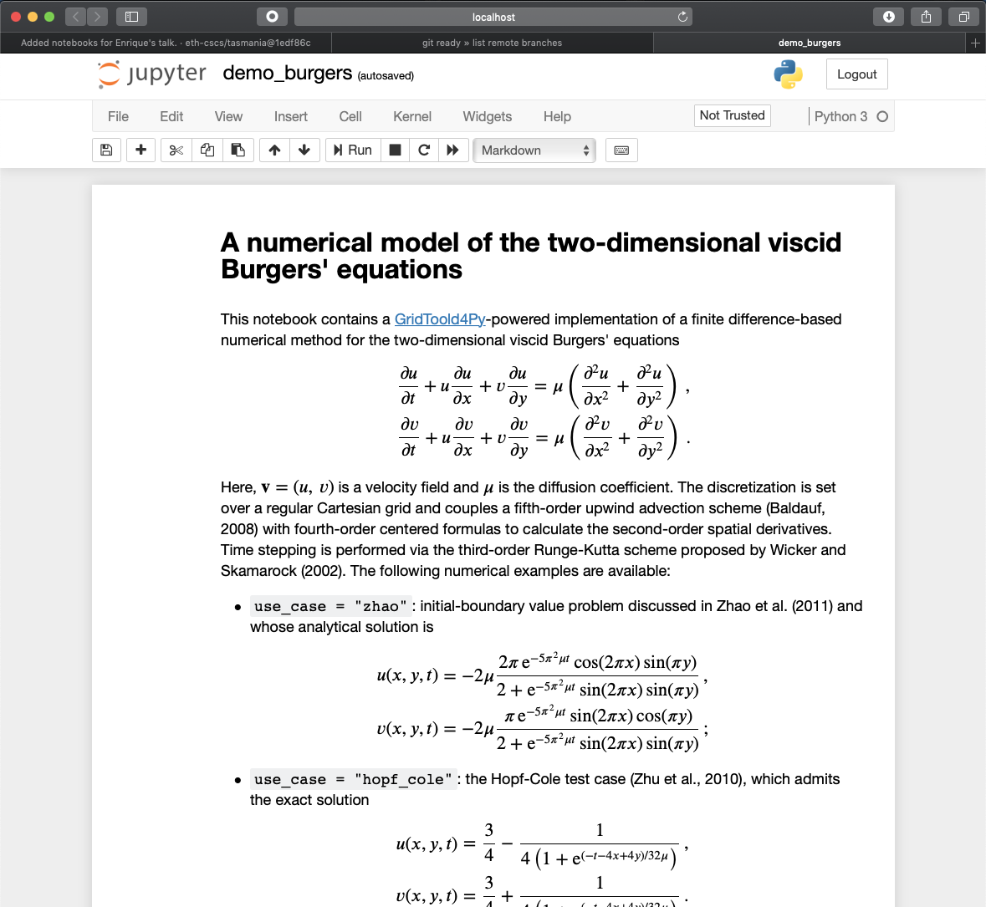
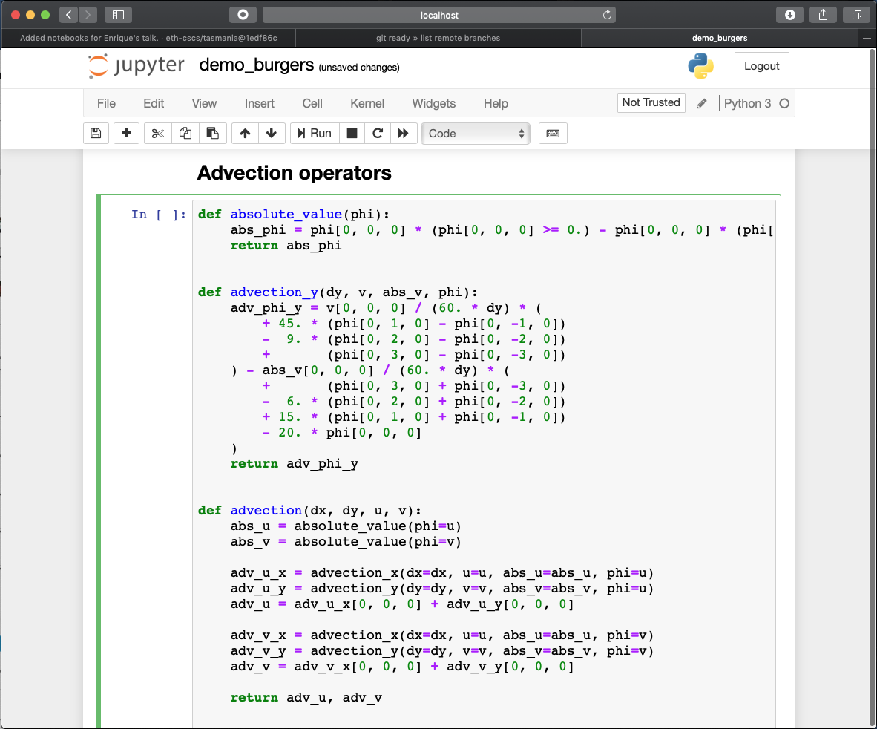
Why Python?
Large and growing community in the atmospheric and data science.
Mature integration with IDEs, huge ecosystem of packages, integration with visualization, interactive workflows using Jupyter notebooks on HPC clusters, …

Slide 20
GT4Py ( )
advection.py
https://github.com/GridTools/gt4py
import gt4py.gtscript as gtscript
@gtscript.function
def advection_x(dx, u, phi):
adv_phi_x = u[0, 0, 0] / (60. * dx) * (
+ 45. * (phi[1, 0, 0] - phi[-1, 0, 0])
- 9. * (phi[2, 0, 0] - phi[-2, 0, 0])
+ (phi[3, 0, 0] - phi[-3, 0, 0])
) – abs(u[0, 0, 0]) / (60. * dx) * (
+ (phi[3, 0, 0] + phi[-3, 0, 0])
- 6. * (phi[2, 0, 0] + phi[-2, 0, 0])
+ 15. * (phi[1, 0, 0] + phi[-1, 0, 0])
- 20. * phi[0, 0, 0] )
return adv_phi_x
@gtscript.stencil(backend=“numpy”)
def advection(
in_u: gtscript.Field[np.float64],
out_adv: gtscript.Field[np.float64],
*,
dx: float
):
with computation(PARALLEL), interval(...):
out_adv = advection_x(dx=dx, u=in_u, phi=u)
Joint open-source development with CSCS and MeteoSwiss.
Features
    No explicit parallelism or optimization
    No loops
    No explicit data-storage layout
    Overhead-free functions (operators)

Slide 21
Demonstrate on FV3GFS
Apply the GT4Py DSL to port the FV3GFS model to Python.
Conduct a km-scale global simulation to provide a dataset to the the machine learning colleagues.
Current status
Dynamical core (FV3) rewritten and validated
3 physical parametrizations ported, 1 on-going, 2 outstanding

Slide 22
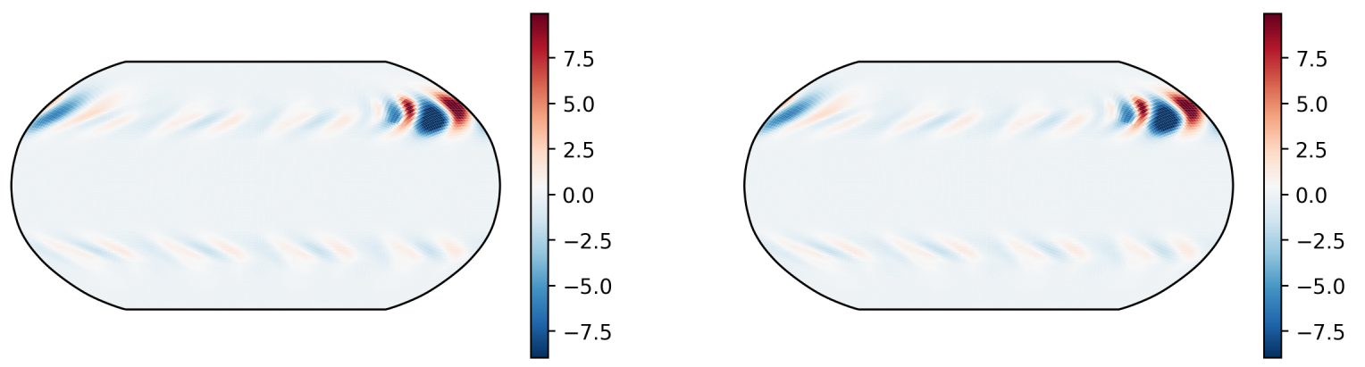
Dynamical Core ( )
https://github.com/VulcanClimateModeling/fv3core
Dynamical core rewritten and validated using Python, x86 CPU and NVIDIA GPU backends.
Parallelized using MPI from Python
Simultaneous development of DSL frontend and compiler (e.g. corners & edges).
Next: Refactoring for new DSL features. Performance improvements.
FV3 (Fortran)
Temperature anomaly [K]
Time = 6 days
FV3 (Python)
Temperature anomaly [K]
Time = 6 days

Slide 23
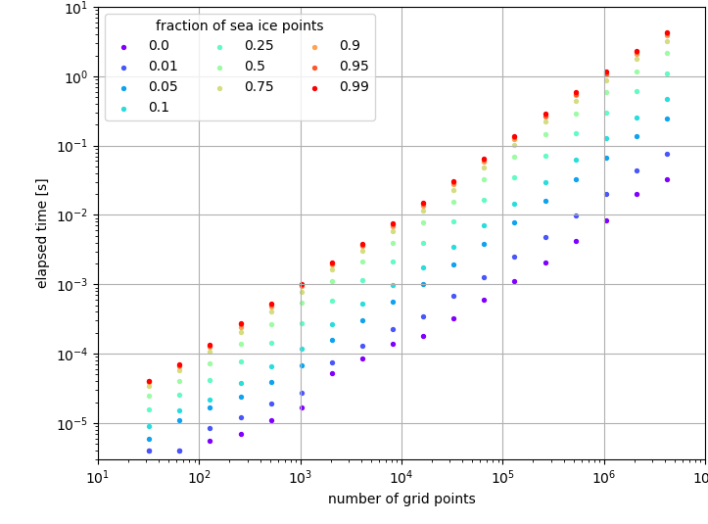
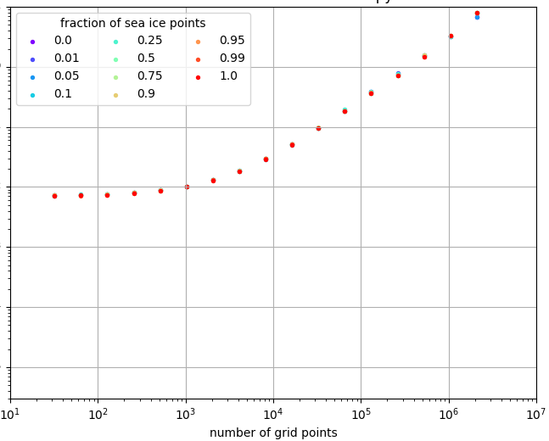
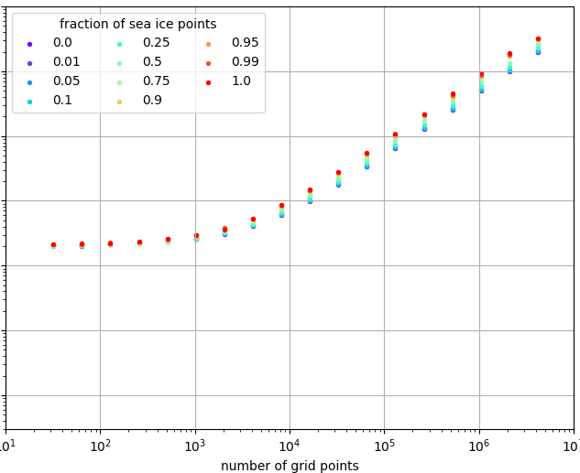
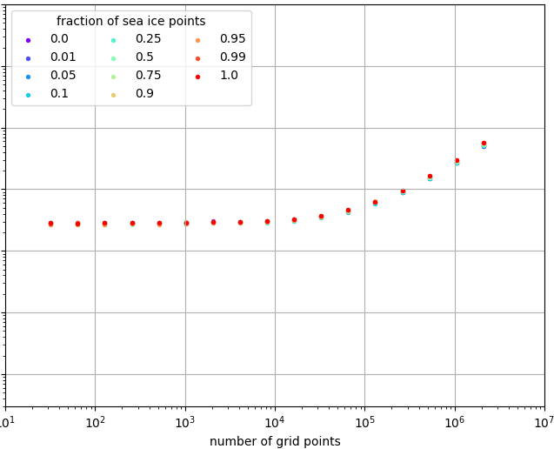
Performance (preliminary!)
Original (Fortran)
Python (numpy)
7.5 s
2.4 s
Physical parameterization from FV3GFS ported by bachelor student as a course project
Performance results on a single node of Piz Daint supercomputer
CPU = Intel Xeon E5-2690 v3 (12 cores, @ 2.6 GHz)
GPU = NVIDIA Tesla P100
~ 8 ms
< 10⁻² ms
CPU (x86)
1.9 s
GPU (CUDA)
55 ms
~ 2 ms
~ 2 ms

Slide 24
Python wrapped FV3GFS
basic_model.py
import os
from mpi4py import MPI
import fv3gfs
if __name__ == '__main__':
comm = MPI.COMM_WORLD
rank = comm.Get_rank()
fv3gfs.initialize()
for i in range( fv3gfs.get_step_count() ):
fv3gfs.step_dynamics()
fv3gfs.step_physics()
fv3gfs.save_restart()
fv3gfs.cleanup()
Allows to run FV3GFS in parallel from Python
Simply replace the dynamical core with our DSL version for validation.
Many more use-cases
    Integration with Python code (e.g. ML training, visualization, …)
    Easy access to model for students
    Rapid prototyping of new developments
    …

Slide 25
Summary
Domain-specific languages have the potential for achieving a good balance between performance, portability and productivity (at the price of generality).
Optimizing for data-movement on different hardware targets can require a higher-level of abstraction in our codes.
No turn-key solutions, but we can build on existing tools and libraries.

