Slide 1


Welcome to
Earth System Model Development Program Area (ESMD)
& the Energy Exascale Earth System Model (E3SM) PI Meeting
PI Meeting Steering Committee
Xujing Davis (DOE) | Program Manager, ESMD
Cristiana Stan (DOE) | IPA Assignee, EESM
Renata McCoy (LLNL) | E3SM Chief Operating Officer/Project Engineer
Dave Bader (LLNL) | E3SM Council Chair
Ruby Leung (PNNL) | E3SM Chief Scientist
Mark Taylor (SNL) | E3SM Chief Computational Scientist
Guang Zhang (SCRIPPS, UCSD) | University PI Representative
October 26-29, 2020
Earth and Environmental
Systems Sciences Division

Slide 2

Basic
Energy
Sciences
Biological and Environmental Research (BER)
S. Weatherwax
High
Energy
Physics
Nuclear
Physics
Fusion
Energy
Sciences
Advanced
Scientific
Computing
Research
(ASCR)
Earth and Environmental Systems Sciences (EESSD)
Gary Geernaert
Biological System Sciences
Todd Anderson
Atmospheric Sciences
Earth and Environmental Systems Modeling (EESM)
Environmental System Science
Data Management
Earth System Model Development (ESDM)
Regional & Globa l Model Analysis (RGMA)
MultiSector Dynamics
(MSD)
Notes:
ASCR as an important but distinctly different Office in the Office of Science, that we coordinate and collaborate with.

Slide 3
Brief Overview of
Earth System Model Development
Xujing Jia Davis, xujing.davis@science.doe.gov
U.S. Department of Energy
Office of Science
Office of Biological & Environmental Research
Earth and Environmental Systems Sciences Division

Slide 4
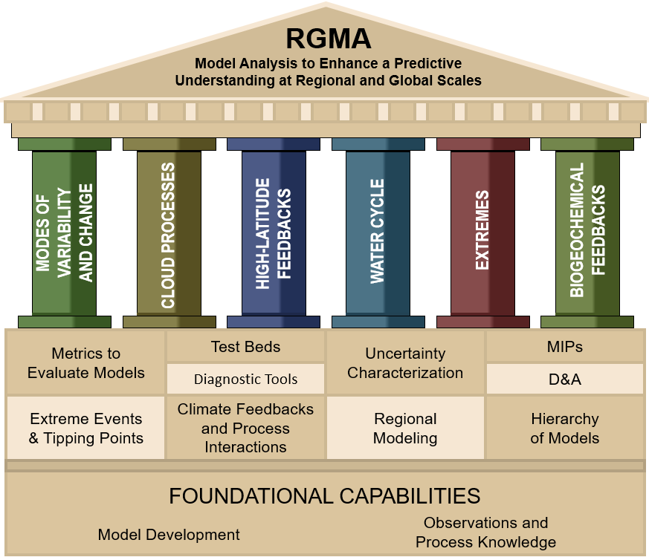
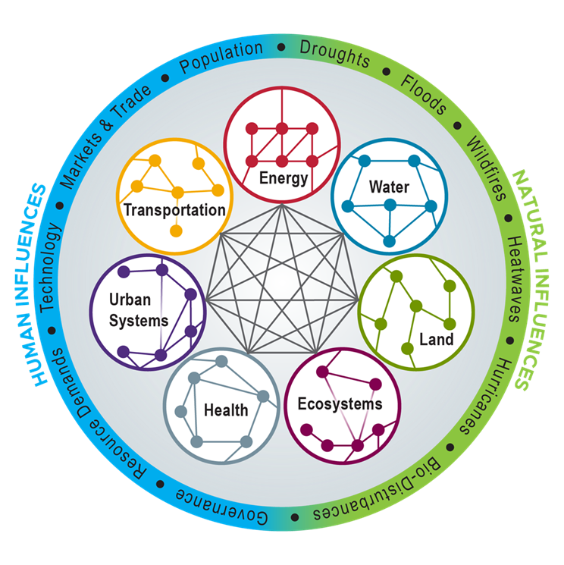
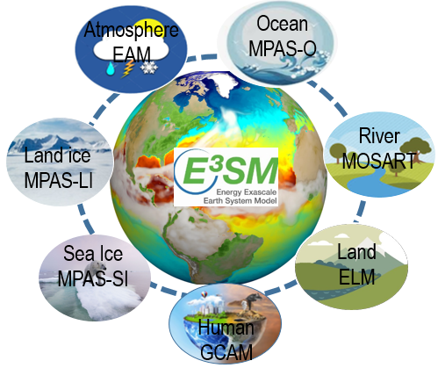

Earth and Environmental Systems Modeling (EESM) Program
Goal: To develop and demonstrate advanced modeling and simulation capabilities, in order to enhance the predictability of the Earth system over multiple temporal and spatial scales.
ESMD
MSD
Notes:
MSD: Explore the complex interactions and potential co-evolutionary pathways within the integrated human-Earth system, including natural, engineered, and socioeconomic systems and sectors
RGMA: To enhance predictive and process level understanding of Variability and Change in the Earth system by advancing capabilities to design, evaluate,
diagnose, and analyze global and regional earth system models informed by observations
Primary Model we focus on is the E3SM – Energy Exascale Earth System Model
Multi-Model approaches and also a use of a hierarchy of models of varying levels of varying complexity to address the relevant science
Questions Portfolio consists of peer reviewed Core (logos below) and University Projects (that are part of FOAs)

Slide 5


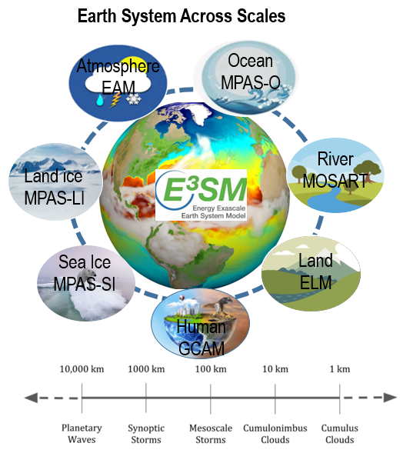
Earth System Model Development (ESMD)
Goal: Develop Earth system models, i.e, E3SM and its subcomponents, to address the grand challenge of actionable predictions of the changing Earth system, emphasizing on the most critical scientific questions facing the nation and DOE
  Strategies:
  Science driver for model development
  Earth system across scales (high-resolution frontier, bridge gaps, quantify uncertainty via LE)
  Prepare for and overcome the disruptive transition to next era of computing
  Innovative computational methods
  EAM: E3SM Atmosphere Model; ELM: E3SM Land Model ; GCAM: Global Change Assessment Model; MOSART: Model for Scale Adaptive River Transport; MPAS-SI: Model for Prediction Across Scales (MPAS) – Sea Ice; MPAS-O: MPAS – Ocean; MPAS-LI: MPAS- Land Ice
More E3SM Acronyms: https://e3sm.org/resources/help/acronyms/
Notes:
ESMD supports the development of E3SM and its subcomponents to represent and simulate all facets of the earth system focusing on the most important questions for DOE mission.
We drive the model development with scientific questions centered around Water Cycle, BGC and Cryosphere; We aim to an integrated each system model with all earth subcomponents and human component by pushing the high resolution frontier, bridging scale gaps and quantity the uncertainty using LE simulations. To leverage DOE supercomputing capability the next generation exascale resource, we are preparing our model code for GPU machines. We also partner with ASCR to support the collaboration between earth scientist and computational scientists to integrate innovative computational methods, tools and algorithm.

Slide 6
ESMD Portfolio
ESMD FY20 Budget: ~$44M
ESMD supported Projects:
Funding instruments: 1. Scientific Focus Area (SFAs); 2. Univ. Awards via Funding Opportunity Announcement (FOA) and 3. Scientific Discovery through Advanced Computing (SciDAC) projects
E3SM SFA is the central driver of the E3SM development with focused scientific questions, well defined time frames, goals and strategies (8 DOE labs and multiple universities)
Advancement from other projects contribute to E3SM development in various ways on different time frames
Year | FY11 | FY12 | FY13 | FY14 | FY15 | FY16 | FY17 | FY18 | FY19 | FY20
ESMD($M) | 36.0 | 35.3 | 35.4 | 35.6 | 35.3 | 35.5 | 35.1 | 40.0 | 44.0 | 44.0
Notes:
ESMD support E3SM through 3 funding instruments. One is the SFA which is the DOE lab led projects. The other one is through FOA , the 3rd one is the partnership with ASCR supporting the SciDAc projects ….

Slide 7

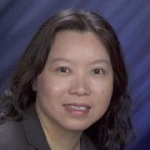
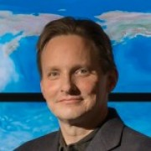

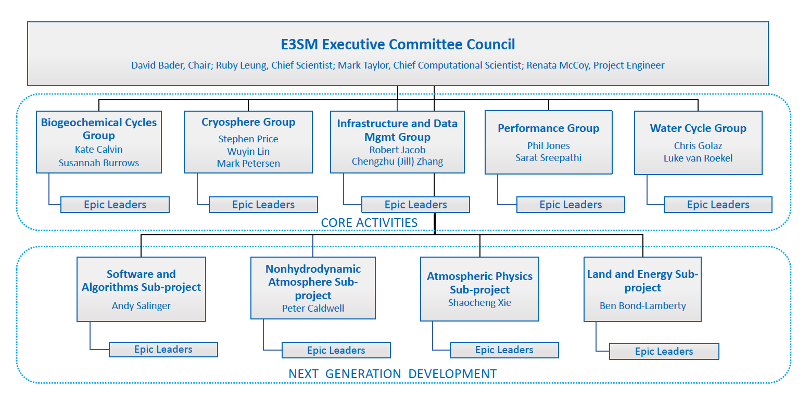

E3SM SFA: The Central Driver
- The leadership team
New
Ocean Sub-Project
Luke van Roekel
(NGD)
On the Agenda today: The overview of E3SM from leaders on Monday, Oct 26th
Notes:
“Core Activities,” encompassing completion and analysis of the v1 simulation campaign, development of v2 model and execution and analysis of the v2 simulation campaign
■ “Next Generation Development (NGD) Activities,“ developing new science and computational capabilities for E3SM versions v3 and v4 with a path for integration into E3SM within 5 years

Slide 8
E3SM SFA: The Central Driver
- The leadership team
E3SM Advisory Committee Members
Detlef vanVuuren – University of Utrecht
Jon Petch – UK Met Office
Anand Gnanadesikan – JHU
Gudrun Magnusdottir – UC Irvine
David M Holland - NYU
Minghua Zhang – Stonybrook University
Paul Fischer – U of Illinois
New
Ocean Sub-Project
Luke van Roekel
(NGD)
On the Agenda today: The overview of E3SM from leaders on Monday, Oct 26th

Slide 9
E3SM SFA: The Central Driver
Some Milestones in FY20
A Special Collection in AGU Journals of 50 papers for v0 and v1. E3SM papers are among the top 10% most downloaded papers from AGU journals
E3SMv1 is publicly available (used by RGMA and ESMD PIs)
> 300 TBytes of E3SM simulation data were downloaded from ESGF by outside researchers
Major computational improvements to the EAM including a new nonhydrostatic dynamical core, the prototype version of the high-resolution EAM, v4 (i.e., SCREAM) is being tested and will contribute simulations to the DYMOND intercomparison project this winter.
E3SM contributed simulation results to the CMIP6 DECK, Historical and C4MIP intercomparisons
And many more in the note …
On the Agenda today: The overview of E3SM from leaders on Monday, Oct 26th
Notes:
The project compiled a Special Collection in AGU Journals of 50 papers covering simulations and developments of versions 0 and 1 of E3SM. These include the papers describing v1 water cycle simulations (Golaz et al. 2019; Caldwell et al. 2019) and BGC simulations (Burrows et al. 2020).
E3SM contributed simulation results to the CMIP6 DECK, Historical and C4MIP intercomparisons
Over 300 TBytes of E3SM simulation results were downloaded from ESGF by outside researchers.
E3SMv1 is now publicly available and used in research by DOE-funded investigators in the RGMA and ESMD programs.
E3SM procured a new computer system, "Chrysalis," at ANL for development of E3SM versions 2 and 3. The system has 512 AMD Epyc nodes with a total of 32K cores and 128TB of memory.
The Non-Hydrostatic Atmosphere NGD Subproject completed and is testing the prototype version of the high-resolution E3SM Atmosphere Model, version 4. Widely known as the Simple Convection Resolving E3SM Atmospheric Model, or SCREAM, the model will contribute simulations to the DYMOND intercomparison project this winter.
The project implemented several major computational improvements to the E3SM Atmosphere model, specifically:
A new nonhydrostatic dynamical core;
A more efficient grid for physics and tracer transport – the "pg2" physics grid;
A new semi-Lagrangian transport algorithm; and
GPU-support for the atmosphere dynamical core
The model now utilizes the SCORPIO I/O library, resulting in a 10x aggregate I/O rate improvement over the old PIO1 library.
The E3SM project maintains a continuously evolving and improving state-of-the-science code repository, testing and documentation infrastructure to support the development, distribution and use of the model.
E3SM maintains and distributes an extensive package of model diagnostic software for all components and the coupled system.
Evaluation and Characterization of Klima (DECK)

Slide 10

EAGLES SFA : Improved Parameterization for E3SM v4
Enabling Aerosol-cloud interactions at Global convection-permitting scalES (EAGLES)
Lead PI: Po-Lun Ma, PNNL
Goal: Improve the confidence in, and understanding of, the role of aerosols and aerosol-cloud interactions (ACI) in the evolution of the Earth system at convection-permitting scales envisioned for E3SMv4.
Some Major Accomplishments in FY20:
Addressing the structural deficiency by improving aerosol and ACI in E3SM
Streamlining the “machine learning (ML)-to-E3SM” workflow
Performing a large LES ensemble covering a wide range of aerosol, cloud, and meteorological regimes
Integrating observationally based process-oriented constraints for ACI in parameterization development
Modernizing software for DOE’s GPU-based computers
On the Agenda: The overview of EAGLES on Tuesday, Oct 27th
Notes:
Figure: Activated aerosol number from the Abdul-Razzak and Ghan (2000) scheme (ARG, default scheme in E3SM) (left panel) and physically informed machine learning (ML) scheme (right panel), compared with cloud parcel model results (considered as truth). Results show that the ML scheme outperforms the E3SM scheme with higher R and lower RMSE. Furthermore, the ARG scheme has a known bias of over-predict activated aerosol number in polluted condition (which produces biased aerosol indirect forcing), as shown by comparing the regression (blue line) line with the 1:1 line. The ML-based scheme corrects this bias.
Addressing the structural deficiency by improving aerosol and ACI in E3SM
New treatments for ultra-fine and giant aerosols, wildfire aerosols, dust, SOA, aerosol activation, rain characteristics and processes, turbulence, etc.
Bring aerosol and ACI parameterizations ready for convection-permitting scales using RRM
Streamlining the “machine learning (ML)-to-E3SM” workflow
New physically regularized ML-based parameterizations for aerosol activation, precipitation, turbulence and clouds, etc., implemented in E3SM
Performing a large LES ensemble covering a wide range of aerosol, cloud, and meteorological regimes
Use a newly developed computationally efficient LES model “PINACLES” to provide aerosol, cloud, precipitation, and meteorological data across regimes for machine learning emulation, parameterization development, and model evaluation
Integrating observationally based process-oriented constraints for ACI in parameterization development
Develop an automated aerosol and ACI diagnostics package and process-oriented metrics based on ARM, satellites, and other observations to guide the model development
Modernizing software for DOE’s GPU-based computers
Redesign the code package to improve efficiency, accuracy, and trustworthiness using modern modeling techniques, better numerics, and testing and verification tools
Prepare the code for porting to C++/kokkos

Slide 11

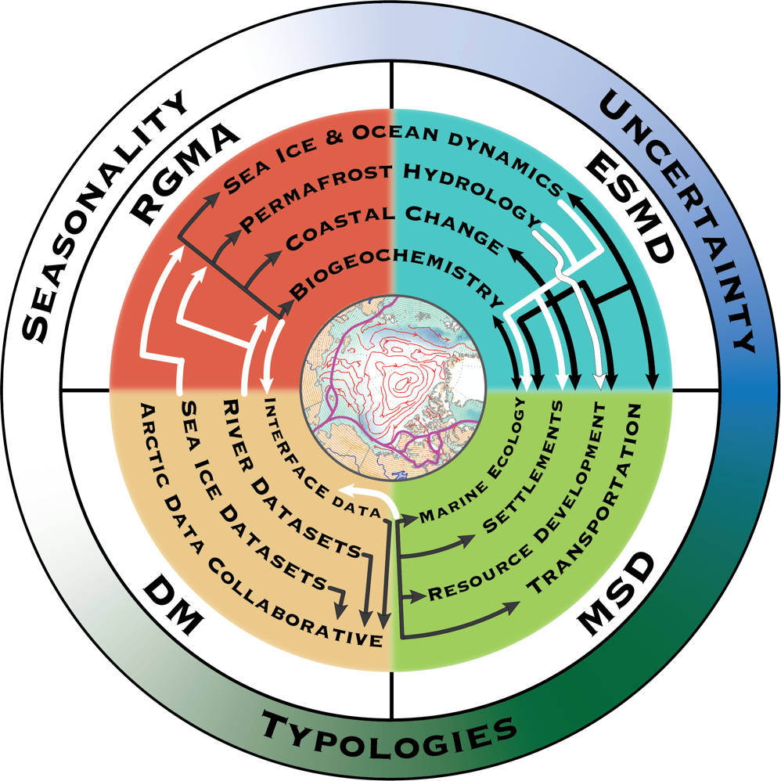
InteRFACE SFA: Arctic Coastal Processes
Interdisciplinary Research for Arctic Coastal Environments (InteRFACE)
Lead: J. Rowland, LANL; ESMD Lead: Andrew Roberts
Goal: The InteRFACE project focuses on how the coupled, multi-scale feedbacks among land processes, sea ice, ocean dynamics, coastal change biogeochemistry, atmospheric processes, and human systems will control the trajectory and rate of change across the Arctic coastal interface.
Earth System focus on:
Sea ice and ocean dynamics
Coastal Change
Permafrost Hydrology
Marine Biogeochemistry
Multi-sector dynamics focus on:
Shipping
Settlements
Resource development
On the Agenda: The overview of InteRFACE on Tuesday, Oct 27th

Slide 12

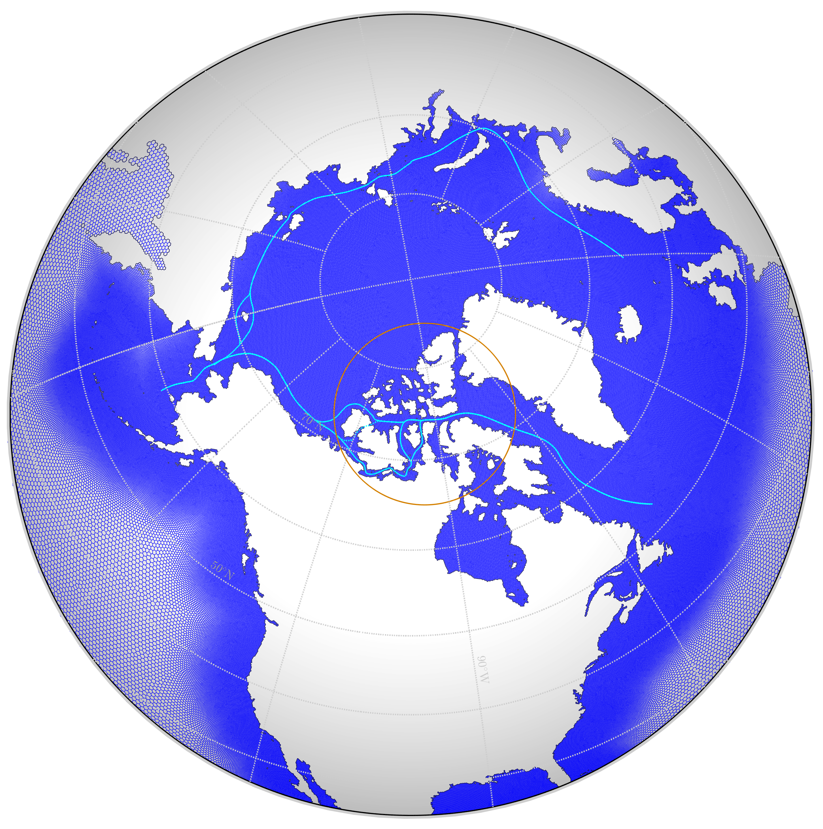







InteRFACE SFA: ESMD Component
ESMD: A. Roberts, E. Coon, A. Garanaik, N. Jeffery, M. Maltrud, L. Van Roekel, J. Rowland, K. Smith, T. Zhou
Some Major Accomplishments in FY20:
All Arctic shipping channels are now open in E3SM V2 and daily navigability output is standard across all of E3SM, not just InteRFACE.
Created a network-based MOSART river-routing capability to couple with the Advanced Terrestrial Simulator for detailed permafrost hydrology.
Completed a column prototype of seafloor sediment biogeochemistry, now being implemented in MPAS-Ocean.
Implemented high order closure mixing in MPAS-Ocean, ported to GPUs, resulting in a 70x speedup.
On the Agenda: The overview of InteRFACE on Tuesday, Oct 27th
Notes:
Highlights from InteRFACE ESMD:
- All major Arctic shipping channels are now open in E3SM V2 at both standard and refined resolutions, and daily navigability output is standard in the upcoming V2 release, available across all of E3SM, not just InteRFACE.
- We have created a “network-based” MOSART river-routing capability, which is critical for coupling with the Advanced Terrestrial Simulator for detailed permafrost hydrology.
- Completed a column prototype of seafloor sediment biogeochemistry that's currently being validated in a Baltic Sea test case, and have implemented a three-dimensional global version in MPAS-Ocean, 1-way coupled to ocean biogeochemistry.
- Implemented high order closure mixing in MPAS-Ocean to better capture important baroclinic processes and reduce sensitivity to vertical resolution.
This has been ported to GPUs, resulting in a 70x speedup.
Next Steps:
- HighResMIP-protocol V2 ensemble generation will commence with the enhanced north American mesh including 14km spacing across the Arctic beneath a standard resolution atmosphere. Landfast ice and wave-ice coupling implementation, and validation of mixing, BGC and hydrology coupling will soon commence.

Slide 13
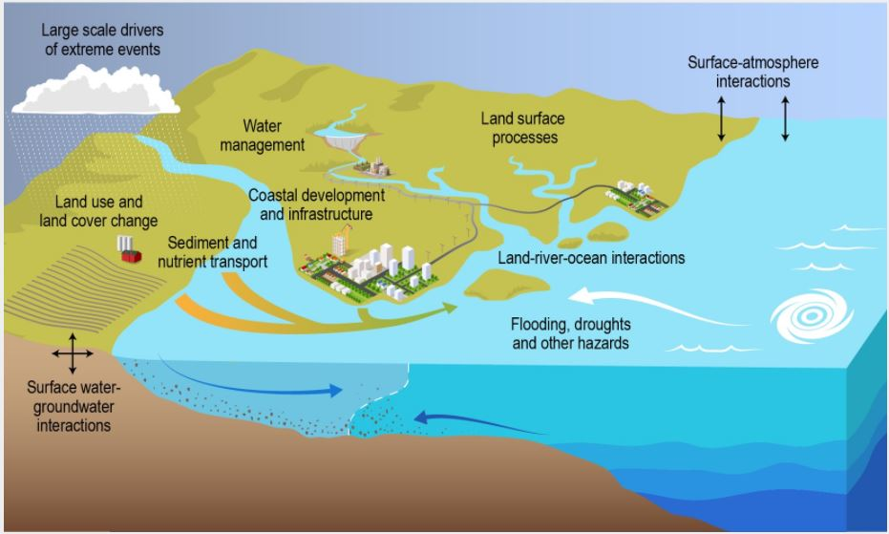

ICoM SFA: Mid-Atlantic Coastal Processes
Integrated Coastal Modeling (ICoM) Project
Lead: Ian Kraucunas; ESMD Lead: Elizabeth Hunke
Vision: Deliver a robust predictive understanding of coastal evolution that accounts for the complex, multi-scale interactions among physical, environmental, and human systems, focusing on processes that represent significant uncertainties in the evolution of coastal systems, that align with the DOE mission
DOE Program Areas
Regional and Global Modeling & Analysis (RGMA)
MultiSector Dynamics (MSD)
ESMD
Subsurface Biogeochemistry Research (SBR)
On the Agenda: The overview of ICoM on Tuesday, Oct 27th

Slide 14
ICoM SFA: ESMD Component
Lead: Elizabeth Hunke
Major Accomplishments in FY20:
MOSART river biogeochemistry, sediment transport, and urban systems:
Developed and tested MOSART-Urban routing model for a single Los Angeles watershed; Added support for unstructured grids in MOSART and performed verification simulations; HexCoastal is being tested using a sample mesh for the mid-Atlantic region
Ocean model development in MPAS-O:
Implemented explicit tides into MPAS-O with astronomical forcing; Implemented and testing variable time stepping scheme in MPAS-O shallow-water core; Developed stand-alone MPAS-O mesh workflow to build simulations of the Delaware River salinity front evolution
Land-river-ocean coupling:
Added two new E3SM model resolutions to allow use of user-defined grids for 2-way land-river coupling results in greater peak annual runoff or inundation fraction than 1-way coupling; New unified mesh for land-river-ocean coupled runs aligns mesh elements with streams, creates smooth river-ocean transition
On the Agenda: The overview of ICoM on Tuesday, Oct 27th
Notes:
MOSART river biogeochemistry, sediment transport, and urban systems:
Developed and tested MOSART-Urban routing model for a single Los Angeles watershed to facilitate development using readily available urban storm-drain network data
Added support for unstructured grids in MOSART and performed verification simulations
Simulated river flow and fluxes of the Susquehanna watershed using the ELM-MOSART-WM framework
HexCoastal is being tested using a sample mesh for the mid-Atlantic region
Added “stream burning” capability to HexWatershed to maintain flow direction on unstructured mesh
Added a hybrid breaching-filling algorithm for flooding
Ocean model development in MPAS-O:
Implemented explicit tides into MPAS-O with astronomical forcing
Working to improve against global observational datasets via self-attraction and loading, bottom drag and topographic wave drag capabilities
Currently working on a super-high resolution barotropic ocean version and coastal-enhanced baroclinic version of the model with ice shelf cavities
Implemented and testing variable time stepping scheme in MPAS-O shallow-water core
Developed stand-alone MPAS-O mesh workflow to build simulations of the Delaware River salinity front evolution
Coupling the General Ocean Turbulence Model for shallow water mixing
Implemented sediment deposition / erosion bed source / sink terms, bedload transport
Land-river-ocean coupling:
Added two new E3SM model resolutions to allow use of user-defined grids for
active ELM-MOSART simulation
MOSART-only simulation
2-way land-river coupling results in greater peak annual runoff or inundation fraction than 1-way coupling
New unified mesh for land-river-ocean coupled runs aligns mesh elements with streams, creates smooth river-ocean transition

Slide 15
University Awards via FOA
- Entrain talent and knowledge from academic community
 | PI/Institution | Title
 | *van Lier-Walqui, Marcus/Columbia U &Morrison, Hugh/UCAR | Improving the Parameterization of Cloud and Rain Microphysics in E3SM using a Novel Observationally-Constrained Bayesian Approach
 | *Westerink, Joannes/UND | Efficiently Resolving the Terrestrial-Aquatic Interface in E3SM with Sub-Grid Methods to Improve Coastal Simulations
 | *Pincus, Robert/Columbia U. | Improving the Capabilities and Computational Efficiency of the RTE+RRTMGP Radiation Code
 | *Primeau, Francois/UC Irvine | Improving the initial state of biogeochemical components in Earth System Models
 | *Randerson, James/UC Irvine | Interactions between land use, fires and dust as drivers of global climate change
 | Zhang, Guang/UCSD | Enhancing Convection Parameterization for Next Generation E3SM
 | Jain, Atul/UIUC | Investigating the impacts of changes in land cover and land management on climate using ACME
 | Teixeira, Joao/UCLA | The Multi-Plume Eddy-Diffusivity/Mass-Flux (EDMF) Unified Parameterization: Stratocumulus and the Transition to Cumulus Boundary Layers
 | Huang, Xianglei/U. of Michigan | Incorporate more realistic surface-atmosphere radiative coupling in E3SM
 | Liu, Zheng-Yu /OSU | Developing Coupled Data Assimilation Strategy for Understanding Model Bias and Extreme Climate Events in E3SM
 | Gnanadesikan, Anand/JHU | Parameterizing the Impact of Mesoscale Eddies on Earth System Process in the E3SM
 | Richter, Jadwiga/UCAR | Improving Momentum Transport Processes in E3SM
 | Bond, Tami/CSU | Collaborative Proposal: Fire, dust, air and water: Improving aerosol biogeochemistry interactions in ACME
*: from FY20 FOA awards
Agenda: on Tuesday, Oct 27th

Slide 16
Scientific Discovery through Advanced Computing (SciDAC) Projects: Partnership with Advanced Scientific Computing Research (ASCR) for computational advances
The SciDAC Partnership with BER is focused on Earth System Models.
Program Managers: Randall Laviolette (ASCR); Xujing Davis (BER);
 | PI/Institution | Title
 | Turner, Adrian/LANL | A New Discrete Element Sea-Ice Model for Earth System Modeling: Phase 2
 | Wan, Hui/ PNNL | Assessing and Improving the Numerical Solution of Atmospheric Physics in E3SM Phase 2
 | Jones, Philip/LANL | Coupling Approaches for Next Generation Architectures (CANGA)
 | Bosler, Peter/SNL | Non-Hydrostatic Dynamics with Multi-Moment Characteristic Discontinuous Galerkin Methods (NH-MMCDG) Phase 2
 | Price, Stephen/LANL | Probabilistic Sea-Level Projections from Ice Sheet and Earth System Models
 | Bisht, Gautam/PNNL | Development of terrestrial dynamical cores for the ACME to simulate water cycle
 | Yamaguchi, Takanobu/ NOAA | Adaptive Vertical Grid Enhancement for E3SM ("Phase 2")
 | Ju, Lili/USC; Gunzburger, Max/FSU | Efficient and Scalable Time-Stepping Algorithms and Reduced-Order Modeling for Ocean System Simulation
Agenda: on Wednesday, Oct 28th

Slide 17
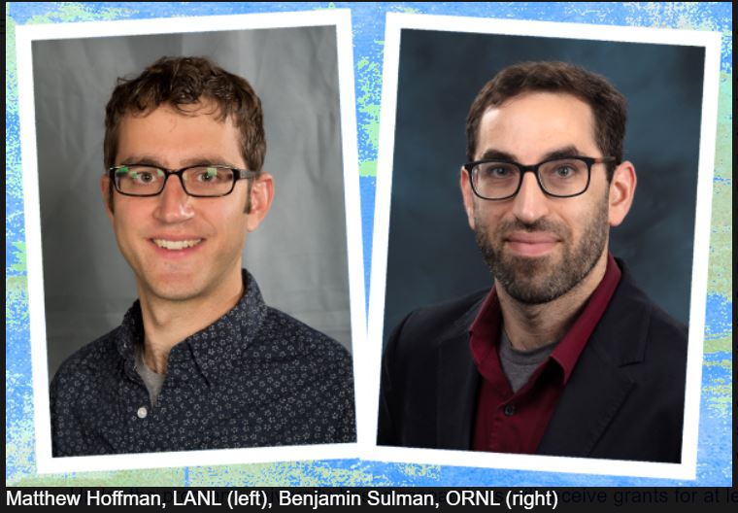
Awards
Two E3SM scientists receive DOE Early Career Awards!
Hoffman: Creating a Sea-Level-Enabled E3SM: A Critical Capability for Predicting Coastal Impacts
Sulman: Simulating Estuarine Wetland Function: Nitrogen Removal, Carbon Sequestration, and Greenhouse Gas Fluxes at the River-Land-Ocean Interface
The effort, now in its eleventh year, is designed to bolster the nation’s scientific workforce by providing support to exceptional researchers during crucial early career years
Agenda: on Tuesday, Oct 27th

Slide 18
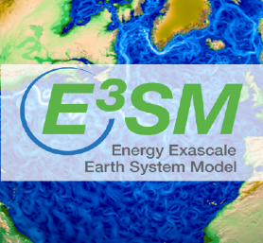
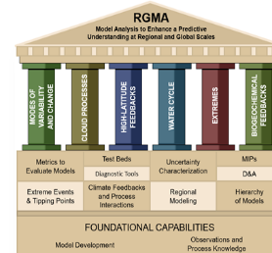
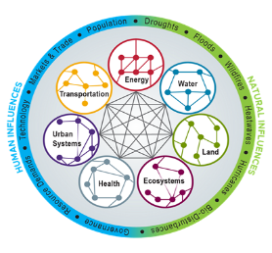
The role of ESMD/E3SM
International Endeavor
Vision
Strengthen the core (ESMD and with RGMA, MSD, DM)
Enhance the integration with DOE programs (SciDAC, ECP, ARM, ASR, SBR, TES … )
Coordination and Collaboration broadly (USGCRP (e.g., ICIM), IARPC, USCLIVAR (e.g., CPTs), CMIP, IPCC … …)
National Efforts
Other DOE Program Activities
ESMD
RGMA
MSD
E3SM contributes to national and global effort endeavor
in advancing Earth System Predictability while addressing the DOE mission

Slide 19
More on the Agenda
Key note talks, 1st and 3rd day
Invited presentations (ML/AI, MMF), 3rd day
COMPASS, 2nd day
Breakout Sessions (fund brainstorming discussion, CPTs….), 3rd and 4th day
E3SM tool session, 4th day
E3SM tunes, 4th day
Posters (2nd and 3rd day) and Vote for your favorites! (results announced on 4th day)
Meeting Summary Report will be available

Slide 20
Thank you and enjoy the meeting!
2020 is a year full of challenges (COVID, wildfires)
Contact us:
ESMD-E3SMPIMEETING@LISTSERV.LLNL.GOV
to PI Meeting Steering Committee and Holly Davis (E3SM Communication Specialist)
Tracey.Vieser@orau.org
to Tracey Vieser of Oak Ridge Institute for Science and Education (ORISE), logistic support
October 26-29, 2020
Earth and Environmental
Systems Sciences Division

