Slide 1
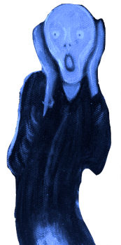
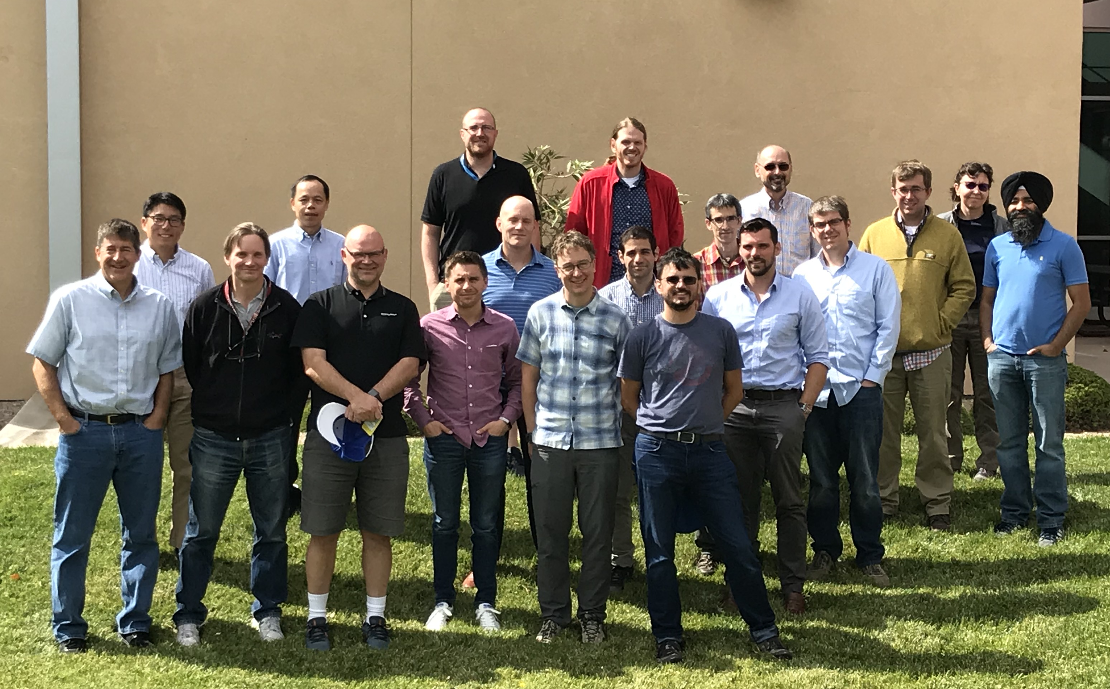
The Simple Cloud-Resolving E3SM Atmosphere Model (SCREAM) Project
Contributors: Peter Caldwell, Andy Salinger, Luca Bertagna, Hassan Beydoun, Peter Bogenschutz, Andrew Bradley, Conrad Clevenger, Aaron Donahue, Chris Eldred, Meredith Fossitt, Jim Foucar, Chris Golaz, Oksana Guba, Ben Hillman, Rob Jacob, Jeff Johnson, Noel Keen, Jayesh Krishna, Wuyin Lin, Weiran Liu, Kyle Pressel, Balwinder Singh, Andrew Steyer, Mark Taylor, Chris Terai, Paul Ullrich, Danqing Wu, Xingqiu Yuan
Work from LLNL is performed under the auspices of the US DOE by LLNL under Contract DE-AC52-07NA27344.
UCRL:LLNL-PRES-815956

Slide 2
What is it?
New atmosphere model written in C++/Kokkos
Kokkos allows CPUs, GPUs, and future architectures to use the same code
Focus on simplicity makes for less code to write and makes interpretation easier
Target is exascale computers (which require lots of parallel work)
Initial focus is 3 km global “cloud-resolving” simulations
Will also use for large low-resolution ensembles (once needed parameterizations are available)
Initial implementation will use prescribed aerosol
EAGLES project is dedicated to creating a prognostic aerosol scheme for SCREAM

Slide 3
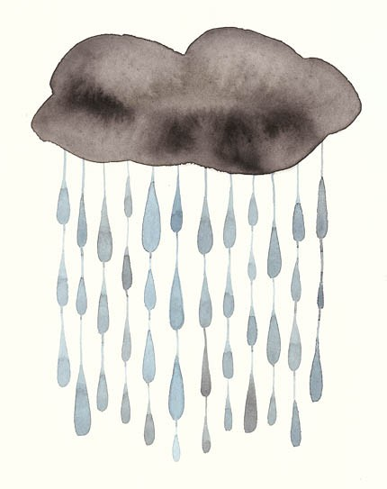
What specifically is it?
parameterized convection
Resolved-scale fluid dynamics treated by a non-hydrostatic Spectral Element (SE) approach
Turbulence and cloud formation handled by Simplified Higher-Order Closure (SHOC)
Radiation handled by RRTMGP rewritten in C++ for GPUs by DOE’s Exascale project
simple prescribed aerosol: CCN and aerosol optical properties are prescribed from E3SMv2 run
Microphysical processes handled by a modified Predicted Particle Properties (P3) scheme

Slide 4
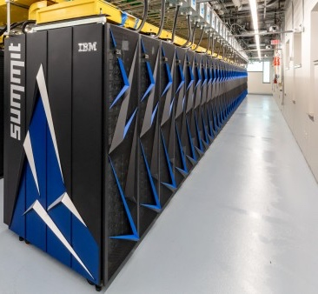
Why a New Model?
Computational breakthroughs are happening on GPUs
Increased parallelism allows E3SM to tackle long-standing problems:
how to parameterize convection
uncertainty due to weather noise and parameter ambiguity
All big DOE machines will use GPUs
Porting the existing E3SM atmosphere to GPUs was deemed too hard
Starting from scratch means less code, more expertise, and more interest
Makes EAM independent from CESM

Slide 5
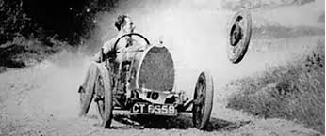
How is it going?
Implementation is occurring in 2 overlapped stages:
SCREAMv0: F90 implementation using existing EAM infrastructure
status: ~done
runs: starting 40 day 3 km simulation for DYAMOND2 intercomparison in ~1 week (https://www.esiwace.eu/services/dyamond/)
SCREAMv1: C++ version using new infrastructure
status: dycore, microphysics, radiation, I/O, coupler, surface coupling ~done. turbulence/macrophysics in progress. Then just coupling/bugfixing/cleanup/small tasks to do.
runs: hoping to start “Cess” runs on Summit next summer

Slide 6
How is it going?
Implementation is occurring in 2 overlapped stages:
SCREAMv0: F90 implementation using existing EAM infrastructure
status: ~done
runs: starting 40 day 3 km simulation for DYAMOND2 intercomparison in ~1 week (https://www.esiwace.eu/services/dyamond/)
SCREAMv1: C++ version using new infrastructure
status: dycore, microphysics, radiation, I/O, coupler, surface coupling ~done. turbulence/macrophysics in progress. Then just coupling/bugfixing/small tasks to do.
runs: hoping to start >1 yr “Cess” runs on Summit next summer
See posters in atm session on Weds:
Chris Terai: evaluation
Hassan Beydoun: anvil clouds
Weiran Liu: hydrostatic vs nonhydrostatic forecasts
Peter Bogenschutz: SCM and doubly-periodic modes
See:
Luca Bertagna: dycore talk Thurs Perf breakout
Aaron Donahue: coupler talk Weds NGD atm breakout

Slide 7
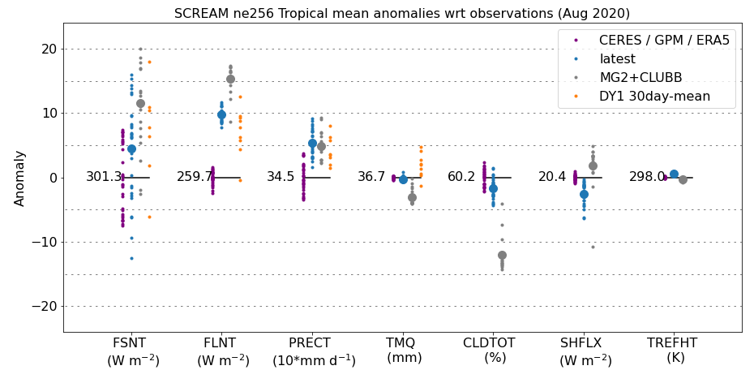
SCREAMv0 Behavior
SCREAMv0 skill is comparable to other DYAMOND models
12 km→3 km Δx has small impact except TOA SW increases by 5 W m⁻² (not shown)
Other DYAMOND1 models have similar low cloud resolution sensitivity
Obs (daily)
SCREAM (daily)
CLUBB+MG2 (daily)
DYAMOND1 (30-day mean)
Tropical bias
TOA SW rad TOA LW rad Precip Integrated Vapor Cloud Frac SHF. 2m T
Fig: Tropical mean bias for DYAMOND1 period (Aug 1-Sept 10, 2016) from SCREAMv0 at 12 km (ne256) compared to runs from other modeling centers.

Slide 8
SCREAMv0 Behavior
Fig: Precip averaged over the first 2 days of a 3 km (ne1024) DYAMOND2 simulation (Jan 20th-22nd, 2020). Numbers in parentheses in the title are global averages.
Precipitation matches ERA5 very well in global mean and spatial pattern
SCREAM slightly underpredicts precip in strong storms
SCREAM convection has too much small-scale (but not grid-scale) noise

Slide 9
Science Plans
There are tons of interesting questions to address, but here are some we’re thinking about:
What weather/climate features is SCREAM good/bad at?
will be answered by SCREAMv0 DYAMOND2 runs
What is climate sensitivity with resolved deep convection?
will be answered by multi-year SCREAMv1 “Cess” runs: radiative difference between runs with prescribed current-climate and +4 K SST (see graphic)
At what resolution do nonhydrostatic effects become important?
See Weiran Liu’s poster in atm session on Weds!
What controls tropical anvil cloud extent?
See Hassan Beydoun’s poster in atm session on Weds!
4xCO2 λ_{cloud} (W m⁻² K⁻¹)
Fixed-SST λ_{cloud} (W m⁻² K⁻¹)
Fig: Cloud feedback from full-complexity (y-axis) versus fixed SST simulations in CMIP5. Adapted from Ringer et al, (2014 GRL).

Slide 10
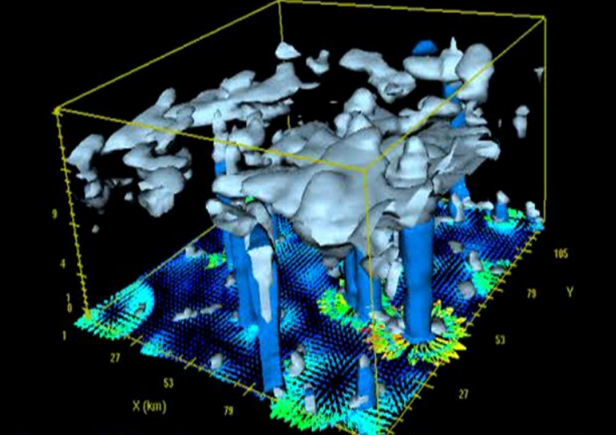
Tools
Single-column model: E3SM’s SCM works in SCREAMv0 and is a quick way to test physics changes
Doubly Periodic SCREAM: A planar, limited-area version of SCREAMv0 should be available in a month or two
Calling processes from Python: SCREAM parameterizations can be called from python using F2PY for v0 or (eventually) c bindings for v1
Forecasts: short forecasts can be performed with CAPT, Betacast, or HICCUP-derived tools
Regionally-Refined Model: Focus resolution on your region of interest and nudge other regions to obs
e3smplot: plot high-res output on native grid compared to appropriate obs
See Peter Bogenschutz poster on Weds!

Slide 11
Extra Slides

Slide 12
SCREAMv1: What’s Done/What’s Not
Prescribed cloud condensation nuclei is ~done
Prescribed aerosol optics is in-progress
Nonhydrostatic C++ dycore is done
Getting hooked up to process coupler now
SHOC is being ported now
Process coupler is mostly done
Finishing up input/ output/restarts now
C++ radiation kernels are done
Getting hooked up to process coupler now
Microphysics in C++ now
Needs better testing + design doc
Coupling to surface (rest of E3SM) is mostly done
Coupling to other processes now

Slide 13
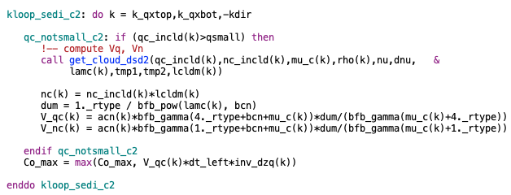
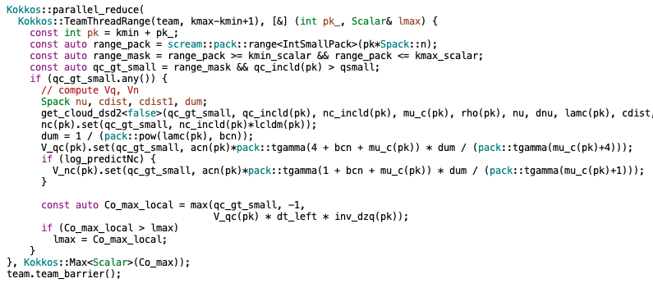
Coding
SCREAM will be rewritten from scratch in C++:
Allows use of Kokkos library, which abstracts on-node parallelism
single code runs efficiently on CPUs, GPUs, etc
Original F90
Unlocks more parallelism…
But results in more complex code
Ported to C++/Kokkos

Slide 14
With adequate parallelization, a step at Δx =3 km takes as long as at Δx=100 km
but stability requires shorter timesteps at finer Δx

