Slide 1
e3sm_to_cmip
This work was performed under the auspices of the U.S. Department of Energy by Lawrence Livermore National Laboratory under contract DE-AC52-07NA27344. Lawrence Livermore National Security, LLC. LLNL-POST-750734 Release #LLNL-PRES-815934
Notes:
Hello everybody, thanks for coming to my talk

Slide 2
e3sm_to_cmip
An extensible and portable python package for conversion of E3SM data to the Climate Model Intercomparison Project (CMIP) format. Available via conda, the e3sm-unified environment, or github repository.
Converts atmosphere, land, sea-ice, and ocean variables into CMIP compliant datasets.
The package has been used to produce for more then 1800 datasets published to CMIP6.
Notes:
As you can tell from the name, the purpose of this package is to convert E3SM output to the CMIP format. The files output from the E3SM model, and the datasets in the CMIP archive are very very different from each other, but the capability to compare the E3SM model to external sources is exceedingly important both to ourselves for the purpose of our own model development, as well as to outside collaborators.
The e3sm_to_cmip package is available for download via the conda package manager, or the repository E3SM-Project repository on girhub. The package is also included as part of the e3sm-unified environment, and so is already available to internal users on all the E3SM supported machines. When installing via conda, or using the unified environment, dependencies are managed automatically.
The e3sm_to_cmip package handles the conversion of the variable data, and then uses Climate Model Output Re-writer (CMOR) provided by the PCMDI group under the hood to write out the datasets in the highly structured CMIP format.

Slide 3
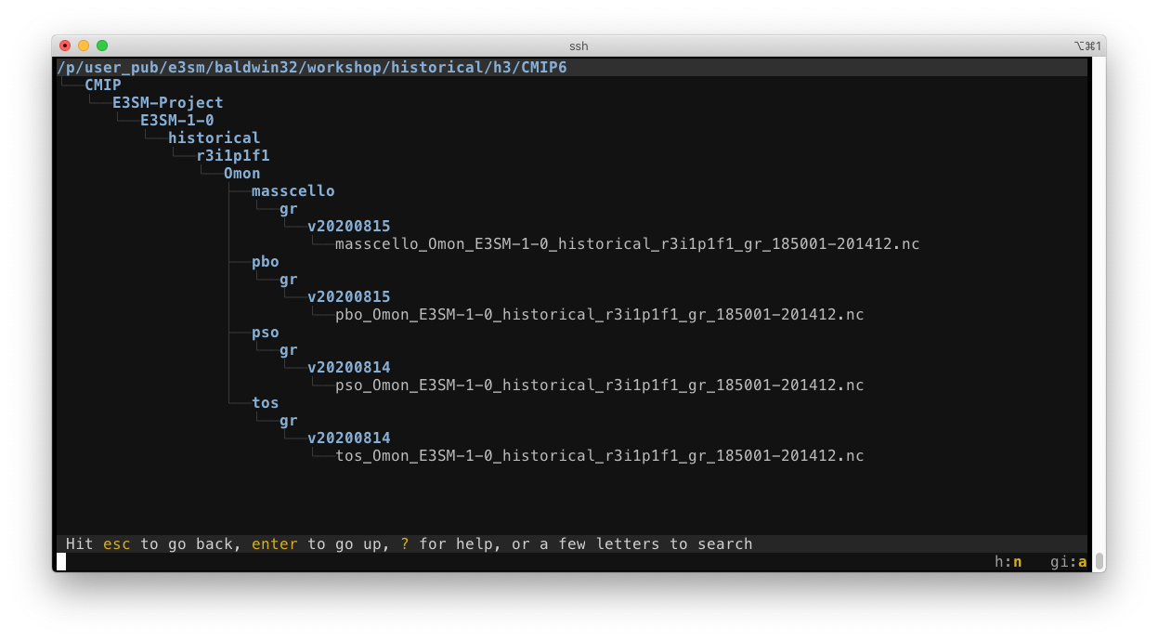
A Tale of Two Cities Runtime Modes
“Production” mode for publication datasets.
Uses strict CMOR metadata checks
Requires a valid CMIP6 experiment
Notes:
The e3sm_to_cmip package supports two main modes of operation, the default “production” mode used for creating CMIP6 ready publication datasets, as well as a “simple” mode for conversion of data not meant for publication.
Here is an example of what the output from a production run of 4 ocean datasets looks like, with the CMIP style nested directory tree. Running in production mode requires the user supply a json metadata file with all the parameters for a valid CMIP experiment, such as the experiment_id, its realization index, and information about the model. These parameters are checked against the values in the CMIP project registration and are included as global attributes of the output datasets.
Although this strict metadata standard can be very useful, it can also be more then a bit cumbersome and adds a considerable amount of extra work when trying to compare the output from a short debugging run of the model. Which takes us to the second mode …

Slide 4
It was the best of models, it was the worst of models
The “Simple” mode doesn’t require any additional metadata
Allows for inter-model comparison of debug simulations
Notes:
The “Simple” mode does all the same variable conversion (literally using the same code) but bypasses all the CMOR metadata checks and just writes the files out directly. This allows anyone to take their E3SM output from a testing/debug run and convert it over to a format that can be easily compared with datasets from any model in the CMIP6 archive, as well as use diagnostic tools such as ILAMB that require CMIP type variables as input.
In this mode, the user doesn’t need to supply any additional metadata, and the experiment doesn’t need to comply with any of the CMIP standards. Here you can see example output from the simple mode, note that because there’s no concept of the “experiment” or “realization” type structure normally given by the CMIP metadata, all the output sits in a single output directory. I’ve made some effort to format the file names in a similar fashion as CMIP6 files, but without the same experiment metadata there’s no way to perfectly mirror the structure. Inside the files, the variables have the same attributes as the production CMIP variables would, and the global attributes of the input files are copied over to the output.

Slide 5
Great Expectations
Currently supports monthly output only
54 Atmosphere variables
24 Land variables
27 Ocean variables
9 Sea-ice variables
Regridded time-series files are required for atmosphere and land processing
ocean and sea-ice data is regridded at runtime.
e3sm_to_cmip -i <input> -o <output> -t ~/cmip_tables -u metadata.json --var-list . . . .
e3sm_to_cmip -i <input> -o <output> --simple --var-list . . . .
Notes:
How you use the e3sm_to_cmip package depends on the type of data you’re going to be processing. Data from the atmos and land components must first be regridded and extracted into time-series files before it can be converted, where as MPAS ocean and sea-ice data is regridded at run time.
Once the time-series files are ready, running the conversion process is as easy as specifying the input and output directories, and supplying the required CMIP metadata.
Here you can see the different between the command line calls for a production mode run and simple mode run.

Slide 6
Much Ado about CMIP
Notes:
As you would expect, the package comes with as many run time options as you can shake a stick at. Most of these are simple customization options, for example by default all the variables are handled in separate parallel processes. This number can be adjusted according to the machine being used, or the converters can be run in serial for debugging purposes.
The package also needs to be told what type of data its operating on, so the “mode” flag is used to specify what type of data the input files are.

Slide 7
Taming of the Shrew Time-Series
Common Workflow Language processing suite for end-to-end processing
Handles horizontal regridding and vertical remapping of atmos/land data
Distributes jobs over a cluster for faster parallel processing
Simple YAML configuration
cwltool –-parallel atm-unified.cwl atm-unified-job.yaml
Notes:
As you may have noticed, I mentioned earlier that for the atmospheric and land variable conversion, the input files must be regridded and extracted as time-series file before they can be converted.
As anyone that’s done any regridding knows, producing these can be a non-trivial task itself. To handle this, a suite of Common Workflow Language workflows were developed to do complete end-to-end processing. These handle all the required steps of horizontal regridding, vertical remapping, and time-series extraction via the excellent NCO tool suite.
Furthermore, the CWL workflows distribute the processing jobs over a SLURM cluster, greatly decreasing the processing time for very long runs.
Anyone that’s not familiar with the CWL, dont worry! From the user's perspective, setting up a run is as simple as filling out parameters in a config file and then just letting the workflow engine take care of managing the execution. These parameters are straightforward, such as the path to your mapping files, where to find the raw data, and your desired list of variables.

Slide 8
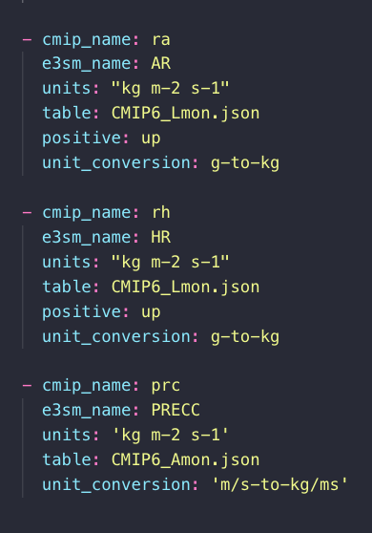
As You Like It
Designed for extensibility
Complex variables managed by extending an Abstract Base Class
Add new variables in moments
1:1 variables managed by a simple configuration file
Notes:
Although the package presently supports more then a hundred variables, there are still hundreds of variables that cant be converted. I’ve tried to make adding new variable converters as simple as possible. For one-to-one variable translation that only require a unit conversion, adding a new variable is as simple as adding an entry in a YAML resource file, no code changes needed.
More complex variable converters can be added by extending what is essentially an Abstract Base Class and defining the input variables required, the output variable name, and then implementing a method to perform the data conversion.
Although there is still work to be done to simplify this process, scientists have already controbuted dozens of variable converters to the package.

Slide 9
A Comedy of Errors Features
Future work:
High frequency datasets
Simplification of variable handlers
Notes:
The main area of planned future work is the addition of support for conversion of “high-frequency” datasets. Although the package has no concept of the temporal frequency of the data being processing, there’s some plumbing work needed in how it interfaces with CMOR before it will be able to process sub-monthly data.
Additionally, there are some improvements to the structure of the variable handlers that I would like make that would further simplify the process of adding new variable handlers.

Slide 10
Links & resources
Repository: https://github.com/E3SM-Project/e3sm_to_cmip/
Getting started with CWL: https://github.com/E3SM-Project/e3sm_to_cmip/blob/master/docs/workflow.md
Example metadata: https://raw.githubusercontent.com/E3SM-Project/e3sm_to_cmip/master/e3sm_user_config_picontrol.json
Notes:
Here are a set of links to useful information, feel free to download these slides and peruse them at your leisure.

Slide 11
Q&A
Special thanks to Xylar Asay-Davis and Charlie Zender for significant contributions to this project

