Slide 1
Biogeochemistry – atmospheric physics NGD coordination: gaps and opportunities
Susannah Burrows and Kate Calvin

Slide 2
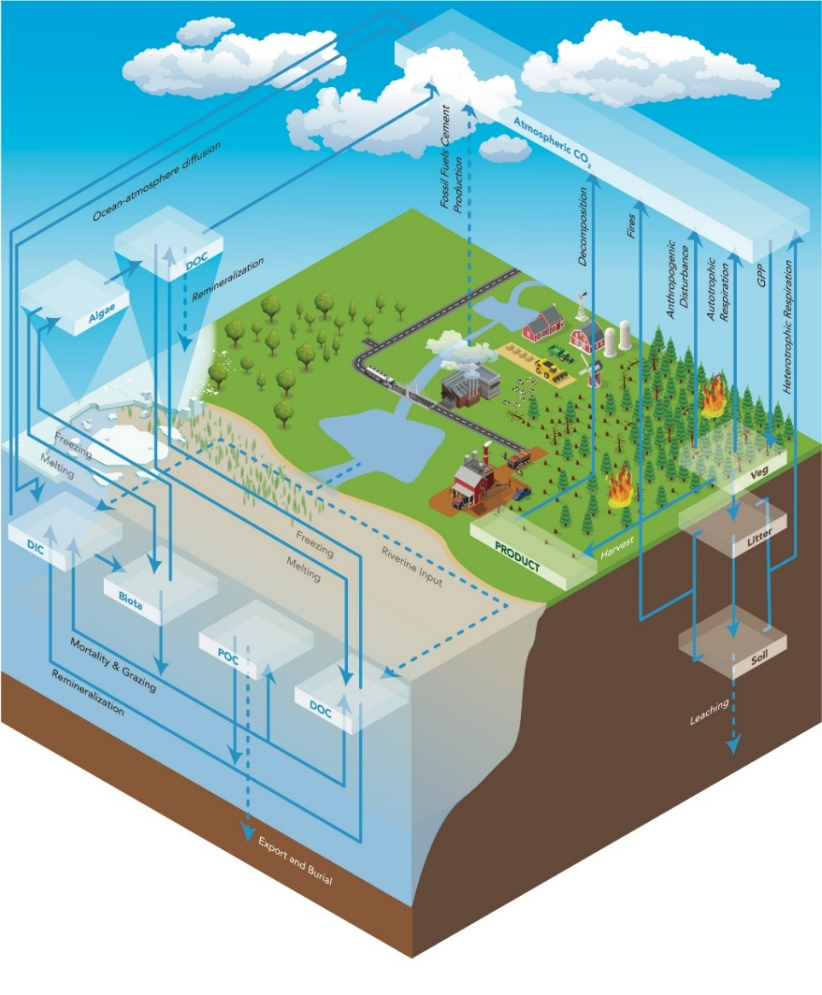
Carbon and nutrient cycles in the DOE’s Earth System Model
E3SMv1.1:
Includes carbon and nutrient cycles in land and ocean.
Compsets defined for prescribed CO₂ simulations.
Evaluation:
Land model performs well on standard observational benchmarks (ILAMB), compared to ancestor and to other CMIP5 models.
Historical CO₂ uptake in land model is consistent with prior observational estimates.
Ocean shows significant biases, and total CO₂ uptake that is lower than supported by observations.
v2 developments:
Main known causes of ocean biases are being addressed.
Adding online coupling of GCAM coupling.
First emissions-driven CO₂ simulations.
E3SMv1.1-BGC allows researchers to model the Earth’s carbon cycle and how it interacts with land use and energy systems.
Burrows, et al., 2020. “The DOE E3SM v1.1 biogeochemistry configuration: description and simulated ecosystem-climate responses to historical changes in forcing,” Journal of Advances in Modelling Earth Systems, 12, e2019MS001766. https://doi.org/10.1029/2019MS001766 .

Slide 3
E3SM v3 Science Campaign
How does the energy system interact with and impact climate and the coupled Earth System?
DOE mission relevance
To be able to credibly simulate interactions between energy and the Earth system, we need:
Credible simulation of climate and climate sensitivity
Energy-relevant outputs
Atmospheric gases and aerosols (CO₂, CH₄, SO₂, BC, OC, dust, O₃, etc.)
Fully coupled carbon cycle

Slide 4
The v3 Model Configuration
General concept: evolution from v2, mostly Fortran, runs on CPUs
The v3 BGC configuration differs from water cycle simulation in having:
Active prediction of plant and soil biogeochemistry on land
Active prediction of ocean biogeochemistry (phytoplankton and ocean carbon uptake)
Active prediction of land cover and anthropogenic emissions in future scenarios from GCAM
Key new features in v3 include:
Atmosphere: gas-phase atmospheric chemistry; nitrate aerosols; stratospheric sulfate aerosol, updated dust emissions
Ocean/Ice: waves; improved eddies; improved vertical mixing; seafloor BGC
Land: dynamic vegetation; crops; natural CH₄; improved fire; managed disturbances
Rivers: nutrient flow from land to ocean; lakes
GCAM*: energy, water, food storage; separation of investment and operation
* GCAM developments are funded by the GCIMS proposal. The listed developments are funded for FY21-FY23.
Notes:
Stratospheric sulfate

Slide 5
Biogeochemistry v3 – possible science themes (this is still under discussion and could change)
(Overarching BGC question) How do changes in carbon, methane, and other nutrients impact climate and the coupled Earth System?
(Methane) How will methane sources change in the future and how will those changes impact the coupled Earth system?
(Carbon) How do changes in the sources and sinks of carbon alter climate and the coupled Earth system?
(Coastal anoxia) How do changes in climate and human activities impact coastal anoxia?
Notes:
(Methane) How will methane sources change in the future and how will those changes impact the coupled Earth system?
Sources include natural (e.g., wetlands and permafrost) and anthropogenic (energy, ag)
Impacts could include ozone effects on plant growth
(Carbon dioxide removal) How do changes in the sources and sinks of carbon alter climate and the coupled Earth system?
CDR options include BECCS, DACCS, afforestation, and potentially ocean options
Could also look at impact of disturbances (e.g., wildfire) on land-based CDR
(Coastal anoxia) How do changes in climate and human activities impact coastal anoxia?
Includes changes in nutrients from rivers

Slide 6
Opportunities for BGC – atmospheric physics NGD collaboration
We would like to collaborate with experts from the atmospheric physics NGD for help in evaluating simulation realism and interpreting responses to different scenarios in the coupled simulations.
Example:
How does the new gas-phase atmospheric chemistry respond under scenarios with different methane emissions?
Is there additional science that could be done through analysis of the BGC simulations, perhaps related to new features developed in the NGD?
Example:
How do new dust emissions change in response to active land biogeochemistry?

Slide 7
Photolysis affects radiative heating and biosphere
Radiative Heating
Concentrations
Greenhouse Gases
Secondary Aerosols
Emissions of chemicals
(Anthropogenic)
O3 CH4 N2O SO4 SOAG Fe
Atmospheric Processes
Photolysis & PAR
Chemistry
Aerosol processes
Deposition/scavenging
Transport/mixing
Emissions of chemicals (Biogeochemistry)
Chemicals affect Biogeochemistry
Fertilization
Leaf damage
Notes:
Slide by Philip Cameron-Smith, LLNL, 2020-10-22. Extracted from LLNL-PRES-815873 with minor tweaks.

Slide 8
Possible gaps / missed opportunities?
Fully-coupled N cycle (missing links here?)
Impacts of P inputs to land?
Iron cycling and impacts of dust Fe inputs to oceans?
Impacts of atmospheric physics parameterizations (turbulence, convection) on tracer transport, and implications for radiative forcing (particularly by CO₂).
Others?

Slide 9
Please let us know about other possible opportunities to get more science out of the v3 campaign!
BGC Group lead: Kate Calvin (katherine.calvin@pnnl.gov)
BGC Deputy group lead: Susannah Burrows (susannah.burrows@pnnl.gov)

Slide 10
Thank you!

