Slide 1









Implementing Oceanic Tides in E3SM
Brian Arbic and Joannes Westerink
Andrew Roberts, Kristin Barton, Stephen Brus, Giacomo Capodaglio, Xylar Asay-Davis, Nairita Pal, Mark Petersen, Michael Schindelegger, Steven Brus, Damrongsak Wirasaet, William Pringle, Guoming Ling, Coleman Blakely, Philip Wolfram, Elizabeth Hunke
ICoM is funded by multiple programs in the Earth and Environmental Systems Sciences Division of DOE’s Office of Science

Slide 2
Why add tides to high-resolution global circulation models?
Thus far, our group and our collaborators have published 28 journal articles and one book chapter on embedding tides within OGCMs.
We work with NASA, the Navy, NOAA, and the European Ocean Forecast Modeling group (Mercator) as well as DOE
Barotropic tidal flow over rough topography in a stratified fluid generates internal tides
Non-linear interactions between internal tides and wind-driven near-inertial waves yield a partially resolved supertidal internal gravity wave (IGW) continuum, or Garrett-Munk spectrum, as shown in Müller et al. 2015 (for HYCOM), Rocha et al. 2016 (for MITgcm), and other papers
Breaking IGWs drive mixing
  can our models help us understand the space-time geography of ocean mixing? (just starting to work on that)
Internal waves impact ocean acoustics
Remotely generated internal waves should be included in boundary conditions for regional models
Global internal wave models help us plan for and interpret the Surface Water Ocean Topography (SWOT) mission
Of special interest to DOE: tides impact coastal flood hazard assessments, interact with other earth system components including sea ice, floating ice shelves

Slide 3
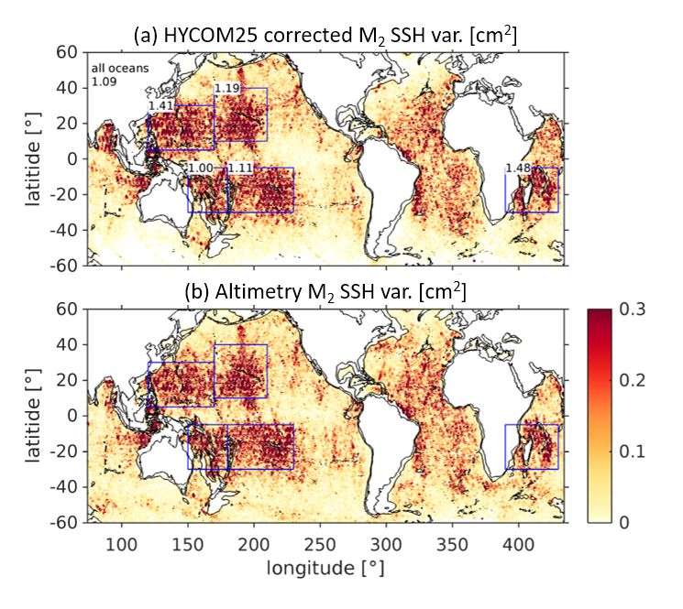
Geographical distribution: Stationary internal tides
Sea surface height (SSH) variance of the stationary principal lunar semidiurnal tide M₂ in non-assimilative HYCOM (top) and altimetry (bottom).
The HYCOM variances have been corrected for the effects of the short duration of the model output record.
Numbers represent the fraction of HYCOM variance to altimetry variance.
Determined by spatially high-passing amplitudes of total tidal SSH (as in Ray and Mitchum 1996)
Buijsman et al. 2020, Ocean Modelling

Slide 4
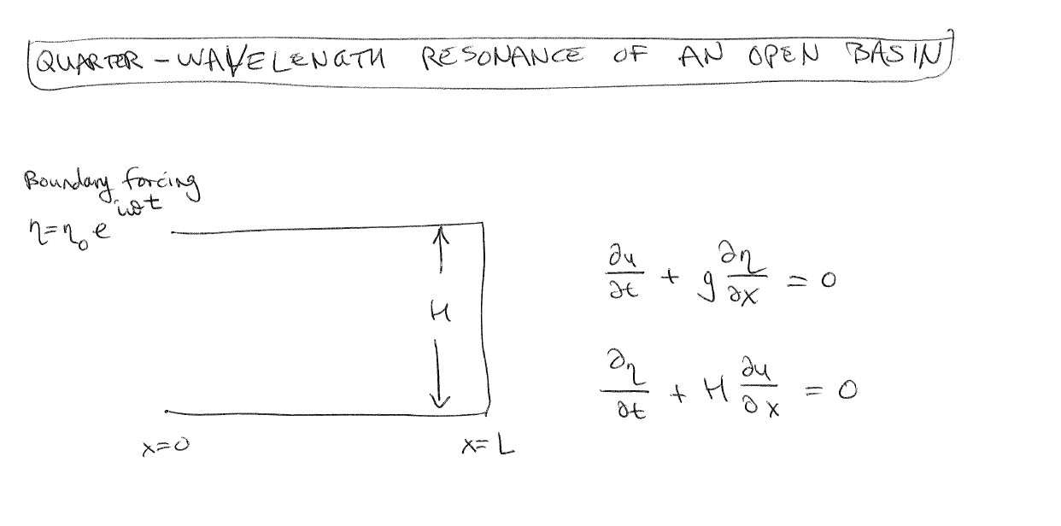
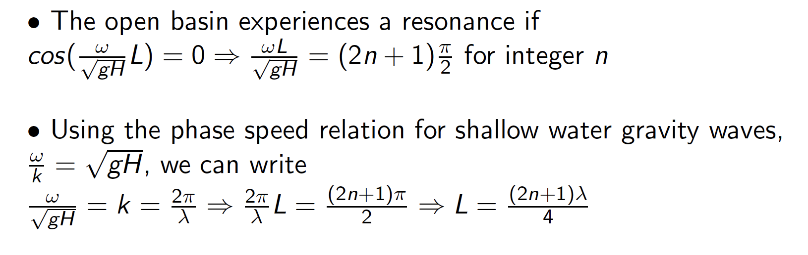
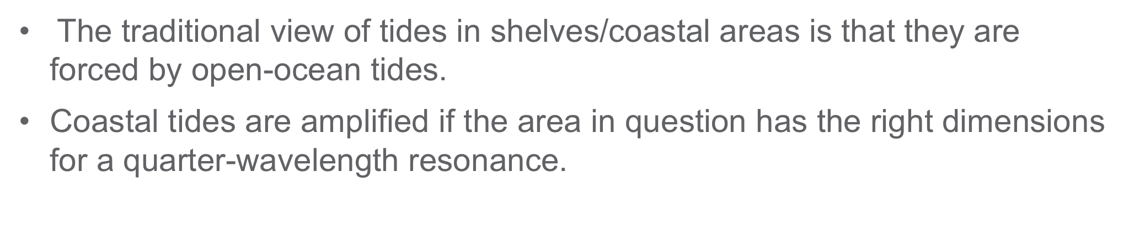
Impact of shelf tides upon open-ocean tides
The traditional view of tides in shelves/coastal areas is that they are forced by open-ocean tides.
Coastal tides are amplified if the area in question has the right dimensions for a quarter-wavelength resonance.

Slide 5
Impact of shelf tides upon open-ocean tides
In a series of papers (Arbic et al. 2007, 2009; Arbic et al. 2010), we demonstrated that coastal/shelf tides have a substantial back-effect on open-ocean tides.
Thus the shelf tides are important not only for their own sake but also because they feed back onto the open-ocean.

Slide 6
Impact of shelf tides upon open-ocean tides
Summary figure, in Haigh et al. (2020), of results in Arbic et al. (2009) and Arbic and Garrett (2010)
Analytical model in Arbic et al. (2009)

Slide 7
Impact of shelf tides upon open-ocean tides
What does all of this mean for our MPAS-O tidal simulations?
In structured grid simulations of ocean tides, the tidal accuracy increases when model grid spacing decreases.
A working hypothesis is that this is due to the increasing resolution in coastal areas, where the length scales of tides is much shorter than in the open ocean.
Another, related, working hypothesis is that, in a head-to-head competition between MPAS-O and a structured grid model with the same resolution in the open-ocean, MPAS-O is likely to have more accurate tides, due to its higher resolution in coastal areas.

Slide 8
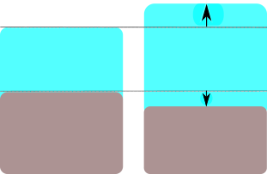
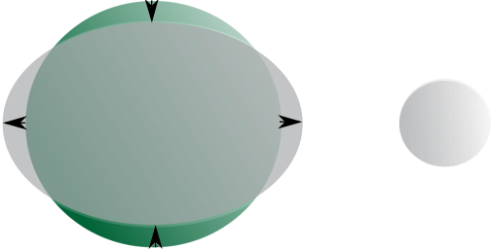
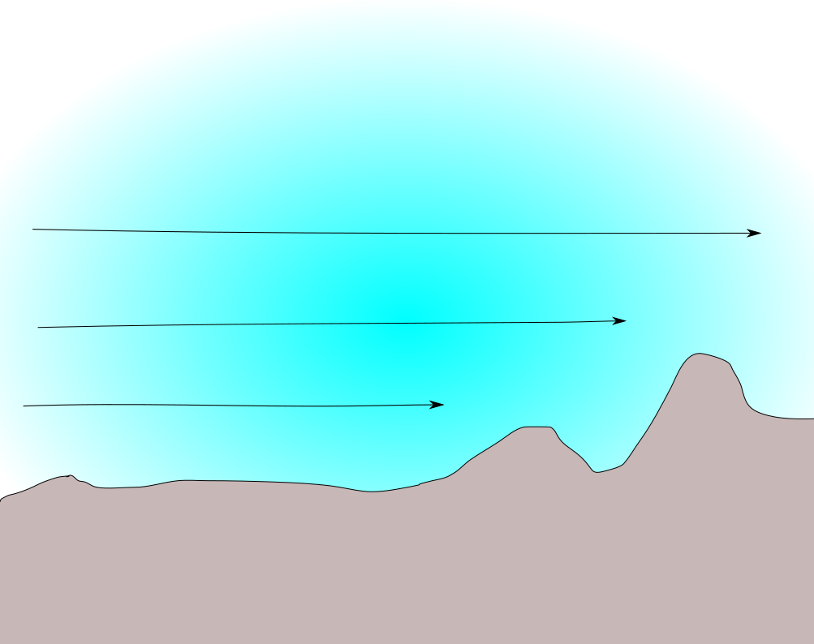
Tidal implementation package accounts for…
Self-Attraction and Loading
    Hendershott 1972
    Ray 1998
Astronomical forcing (Sun and Moon)
    Newton 1687
    Laplace 1775,1776
    Cartwright 1999
Nairita Pal
is implementing
the damping
Earth
Moon
SAL includes effects from:
    Tides deforming the earth
    Self-gravitation of earth
    Self-gravitation of water
Damping
Hendershott 1972→
Adjusted to account for:
    Solid body tide deformation
    Perturbation to potential due
    to self-gravitation
Kristin Barton
is implementing
an inline SAL
Damping includes:
    Quadratic bottom boundary layer drag (Taylor 1919)
    Parameterized topographic internal wave drag (Jayne and St. Laurent
    2001, and many others)

Slide 9
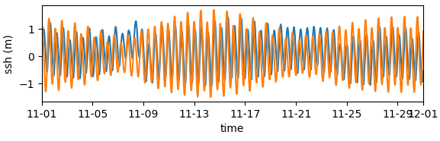
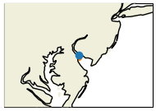
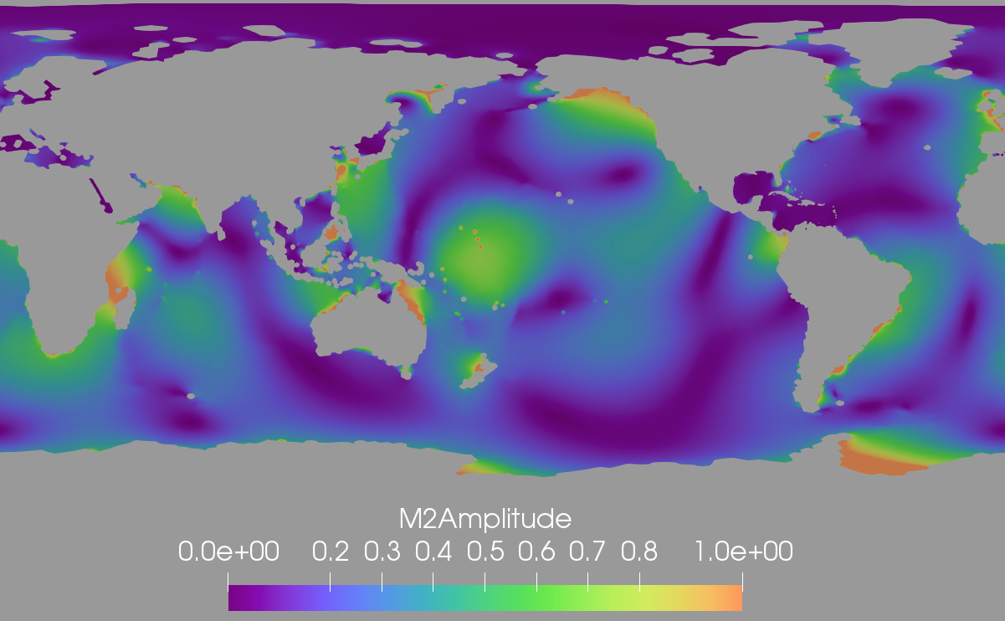
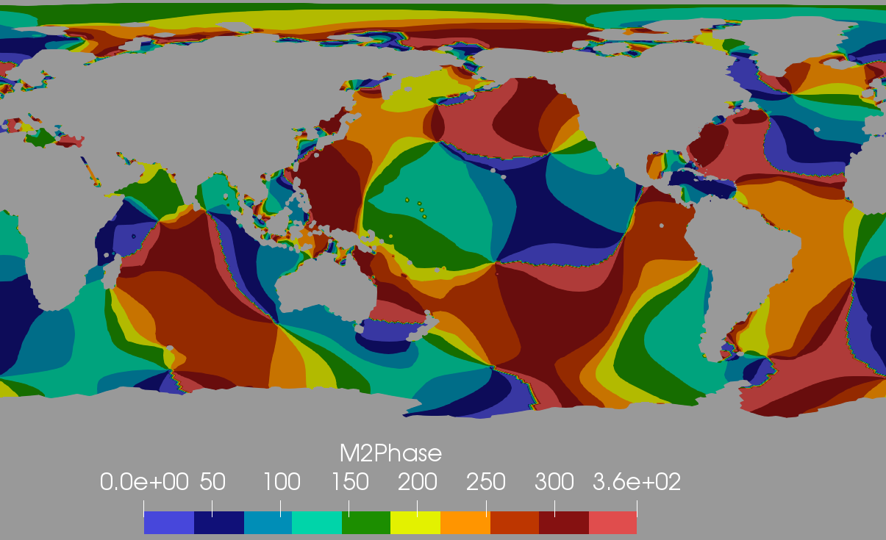
Tidal Modeling for E3SM So Far
Delaware Bay
Eight tidal constituents are now in MPAS-Ocean:
M₂, S₂, N₂, K₂, K₁, O₁, Q₁ and P₁
There are two phases of tidal development in MPAS: Short-term (months-long) barotropic simulations, and fully coupled climatic baroclinic simulations in E3SM, including sea ice, atmospheric and land coupling.
The barotropic model can have a finer (1-10km) mesh along the coastline.
Example of the M₂ Tide in MPAS-Ocean
Notes:
This slide was already presented by Elizabeth
Tides represent a major astronomical forcing in the earth system that are completely missing from most climate simulations, except by way of implicit terms in oceanic mixing schemes.
We anticipate that explicit oceanic tides in E3SM will contribute to simulated multi-decadal climate variability through interactions with sea ice, oceanic mixing and energy dissipation, and by improving the realism of simulated ice shelf melt rates. Most importantly, explicit tides are needed to model sea level change.
We are at the stage of simulating the largest semidiurnal (M2, S2, N2, K2) and diurnal (K1, O1, Q1 and P1) tidal constituents in Model for Prediction Across Scales or MPAS-O and running this in fully coupled simulations in E3SM.
We are now introducing self-attraction and loading, improved bottom drag, and topographic wave drag into the model to improve the accuracy of our simulations and are configuring MPAS-O to simulate tides using as a single-layer barotropic model at extremely high resolution (~1km) in coastal regions, and as a full baroclinic model coupled within E3SM.

Slide 10
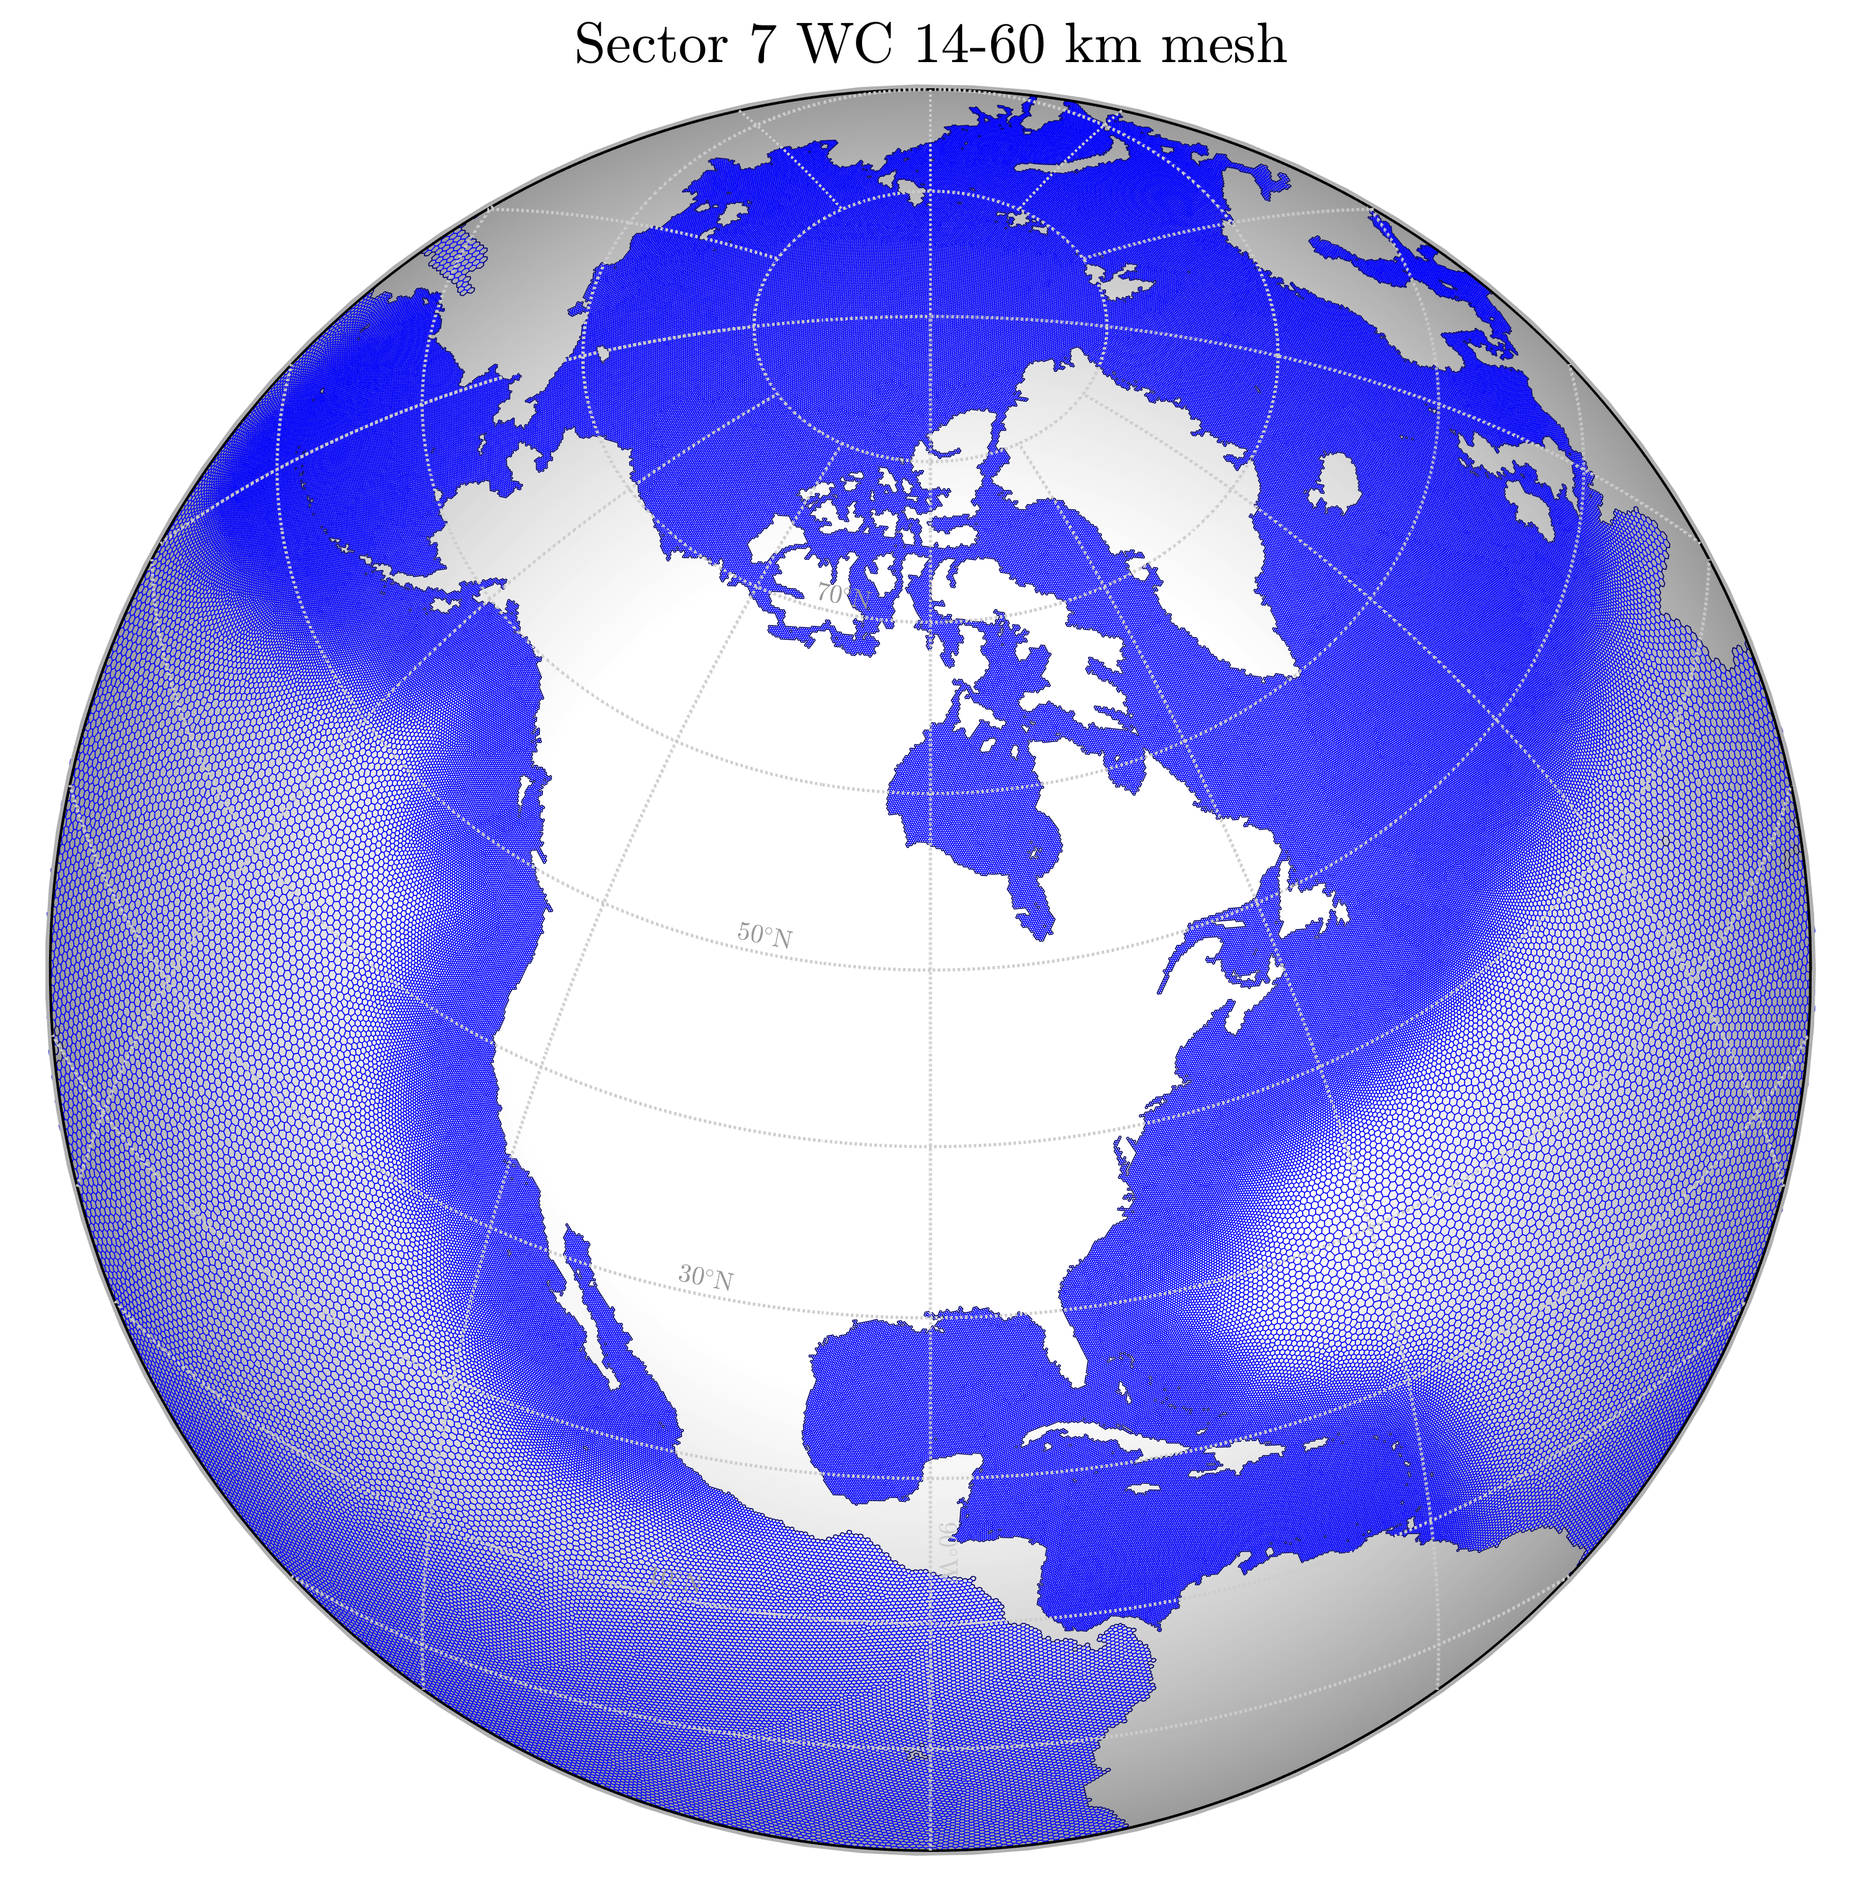
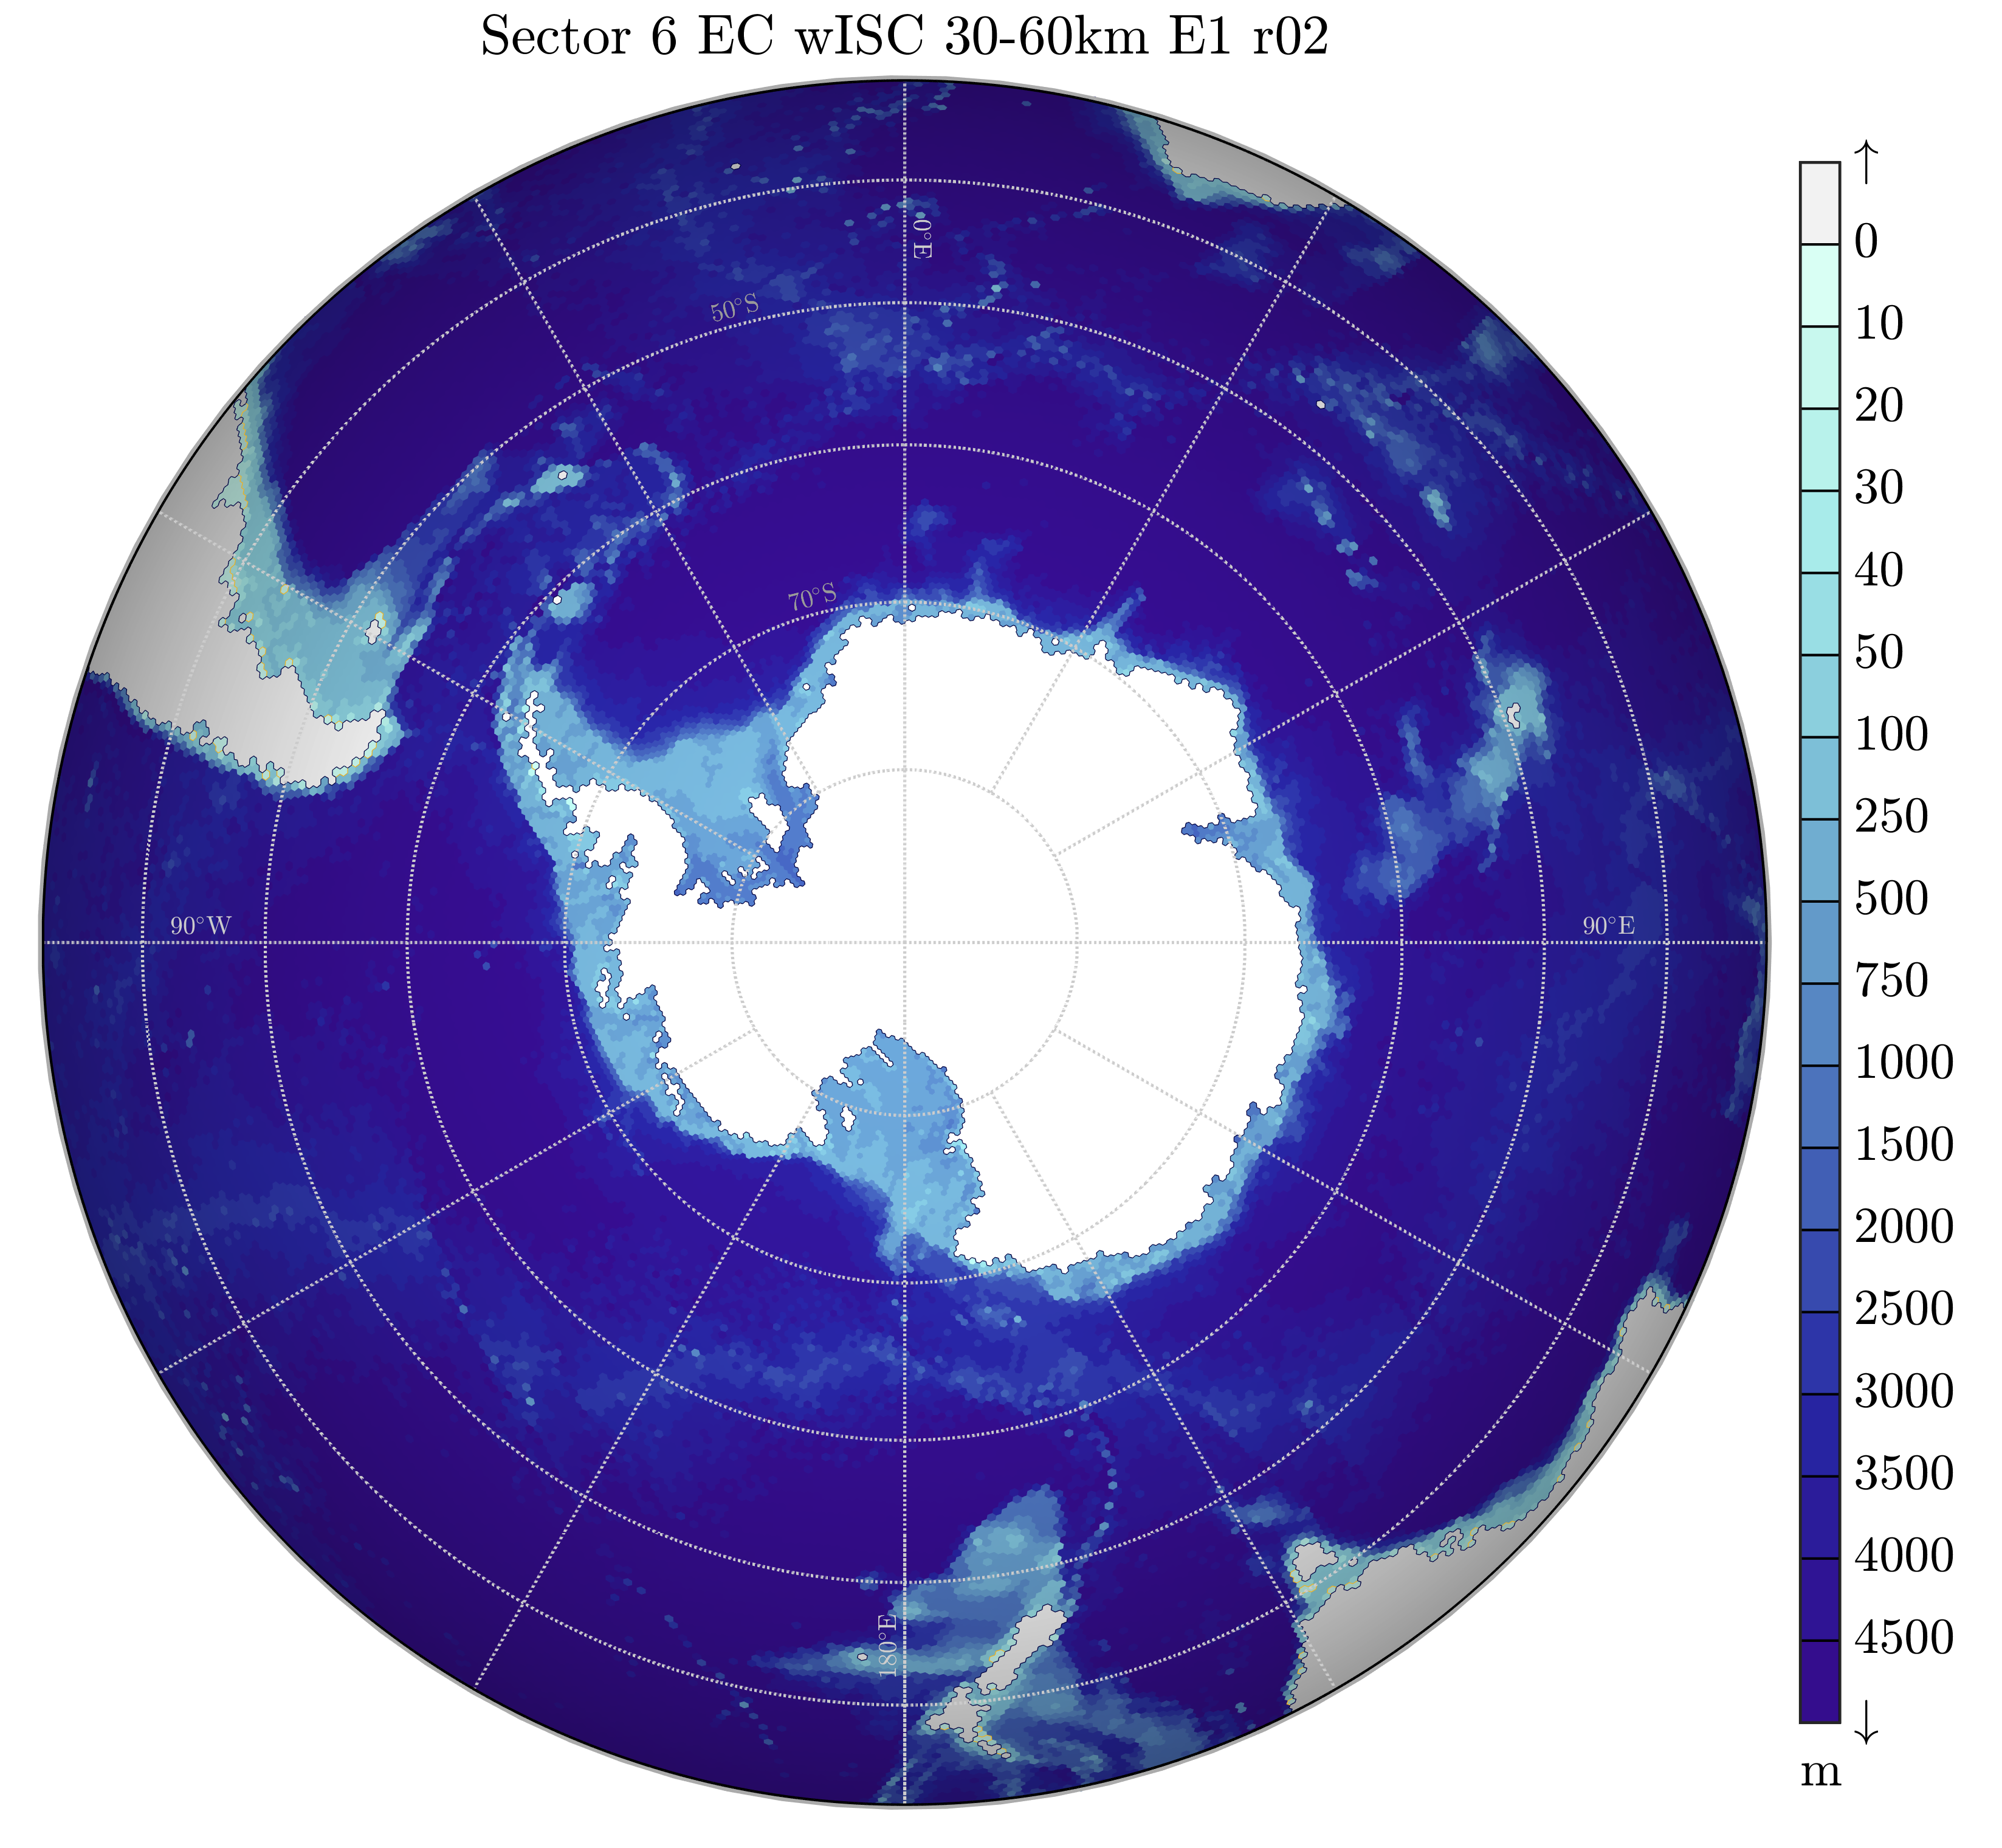
Tides Simulation Campaign in MPAS and E3SM
Example of mesh being trialed in the coming year –
Regional refinement (top), including with Antarctic ice shelf cavities (bottom)

Slide 11
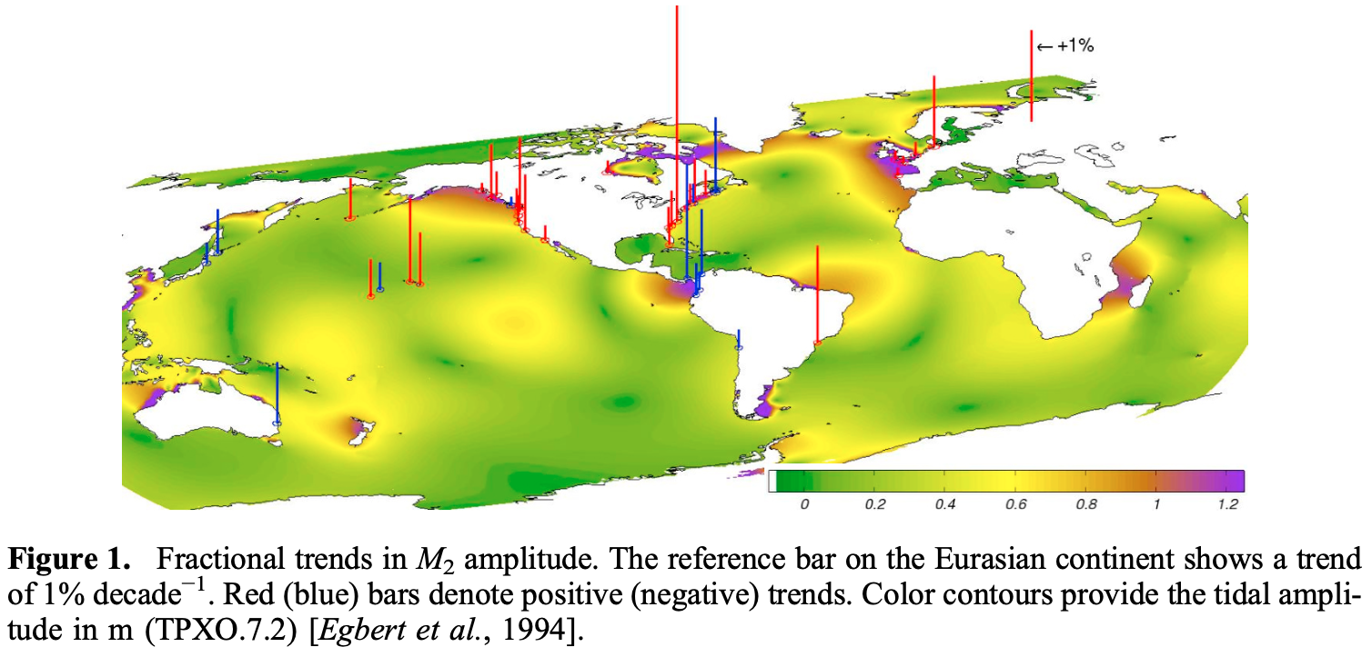
Importance of tides in a global ocean model
Tides themselves are not constant, they can be influenced by things like:
Tectonics
Water depth
Shoreline position
Seabed roughness
Extent of sea ice coverage
More!
Figure taken from Müller et al. (2011). See also Haigh et al. (2020) for an overview of centennial-scale secular changes in tides.

Slide 12
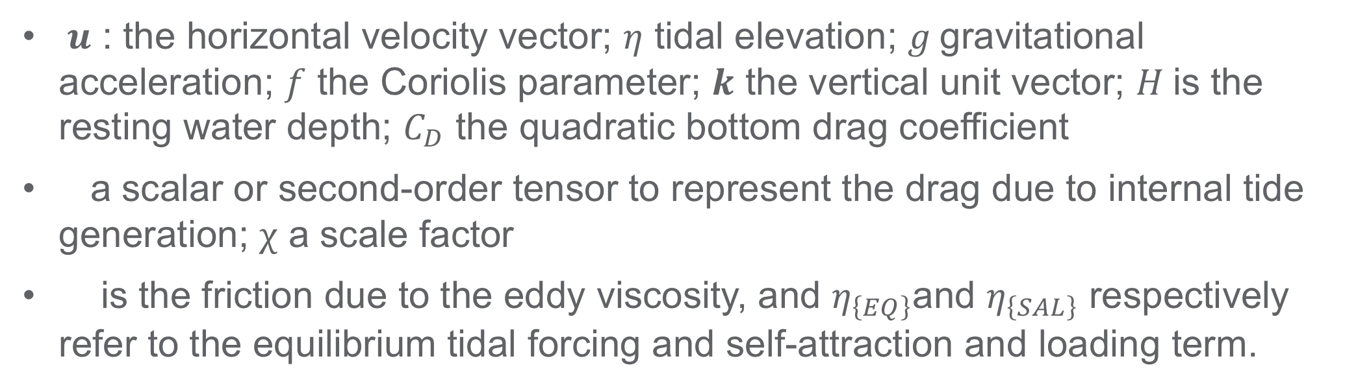
Implementation of internal wave-drag in MPAS-O
Momentum equation with wave-drag
$u$ : the horizontal velocity vector; $η$ tidal elevation; $g$gravitational acceleration; $f$ the Coriolis parameter; $k$ the vertical unit vector; $H$is the resting water depth; $C_{D}$ the quadratic bottom drag coefficient
a scalar or second-order tensor to represent the drag due to internal tide generation; $χ$ a scale factor
is the friction due to the eddy viscosity, and $η_{\left\{EQ\right\}}$and $η_{\left\{SAL\right\}}$ respectively refer to the equilibrium tidal forcing and self-attraction and loading term.
Buijsman et al. (2015), amongst others.

Slide 13
Internal Wave drag term
The internal wave drag term is
is the e-folding decay time
We used the Jayne and St. Laurent (2001) scheme in our work
Wave drag using the Jayne and St. Laurent (2001) scheme
bottom roughness; buoyancy frequency at the bottom; wavelength of the topography

Slide 14
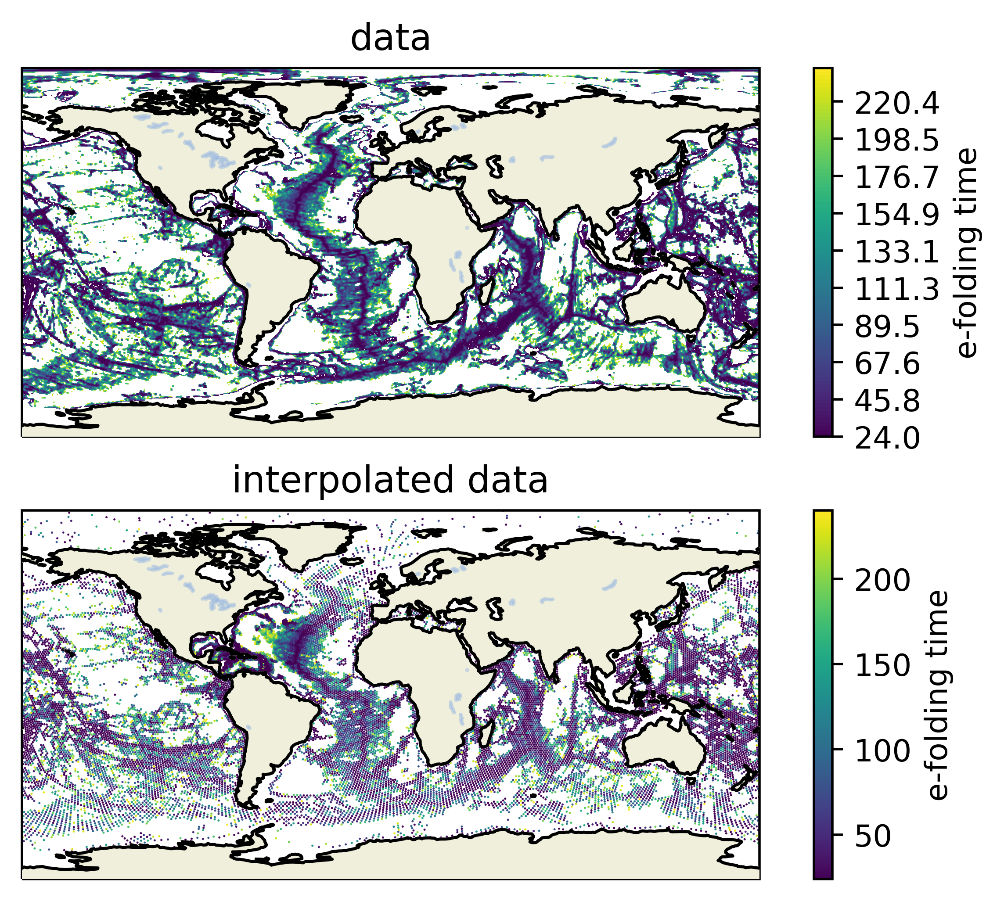
e-folding time from HYCOM
Top: e-folding time scale map used in HYCOM.
Bottom: e-folding time-scale map interpolated to MPAS grid
The e-folding times are clipped so that the range is 24 hours to 240 hours. The high values occur because those areas do not have a defined e-folding time.
The drag used in MPAS is the inverse of the e-folding time.

Slide 15
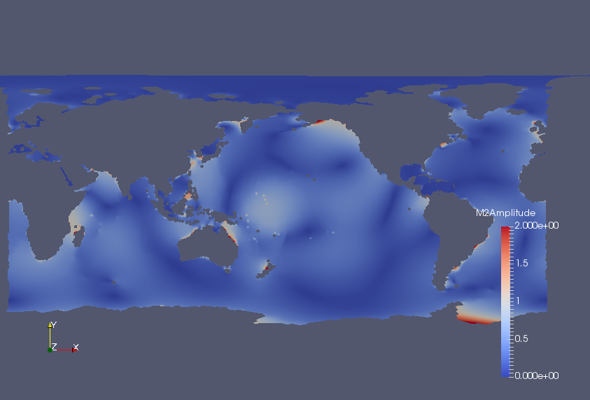
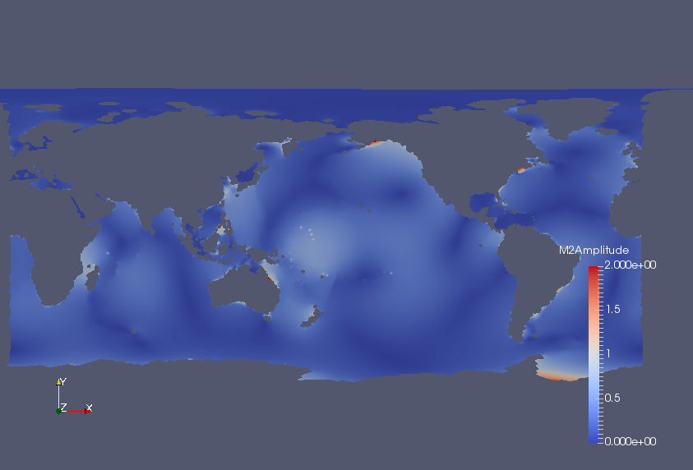
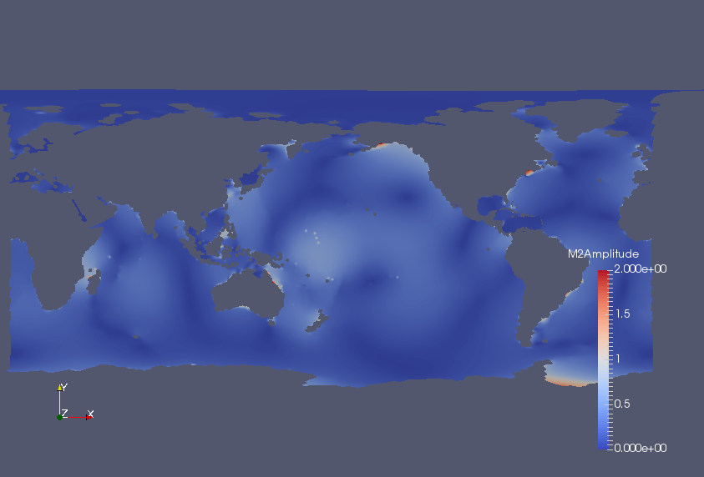
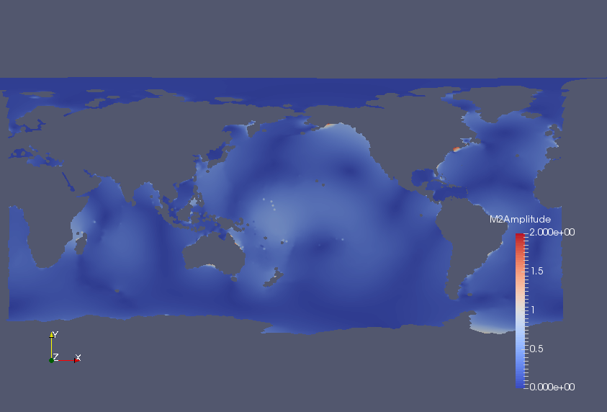
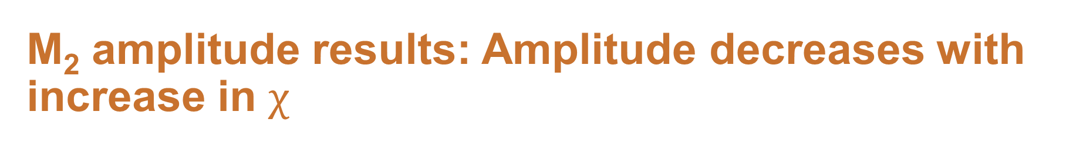
M₂ amplitude results: Amplitude decreases with increase in $χ$
No drag
$$χ=0.01$$
$$χ=0.08$$
$$χ=0.3$$

Slide 16
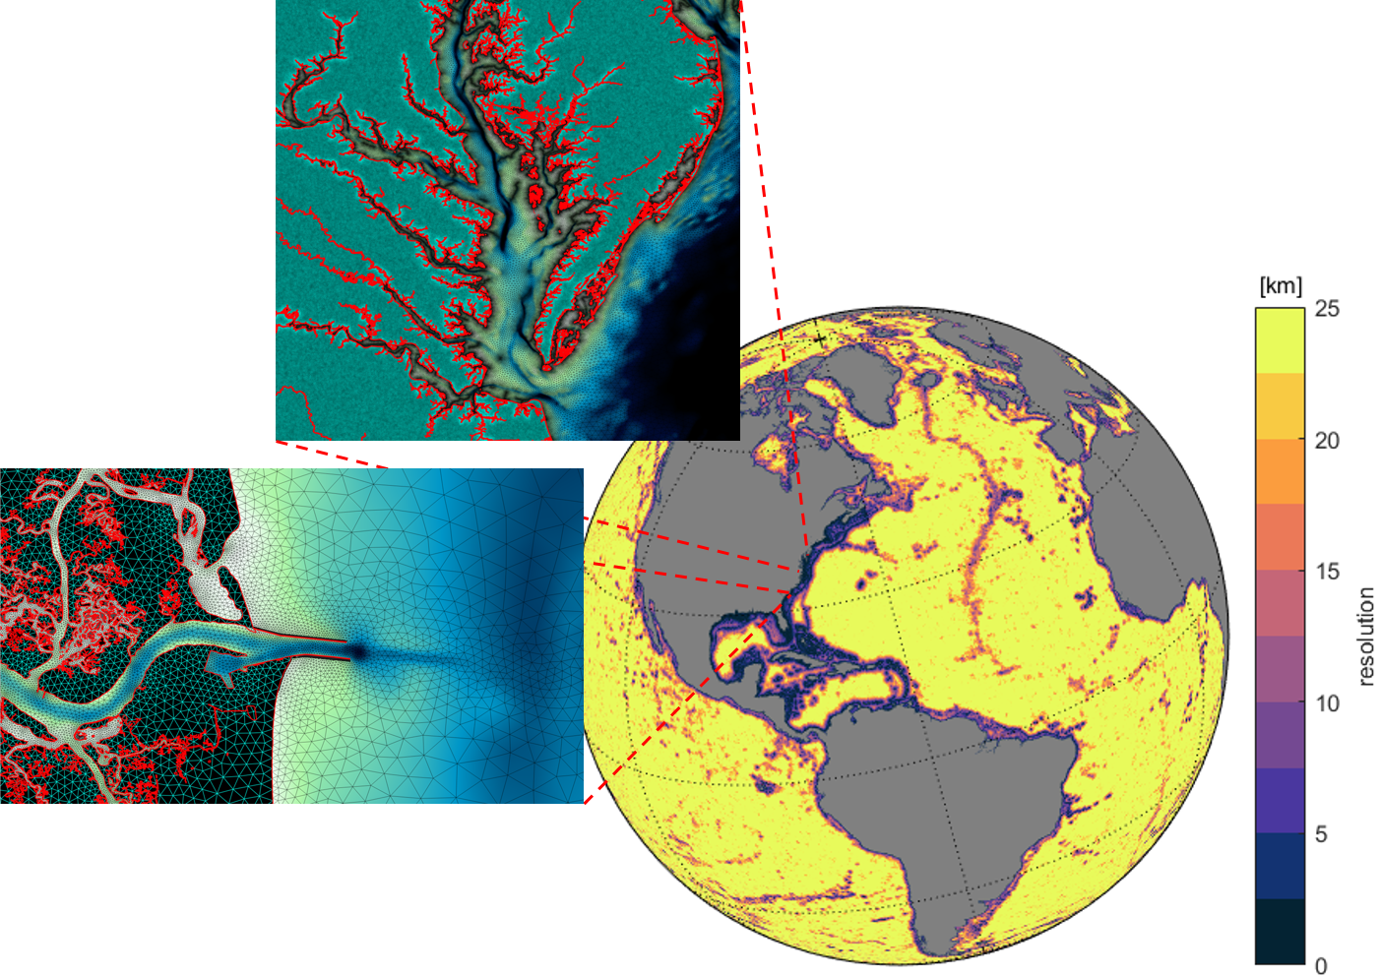
NOAA’s Global Extratropical Storm and Tide Model (G-ESTOFS)
Integrated global model with non-conformal unstructured finite elements from down to 30m and up to 24km resolution
Pringle, W.J., D. Wirasaet, K.J. Roberts, J.J. Westerink, "Global Storm Tide Modeling with ADCIRC v55: Unstructured Mesh Design and Performance," Geoscientific Model Development, preprint https://doi.org/10.5194/gmd-2020-123, 2020

Slide 17
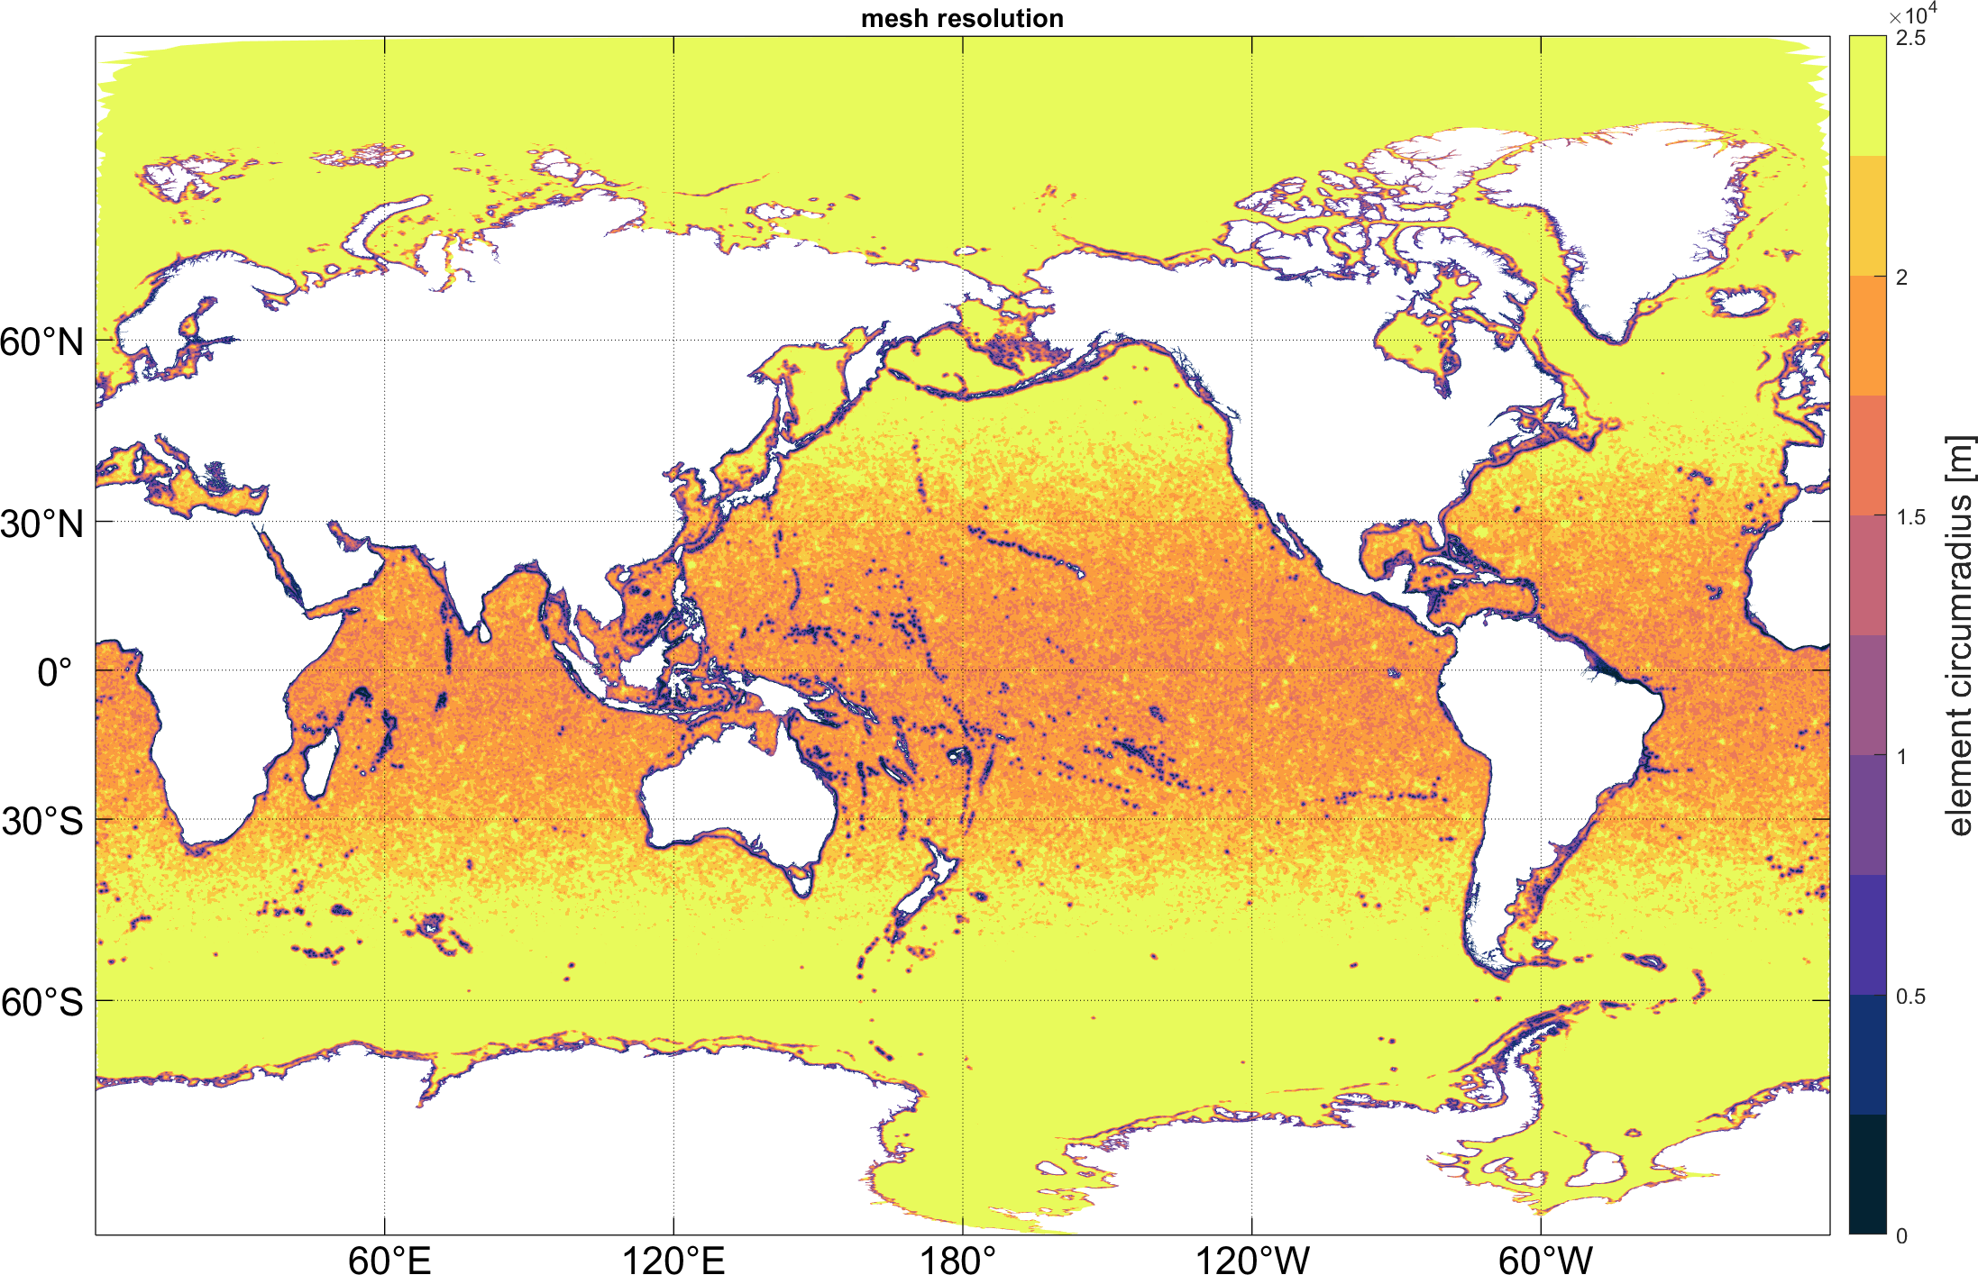
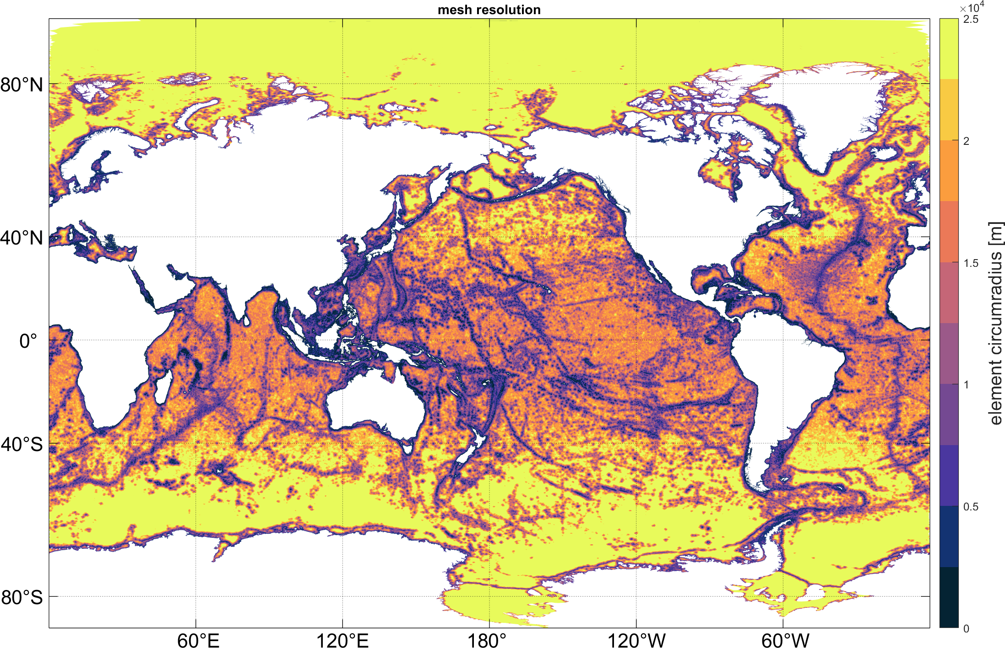
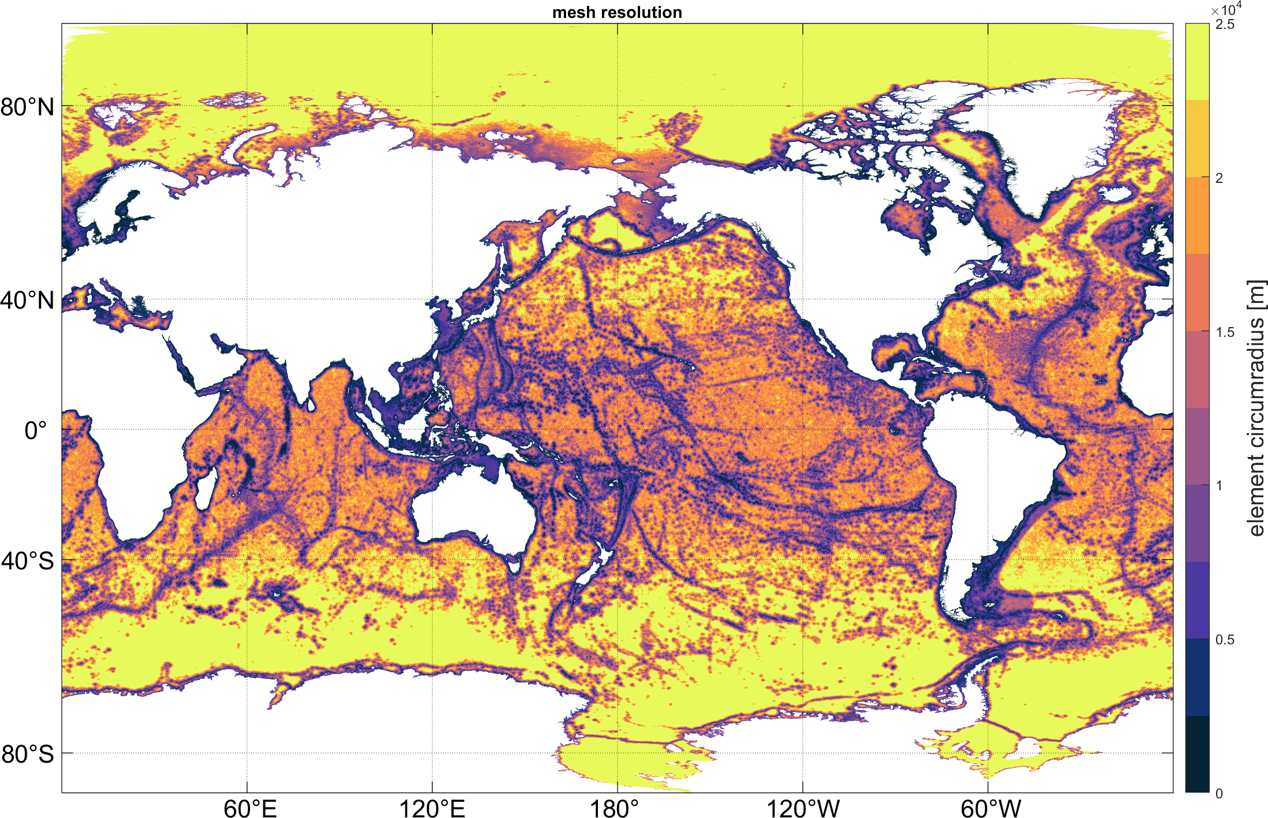
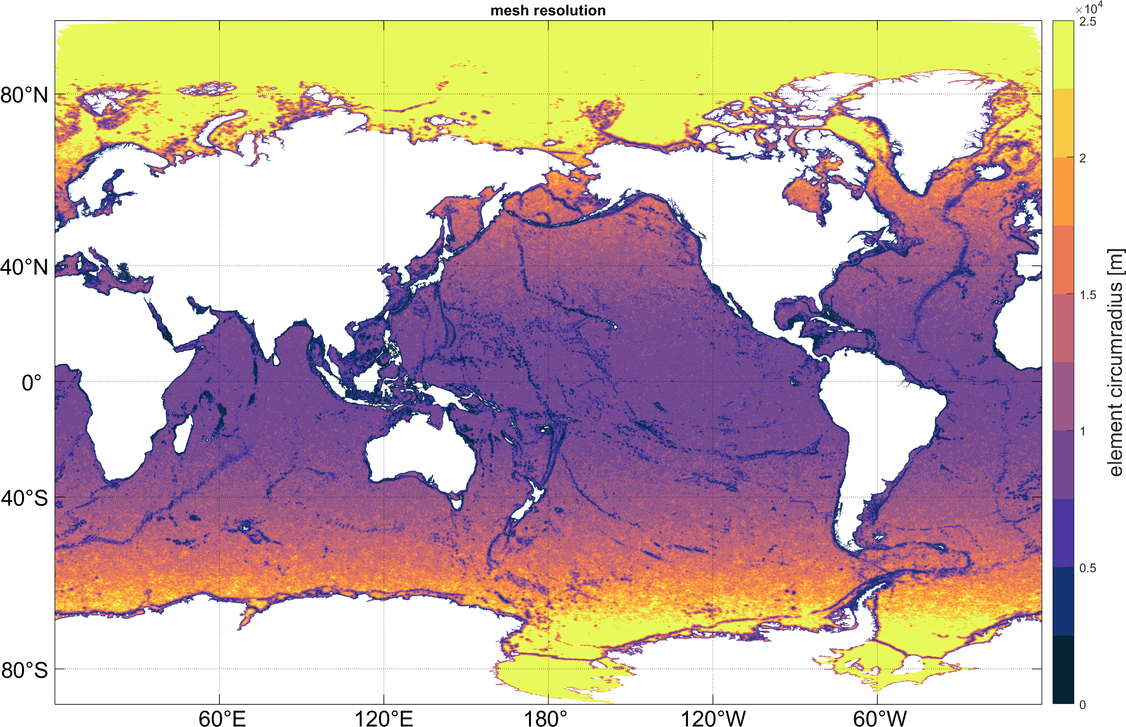
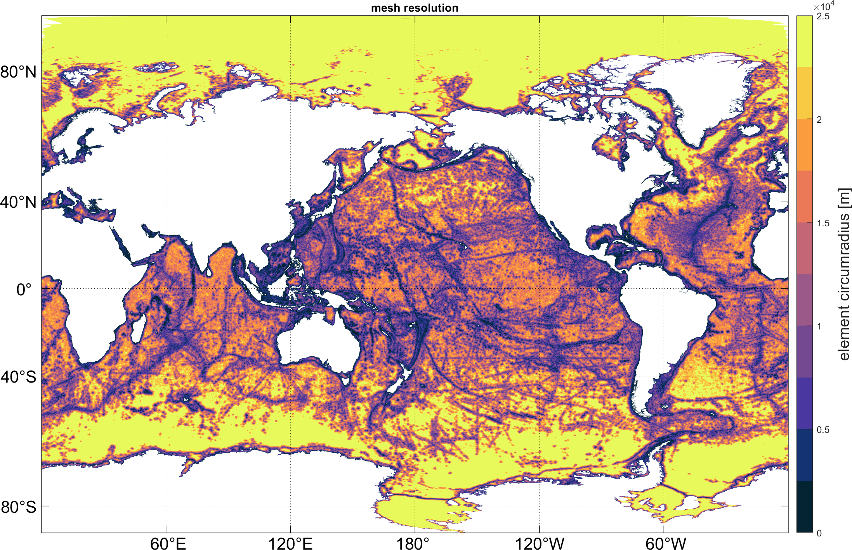
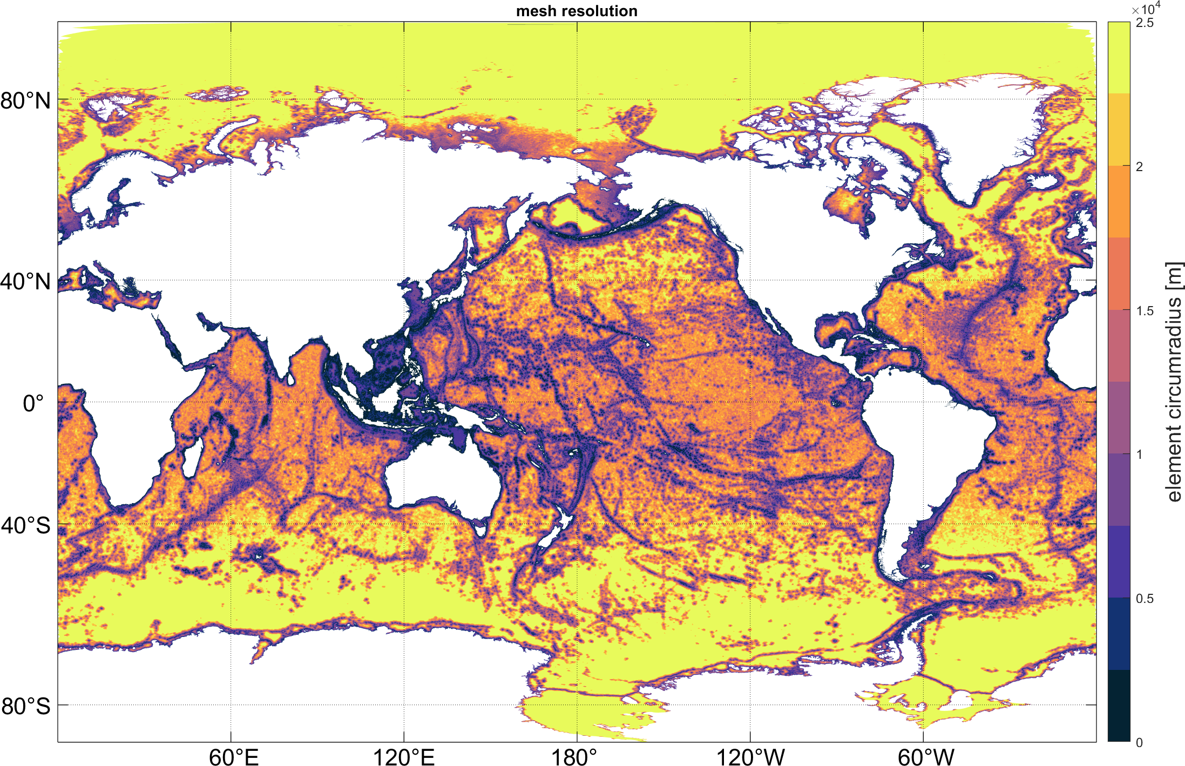
Lessons learned: Resolution, topography, and dissipation
Study resolution of topographic gradients, local increases in nearshore and shelf resolution, and deep ocean resolution
25 to 2 km high topo filter 25 to 2 km low topo filter Hot spot resolution
12.5 to 2 km low topo filter 25 to 1 km low topo filter 25 to 2 km with regional

Slide 18
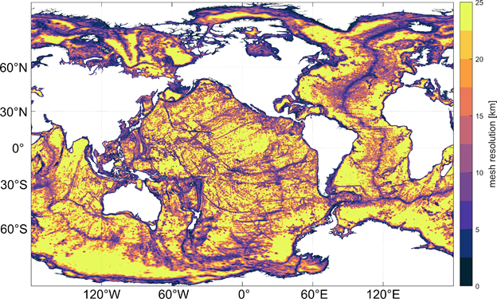
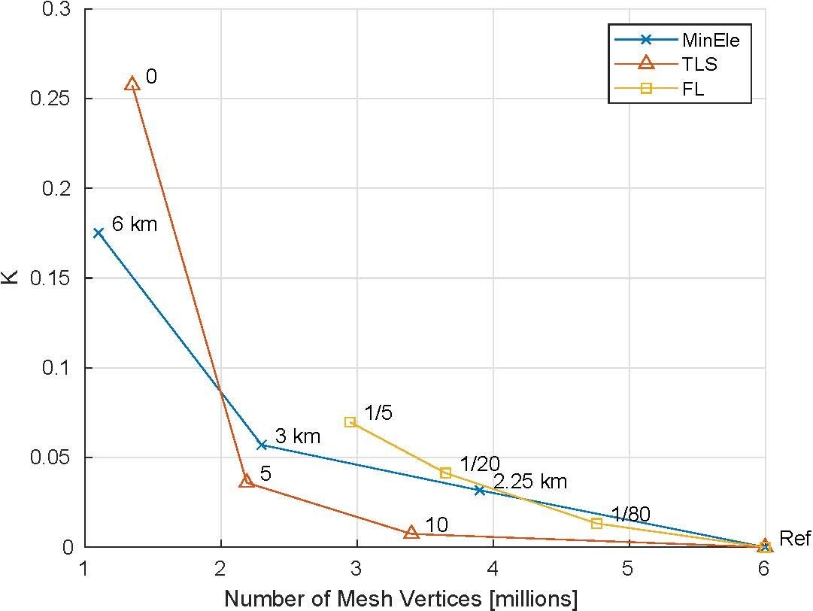
Lessons learned: Resolution, topography, and dissipation
Resolving topographic lengths scales is critical in achieving efficient accurate meshes
Operational mesh with re-oriented poles Two-sample Kolmogorov-Smirnov test statistic

Slide 19
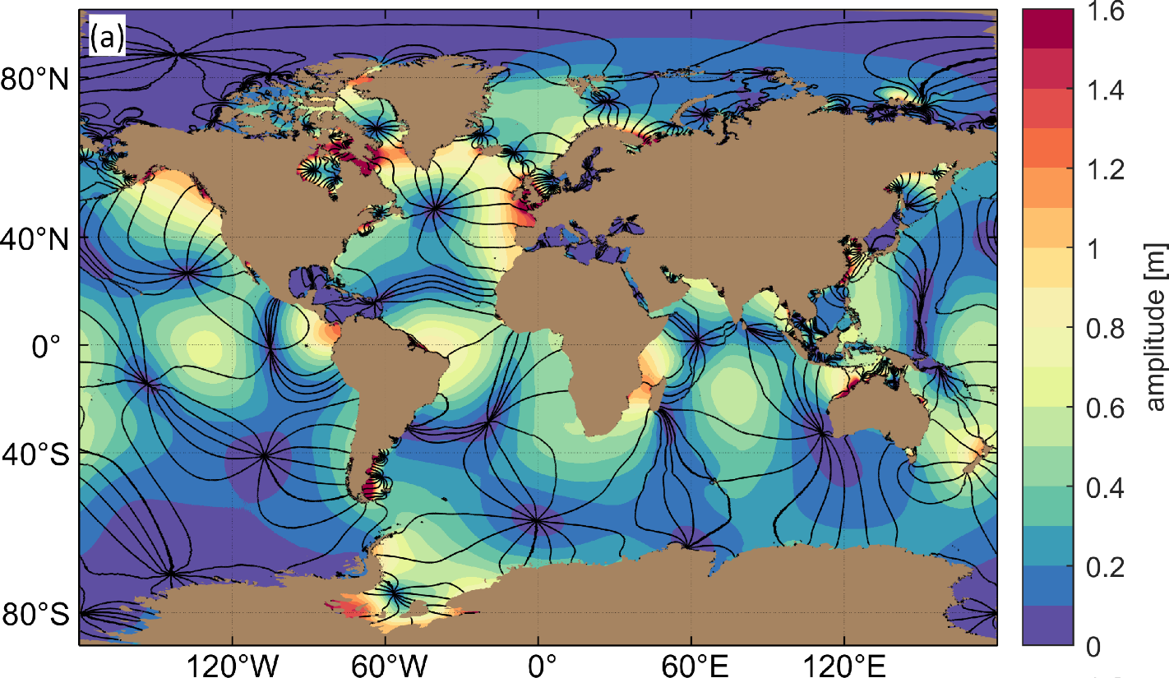
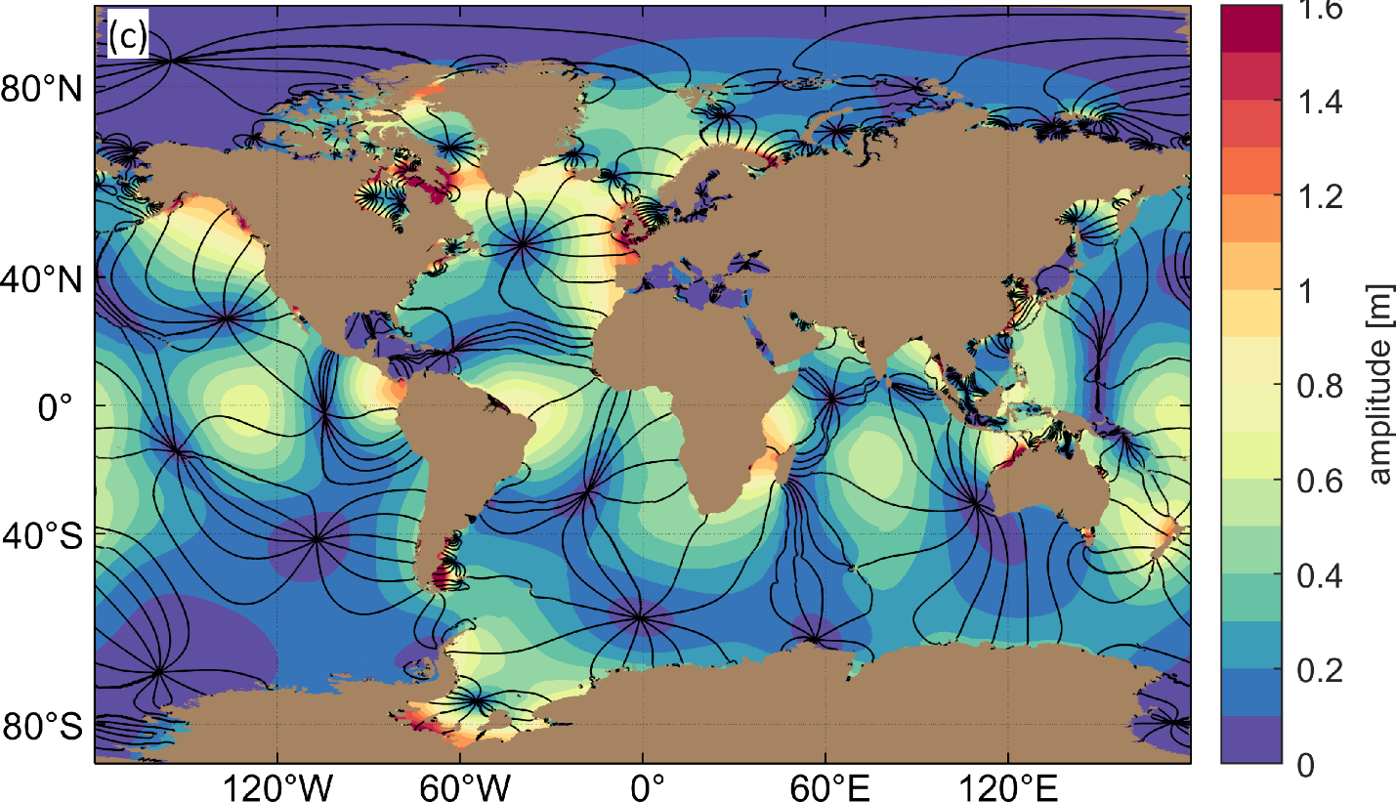
Lessons learned: Resolution, topography, and dissipation
M₂ amplitude and phase lines
ADCIRC
TPX08
dg

Slide 20
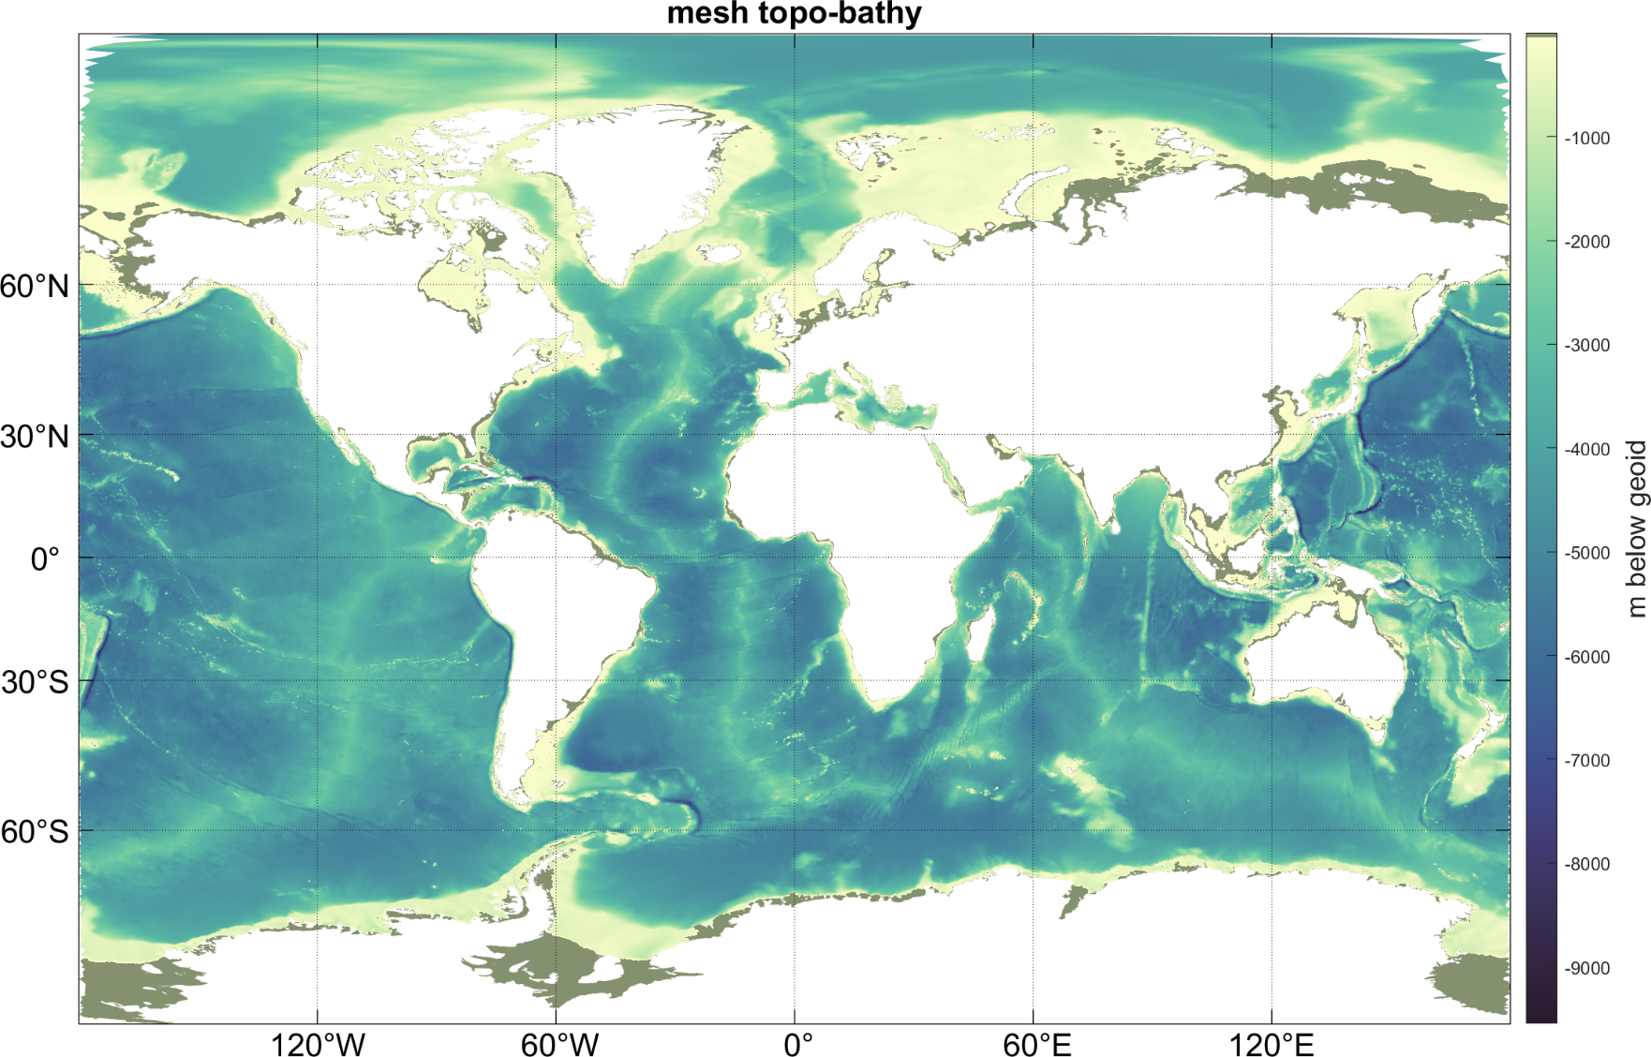
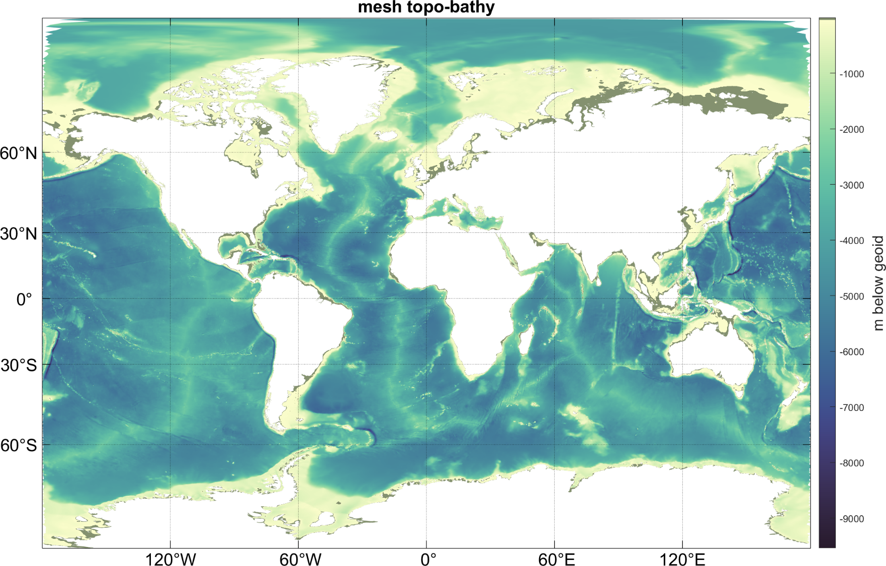
Lessons learned: Resolution, topography, and dissipation
Study impact of topographic data sets
GEBCO2014 GEBCO2019+Rtopo+NONNA+AUS

Slide 21
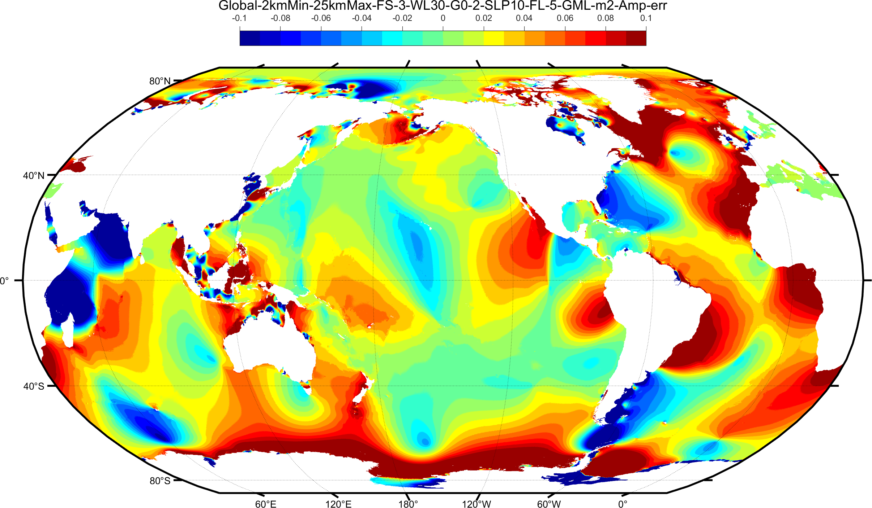
Lessons learned: Resolution, topography, and dissipation
M₂ amplitude: ADCIRC(GEBCO2014) – TPX08
GEBCO2019+Rtopo (Antarctica) GEBCO2019+Rtopo+NONNA+AUS

Slide 22
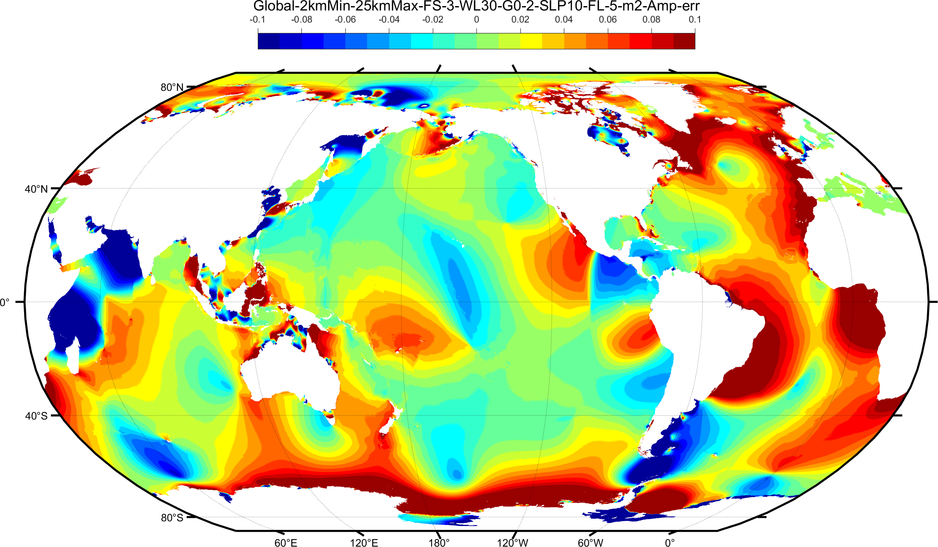
Lessons learned: Resolution, topography, and dissipation
M₂ amplitude: ADCIRC(GEBCO2019) – TPX08
GEBCO2019+Rtopo (Antarctica) GEBCO2019+Rtopo+NONNA+AUS

Slide 23
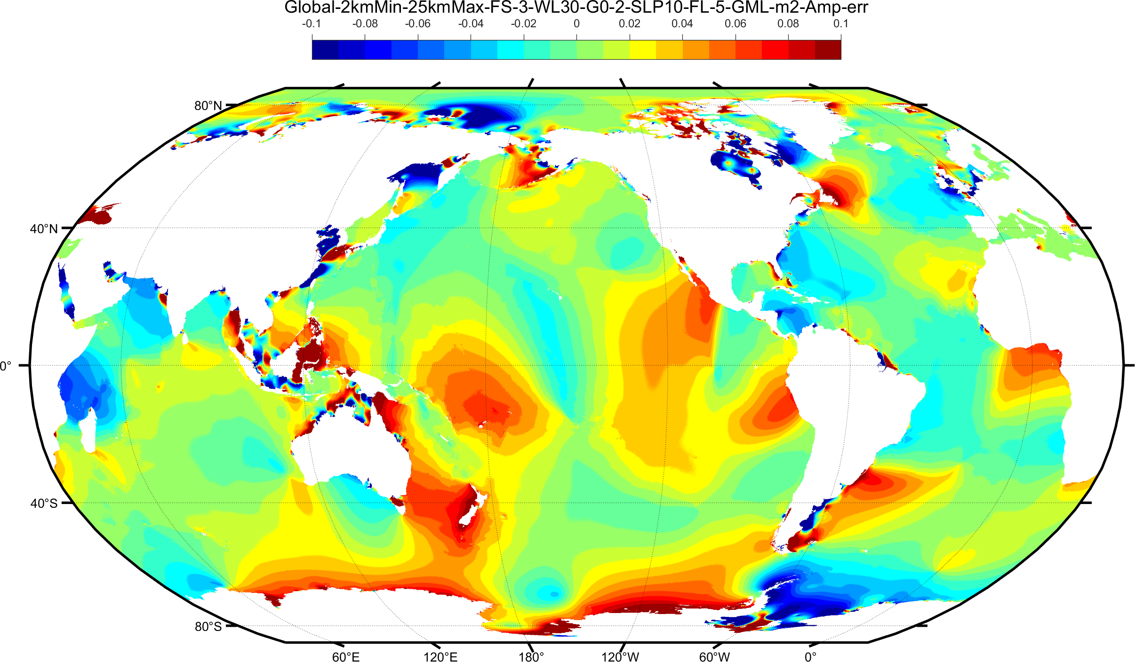
Lessons learned: Resolution, topography, and dissipation
M₂ amplitude: ADCIRC/(GEBCO2019+Rtopo) – TPX08
GEBCO2019+Rtopo (Antarctica) GEBCO2019+Rtopo+NONNA+AUS

Slide 24
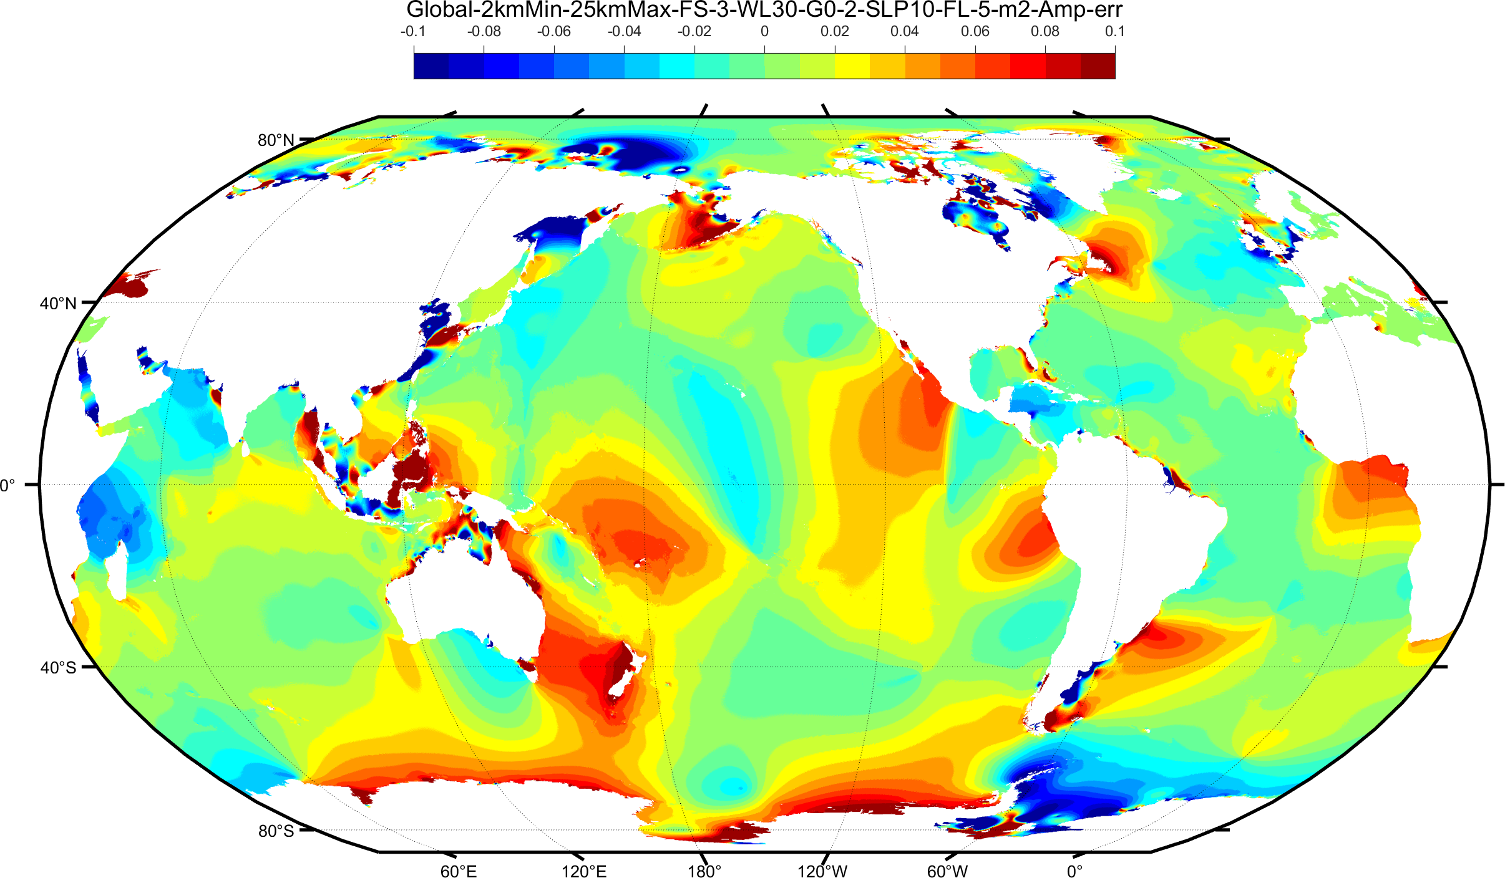
Lessons learned: Resolution, topography, and dissipation
M₂ amplitude: ADCIRC/(GEBCO2019+Rtopo+NONNA+AUS) – TPX08
GEBCO2019+Rtopo (Antarctica) GEBCO2019+Rtopo+NONNA+AUS

Slide 25
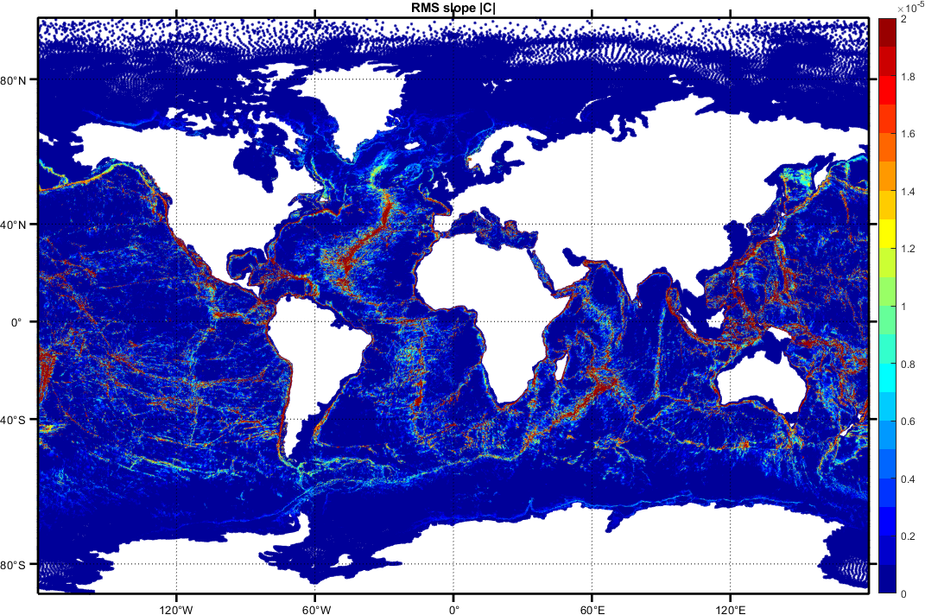
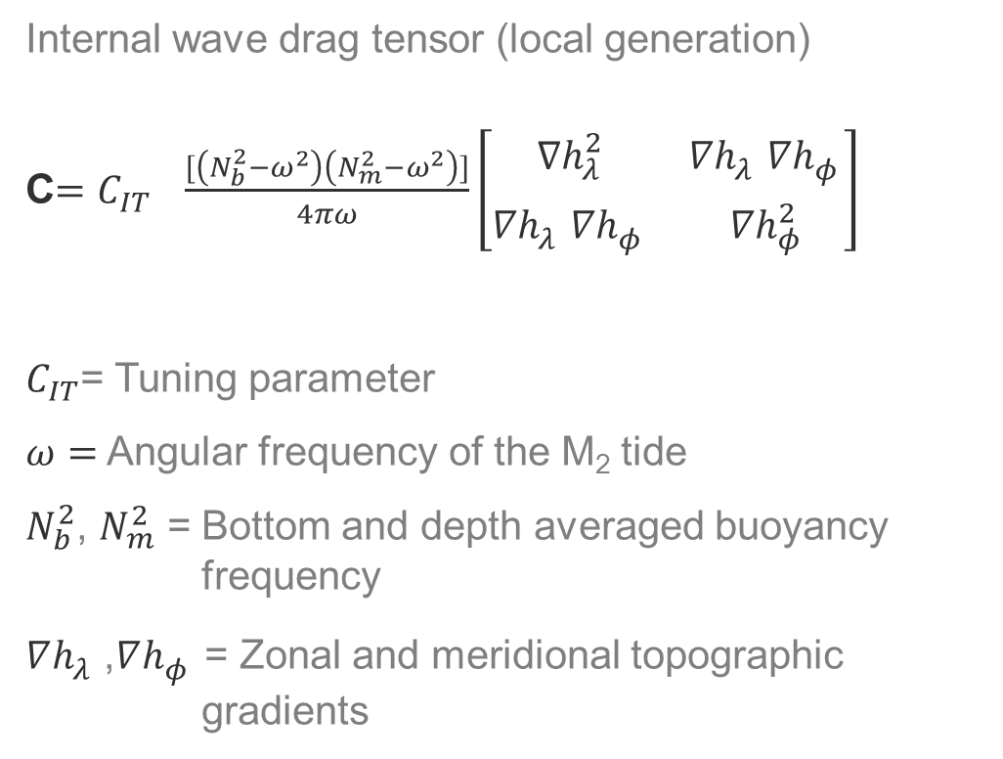
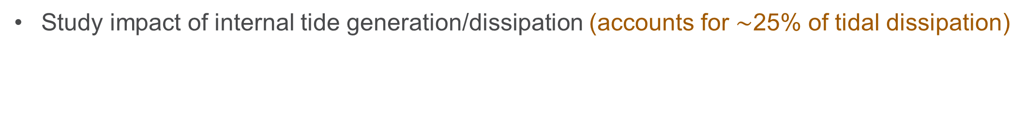
Lessons learned: Resolution, topography, and dissipation
Study impact of internal tide generation/dissipation (accounts for $\sim$25% of tidal dissipation)
Internal wave drag tensor (local generation)
C$=C_{IT} \frac{[\left(N_{b}^{2}−ω^{2}\right)\left(N_{m}^{2}−ω^{2}\right)]}{4πω}\left[\begin{matrix}∇h_{λ}^{2} & {∇h}_{λ}^{}{∇h}_{φ}^{} \\ {∇h}_{λ}^{}∇h_{φ}^{} & ∇h_{φ}^{2}\end{matrix}\right]$
$C_{IT}$= Tuning parameter
$ω=$ Angular frequency of the M₂ tide
$N_{b}^{2}$, $N_{m}^{2}$ = Bottom and depth averaged buoyancy frequency
$∇h_{λ}^{}$,$∇h_{φ}^{}$ = Zonal and meridional topographic gradients
Internal tide dissipation |C|
Lyard et al., 2006; Garrett and Kunze, 2007; Pringle, W.J., D. Wirasaet, A. Suhardjo, J. Meixner, J.J. Westerink, A.B. Kennedy, S. Nong, "Finite-Element barotropic model for the Indian and Western Pacific Oceans: Tidal model-data comparisons and sensitivities," Ocean Modeling, https://doi.org/10.1016/j.ocemod.2018.07.003, 129, 13-38, 2018.

Slide 26
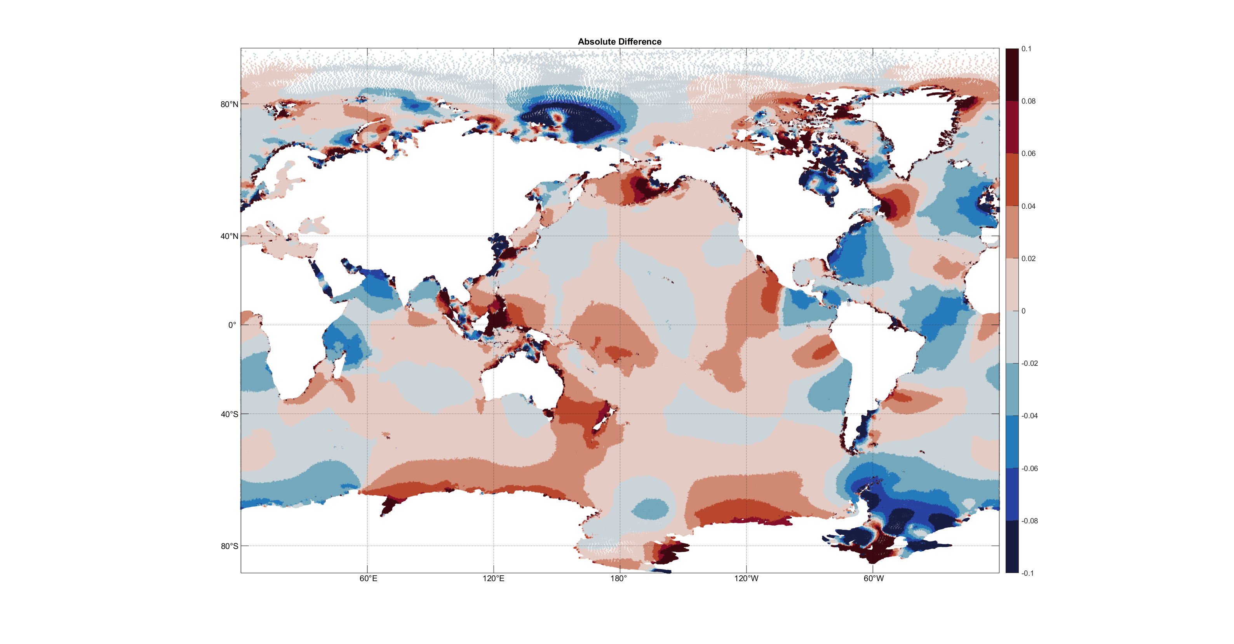
Lessons learned: Resolution, topography, and dissipation
M₂ amplitude: ADCIRC (C_{IT} = 1.7) - TPXO8 solution

Slide 27
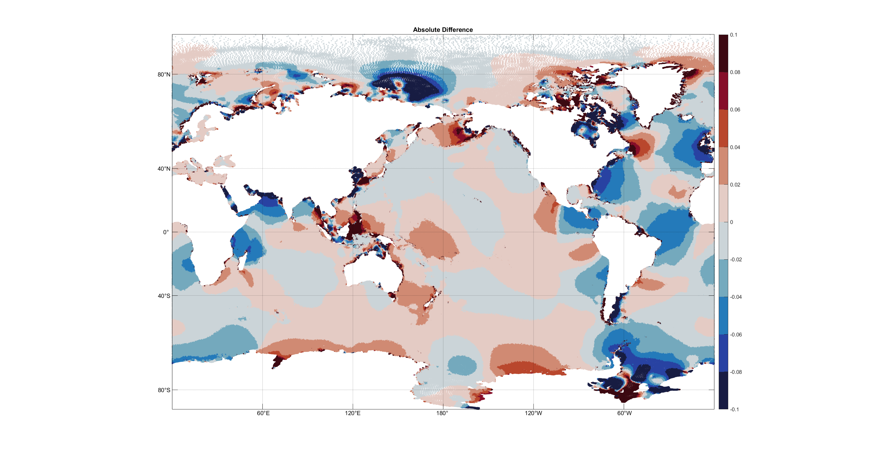
Lessons learned: Resolution, topography, and dissipation
M₂ amplitude: ADCIRC (C_{IT} = 1.9) - TPXO8 solution

Slide 28
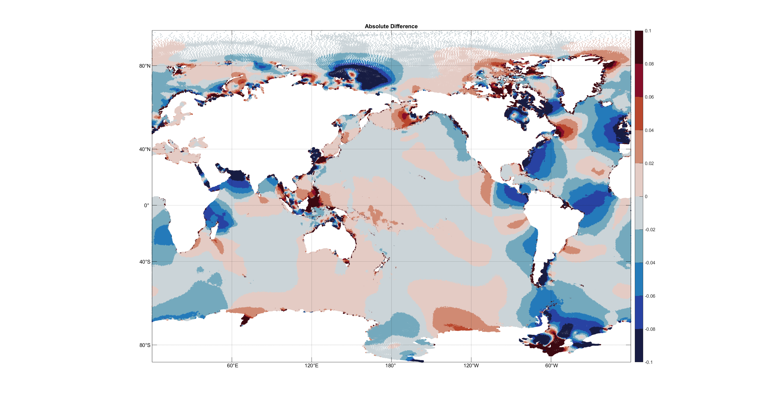
Lessons learned: Resolution, topography, and dissipation
M₂ amplitude: ADCIRC (C_{IT} = 2.1) - TPXO8 solution

Slide 29
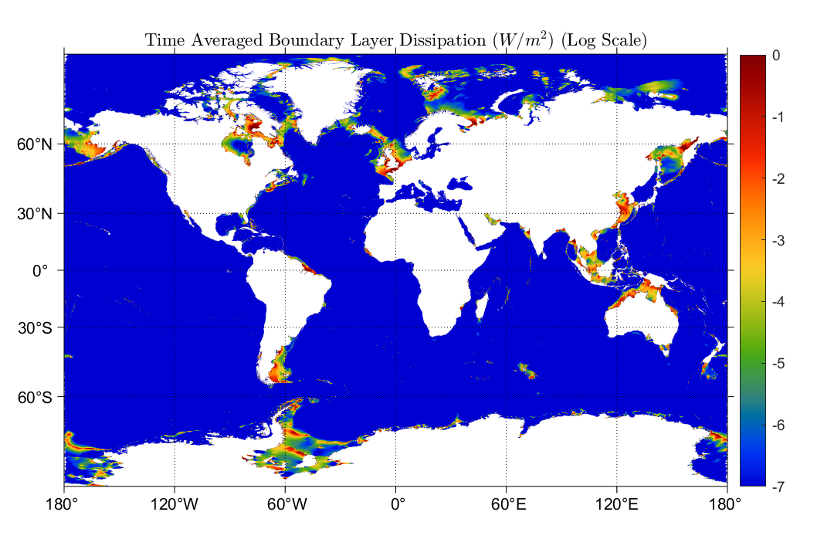
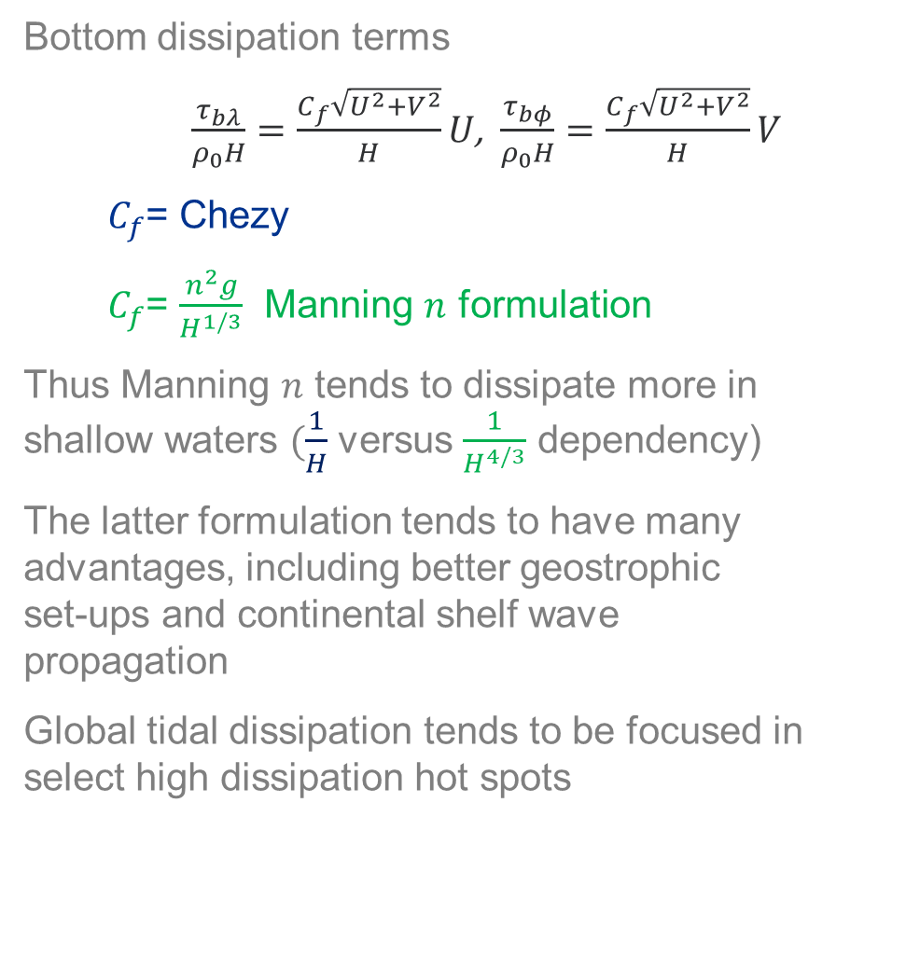
Lessons learned: Resolution, topography, and dissipation
Study bottom boundary layer dissipation (accounts for $\sim$75% of tidal dissipation)
Bottom dissipation terms
$\frac{τ_{bλ}}{ρ_{0}H}=\frac{C_{f}\sqrt{U^{2}+V^{2}}}{H}U$, $\frac{τ_{bφ}}{ρ_{0}H}=\frac{C_{f}\sqrt{U^{2}+V^{2}}}{H}V$
  $C_{f}$= Chezy
  $C_{f}$= $\frac{n^{2}g}{H^{1/3}}$ Manning $n$ formulation
Thus Manning $n$ tends to dissipate more in shallow waters $(\frac{1}{H}$ versus $\frac{1}{H^{4/3}}$ dependency)
The latter formulation tends to have many advantages, including better geostrophic set-ups and continental shelf wave propagation
Global tidal dissipation tends to be focused in select high dissipation hot spots

Slide 30
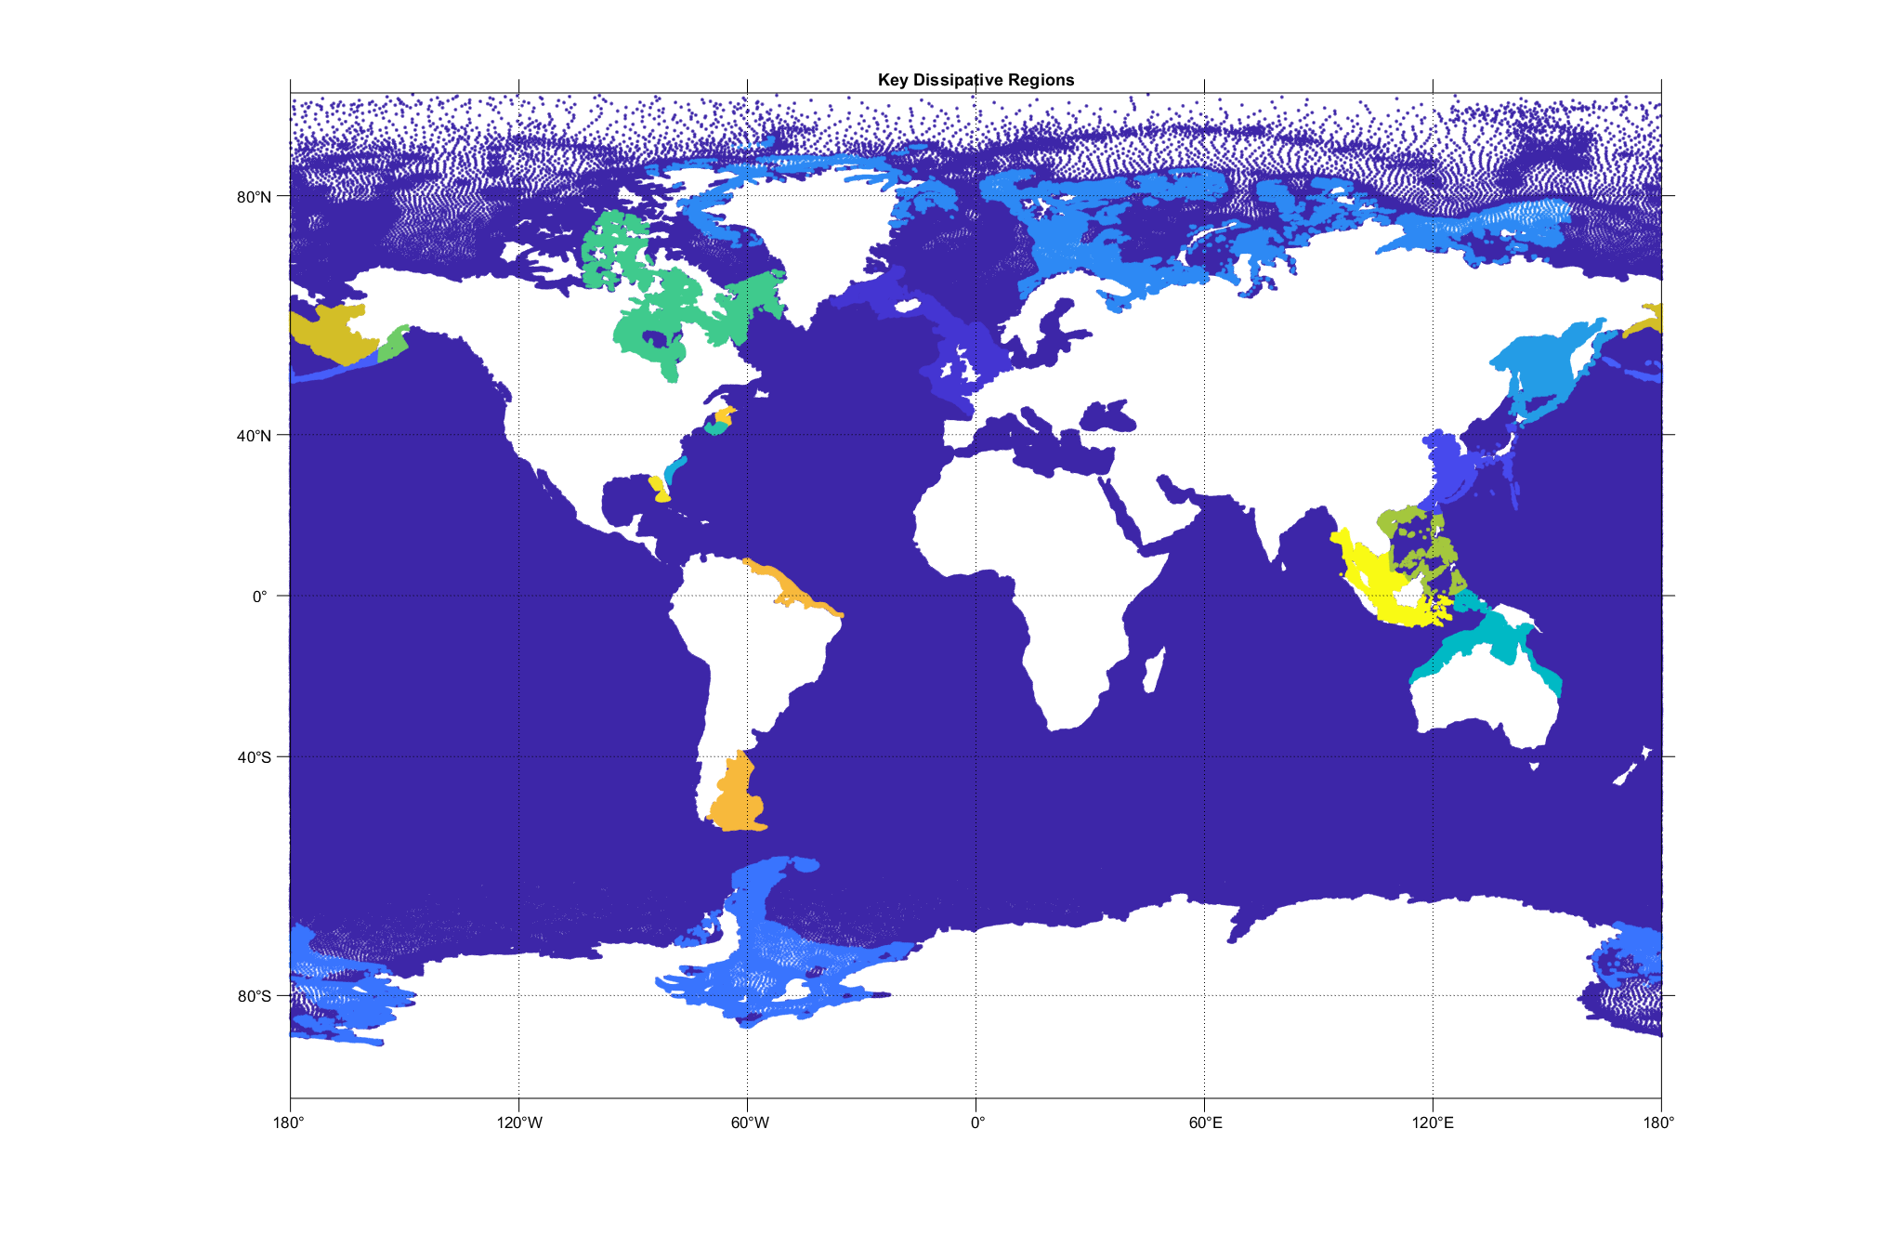
Lessons learned: Resolution, topography, and dissipation
To understand global impact we perturbed Manning n in dissipation hot spots

Slide 31
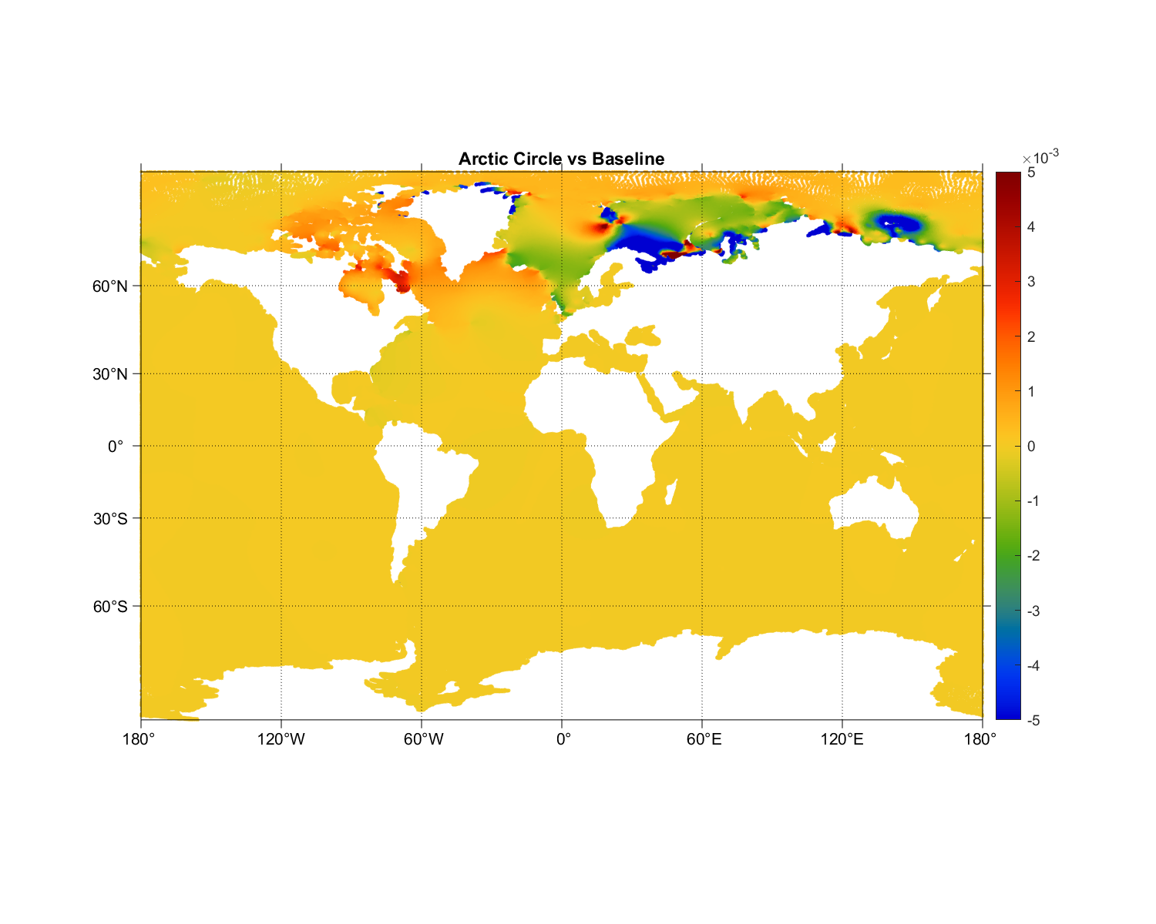
Lessons learned: Resolution, topography, and dissipation
M₂ amplitude difference (m) baseline to perturbed solution

Slide 32
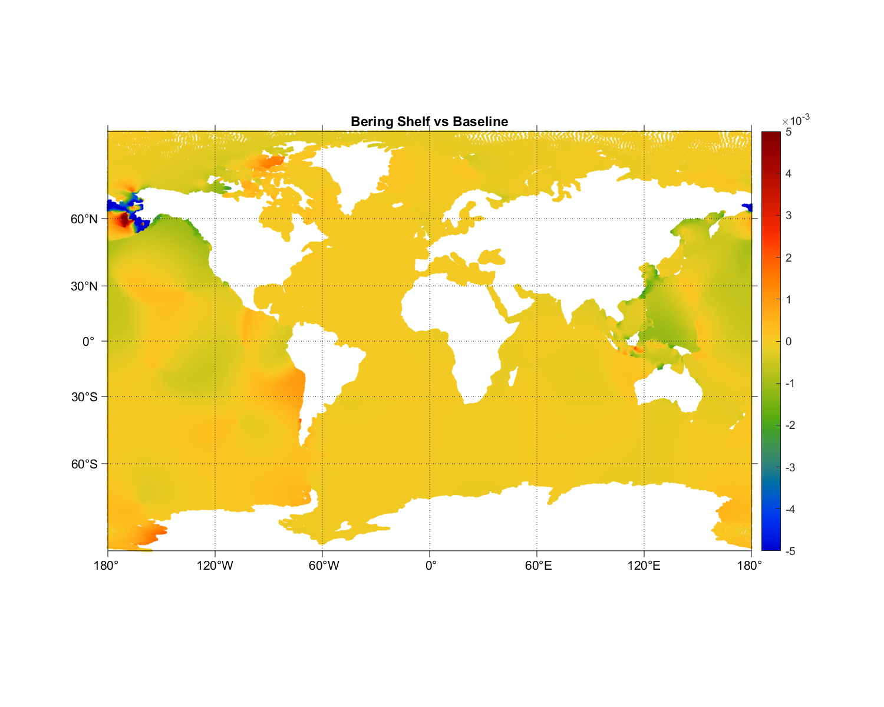
Lessons learned: Resolution, topography, and dissipation
M₂ amplitude difference (m) baseline to perturbed solution

Slide 33
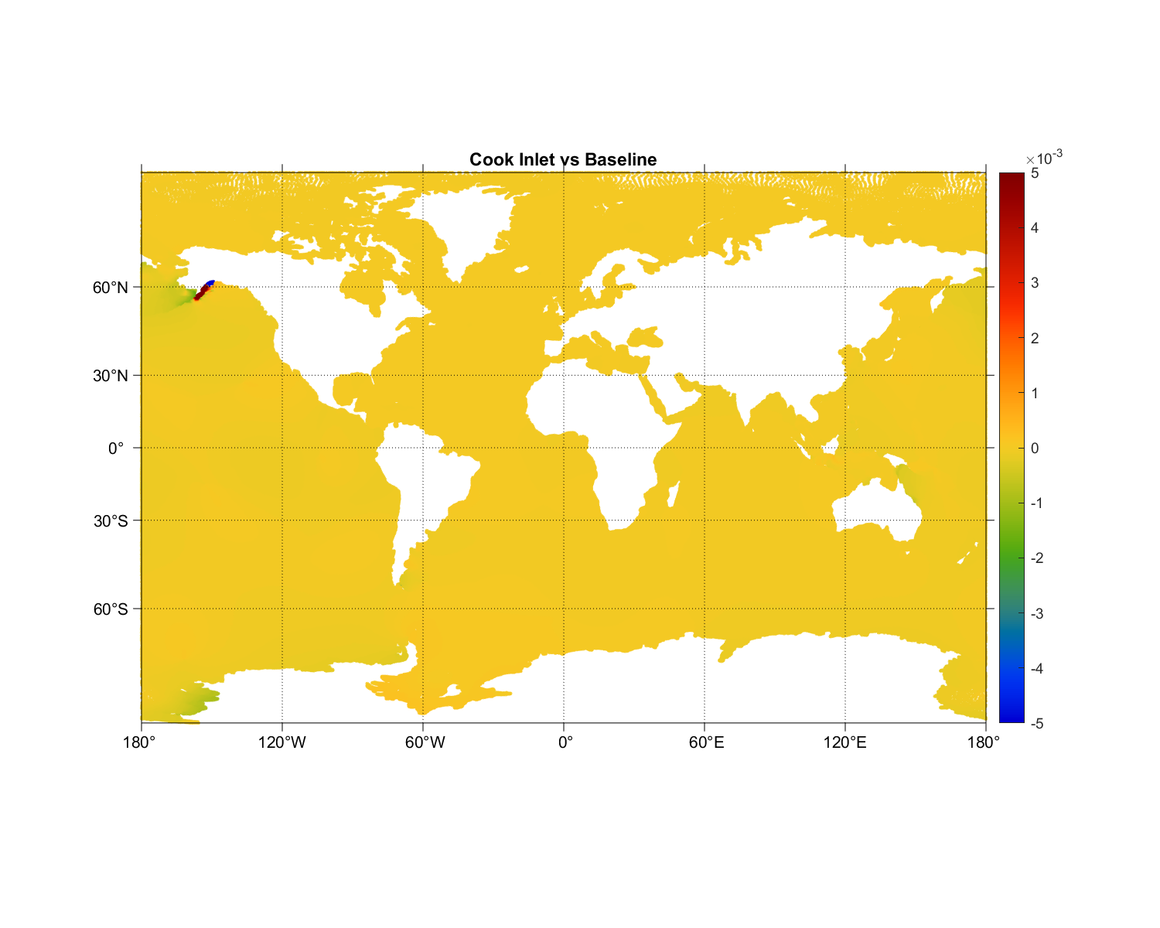
Lessons learned: Resolution, topography, and dissipation
M₂ amplitude difference (m) baseline to perturbed solution

Slide 34

Lessons learned: Resolution, topography, and dissipation
M₂ amplitude difference (m) baseline to perturbed solution

Slide 35

Lessons learned: Resolution, topography, and dissipation
M₂ amplitude difference (m) baseline to perturbed solution

Slide 36

Lessons learned: Resolution, topography, and dissipation
M₂ amplitude difference (m) baseline to perturbed solution

Slide 37

Lessons learned: Resolution, topography, and dissipation
M₂ amplitude difference (m) baseline to perturbed solution
v

Slide 38

Lessons learned: Resolution, topography, and dissipation
M₂ amplitude difference (m) baseline to perturbed solution

Slide 39

Lessons learned: Resolution, topography, and dissipation
M₂ amplitude difference (m) baseline to perturbed solution

Slide 40

Lessons learned: Resolution, topography, and dissipation
M₂ amplitude difference (m) baseline to perturbed solution

Slide 42
Extra slides

Slide 43
Slide from Richard Ray’s “100 years of tides” talk at Fall 2019 AGU meeting

Slide 44
Geographical distribution: Stationary internal tides
Sea surface height (SSH) variance of the stationary principal lunar semidiurnal tide M₂ in non-assimilative HYCOM (top) and altimetry (bottom).
The HYCOM variances have been corrected for the effects of the short duration of the model output record.
Numbers represent the fraction of HYCOM variance to altimetry variance.
Determined by spatially high-passing amplitudes of total tidal SSH (as in Ray and Mitchum 1996)
Buijsman et al. 2020, Ocean Modelling

Slide 45

Internal gravity wave continuum spectrum in global models
Horizontal wavenumber-frequency (K-ω) spectrum of kinetic energy in North Pacific in 1/12° HYCOM and 1/25° HYCOM
Spectrum fills out along vertical mode linear dispersion curves.
Near-inertial and tidal peaks visible.
Spectrum fills out more completely with higher horizontal resolution.
Müller et al. (2015)

Slide 46

Improved internal gravity wave spectrum in a regional model forced by a global internal wave model (Nelson et al. 2020)
With boundary conditions that include radiating internal waves + an increase in resolution, IGW continuum energy in a regional model goes up

