Slide 1









Land River Two-Way Coupling Development in E3SM
2020 ESMD-E3SM PI meeting
Donghui Xu¹, Gautam Bisht¹, Tian Zhou¹,
Chang Liao¹, Hong-Yi Li², Zeli Tan¹
¹Pacific Northwest National Laboratory
²University of Houston
October 26, 2020
ICoM is funded by multiple programs in the Earth and Environmental Systems Sciences Division of DOE’s Office of Science

Slide 2
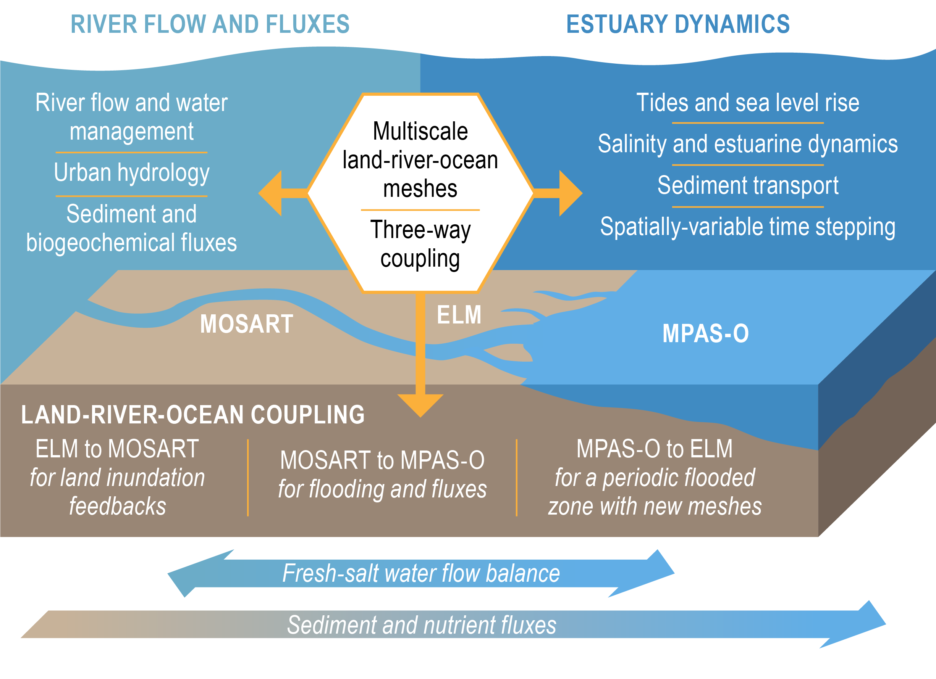
Land-river-ocean three-way coupling in E3SM
ELM
MPAS-O
MOSART
Notes:
Combine this one and configuration

Slide 3
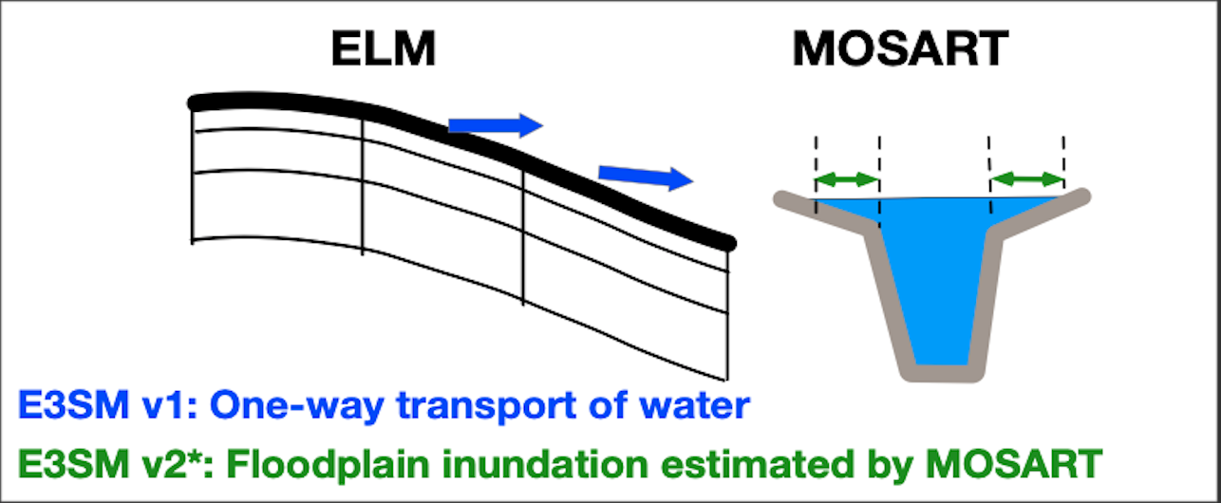
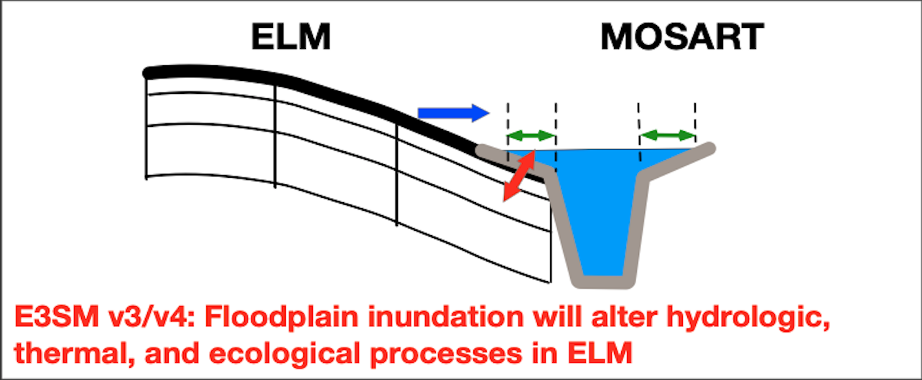
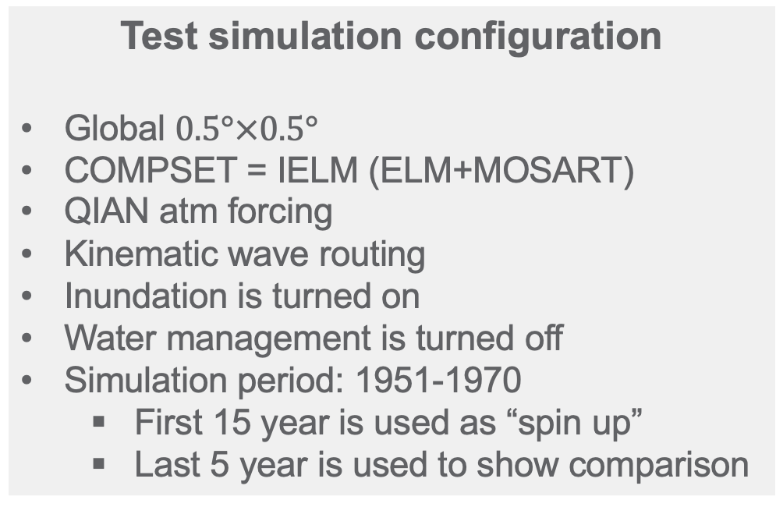
Proposed Two-Way Coupling Scheme
Ongoing E3SM developments
Inundation Fraction, Inundation Volume
ELM
MOSART
Infiltration on Floodplain
Test simulation configuration
Global $0.5°×0.5°$
COMPSET = IELM (ELM+MOSART)
QIAN atm forcing
Kinematic wave routing
Inundation is turned on
Water management is turned off
Simulation period: 1951-1970
  First 15 year is used as “spin up”
  Last 5 year is used to show comparison
ICoM proposed developments
Notes:
Combine this one and configuration

Slide 4
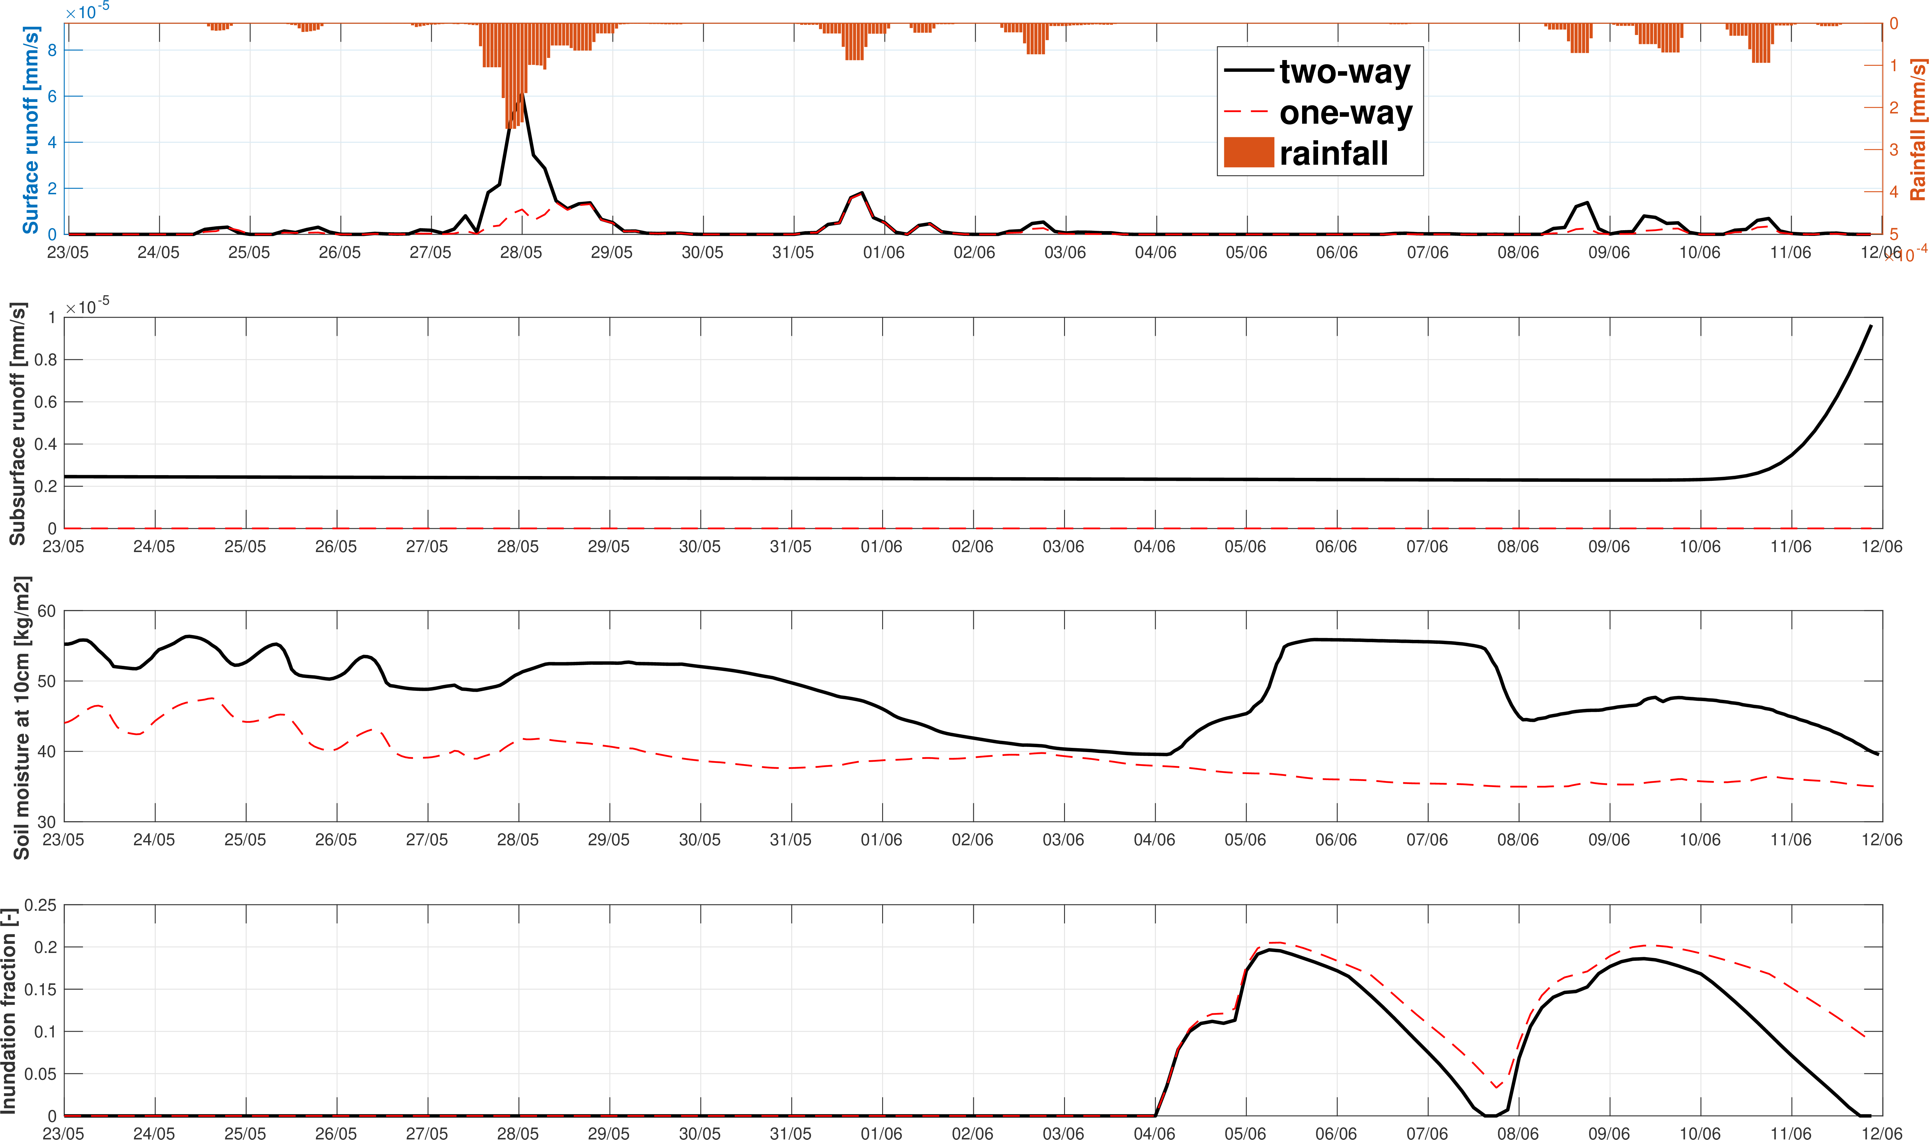
Comparison Between Two-Way and One-Way
Results of a single cell during a rainfall event
Two-way coupling has
Higher surface runoff
Higher subsurface runoff
Wetter Soil
Less floodplain inundation
Notes:
Subsurface runoff, replace the channel volume. Water table comparison

Slide 5
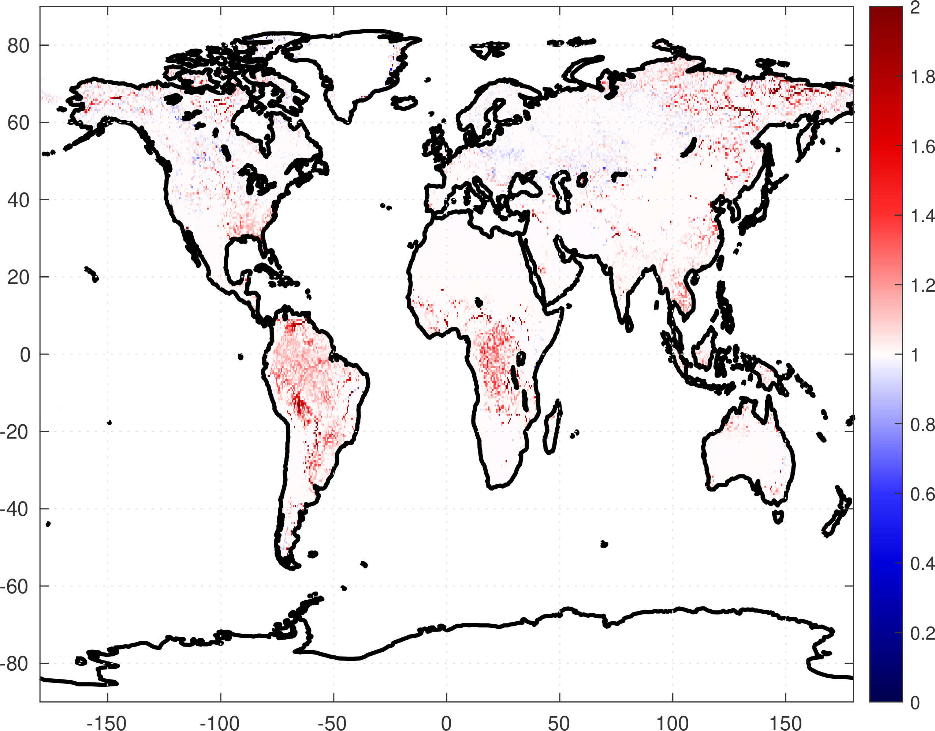
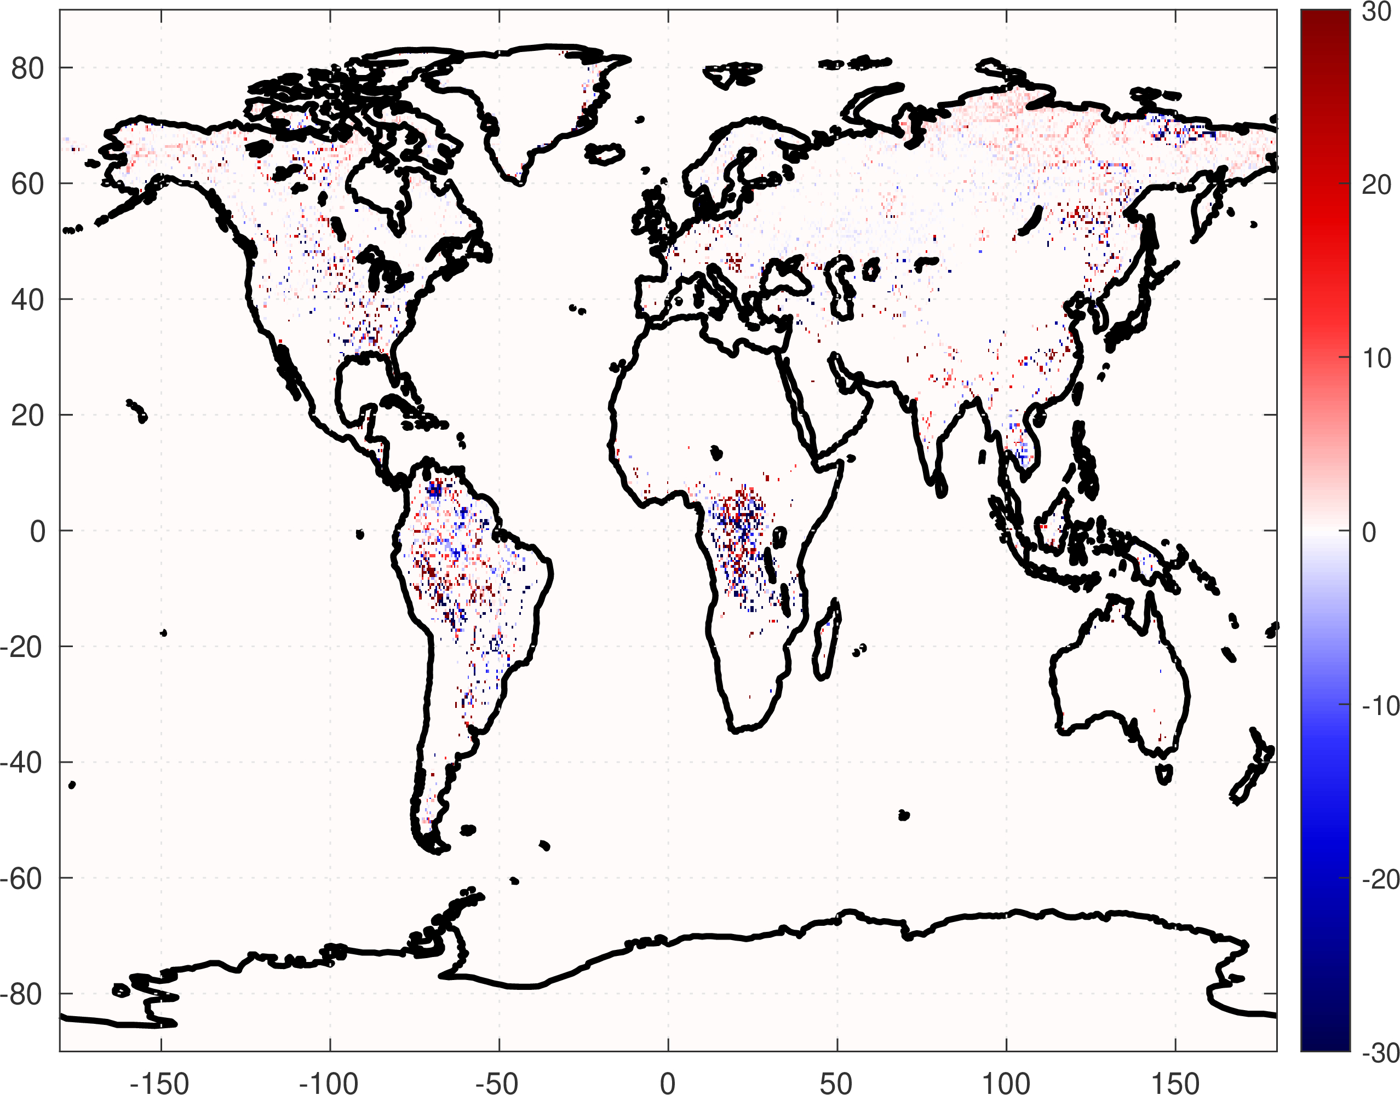
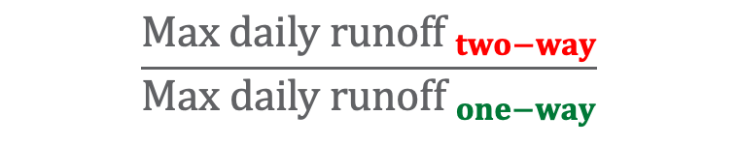

Comparison of Peak Runoff at Global Scale
$$\frac{Max daily runof{f }_{two−way}}{Max daily runof{f }_{one−way}}$$
$$maximum daily runoff timing change:$$
$two_way$ - $one_way$
[-]
[days]
13% cells with increase at least 5%
2% cells with decrease at least 5%
17.6% cells the peak runoff doesn’t occur on the same day between two-way and one-way
Notes:
Time series daily scale
Max daily runoff

Slide 6
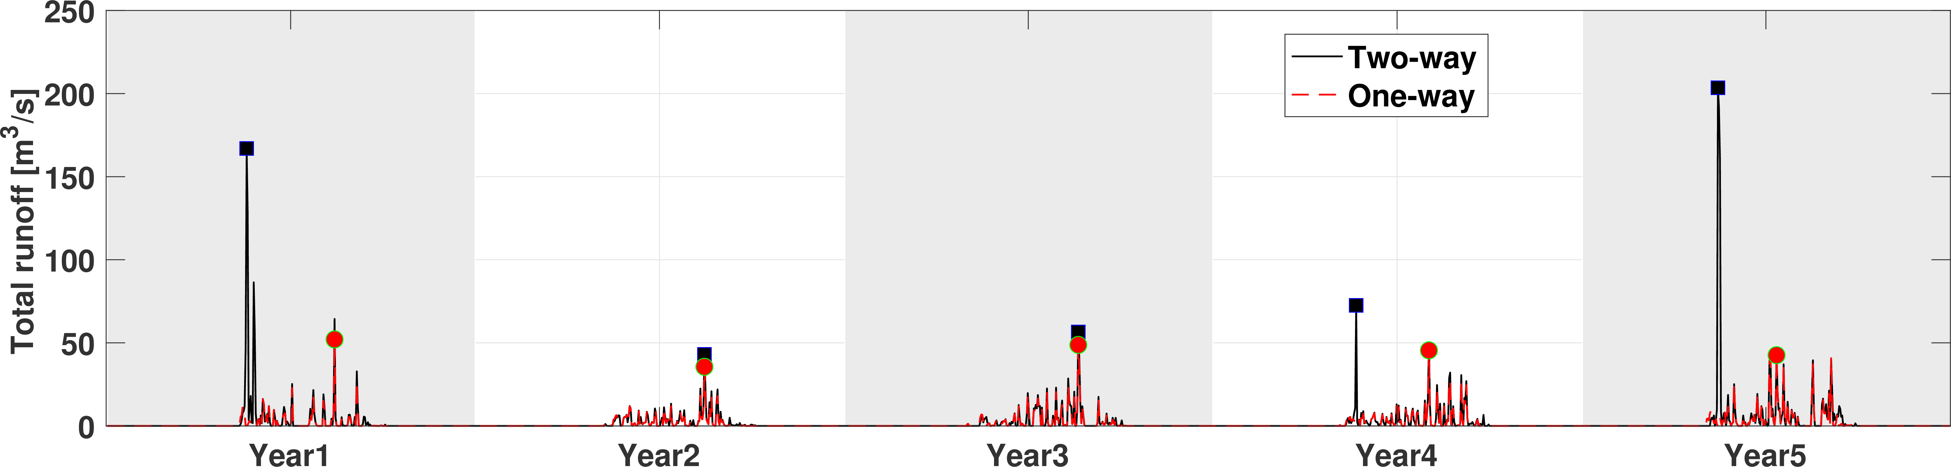
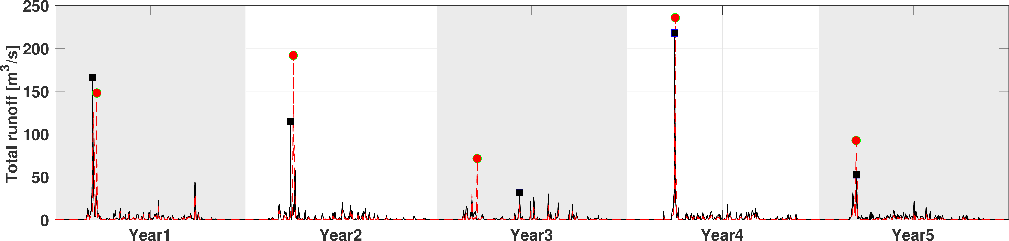
Magnitude Timing | Higher | Same | Lower
Earlier | 4% | 0 | 2.4%
Same day | 37.7% | 11.6% | 31.7%
Later | 6.5% | 0 | 2%
Notes:
Time series at daily for each example

Slide 7
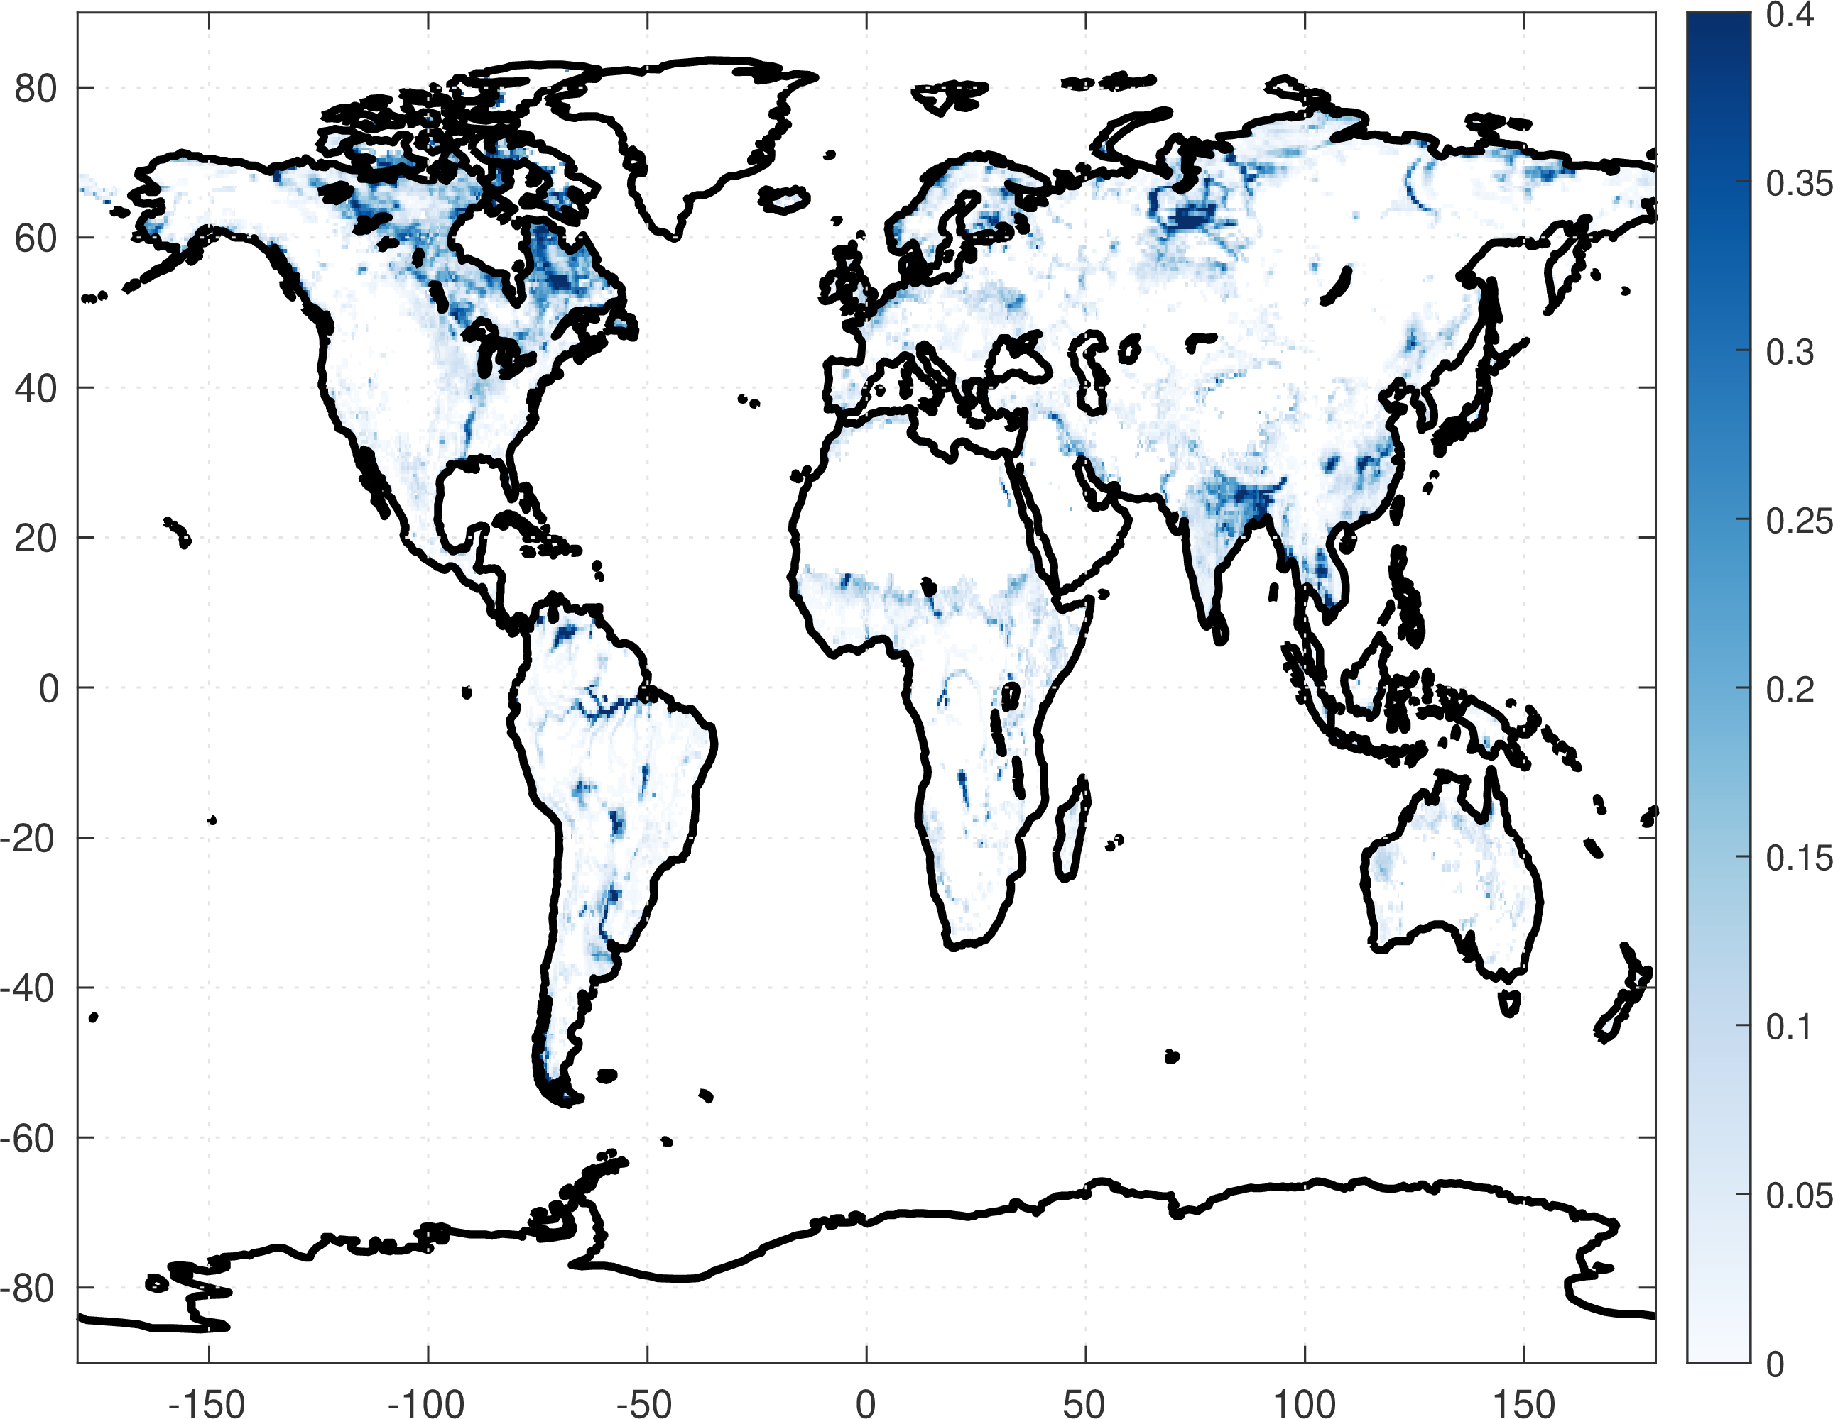
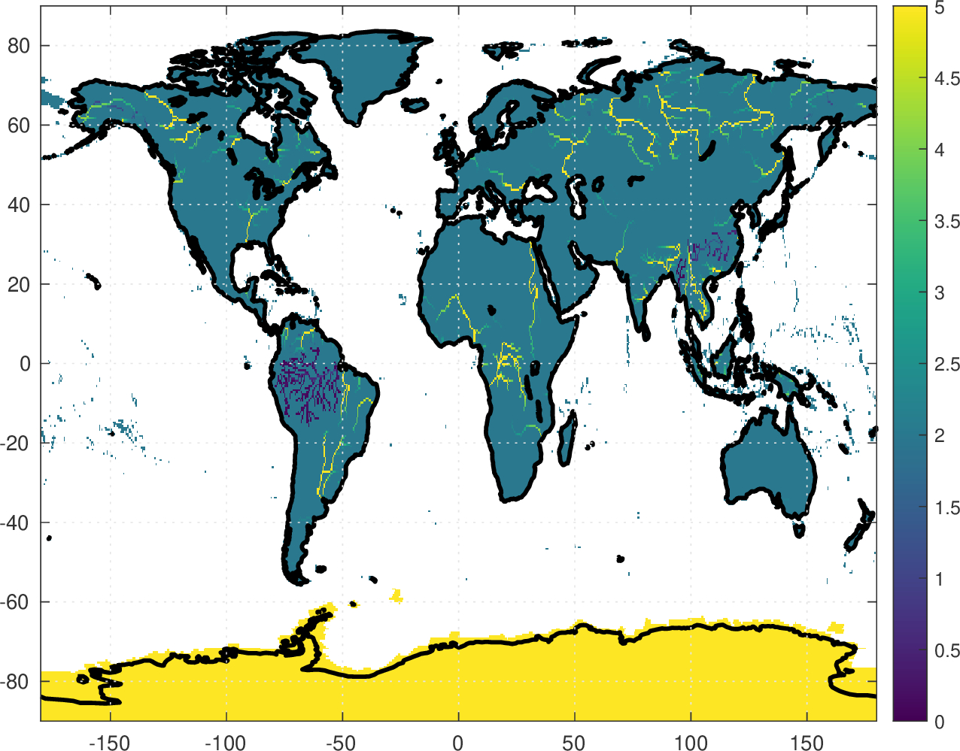
Calibration
Previous study calibrated for the inundation faction by tunning river depth and width, but result in unrealistic parameters.
GIEMS
Current river depth
Notes:
Zoom in plot

Slide 8
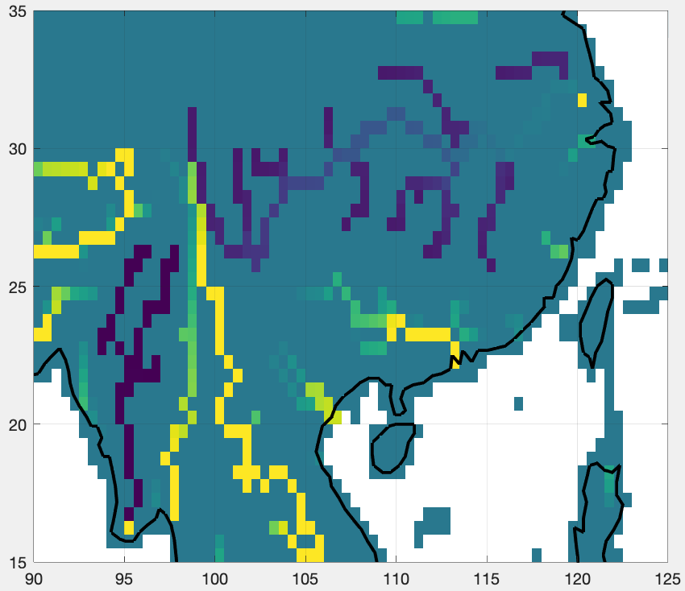
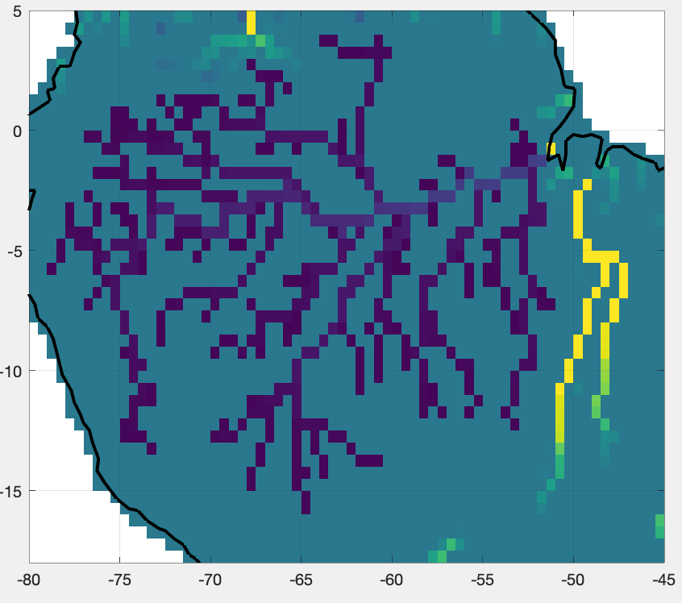
Calibration
Previous study calibrated for the inundation faction by tunning river depth and width, but result in unrealistic parameters.
GIEMS
Current river depth
Notes:
Zoom in plot

Slide 9
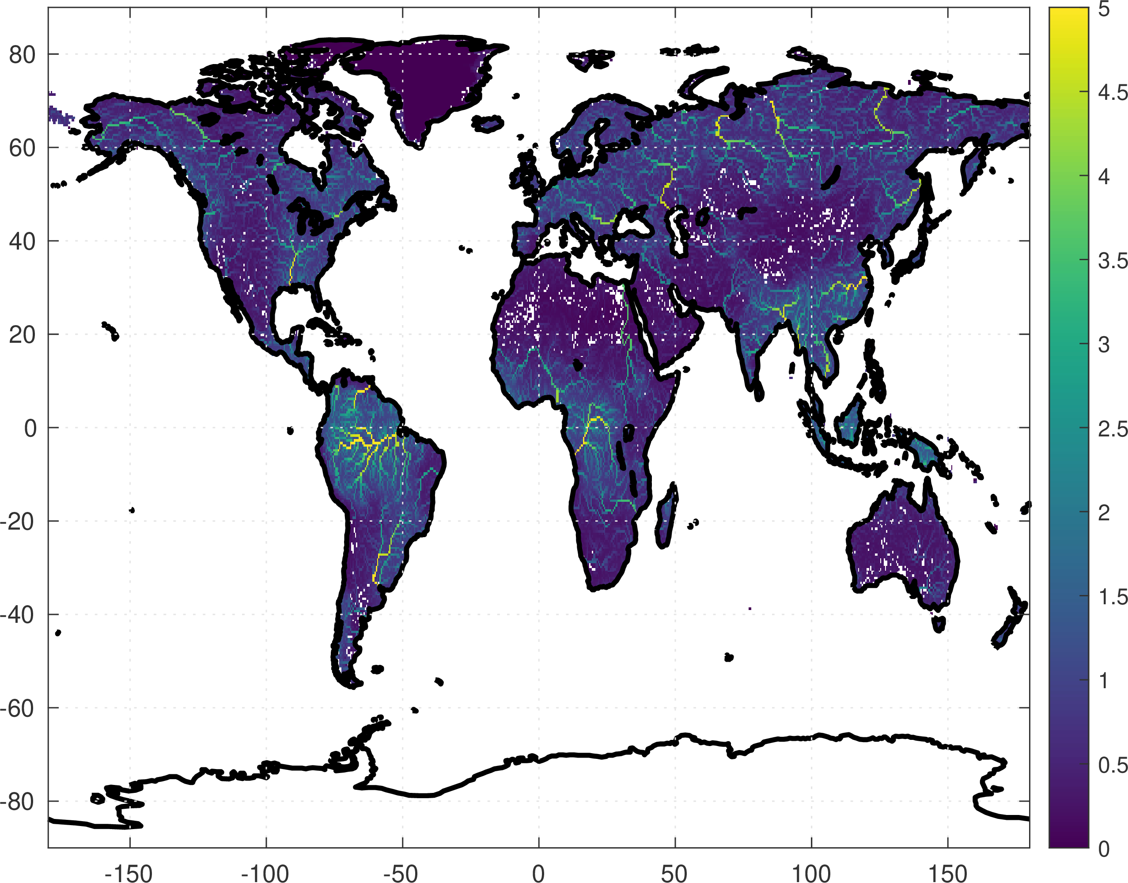
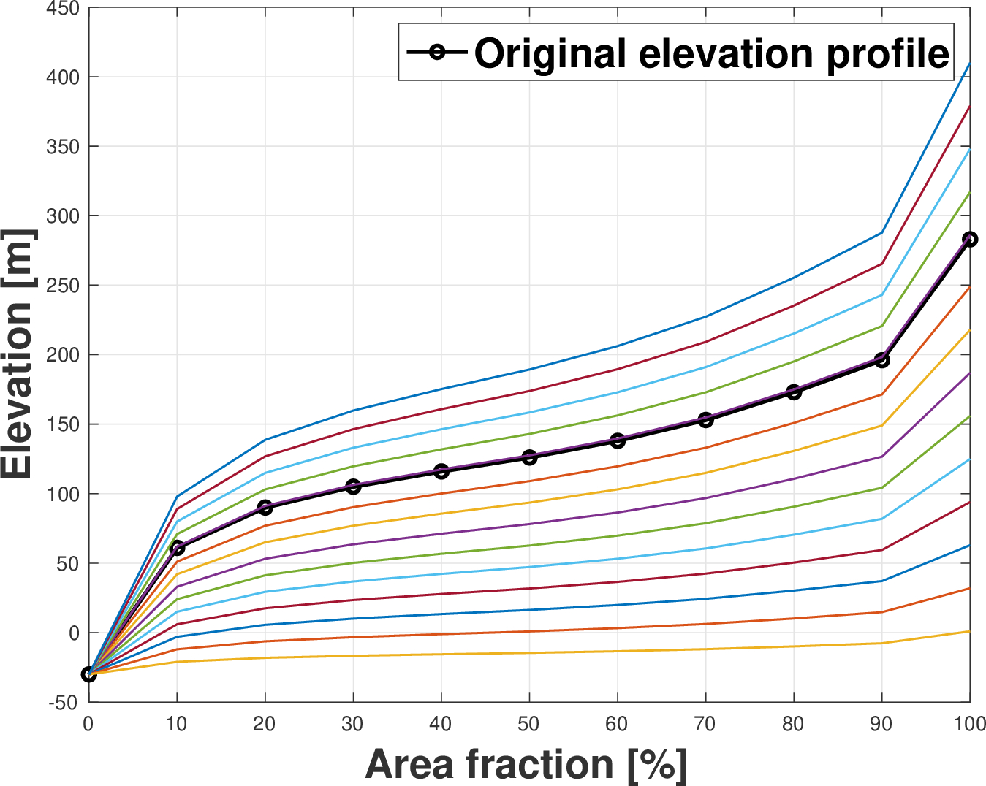


Calibration: ongoing process
Step 1 - calibrate discharge
Step 2 - calibrate inundation
Estimate river width and depth based on [Andreadis et al., 2013]:
($Q$is the 2-year return period annual peak discharge)
Keep $w$ and $d$ fixed, and calibrate elevation profile with a satellite inundation product (GIEMS).
$$w=7.2Q^{0.5},d=0.27Q^{0.3}$$
Less Inundation
[m]
More Inundation
Notes:
Show giem inundation

