Slide 1
E3SM v1.1 Coupled Biogeochemistry Simulations
Climate-carbon-nutrient feedbacks under a future climate change scenario in the E3SM v1.1 model with coupled biogeochemistry
Peter Thornton (ORNL), Dan Ricciuto (ORNL), Xiaojuan Yang (ORNL), Xiaoying Shi (ORNL), Susannah Burrows (PNNL), Kate Calvin (PNNL)

Slide 2
Overview
Carbon-nutrient-climate feedbacks for the E3SM v1.1 coupled biogeochemistry experiments were quantified over the historical period (1850-2014) as part of the analysis published by Burrows et al. (2020).
Here we update the carbon-nutrient-climate analysis to assess feedbacks extending into the future simulation period (2015-2100), under the SSP585 scenario (high radiative forcing).
We examine global mean feedbacks and how they vary over time through the 21st century.
We also examine the spatial distribution of land ecosystem contributions to the global mean feedbacks, and how those spatial distributions vary over time.

Slide 3
Experimental design allows quantification of Earth system response to multi-factor forcings
Five coupled atmosphere – ocean – land – ice simulations:
BCRC
BCRD
constant
Biogeochemical response to rising CO₂
Control
+
BDRC
BDRD
dynamic
constant
dynamic
Radiative response to rising CO₂

Slide 4
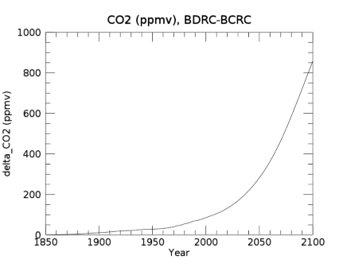
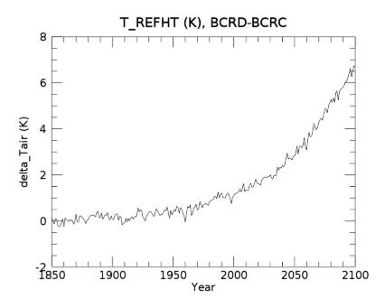
Background: Global mean changes in CO₂ and T_{air}
(prescribed)
(prognosed, BDRD)

Slide 5
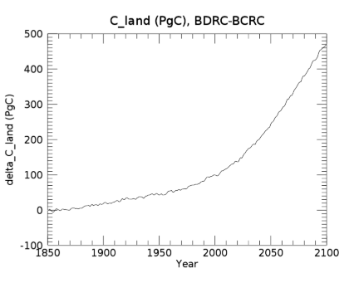
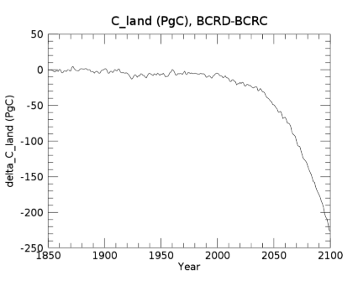
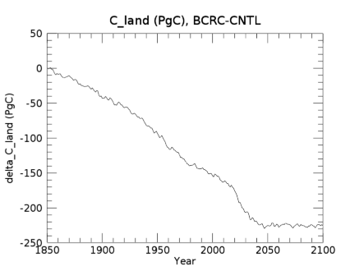
Changes in Land Carbon due to various forcings (1850-2100)
CO₂ effect (sink)
Temperature effect (source)
Land use effect (source)*
*Includes other factors such as N deposition

Slide 6
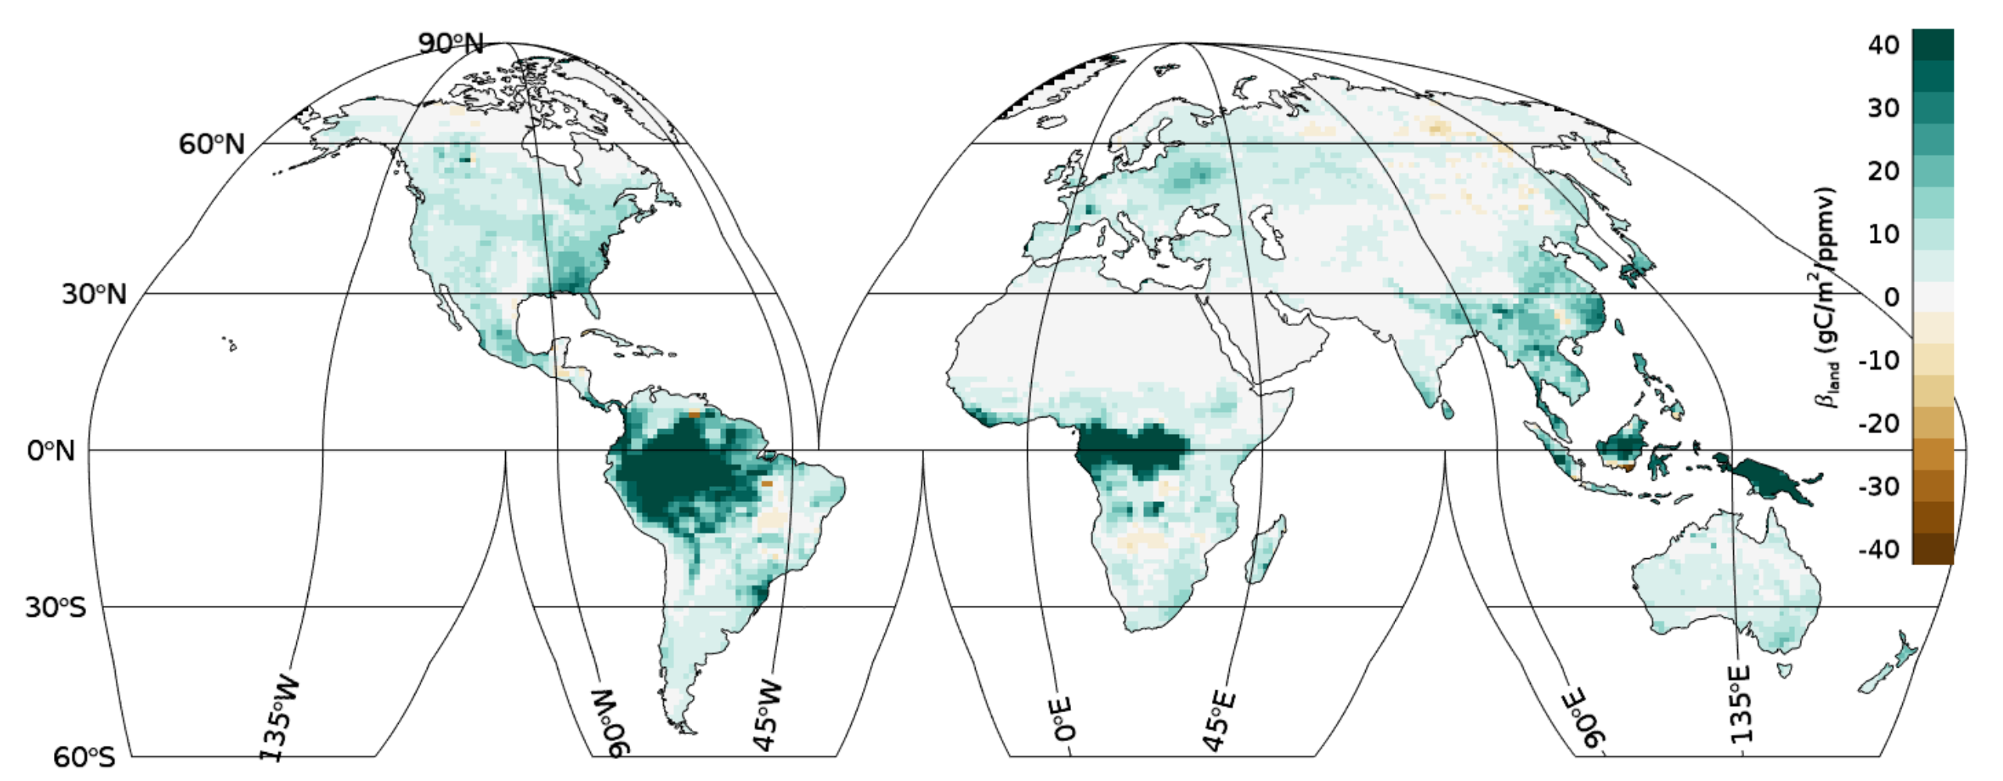
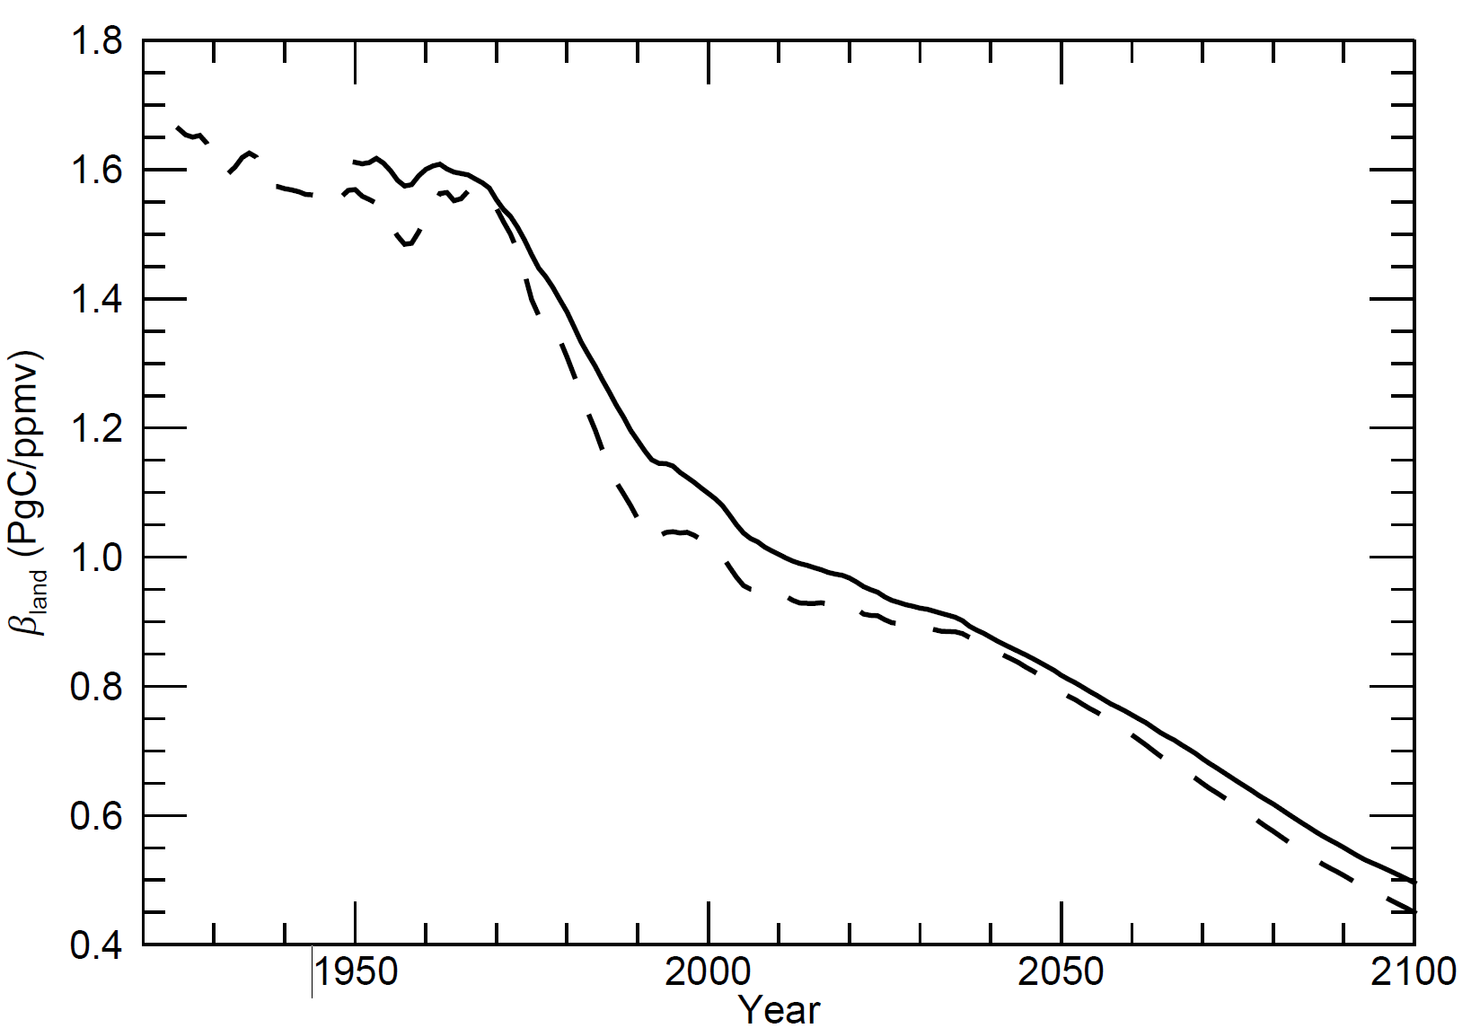
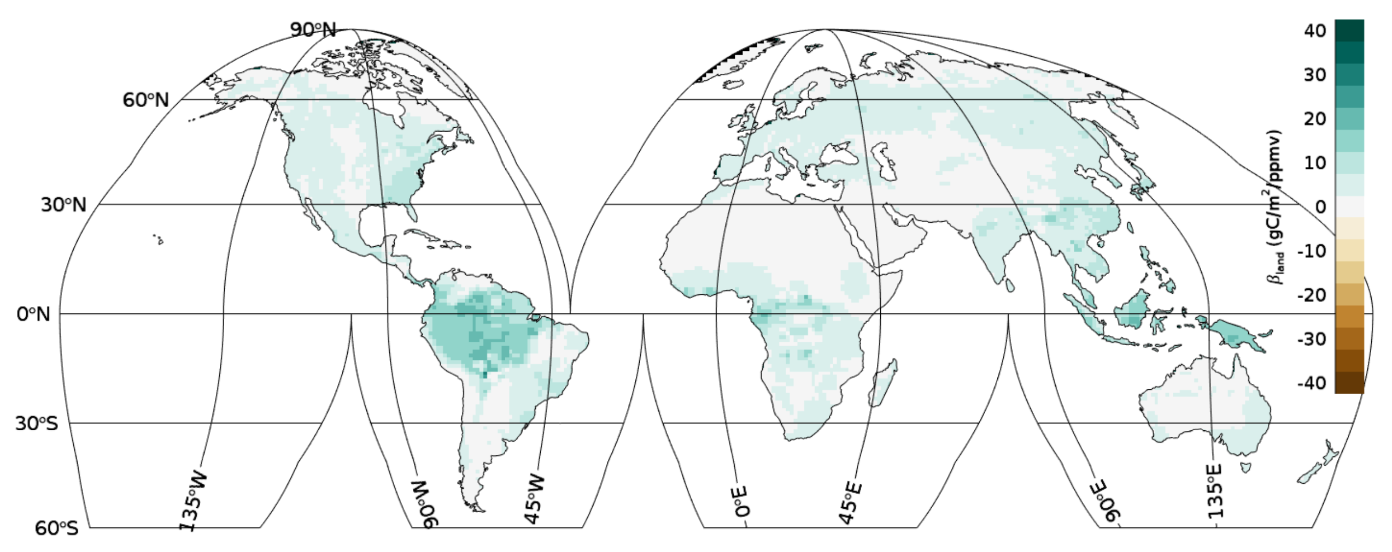
C-Climate feedback due to CO₂ fertilization on land
Beta_{land} assessed at 2015
Beta_{land} assessed at 2100

Slide 7
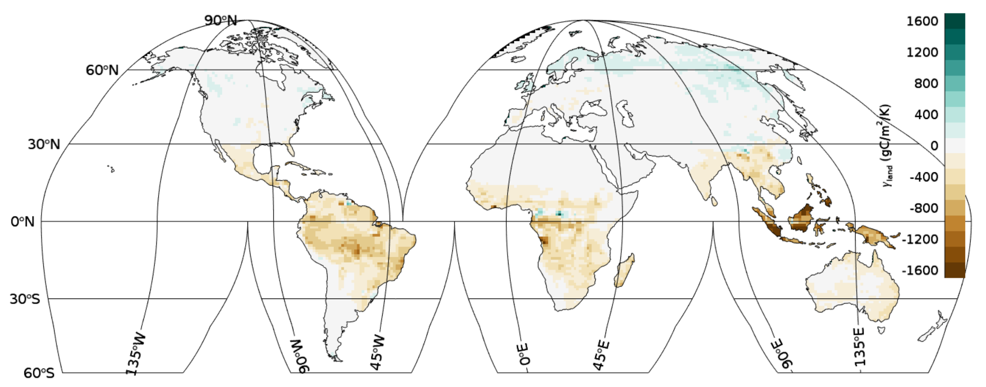
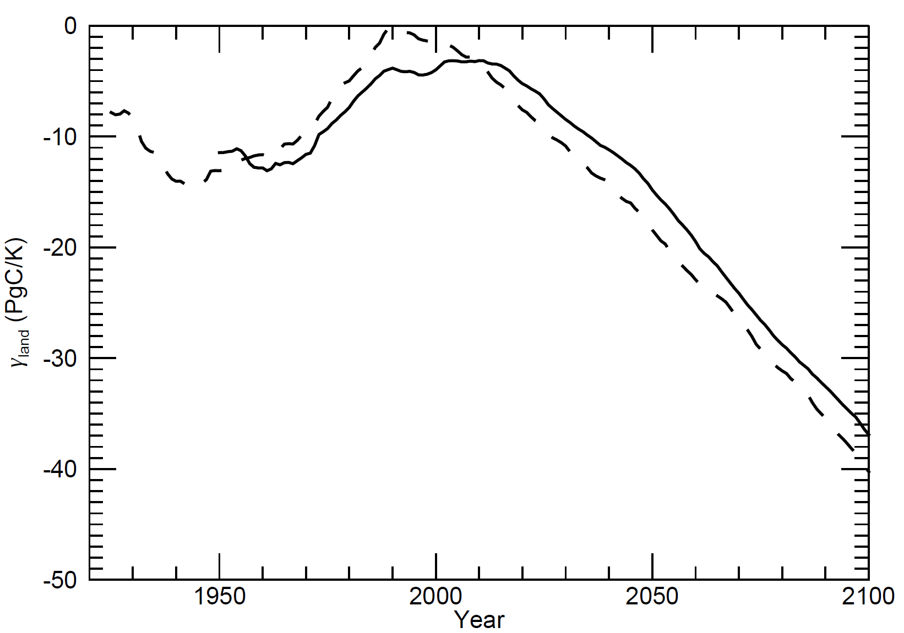
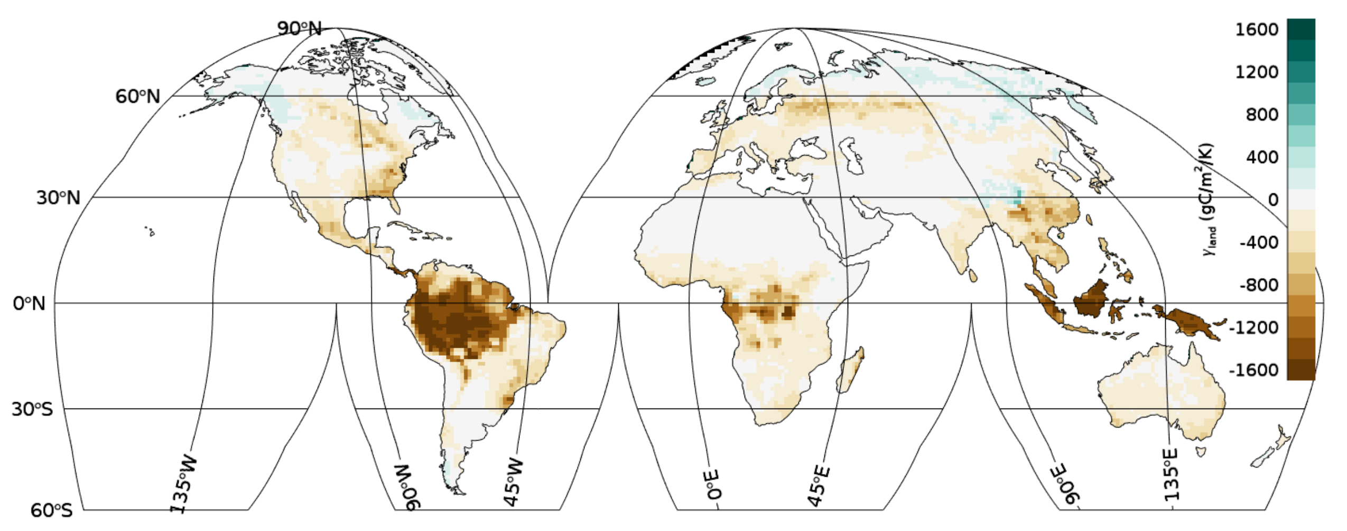
C-Climate feedback due to warming on land
Gamma_{land} assessed at 2015
Gamma_{land} assessed at 2100

Slide 8
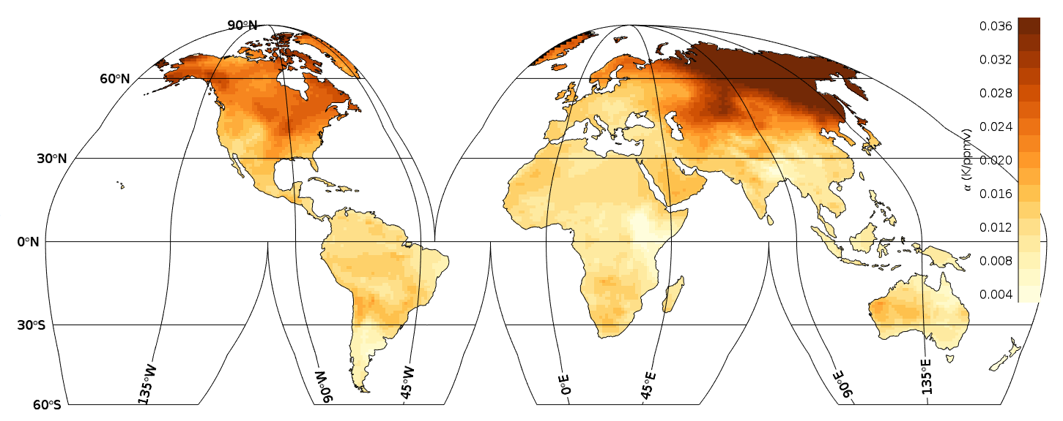
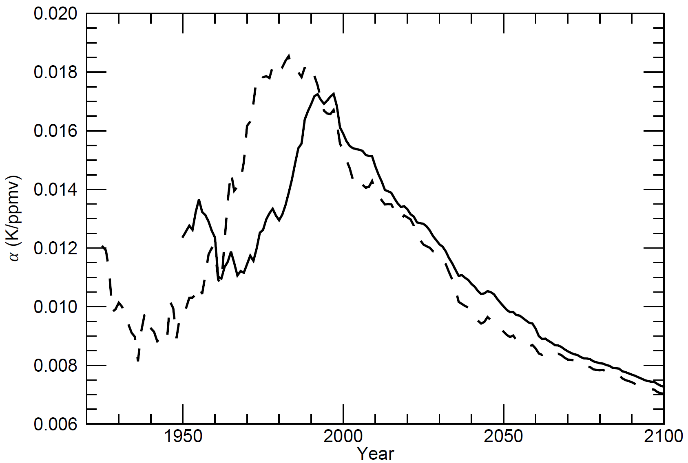
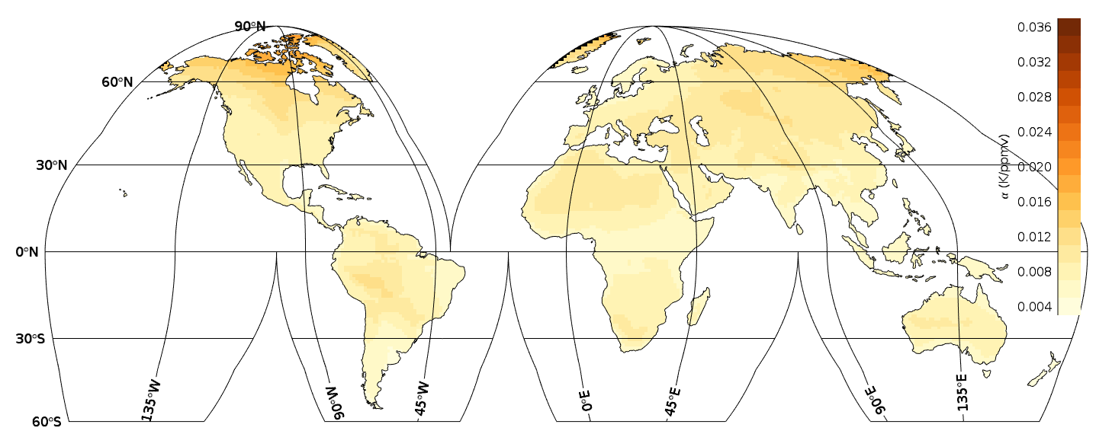
Transient climate sensitivity to GHG forcing (over land)
Alpha assessed at 2015
Alpha assessed at 2100

Slide 9
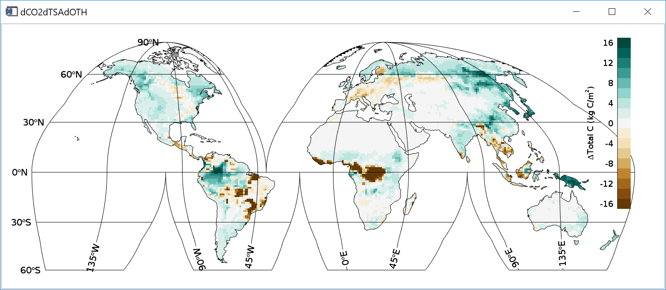
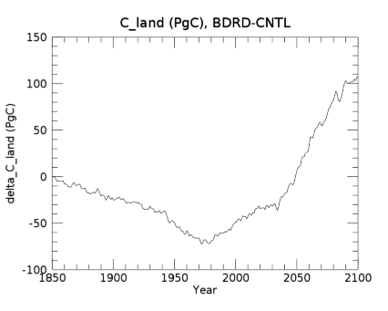
Changes in Land Carbon due to Combined Factors
Change in Land carbon assessed at 2100

Slide 10
Conclusions
Land ecosystem fertilization response to rising CO₂ diminishes along the SSP585 future trajectory.
Land ecosystem response to warming temperatures shifts from neutral to a carbon release along the SSP585 future trajectory.
Atmospheric warming response to radiative forcing from rising CO₂ declines along the SSP585 future trajectory.
We predict that land ecosystems by 2100 will account for a cumulative sink of about 100 PgC, compared to global ecosystem state in 1850, or approximately 25% of cumulative fossil emissions since 1850.

