Slide 1


Quantifying Drivers of Uncertainty in
Land Model Predictions at Global Scales Using Machine Learning
Daniel M. Ricciuto (ORNL) and Khachik Sargsyan (SNL-CA)
Dan Lu, Peter Thornton (ORNL)
ESMD PI meeting
October 26-29, 2020

Slide 2
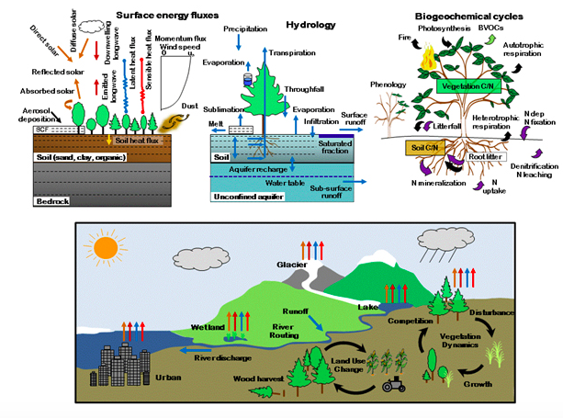
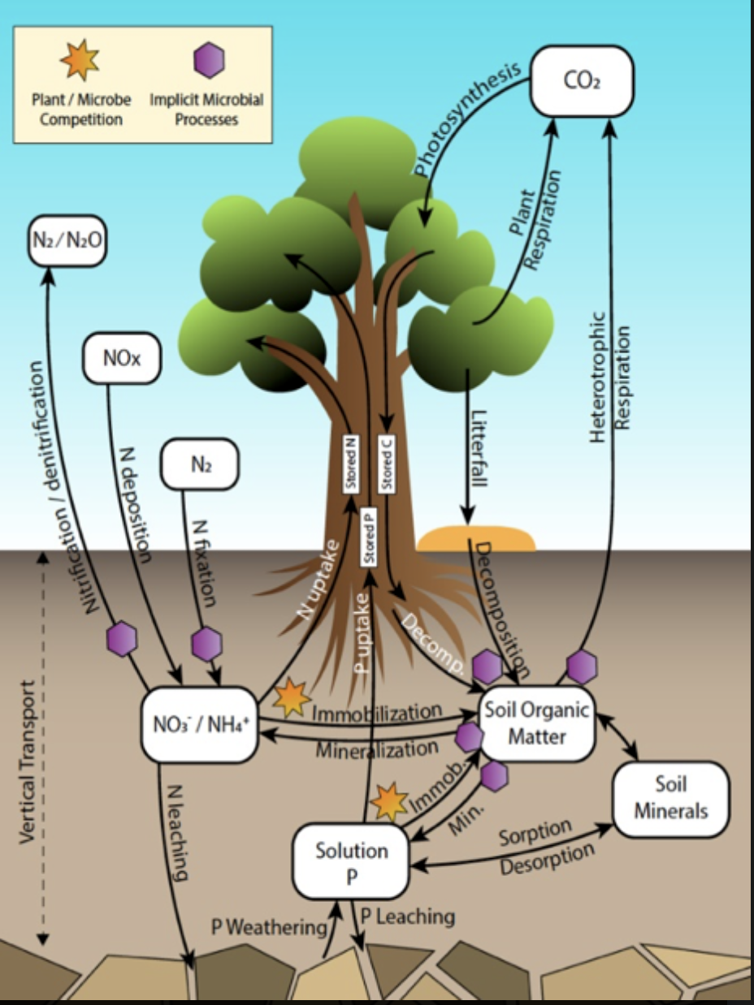
Overview and motivation:
Land model uncertainty quantification
Biogeochemistry
ELM is an increasingly complex model with many processes
Large ensembles are needed for UQ but computationally infeasible
For BGC simulations, spinup limits ensemble size.
Surrogate models based on small ELM ensemble increase the efficiency of sensitivity analysis and calibration

Slide 3
An ELM model parameter ensemble
Parameter | description | Min | Max | Default range
flnr | Fraction of leaf N in RuBisCO | 0.03 | 0.25 | [0.042,0.176]
mbbopt | Ball-Berry slope parameter | 4.0 | 13.0 | [4,9]
bbbopt | Ball-Berry intercept parameter | 1000 | 40000 | [10000,40000]
roota_par | Rooting depth distribution parameter | 1 | 10 | [3,10]
vcmaxha | Activation energy for Vcmax | 50000 | 90000 | 72000
vcmaxse | Entropy for Vcmax | 640 | 700 | 670
dayl_scaling | Day length scaling parameter | 1.0 | 2.5 | 2.0
dleaf | Characteristic leaf dimension | 0.01 | 0.1 | 0.04
xl | Leaf/stem orientation index | -0.6 | 0.8 | [-0.5,0.65]
fff
200 simulations at 1.9x2.5 degree resolution were performed varying parameters randomly over the specified ranges
Uses ELM-SP (satellite phenology) as a demonstration, will later expand to full BGC
Used for surrogate model construction, sensitivity analysis, and calibration

Slide 4
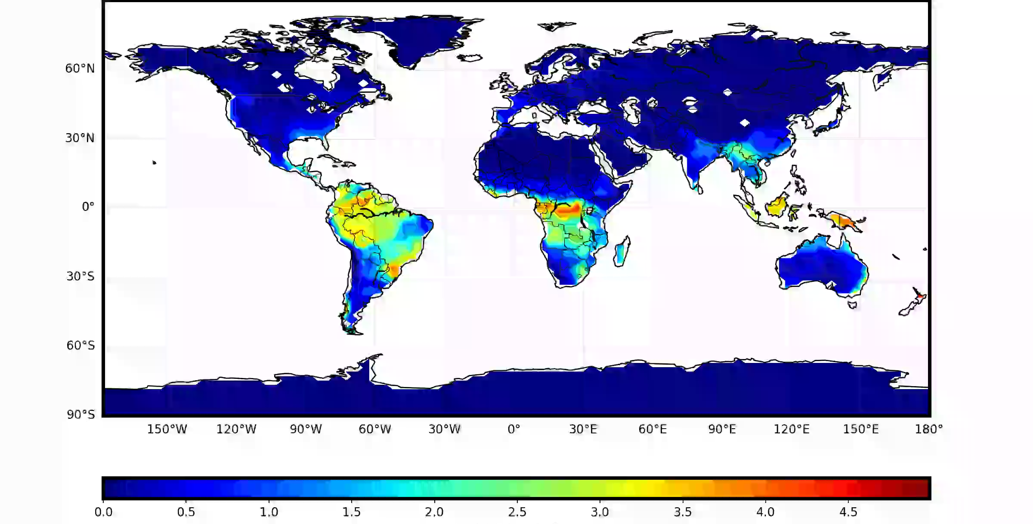
GPP ensemble standard deviation
Video: GPP standard deviation (gC m⁻² day⁻¹) over 200 ensemble members

Slide 5
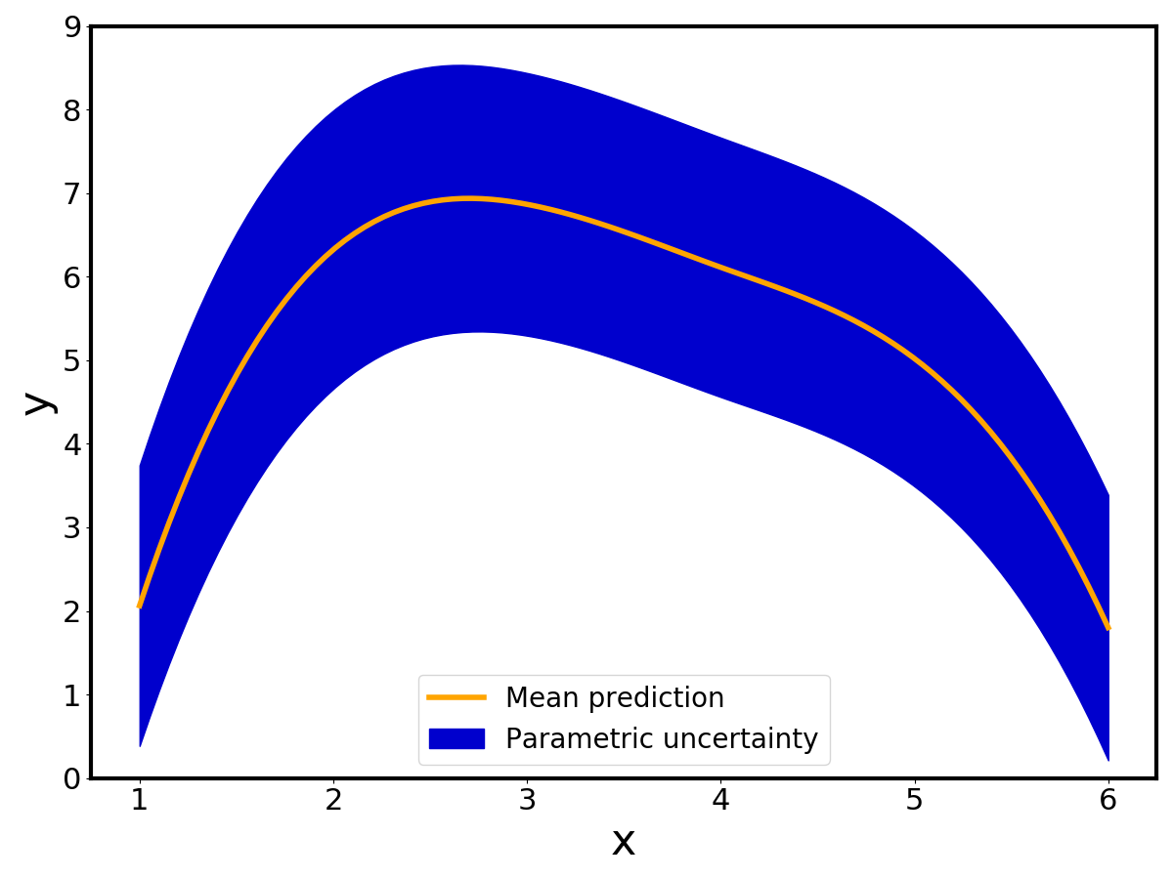
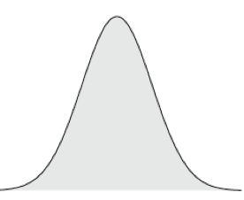
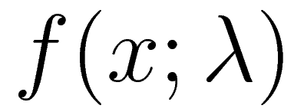


Uncertainty Propagation is enabled by Surrogate Models
Forward predictions:
  surrogate models,
  sensitivity analysis,
  parametric uncertainty
Comp. model
Input parameters
Output prediction
Work with the model as a black-box (non-intrusive):
create an ensemble of simulations with varying/perturbing
We never analyze the ensemble directly:
build a surrogate first
… otherwise called proxy, metamodel, emulator, response surface, supervised ML
Method: Karhunen-Loève expansions (see supplementary slide) – for high-dimensional outputs

Slide 6
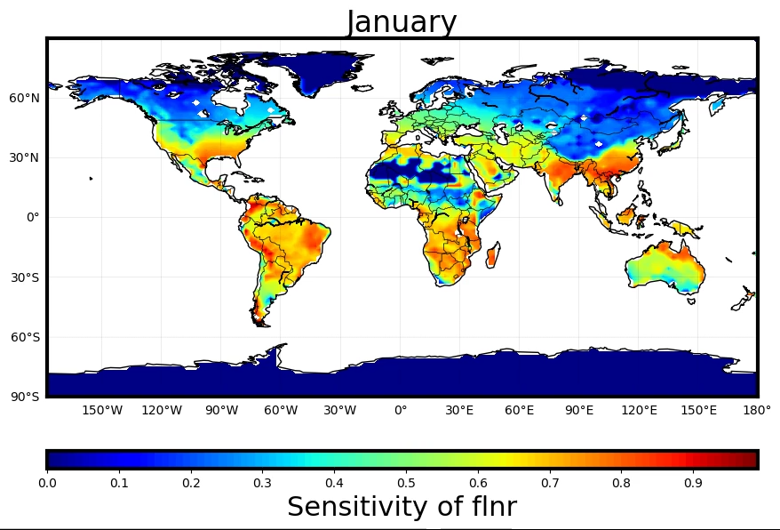
Globally mapped sensitivities
Video: Sensitivity of GPP to fraction of leaf N in RuBisCO (flnr) using surrogate model

Slide 7
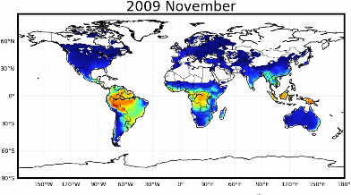
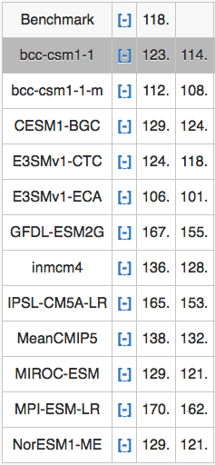
Model calibration enabled using gridded observations/benchmarks
ESM GPP from ILAMB
FLUXNET – based GPP: Directly comparable with model GPP output
Can be used for single gridcell to global-scale calibration
Methods eventually extensible to other ILAMB products

Slide 8
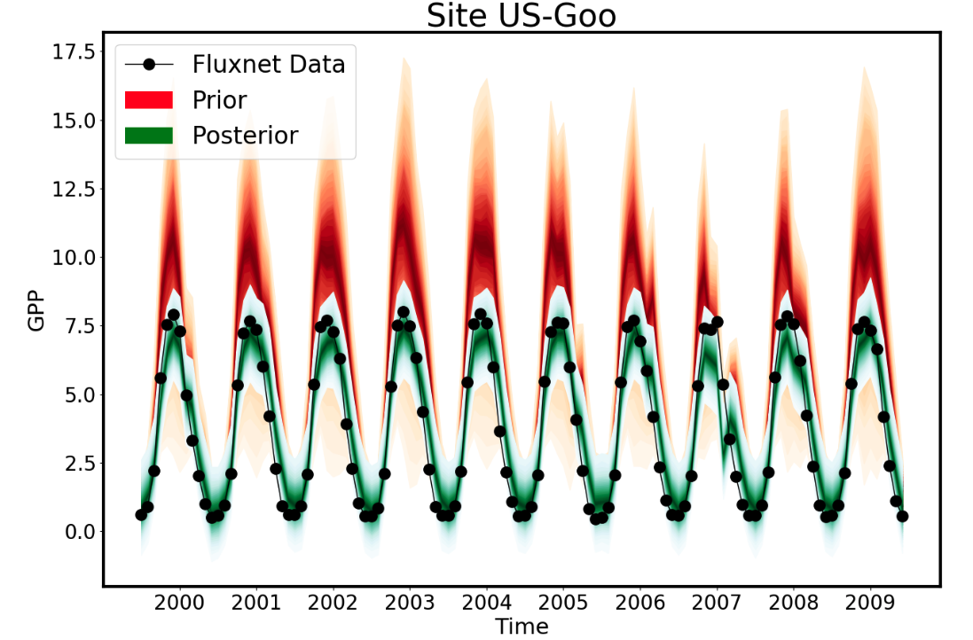
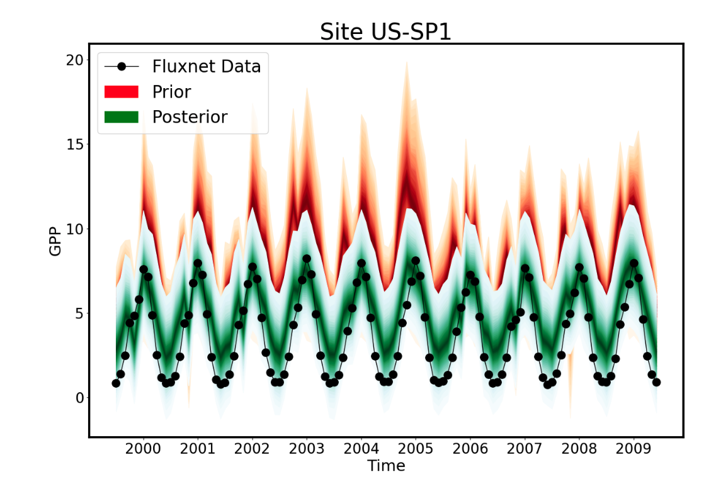
Bayesian approach for parameter calibration
Bayesian inference allows incorporation of various sources of uncertainty
Markov chain Monte Carlo (MCMC) for building posterior PDFs of parameters, which can be also used for prediction variables
Requires many online, mostly serial evaluations of the model (> 10⁴)
  This is why surrogate models are handy!
Example MCMC calibration at 2 FLUXNET sites

Slide 9
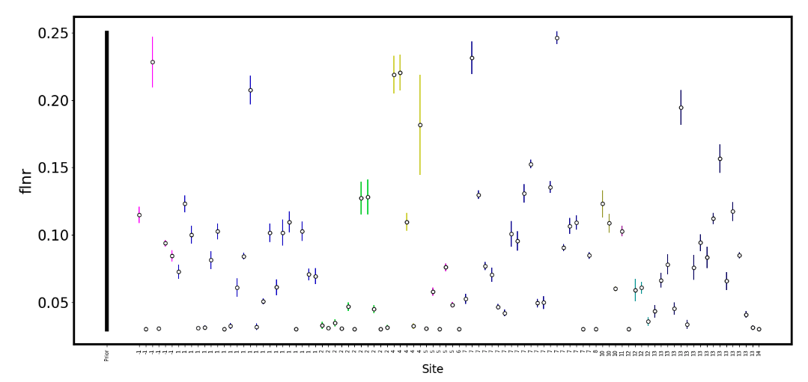
Calibrated parameter values across 96 FLUXNET sites
← Prior range →
96 sites (grouped by plant functional type)
High variability in flnr across sites within and across PFTs
Likely some overfitting: Incorporating model structural error will likely give more reasonable posterior distributions (ongoing work)

Slide 10
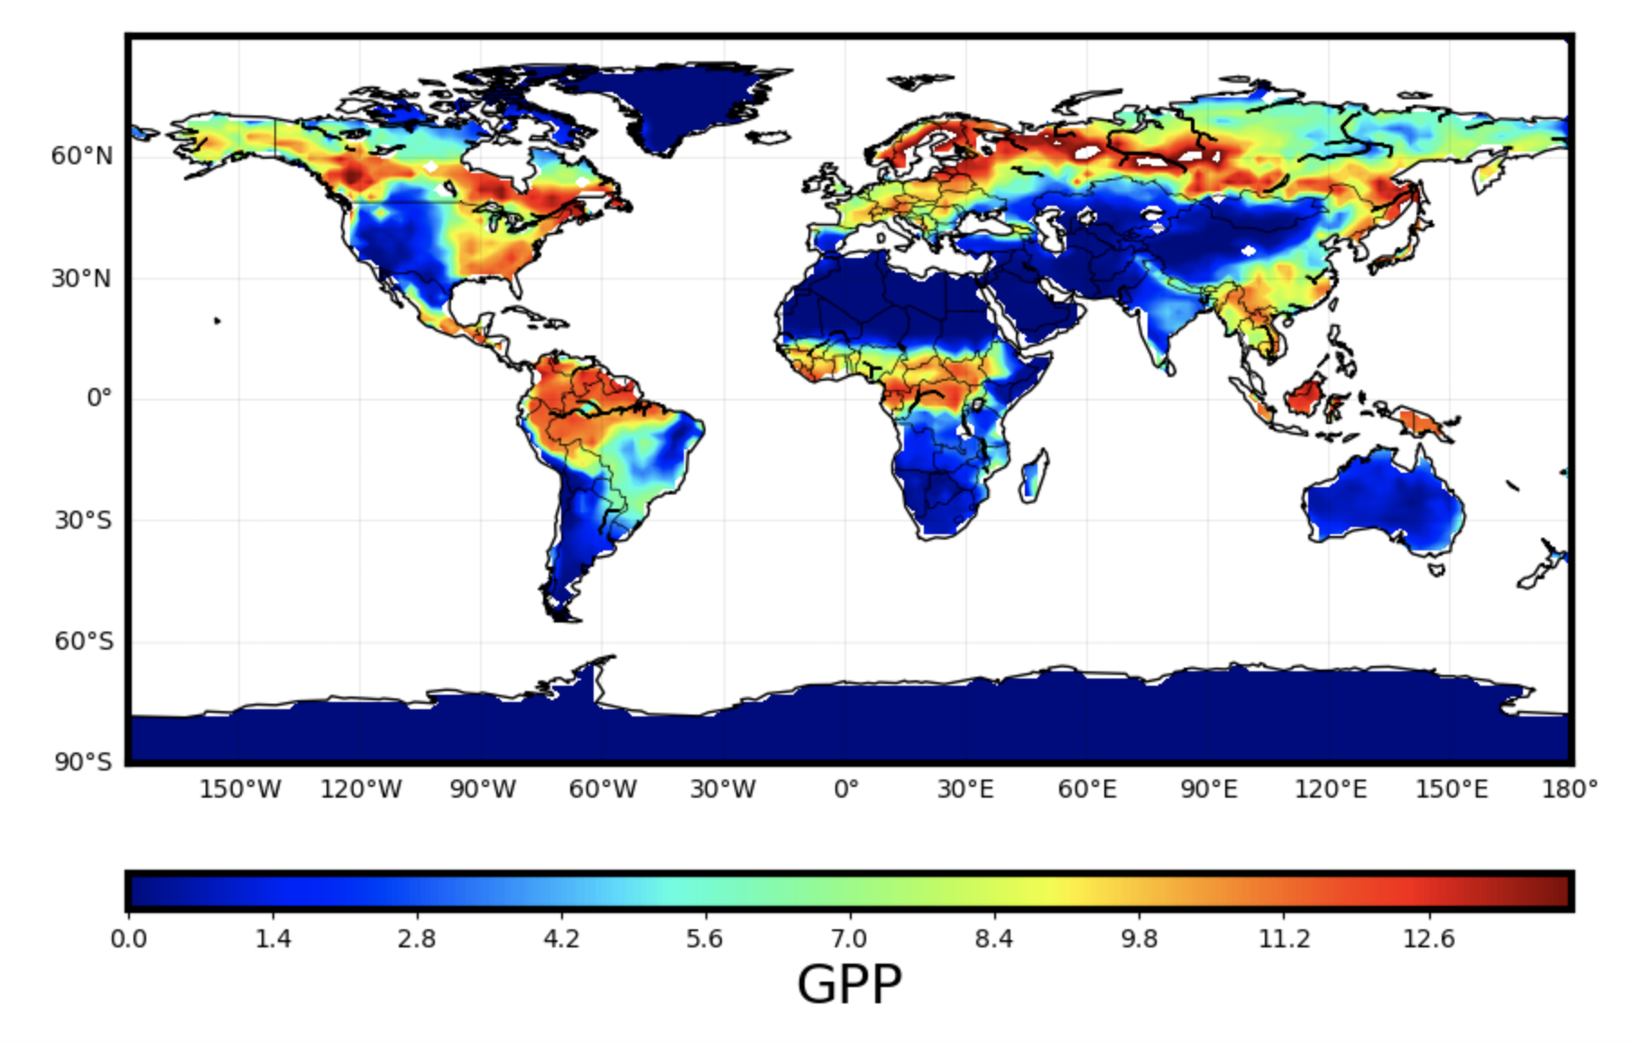
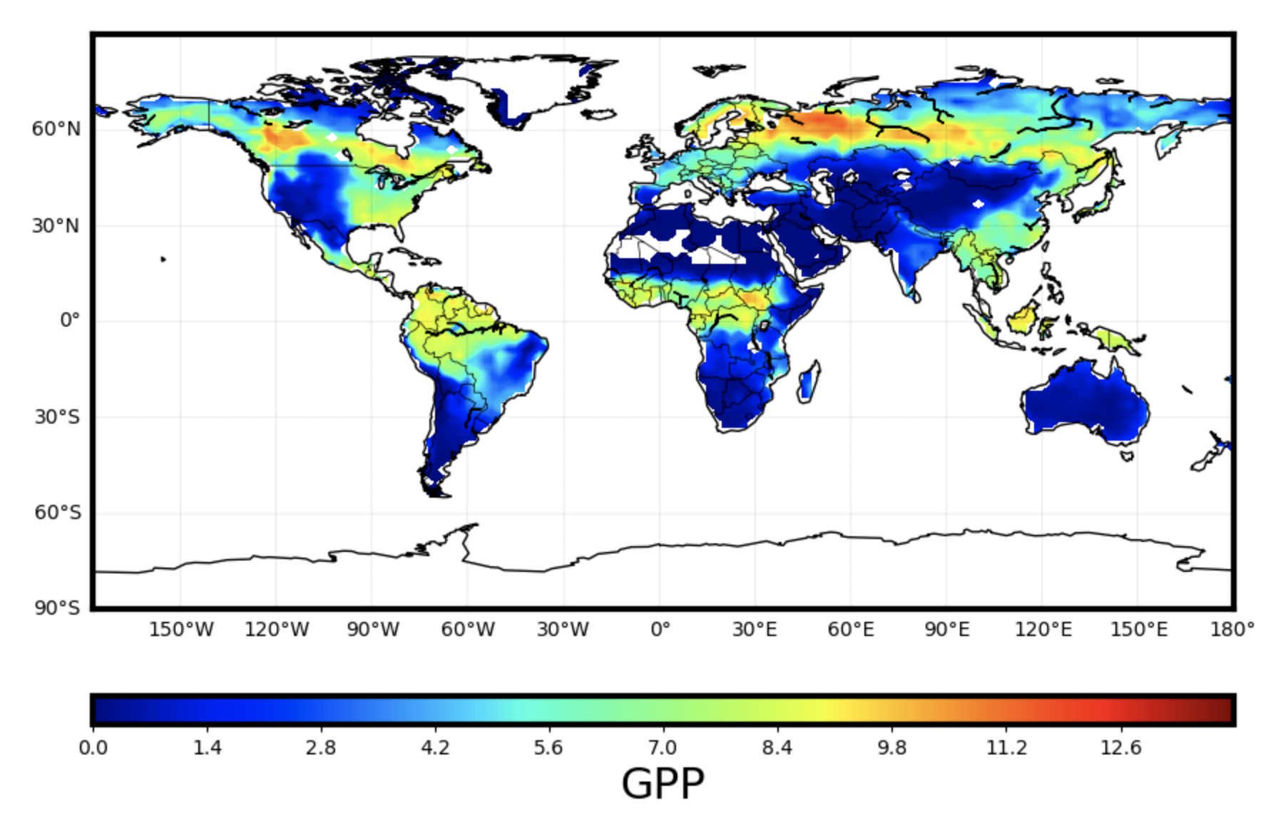
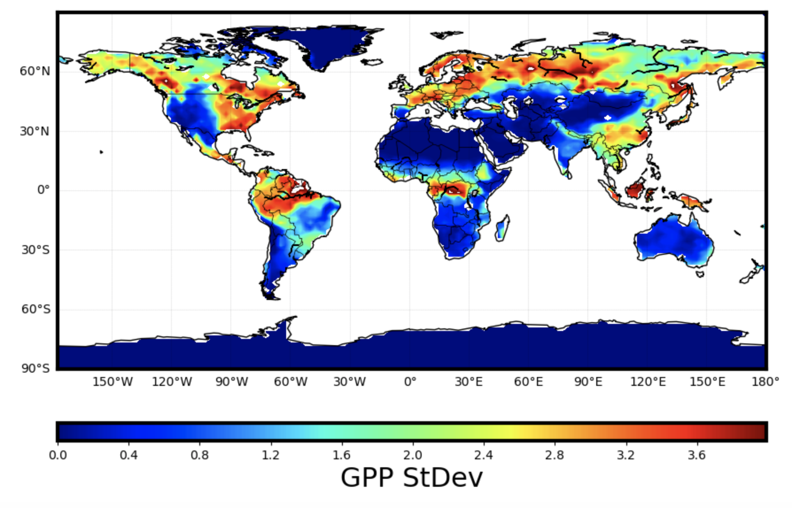
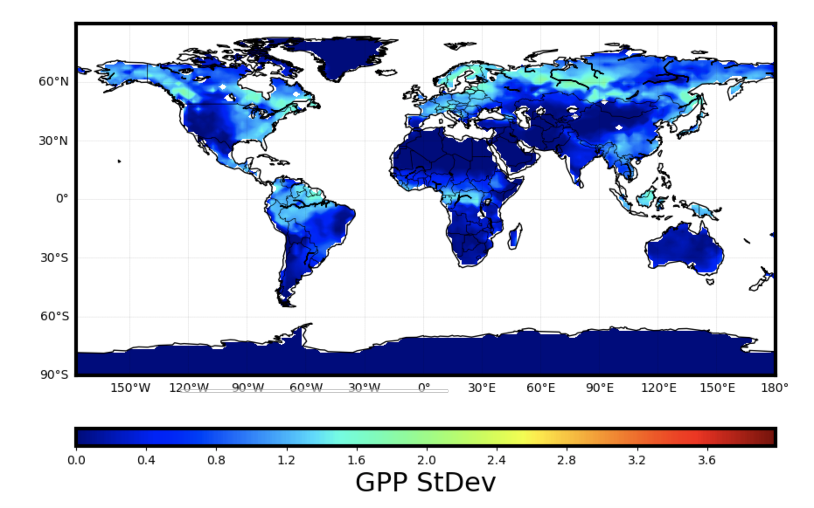
Impact of calibration
Calibrated PDF (flnr only) using 28 US sites, used for posterior prediction globally
Accounts for model structural error (see supplementary slide)
Predictions shown for one month (July 2001)
Prior mean
Posterior mean
Prior
Stdev
Posterior Stdev

Slide 11
Summary
Forward UQ (uncertainty propagation):
  Surrogate modeling is the key
    For point/site simulations, we have well-developed workflows and willing to work with core, NGD and ecosystem projects.
    With a combination of approaches, we can achieve high surrogate accuracy with global relevance using a relatively small number of simulations.
  Global sensitivity analysis or variance decomposition for parameter dimension reduction
  Extending global work to BGC: Possible but computational resources needed
Inverse UQ (parameter calibration):
  Bayesian model calibration with Markov chain Monte Carlo (MCMC) sampling
  Expense is alleviated by using an accurate surrogate: makes ELM calibration feasible
  Key advances: Spatially explicit surrogates, incorporating model structural error
“MODEX” loop enabler: use attributable model prediction uncertainties to optimally locate new observation locations.

Slide 12
Supplementary materials

Slide 13
Spatio-temporal surrogate model via Karhunen-Loève expansions
3183 active land cells over 180 months is > 500,000 outputs
Karhunen-Loève expansions help reduce dimensionality due to strong
spatio-temporal correlations (think of Principal Component Analysis
in stochastic space)
Instead of 500K surrogates, we build about 2K surrogates,
one for each eigen-component
End result: a single surrogate, resolved in space and time,
with about 5% relative error compared to true ELM
Surrogate ELM is extremely cheap to evaluate and is being used
online to calibrate the parameters

Slide 14
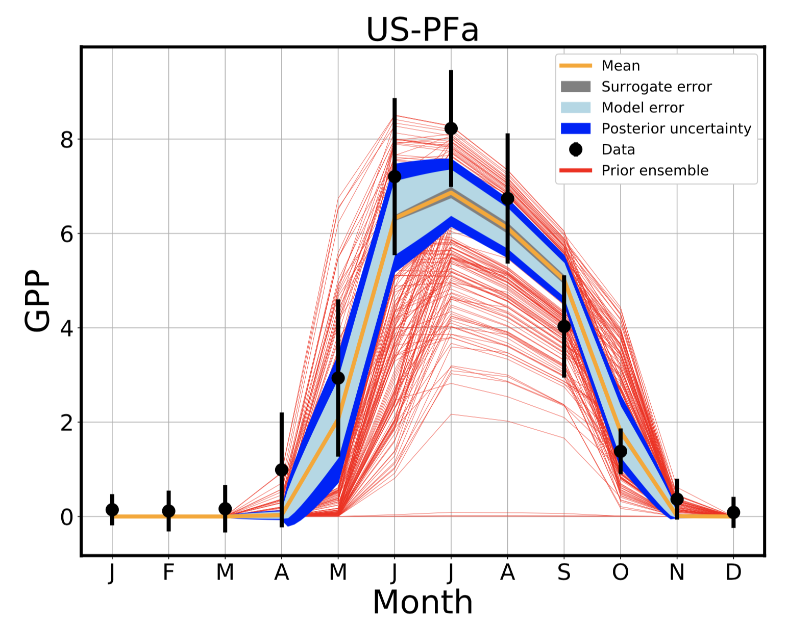
Calibration with Embedded
Model Structural Error
Model structural error embedding approach [Sargsyan et. al., 2015, 2018]
    Embedded, but not intrusive, i.e. black-box
    Physics-driven model correction
    Meaningful extrapolation to full set
    of QoI predictions
    Disambiguation between model error and
    data noise
    Core FASTMath capability
Calibration of sELM with FLUXNET sites data
Model error is the dominant uncertainty component
Removes parameter biases and overfitting
Points to submodels/parameters that are the culprit

