Slide 1









CICE Consortium Progress and Plans
Elizabeth Hunke and Andrew Roberts
Los Alamos National Laboratory
DOI 10.5281/4122287
LA-UR-20-28461

Slide 2
What we do:
The CICE Consortium is a group of stakeholders and primary developers of the Los Alamos
sea ice model (CICE) formed
to maintain the current CICE model for existing and new users,
to incorporate and maintain new research and development, and
to accelerate scientific sea ice model development and its transfer into operational use.
The CICE model was originally developed and maintained by the Department of Energy as a computationally efficient sea ice component for use in fully coupled, atmosphere-ice-ocean-land global circulation models. Over the past two decades, a broad community of climate and weather forecasting groups have adopted and enhanced the code. The CICE Consortium is recognized* as a vehicle for collaboration in sea ice model support and development as the community continues to use and improve sea ice models.
What we do for DOE:
Since DOE moved to the MPAS framework for the sea ice component in E3SM and is also supporting development of a new, discrete element sea ice model, the Consortium provides the sea ice column physics (Icepack) for these DOE models. Here we provide an update of new sea ice modeling capabilities incorporated into the Consortium's CICE and Icepack repositories with particular relevance to DOE, and outline expected future developments.
* Fisher and Koven (2020). Perspectives on the future of land surface models and the challenges of representing complex terrestrial systems. J. Adv. Model. Earth Syst., 12.

Slide 3
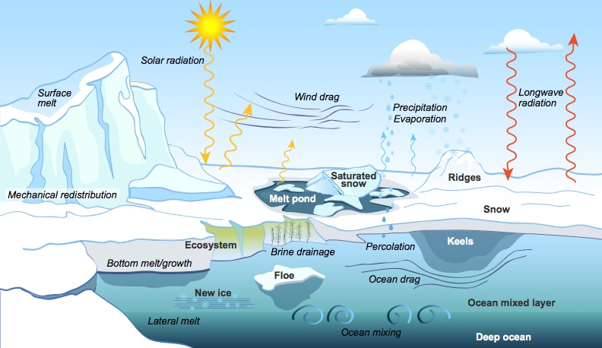
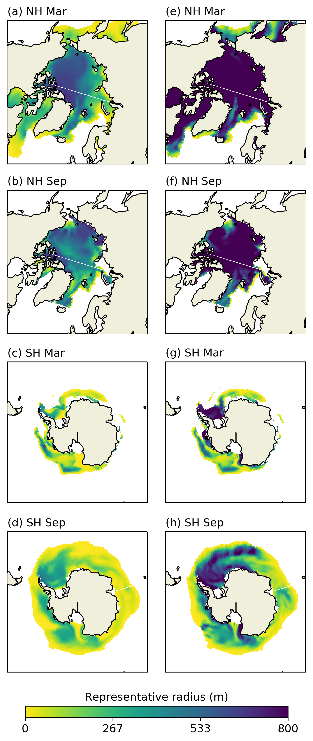
Icepack
Sea-ice column-physics package
Floe size distribution
and wave-ice interactions ¹
For DOE’s new focus on coastal regions, waves and tides are important for determining the size distribution of sea ice floes, which affects the behavior of the ice pack.
Major improvements to Icepack
Floe size distribution with wave-ice interactions
Water isotopes
Mushy thermodynamics improvements
Improved interfaces between Icepack and host sea ice models
Coming:
Snow model, radiation upgrades from E3SM
Satellite emulator
Machine learning for wave-ice interactions
Improved radiation using MOSAiC data
Stochastic and variational² mechanical redistribution schemes
Representative floe radius simulated by the FSD model in CICE v5.
¹ Roach, L. A., et al. (2018). An emergent sea ice floe size distribution in a global coupled ocean--sea ice model. J. Geophys. Res. Oceans.
² Roberts, A., et al. (2019). A Variational Method for Sea Ice Ridging in Earth System Models, Part I: Theory. J. Adv. Model. Earth Syst., 11.

Slide 4
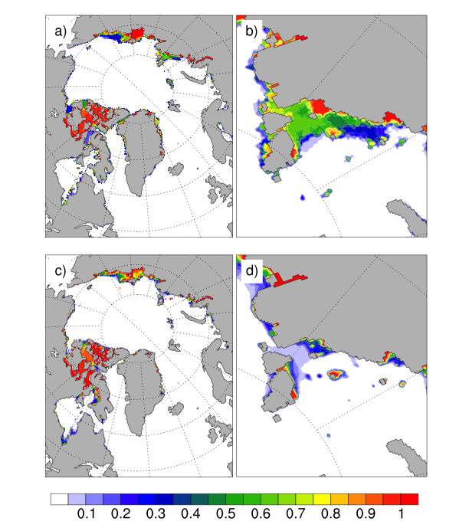
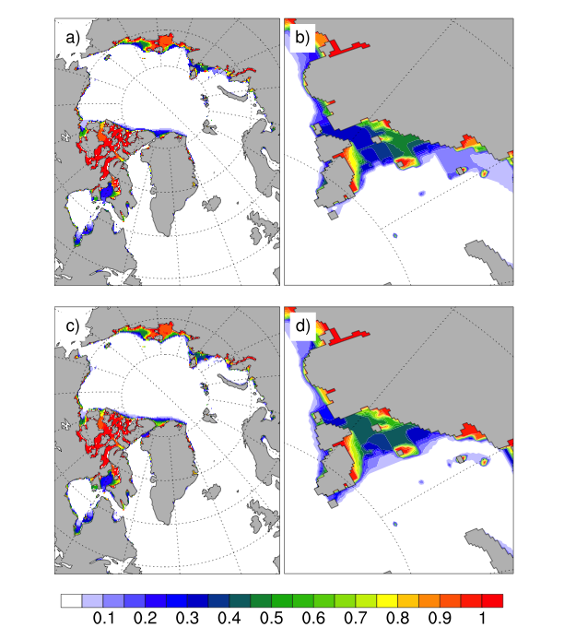

Major community contributions
Major additions to Icepack
Floe size distribution with wave forcing
Water isotopes ¹
Mushy thermodynamics improvements
Improved Icepack-host model interfaces
Major additions to CICE
Basal stress / landfast ice ²
Vectorized EVP kernel
Implicit solver for viscous-plastic (VP) dynamics ³
NUOPC drivers
Coming:
Mohr-Coulomb rheology
Landfast ice: probability based grounding, iceberg interactions
C-grid dynamical core
Debugging and improvements for OpenMP
New time manager
Metrics and scripts for comparison with obs
JRA-55 forcing data
Both Icepack and CICE
Automated testing of code ⁴ and documentation
CMIP6 history support ⁵
Improved landfast-ice representation ²
Coastal research in the Arctic must account for fast ice, a new capability implemented in CICE. The parameterization causes the ice to stop moving when keels reach the sea floor.
Observation
Model
See references on the next slide
¹³ Brady, E., et al. (2019), The Connected Isotopic Water Cycle in the Community Earth System Model Version 1, J. Adv. Model. Earth Syst., 11, 2547– 2566..
¹⁴ Lemieux, J.‐F., et al. (2016). Improving the simulation of landfast ice by combining tensile strength and a parameterization for grounded ridges, J. Geophys. Res. Oceans, 121, 7354– 7368.
¹⁵ Lemieux, et al. Using the preconditioned Generalized Minimum RESidual (GMRES) method to solve the sea-ice momentum equation. J. Geophys. Res. Oceans, 113(C10), 2008.
¹⁶ Roberts, A. et al. (2018). Quality Control for Community Based Sea Ice Model Development. Phil. Trans. Royal Soc. A, 376: 2017.0344.
¹⁷ Notz, D., et al. (2016). Sea ice Model Intercomparison Project (SIMIP): Understanding sea ice through climate-model simulations. Geosci. Mod. Dev., 9, 3427—3446.

Slide 5
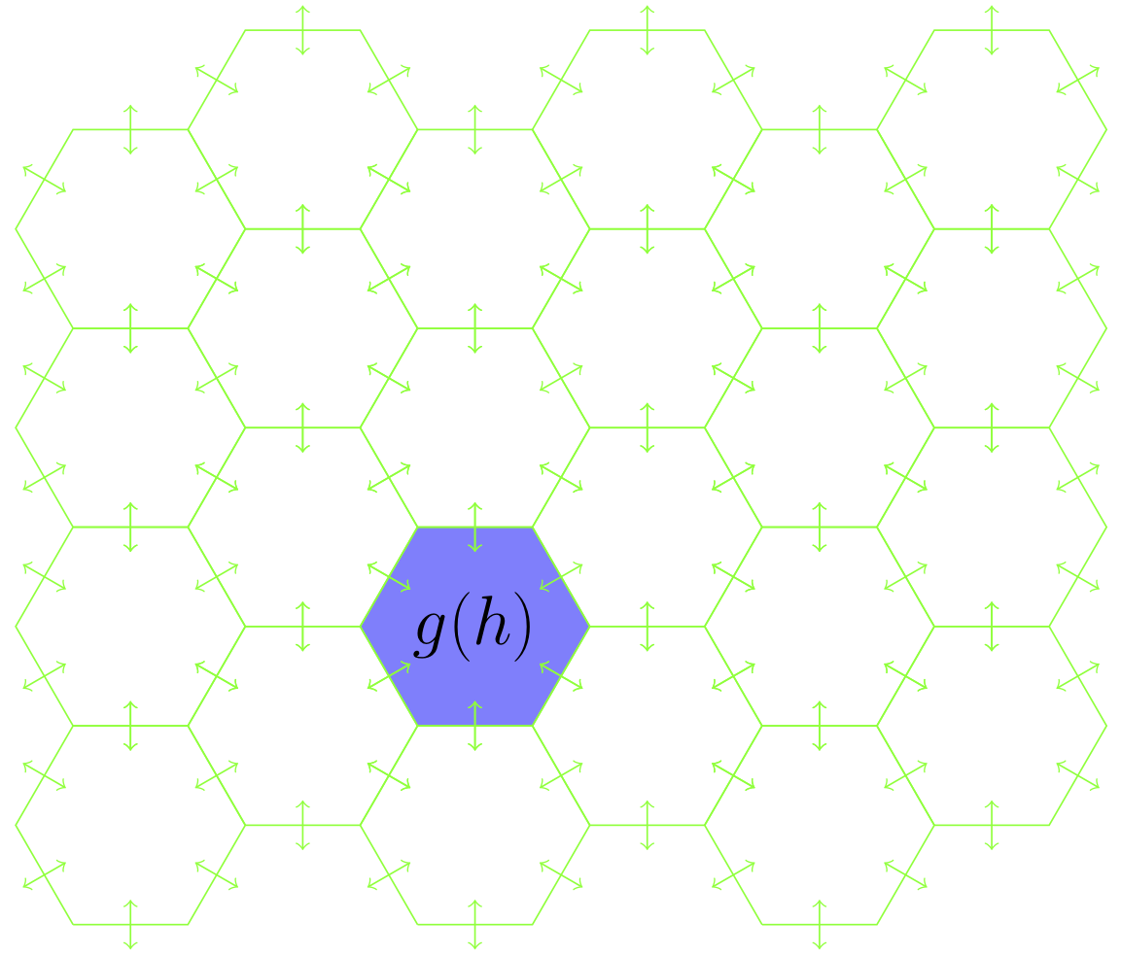
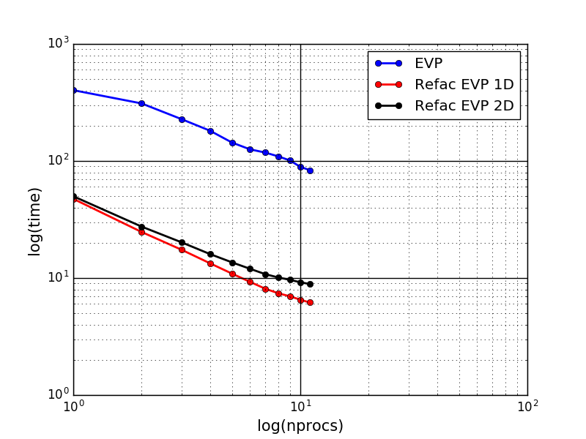
Major community contributions
Vectorized EVP kernel
The elastic-viscous-plastic dynamics module was vectorized, enabling the entire stress calculation to be put onto a single processor (or GPU), while keeping the rest of the code parallelized using a domain decomposition. Performance improved 10X.
C-grid dynamical core
A C-grid option for momentum, stress and transport equations will be added to the CICE repository for NOAA/NCAR grids. LANL is considering how to do this more generally, to include MPAS meshes.
¹ Brady, E., et al. (2019), The Connected Isotopic Water Cycle in the Community Earth System Model Version 1, J. Adv. Model. Earth Syst., 11, 2547– 2566..
² Lemieux, J.‐F., et al. (2016). Improving the simulation of landfast ice by combining tensile strength and a parameterization for grounded ridges, J. Geophys. Res. Oceans, 121, 7354– 7368.
³ Lemieux, et al. Using the preconditioned Generalized Minimum RESidual (GMRES) method to solve the sea-ice momentum equation. J. Geophys. Res. Oceans, 113(C10), 2008.
⁴ Roberts, A. et al. (2018). Quality Control for Community Based Sea Ice Model Development. Phil. Trans. Royal Soc. A, 376: 2017.0344.
⁵ Notz, D., et al. (2016). Sea ice Model Intercomparison Project (SIMIP): Understanding sea ice through climate-model simulations. Geosci. Mod. Dev., 9, 3427—3446.

Slide 6
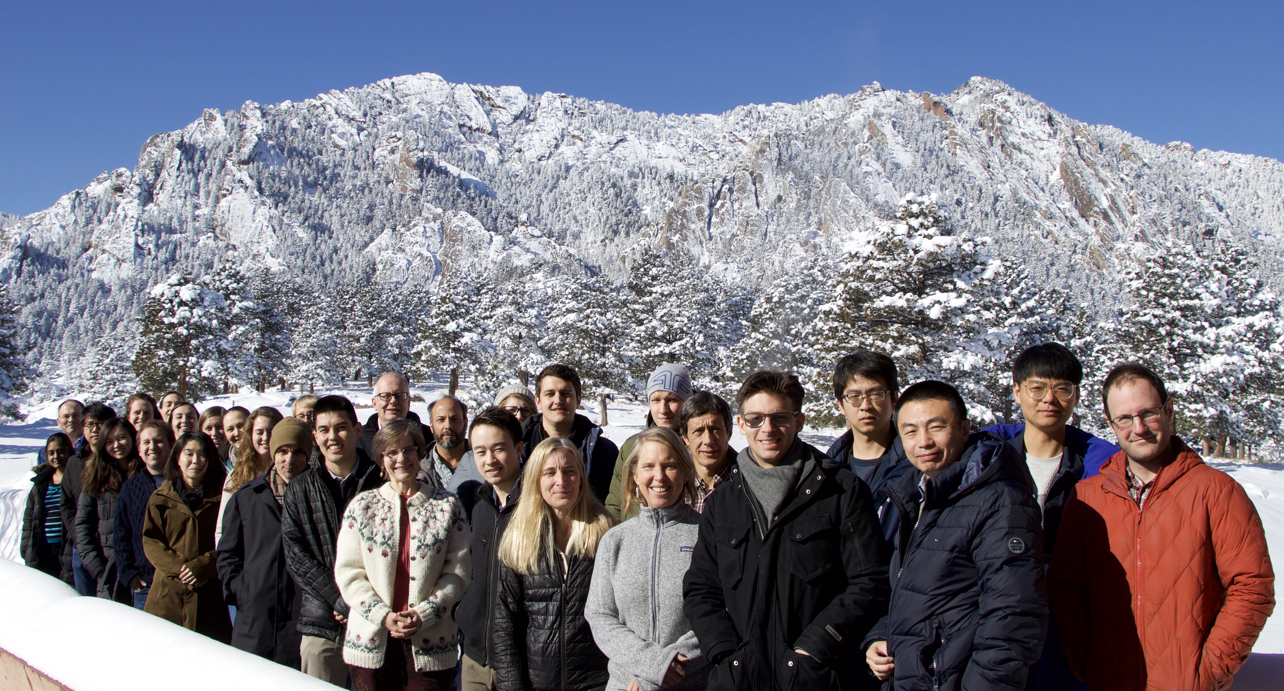
Icepack and CICE
User workshop and tutorial
February 3-5, 2020, National Center for Atmospheric Research
Major recommendations:
Develop a set of observations and metrics (international benchmarking project)
Set up short-term, topical working groups
Areas of common interest:
Snow, waves in sea ice, radiation effects, data assimilation, freshwater ice (lake ice, icebergs)
Longer-term physics priorities:
Dependence of rheology on model resolution
Validate/improve sea ice hydrology including ocean coupling
Snow

Slide 7
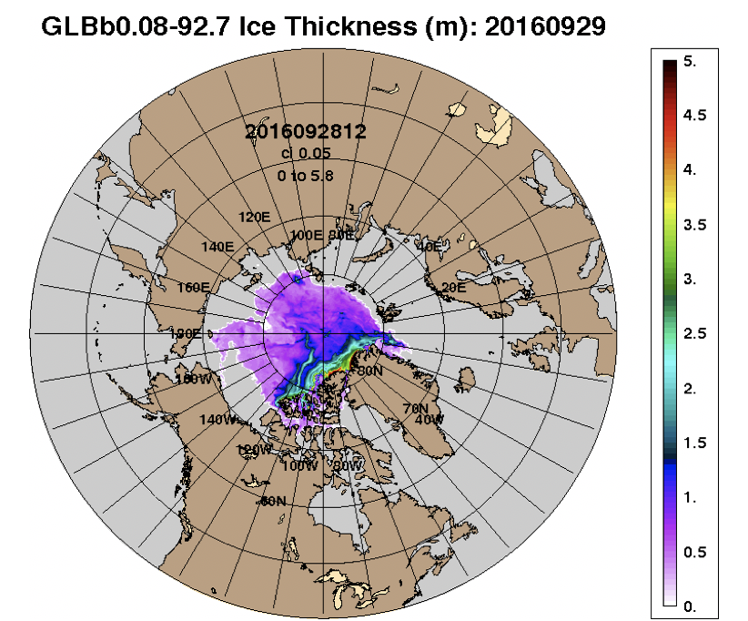
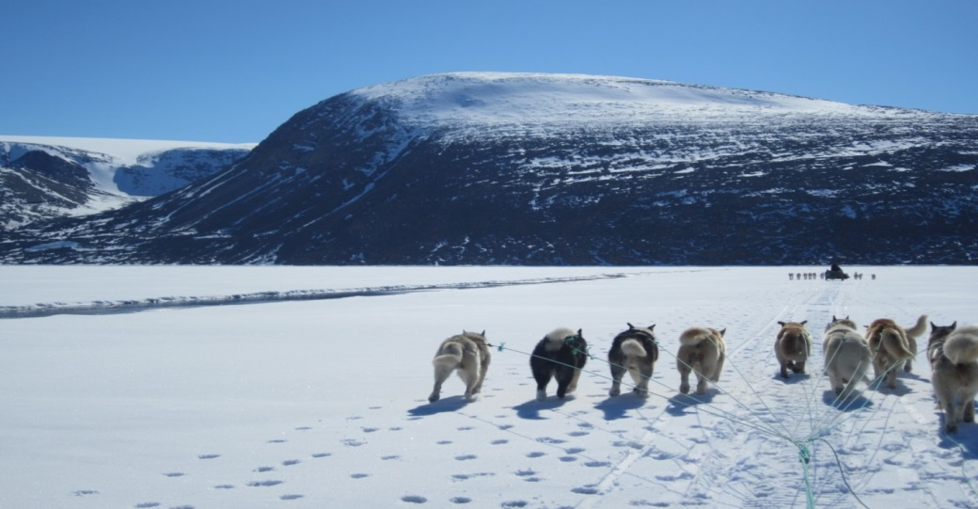
The CICE Consortium strengthens
scientific research and operational applications
U.S. and international operational forecasting
U.S. Navy forecasts of ice concentration, thickness and drift are pushed daily to the U.S. National Ice Center and NOAA. NOAA uses the data for weather forecasting and to produce experimental sea ice forecasts.
Surface temperature in the Gulf of St. Lawrence. Environment and Climate Change Canada provides forecasts for North American and Arctic regions in a variety of domains and resolutions.
DMI provides in-situ observations, ice charts and remotely sensed data for users and model validation, including CICE model products (ice thickness, concentration, convergence, drift, temperature).

Slide 8
Should sea-ice modeling tools designed for climate research be used for short-term forecasting?
Yes. | Develop a community modeling framework for staged improvements:
Status quo | Continue using existing models
Evolution | Continue improving existing models, porting new advancements into operational modeling systems
Revolution | Develop new modeling strategies such as Discrete Element Models and superparameterizations
(a) Sea-ice drift forecast from GOFS 3.1 (green vectors) in support of the ICEX joint exercise “Camp Seadragon” in March 2020, overlain on VIIRS and RADARSAT2 (red rectangle) sea-ice imagery (National Ice Center, 2020). Colored dots show buoys rotating in inertial motion. (b) GOFS sea-ice compressive strength (104 N/m). The ice is weak where it is moving away from the shore and along the shore lead, visible as a white line in the satellite image in (a). The ice has slowed under compressive conditions in the eastern area of the NIC domain (black box). (c) Sea-ice opening rates (%/day) associated with divergence and shear. Linear kinematic features appear in response to shifting winds.
Hunke, E. et al (2020). Should Sea-Ice Modeling Tools Designed for Climate Research Be Used for Short-Term Forecasting? Curr. Clim. Change Rep., 2020. DOI 10.1007/s40641-020-00162-y

Slide 9
Team Members and Code Contributors, FY20
Elizabeth Hunke ¹, Richard Allard ², David A. Bailey ³, Philippe Blain ⁴, Amelie Bouchat ⁴, Tony Craig ⁵, Frederic Dupont ⁴, Alice DuVivier ³, Robert Grumbine ⁵, David Hebert ², Marika Holland ³, Nicole Jeffery ¹, Jean-Francois Lemieux ⁴, Robert Osinski ⁶, Till Rasmussen ⁷, Mads Ribergaard ⁷, Lettie Roach ⁸, Andrew Roberts ¹, Matt Turner ¹, Michael Winton ⁹
  ¹ Los Alamos National Laboratory
  ² Naval Research Laboratory Stennis Space Center
  ³ National Center for Atmospheric Research⁴ Environment and Climate Change Canada
  ⁵ National Oceanic and Atmospheric Administration
  ⁶ Institute of Oceanology, Polish Academy of Sciences
  ⁷ Danish Meteorological Institute
  ⁸ University of Washington
  ⁹ NOAA Geophysical Fluid Dynamics Laboratory
  Funding sources. LANL: Energy Exascale Earth System Model project in DOE’s Biological and Environmental Research Division. DMI: National Centre for Climate Research and the ERA4CS/SALIENSEAS project co-funded by Innovation Fund Denmark and Horizon 2020 Framework Programme of the European Union. ECCC. GFDL. NCAR: National Science Foundation. IOPAN: Office of Naval Research support for the Regional Arctic System Model. NRL-Stennis: Office of Naval Research. NOAA: Oceanic and Atmospheric Research, National Weather Service.

