Slide 1
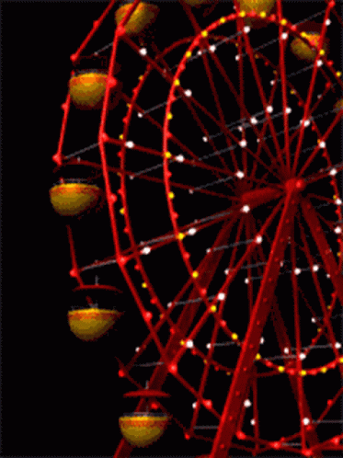
Modelling the Ferrous Wheel
(the iron cycle) and Anthropocene
changes in ocean BGC
Douglas S. Hamilton
Rachel Scanza, Natalie Mahowald, Sagar Rathod,
Longlei Li, Keith Moore, Tami Bond,
Jasper Kok, Yan Feng

Slide 2
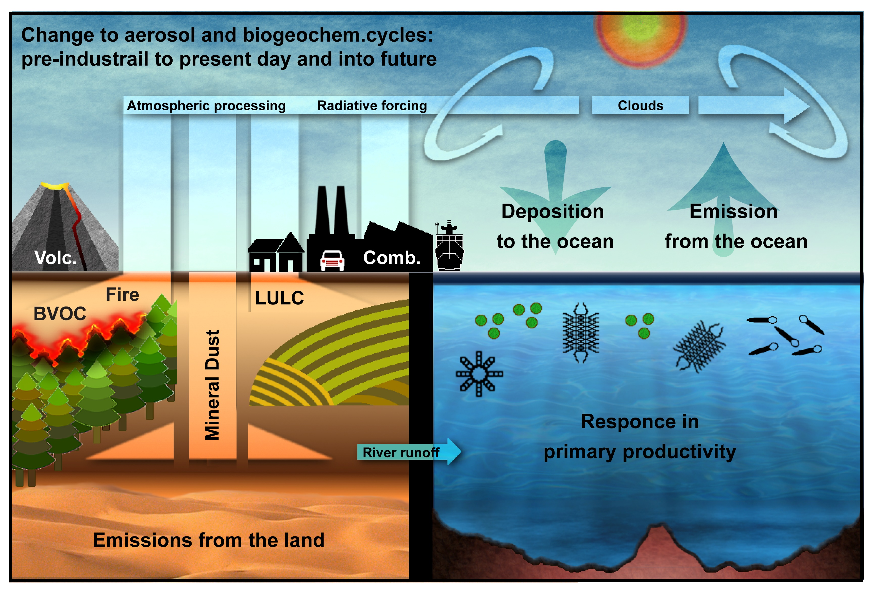
Why study iron aerosol?
Figure adapted from Hamilton et al. (2020a)

Slide 3
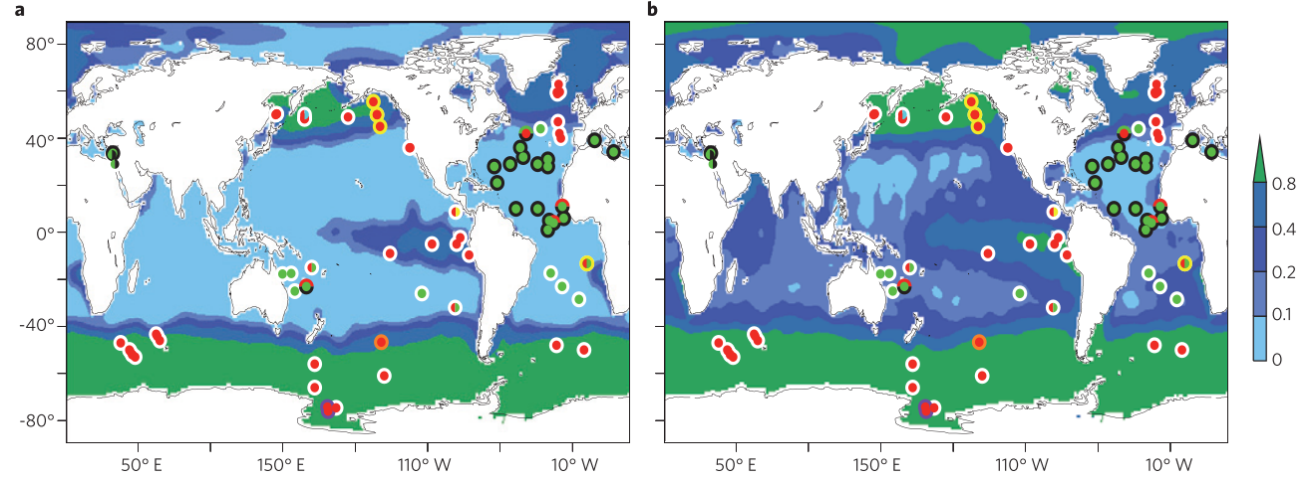
Where is iron-anemia limiting primary productivity?
Nitrogen concs.
Phosphorus concs.
Iron Limitation: Red circles (high nutrient low chlorophyll regions)

Slide 4
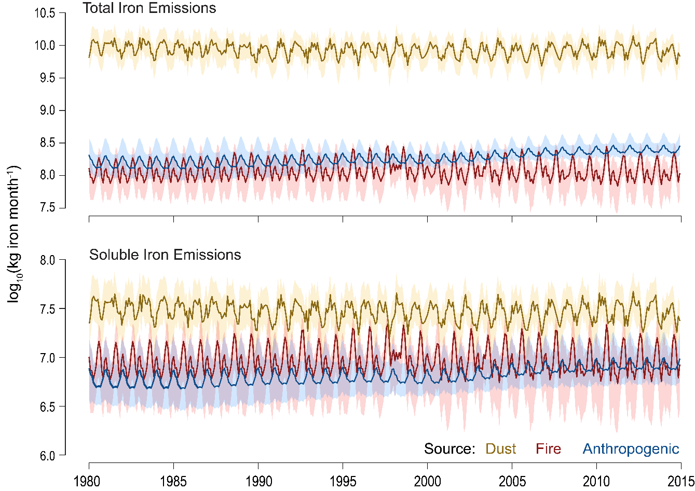
Emission sources (1980-2015)
Difference in soluble to
total due to solubility diffs.
(soluble/total) at emission:
Dust: <1%
Fires¹: 0.4-44%
Anthropogenic²
Coal: 0-4%
Wood: 5-15%
Oil: 8-81%
Emissions: ¹Hamilton et al. (2020b) and ²Rathod et al (2020)

Slide 5
Lifetime linked to abatement methods for air quality?

Slide 6
Anthropocene soluble iron deposition changes
PI = ca. 1750 CE
PD = ca. 2008 CE
FU = ca. 2100 CE
Northern Hemisphere
Anthropogenic combustion increases
Dust increases
Southern Hemisphere
Wildfire decreases
Northern Hemisphere
Anthropogenic combustion decreases
Southern Hemisphere
Wildfire increases

Slide 7
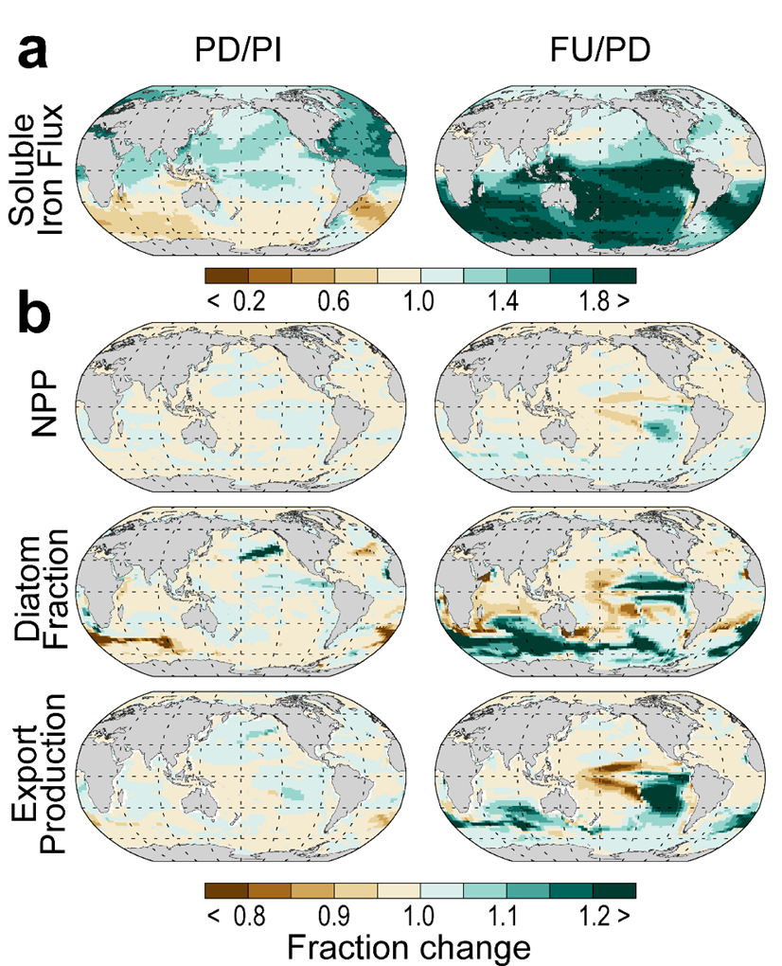
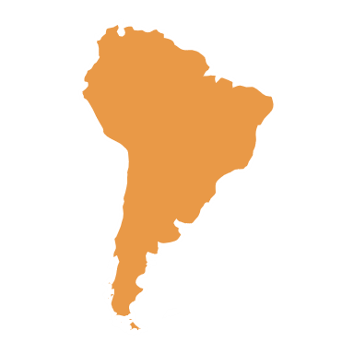
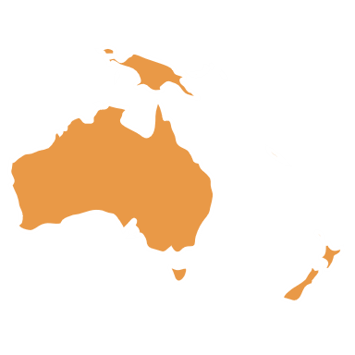
Southern Ocean dominates carbon
cycle response. Main emission
sources:

Slide 8
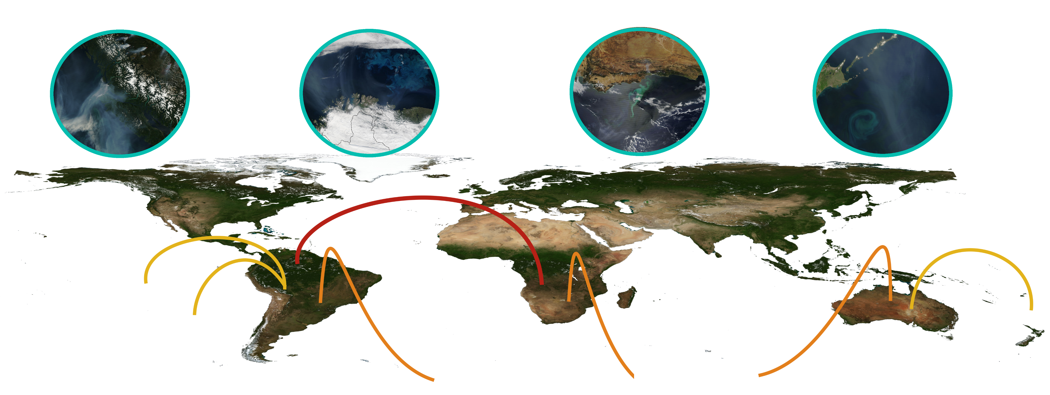
Selected NASA images of phytoplankton &
fire plumes from MODIS Terra & Aqua
(proviso: correlation ≠ causation)
Phosphorus
Pacific dep. drives
Nitrogen Cycle response
Southern Ocean dep. drives global Carbon Cycle response
Fires in biogeochemical cycles:
(1) Hamilton et al. (2020) Impact of Changes to the Atmospheric Soluble Iron Deposition Flux on Ocean Biogeochemical Cycles in the Anthropocene
(2) Barkley et al. (2019) African biomass burning is a substantial source of phosphorus deposition to the Amazon, Tropical Atlantic Ocean, and Southern Ocean

Slide 9
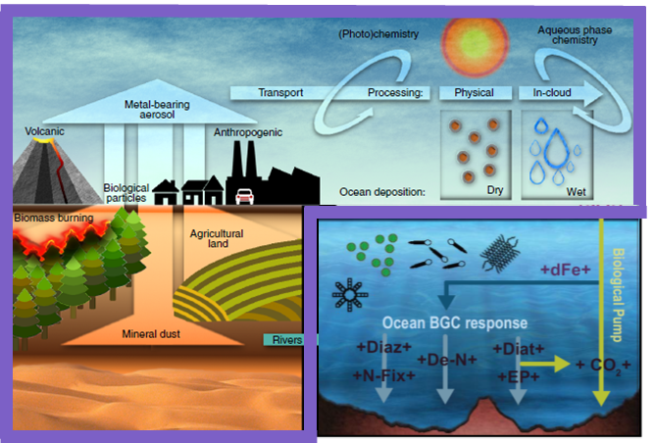
Mechanism of Intermediate complexity for Modelling Iron (MIMI v1.0)
Iron is an essential component of the Earth system which requires more study on climate, health, and biogeochemistry impacts.
Aerosol soluble iron is a new source to marine ecosystems and fuels primary productivity where it is the limiting micronutrient.
MIMI does this:
Natural iron emissions with dust and fires: both of which are coupled/online;
Anthropogenic activity iron emissions: offline from inventory;
Further dissolution of iron to a soluble (bioaccessible) form during transport;
Acid processing of interstitial aerosol;
Organic-ligand (oxalate) processing of cloud-borne aerosol;
and requires minimal core-cores to run for CAM6.
So as to better quantify the marine biogeochemical response
MIMI is an intermediate complexity iron aerosol module, designed for MAM4 and being coupled to E3SM by Yan Feng
MIMI has been tested against observations and an initial study on the ocean BGC response have been undertaken

Slide 10
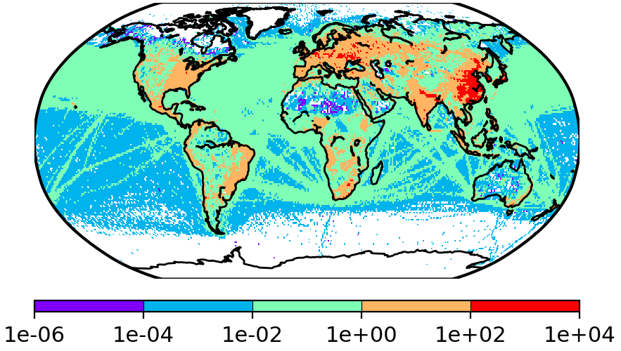
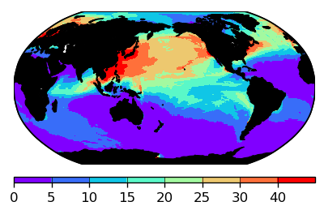
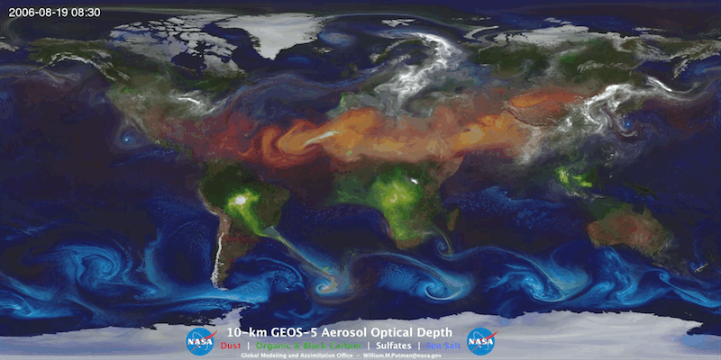
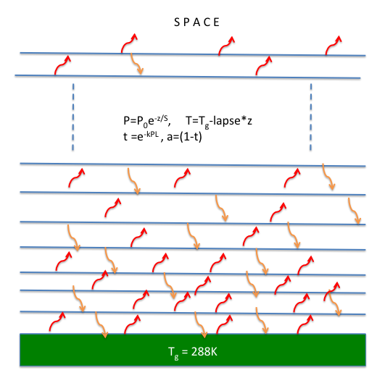
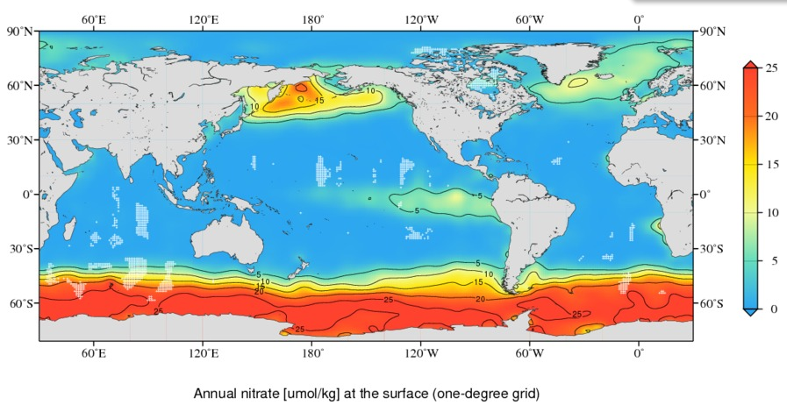
METHODS
Rathod
Talk
2. Ocean effects
1. Radiative effects
Mineralogy-based Emission inventory
Estimating fixed C
C-Fixed_{Fedep} = (C/Fe)_{phytoplankton} * Fe_{dep} ;
in basins with surface NO₃⁻¹ > 2, 4, or 8uM
C/Fe: 1.5e5 g/g
AnthroSolFeDep * 100 / TotalSolFeDep
Anthropogenic soluble iron deposition
Earth system model
Radiative transfer model
Surface nitrate concentrations

