Slide 1
Creation of an SST variability metric for E3SM
LeAnn Conlon, Luke Van Roekel

Slide 2
Can we use sea surface temperature to predict patterns on land in E3SM?
Goal: create an SST variability metric for E3SM that tells us something about patterns on land

Slide 3
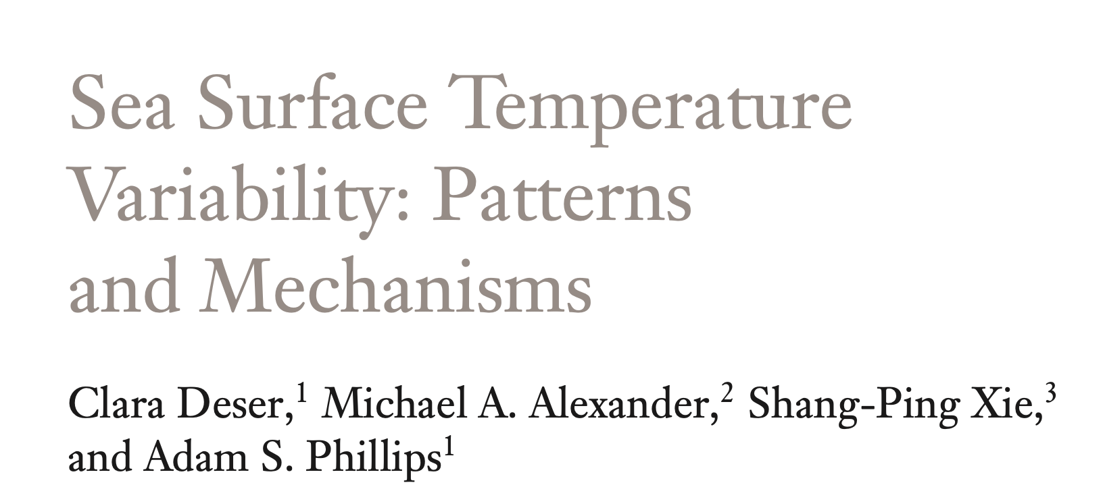
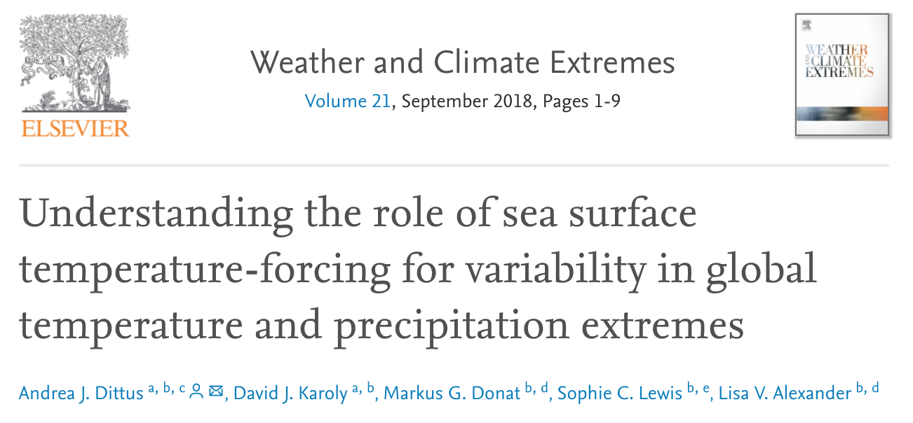
SST variability
Variability is mostly seasonal
De-seasoned: dominated by ENSO processes
Other important oscillations:
NAO
PDO
Deser et al. 2010
Bulgin et al. 2020
O’Brien et al. 2019
Dittus et al. 2018

Slide 4
Ocean/ Land relationships
Dittus et al. 2018

Slide 5
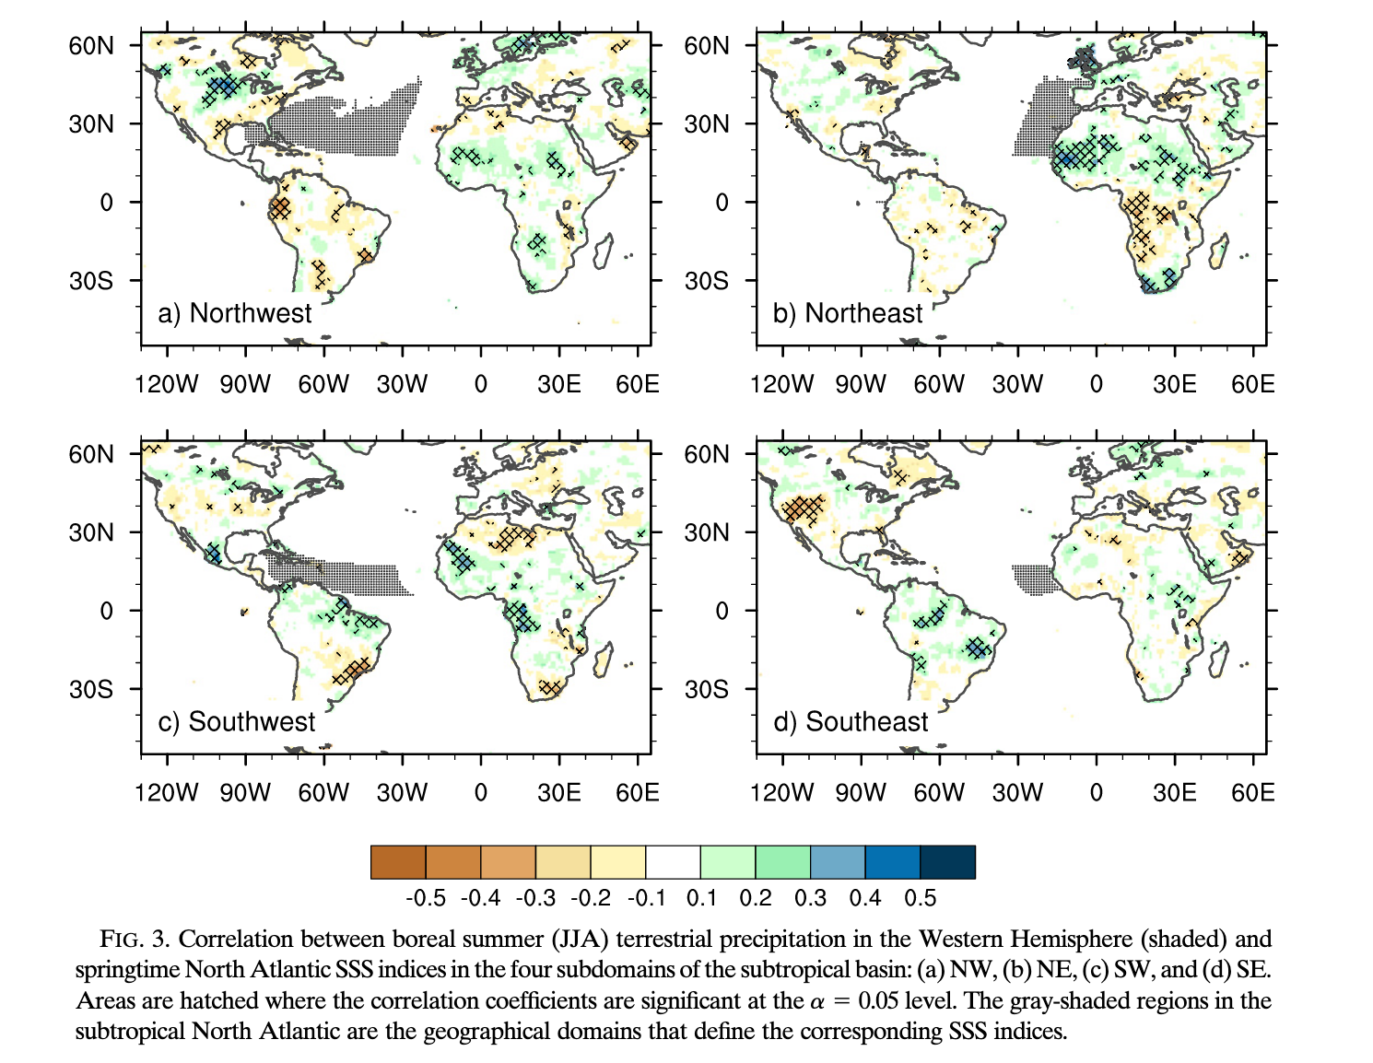
Ocean/ Land relationships
Li et al (2016) looked at the relationship between salinity and precipitation
High SSS over the northwestern subtropical Atlantic coincides with a local increase in moisture. The moisture is then directed toward and converges over the southern United States, which experiences increased precipitation and soil moisture
Approach: do something similar for the U.S. in E3SM using SST

Slide 6
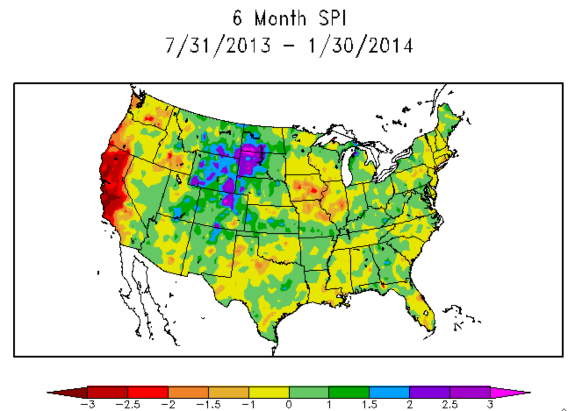
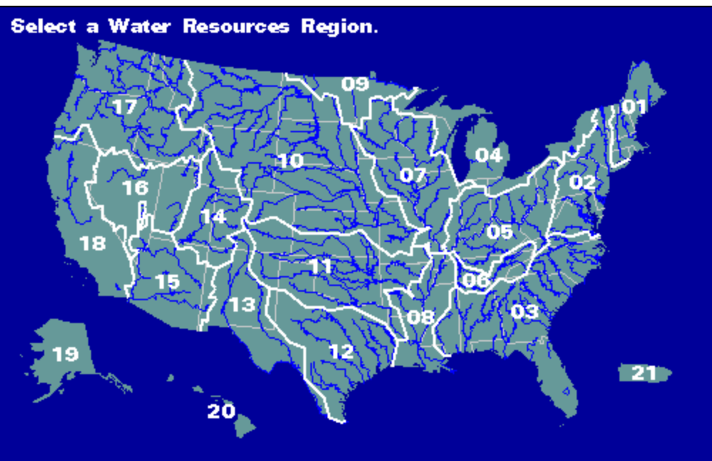
Data Analysis
Start with low res PI run, SST and precipitation
Precipitation
Standardized precipitation index (SPI)
a widely used index to characterize meteorological drought on a range of timescales
Averaged over each HUC02 watershed
NCAR
dry
wet
Precipitation
Standard Dev.
Mean
Precipitation
USGS

Slide 7
Standardized Precipitation Index
SPI for a typical year for each of the HU02 watersheds
What about SST?

Slide 8
SST variability

Slide 9
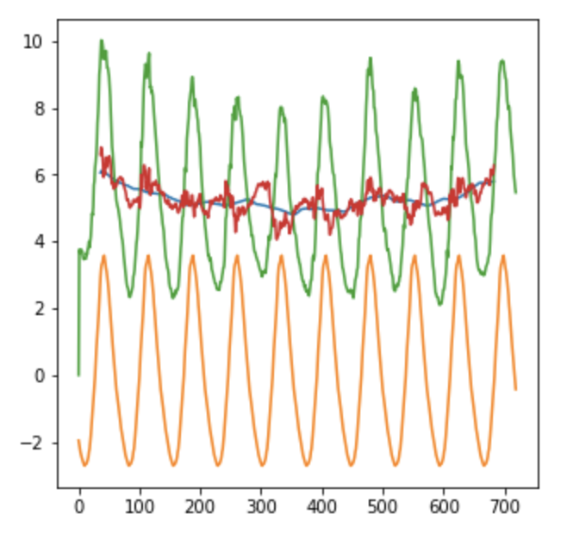
Data Analysis
Holt-Winters decomposition on SST: seasonal, trend, residual, raw data
SST (continued)
Seasonal cycles give spurious correlations (basically relating a seasonal cycle to itself)
Holtz-Winters decomposition avoids this
SST
Time

Slide 10
SST/SPI correlations
Correlated SST pointwise over much of the global ocean with SPI in each HUC02 watershed
Low resolution, de-seasoned SST (50 years)
Shading indicates significance
A positive correlation indicates that SST increases with SPI (a + SPI indicates more precipitation, a - indicates less). Overall, this means that warmer temperatures along the equator (e.g. an El Nino event) tended to produce significant increases in precipitation in many watersheds; PDO and NAO produce similar results.

Slide 11
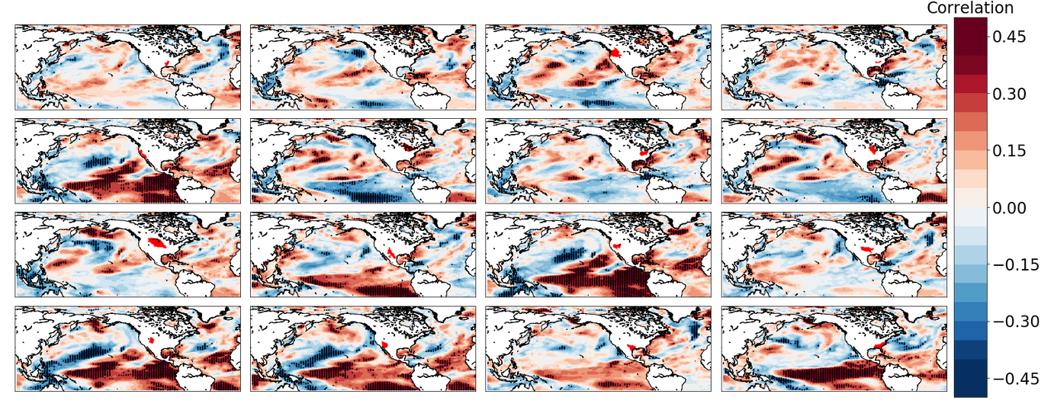
SST/SPI correlations: Seasonal
Low resolution, March only (50 years)
Shading indicates significance

Slide 12
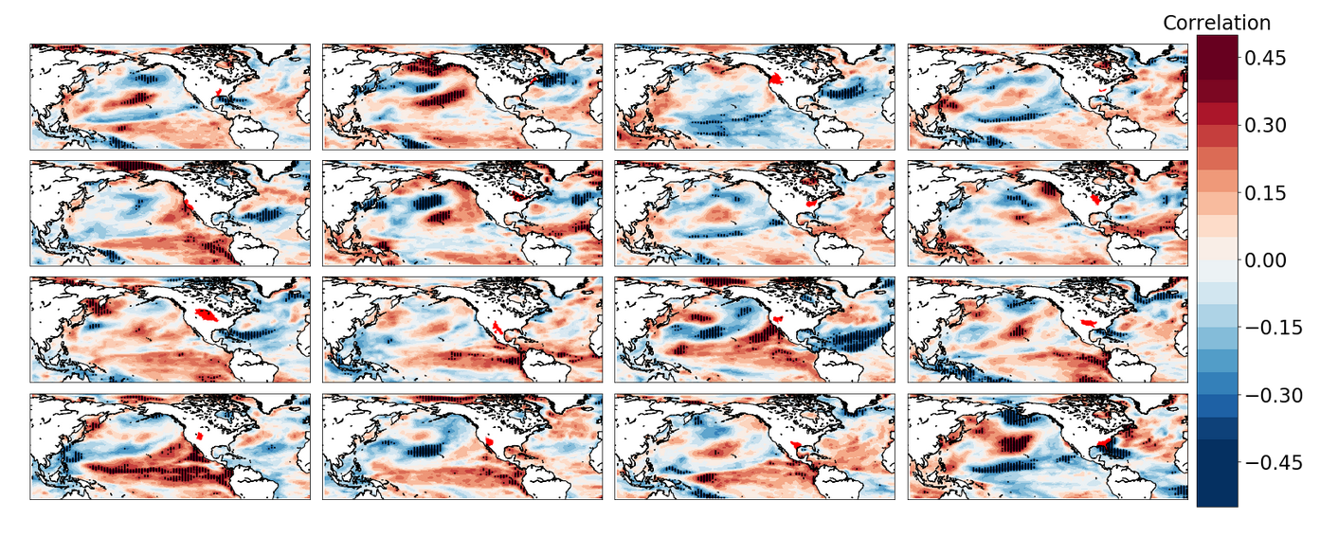
SST/SPI correlations: Seasonal
Low resolution, September only (50 years)
Shading indicates significance

Slide 13
Correlation of timeseries at 3 points, by watershed
PDO
ENSO
NAO

Slide 14
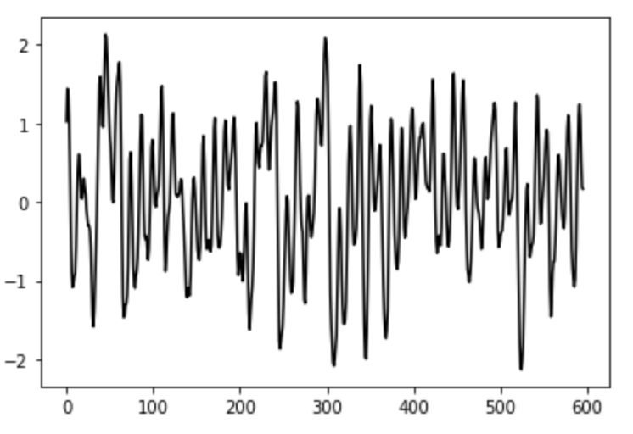
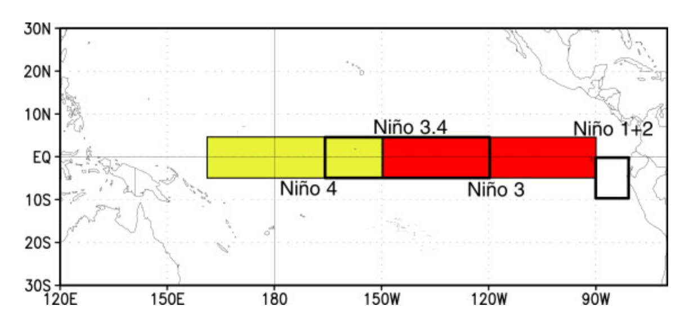
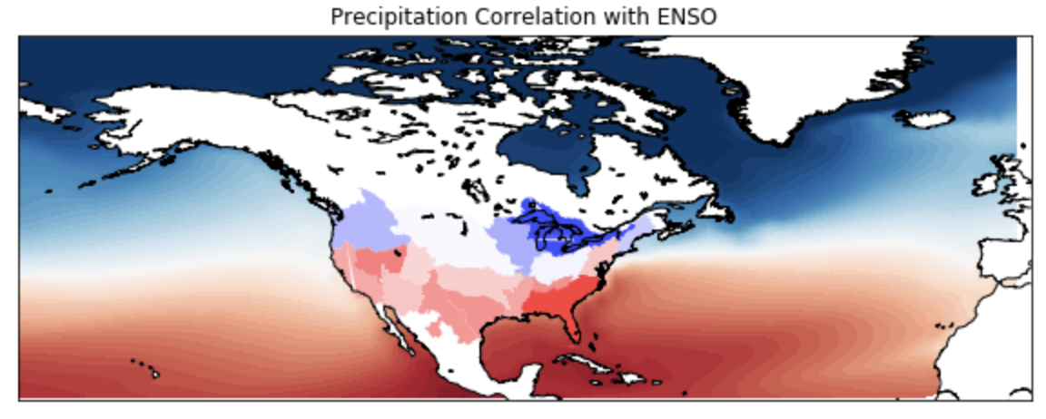
ENSO Comparison with NOAA
ENSO index
Instead of examining precipitation where it looks like ENSO is occurring, we can calculated ENSO itself and see how it relates to precipitation
ENSO is calculated based on the NOAA Oceanic Nino Index= surface temperature anomaly for Nino 3.4 (5N to 5S, 170W to 120W)
month

Slide 15
ENSO
dry
wet

Slide 16
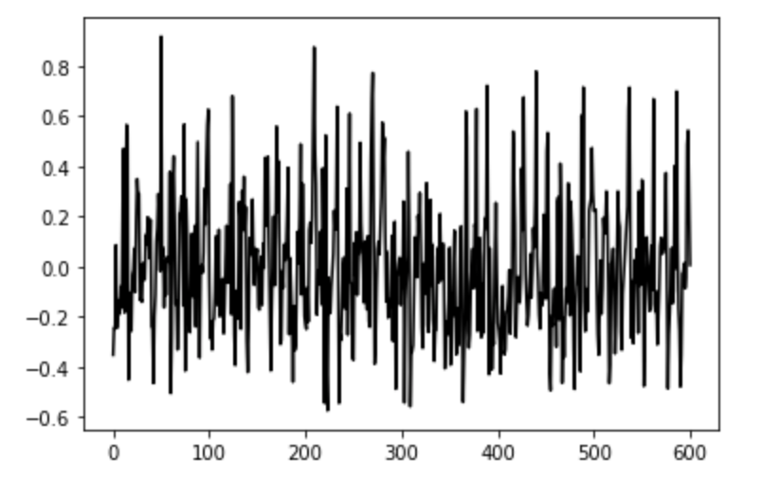
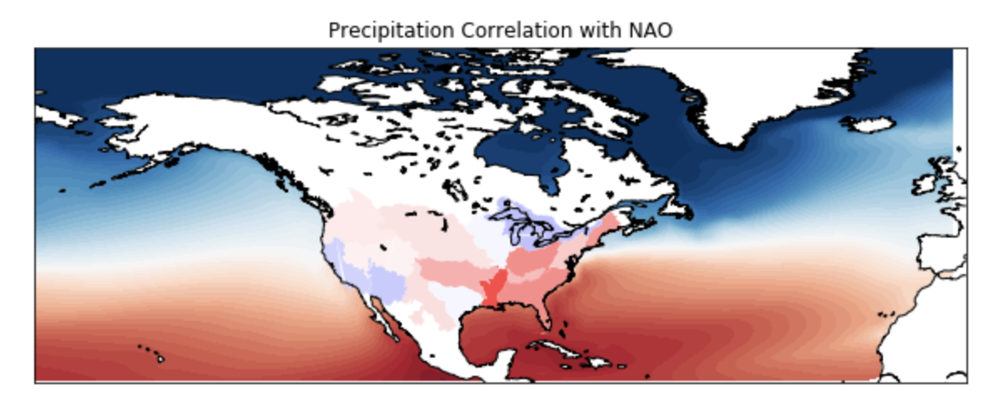
NAO
NAO index
NAO can be calculated as the normalized sea level pressure difference between Reykjavik and Lisbon
+ NAO=strengthening of the Icelandic low and the Azores high
-NAO= weakening of both the Icelandic low and Azores high
month

Slide 17
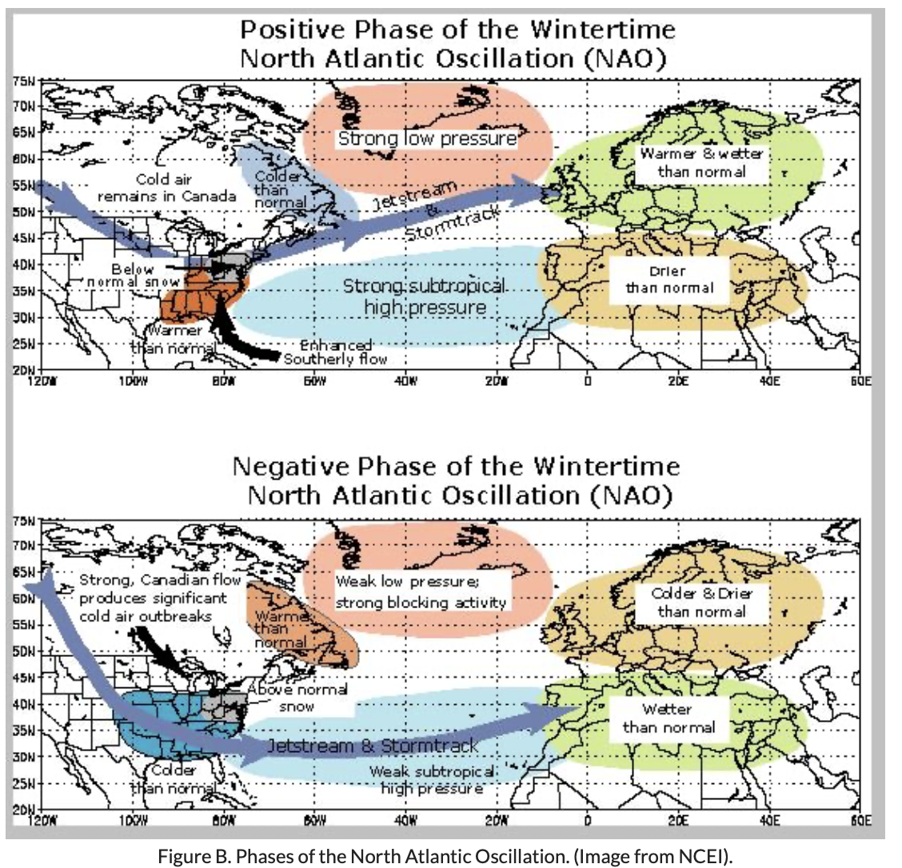

Slide 18
Summary
We can now pinpoint specific locations where SST affects drought/wetness across the U.S. in E3SM
Most watersheds across the U.S. are influenced primarily by variability in decadal oscillations, especially ENSO and NAO
NAO and ENSO affect precipitation patterns as expected across the U.S.

Slide 19
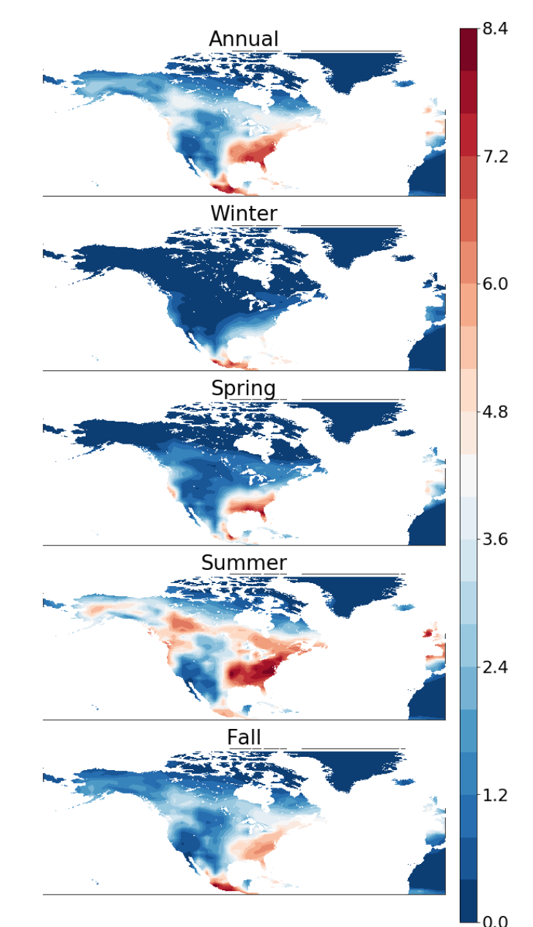
In progress
Projection, high resolution run correlations
Chlorophyll
Other ideas?

