Slide 1
Progress update: High-resolution offline ELM simulation over North America
Peter Thornton, Peter Schwartz, Dali Wang, Rupesh Shrestha, Michele Thornton, Shih-Chieh Kao, Marcia Branstetter, Fengming Yuan,
ORNL

Slide 2
Project tasks and schedule
Year | Month | Task 1 | Task 2 | Task 3 | Task 4 | Task 5
2019 | Jun | Construct hi-res surface weather forcings, including sub-daily down-scaling | Assemble other hi-res surface data
 | Jul
 | Aug |  |  | Adapt ELM with coupler bypass method for GPU system (Summit)
 | Sep
 | Oct
 | Nov |  |  |  | Apadpt ELM I/O methods for GPU system (init, history and restart)
 | Dec
2020 | Jan
 | Feb |  |  |  |  | Execute NA spinup runs
 | Mar
 | Apr
 | May

Slide 3
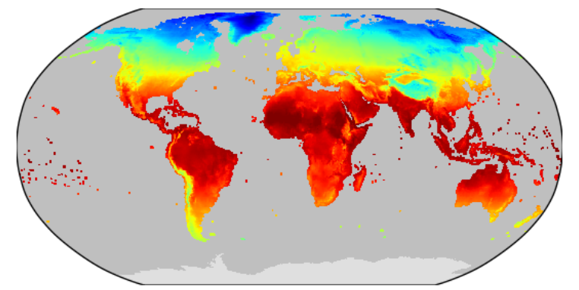
Target: 1km² grid resolution over N. America
Current ELM offline grid: 0.5°
Notes:
The images for annual total precipitation and annual average Tmax are used to show what a 1km N. Am. grid looks like, for some of the typical offline land forcings. These summary images are from the Daymet dataset, which is being amended with temporal downscaling and used to force the offline simulations. The inset shows an example of the current global offline land grid at 0.5 degrees resolution (CRY air temperature model driver), for comparison. In case anyone asks, we will also be running Puerto Rico and Hawaii.

Slide 4
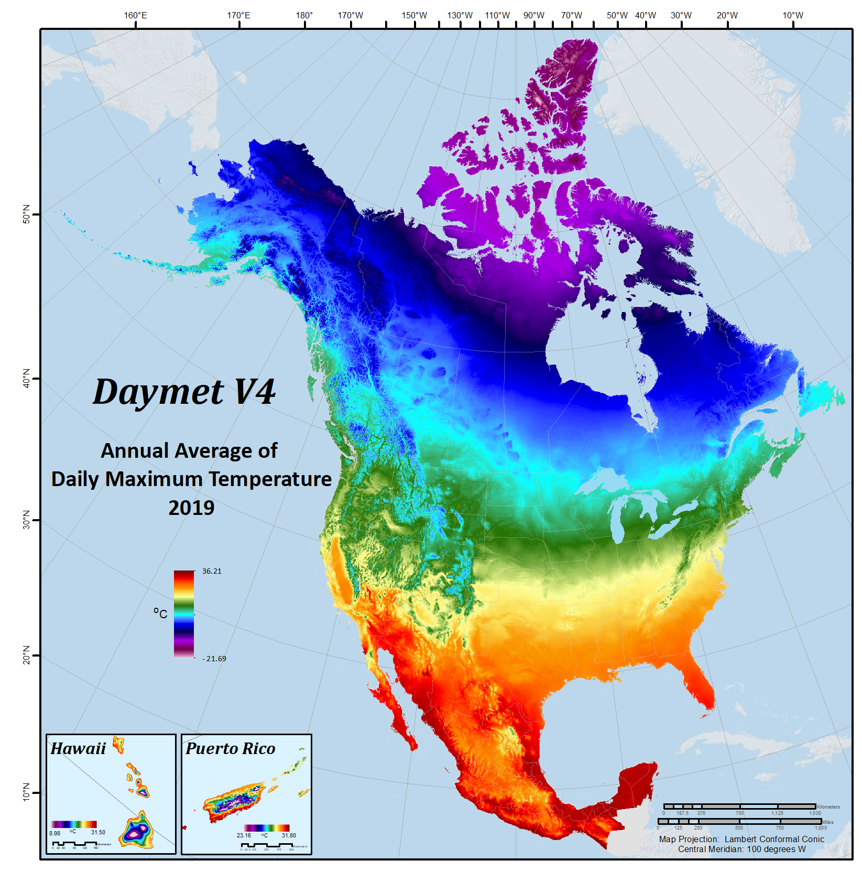
Target: 1km² grid resolution over N. America
~ 22,000,000 gridcells
~ 10,000 gridcells
Annual Average Tmax (2019)

Slide 5
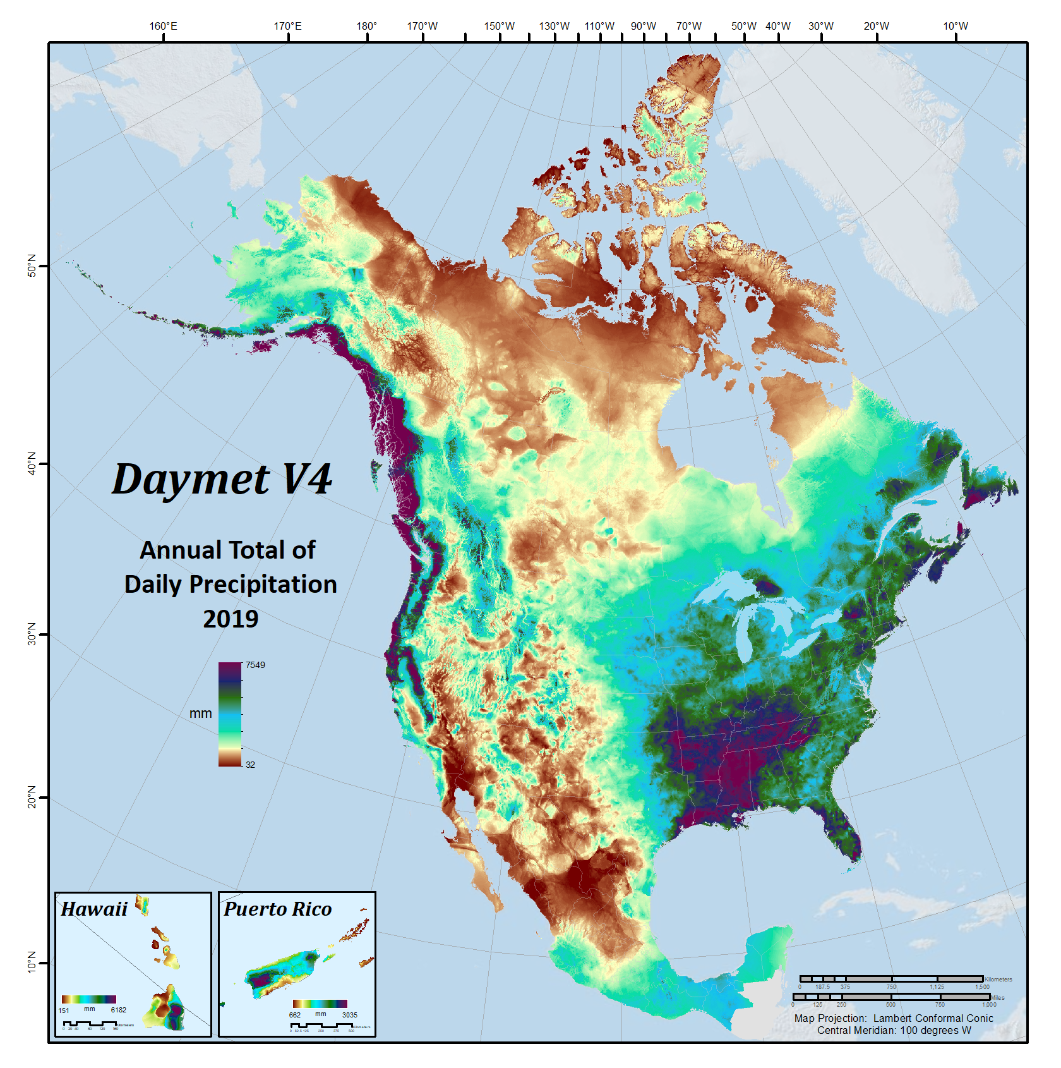
Target: 1km² grid resolution over N. America
High-resolution surface weather inputs:
Updated with new station data for 1980-2019
Corrected time-of-observation biases in daily temperature
Corrected temperature sensor biases in SNOTEL data record
Applied temporal downscaling based on GSWP3
Annual Average Tmax (2019)
Annual Total Prcp (2019)

Slide 6
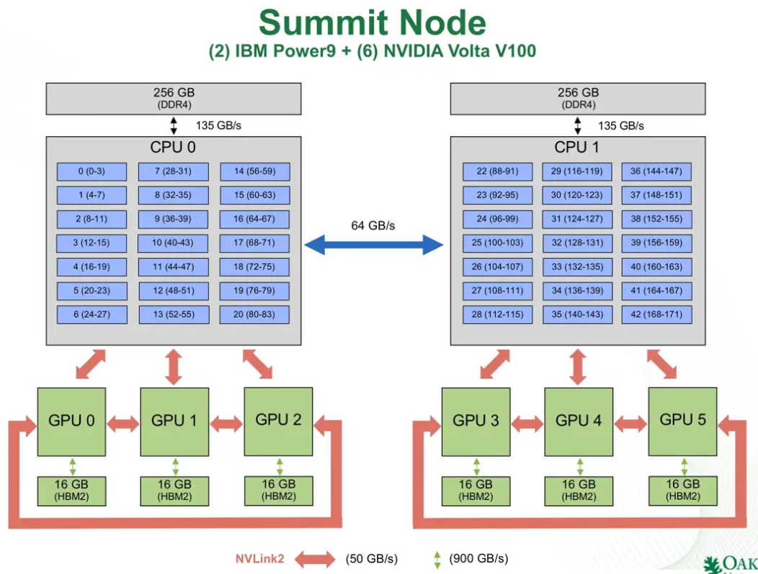
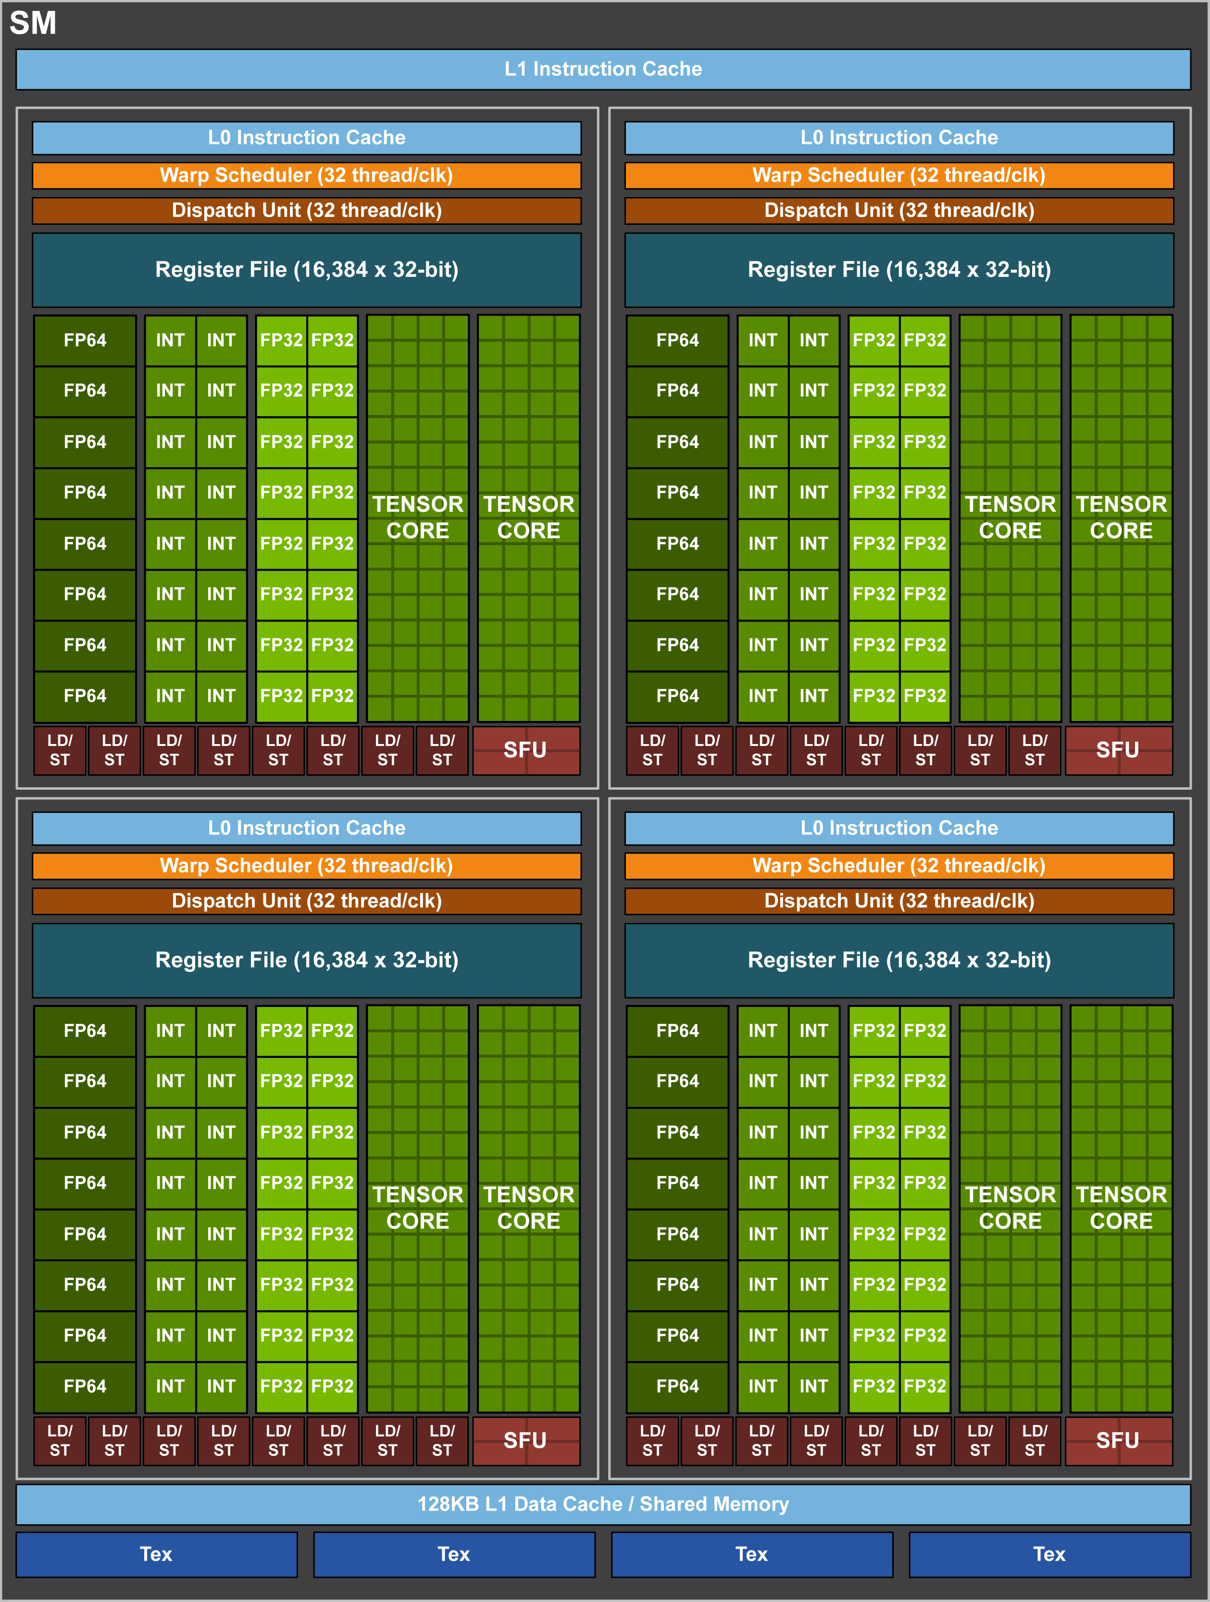
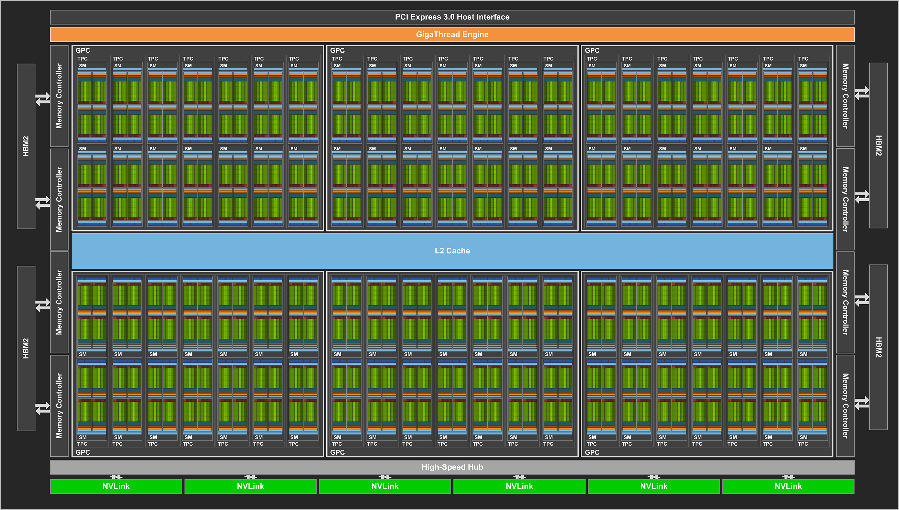
Computational strategy: OpenACC on Summit
Each GPU has 80+ Streaming Multiprocessors (SMs) and 16 GB of shared memory (HBM2)
Each SM has 32 double precision cores, which can be “over-subscribed” with threads to an extent that depends in part on availability of register space and heap space.
Each Summit node has 6 NVIDIA Volta V100 GPUs. We plan to have 1 ELM MPI task per GPU, so 6 MPI tasks per node
Our approach is to use the existing “clumps” parallelism in ELM (traditionally connected to OpenMP), and tie it to the double precision cores on the V100 GPUs via OpenACC, using 1 gridcell per clump.
Notes:
This slide shows what the GPU computational resource looks like on Summit, and how we are making use of an existing parallelism in the model to move computation onto the GPU

Slide 7
Parallel strategy and data management
NVMe
Global data staging
Domain decomposition
Data management and communication
NVMe
High-performance file systems
External Forcing Data
E3SM
Coupler-by-pass
MPI
Data staging on each node
Data staging
OpenACC/MPI
Deepcopy (data/code)
OpenACC/MPI
GPU
GPU
GPU
GPU
GPU
SM
SM
Site ELMs
Site ELMs
Site ELMs
Site ELMs
Site ELM on SM/cores
Sub-communicator
Deepcopy (data)
Data update on each node
Data update

Slide 8
OpenACC implementation within ELM timestep
CPU
Initialize
Using OpenACC deep copy method to move entire ELM data structure (all clumps) onto GPU.
Sequential execution of major science routines in ELM run step on GPU (6 clump-parallel regions).
Update CPU on exit from GPU block, to allow I/O
Using the Functional Unit Testing framework developed by Dali Wang during E3SM Phase 1 to rapidly prototype the GPU kernel
Initial performance tests showed near-ideal scaling of compute time out to ~10,00 clumps per GPU.
As expected, data transfer time scales with number of clumps per GPU.
Timestep
GPU
Sub-Step1
Clump-parallel
Sub-Step 2
…
Update
Notes:
Near-ideal scaling of compute time means that we can go from 1 to 2200 clumps (gridcells) of work on one GPU, and the compute time for one model time step is the same. We are testing other configurations that allow us to put more than 2200 clumps on one GPU.
“Data transfer time scales with number of clumps per GPU” means that, as we put more gridcells on the GPU, it takes more time to initialize the data structures on the device. After that initial overhead, the actual computation goes equally fast if we are running one gridcell (one clump) or 2200 gridcells. In other words, this looks like it is working exceptionally well.
Note that this is a very different computational paradigm than is usually pursued for a GPU port. We’re not trying to find the slowest parts of the code and customizing parallelization for those parts. Instead, we’re taking advantage of the deep copy and other nice features of OpenACC to just push large amounts of rather routine computation out to the GPUs. Our approach requires very little rewriting at the driver and subroutine level.

Slide 9
Timing for Data Movement and Computation
Time required for initial data movement onto GPU scales with the number of threads (gridcells)
Time required for computation is level as more of the SMs on a GPU device are used to do more work

Slide 10
Baseline time profiling
The dominance of data transfers and history update decreases with longer compute periods

Slide 11
Summary of problem size and timing
Memory constraints mean that we can get about 2000 gridcells to run in parallel on a single Summit GPU device
With 6 devices per node, 12K gridcells per node
With 22M gridcells, we could efficiently use about 1800 Summit nodes (out of 4600)
Current GPU timing is 160 seconds per model day, or about 1.5 SYPD
Many opportunities for additional optimization (discussed later), but with current timing:
200 year spinup simulation on Summit would take about 5 months

Slide 12
Accelerating ELM with OpenACC(Data)
Approach: 1 MPI task controls 1 GPU and use existing clump structure to have each GPU thread compute 1 gridcell.
Module variables must be in !$acc declare directive.
Deepcopy enabled via compilation flag
  Currently, PGI couldn’t get correct structure for all derived types — even for types that held parameter
  Changing to pointer elements works
Unstructured Data Regions used to transfer data only at beginning and end of run and history tapes when needed.
Directive must accompany variable declaration
type(DecompCNParamsType) :: DecompCNParamsInst
!$acc declare create(DecompCNParamsInst)
Changing to pointers Example
type, public :: DecompCNParamsType
real(r8), pointer :: cn_s1_cn => null()
real(r8), pointer :: cn_s2_cn => null()

Slide 13
Accelerating ELM with OpenACC(Routines)
Every routine used in a GPU region must have GPU code generated — including intrinsic functions
  Removed custom timing, error checking, and I/O functions.
  Device code for most routines is generated by the !$acc routine seq directive.
  Slicing arrays of derived types is not supported — must make local pointer first (e.g., associate clause)
  Class methods are not supported — must create separate routine and pass variable as argument.
Developed python script to recursively parse routines to add acc directives, make consistent changes and identify class methods to streamline adding new modules/developments
Introduced clump parallelism to code that didn’t support it, such as history and accumulation buffer update.
Class Method example
!call col_nf%Summary(bounds, num_soilc, filter_soilc)
call colnf_summary_acc(col_nf,bounds, num_soilc, filter_soilc, dt)
Array slicing (error due to implicit intrinsic)
!call c2g(bounds, col_cf%nee(begc:endc), &
! lnd2atm_vars%nee_grc(begg:endg), &
! c2l_scale_type= unity, l2g_scale_type=unity)
call c2g(bounds, nee(begc:endc) , nee_grc(begg:endg) , &
c2l_scale_type= unity, l2g_scale_type=unity)
Notes:
Customs functions that are removed include ones like shr_sys_log, endrun, write(iulog,*), SHR_ASSERT, etc…
Array Slicing Example:
PGI only supports a few intrinsics, primarily math related, so the one implicit in this example has no device code and cannot be used in a device region.
nee and nee_grc are pointers associated with the corresponding derived type components col_cf%nee and lnd2atm_vars%nee_grc.

Slide 14
Performance Optimization
real(r8) :: diffus (bounds%begc:bounds%endc,1:nlevdecomp+1)
real(r8) :: adv_flux(bounds%begc:bounds%endc,1:nlevdecomp+1)
real(r8) :: a_tri(bounds%begc:bounds%endc,0:nlevdecomp+1)
real(r8) :: b_tri(bounds%begc:bounds%endc,0:nlevdecomp+1)
real(r8) :: c_tri(bounds%begc:bounds%endc,0:nlevdecomp+1)
real(r8) :: r_tri(bounds%begc:bounds%endc,0:nlevdecomp+1)
real(r8) :: d_p1_zp1(bounds%begc:bounds%endc,1:nlevdecomp+1)
real(r8) :: d_m1_zm1(bounds%begc:bounds%endc,1:nlevdecomp+1)
real(r8) :: f_p1(bounds%begc:bounds%endc,1:nlevdecomp+1)
real(r8) :: f_m1(bounds%begc:bounds%endc,1:nlevdecomp+1)
real(r8) :: pe_p1(bounds%begc:bounds%endc,1:nlevdecomp+1)
real(r8) :: pe_m1(bounds%begc:bounds%endc,1:nlevdecomp+1)
real(r8) :: dz_node(1:nlevdecomp+1)
real(r8) :: conc_trcr(bounds%begc:bounds%endc,0:nlevdecomp+1)
After:
real(r8) :: diffus_j, diffus_jm1, diffus_jp1
real(r8) :: adv_flux_j,adv_flux_jm1, adv_flux_jp
real(r8) :: a_tri(num_soilc,0:nlevdecomp+1)
real(r8) :: b_tri(num_soilc,0:nlevdecomp+1)
real(r8) :: c_tri(num_soilc,0:nlevdecomp+1)
real(r8) :: r_tri(num_soilc,0:nlevdecomp+1)
real(r8) :: d_p1_zp1
real(r8) :: d_m1_zm1
real(r8) :: pe_p1
real(r8) :: pe_m1
real(r8) :: dz_node
real(r8) :: conc_trcr(num_soilc,0:nlevdecomp+1) !
Allocating dynamic memory is slower on GPU than CPU.
Highest priority optimization is slight refactoring to replace local arrays with scalars
  If can’t, then allocate based on relevant filter and not entire clump.
  Has greatly increased performance in routines done so far –many more to go.
Next steps:
  Enable compiler optimizations such as in-lining, unrolling, etc.. (-OX flags crash)
  Increase parallelism for routines that are most compute intensive (e.g., history buffer is parallelized across fields as well as gridcells)
  Task parallelism and better data locality for routines that aren’t compute heavy but with hundreds of global memory accesses.
  Fine tuning of OpenACC parameters: gangs, registers, etc..

Slide 15
Underway now:
40,000 gridcell (subset) simulations on Summit using production datasets to evaluate input data staging
Continued OpenACC optimization at subroutine level

