Slide 1
Unstructured Wave Modeling in E3SM
Steven Brus, Phillip J. Wolfram, Jon Wolfe, Andrew Roberts, Elizabeth Hunke, Qing Li, Luke Van Roekel, & the E3SM community
E3SM Coastal Waves NGD

Slide 2
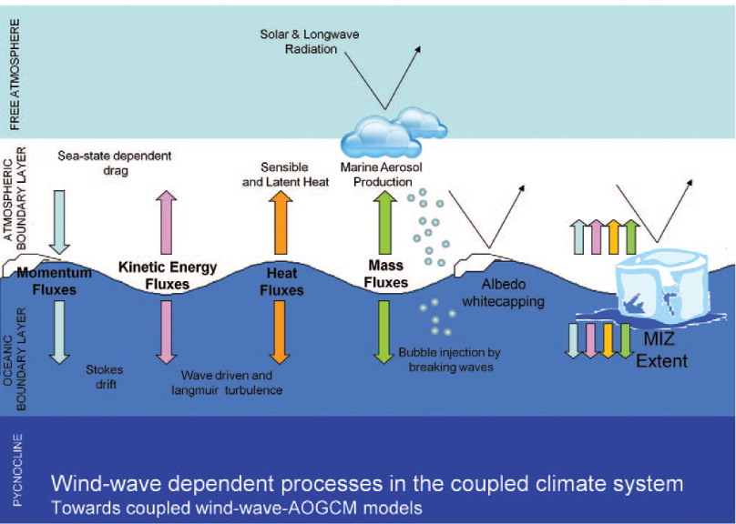
Role of Waves in the Coupled Climate System
Wind-generated waves are an important interfacial process in the climate system
Some cross-component interactions include:
Ocean vertical mixing
Sea-state dependent drag
White-capping albedo
Sea-ice floe size
Cavaleri et al. (2012)

Slide 3
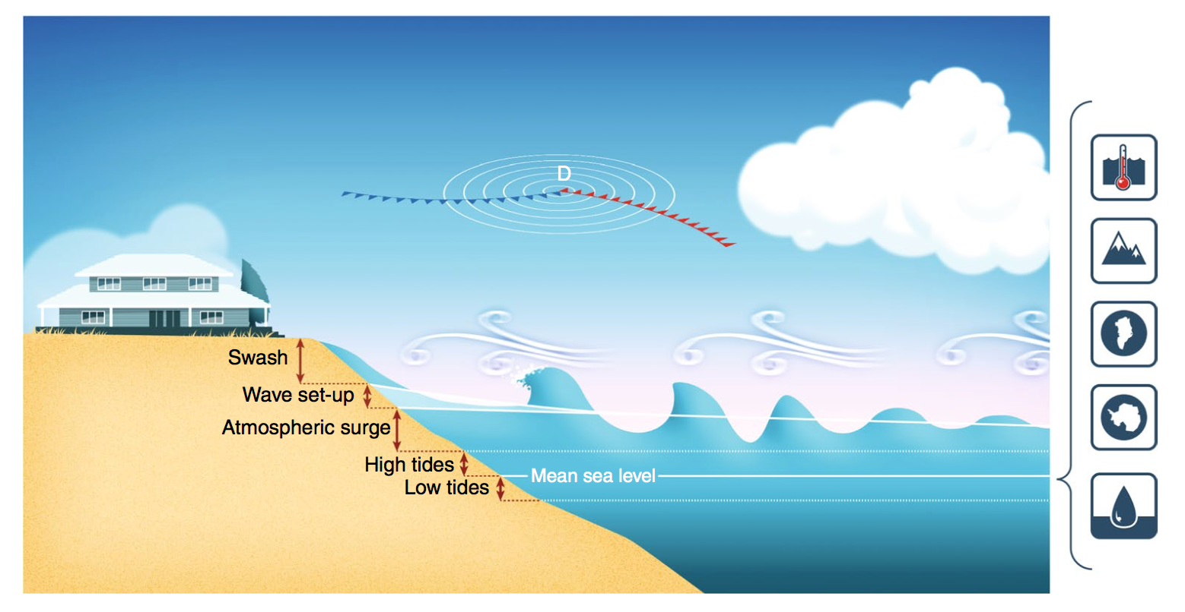
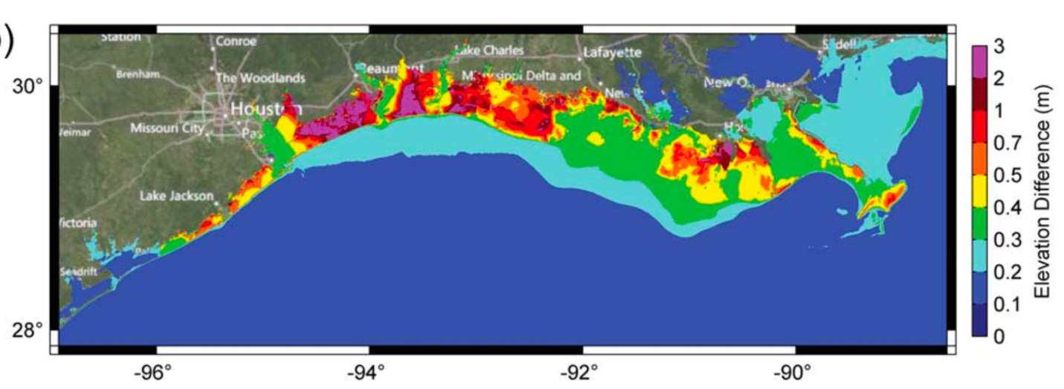
Role of Waves in Coastal Flooding
Wave contribution to water levels during Hurricane Ike
Climate drivers
Maximum water level difference
(Storms)
Kerr et al. (2013)
Melet et al. (2018)

Slide 4
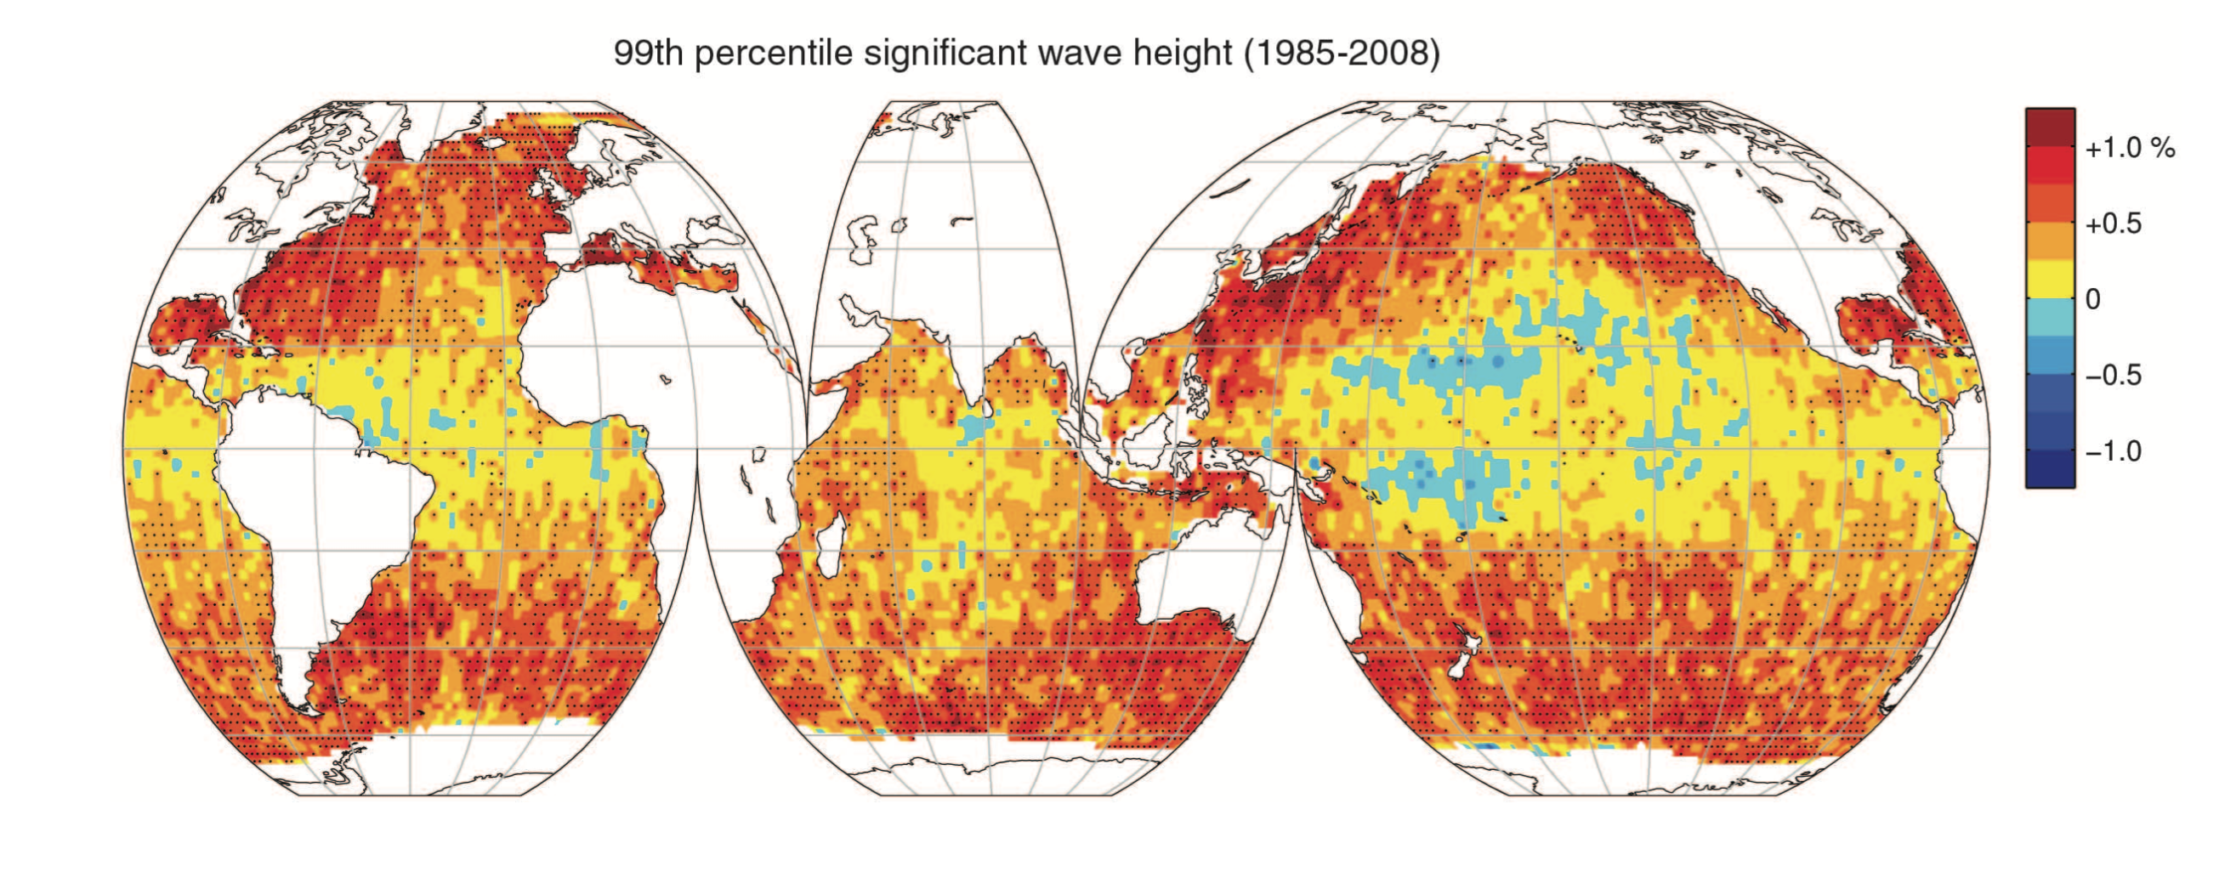
Trend in Global Wave Climate
Global wave (and wind) extremes have been increasing
Especially at high latitudes
Young et al. Science (2011)

Slide 5
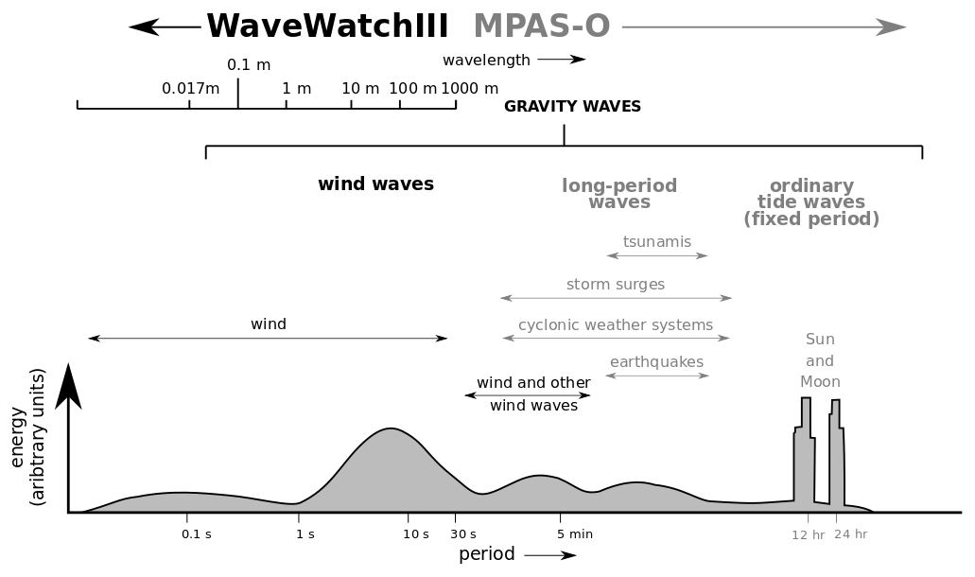
Wave Energy Spectrum
Wind waves represent a distinct portion of the energy spectrum
Wavelengths order 10-100 m
Periods order 1-10s
Require separate modeling approach
Phase averaged paradigm vs. directly modeling sea surface

Slide 6
Spectral Description of Waves
Actual water surface represented by summation of sinusoidal components with different frequencies and directions
Spectrum: Distribution of energy among the components
Image Credit: ECMWF
Image Credit: ECMWF

Slide 7
Spectral (Phase-Average) Wave Modeling
Describes evolution of action density:
$$N\left(φ, λ, σ,θ,t\right)=\frac{F}{σ}$$
energy density
lon
lat
relative
fequency
direction
time
$$\frac{∂N}{∂t}+\frac{∂(c_{φ}N)}{∂φ}+\frac{∂(c_{λ}N)}{∂λ}+\frac{∂(σN)}{∂σ}+\frac{∂(c_{θ}N)}{∂θ}= \sum_{i}{S_{i}}$$
$S_{in}$- Atmosphere-wave interaction
$S_{ds}$- Dissipation
$S_{nl}$- Non-linear wave interactions
$S_{tr}$- Triad interactions
$S_{sc}$- Wave scattering
$S_{bot}$- Wave-bottom interactions
$S_{db}$- Depth-limited breaking
$S_{ice}$- Wave-ice interactions
$S_{ref}$- Reflection
Advection by group velocity and currents
Frequency dispersion
(stretching)
Refraction
(bending)
Production,
Dissipation,
Non-linearities

Slide 8
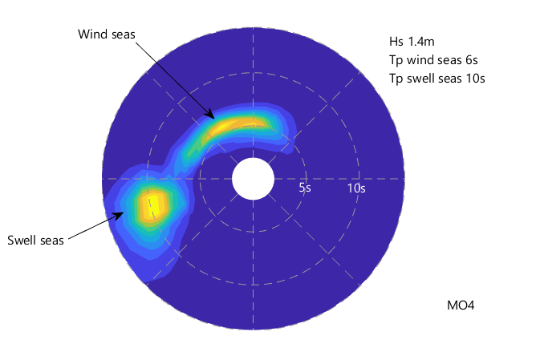
Mean Wave Parameters
Significant Wave Height
$H_{s}=4\sqrt{E}$
$$E=\int_{0}^{2π}{\int_{0}^{∞}{F\left(σ,θ\right)dσdθ}}$$
Mean Wave Period
$$T_{m}=E^{−1}\int_{0}^{2π}{\int_{0}^{∞}{σF\left(σ,θ\right)dσdθ}}$$
Mean Wave Direction
$$θ_{m}=\tan^{−1}{\frac{\int_{0}^{2π}{\int_{0}^{∞}{\sin{θ}F\left(σ,θ\right)dσdθ}}}{\int_{0}^{2π}{\int_{0}^{∞}{\cos{θ}F\left(σ,θ\right)dσdθ}}}}$$
Image credit: Motion Forecasting

Slide 9
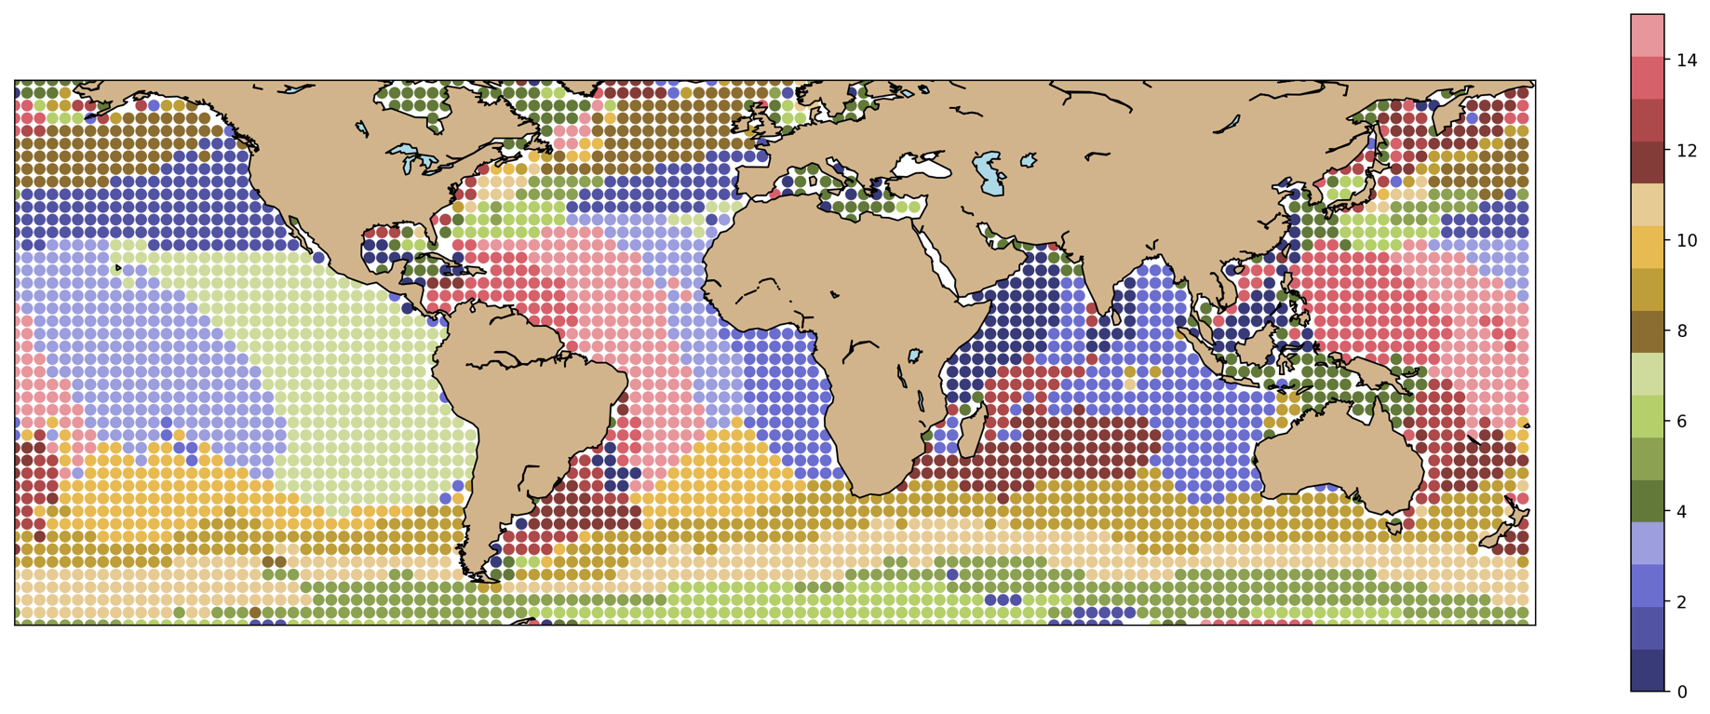
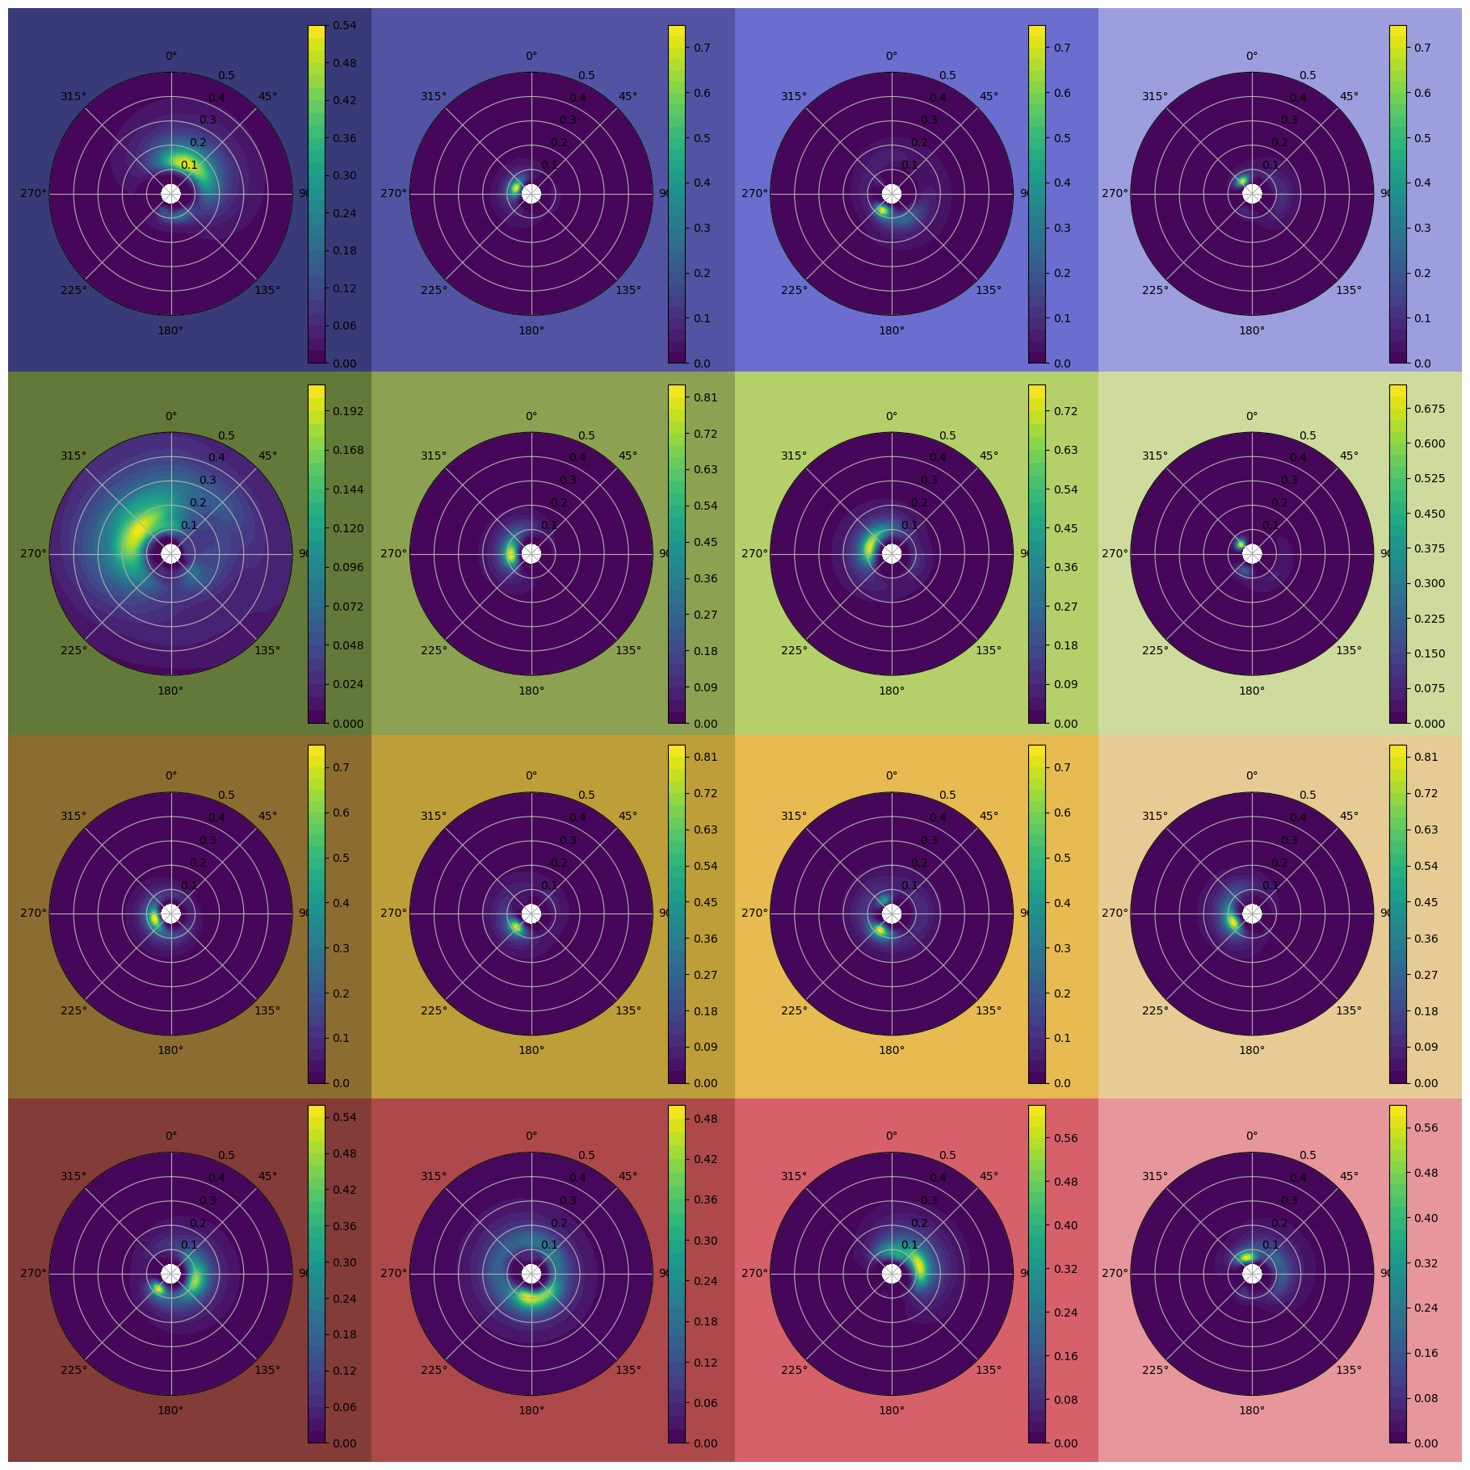
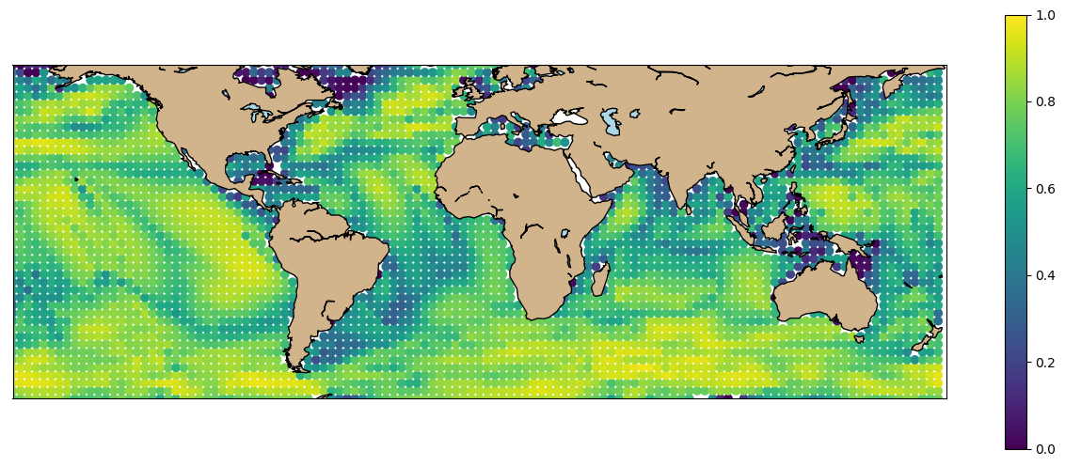
Global Wave Spectra ML Classification
Wave spectrum clusters
Representative cluster wave spectra
Correlation Coefficient

Slide 10
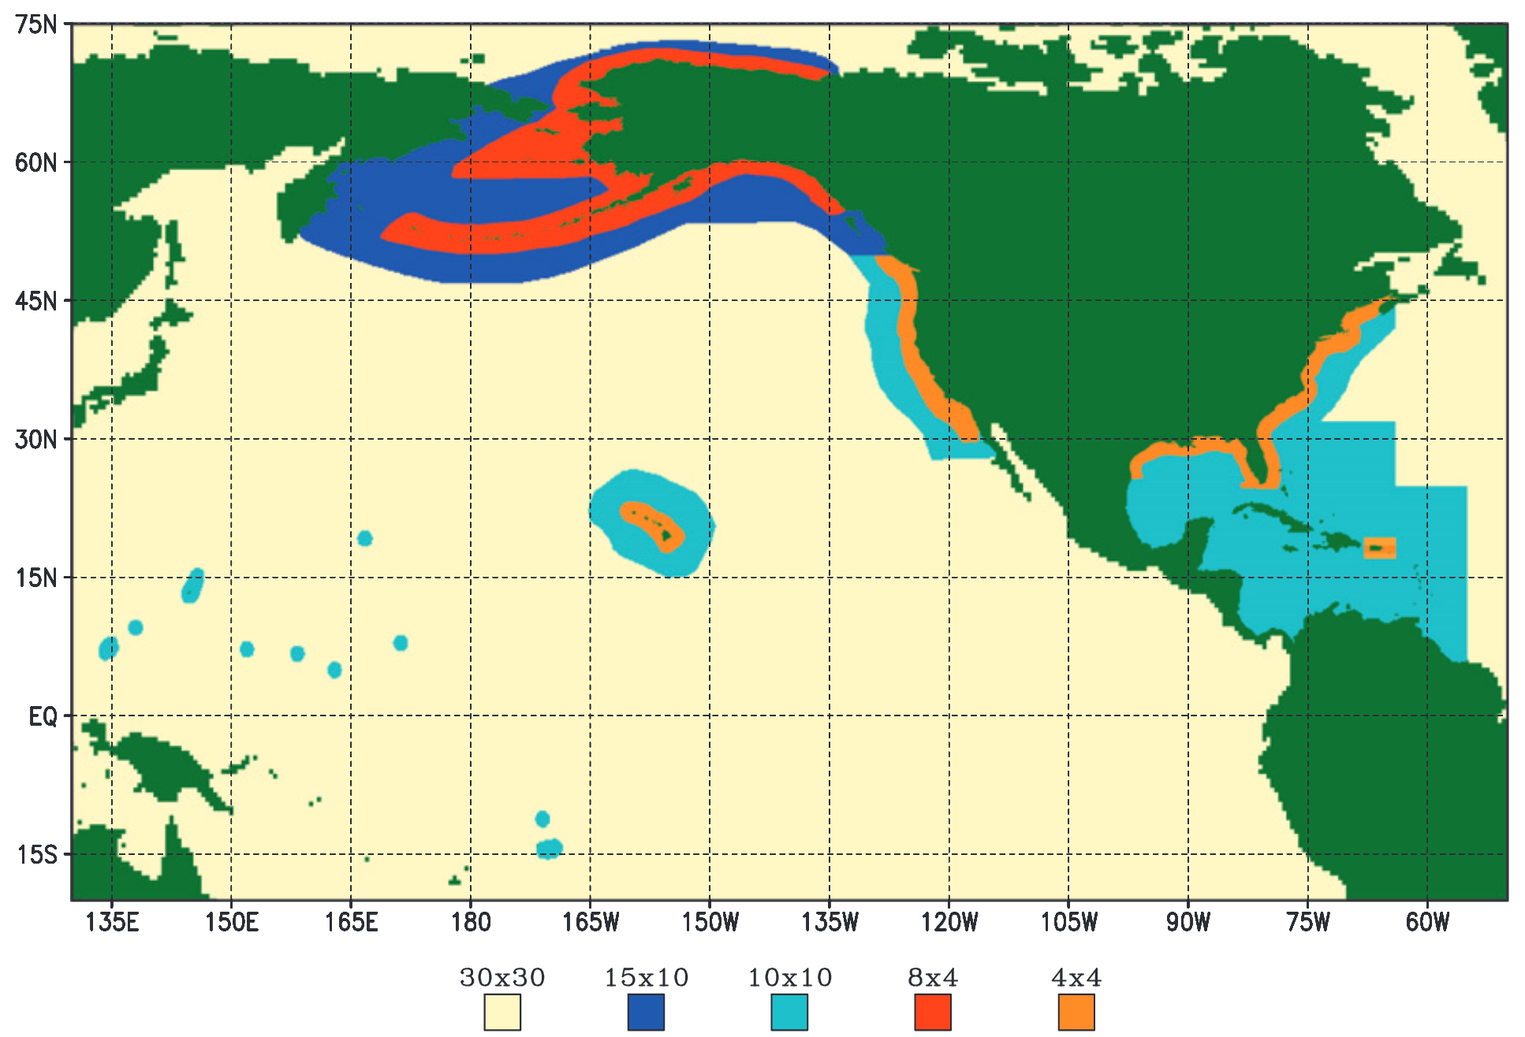
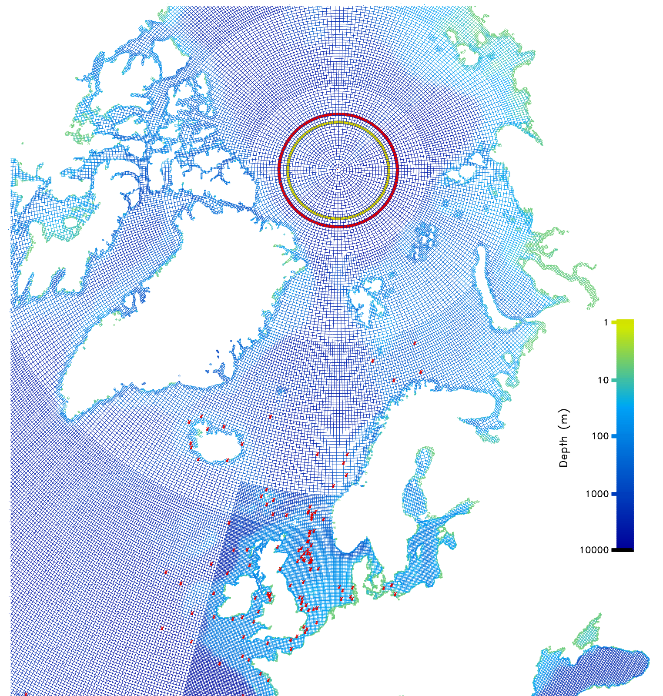
WaveWatchIII Mesh Configurations
Spherical Multi Cell WWIII grid
Current operational WWIII nesting
Regional Triangular Mesh
Li (2012)
Abdolali et al. (2020)
Chawla et al. (2013)

Slide 11
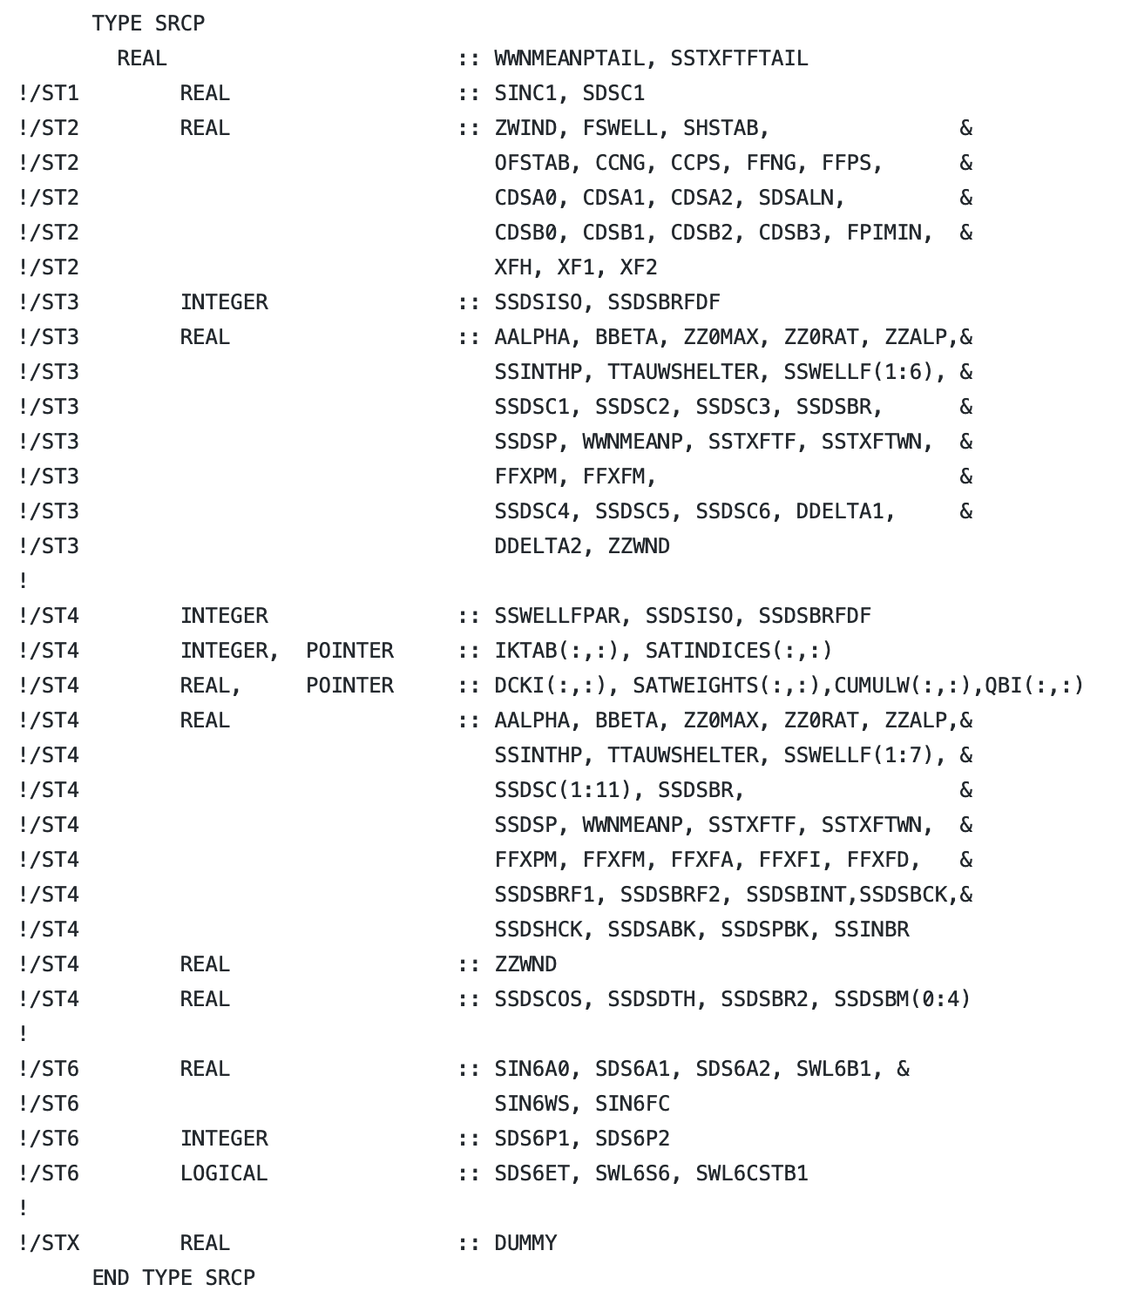
Integration of WaveWatchIII into E3SM
WaveWatchIII is now available via GitHub: https://github.com/NOAA-EMC/WW3
Latest version 6.07 has been made a submodule in E3SM
WaveWatchIII uses “switches” to define physics/formulation options. Source code must be pre-processed to generate compliable code.
Several auxiliary programs are necessary for processing grids, initial conditions, and output

Slide 12
Importance of Regional Refinement
Deeper (open ocean):
Accurate with
lower resolution
Shallower (coastal):
Requires higher resolution
Structured lon-lat meshes
June-August 2005 CFSR winds
Comparison with NDBC buoys

Slide 13
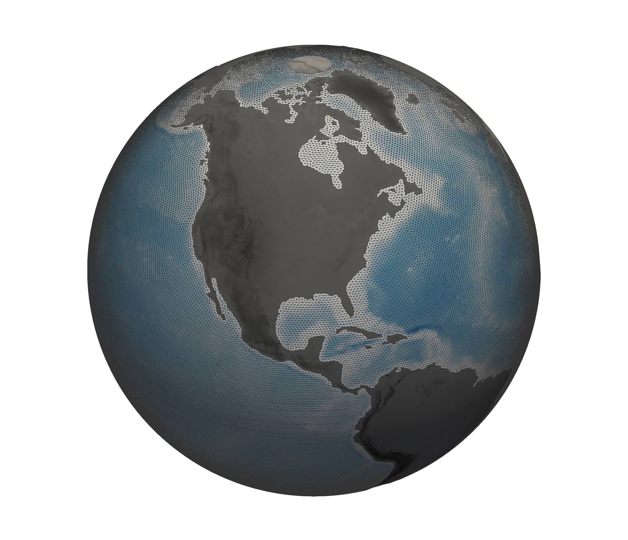
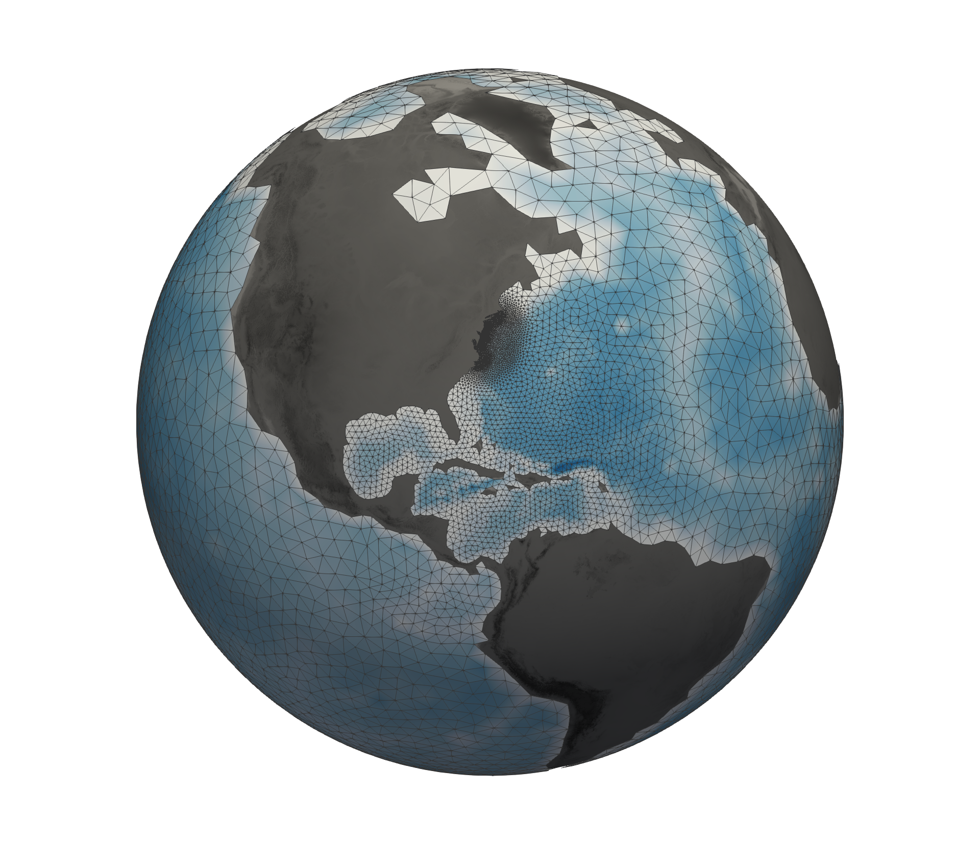
Global Unstructured WaveWatchIII Meshes
Regionally Refined Delaware Bay
240km – 4km
Quasi-uniform 50 km
Meshes generated with OceanMesh2D software:
https://github.com/CHLNDDEV/OceanMesh2D

Slide 14
Global Unstructured Mesh Validation
June-August 2005
CFSR winds (1/2 degree resolution)
Comparison with NDBC buoy data
Observed
50km unstructured
100km unstructured
½º structured

Slide 15
Global Unstructured Mesh Validation
June-August 2005
CFSR winds (1/2 degree resolution)
Comparison with NDBC buoy data
Observed
50km unstructured
100km unstructured
½º structured

Slide 16
Global Unstructured Mesh Validation
June-August 2005
CFSR winds (1/2 degree resolution)
Comparison with NDBC buoy data
Observed
50km unstructured
100km unstructured
½º structured

Slide 17
Global Unstructured Mesh Validation
June-August 2005
CFSR winds (1/2 degree resolution)
Comparison with NDBC buoy data
Observed
50km unstructured
100km unstructured
½º structured

Slide 18
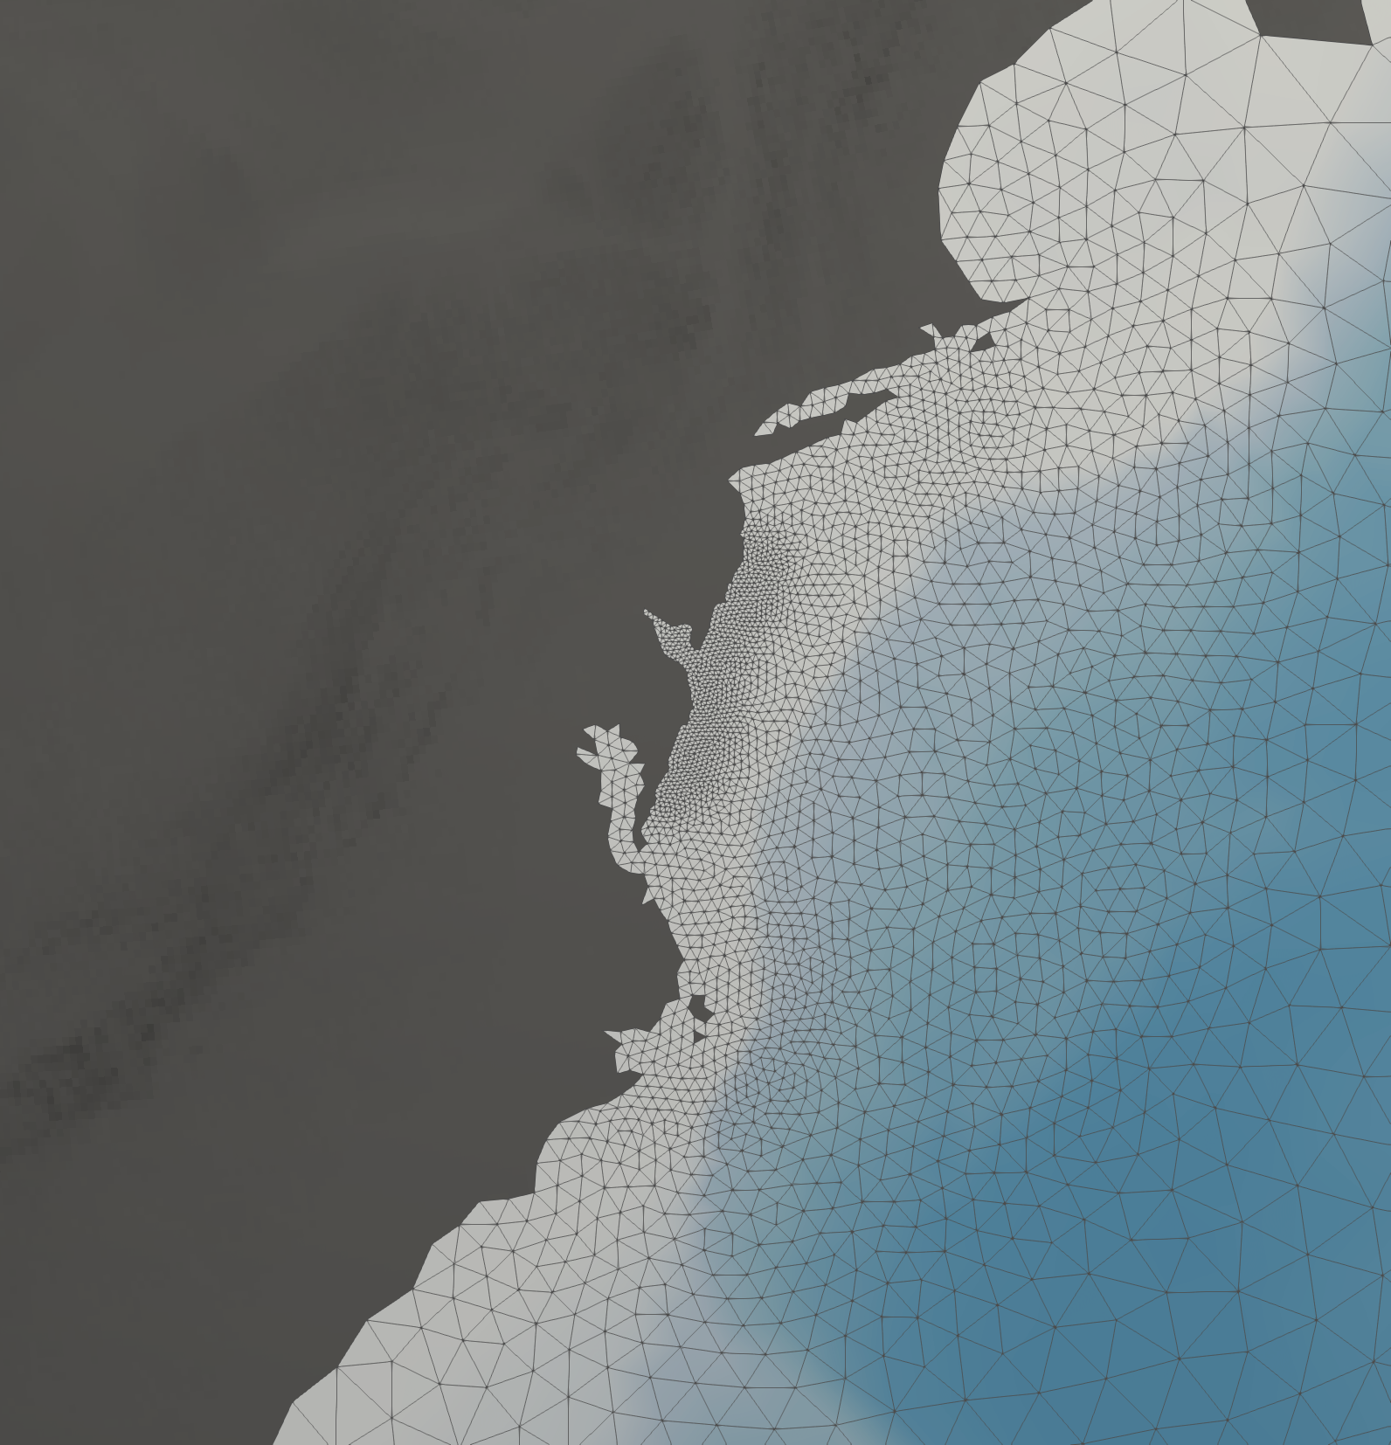
Global Regionally Refined Mesh Validation
4km unstructured
14x faster than
1/2º structured
Hurricane Sandy 2012
CFSv2 winds (0.2 degree resolution)
Comparison with NDBC buoy data
Observed
2km unstructured
4km unstructured
½º structured

Slide 19
Global Regionally Refined Mesh Validation
4km unstructured
14x faster than
1/2º structured
Hurricane Sandy 2012
CFSv2 winds (0.2 degree resolution)
Comparison with NDBC buoy data
Observed
2km unstructured
Observed
2km unstructured
4km unstructured
½º structured
4km unstructured

Slide 20
Global Regionally Refined Mesh Validation
4km unstructured
14x faster than
1/2º structured
Hurricane Sandy 2012
CFSv2 winds (0.2 degree resolution)
Comparison with NDBC buoy data
Observed
2km unstructured
Observed
2km unstructured
4km unstructured
½º structured
4km unstructured

Slide 21
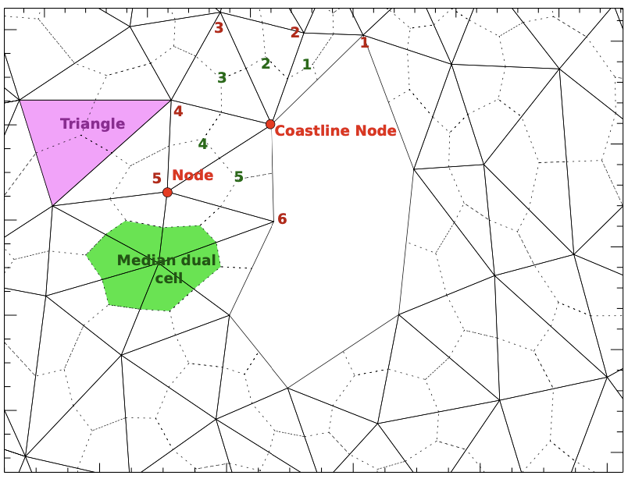
WaveWatchIII Coupler Mapping
WaveWatchIII already uses SCRIP internally for mapping nested grids
Repurposed for generating mapping files for E3SM
mesh.msh
ww3_grid.inp
ww3_grid
mod_def.ww3
wave_scrip_file.nc
other_scrip_file.nc
ESMF_RegridWeightGen
E3SM
map_file.nc
Image Source: WaveWatchIII User’s Manual

Slide 22
Data Atmosphere + Unstructured Waves Compset
Hurricane Sandy 2012
CFSv2 winds (0.2 degree resolution)
Comparison with NDBC buoy data
Observed
WWIII Standalone
E3SM: datm+WWIII

Slide 23
Data Atmosphere + Unstructured Waves Compset
Hurricane Sandy 2012
CFSv2 winds (0.2 degree resolution)
Comparison with NDBC buoy data
Observed
WWIII Standalone
E3SM: datm+WWIII

Slide 24
Data Atmosphere + Unstructured Waves Compset
Hurricane Sandy 2012
CFSv2 winds (0.2 degree resolution)
Comparison with NDBC buoy data
Observed
WWIII Standalone
E3SM: datm+WWIII

Slide 25
Summary
Waves are an important interfacial process in the climate system
High latitude wave heights are increasing
E3SM will have the first coupled, global unstructured WaveWatchIII configuration
Our initial validation results have shown promise in balancing accuracy and cost
Next Steps
Performance evaluation of global unstructured configuration
One-way coupling from ocean and sea-ice to waves (verification)
Two-way coupling between waves, ocean, and sea ice (G case+waves)
Collaborate with InterFACE project on wave/ice couplings and simulations

