Slide 1
Coupling Stochastic Convection Parameterization with ZM in E3SM
Guang Zhang¹, Yong Wang², Shaocheng Xie³
1 Scripps Institution of Oceanography, UCSD
2 Dept. of Earth System Science, Tsinghua University
3 Lawrence Livermore National Laboratory

Slide 2
Outline
Why stochastic parameterization?
Parameterization specifics
Results
Summary

Slide 3
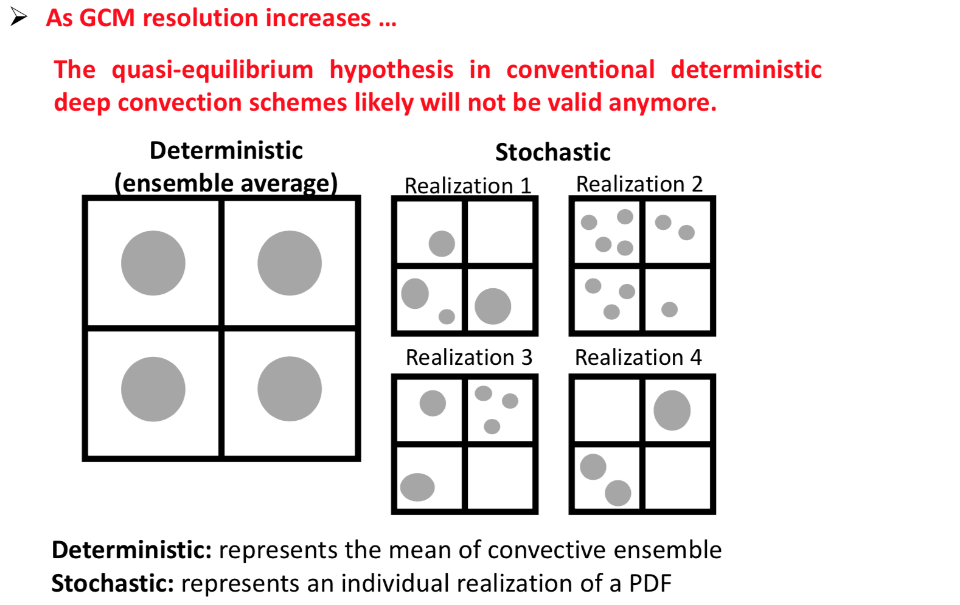
Stochasticity of Convection

Slide 4
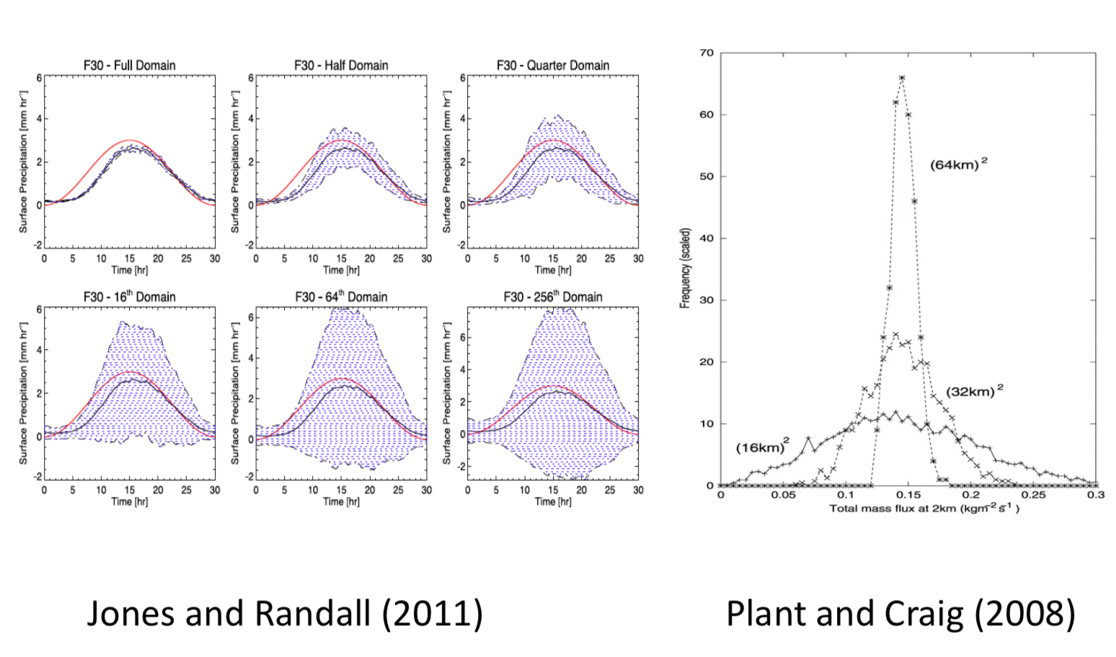
Stochasticity of Convection
deterministic
mean value
stochasticity

Slide 5
A physically based stochastic convection model (Plant and Craig 2008)
$$p\left(m\right)dm=\frac{1}{<m>}e^{{−m}/{<m>}}dm$$
$p_{N_{m}}\left(n\right)=\frac{{<N_{m}>}^{n}e^{−<N_{m}>}}{n!}$
for n=0, 1, 2,…
Assume non-interacting clouds:
cloud mass flux follows Boltzmann distribution
Assume clouds are initiated randomly in space, triggering n clouds follows Poisson distribution
$p_{d\overline{n}(m)}\left(n=1\right)=\frac{<N>}{<m>}e^{−\frac{m}{<m>}}dm$
The probability of triggering one cloud with mass flux
between m and m+dm

Slide 6
Coupling PC08 with the ZM deterministic scheme
The averaged variables are used in closure only to compute <M> !

Slide 7
Model: EAMv1
Configuration: AMIP (6 years each)
CTL: Standard Model
EXP: Stochastic Parameterization

Slide 8
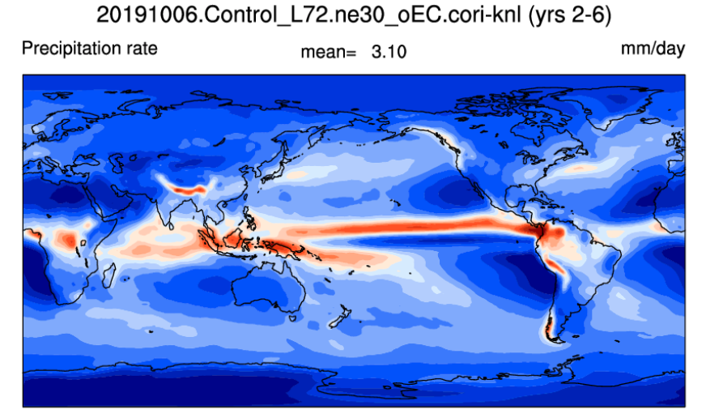
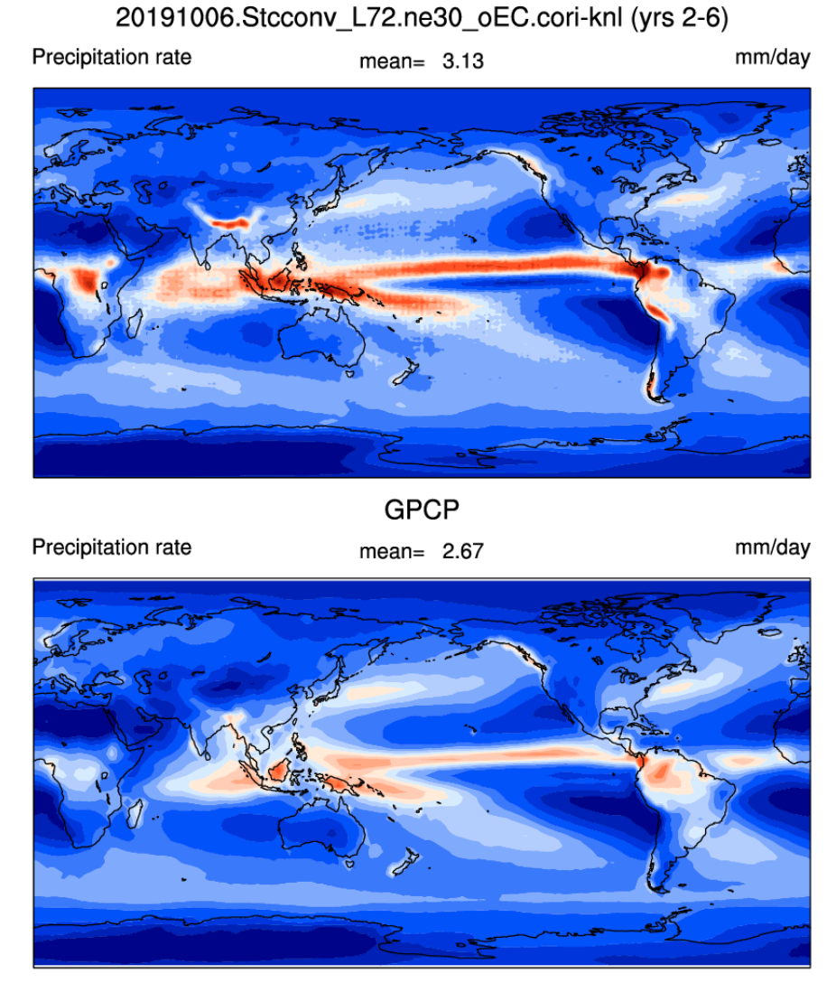
Precipitation (EAMv1)
CTL
EXP
GPCP

Slide 9
Convective & Large-scale precipitation
Convective
Large-scale

Slide 10
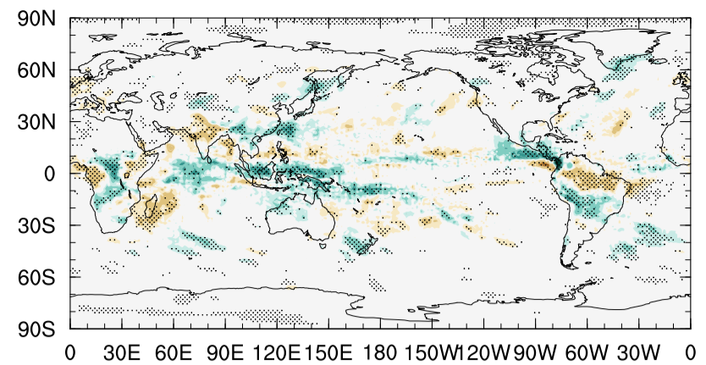
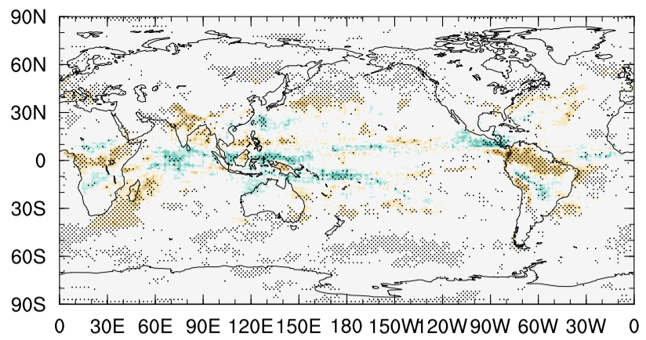
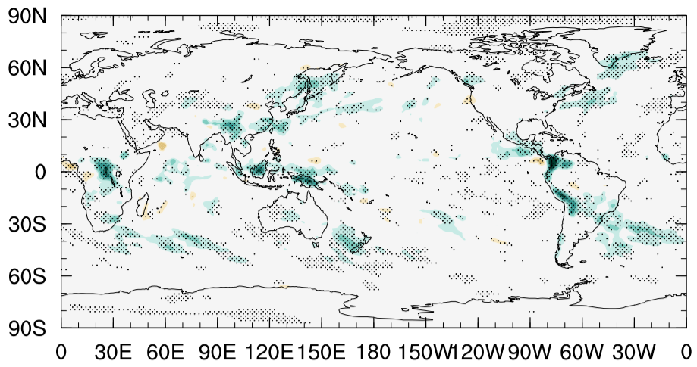
EXP – CTL
Total Precipitation
Convective Precipitation
Large-scale Precipitation

Slide 11
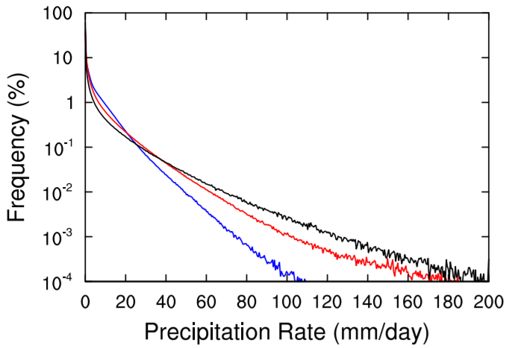
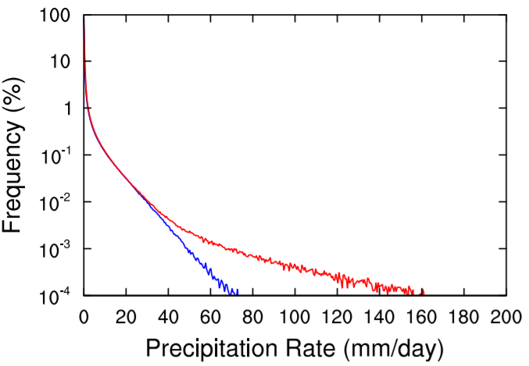
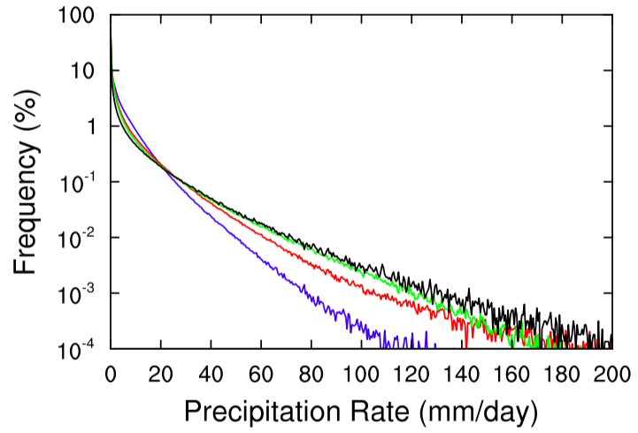
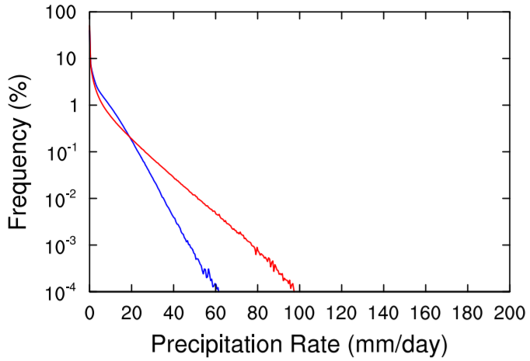
PDF of Daily Precipitation (Tropics)
Total Precipitation
Convective Precipitation
Large-scale Precipitation
TRMM
CTL
EXP
EXP (30 levels)
TRMM
CTL
EXP

Slide 12
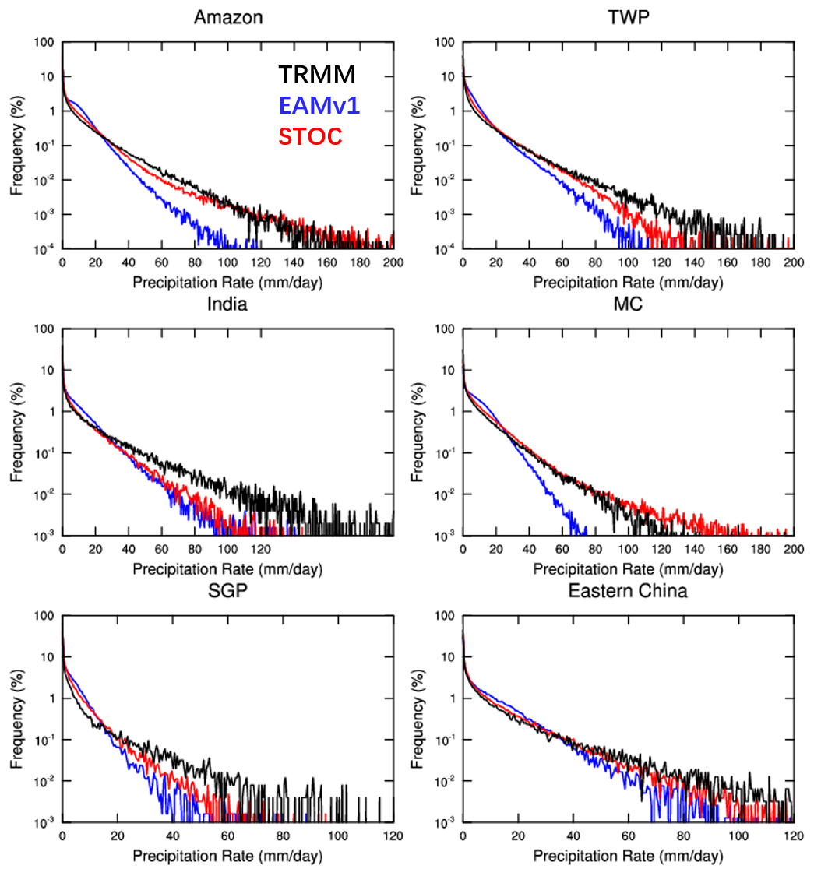
PDF of Daily Precipitation (Tropics)

Slide 13
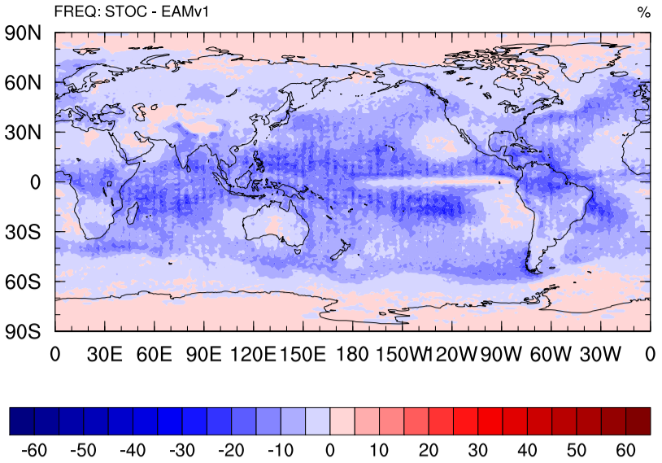
Frequency of Convective Precipitation
EXP-CTL
Frequency of Convective Precipitation < 20 mm/day EXP-CTL

Slide 14
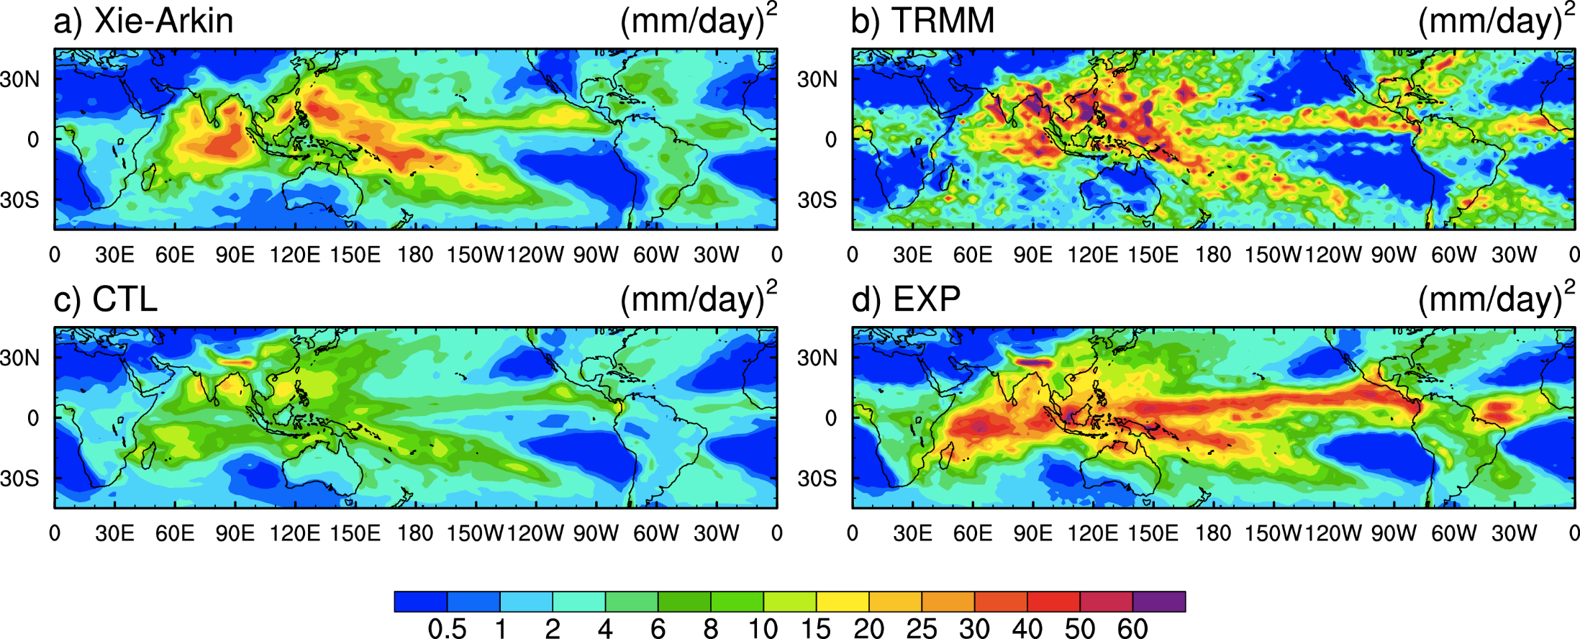
Intraseasonal Variability
CTL
EXP

Slide 15
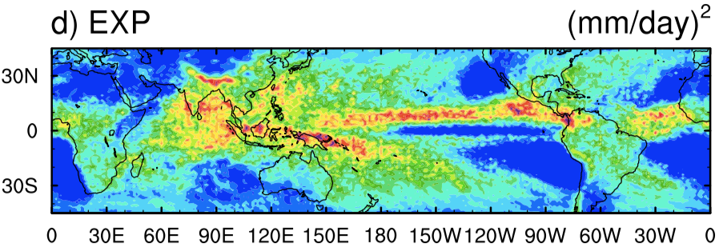
Intraseasonal Variability
CTL
EXP
EXP (30 levels)

Slide 16
Synoptic-scale Variance

Slide 17
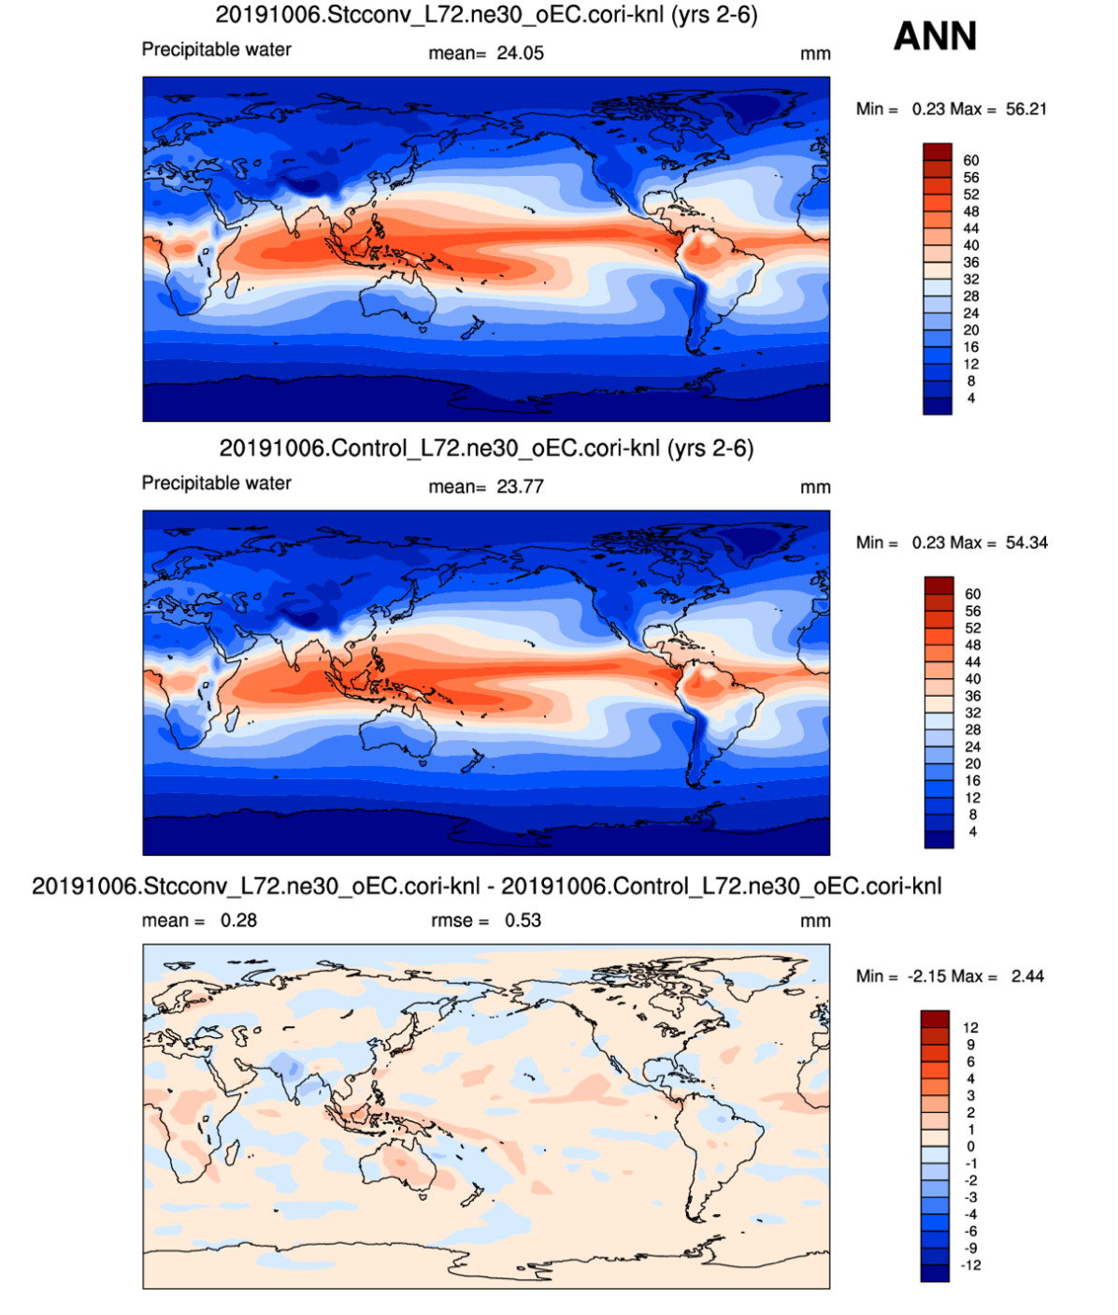
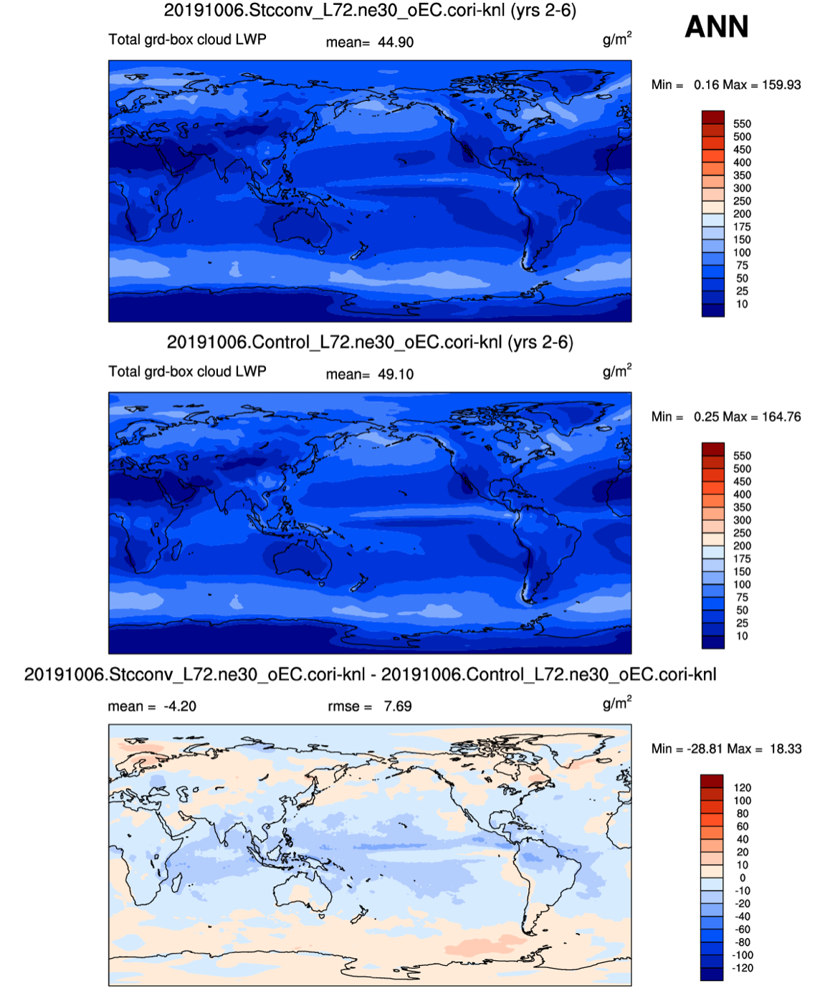
Column water vapor Liquid water path

Slide 18
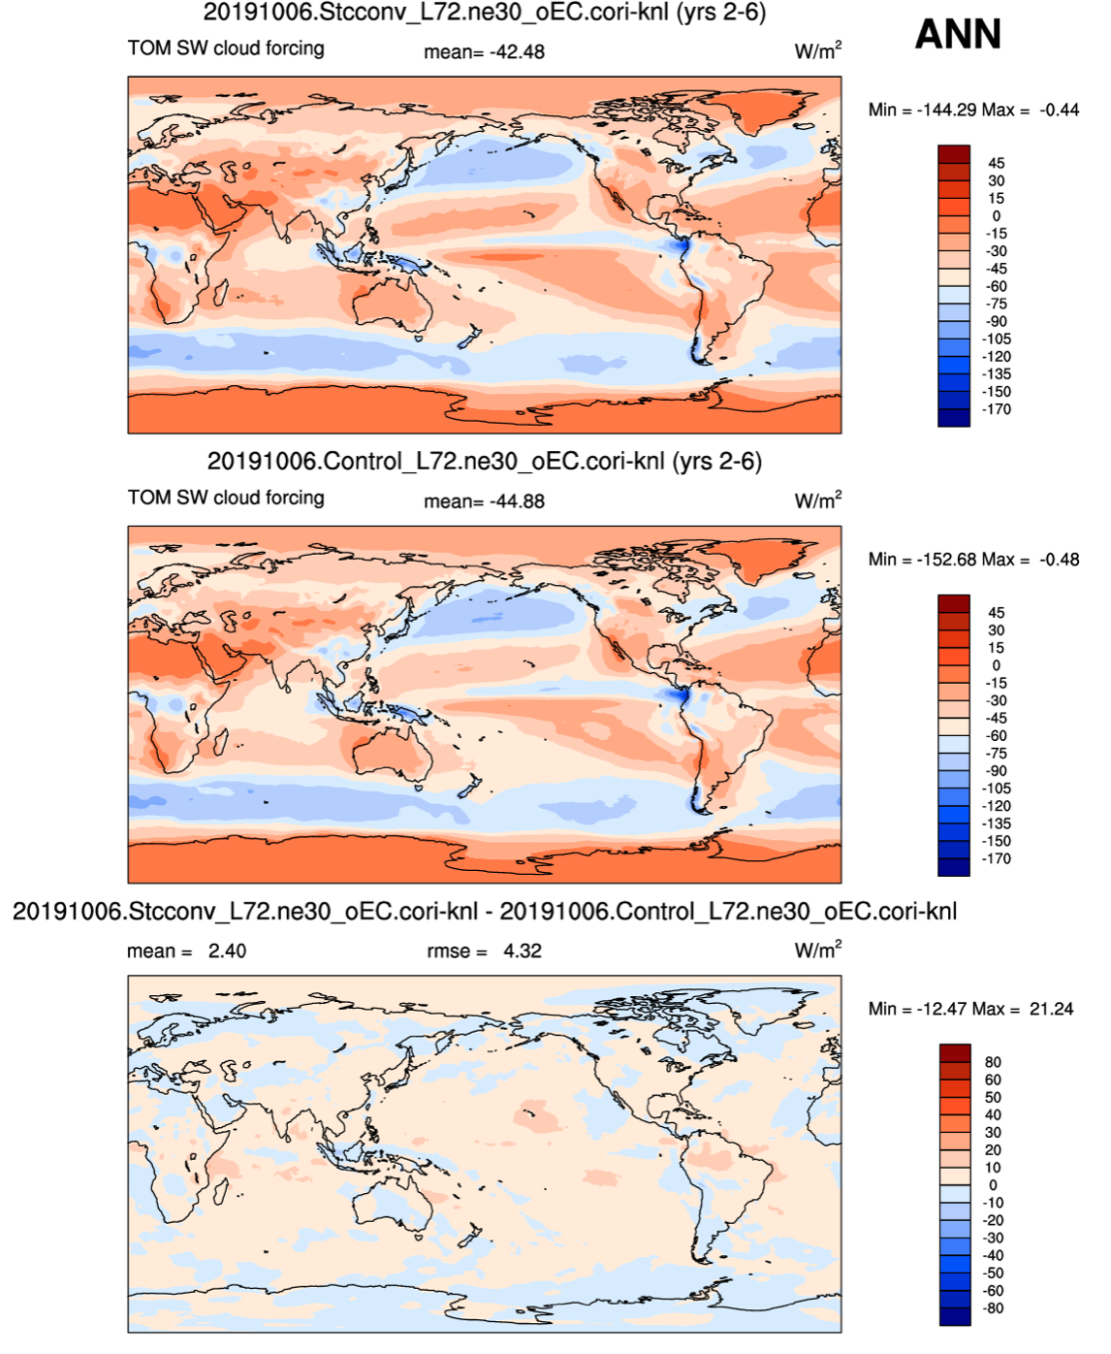
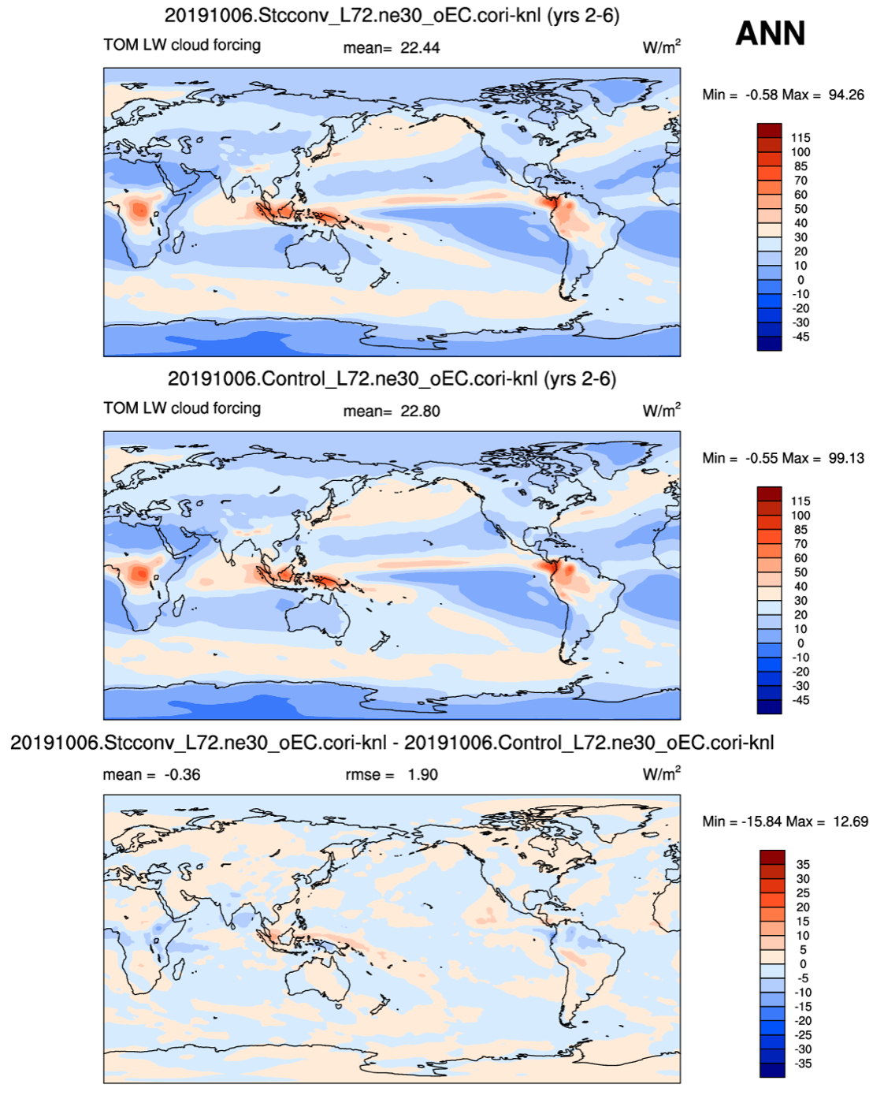
Shortwave CRF Longwave CRF

Slide 19
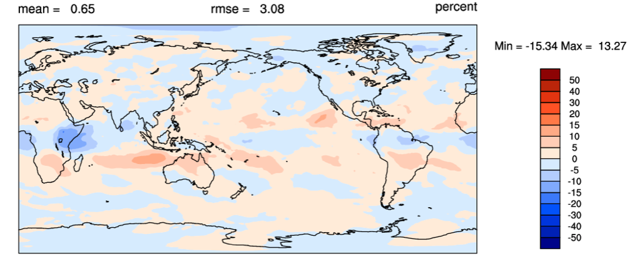
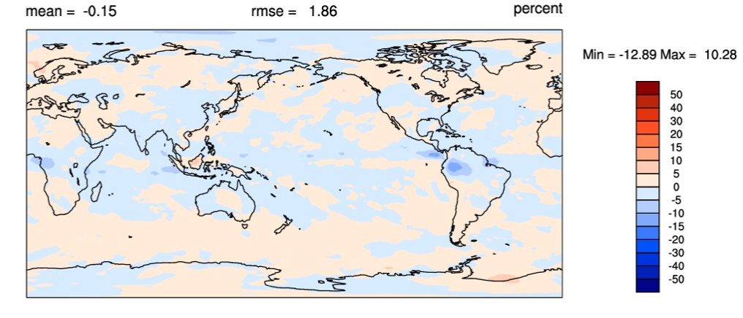
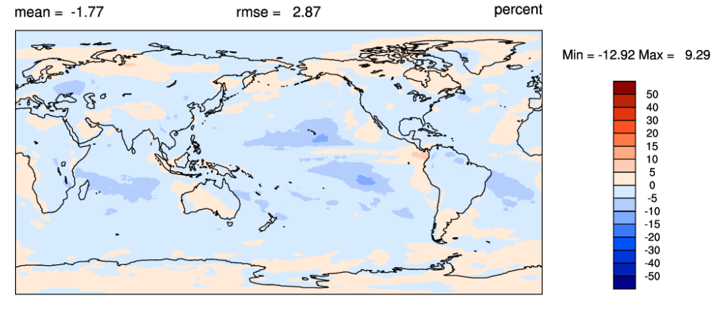
Clouds: EXP - CTL
High
Middle
Low

Slide 20
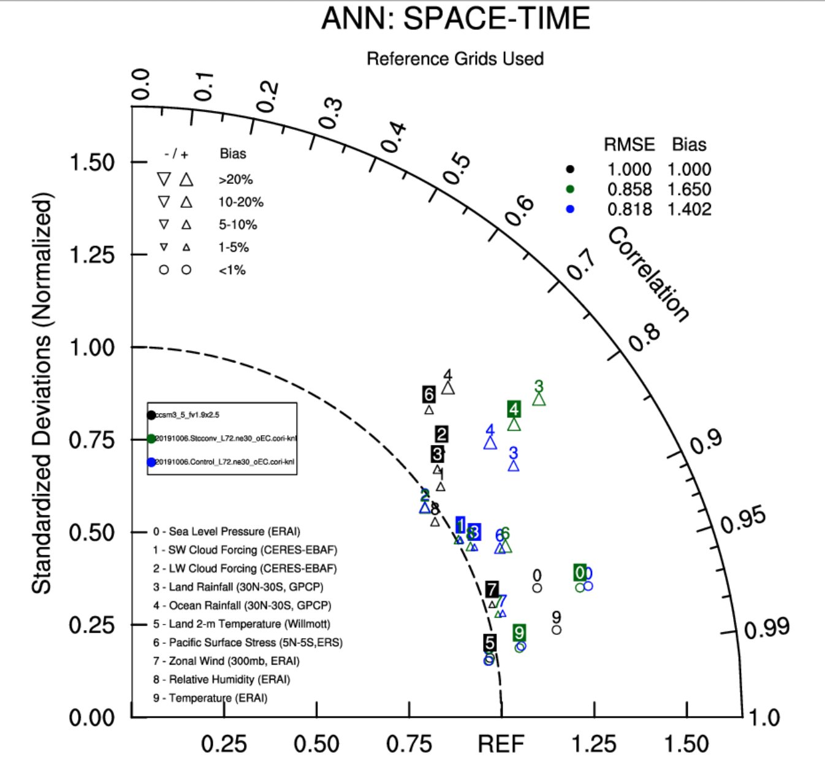
Taylor diagram (EAMv1)
EXP
CTL

Slide 21
Conclusions
Incorporating a stochastic convection scheme significantly improves the pdf of precipitation intensity, alleviating the problem of “too much drizzle and too little intense rain”.
Frequency of convection with low precipitation intensity is reduced globally.
Intraseasonal and synoptic-scale variances are also improved.
Mean states do not change much, which means less work for retuning if/when used in E3SM.

