Slide 1

Data Analysis and Modeling of
Land-Atmosphere Interactions
Xubin Zeng, Michael Brunke,
Jack Reeves Eyre, Josh Welty
University of Arizona
27 February 2020
E3SM All Hands Webinar

Slide 2
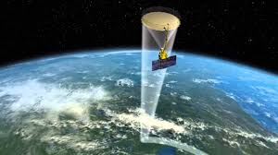
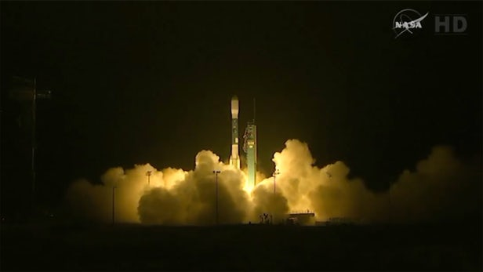
Motivation
Evaluation of climate models needs to go beyond the simple use of an individual variable (e.g., precipitation) to include relationships.
Challenges:
What is the right approach to evaluate and determine the appropriate observation-based datasets for relationships?
What are the observed relationships?
Three examples:
Surface water balance over the Amazon Basin
Snow-water equivalent over CONUS
Morning soil moisture effect on afternoon rainfall

Slide 3
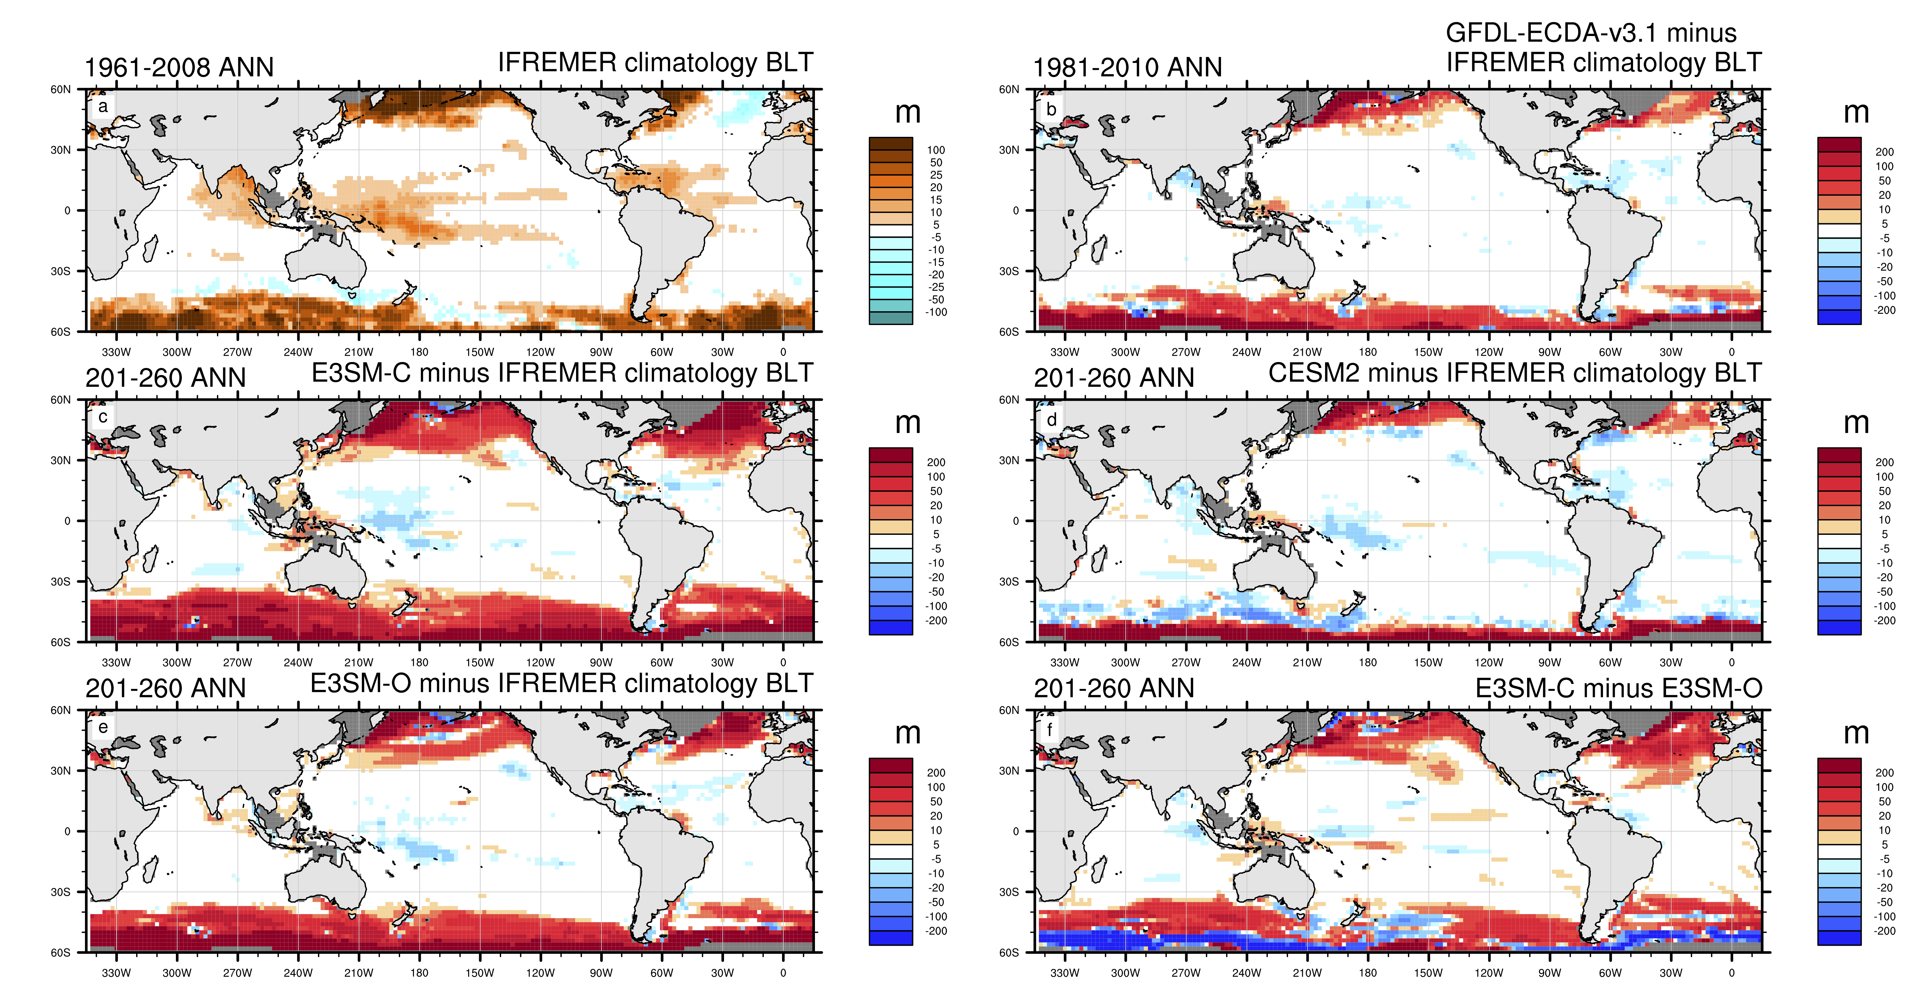
1. Surface water balance over the Amazon River Basin
E3SM Ocean Barrier layer discrepancy around the Amazon
Annual mean BLT bias:
Ocean-only run (top), with Amazon discharge specified from observations, has larger BLT bias than the coupled run (bottom), with (apparently biased) Amazon discharge from the land model.
Is this just an ocean model problem? Or an issue with observations used in the forcing?
Reeves Eyre, Van Roekel, Zeng, Brunke, Golaz (2019)
Top: ocean-only
Bottom: coupled

Slide 4
E3SM Precipitation and runoff Biases
Red = E3SM, Black = obs.
Amazon precip:
Not enough
Correct phase
Amazon discharge:
Not enough
Wrong phase!
Congo precip:
A bit too much
Correct phase
Congo discharge:
Way too much!
Exaggerated seasonal cycle!
Are these just atmosphere and land model problems? Or issues with the observations?

Slide 5
Terrestrial water budget:
P – E – R = dS/dt
Our Approach:
  Test water budget closure for different combinations of individual data sets over the Amazon River basin
  Use ocean salinity as an independent consistency check – exploiting the large and relatively well understood freshwater “plume” in the Atlantic.
  Reeves Eyre et al. (to be submitted in March 2020)

Slide 6
Data
Precipitation – 4 (GPCP, CMAP, ERA5, MERRA2)
Evaporation – 3 (ERA5, MERRA2, GLEAM)
Atmospheric convergence – 2 (ERA5, MERRA2)
  This is an alternative to (P–E)
Terrestrial water storage – 3 (JPL, GFZ, CSR)
  Different retrievals using the same GRACE measurements
River discharge – 1 (HyBAm)
  Also use Dai et al. (2009) method to upscale gauging station to river mouth
Total number of closure “combinations”: 30 (+3 ensemble means)
Salinity – 3 (SMOS, SMAP, Aquarius)

Slide 7
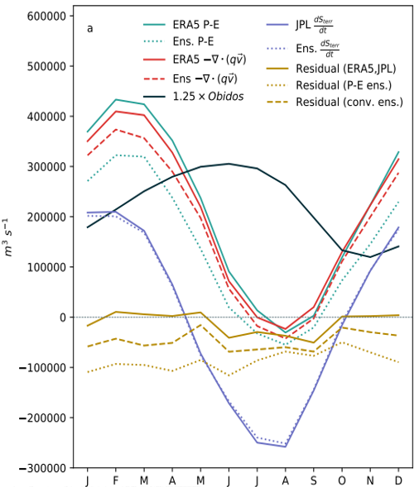
How well do data sets agree?
Three GRACE data agree with each other well
Residuals vary by ~50% of discharge, and ERA5 P and E give smallest residuals
Large difference in P-E between ensemble mean and ERA5
P-E differences come from both P and E (not shown)
Three salinity data sets have very similar seasonal cycles (not shown)

Slide 8
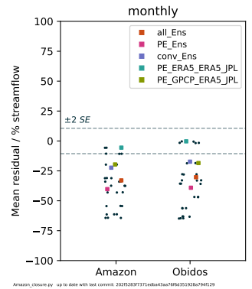
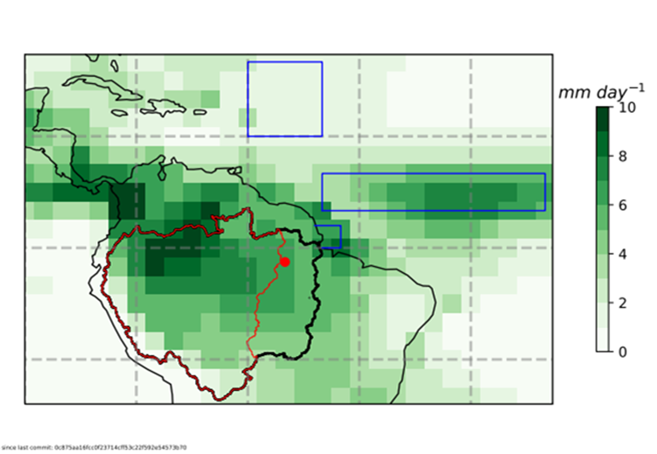
Can we close the water budget?
Only a few combinations close the water budget (within estimated uncertainty) – mostly with ERA5
Ensemble means do not close the budget
The better closure for “Obidos” than “Amazon” implies that the Dai et al. method may not give the correct seasonal cycle
Óbidos gauge captures runoff from about 78% of the area of entire Amazon basin.
Dai et al. (2009):
R_{Amazon} = 1.25 x R_{obidos}
Each point is one combination of data sets: some are “highlighted”

Slide 9
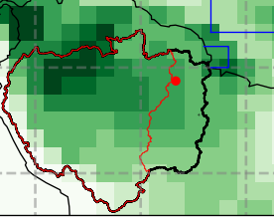
Using salinity as a consistency check
Use ocean salinity near the river mouth (small blue box in inset) to test this idea
Water budget estimates of discharge have higher correlation with salinity than either Obidos discharge
Note – we expect negative correlations: more freshwater discharge means lower salinity

Slide 10
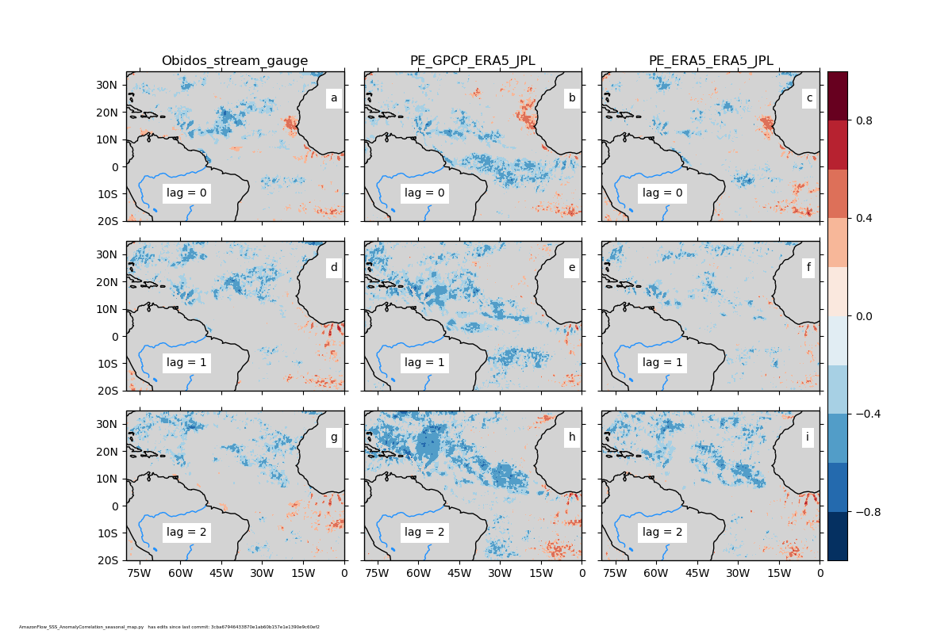
Application: variability of the Amazon plume
Correlation between ocean salinity and Amazon River discharge
We see quite different lag correlations depending on the discharge estimate

Slide 11
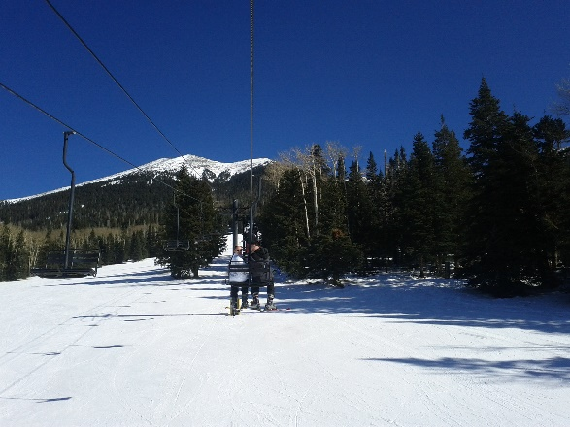
2. Snow-Water Equivalent over CONUS
Importance:
Snowpack is a major component in land-atmosphere interactions.
Challenge:
Global snow-water equivalent (SWE) observation-based data have relatively poor quality: re-analysis, land data assimilation (GLDAS), satellite passive microwave (e.g., AMSR-E), and merged products
Our Approach:
We spent three years to develop the UA daily 4 km SWE and snow depth dataset over CONUS from Oct 1981- present (Broxton et al. 2016; Dawson et al. 2017; Zeng et al. 2018)

Slide 12
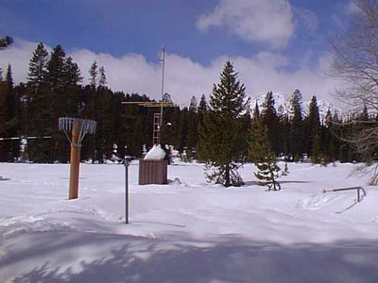
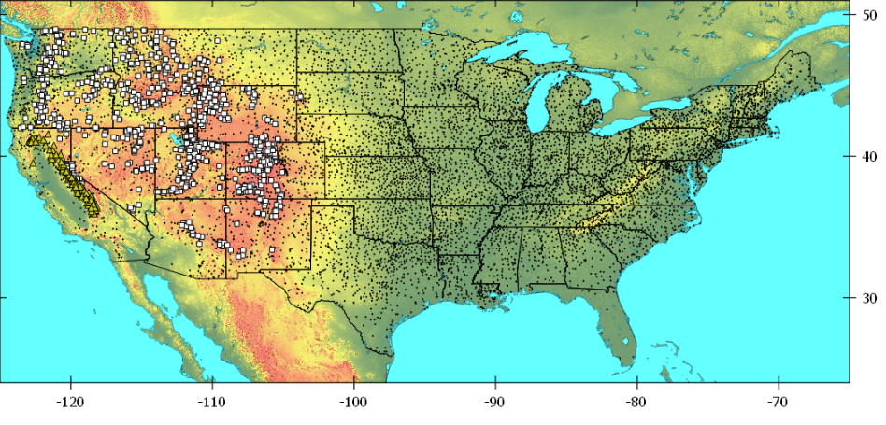
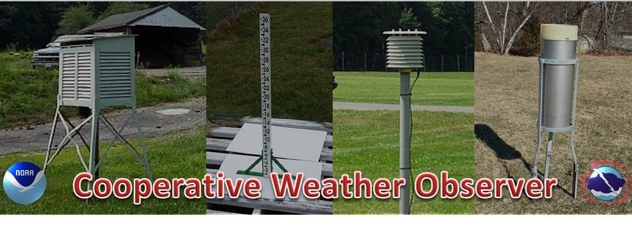
UA Daily 4 km SWE and snow depth dataset
Schneider Meadows
SNOTEL site in Oregon
a) Input data:
(USDA/CA DWR) SNOTEL SWE/snow depth sites, NWS COOP snow depth sites,
PRISM daily 4 km precipitation and temperature data
b) Main ideas in data assimilation
Point-area interpolation (Broxton et al. 2016; Editor’s highlight)
A new snow density model to combine SWE and snow depth measurements (Dawson et al. 2017)
c) Passed four rigorous tests:
Point-point interpolation test
Point-pixel interpolation test
Evaluation using the JPL ASO airborne lidar data in CA and CO
Evaluation using the independent snow cover data
d) Passed independent test by another group
Using NOAA airborne Gamma radiation SWE measurements
NWS Boston COOP Program
Notes:
The National Weather Service (NWS) Cooperative Observer Program (COOP Program) is older than the United States, dating to the pre-Revolutionary War colonies. Farmers like Thomas Jefferson and George Washington and scientists like Ben Franklin were always interested in the weather. Many kept detailed daily records and these records are part of the continuing study of our weather and our climate.
https://www.weather.gov/box/coop

Slide 13
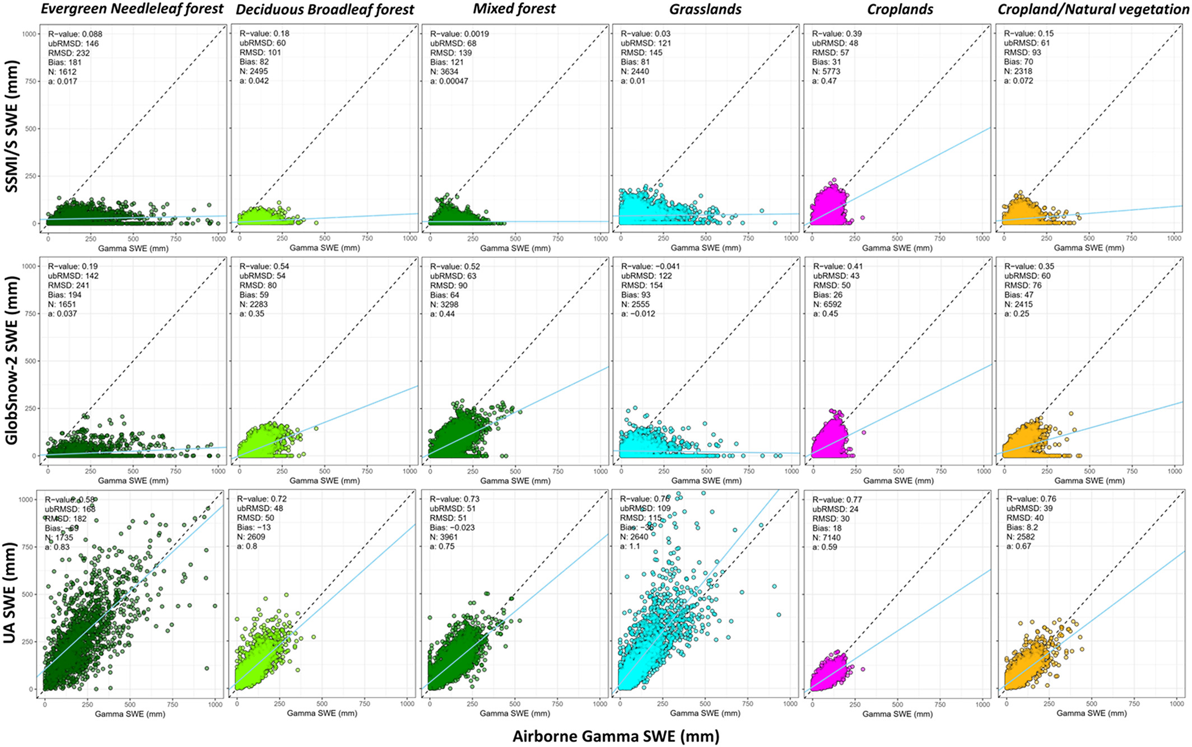
E. Cho, J. Jacobs, and C. Vuyovich (Dec 2019) used 40-year airborne Gamma radiation SWE record to evaluate satellite (SSMI/S), merged (GlobSnow), and UA SWE products, and concluded in Abstract:
“UA SWE has much better agreement with gamma SWE in all land cover types and snow classes” and
“The results demonstrate the reliability of the UA SWE products…”

Slide 14
Question: Do point measurements at SNOTEL represent the snowpack decline across the whole western U.S.?
The trends of annual maximum snow mass are very similar at government sites and co-located 4 km grids:
their median trends are -2.8 and -2.9 mm/year,
These results do not represent those using all snowy grids of western U.S. above 5000 ft (or 1500 m) in elevation:
median trend is -0.5 mm/year

Slide 15
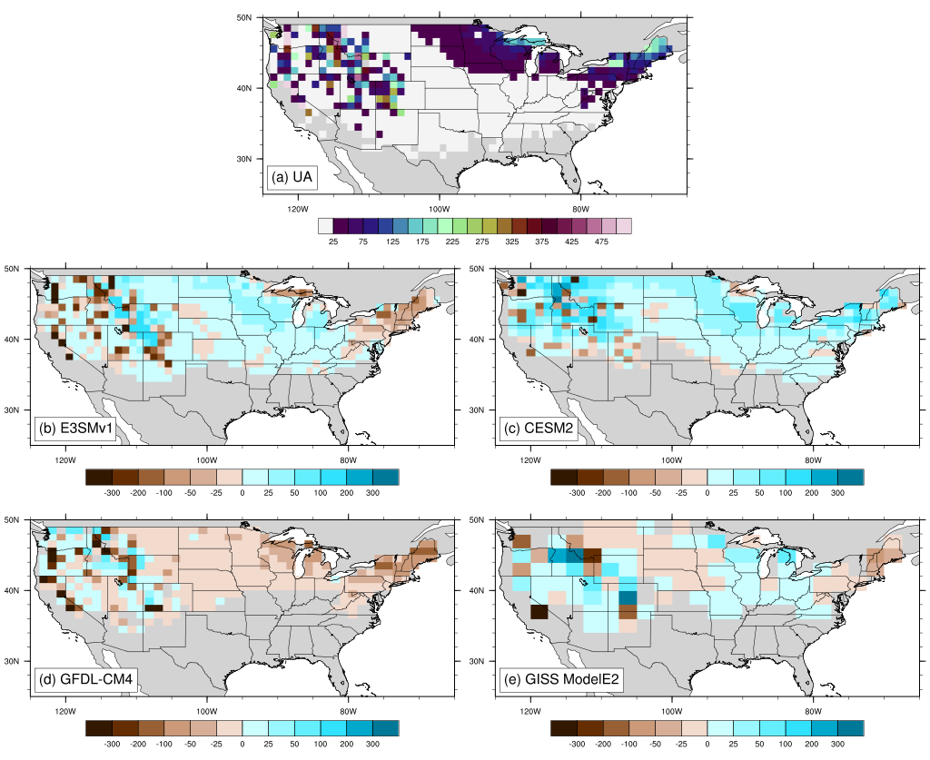
UA
March SWE (mm)
Evaluation of AMIP runs of CMIP6 models in the U.S.
Overall E3SMv1 simulates SWE slightly better over CONUS than other three models.
CESM2 produces too much SWE over CONUS.
Brunke et al. (to be submitted in April 2020)
(Model – UA)
March SWE
Bias (mm)

Slide 16
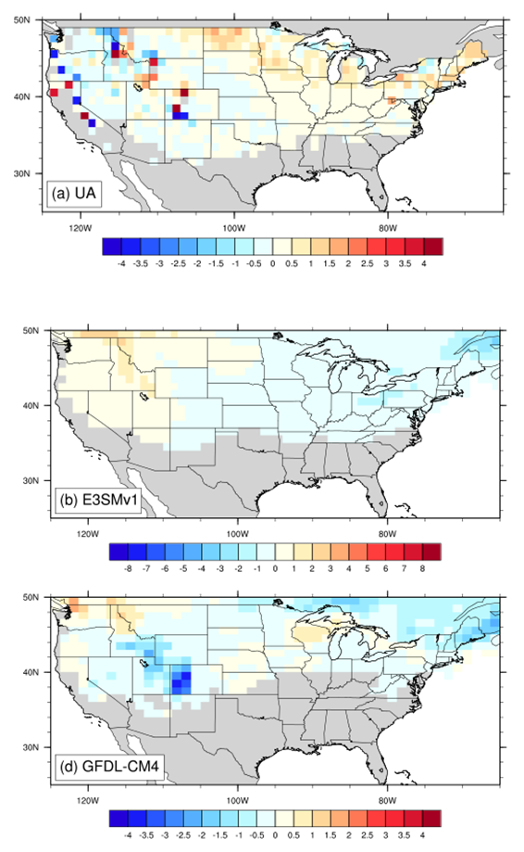
March SWE trend (mm/yr)
UA
E3SMv1
(with a different color bar)
GFDL-CM4
March SWE trends (mm/yr)
Both E3SMv1 and GFDL-CM4 miss the observed SWE trend near the West Coast
Challenge:
How do we gain any insights on model’s performance?

Slide 17
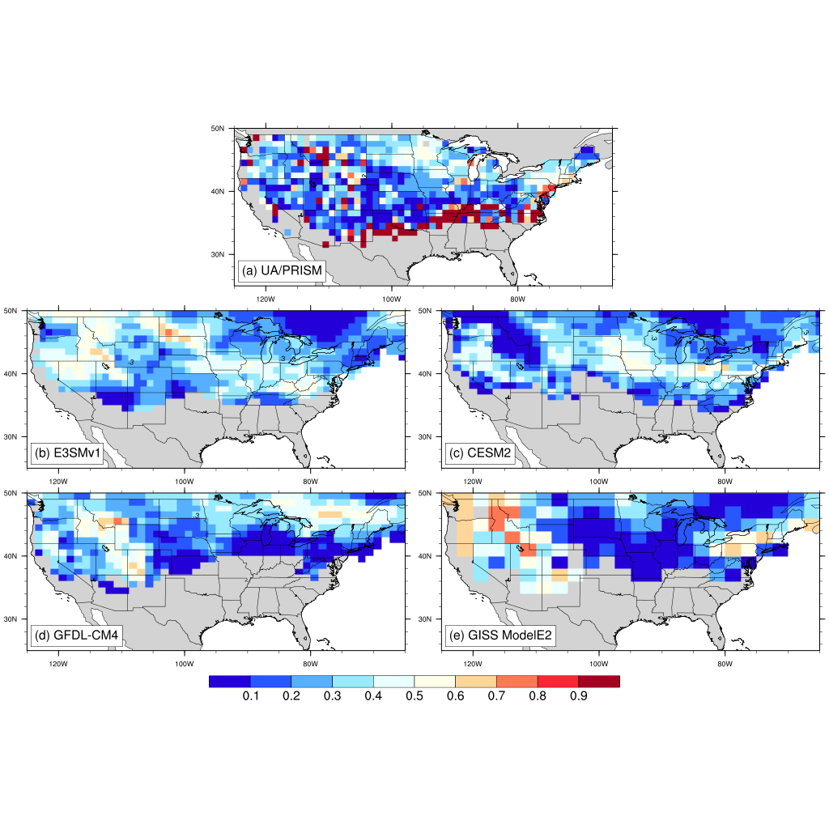
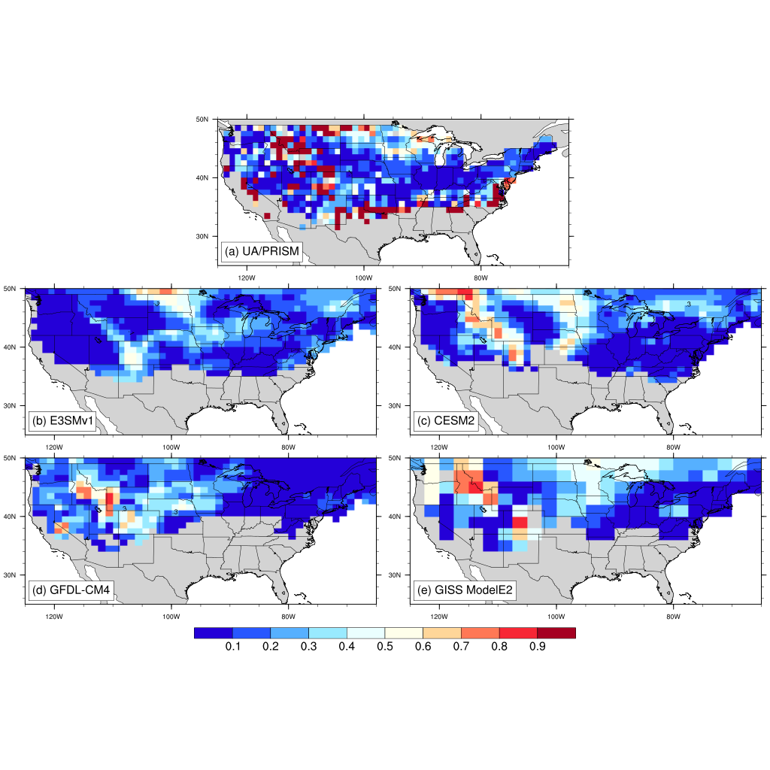
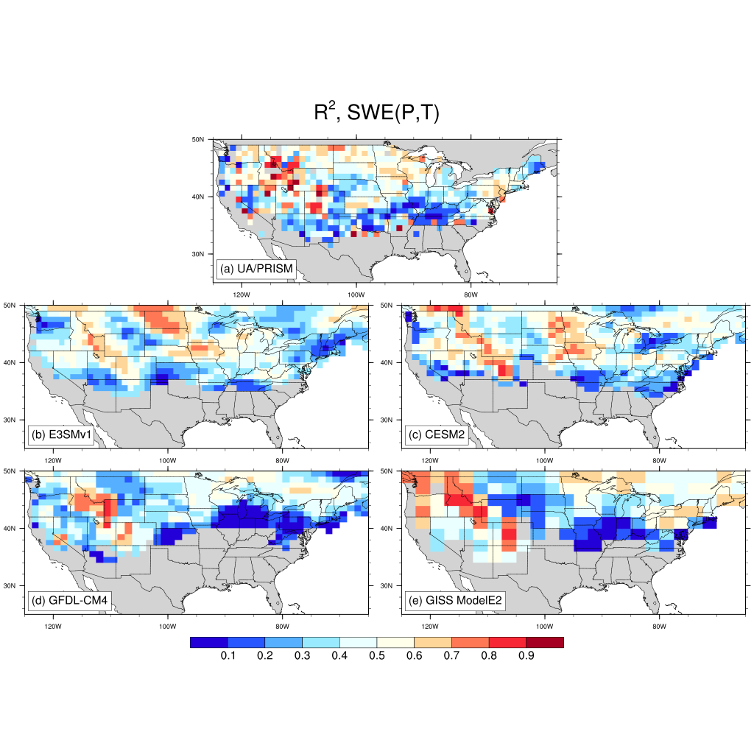



Oct.-March mean temp. relation. R²
Oct.-Mar. accum precip. relation. R²
Multi-linear relationship R²
$$SWE=aT+b$$
$$SWE=aP+b$$
$$SWE=a_{T}T+a_{P}P+b$$
Obs
Models
OBS: SWE has a strong correlation with P (particularly over mountains), and has a weaker relation with T
E3SM: SWE has a weak correlation with P and has a stronger correlation with T
For OBS and models, using T and P yields much higher correlation than using T or P alone
Notes:
It’s clear that either temperature or precipitation alone cannot explains simulated SWE.

Slide 18
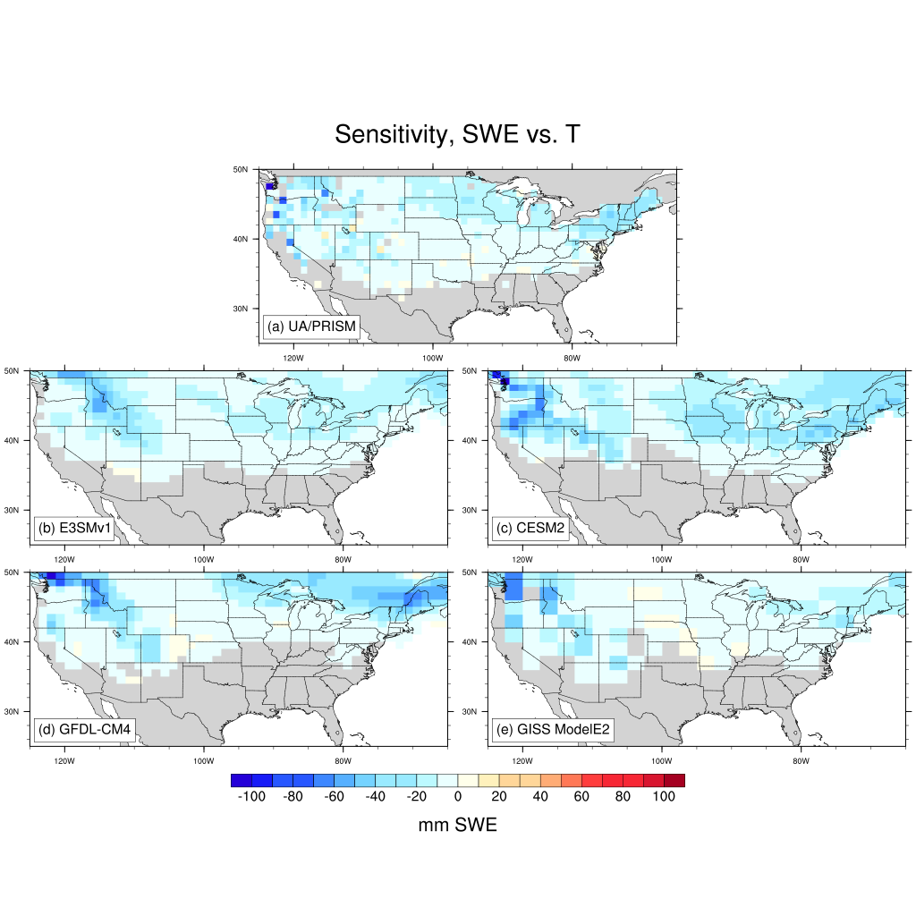
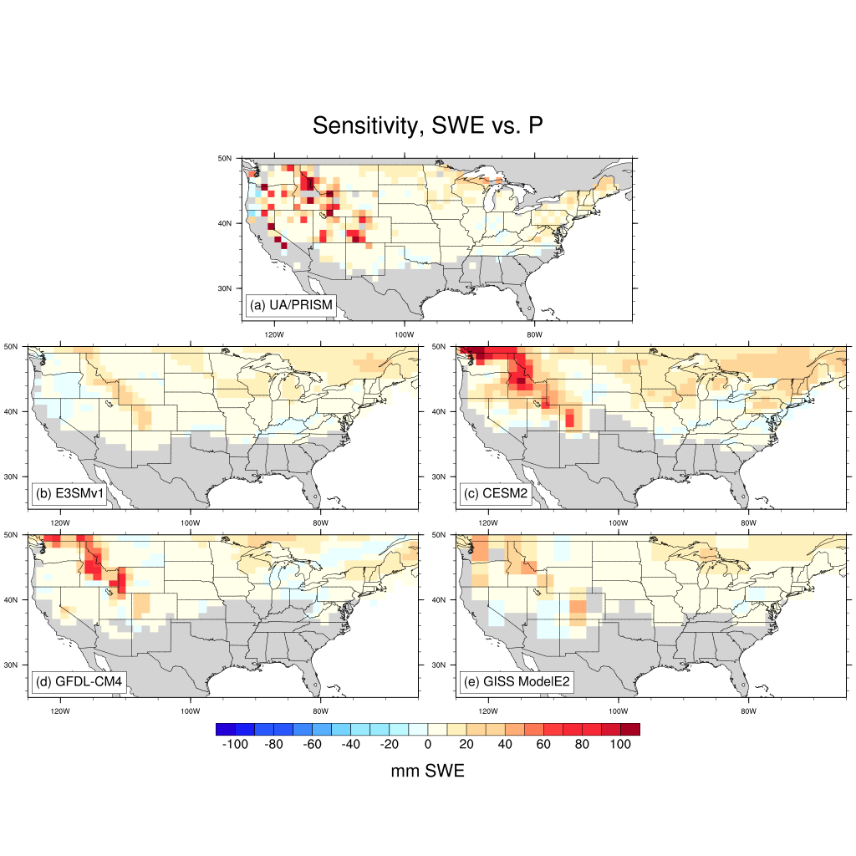
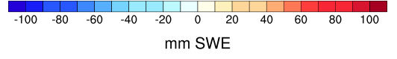


Temp. sensitivity indices
Precip. sensitivity indices
$$SWE=a_{T}T+a_{P}P+b$$
$${S_{X}=a}_{X}σ_{X}, X=T,P$$
Obs
Observed sensitivity to precip > that of temperature over W CONUS highest elevations.
E3SMv1 precip. sensitivity < observed precip. sensitivity.
Models
Models miss greater sensitivity to temperature and precipitation over coastal mountains.

Slide 19
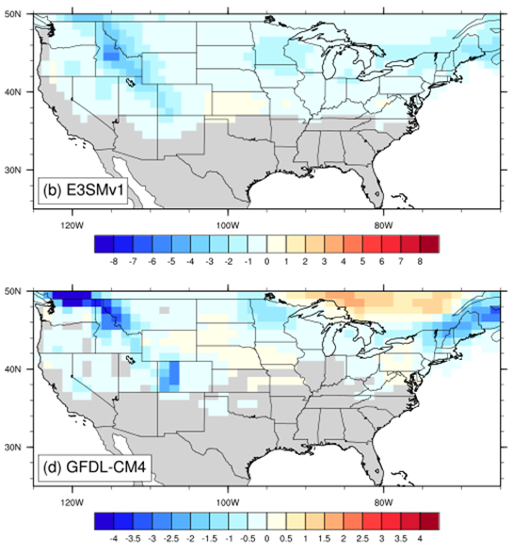
Comparison of March SWE trends from AMIP runs versus coupled runs
CMIP6 coupled runs
March SWE trend (mm/yr)
UA
E3SMv1 AMIP run
(with a different color bar)
GFDL-CM4 AMIP run

Slide 20

SM-P Correlations under Different Dynamic Regimes (from NASA MERRA2)
3. Morning soil moisture effect on afternoon rainfall
Negative (positive) correlation between seasonal standardized anomaly of morning SM with afternoon P accumulation under low (high) regime
When all afternoon P days taken as a whole, no statistically significant relationship between SM and P
Welty and Zeng (2018)
UA News Release on 8/8/2018: Does rain follow the plow?
DOE Office of Science web site: University research highlight

Slide 21
Physical Pathways
Under low regime:
  positive correlations for soil T, 2m T, 2m Q, CAPE, and PBLHd/LCLd
  negative correlation for SM
Under high regime:
  positive correlation for EF, SM
*CTP: Convective Triggering Potential
*HI_{low}: Low-level Humidity Index

Slide 22
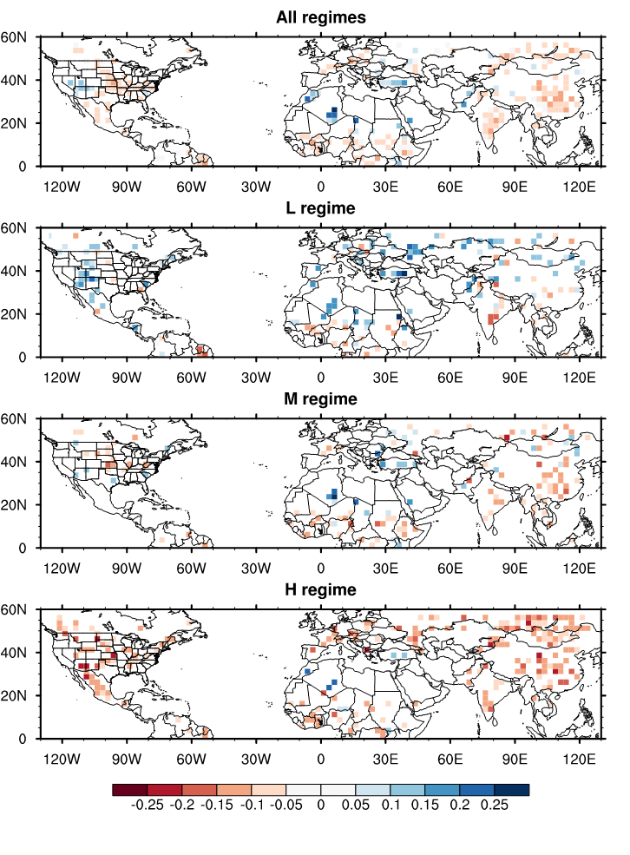
For each regime, compute afternoon rainfall frequency over wetter soil minus that over drier soil:
Positive differences: occurrence more likely over wetter soils
Negative differences: occurrence more likely over drier soils
Afternoon rainfall tends to occur over wetter soils under low (L) moisture convergence conditions.
Afternoon rainfall tends to occur over drier soils under high (H) moisture convergence conditions.
Results over ARM SGP are not representative of global results.
Welty et al. (to be submitted in March 2020)

Slide 23
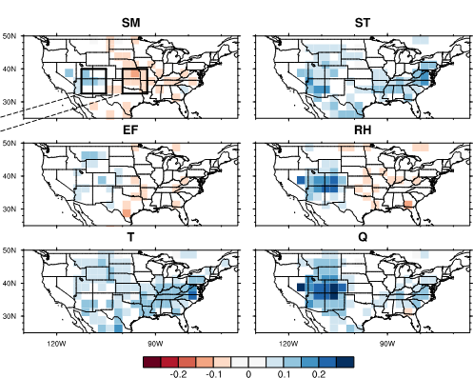
Investigating other variable relationships with afternoon rainfall
Conditional probability difference of afternoon rainfall over positive and negative anomalies of each indicated variable over CONUS for all regime days.
Afternoon rainfall tends to occur over warmer surface (using surface or air T) and primarily over higher specific humidity
Results depend on location for soil moisture, evaporative fraction, and relative humidity
We are currently analyzing global model representation of afternoon rainfall processes (e.g., E3SM)

Slide 24
Conclusions
1. Surface water balance over the Amazon Basin
  Only a few combinations of data sets allow water budget closure: ensemble mean P and E do not
  Using scaled Obidos discharge to represent Amazon discharge appears to give correct long term mean but incorrect seasonal cycle
  Using water budget estimates of discharge should be considered for oceanographic studies of the tropical Atlantic using climate models (including E3SM)
2. Snow-water equivalent (SWE) over CONUS
  Developed a high-quality daily 4km SWE data over CONUS
  Observed SWE shows more sensitivity to P (particularly over mountains) than T
  Models (including E3SM) show more sensitivity to T than P, which has implications on future SWE projection
  Models miss greater sensitivity to T and P over coastal mountains.
3. Morning soil moisture effect on afternoon rainfall
  Afternoon rainfall in summer over Northern Hemisphere tends to occur over wetter soils under low moisture convergence conditions.
  It tends to occur over drier soils under high moisture convergence conditions.
  It tends to occur over warmer surface (using surface or air T)

