Slide 1
Surface-flux driven water mass transformation analysis in E3SM simulations
Hyein Jeong
Adrian K. Turner, Xylar S. Asay-Davis, Darin S. Comeau, Stephen F. Price, Milena Veneziani, Mark R. Petersen, Matthew J. Hoffman, Todd D. Ringler, Luke Van Roekel, Andrew Roberts, Jonathan Wolfe, and Ryan Abernathey¹
Los Alamos National Laboratory
¹ Lamont-Doherty Earth Observatory of Columbia University

Slide 2
Outline
Importance of Southern Ocean and Sea-ice
Water Mass Transformation framework
Application (I) to Southern Ocean in E3SM simulations
Application (II) to dense water formation in Antarctic coastal polynyas
Application (III) to Labrador Sea bias in E3SM simulations

Slide 3
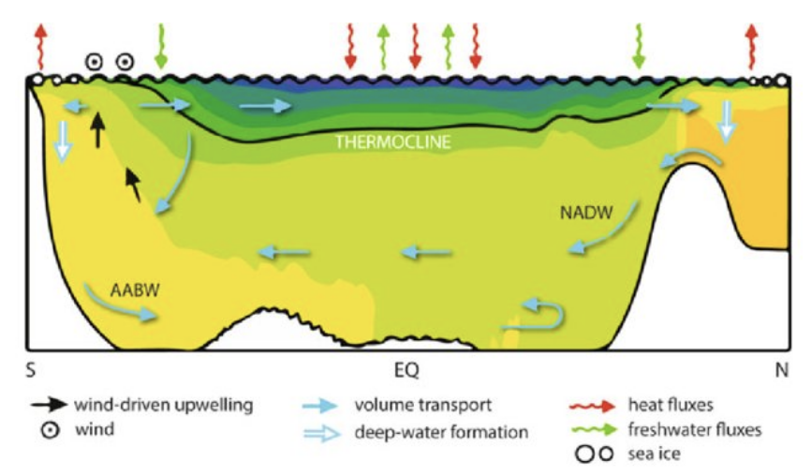
Southern Ocean
Atlantic Meridional Overturning Circulation (AMOC)
Significant sink for atmospheric heat, anthropogenic carbon dioxide
Producing the densest water mass in global ocean, Antarctic Bottom Water (AABW)
From Kuhlbrodt et al. 2007, Violante et al., 2017

Slide 4
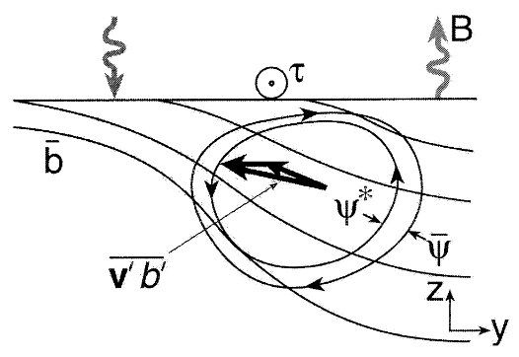
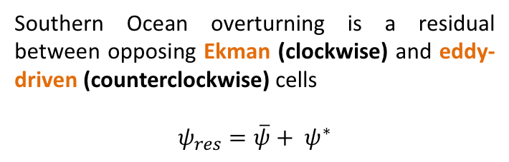
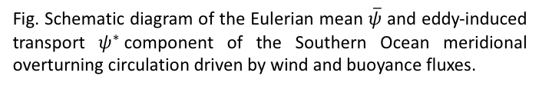
Marshall and Radko (2003) : Residual Mean
Southern Ocean overturning is a residual between opposing Ekman (clockwise) and eddy-driven (counterclockwise) cells
$$ψ_{res}=\overline{ψ}+ ψ^{∗}$$
Ekman flow
Eddy-driven flow
Fig. Schematic diagram of the Eulerian mean $\overline{ψ}$ and eddy-induced transport $ψ^{∗}$component of the Southern Ocean meridional overturning circulation driven by wind and buoyance fluxes.

Slide 5
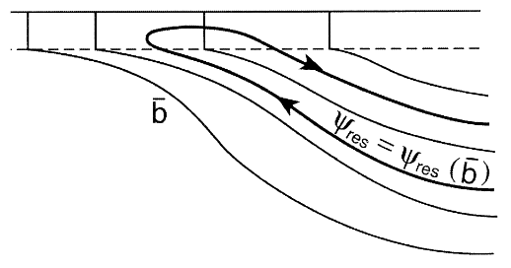
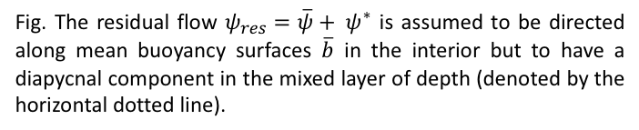
Marshall and Radko (2003) : Residual Mean
“Buoyancy budget” of surface layer controls the strength of the residual overturning
Fig. The residual flow $ψ_{res}=\overline{ψ}+ ψ^{∗}$ is assumed to be directed along mean buoyancy surfaces $\overline{b}$ in the interior but to have a diapycnal component in the mixed layer of depth (denoted by the horizontal dotted line).

Slide 6

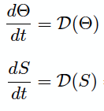
Buoyance budget: Heat vs. Freshwater
Potential Density Equation
Thermal
expansion
Haline coefficient of contraction
: Temperature change over time
: Salinity change over time

Slide 7




Buoyance budget: Heat vs. Freshwater
$$\frac{∂σ}{∂θ}$$
$$\frac{∂σ}{∂S}$$
$$: α$$
$$: β$$
“Relatively low latitudes”
“Relatively high latitudes”

Slide 8
Several sources of freshwater flux
atmosphere/land
ice sheet
Evaporation/Precipitation/Runoff
sea-ice
Freezing/Melting
Freezing/Melting
southern ocean

Slide 9
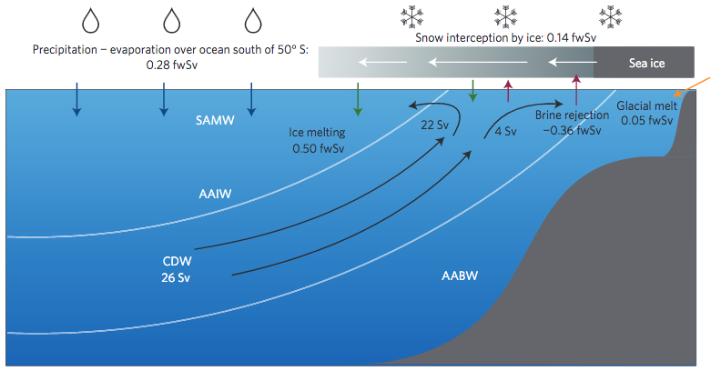
Abernathey et al. (2016) Freshwater flux exchange (SOSE)
1 fwSv = 10⁶m³ freshwater s⁻¹ $≅$ 3.15 x10⁴ Gt freshwater / year
SOSE: Southern Ocean State Estimate, 6yrs (2005-2010) high-res ocean data assimilated product (Mazloff et al. 2010)

Slide 10
Surface freshwater fluxes (sea-ice/ocean interaction)
Winter: brine rejection, freshwater transports to sea-ice
salinity goes up
sea-ice
ocean

Slide 11
Surface freshwater fluxes (sea-ice/ocean interaction)
Winter: brine rejection, freshwater transports to sea-ice
salinity goes up
sea-ice
Summer: freshwater transports to ocean
salinity goes down
ocean

Slide 12
Surface freshwater fluxes (sea-ice/ocean interaction)
Winter: brine rejection, freshwater transports to sea-ice
salinity goes up
sea-ice
Summer: freshwater transports to ocean
salinity goes down
ocean
Occurs at high latitudes
Occurs at low latitudes
There should be wind-driven sea-ice movement!

Slide 13
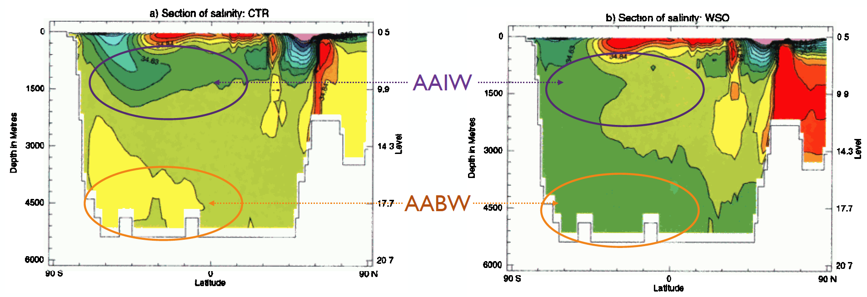
Sea-ice’s role in AABW and AAIW (Saenko and Weaver 2001)
fully coupled ocean and sea-ice
removed sea-ice component
intermediate model with coarse resolution ocean (MOM2), 2D atmosphere, and dynamic /thermodynamic sea-ice model
”Sea-ice” is very important in Southern Ocean water masses!

Slide 14


Water Mass Transformation (Walin 1982, Abernathey et al. 2016)
Powerful way to characterize the role of different processes in driving ocean circulation (overturning).
“Water mass” refer to a body of water with similar temperature, salinity, and/or density properties.
“Water mass transformation” is considered to be a process which some properties of a water parcel are changed.
Depending on the nature of the transformation, the density of the water parcel might be changed continuously.
→ Density changes ultimately affect the ocean dynamics (ocean circulation).
To aid in our investigation of SO interactions between the atmosphere, ocean, sea ice, and ice shelves, we applied WMT analysis.
$$Ω\left(σ_{k},t\right)=−\frac{1}{\left(σ_{k+1}−σ_{k}\right)}\iint_{A}{\left(\frac{αQ_{net}}{{ρ_{0}C}_{p}}\right)dA+ }\frac{1}{\left(σ_{k+1}−σ_{k}\right)}\iint_{A}{\left(\frac{βSF_{net}}{ρ_{0}}\right)dA }$$
Total WMT
Net surface heat flux
Net surface freshwater flux
$$F_{net}= F_{A→O}+ F_{I→O}$$
$$F_{A→O}$$
$$F_{I→O}$$
: Atmosphere to Ocean
: Sea ice to Ocean (formation and melting)

Slide 15
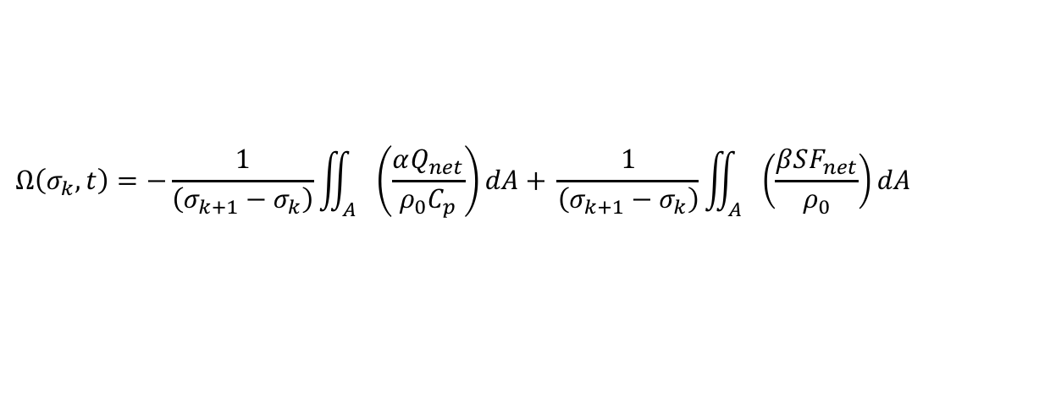
Water Mass Transformation (Walin 1982, Abernathey et al. 2016)
Water-mass transformation rates:
$$Ω\left(σ_{k},t\right)=−\frac{1}{\left(σ_{k+1}−σ_{k}\right)}\iint_{A}{\left(\frac{αQ_{net}}{{ρ_{0}C}_{p}}\right)dA+ }\frac{1}{\left(σ_{k+1}−σ_{k}\right)}\iint_{A}{\left(\frac{βSF_{net}}{ρ_{0}}\right)dA }$$
Water-mass formation rates:
$$Μ\left(σ_{k}\right)=−[\overline{Ω\left(σ_{k+1}\right)}−\overline{Ω\left(σ_{k}\right)}]$$
 | Positive | Negative
Transformation rates | Denser Lose buoyancy | Lighter Gain Buoyance
Formation rates | Water convergence Downwelling motion | Water divergence Upwelling motion

Slide 16
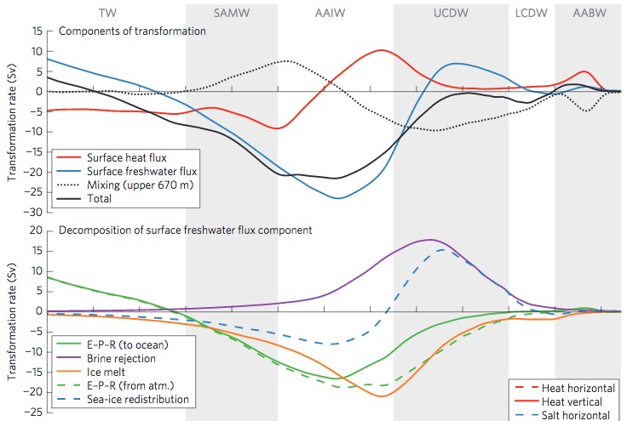
Water Mass Transformation (Abernathey et al. 2016, SOSE)
Equatorward
Southward
Surface freshwater flux term is dominant
Heat flux is secondary to freshwater flux
Sea-ice formation/melting is dominant
brine rejection peaks in UCDW range
sea-ice melting peaks in AAIW range

Slide 17
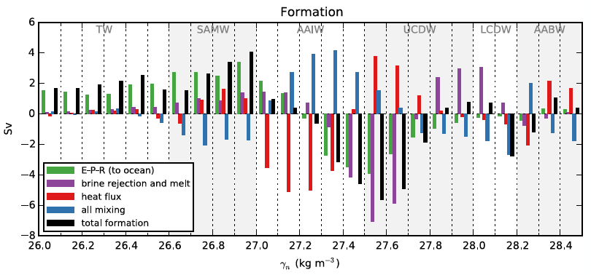
Water Mass Formation Rates (Abernathey et al. 2016, SOSE)
downwelling motion
downwelling motion
Upwelling motion
Destruction (upwelling motion) of UCDW and some AAIW dominated by “sea-ice”
Precipitation, heat flux, and sea-ice melting contribute to production of SAMW
Heat flux term makes AABW → limitation of SOSE data, real ocean transformation rate in AABW mainly caused by brine rejection!

Slide 18
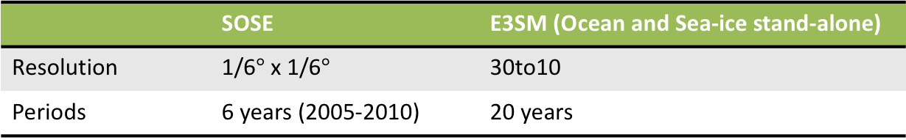
Application (I) to Southern Ocean in E3SM simulations
 | SOSE | E3SM (Ocean and Sea-ice stand-alone)
Resolution | 1/6$°$ x 1/6$°$ | 30to10
Periods | 6 years (2005-2010) | 20 years
SOSE: Southern Ocean State Estimate, 6yrs (2005-2010) high-res ocean data assimilated product (Mazloff et al. 2010)

Slide 19
Water Mass Transformation in Southern Ocean
Sea-ice formation (brine rejection)
Sea-ice melting
Sea-ice formation and melting
E-P-R
Salinity restoring

Slide 20
Application (II) to dense water formation in coastal polynyas
 | LR tuned HR E3SM | HR E3SM (Caldwell et al. 2019)
Resolution | Low Res. 60to30 | High Res. 18to6
Periods | 30 years (26-55) | 30 years (26-55)

Slide 21
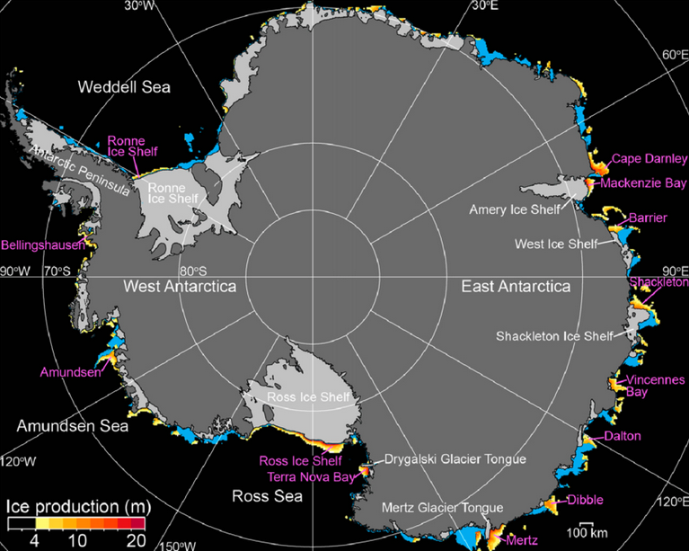
Sea-ice production in coastal polynyas
Small in area compared to the total sea-ice zone (<3%)
High Sea-ice production (10% of total sea-ice volume)
Important climate impact on atmospheric mesoscale motions by transporting latent heat from ocean
Impact on strong water mass transformation → AABW
From Nihashi and Ohshima, 2015

Slide 22
Sea-ice production in Antarctic coastal polynyas
Jeong et al. (in prep)

Slide 23
Water Mass Transformation in coastal polynyas
HR
LR
Dense water-mass transformation in HR
Major role of surface freshwater flux
Brine rejection term is dominant
However, it occurs at relatively low density ranges → it is related to fresh bias along the Antarctic coast in HR
Jeong et al. (in prep)

Slide 24
Application (III) to Labrador Sea bias in E3SM simulations
 | LR tuned HR E3SM | HR E3SM (Caldwell et al. 2019)
Resolution | Low Res. 60to30 | High Res. 18to6
Periods | 30 years (26-55) | 30 years (26-55)

Slide 25
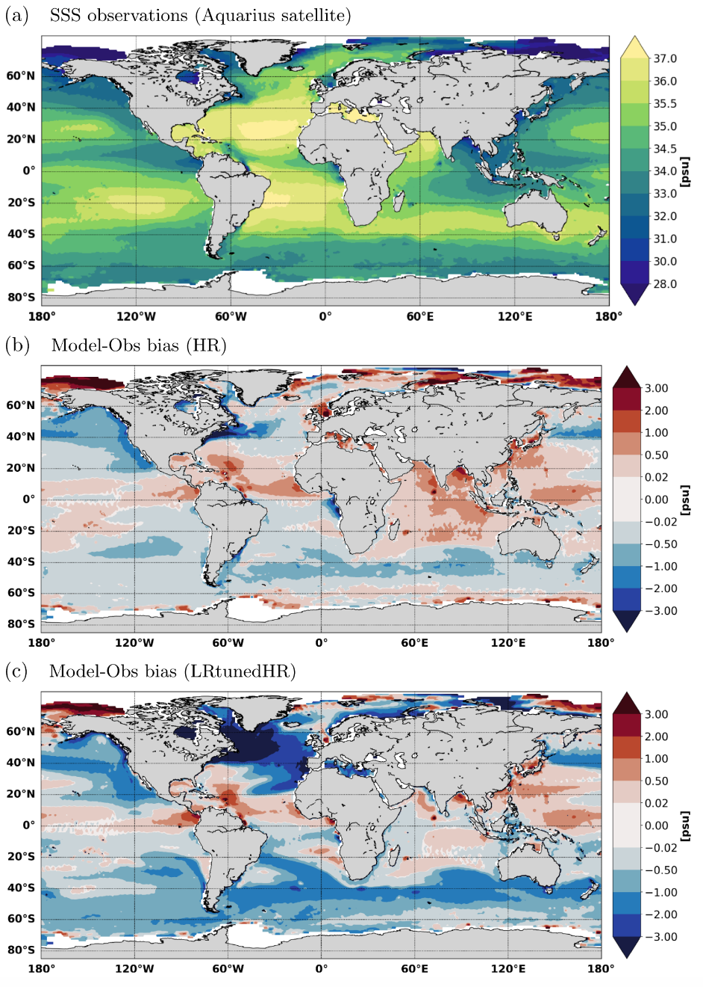
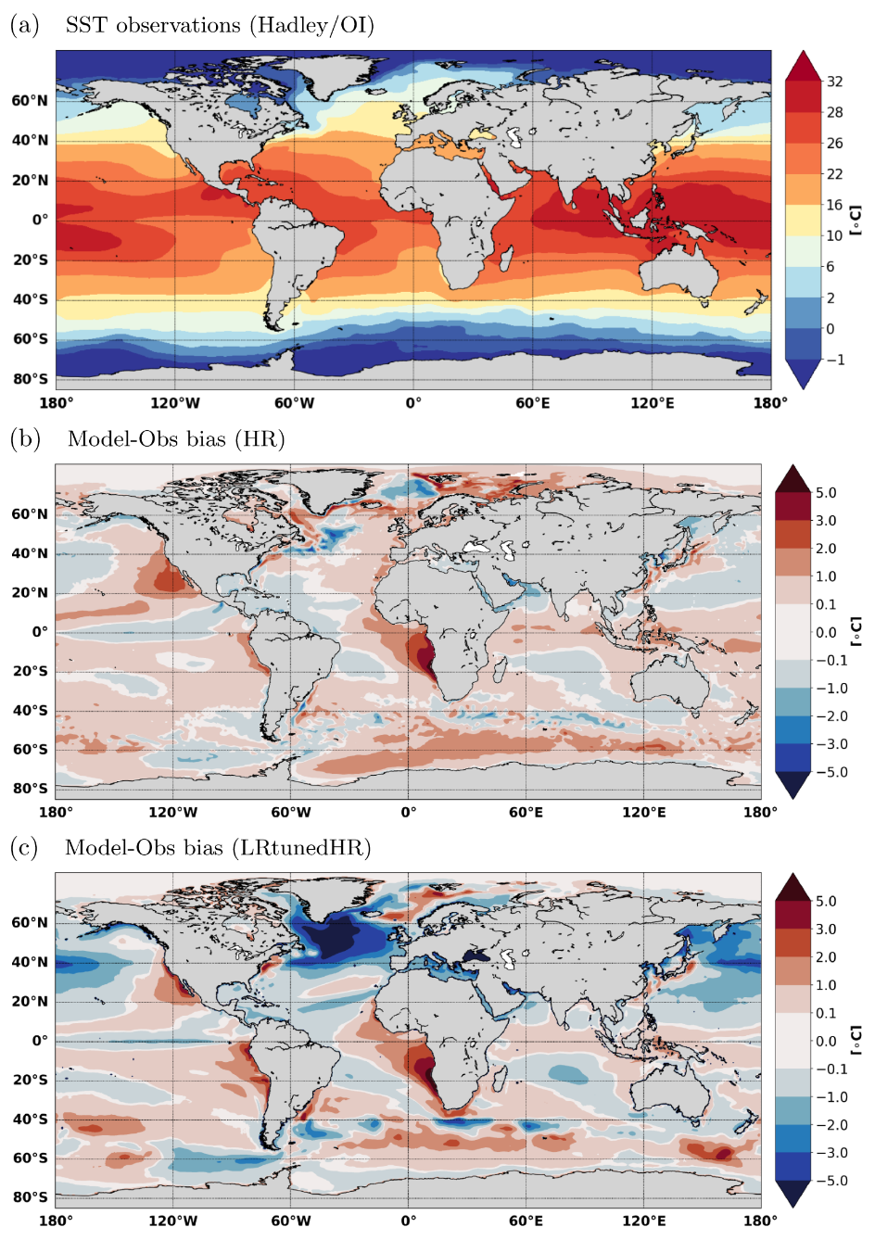
Labrador Sea bias in E3SM simulations
Sea Surface Salinity
Sea Surface Temperature
OBS
HR - OBS
LR - OBS
From Caldwell et al. 2019

Slide 26
Water Mass Transformation in E3SM simulations
HR
LR
Dense water-mass transformation in HR
Major role of heat flux loss (to the atmosphere) rather than surface freshwater flux term
However, no dense water-mass transformation in LR

Slide 27
Atlantic Meridional Overturning Circulation (AMOC)
From Kuhlbrodt et al. 2007, Violante et al., 2017

Slide 28
Thank you
Kuhlbrodt, T., Griesel, A., Montoya, M., Levermann, A., Hofmann, M. and Rahmstorf, S., 2007. On the driving processes of the Atlantic meridional overturning circulation. Reviews of Geophysics, 45(2).
Violante, R.A., Laprida, C. and Chapori, N.L.G., 2017. The Argentina Continental Margin: Location and Significance. In The Argentina Continental Margin (pp. 11-32). Springer, Cham.
Marshall, J. and Radko, T., 2003. Residual-mean solutions for the Antarctic Circumpolar Current and its associated overturning circulation. Journal of Physical Oceanography, 33(11), pp.2341-2354.
Abernathey, R.P., Cerovecki, I., Holland, P.R., Newsom, E., Mazloff, M. and Talley, L.D., 2016. Water-mass transformation by sea ice in the upper branch of the Southern Ocean overturning. Nature Geoscience, 9(8), p.596.
Mazloff, M.R., Heimbach, P. and Wunsch, C., 2010. An eddy-permitting Southern Ocean state estimate. Journal of Physical Oceanography, 40(5), pp.880-899.
Saenko, O.A. and Weaver, A.J., 2001. Importance of wind‐driven sea ice motion for the formation of Antarctic Intermediate Water in a global climate model. Geophysical Research Letters, 28(21), pp.4147-4150.
Walin, G., 1982. On the relation between sea‐surface heat flow and thermal circulation in the ocean. Tellus, 34(2), pp.187-195.
Nihashi, S. and Ohshima, K.I., 2015. Circumpolar mapping of Antarctic coastal polynyas and landfast sea ice: Relationship and variability. Journal of climate, 28(9), pp.3650-3670.
Caldwell, P.M., Mametjanov, A., Tang, Q., Van Roekel, L.P., Golaz, J.C., Lin, W., Bader, D.C., Keen, N.D., Feng, Y., Jacob, R. and Maltrud, M.E., The DOE E3SM coupled model version 1: Description and results at high resolution. Journal of Advances in Modeling Earth Systems.

