Slide 1
Performance Overview The Democratic Plan
Phil Jones, Sarat Sreepathi on behalf of Performance Group:
Oksana Guba, Noel Keen, Jayesh Krishna, Azamat Mametjanov, Henry Moncada, Mark Taylor, Matt Turner, Pat Worley, Min Xu

Slide 2
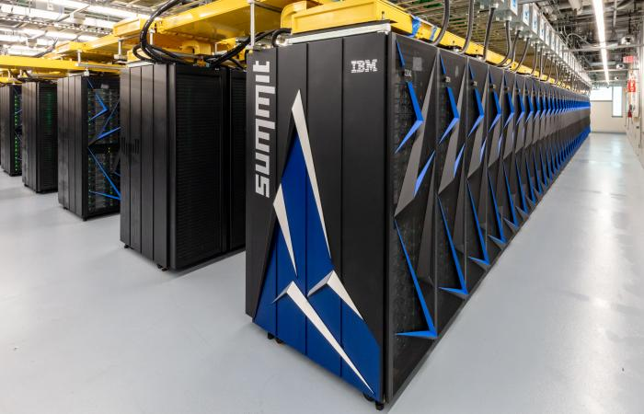
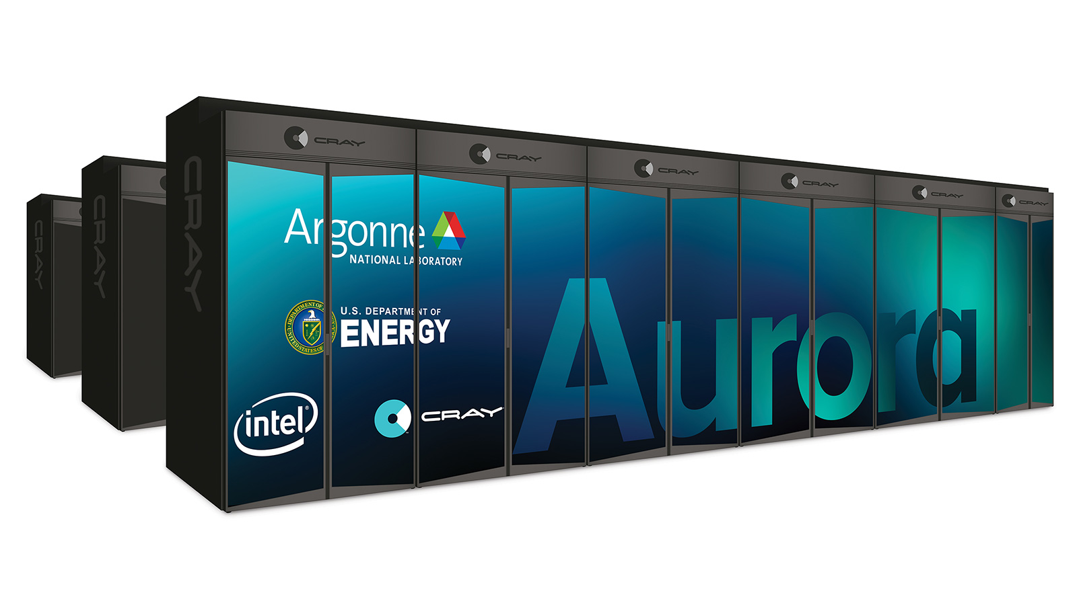
Performance Group Goals
Reduce performance inequality
CompyMcNodeFace (Skylake)
Cori and Theta (Intel Phi)
Summit (IBM P9/Nvidia GPU)
Hold performance accountable
Standard benchmarks
Performance tools
Make new architectures work for all
Perlmutter (Better Call Saul, EPYC/Nvidia GPU, Shasta/slingshot, no spinning disk)
A21 (Intel Xeon SP with Xe GPU, Shasta/slingshot, memory innov)
Frontier (AMD EPYC, AMD Radeon GPU)
Longer term – non-GPU?

Slide 3
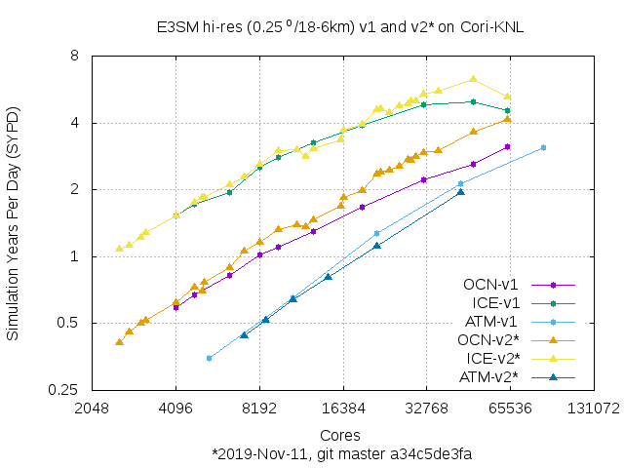
Rates are Rising
Standard Hi-res benchmark cases
F-case (atm/sfc) 0.25 deg
G-case (ocean/ice), RRS 18-6
No I/O
I/O benchmarks
Incremental improvements in node performance (CPU)
Larger expected improvement still in pipeline
Does not include GPU work
Substantial improvement in I/O
SCORPIO
 | PIO1/pnetcdf | PIO2/pnetcdf | PIO2/adios
High-res G-case Summit | 12.36 GB/sec | 27.89 GB/sec (BOX) 2.64 GB/sec (SUBSET) | 129.58 GB/s
High-res G-case Cori | 1.68 GB/sec | 4.94 GB/sec (BOX) 2.86 GB/sec (SUBSET) | 18.52 GB/sec
High-res F-case Summit | 536.15 MB/sec | 3.04 GB/sec (BOX) 1.31 GB/sec (SUBSET) | 12.45 GB/sec
High-res F-case Cori | 100.37 MB/sec | 1031.03 MB/sec (BOX) 663.09 MB/sec (SUBSET) | 4.86 GB/sec

Slide 4
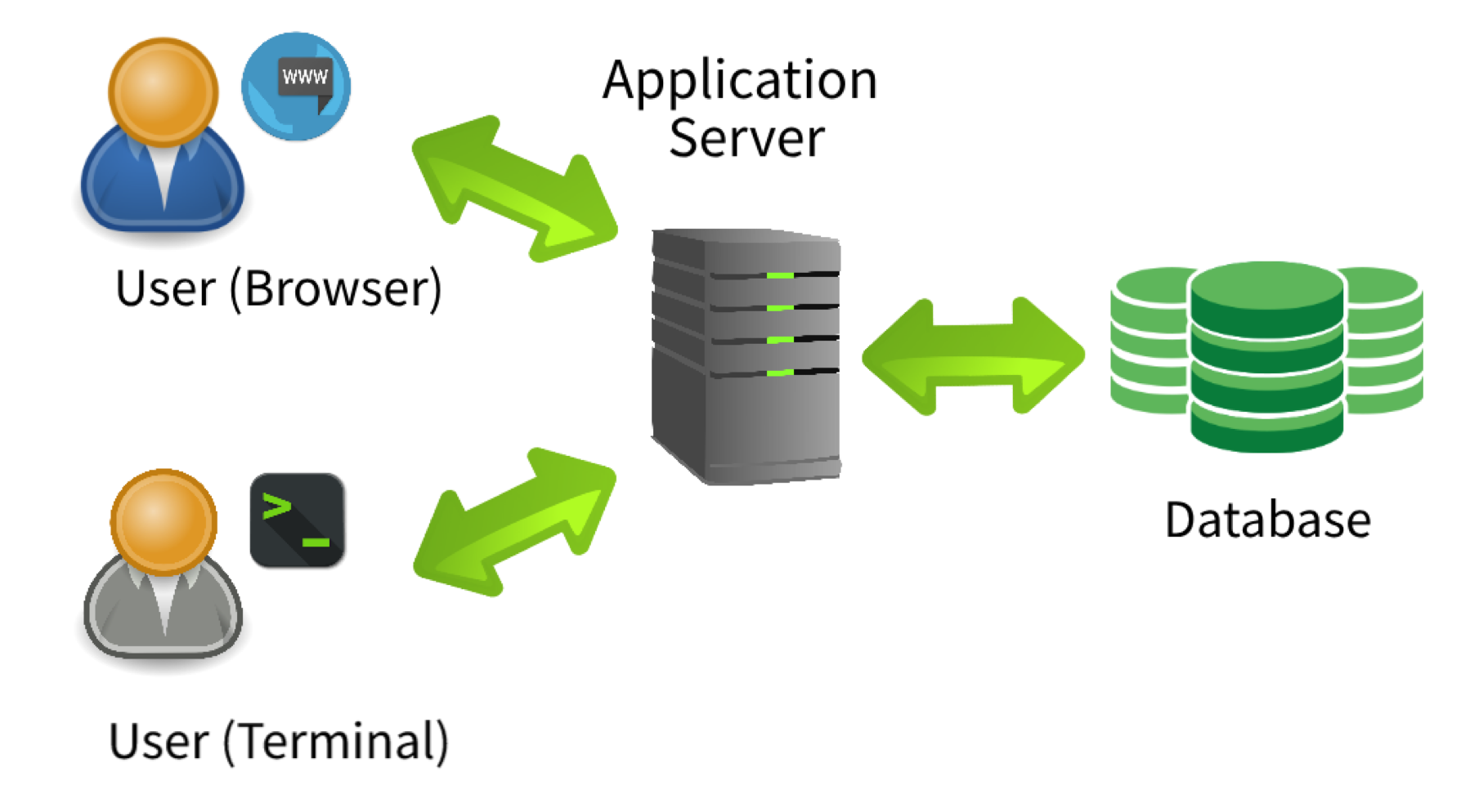
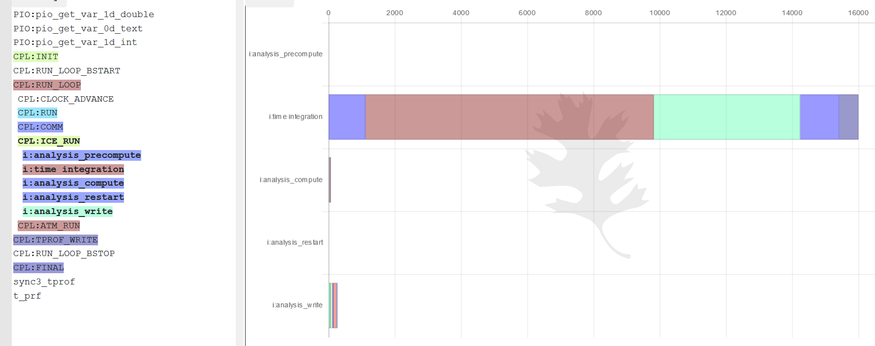
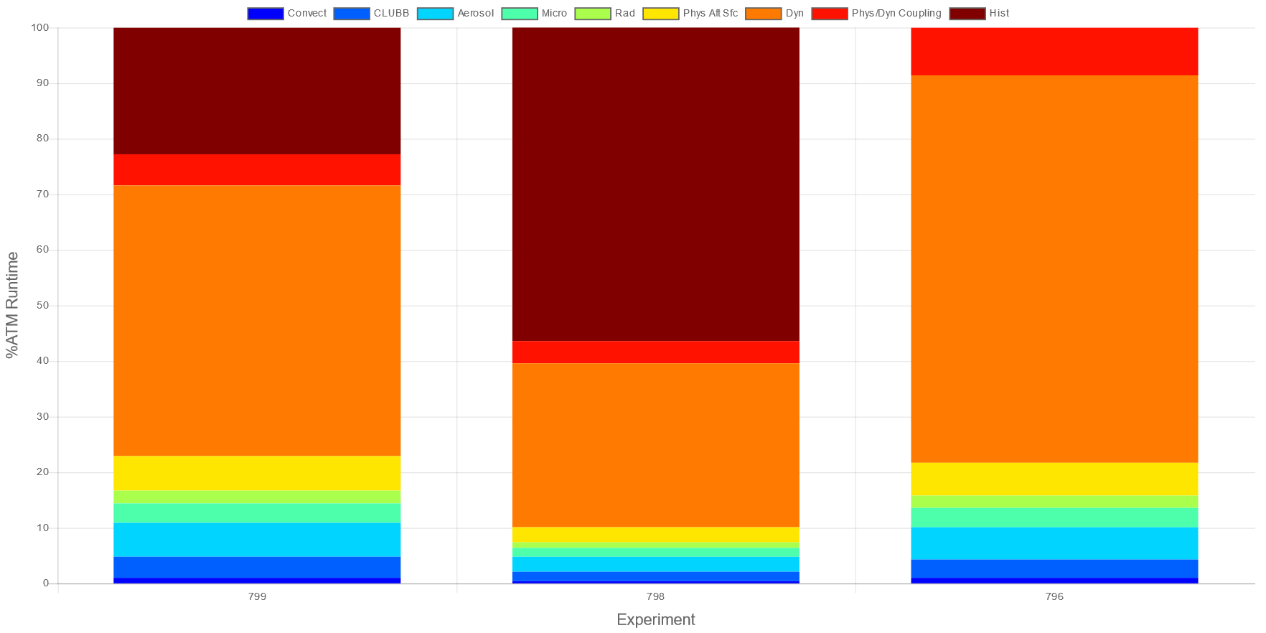
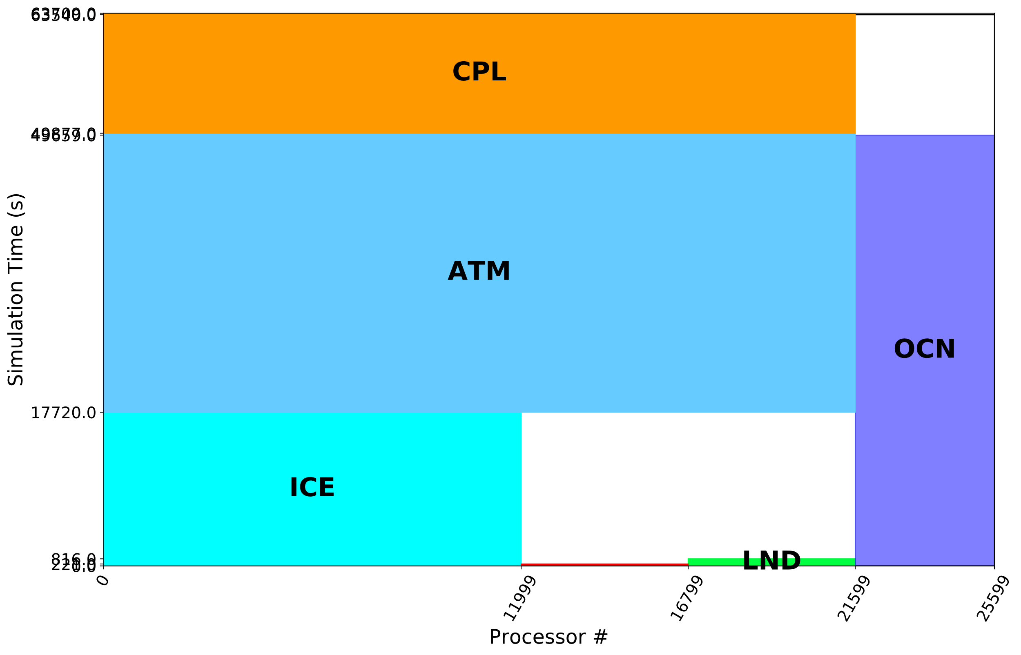
Polling and Analytics
Identifying where to target our ad buys.
Harvest/collect performance of all sims
Central hub of performance data
Interactively deep-dive as desired
Facilitate performance research
User input, existing scripts
https://pace.ornl.gov
Atmosphere model time distribution
Summary Performance Graphs
Load Balance:
MPI Task Mapping

Slide 5
GPU Care
Porting and portability
Kokkos: GPUs for all
Data model + Loop-level abstractions
Template metaprogramming
Must give up your current plan and adopt C++
OpenACC/OpenMP: GPUs for those who want it
Directives for both data mgmt, loop execution
Get to keep your current Fortran, C
Issues
High occupancy still difficult
Both approaches require significant work for optimal implementation
Future of GPU acceleration, Kokkos, OpenX
Utilize GPU differently: Universal Basic Subgrid
Give every GPU 1000 subgrid models (CRM, LES)
Asynchronous execution to split work across devices

Slide 6
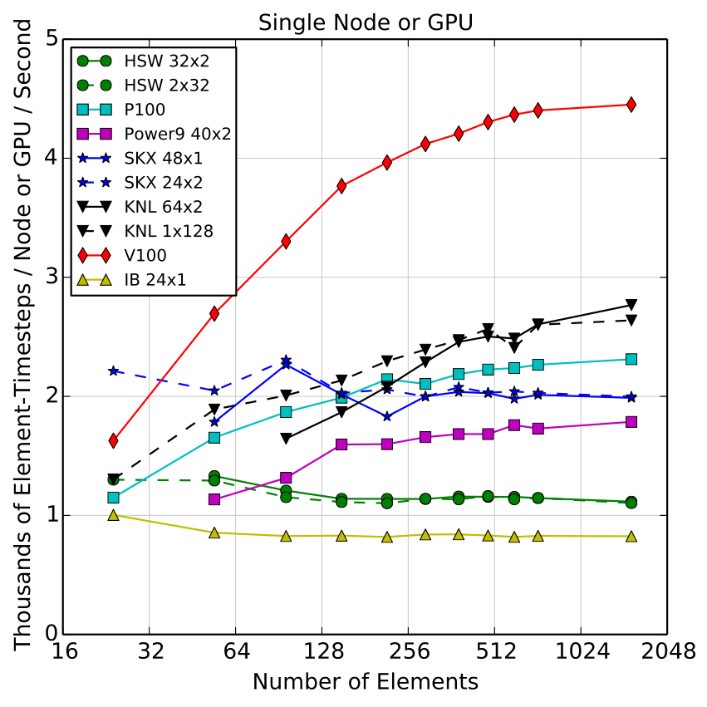
Atmosphere
HOMEXX
HOMMEXX dycore
Kokkos
NGD + Prior work
NH atmosphere NGD/SCREAM
New physics in Kokkos
Old v1 physics
Feasibility study porting MAM
OpenACC
Estimate of 2 man-years
Decided not to pursue
Superparameterization
ECP project
Run cloud-resolving models on GPU
Initial sims look promising

Slide 7
Ocean/Ice
Sea-ice
Communication dominated, hard to get GPU performance
SciDAC/ DEMSI
New discrete-element model
Ocean
ECP: Ocean OpenACC port
Demonstrated 2x speedup partial port
Likely better when more data resident
MPAS refactor
MPAS framework/style inhibiting progress
Embarking on significant refactor
New staff additions

Slide 8
Quid Pro Quo
Bypass performance team with rogue performance efforts:
New algorithms
Software/Algorithm NGD: new ocean barotropic solver
SciDAC: new transport algorithms
SciDAC DEMSI: discrete-element sea-ice model
SciDAC CANGA: new coupling algorithms
New programming models and GPU approaches
NGD: NH atm, SCREAM, Software and Algorithm
Exascale Computing Project (ECP): dycore, MMF/superparam, GPU ocean/ice
SciDAC
CANGA: Exploration of Asynchronous Many-Task runtimes, coupling and remap algorithms
Others as noted above

Slide 9
Staffing
Three candidates have dropped out
Shan, Matthias, D. Gunter
New entries
Matt Turner
Pranay Kommera
Open license

Slide 10
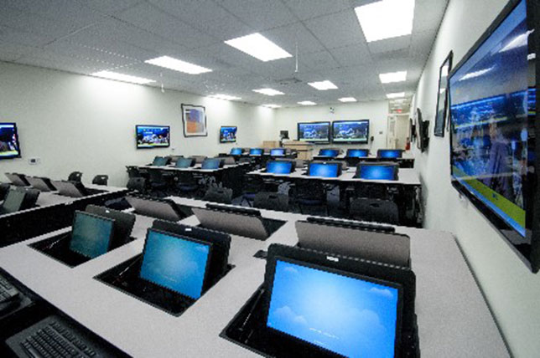
Free College
Workforce of Future
Increase pool of exascale developers
Community College
See OpenACC tutorial
Hackathons, etc.
Retrain displaced Fortran developers
Kokkos workshops/tutorials

