Slide 1
Biogeochemistry
Kate Calvin (on behalf of the E3SM BGC team)

Slide 2
The BGC Team
Susannah M. Burrows, Mathew Maltrud, Xiaojuan Yang, Qing Zhu, Nicole Jeffery, Xiaoying Shi, Daniel Ricciuto, Shanlin Wang, Gautam Bisht, Jinyun Tang, Jon Wolfe, Bryce E. Harrop, Balwinder Singh, Lee Brent, Tian Zhou, Philip Cameron-Smith, Nathan Collier, Min Xu, Elizabeth C. Hunke, S. M. Elliott, A. K. Turner, Hongyi Li, Hailong Wang, Jean-Christophe Golaz, Ben Bond-Lamberty, Forrest M. Hoffman, William J. Riley, Peter E. Thornton, Kate Calvin, L. Ruby Leung

Slide 3
Atmospheric CO₂ : historical sources and sinks
Land and ocean CO₂ sinks control the response of atmospheric CO₂ concentration to anthropogenic emissions.
Nutrient availability limits biological CO₂ uptake in both land and ocean.
The land sink is substantially modified by human-driven land use change (e.g., conversion of forests to crops).
IPCC AR5, Ch. 6

Slide 4
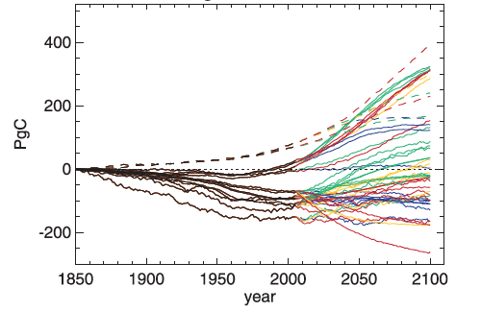
Motivation: There is large uncertainty in future changes in terrestrial and ocean carbon.
Changes in carbon vary dramatically across models in CMIP5.
Land models that included nitrogen limitations tended to have weaker terrestrial carbon uptake.
These results suggest that model structure and nutrient limits matter.
Change in Vegetation Carbon
Source: Jones et al. (2013)

Slide 5
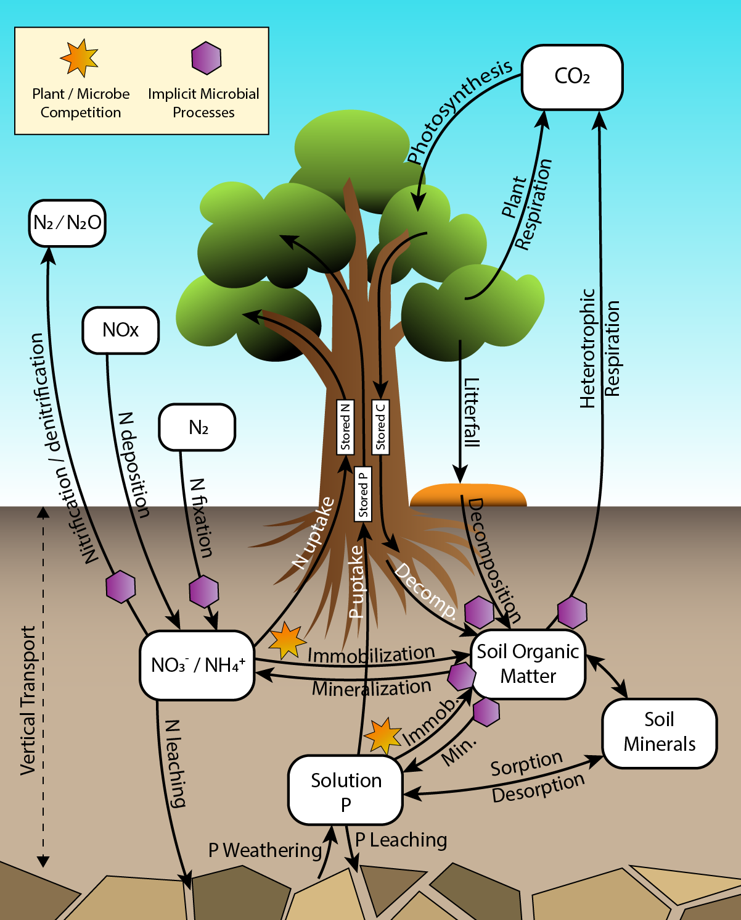
The v1 BGC model
ELM v1 CNP dynamics in vegetation and soil
Terrestrial:
  Two approaches to soil biogeochemistry (ECA and CTC), both including N and P limits on C uptake
Ocean/ice:
  Based on the Biogeochemical Elemental Cycling model (BEC), including N, P, Si, Fe
  Includes ocean-ice biogeochemical interactions

Slide 6
Simulation Plan
V1 Science Question: What are the effects of nitrogen and phosphorous on climate-biogeochemistry interactions, and how sensitive are these interactions to model structural uncertainty?
Multiple simulations
Multiple representations of the same model feature

Slide 7
Simulation plan
 | CO₂ input to radiation scheme | CO₂ input to carbon-cycle scheme | Non-CO₂ climate forcings | Reason | CMIP6 Scenario (Years) | Years Complete (for both CTC & ECA)
BDRD-hist (fully-coupled) |  |  | historical | Simulates the fully-coupled system | HIST+SSP5-85 (1850-2100) | 1850-2014
BDRC-hist (biogeochemically-coupled) |  |  | historical | Isolates the carbon-cycle response to CO2 (β) for land and oceans | HIST+SSP5-85 (1850-2100) | 1850-2014
BCRD-hist (radiatively-coupled) |  |  | historical | Isolates carbon-cycle response to climate change (γ) for land and for oceans | HIST+SSP5-85 (1850-2100) | 1850-2014
BCRC-hist (CO₂ constant) |  |  | historical | Isolates effect of non-CO₂ historical forcings | HIST+SSP5-85 (1850-2100) | 1850-2014
CNST-forcing (all forcings constant) |  |  | constant | Control for model drift in absence of forcings | 1850 (1850-2100) | 165 years

Slide 8
Physical climate evaluation

Slide 9
Surface air temperature anomalies – radiative impact of CO₂ dominates
RD
RC
Notes:
2-m air temperature global mean
Compared with envelope of DECK ensemble, and with observational benchmarks
CNST-forcing simulation: temperature is stable
RC simulations: include aerosol cooling and LULCC, but no increase in GHG concentrations, so they cool in 20th century
RD simulations: GHG warming balances and then exceeds aerosol cooling, similar to DECK

Slide 10
Anomalies in globally integrated carbon cycle metrics
Gross Primary Productivity (GPP)
Net Ecosystem Exchange (NEE)
BD
BC
BD
BC
Total land ecosystem carbon
Total soil organic carbon
Total vegetation carbon
CNST
CNST
BD
BD
BC
BC
Notes:
Biogeochemical influence of transient CO₂ concentration dominates for GPP, NEE, TEC, vegetation carbon
ECA (dashed lines) exhibits drift in TEC in CNST-forcing scenario; this is due to the disequilibrium (by design) of the P soils in the initial state
Observational benchmarks for historical loss of TEC over the period 1850 – ca. 2000 are about 50 PgC; the CTC BDRD case is quite close to this. The ECA BDRD case loses 2-3x too much carbon over the historical period, compared with observational benchmarks.

Slide 11
Time series of global nitrogen and phosphorus pools, fluxes
Notes:
ECA has more N fixation, and it is more sensitive to increasing CO2 (unclear why)
Soil mineral N therefore also increases more in ECA
ECA soil loses P due to non-equilibrium in initial condition (by design). CTC adds P to surface soils (top 1-m) due to plant root mobilization of P from lower soil layers.

Slide 12
Geographic distribution of nutrient limitation
Notes:
Nutrient limitation is stronger in the tropics, especially soil P
N limitation is more important overall, and especially in northern extratropics (Europe, Siberia, North America)

Slide 13
ILAMB global benchmarking for land model
Overall, both ECA and CTC simulations perform better than most CMIP5 models
CTC does slightly better on metrics such as biomass, burned area, and CO₂
ECA does slightly better on others, including some of the “relationship” metrics

Slide 14
Ocean / sea ice results (physics and BGC)

Slide 15
Ocean physics biases: BDRD-hist (1977-2006)
Sea ice fraction
NASA Team satellite
Sea Surface Temperature
Hadley NOAA/OI merged SST (1985-2014)
Sea Surface Salinity
Aquarius satellite
Mixed-Layer Depth
Holte-Talley Array
Too much ice in Labrador Sea (a)
North Atlantic is too cold (b), and too fresh (c), resulting in a too-stable water column and too-shallow mixed layer (d)
Notes:
Dierences between simulated fields averaged over the final 30 years of BDRD
and observations (a) sea ice fraction relative to NASA Team satellite data (Cavalieri et al., 1996),
(b) sea surface temperature (C) relative to the Hadley National Oceanic and Atmospheric Ad-
ministration (NOAA)/Optimal Interpolation merged sea surface temperature dataset (years
1985-2014, Hurrell et al. (2008)), (c) sea surface salinity (psu) relative to the Aquarius satellite
observations (Project", 2010), and (d) mixed layer depth (m) relative to Holte-Talley Array of
Real-time Geostrophic Oceanography based observations (Holte et al., 2017)

Slide 16
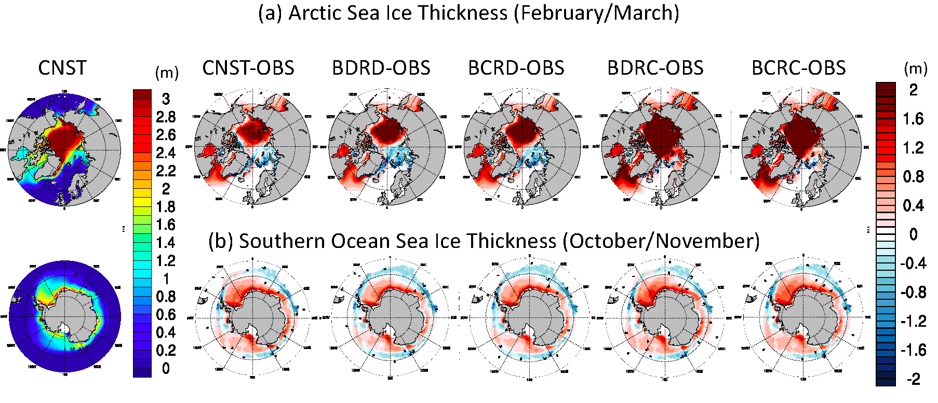
Sea ice biases
Too much sea ice in Labrador Sea
This sea ice bias is likely responsible for the cold/fresh bias in the North Atlantic…

Slide 17
Net CO₂ flux from ocean to atmosphere (mmol/m²/yr), present-day
MODEL (BDRD-hist, 1977-2006)
OBS (World Ocean Atlas)
Red colors are fluxes out of ocean (outgassing)
Blue colors are fluxes into ocean (uptake / sink)
Low bias in ocean productivity causes ocean CO₂ sink to be too small.
Note the prominent biases in:
  Upwelling regions
  Southern Ocean

Slide 18
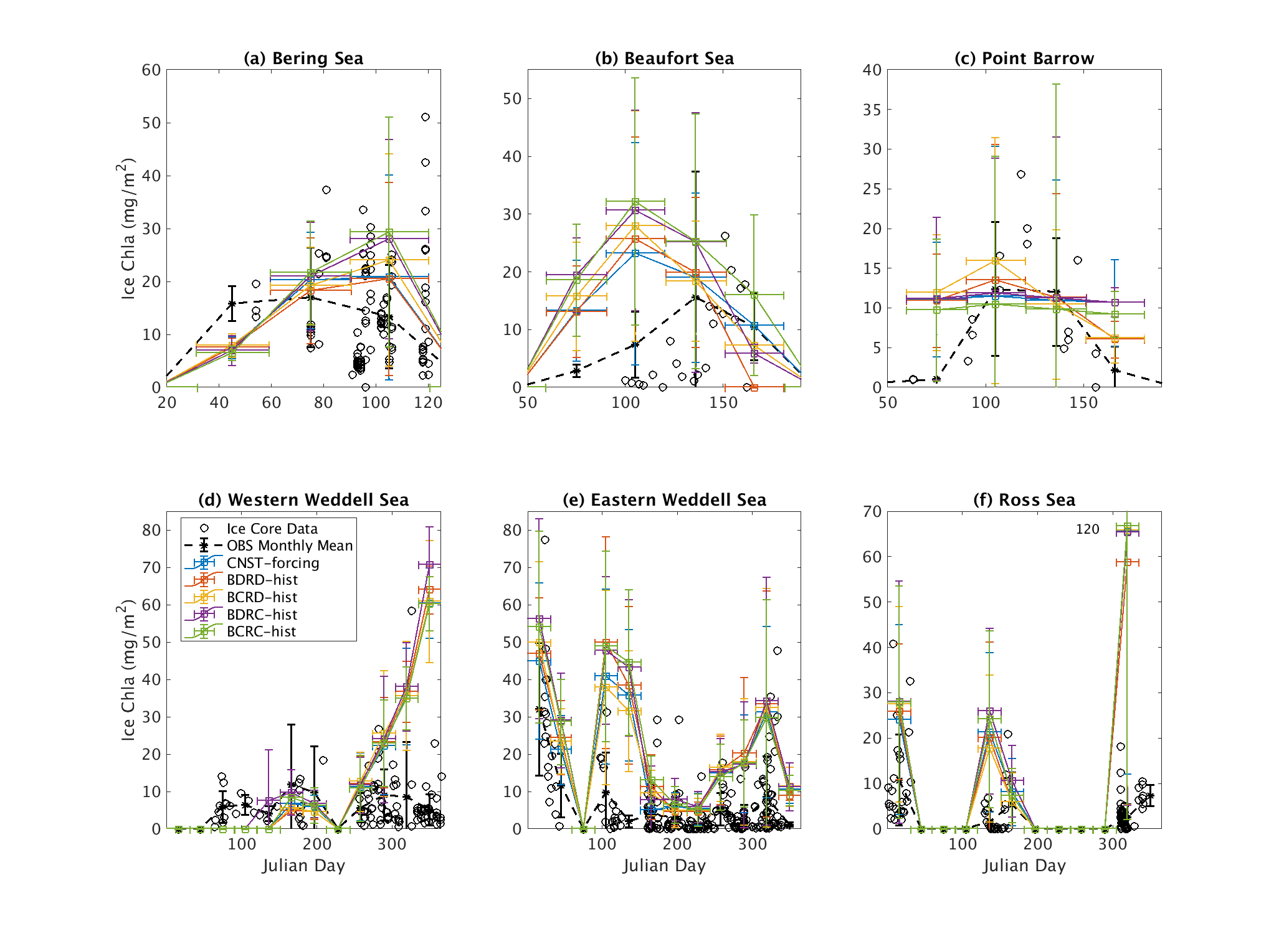
Sea ice chlorophyll
Arctic
Southern Ocean
Notes:
Arctic:
Sea ice algae primary production significantly underestimated
Caused by low surface ocean nitrate and silicate biases – missing riverine inputs
Despite this, relatively good agreement in sea ice chlorophyll (shown here)
Good Chl agreement in key Artic PP regios: Bering Sea and North of Point Barrow
Substantial overestimates in Beaufort Sea
Antarctic:
Limited by light, not nutrients, so less affected by surface nutrient biases
Tendency to overestimate chlorophyll in austral summer

Slide 19
Additional Information on v1: Wednesday at 11am
“Controls on sea ice primary production in E3SMv1.1-BGC” - Nicole Jeffrey
“Evaluating the historical trajectory of land and ocean carbon-climate feedbacks in E3SMv1.1-BGC” - Peter Thornton

Slide 20
v2 Model Developments
Completed:
  Atmosphere: Reporting wind speed at hub height, Fixing mass conservation of CO2 in CLUBB and GW, Preserve vertical shape of CO2 tracers
  Land: New land data architecture, Dynamic planting dates for crops, Plant hydraulics
  Energy: IAC component added to the coupler, Updated GCAM coupling code
  Ocean/ice: Black carbon and dust deposition on sea ice, Improved Nitrogen cycling in sea ice
Remaining:
  Incorporate MARBL, a modular framework for representing biogeochemistry, into MPAS-O
  Updated river nutrient file
  GCAM coupling
  Decision on vegetation scheme
  Stream temperature and sediment flow

Slide 21
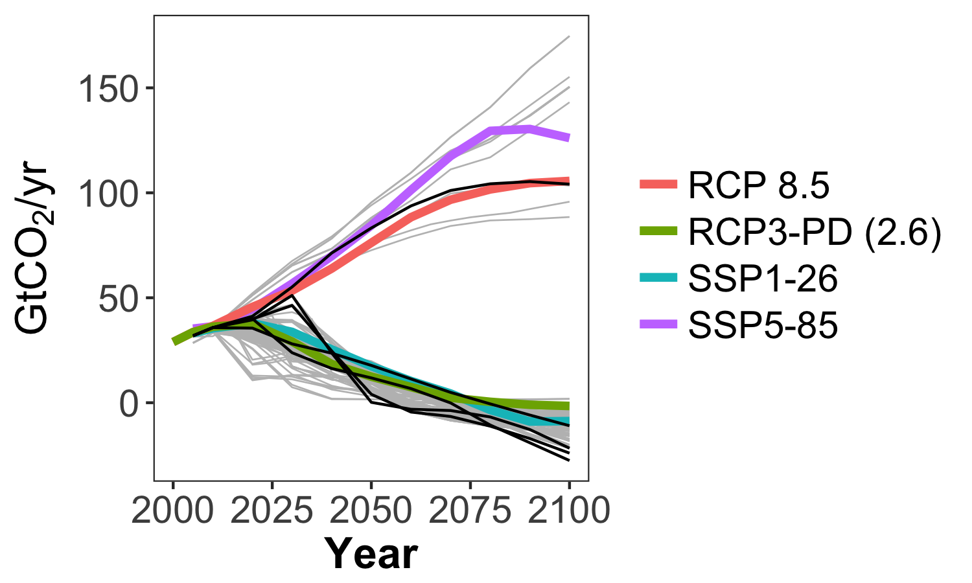
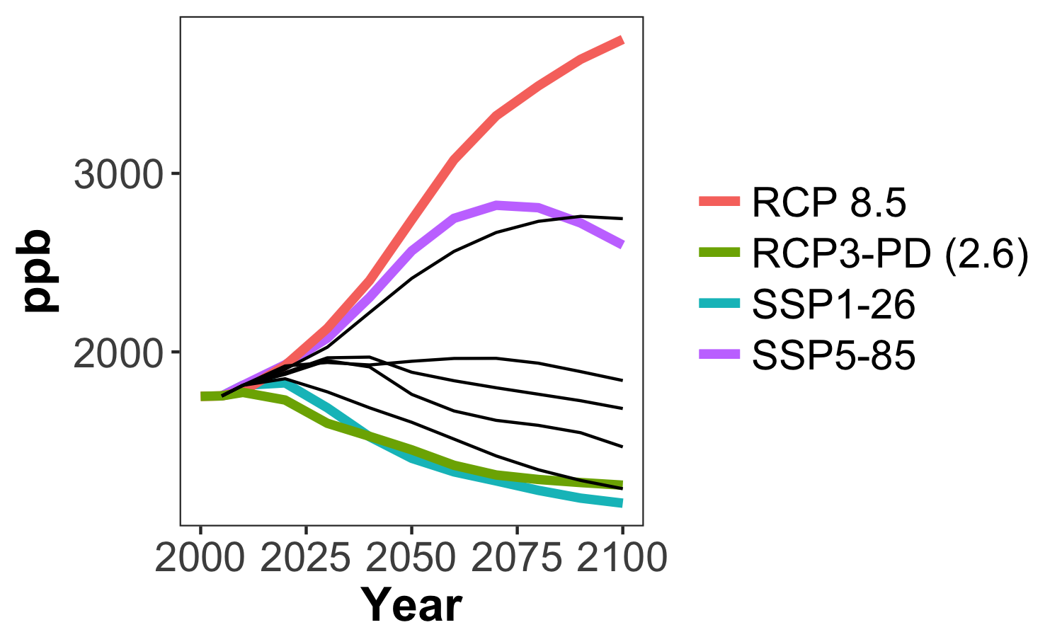
v2 Simulation Plan
Global CO₂ Emissions
Two different energy futures, including a high emissions and a low emissions scenario:
  Generated by GCAM
  Chosen to span a range of values across key variables (e.g., CO₂, CH₄, LULCC).
CH₄ Concentration
Gray = AR5 Database
Colors = CMIP5 and CMIP6
Black = GCAM-generated from Calvin et al. (2017)
To be discussed more on Wednesday

Slide 22
Next Steps for the BGC Team
v1 Simulations:
  Complete the remaining simulations (future scenarios and simulations without phosphorus limits)
  Complete the analysis papers
v2 Model Development:
  Finalize the three remaining developments (ocean/ice biases, GCAM integration, vegetation model integration)
  Model tuning
v2 Simulations:
  Finalize details of the simulation plans
  Spin-up
  Simulations
  Sensitivity experiments

Slide 23
Thank you!

